Slide 1
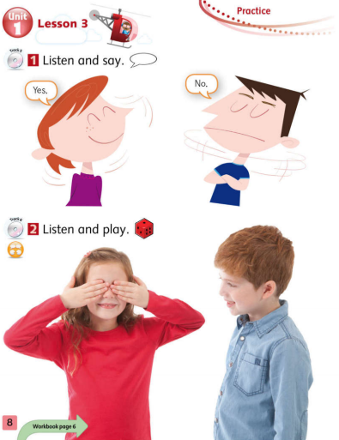
Tiếng Anh 1 - MacMillan Next Move Unit 1 - Lesson 3: PRACTICE
Learning topic: Yes & No
Class objectives: Practice saying yes/no
Class duration: 40 minutes
Vocabulary: yes, no
Resources: Student’s book p8, Workbook P5
Songs: Uh Huh Song & previously learned songs, goodbye song.

Slide 2
Let’s sing warm up song

Slide 3
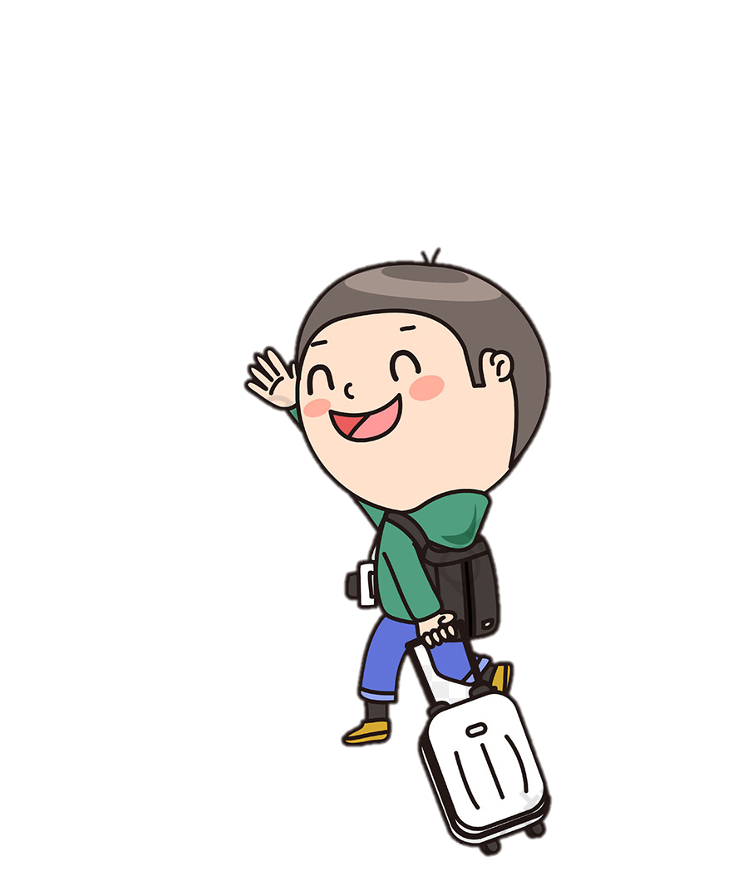
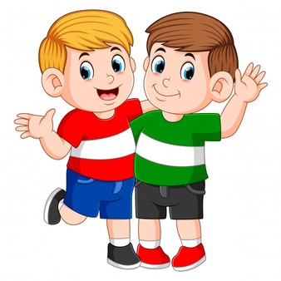
Goodbye!
Hello!
Notes:
Review:
T give Ss a ball and say:
Hello, What’s your name?
The student gets the ball and answer:
Hello, I’m …

Slide 4
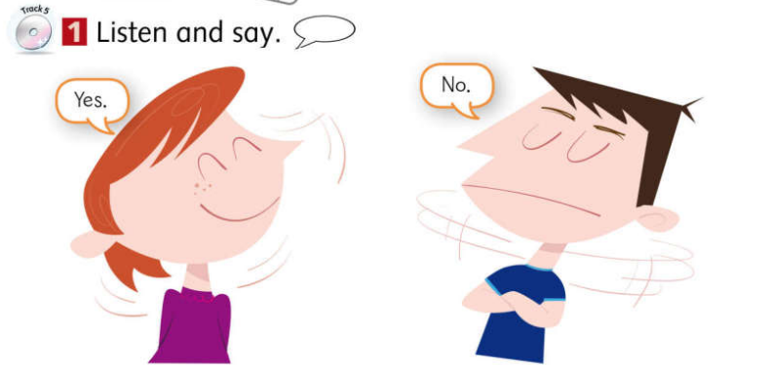
Click to the picture to open the audio
Notes:
Activity 1: Listen and say.
- Have Ss listen to the audio 2 times.
- Show power point at 1st time.
- Let them listen and teach them how to act it out. (teacher doesn’t act it out when listen)
- Second time, teacher plays the audio and acts it out.

Slide 5
Yes
No

Slide 6
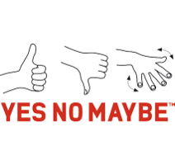
Gestures & Motions for Yes/No!
Yes
No
Yes
No

Slide 7
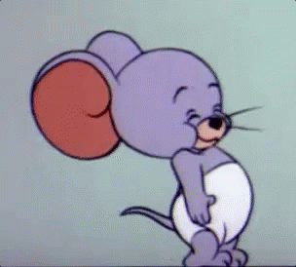
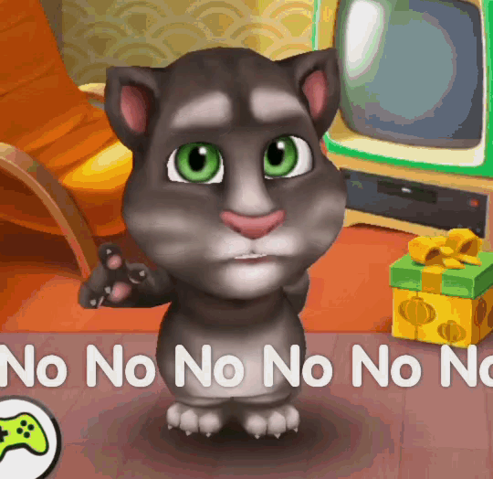
Yes Yes Yes Yes Yes

Slide 8
- Divide the board into 2 columns:
1st column: Smiley face - Yes
2nd column: Sad face - No
- Divide class into 2 teams.
- When teacher points to smiley face, 1 team says: Yes (nod their heads)
- When teacher points to sad face, 2 team says: No (shake their heads)

Slide 9
Let’s sing: Uh Huh Song

Slide 10
Vocabulary: Yes and No

Slide 11
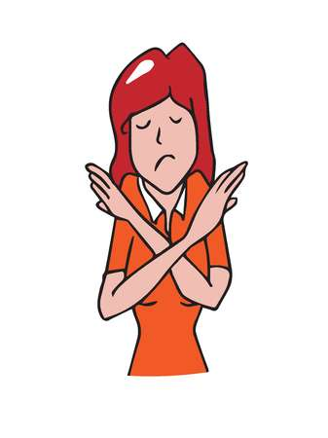
Yes or No
Look and say:

Slide 12
Notes:
T shows some pictures of (food, drink, activities).
If Ss like, they say “Yes”, if not they say “No”.
If they can do, they say “Yes”, if not they say “No”.

Slide 19
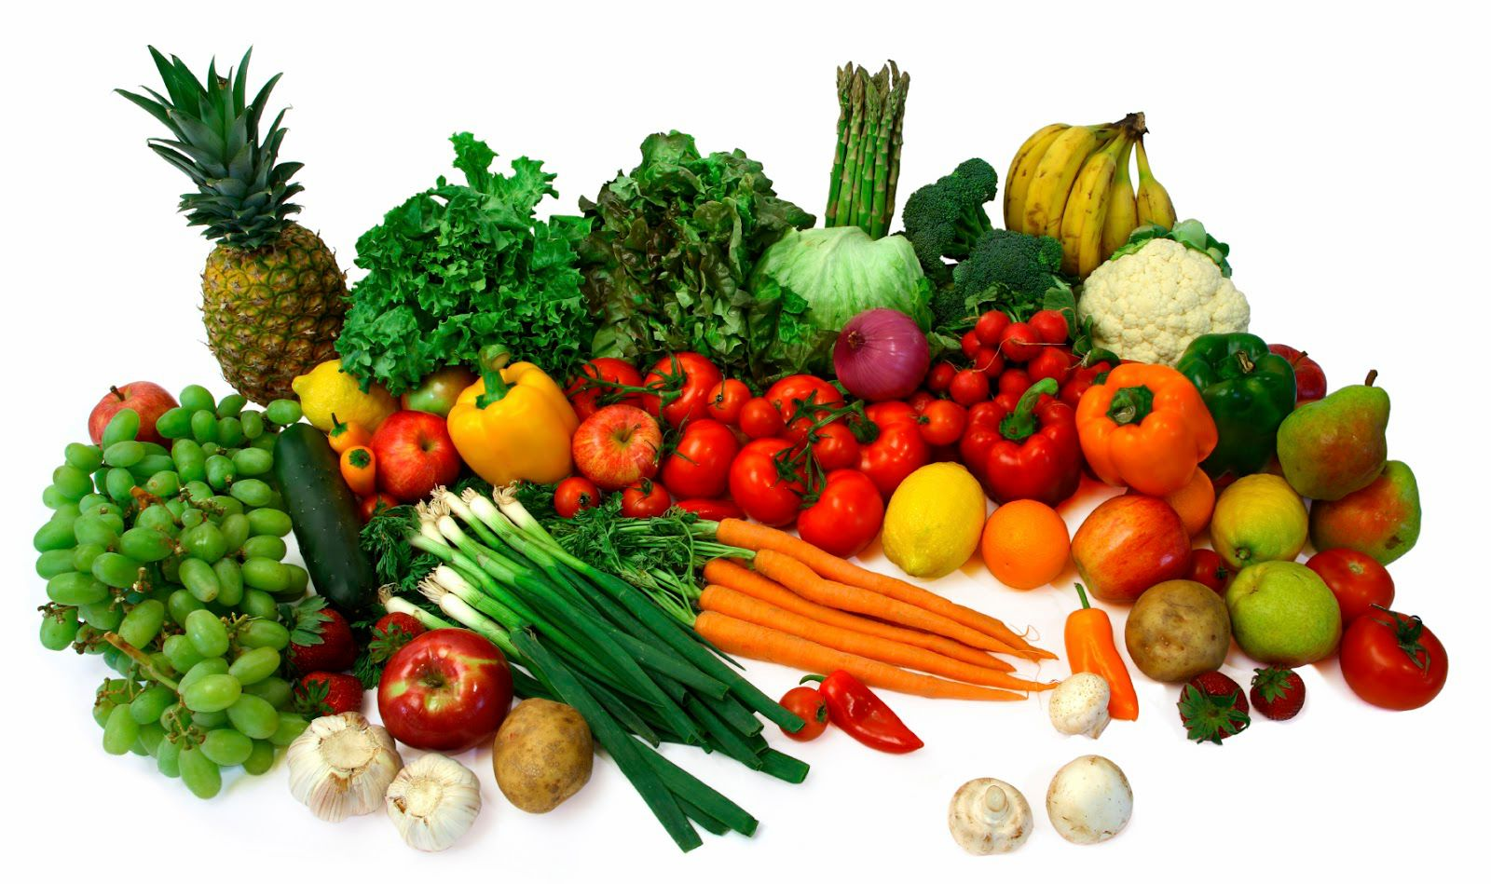

Slide 23
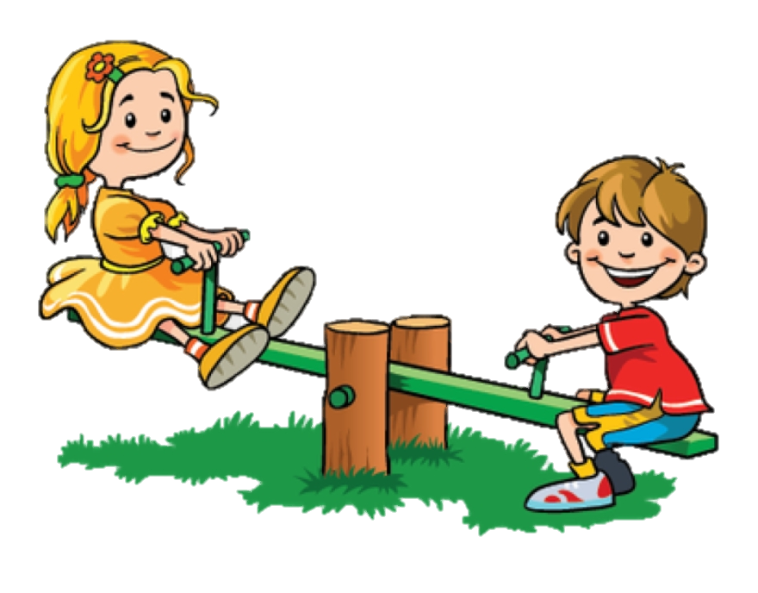

Slide 24
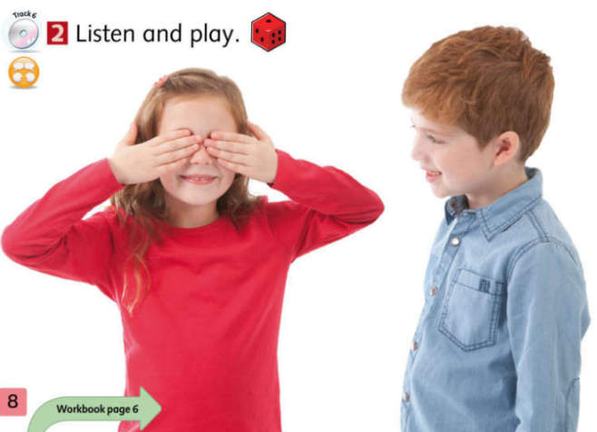
Guessing game
A: Hello, Rosy
B: Hello, Tom?
A: No
B: Hello, Jack?
A: No
B: Hello, Alex?
B: Yes
A
B
Click to the picture to open the audio
Notes:
Click to the picture to open the audio.

Slide 25
Speaking Practice
Call two students to go and play.
Student A says Hello first. Then student B who’s blinding her/ his eyes, listens to the saying Hello and guess who student A is by saying Hello + name (of that student).
The student A says Yes/ No.

Slide 26
Passing ball
Notes:
Divide Ss into teams, prepare a song on PP, when the music plays, pass the ball for the first student in each team.
- When the music pauses, whoever has the ball have to answer T’s question:
- “What’s your name?”
- “Is your name …?”

Slide 27
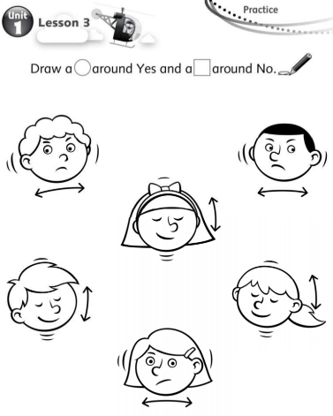
Describe these faces for Ss: how is the face when we feel agree/ disagree?
Make samples:
Circle a around Yes.
Circle a around No.
Notes:
- Have Ss open theirs workbook and guide them to do exercise.
- Have ss act it out.

Slide 28
