Slide 1
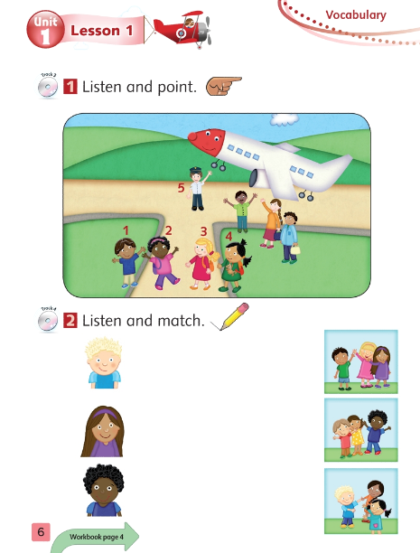
Tiếng Anh 1- Macmillan Next Move
Unit 1 - Lesson 2 - Grammar
Learning topic: Greetings
Class objectives: Learn to greet each other using hello, goodbye, what’s your name? – I’m…./ what’s your name?
Class duration: 40 minutes
Vocabulary: hello, goodbye, what’s your name, my name is….
Resources: Workbook P6
Songs: Hello song, How are you song, What’s your name song

Slide 2
Let’s sing Hello song”

Slide 3
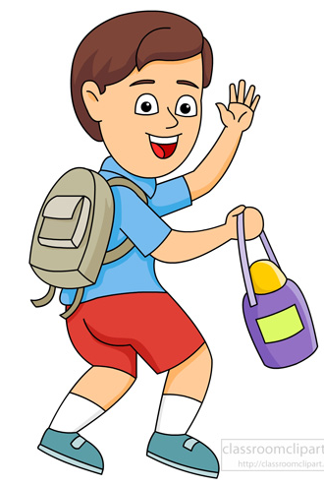
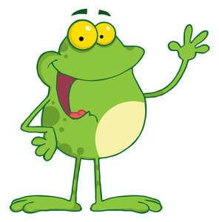
Review: Hello/Goodbye
Goodbye!
Hello!

Slide 4
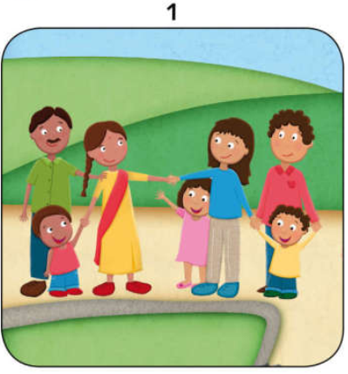
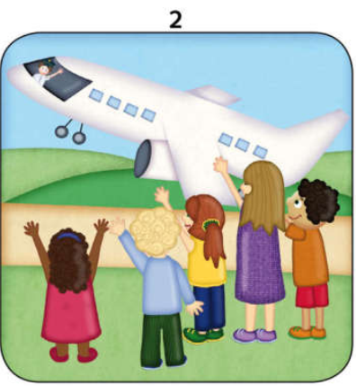
Activity 1: Listen and point.

Slide 5
Hello! I’m Roberto.
Hi, I’m Jinsu.
Notes:
Click on the picture to play sound.

Slide 6
Goodbye!
Bye bye!
Notes:
Click on the picture to play sound.

Slide 7
Work in groups:
Divide class into 2 teams.
Have them role play after listening to the CD of pictures 1 and 2. (do the actions such as stand up, wave hands, …)
For example:
+ Group 1: Hello, I’m Roberto.
+ Group 2: :Hi, I’m Jinsu! /
+ Group 1: Goodbye!
+ Group 2: Bye bye!

Slide 8
What’s your name?

Slide 9
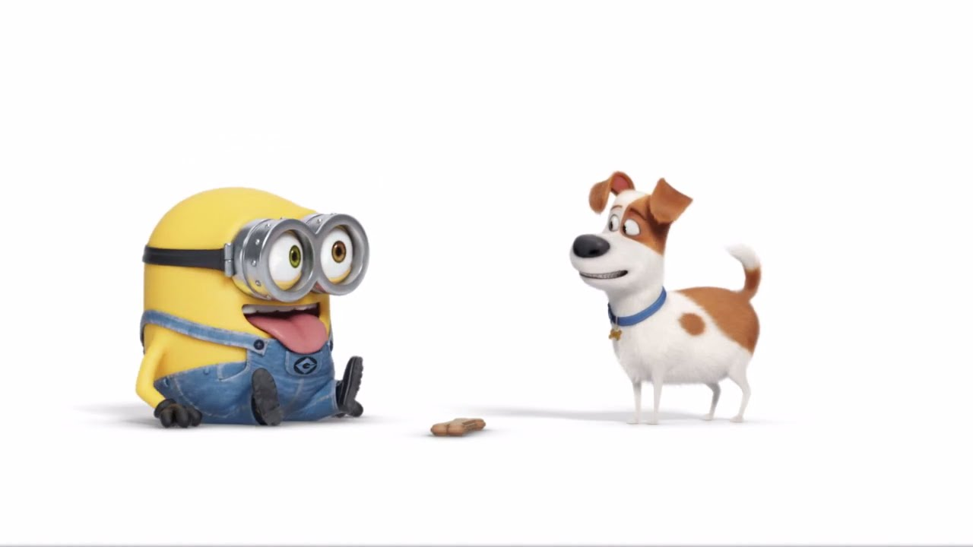
Hello, what’s your name?
Hello, what’s your name?
Hello! My name is Max.
I’m Max.

Slide 10
Game 1:
passing ball
Notes:
Teacher plays a song while students pass a ball. When the music stops, the student who is holding the ball have to stand up and introduce his/her name aloud using
“I’m ... .”
- For each turn, student gets stars/point for his/her team.

Slide 11
I’m …….
Teacher asks students to put hands on their chests and say I’m…….
Then teacher goes around and encourage students to say their own names. Teacher should say model sentence with her name first.

Slide 12
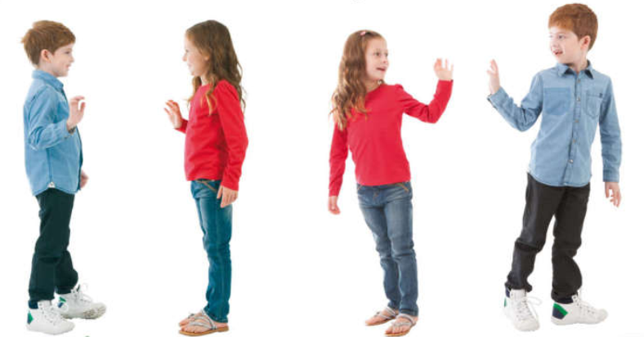
Activity 2: Say Hello and Goodbye.
Notes:
- Teacher calls some pairs to stand up and role play saying “Hello” and introduce their name with the sentence “I’m …. “ and then say “Goodbye”
- They pretend to go from two different corners of the class. When they meet, they say “Hello, I’m ….” . Then, they go pass each other and say “Goodbye”.

Slide 13
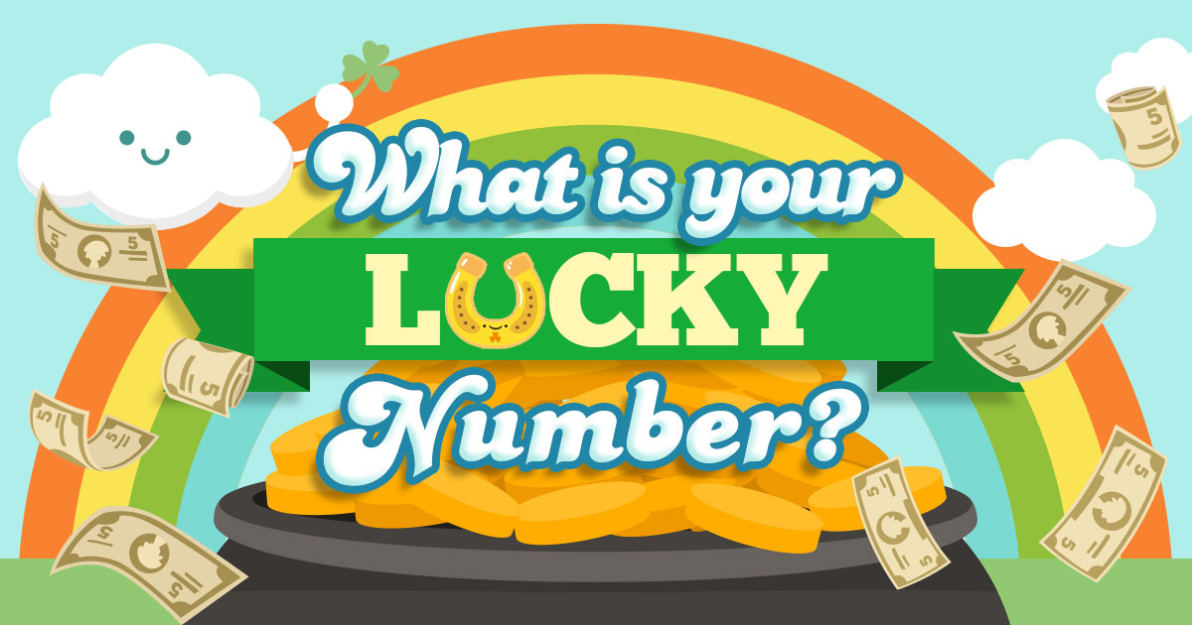
Notes:
- Divide Class in 2 teams. Each team have to choose a number from 1 - 9 on a table (on the board).
- For each number, teacher shows a flashcard (picture) of Roberto, … => Ss will say: I’m …
If they choose a lucky number, they will get a star without answering.

Slide 14
1
2
3
? | ?
 | ?
 | ? | ?
4
5
6
7
8
9

Slide 15
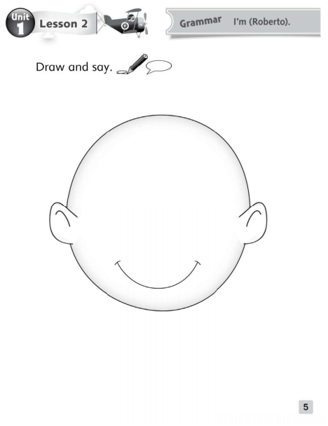
Workbook P5
Demo how to draw a face on the board for Ss.
Draw a circle, call on Ss to come up and try drawing a face
Pass out pencils to draw, T walks around to help with pencil control
Colour when finished!

Slide 16
Let’s sing Goodbye song

