Slide 1
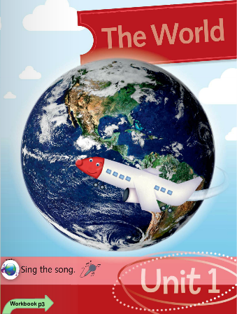
TIẾNG ANH 1 - MacMillan Next Move
Unit 1. Lesson 1
Learning topic: Greetings
Class objectives: Learn to greet each other using hello, goodbye with a positive attitude.
Class duration: 40 minutes
Vocabulary: hello, goodbye
Resources: Student Book P6, Work book P 3 4
Songs: Baby Shark, Hello Song, Goodbye Song, What’s your name song!

Slide 2
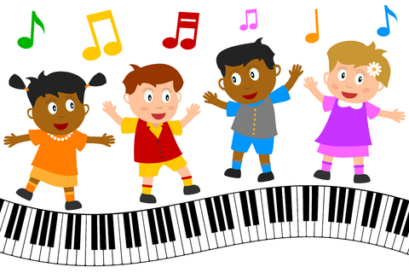
WARM UP: Hello Song!

Slide 3
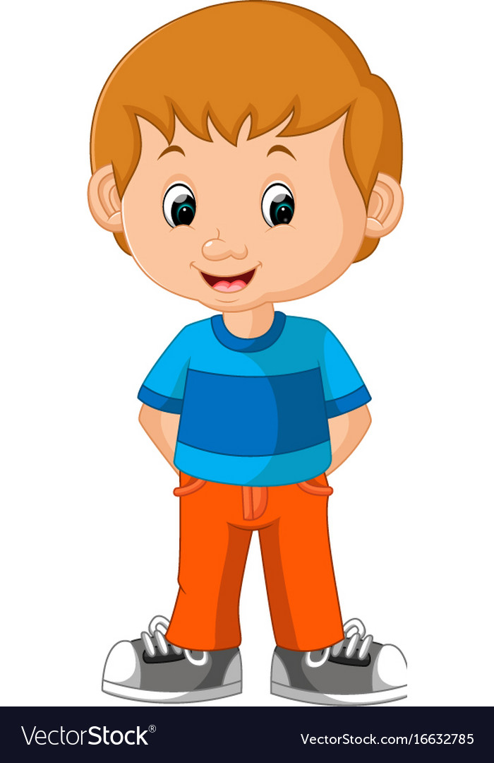
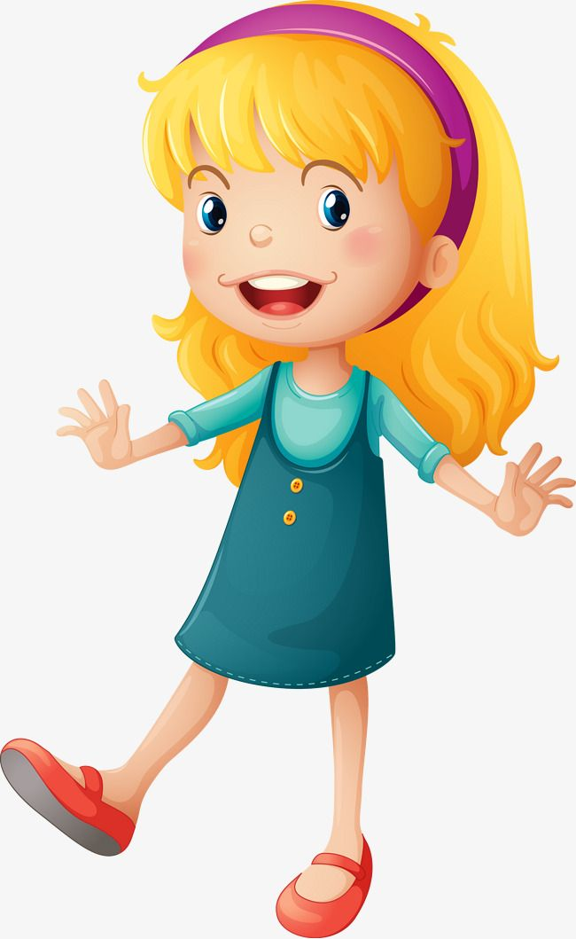
Hello!
Hello

Slide 4
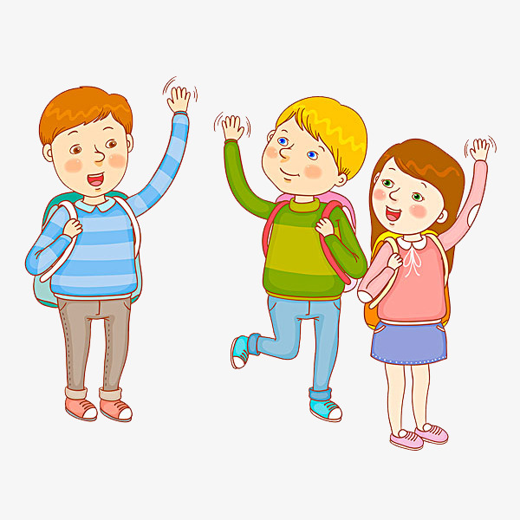

Slide 6
Greetings
T tells Ss to greet friends on their left.
T tells Ss to greet friends on their right.
T tells Ss to greet friends in front of them.
T tells Ss to greet friends behind them.
Hello!
I’m Hoa.
I’m Lan.
Hello!

Slide 7
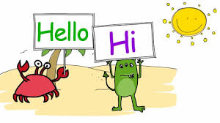
- Teacher invites some students to go out of the class and pretend to be new students. They take turn to come in the class, wave hands and say “Hello” to the class. The class will wave hands and say “Hi”. Then, he/ she turns back to go out of the class again and say “Goodbye”.
Continue with other students.

Slide 9
Let’s sing “Hello Song”

Slide 11
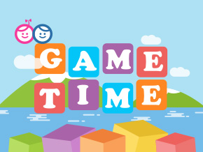

Slide 12
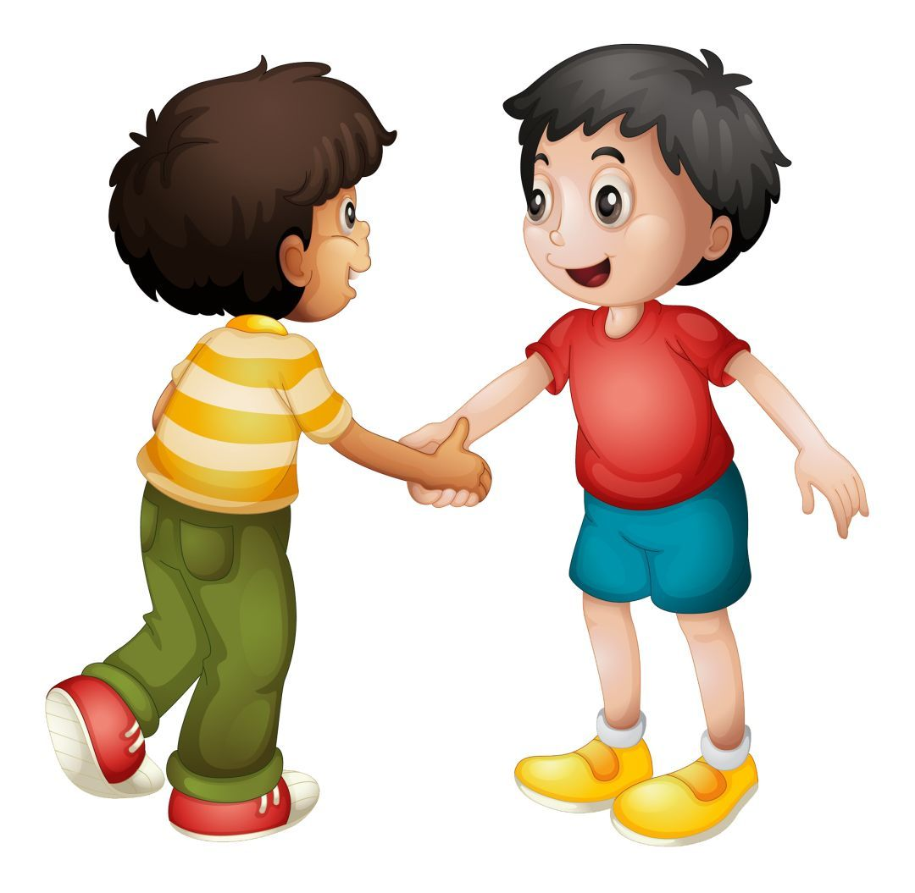
Making new friends
Notes:
- Invite some students to go to the stage and say: “Hello!”
- The class will say: “What’s your name?”
- The Ss says: My name is …
- Have Ss back the seat - Class say: Goodbye!
- Give them a big clap.

Slide 13
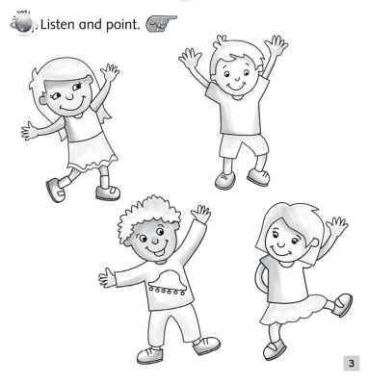
Teacher explains the request.
Teacher plays the CD and demo for student one time.
Students listen to the CD and point to the correct pictures..

Slide 14
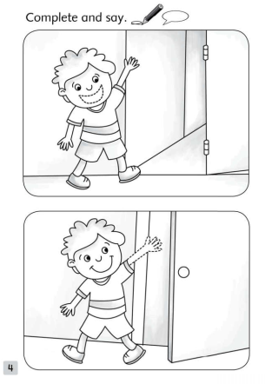
Teacher shows how to do the task.
Students fill in the blank following the pictures...
hello
goodbye

Slide 15
Tik tik bum
Notes:
- T gives Ss ball and has Ss pass the ball and say: Tic tic bum
- When T says” Bum!”, who is keeping the ball stands up and answers T’s question. (T can wave hands, asks about name, …)

Slide 16
Let’s sing Goodbye song!

Slide 17
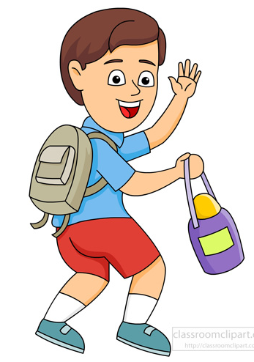
Goodbye!
Teacher asks students to stand in line and take turn to say goodbye before he/she goes out of the class.
Or
- Teacher goes around to the class, waves hands and says Goodbye to every student before the ending the class.

