Slide 1
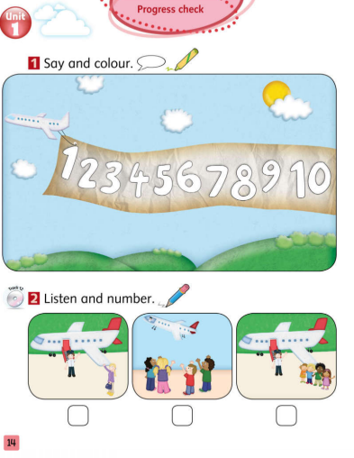
Tiếng Anh 1 - MacMillan Next Move
Unit 1- Lesson 9: PROGRESS CHECK
Class objectives: Number cards 1-10, review grammar and vocabulary form Unit 1
Class duration: 40 minutes
Vocabulary review: hello, goodbye, numbers one to ten
Grammar review: Hello & Goodbye, I’m + name, number 1 – 10, I’m + age.
Resources: Student Book P14, Number cards 1-10, PowerPoint
Materials: PowerPoint, Song, Flashcards, Student Book, Workbook.
Songs: How old are you song, What’s your name song

Slide 3
GRAMMAR

Slide 4
1
2
3
4
5
one
two
three
four
five
6
7
8
9
10
six
seven
eight
nine
ten

Slide 6
Flappy Bird game
Divide class into 2 teams
Choose a number (from 1 to 10)
If the answer is correct, click
Click on or to move, then click
If not, click to back to questions
Which team reaching the finish line first will be the winner

Slide 7
NEXT

Slide 8
Click to make the yellow bird move
Click to make the pink bird move

Slide 9
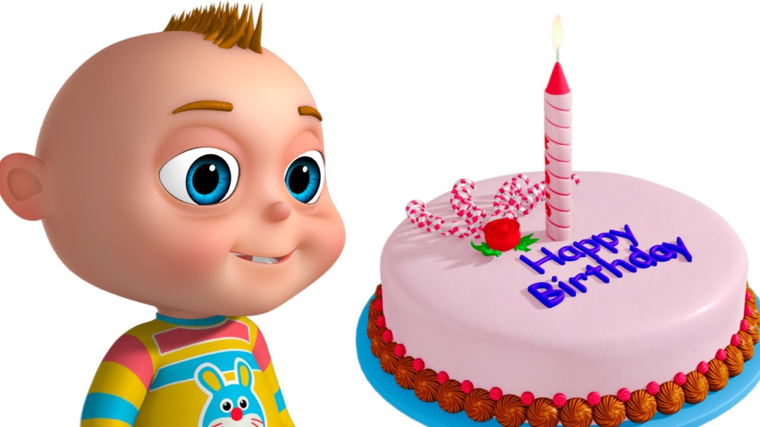
I'm _______.
one

Slide 10
I'm _______.
two

Slide 11
I'm _______.
three

Slide 12
I'm ________.
four

Slide 13
I'm ________.
five

Slide 14
I'm __________.
six

Slide 15
I'm _______.
seven

Slide 16
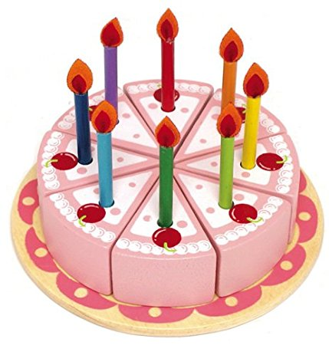
I'm ___________.
eight

Slide 17
I'm ________.
nine

Slide 18
I'm ___________.
ten

Slide 19
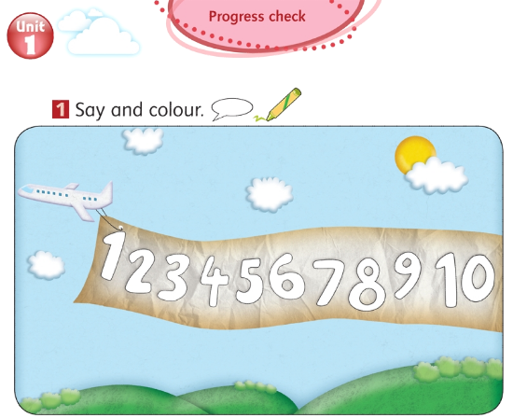
Notes:
Let Ss say the numbers from 1 to 10.
Ask Ss to colour these numbers.

Slide 20
Let’s sing a song together!
Notes:
- Click to the picture to play the CD: What’s your name song!
Review: Hello/ Hi, I’m + name…
Ask Ss to work in pairs and practice the structure: I’m + name.

Slide 21
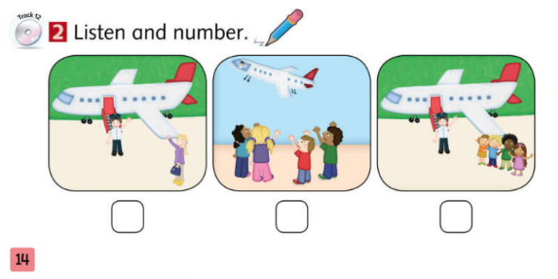
1
3
2
Notes:
Play the CDs (click to the picture to open the CD)
Let SS listen to the CD for 2-3 times and number the pictures.
Practice

