Slide 1
Tiếng Anh 1 - MacMillan Next Move Unit 1 - Lesson 7: STORY
Lesson Summary
Learning topic: Story time
Class objectives: practice listening skills; and learn the value of being friendly
Vocabulary: Hello
Resources: Student Book P12, Workbook P10, Tiếng Anh 1Macmillan Next Move.
Time: 40 minutes
Songs: Number song, goodbye song

Slide 2
Warm up song: Hello song
Warm up: Hello song

Slide 3
- Show the picture and Ask students to guess what the people are doing in each picture (Saying hello).
- Have students do action like the pictures, practice in pairs and groups.

Slide 5
Hello !
Have Ss say Hello and bow

Slide 6
Hello !
Have Ss say Hello and shake hanhds

Slide 7
Hello !
Have Ss say Hello and hug.

Slide 8
Hello !
Have Ss say Hello and wave hands.

Slide 9
Hello !
Have Ss say Hello by shouting horse sound.

Slide 10
Goodbye!
Have Ss say Goodbye and wave hand

Slide 11
Now, play the CD and have students point to the correct picture. Then repeat after the CD.

Slide 13
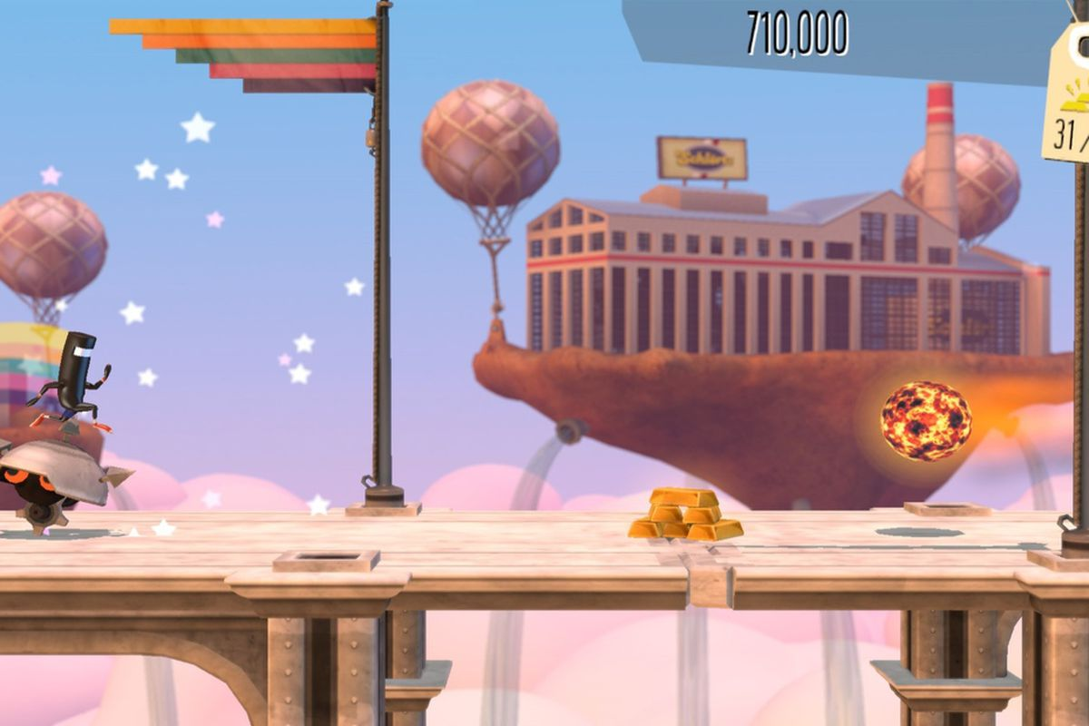
Rolling Play Minion!
Notes:
Click chuột vào từng tấm thẻ để đến với câu hỏi.
Click chuột vào hình tam giác để trở về.
Mỗi tấm thẻ xuất hiện một bức tranh trong câu truyện, Gv sẽ gọi hai hoặc ba học sinh đứng trước lớp diễn tả và nói thật to tình huống.

Slide 14
Warm up song: Hello song
Valuable: Being friendly!
Say Hello to your friend!

Slide 15
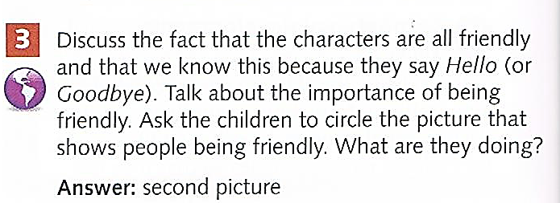

Slide 17
Look and choose the right value:

Slide 18
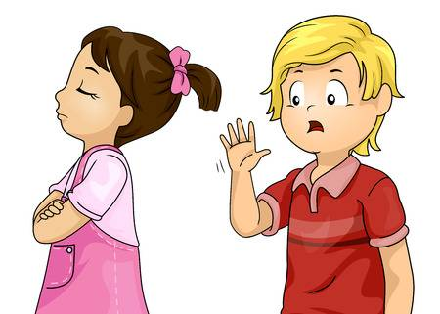
Look and choose the right value:

Slide 19
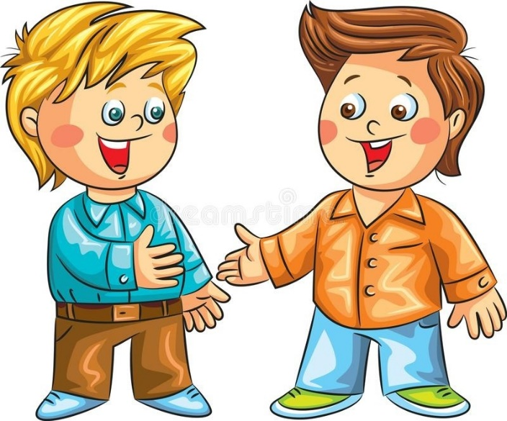
Look and choose the right value:

Slide 20
Look and choose the right value:

Slide 21
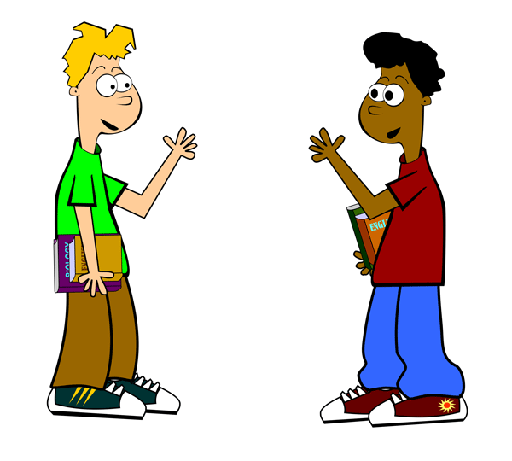
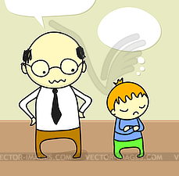
Look and choose the right value:

Slide 22
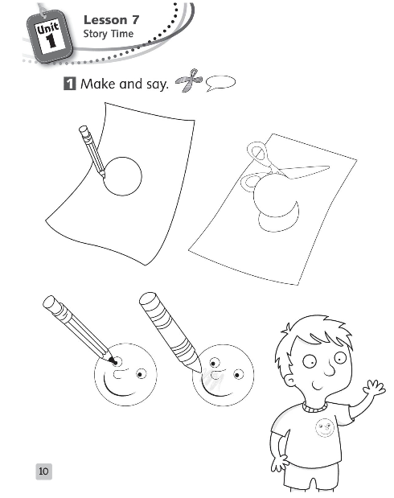
Instruct students to draw a smiling face
Ask them to use the smiling face to say Hello to friends.

Slide 23
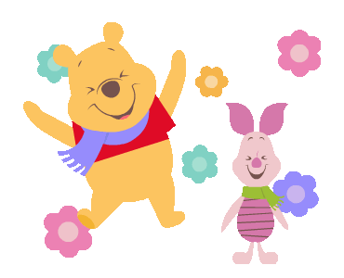
Bye-bye!

