Slide 1
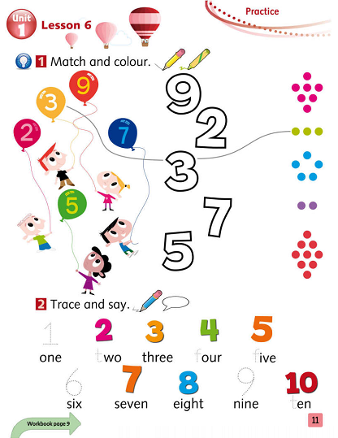
Tiếng Anh 1 - MacMillan Next Move Unit 1 - Lesson 6 - PRACTICE
Lesson Summary
Learning topic Age, numbers 1-10
Class objectives: Answer “How old are you?/I am __.”, write #1-10, number recognition
Class duration: 40 minutes
Vocabulary: one, two, three, four, five, six, seven, eight, nine, ten
Resources: Student Book P11, Workbook P9, Next Move CD1
Songs: Clap hands song, counting songs, Goodbye song.

Slide 2
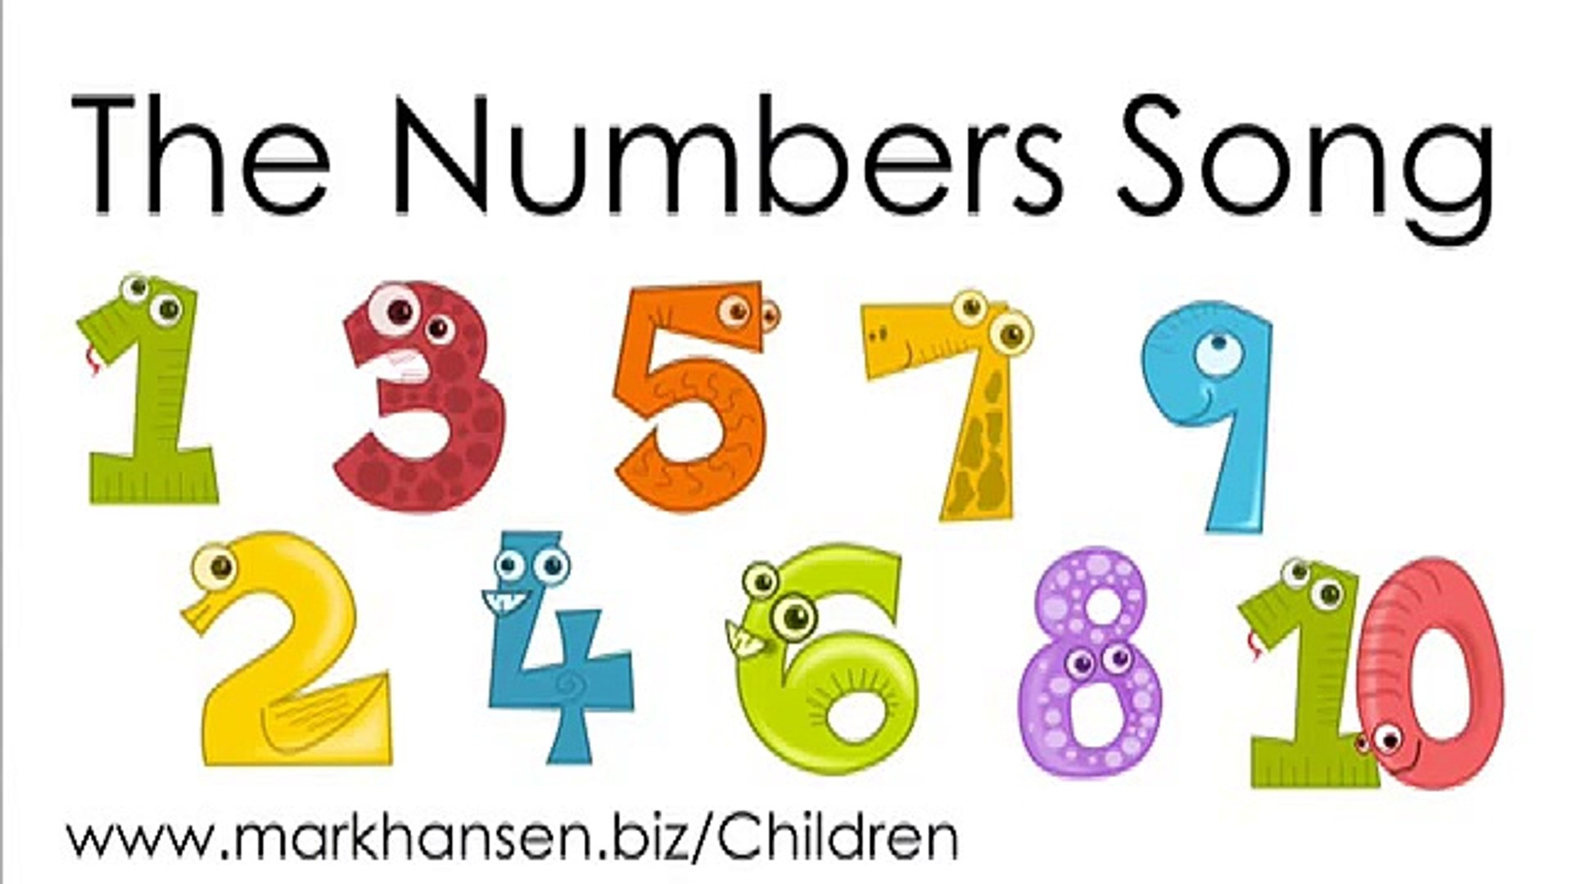
WARM UP: NUMBERS 1-10 SONG

Slide 3
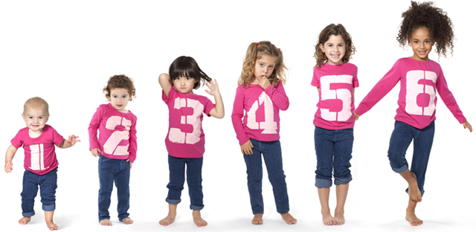
Hello, I am ....
Look and say
I’m 6.
I’m 2.
I’m 5.
I’m 1.
I’m 3.
I’m 4.

Slide 5
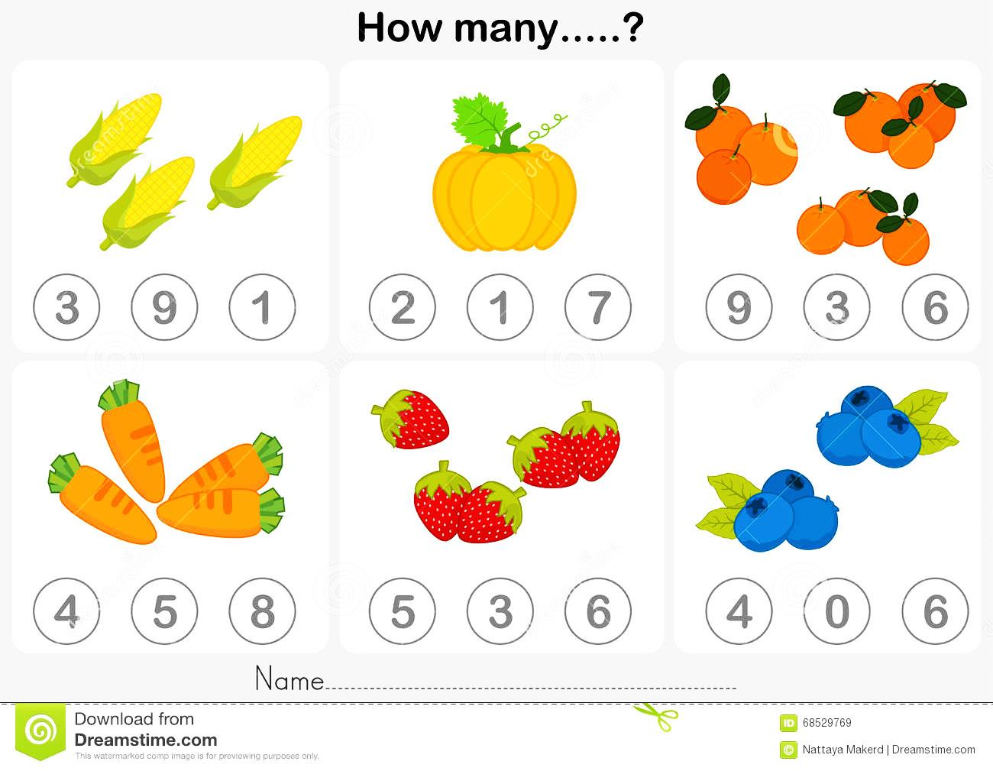
Look, count and circle

Slide 6
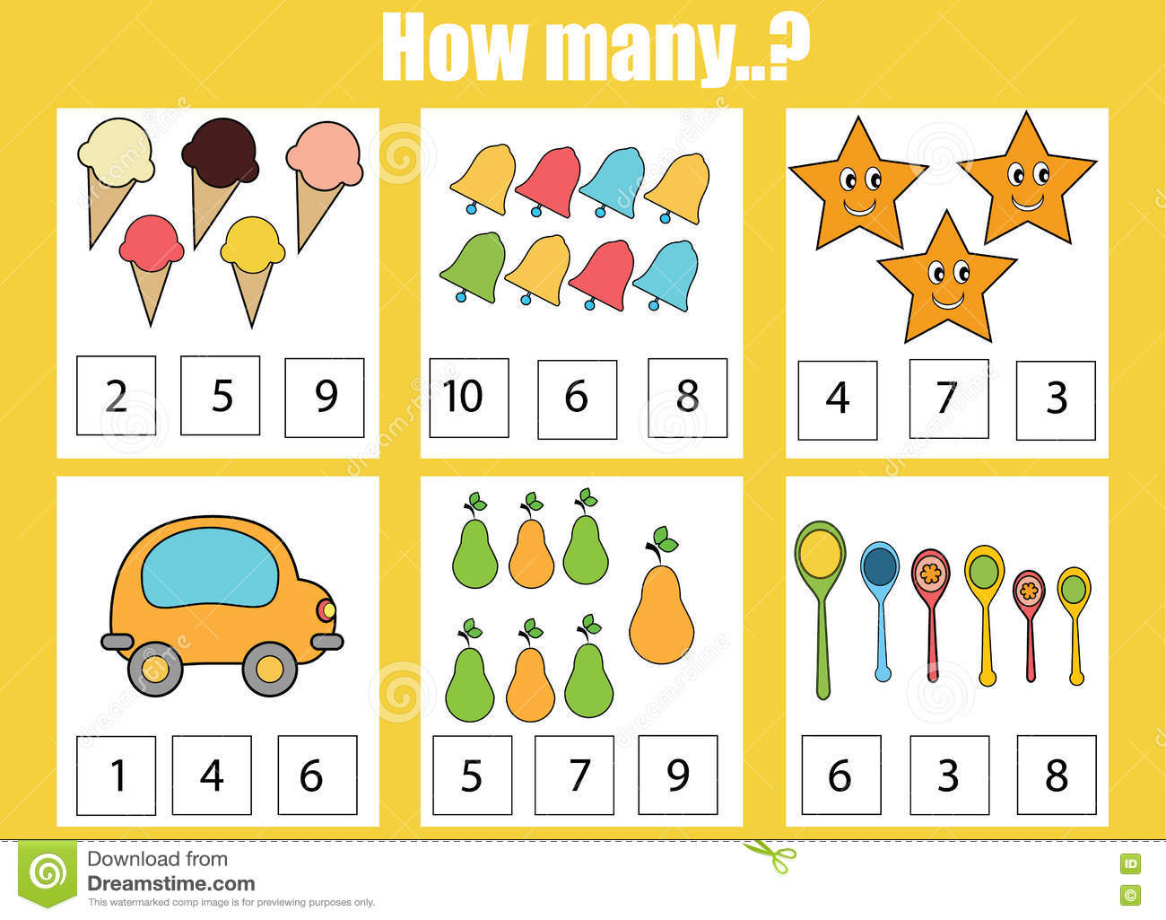
Look, count and circle

Slide 7
Count and match the numbers!

Slide 8
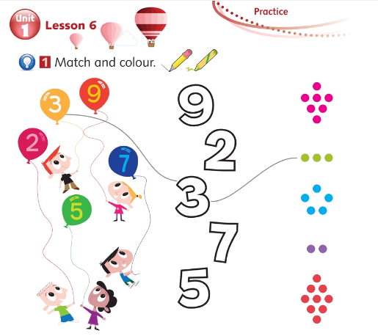

Slide 10
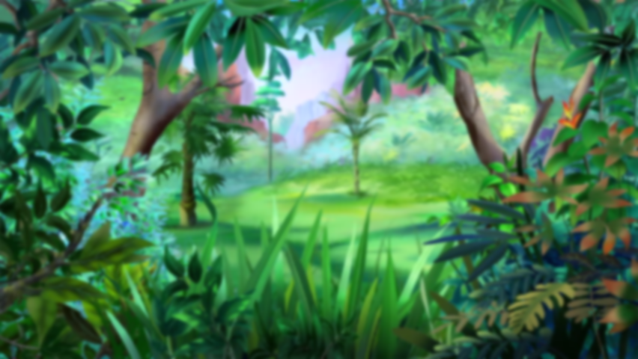
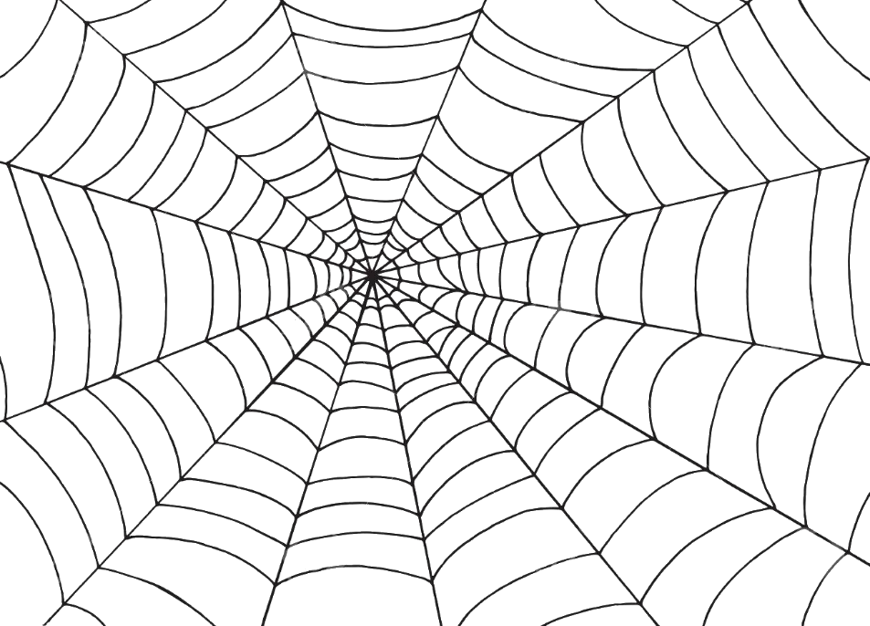
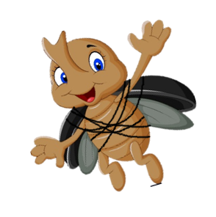
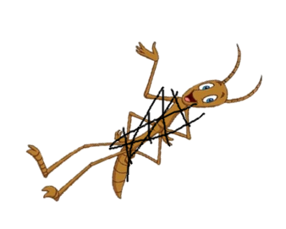
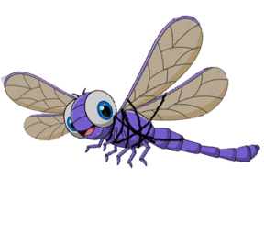
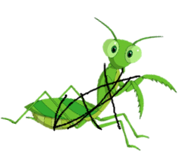
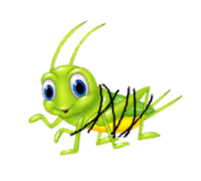
ANGRY SPIDER

Slide 11
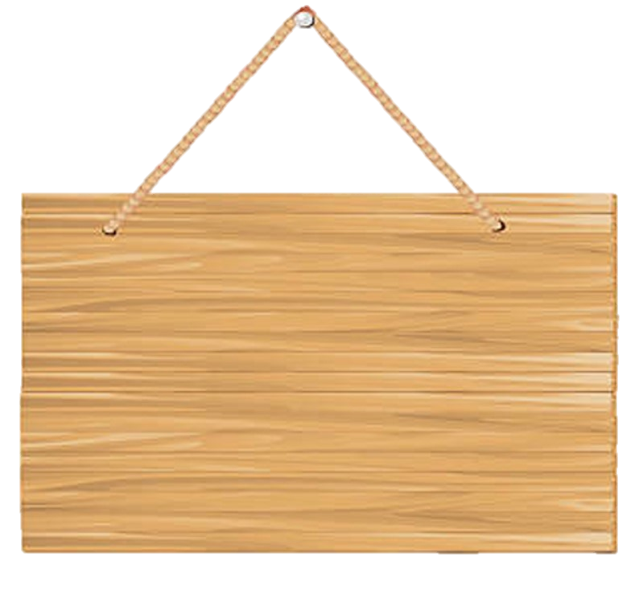
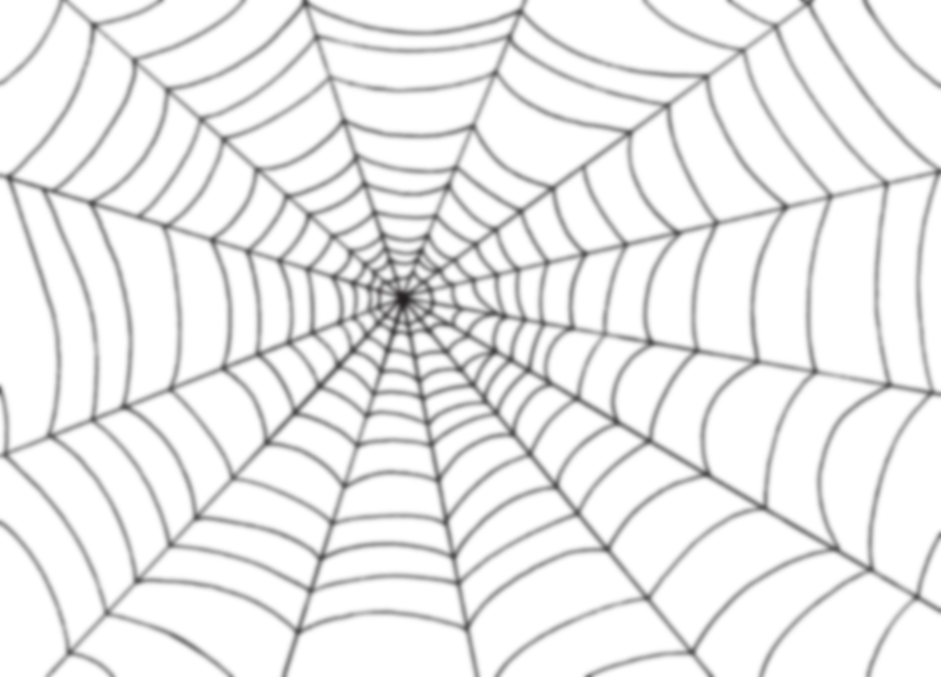
Các bạn côn trùng không may
bị vướng vào lưới nhện
Các em hãy giúp các bạn ấy
thoát khỏi lưới nhện bằng cách
trả lời thật nhanh và đúng các câu hỏi.

Slide 12
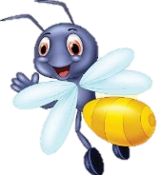
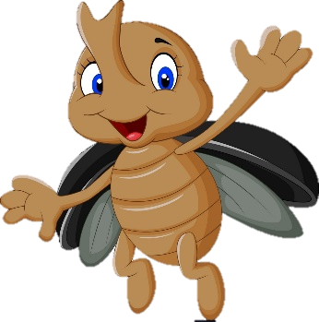
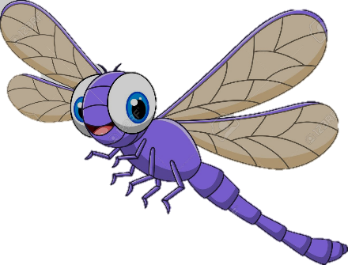
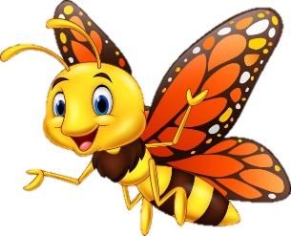
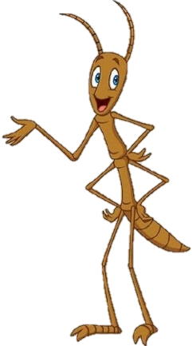
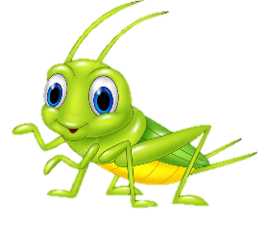
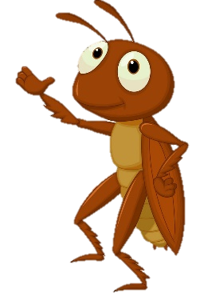
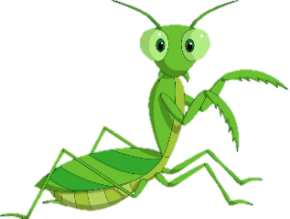
Đom Đóm
Bọ
Cánh Cứng
Chuồn Chuồn
Ong Vàng
Bướm
Cánh Cam
Bọ Que
Cào Cào
Dế Mèn
Bọ Ngựa

Slide 13
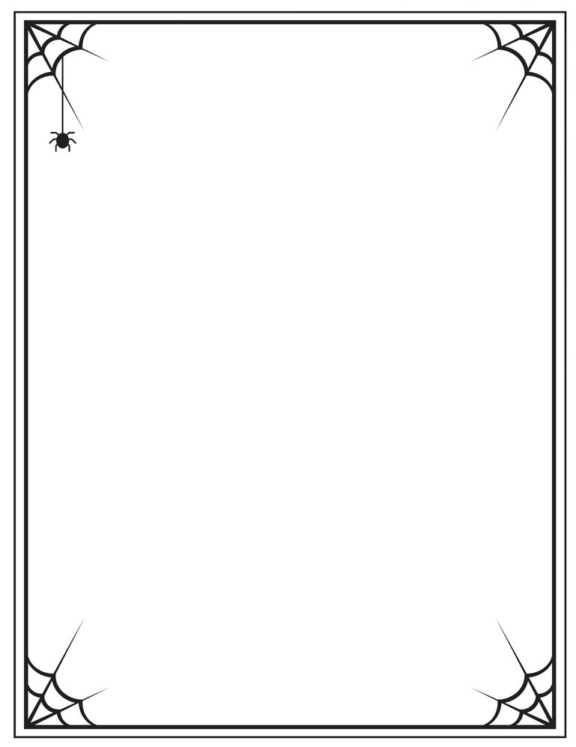
I am .....

Slide 14
I am ...

Slide 15
I am ...

Slide 16
I am ...

Slide 17
I am ...

Slide 18
I am ...

Slide 19
I am ...

Slide 20
I am .....

Slide 21
I am .....

Slide 22
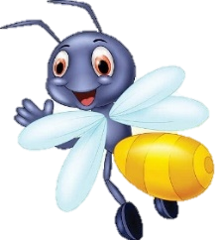
I am .....

Slide 23
Look and remember

Slide 24
Trace and write
Notes:
Ask one child to come and write the number one on the board. Call other child to come and write number 2. Then continue calling others to take turn and write the next number until ten.
After that, show the picture of activity 2 and ask students call out the missing numbers.

Slide 25
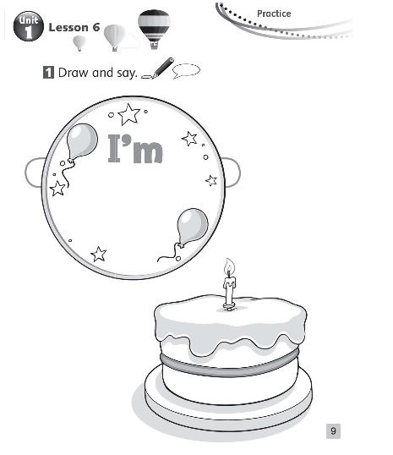
Workbook P9
T shows Ss how to write individually on board, call on Ss to come up and try! (everyone should be about the same age so focus on that number)
Show Ss how to draw a line for a ‘candle’ and to draw that many candles on their birthday cake
Walk around, help Ss with pencil control if needed
Color if time permits!
Rewards/Team points for job well done!

Slide 26
Let’s sing goodbye song!

