Slide 1
Notes:
Click on the background to play the music

Slide 2
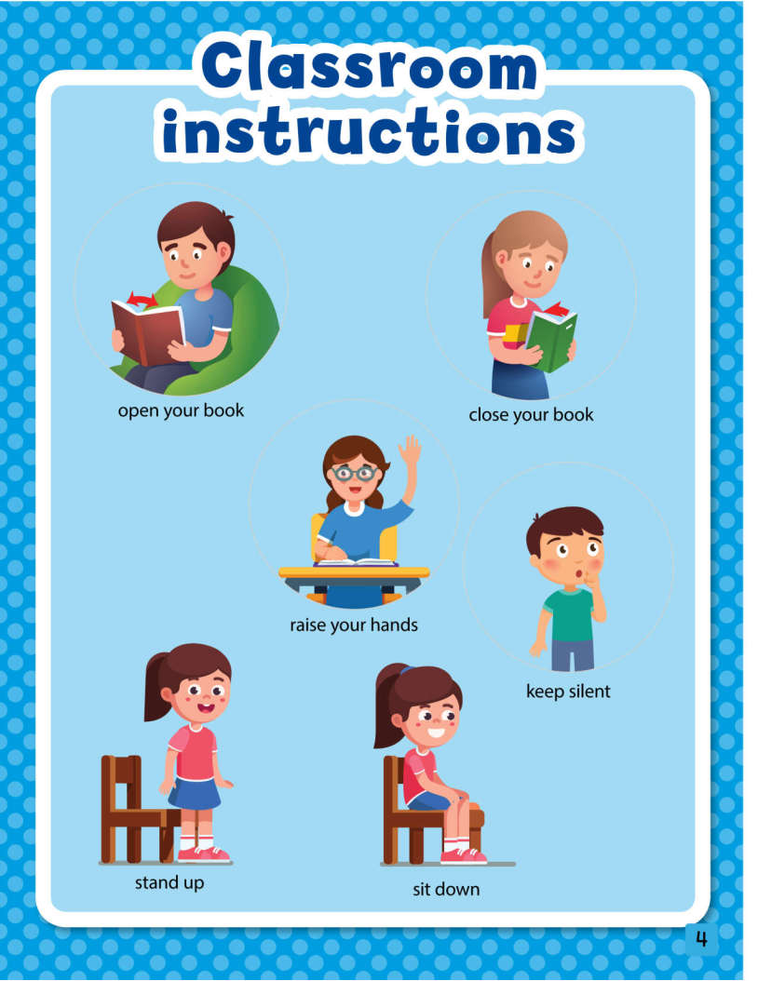
TIẾNG ANH 1 - MacMillan Next Move
Unit 1 – Instructions
Lesson Summary
Objectives: By the end of the lesson, students will be able to identify and follow classroom instructions with a positive attitude
Class duration: 40 minutes
Vocabulary: open your book, close your book, raise your hands, keep silent, stand up, sit down
Resources: pupils’ book page 4

Slide 3
Let’s learn English!

Slide 4
warm-up song
(click here to play the video)

Slide 5
open your book

Slide 6
close your book

Slide 7
raise your hands

Slide 8
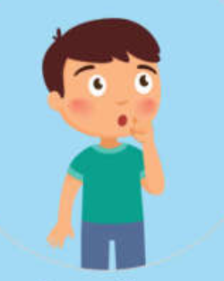
keep silent

Slide 9
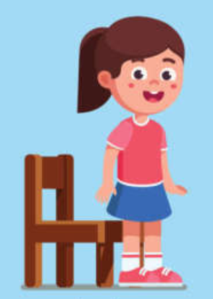
stand up

Slide 10
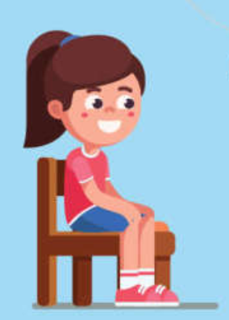
sit down

Slide 11
GAME
GAME
“SIMON SAYS … “
Ask the whole class to do the action following teacher’s instructions if the sentence includes “Simon says …”. if it doesn’t, students have to stand still
Ex: - “Simon says: raise your hands” – Students raise their hands
- “Sit down, please!” – Students don’t do the action
The students who lose the game have to sit down. The winners will get stickers when the lesson ends.

Slide 12
GUESSING GAME
Divide class into 3-4 teams
Invite a student to come to the board to do an action and ask the others to guess the instruction is.
Whoever has the correct answer 1st will get a star for his/her team. The team that has more stars will be the winner.

Slide 13
sing the song:
FUNNY CLASS
Sit down, stand up and jump jump jump!
Open your book and raise your hands
Now please sit down and clap clap clap!
Then close your book and keep silent
(0ne more time)
Sit down, stand up and jump jump jump!
Open your book and raise your hands
Now please sit down and clap clap clap!
Then close your book and keep silent

Slide 14
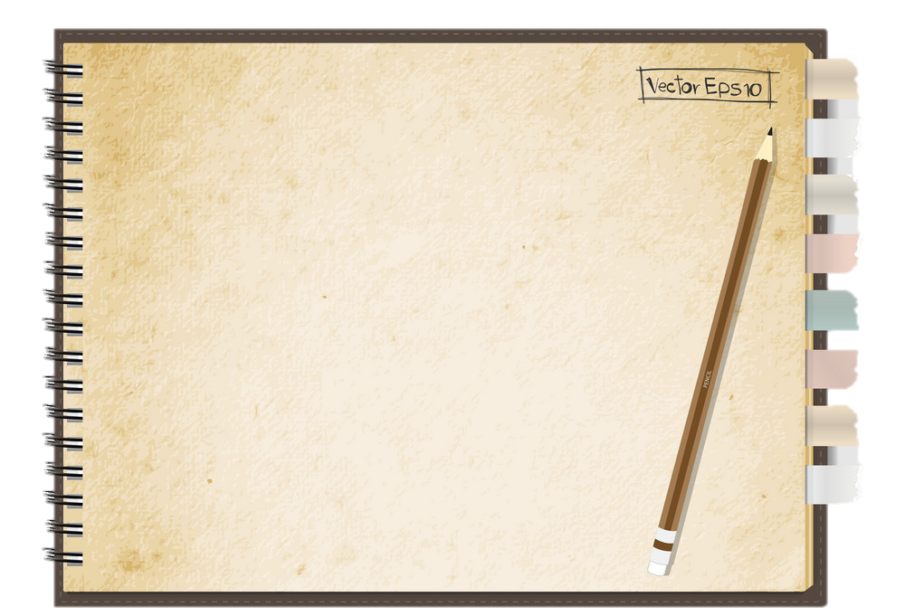
WRAP-UP
Review the classroom instructions that students have learned
Tell students about the value of being nice in the class as an action of respect teacher and others as well
Ask students to point to the pictures and say (pupils’ book page 4) at home
Sing “Goodbye song” and wave hands to students

Slide 15
Goodbye song
(click here to play the song)

Slide 16
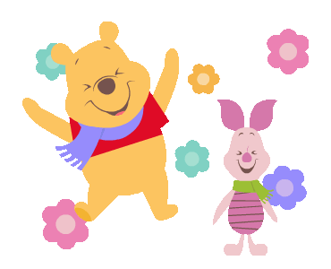
Bye bye!

