Slide 2
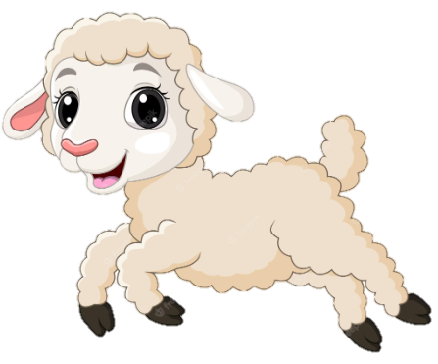
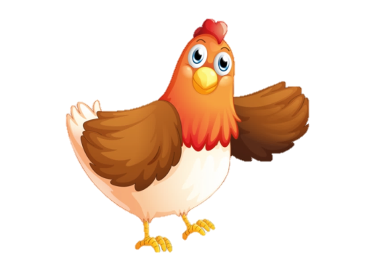
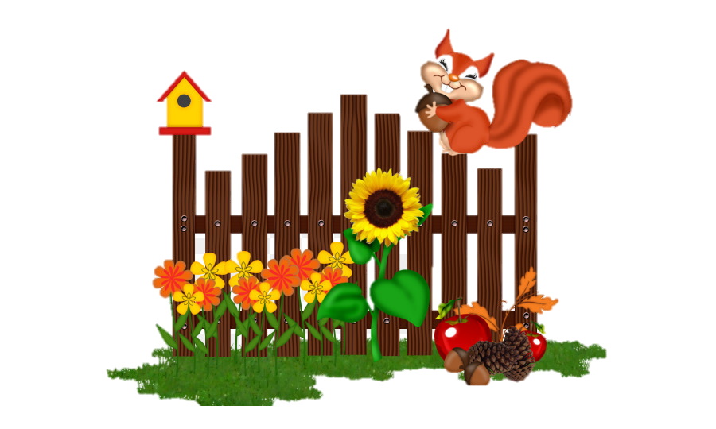
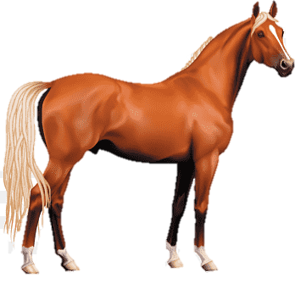
Unit 6 ON THE FARM
Lesson 2 + Lesson 3

Slide 3
I. OBJECTIVES.
By the end of this lesson, pupils will be able to:
1. Knowledge and skills.
- Use the sentence structures “Is there a/an _____?” and “Yes, there is. / No, there isn’t.” to ask and answer questions about whether or not something is present.
- Sing a song with the sentence structures “Is there a/an _____?” and “Yes, there is. / No, there isn’t.”.
2. Competences.
- Critical thinking and creativity: learn how to ask and answer questions about whether or not something is present correctly and fluently.
- Communication and collaboration: work in pairs or groups to complete the learning tasks.
- Self-control & independent learning: perform speaking task.
3. Attributes.
- Show their love for animals.
- Raise awareness of caring for and protecting the animals.
- Evaluate abilities and participate in appropriate tasks for themselves and their friends.
II. MATERIALS.
- Pupil’s book: Page 28
- Audio Tracks 33, 34
- Teacher’s guide: Pages 48, 49
- Flashcards/ pictures and posters (Unit 6)
- Computer, projector, …

Slide 4
Warm-up
and
Review

Slide 5
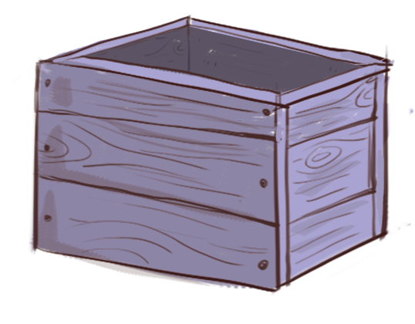
?
What’s this?
box
Notes:
- GV cho HS xem tranh sau đó che hình lại để HS trả lời.
- GV click vào hình dấu chấm hỏi để check đáp án.

Slide 6
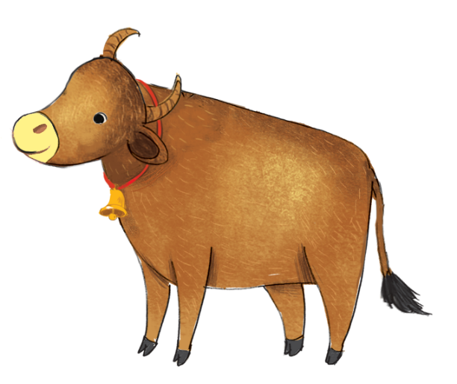
?
What’s this?
ox
Notes:
- GV cho HS xem tranh sau đó che hình lại để HS trả lời.
- GV click vào hình dấu chấm hỏi để check đáp án.

Slide 7
?
What’s this?
fox
Notes:
- GV cho HS xem tranh sau đó che hình lại để HS trả lời.
- GV click vào hình dấu chấm hỏi để check đáp án.

Slide 8
Well done

Slide 9
5. Listen and chant

Slide 10
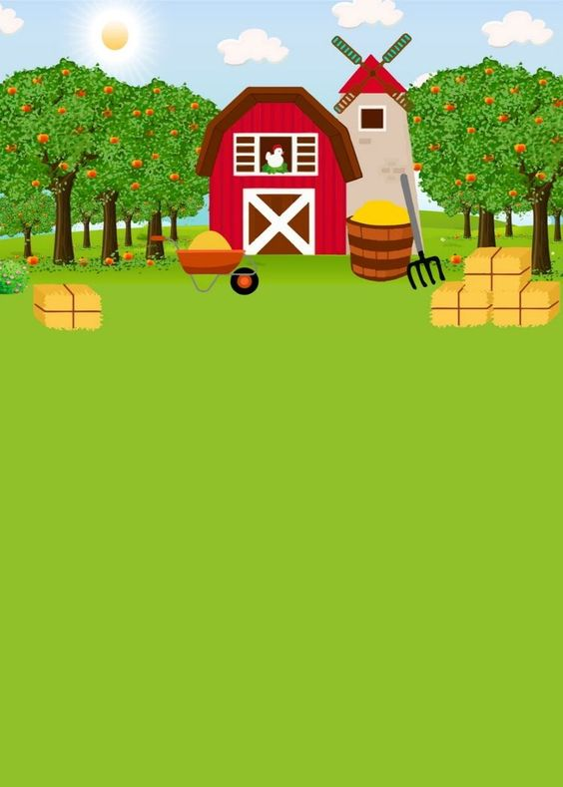
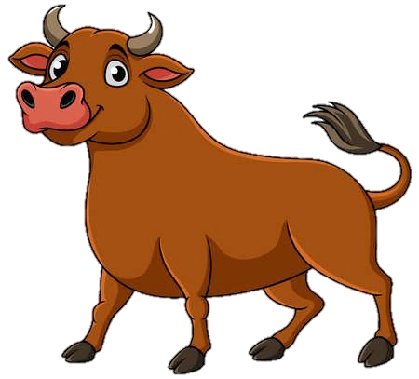
X, x, a box.
X, x, a box.
X, x, a box.
X, x, a box.
I can see a box on the farm.
I can see a box on the farm.
I can see a box on the farm.
I can see a box on the farm.
X, x, a fox.
X, x, a fox.
X, x, a fox.
X, x, a fox.
I can see a fox on the farm.
I can see a fox on the farm.
I can see a fox on the farm.
I can see a fox on the farm.
X, x, an ox.
X, x, an ox.
X, x, an ox.
X, x, an ox.
I can see an ox on the farm.
I can see an ox on the farm.
I can see an ox on the farm.
I can see an ox on the farm.

Slide 11
6.Listen and repeat

Slide 12
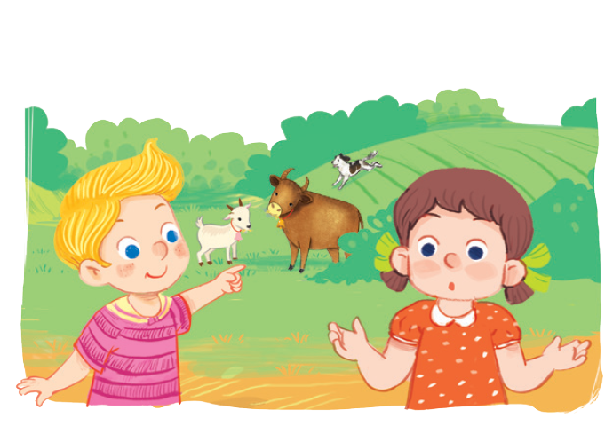
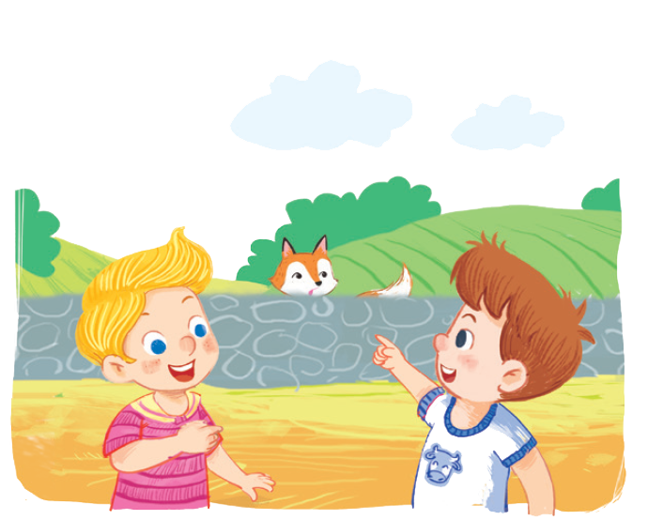
Is there a fox?
No, there isn’t.
Is there a fox?
Yes, there is.

Slide 13
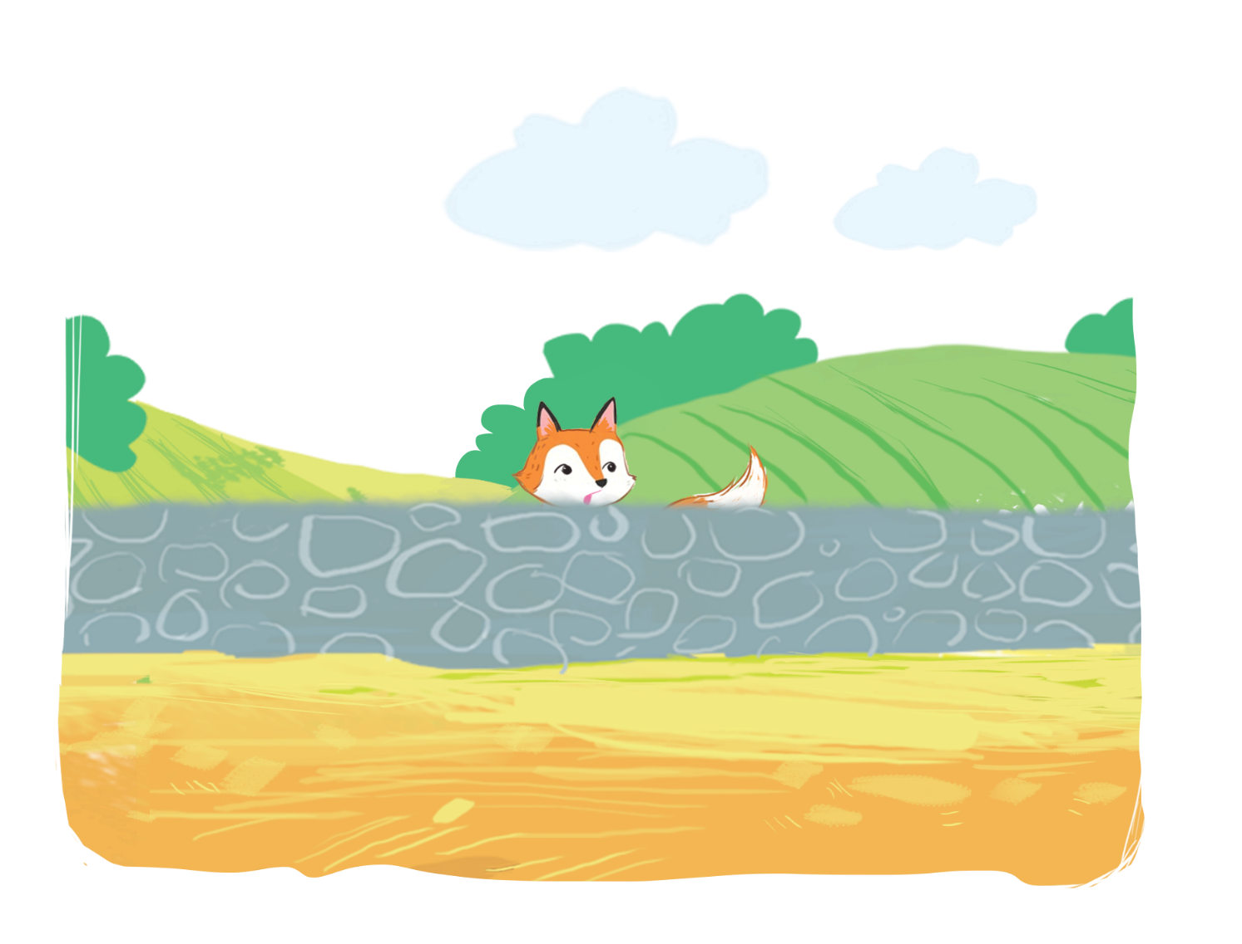
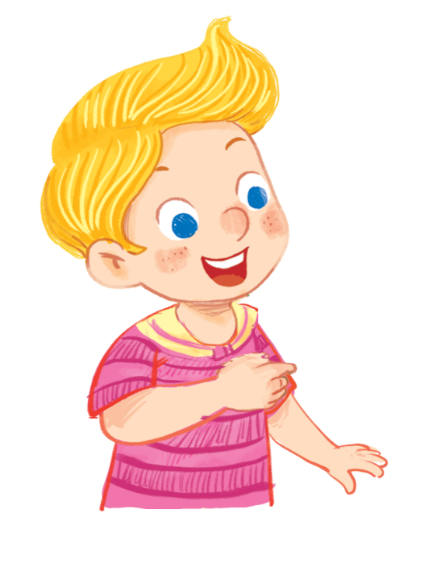
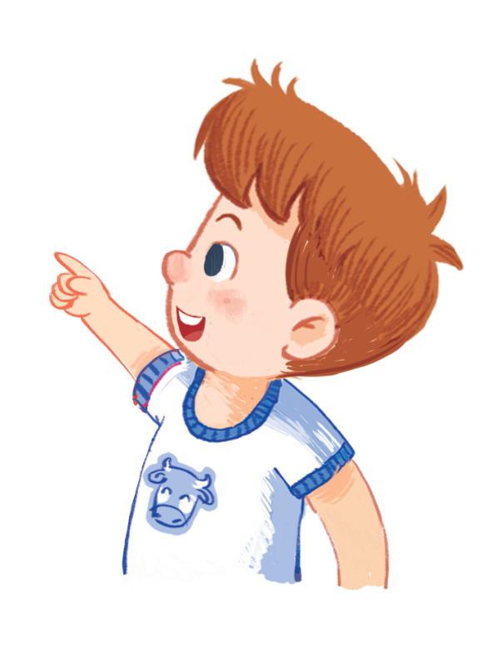
Is there a fox?
Is there a fox?
Is there a fox?
Is there a fox?
Yes, there is.
Yes, there is.
Yes, there is.
Yes, there is.

Slide 14
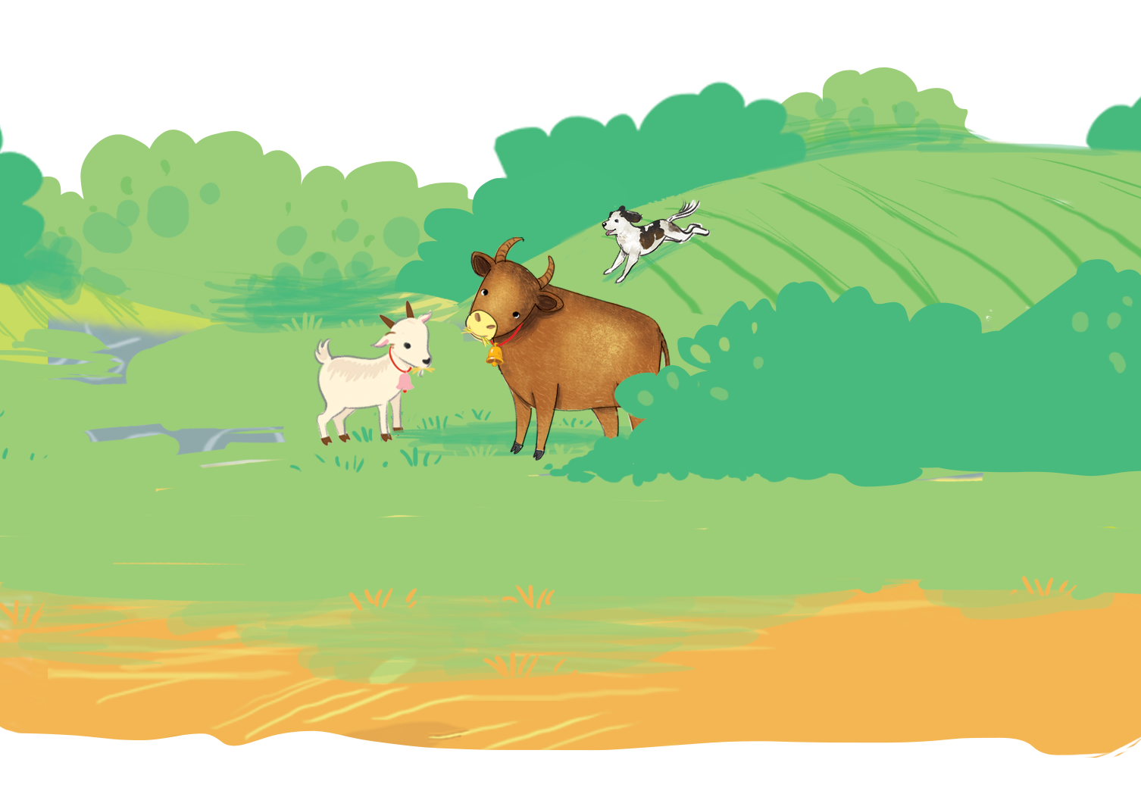
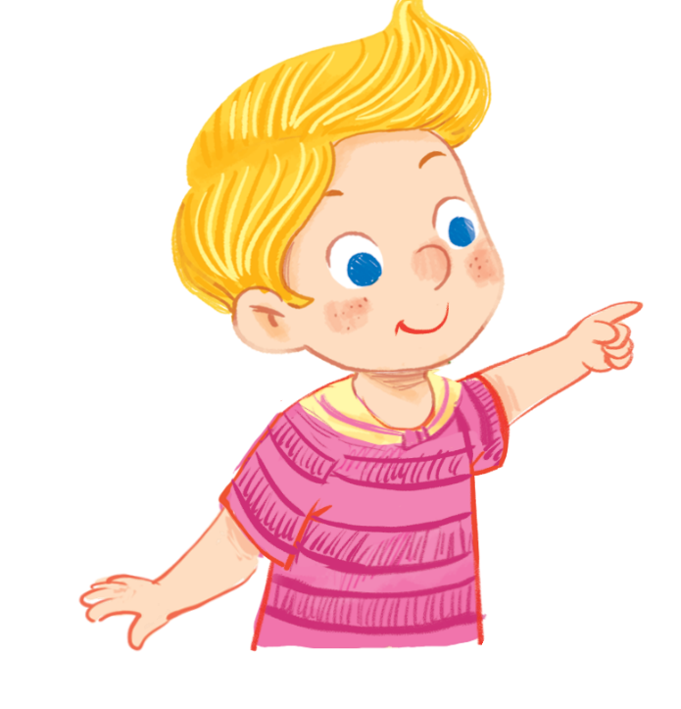
Is there a fox?
Is there a fox?
Is there a fox?
Is there a fox?
No, there isn’t.
No, there isn’t.
No, there isn’t.
No, there isn’t.

Slide 15
7. Let’s talk.

Slide 16
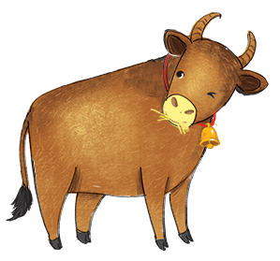
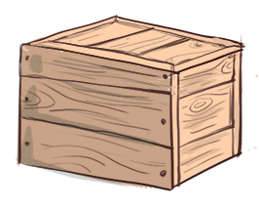
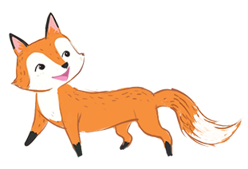
Is there a/an ?
Yes, .
No, .
a
b
c

Slide 17
fox
Is there a ?
Yes, .
there isn’t
No, .
a

Slide 18
box
Is there a ?
there is
Yes, .
No, .
a

Slide 19
ox
Is there an ?
Yes, .
there isn’t
No, .
b

Slide 20
fox
Is there a ?
there is
No, .
Yes, .
b

Slide 21
box
Is there a ?
Yes, .
there isn’t
No, .
c

Slide 22
ox
Is there an ?
there is
No, .
Yes, .
c

Slide 23
8. Let’s sing

Slide 24
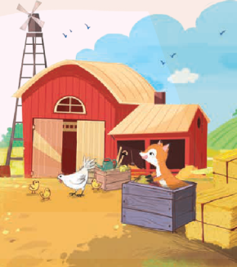
Is there a fox? Is there a fox?
Is there a fox? Is there a fox?
Is there a fox? Is there a fox?
Is there a fox? Is there a fox?
Yes, there is. Yes, there is.
Yes, there is. Yes, there is.
Yes, there is. Yes, there is.
Yes, there is. Yes, there is.
There’s a fox in the box.
There’s a fox in the box.
There’s a fox in the box.
There’s a fox in the box.
Is there an ox? Is there an ox?
Is there an ox? Is there an ox?
Is there an ox? Is there an ox?
Is there an ox? Is there an ox?
No, there isn’t. No, there isn’t.
No, there isn’t. No, there isn’t.
No, there isn’t. No, there isn’t.
No, there isn’t. No, there isn’t.
There isn’t an ox on the farm.
There isn’t an ox on the farm.
There isn’t an ox on the farm.
There isn’t an ox on the farm.

Slide 25
Option 1
Option 2

Slide 26
Listen and run
START
Notes:
- GV để các flashcard xung quanh lớp học, sau khi HS nghe xong từ sẽ chạy đi tìm đúng hình từ đã nghe và đem về cho GV.

Slide 27
Listen and run
ox
Notes:
- GV để các flashcard xung quanh lớp học, sau khi HS nghe xong từ sẽ chạy đi tìm đúng hình từ đã nghe và đem về cho GV.

Slide 28
Listen and run
box

Slide 29
Listen and run
fox

Slide 30
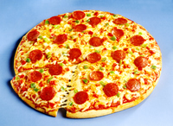
Listen and run
pizza

Slide 31
Listen and run
river

Slide 33
ROCK, PAPER, SCISSORS
20
19
18
17
16
15
14
13
12
11
10
9
8
7
6
5
4
3
2
1
0
20
19
18
17
16
15
14
13
12
11
10
9
8
7
6
5
4
3
2
1
0
START
1
2
3
4
5
1
2
3
4
5
Team A
Team B
Notes:
Chia 2 đội chơi. GV click vào START để bắt đầu cho HS của 2 đội chơi oẳn tù tì trên thực tế trước. Sau khi HS ra búa, kéo hay bao thì GV sẽ chọn vào biểu tượng tương ứng bên dưới trong vòng tròn đỏ. Đội nào thắng sẽ dành được quyền ưu tiên trả lời câu hỏi để ghi điểm trước. Đội nào nhiều điểm và trả lời hết các câu hỏi trước thì thắng.

Slide 34
………….
Is there …….?

Slide 35
Is there …….?
…………….

Slide 36
Is there …….?
………….

Slide 37
……………….
Is there …….?

Slide 38
Is there …….?
…………….

