Slide 1




Welcome to our class

Slide 2

OUR SPECIAL DAYS
Lesson 3 – Parts 1,2,3

Slide 3
01
Warm-up
Guess the food and drinks.

Slide 4


chips

Slide 5
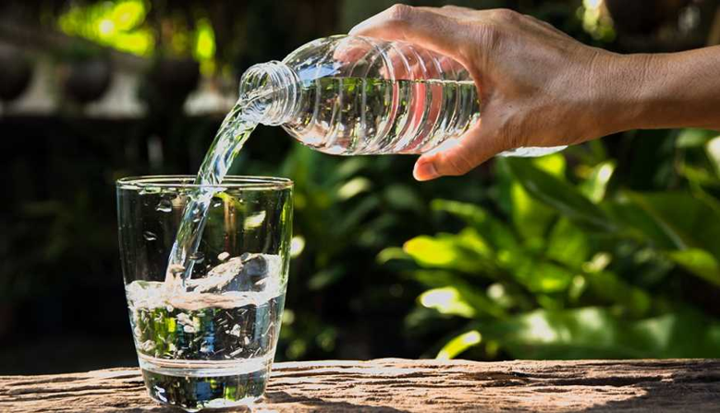

water

Slide 6

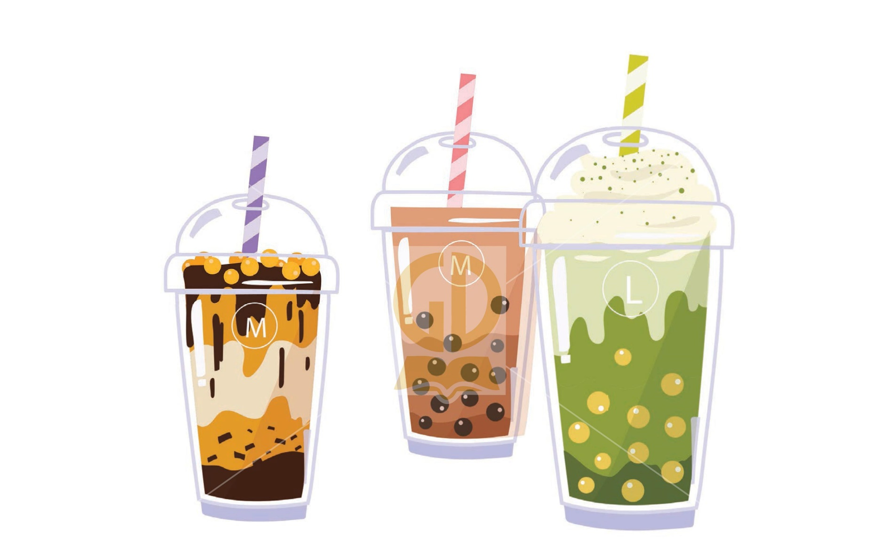

Milk tea

Slide 7
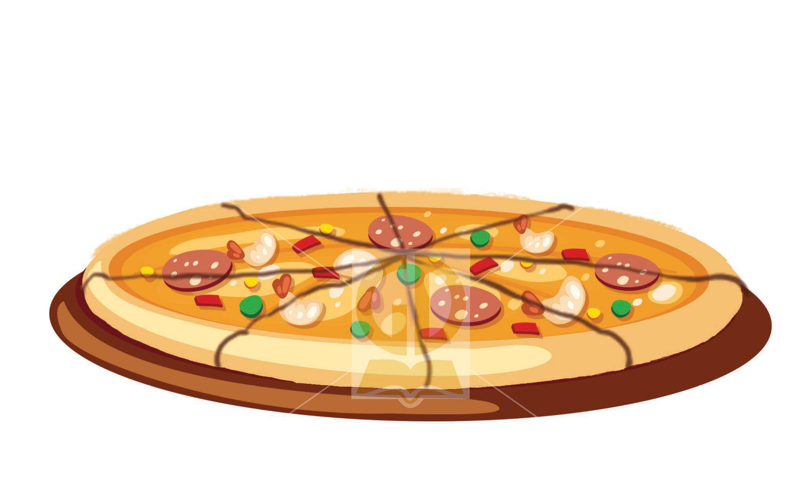

pizza

Slide 8


Apple juice

Slide 9
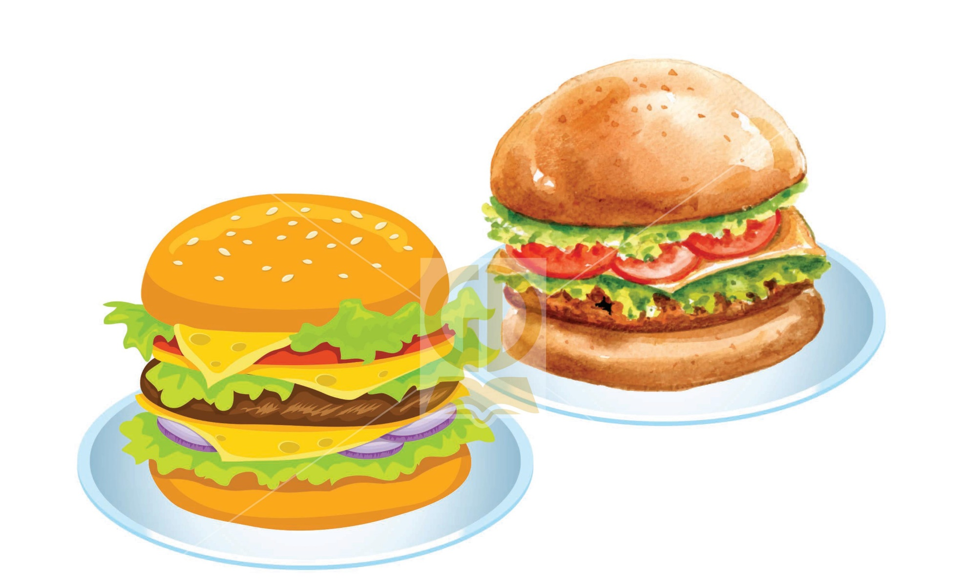
Burgers

Slide 10
02
Activity 1
Listen and repeat.

Slide 11


1.Listen and repeat
What food will you have at the party?
‘What ‘food will you ‘have at the ‘party?

Slide 12

1.Listen and repeat
What drinks will you have at the party?

Slide 13
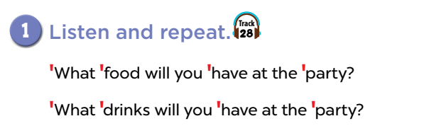

Slide 14
1.Listen and repeat
What food will you have at the party?
What drinks will you have at the party?

Slide 15
What food will you have at the party?
Noun
(danh từ)
Verb
(động từ)
(noun)
danh từ
Từ để hỏi
(what,where,when,How,
How many)…

Slide 16
It’s a beautiful house.
(adjective)
Tính từ
(noun)
danh từ

Slide 17
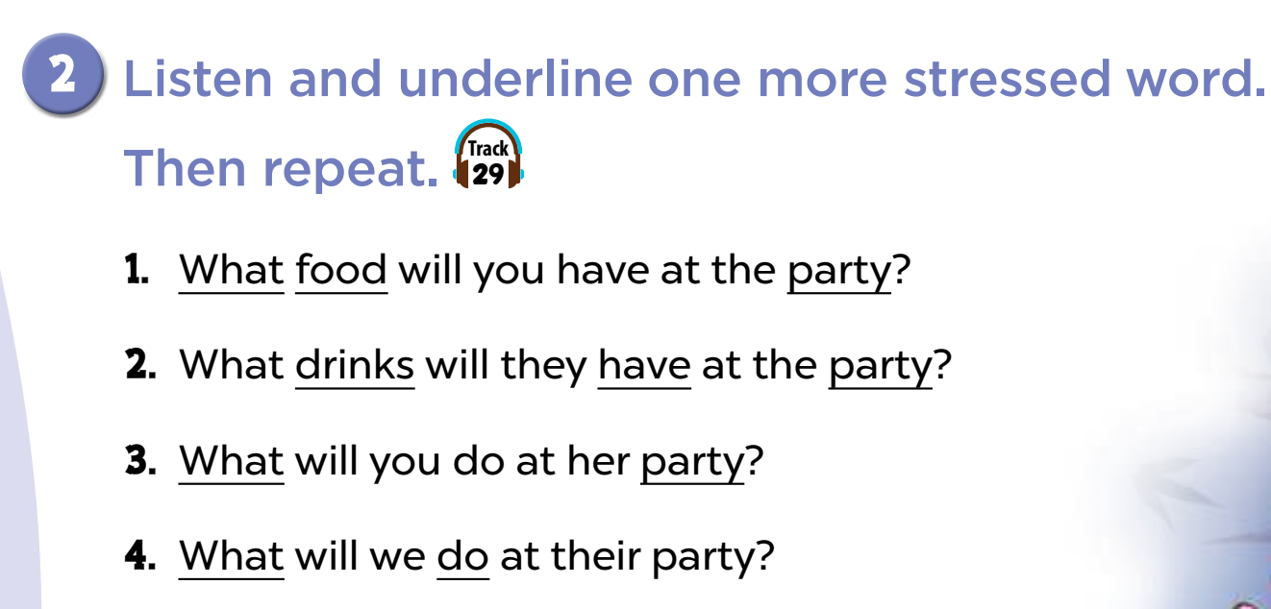

Slide 18
GUESSING THE ANSWERS

Slide 20
Listen again and check

Slide 21
1.What food will you have at the party?
1.What food will you have at the party?
A. will
B. you
C. at
D. have

Slide 22
2. What drinks will they have at the party?
2. What drinks will they have at the party?
A. What
B. will
C.they
D. the

Slide 23
3.What will you do at her party?
3.What will you do at her party?
A. will
B. you
C. do
D. her

Slide 24
4.What will we do at their party?
4.What will we do at their party?
A. will
B. we
C. their
D. party

Slide 25
1.’What ‘food will you ‘have at the ‘party?
What food
have
party ?
will you
at the

Slide 26
2.’What ‘drinks will they ‘have at the ‘party?
What drinks
have
party ?
will they
at the

Slide 27
3.’What will you ‘do at her ‘party?
What
do
party ?
will you
at her

Slide 28
4.’What will we ‘do at their ‘party?
What
do
party ?
will we
at their

Slide 29
5.What food will she have for dinner?
6.What will they do on Teachers’ Day?

Slide 30

1.’What ‘food will you ‘have at the ‘party?
2.’What ‘drinks will they ‘have at the ‘party?
3.’What will you ‘do at her ‘party?
4.’What will we ‘do at their ‘party?
5.’What ‘food will she have for dinner?
6. ‘What will they do on Teachers’ Day?

Slide 31
Activity 3
04
Let’s chant.

Slide 32
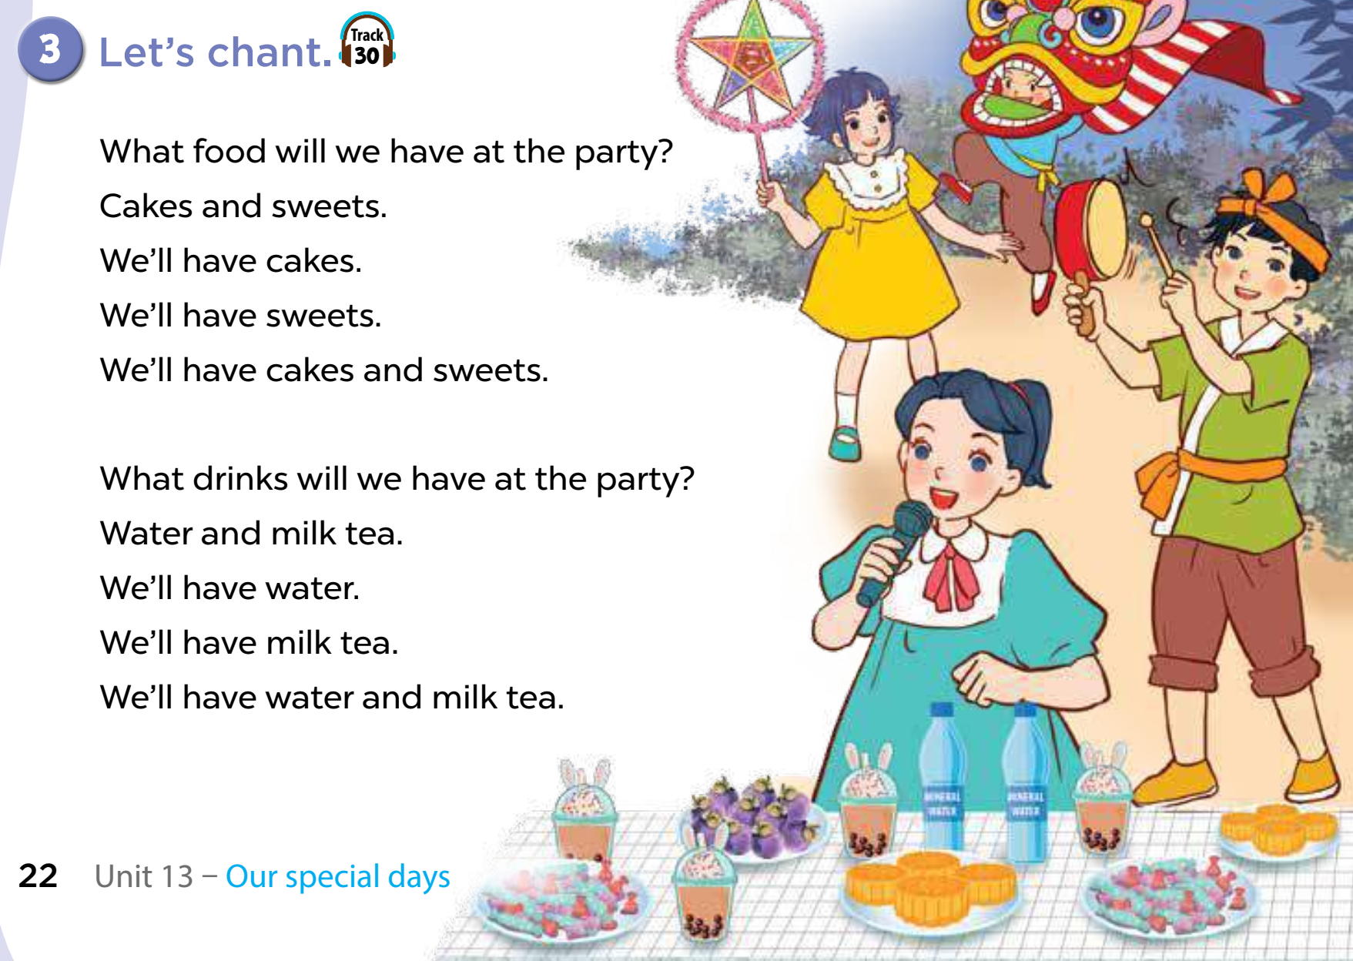

Slide 33
Mark stressed word

Slide 34
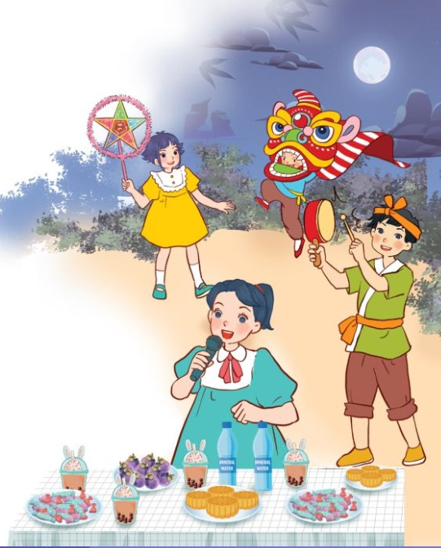
Read the chant
‘What ‘food will we ‘have at the ‘party?
‘Cakes and ‘sweets.
We’ll ‘have ‘cakes.
We’ll ‘have ‘sweets.
We’ll ‘have ‘cakes and ‘sweets.
‘What ‘drinks will we ‘have at the ‘party?
‘Water and ‘milk tea.
We’ll ‘have ‘water.
We’ll ‘have ‘milk tea.
We’ll ‘have ‘water and ‘milk tea.

Slide 35


Slide 36
Chant sentence by sentence
What food will we have at the party?
Cakes and sweets.
We’ll have cakes.
We’ll have sweets.
We’ll have cakes and sweets.
What drinks will we have at the party?
Water and milk tea.
We’ll have water.
We’ll have milk tea.
We’ll have water and milk tea.

Slide 37
3.Let’s chant
What food will we have at the party?
Cakes and sweets.
We’ll have cakes.
We’ll have sweets.
We’ll have cakes and sweets.
What drinks will we have at the party?
Water and milk tea.
We’ll have water.
We’ll have milk tea.
We’ll have water and milk tea.

Slide 39
Underline the name of food and drinks
What food will we have at the party?
Cakes and sweets.
We’ll have cakes.
We’ll have sweets.
We’ll have cakes and sweets.
What drinks will we have at the party?
Water and milk tea.
We’ll have water.
We’ll have milk tea.
We’ll have water and milk tea.

Slide 40
Let’s make a new chant
What food will we have at the party?
Cakes and sweets.
We’ll have cakes.
We’ll have sweets.
We’ll have cakes and sweets.
What drinks will we have at the party?
Water and milk tea.
We’ll have water.
We’ll have milk tea.
We’ll have water and milk tea.

Slide 41


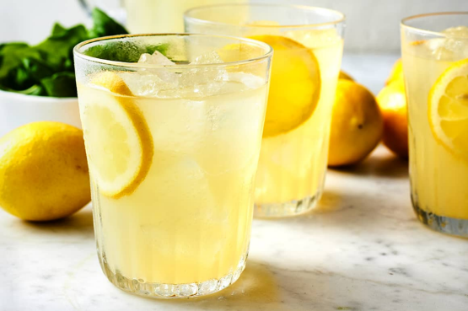
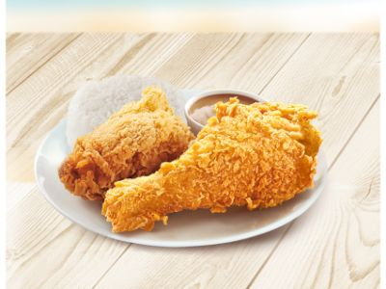
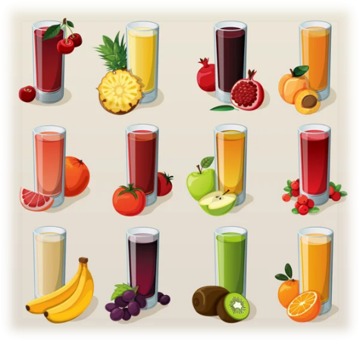



Food | Drinks
chips
chicken
fish
lemonade
apple juice
burgers
pizza
milk
juice

Slide 42
What food will we have at the party?
______ and ________.
We’ll have _________.
We’ll have _________.
We’ll have _______ and ________.
What drinks will we have at the party?
________ and _________.
We’ll have __________.
We’ll have __________.
We’ll have ________ and _________.

Slide 43


Thanks for your attention!

