Slide 1
14
My bedroom
Lesson 1 – Period 1

Slide 2
①
Warm-up and review
②
Look, listen and repeat.
③
Listen, point and say.
④
Let’s talk.
⑤
Fun corner and wrap-up

Slide 3
Lesson 1
Period 1
①
Warm-up and review

Slide 4
Game: What room is this?
Look and guess
Notes:
Open the coloured squares and guess the room behind.

Slide 5
Lesson 1
Period 1
②
Look, listen and repeat.

Slide 7
Lesson 1
Period 1
③
Listen, point and say.

Slide 8
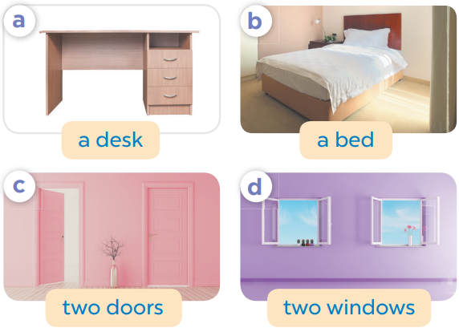
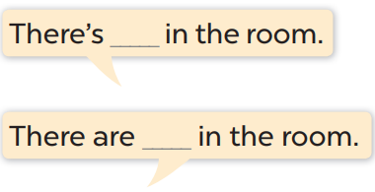

Slide 9
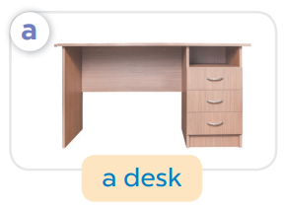
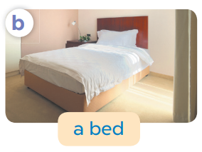
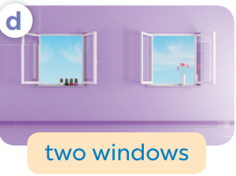
Game: What’s missing?
Notes:
Game: What’s missing?
T divides the class into 2 teams: BOYS and GIRLS.
T shows 4 pictures on the board. Take out 1, then 2 pictures then ask pupils to find out what is/ are missing.
Members of each team try to say out loud the missing room as fast as possible.

Slide 10
What’s missing?

Slide 11
What’s missing?

Slide 12
What’s missing?

Slide 13
What’s missing?
What’s missing?

Slide 14
What’s missing?
What’s missing?

Slide 15
Lesson 1
Period 1
④
Let’s talk.

Slide 16
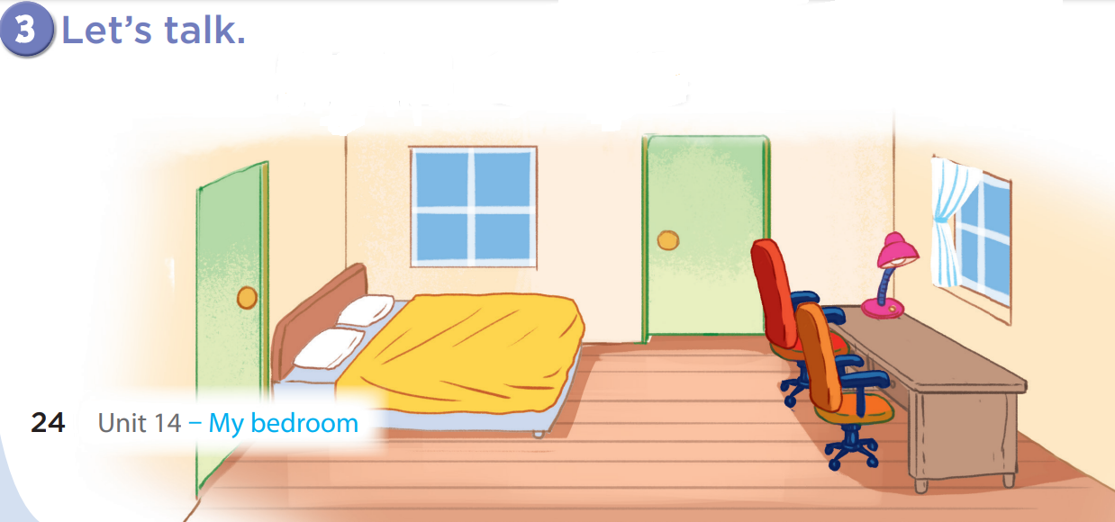
There are
two windows.
There is a bed.

Slide 17
There are
two doors.
There is a desk.

Slide 18
There are
two chairs.
There is a lamp.

Slide 19
Game: Look and say!
Notes:
Game: Look and say
- Divide the class into 2-4 teams.
- Have the pupils look at the arrows and say the sentences.

Slide 20
There are two windows.
5

Slide 21
There are two doors.
3

Slide 22
There is a bed.
2

Slide 23
There are two doors.
5

Slide 24
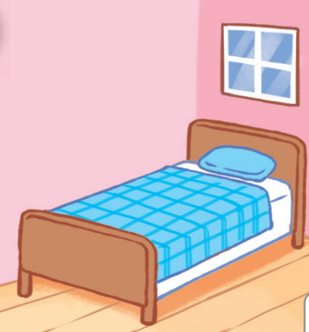
There is a bed.
2

Slide 25
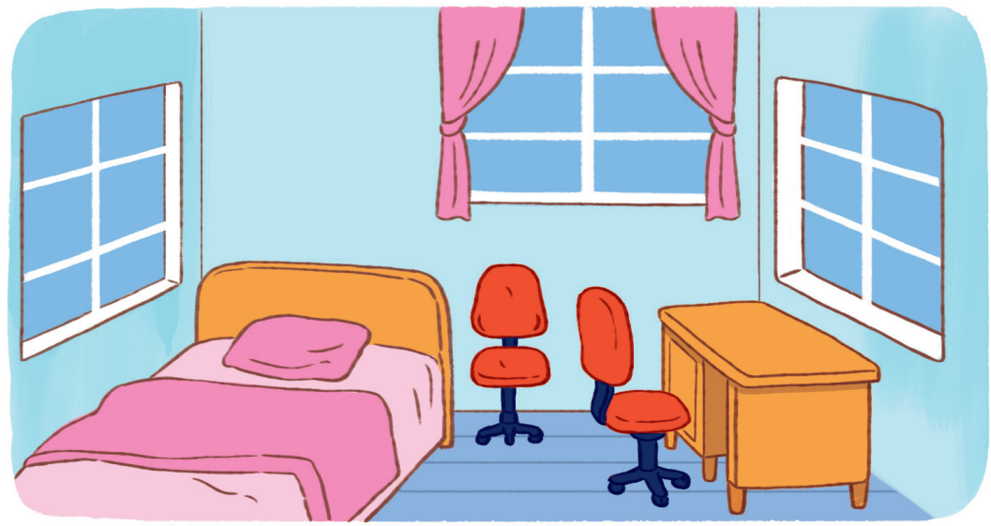
There is a desk.
3

Slide 26
There are two chairs.
3

Slide 27
Lesson 1
Period 1
⑤
Fun corner and wrap-up

Slide 28
What can you see in the room?
Notes:
Teacher asks pupils some questions about the picture and has them answer, e.g.:
+ What can you see in the picture?
+ How many…..?

Slide 29
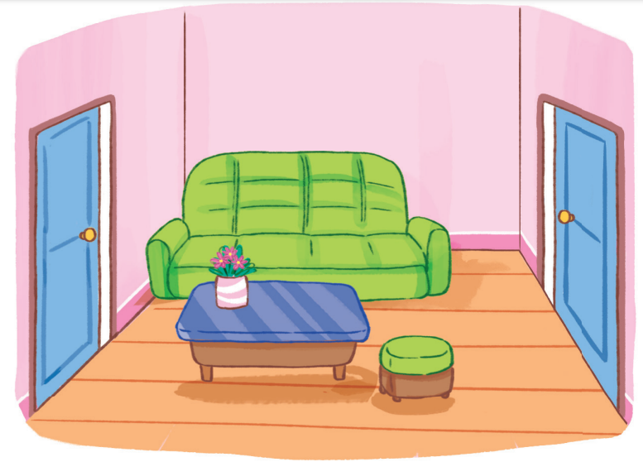
What can you see in the room?

