Slide 1
13
My house
LESSON 2 - PERIOD 3

Slide 2
TABLE OF CONTENTS
Warm-up and review
Look, listen and repeat.
1
2
3
4
Let’s talk.
Listen, point and say.
5
Fun corner and wrap-up

Slide 3
1
Warm-up and review

Slide 4
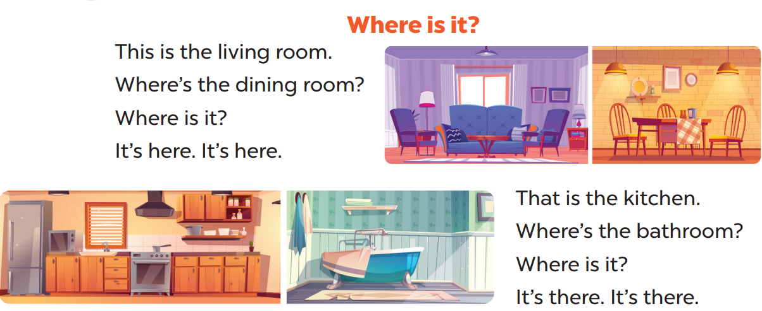
Sing a song
Option 1

Slide 5
Revising words
Option 2

Slide 6
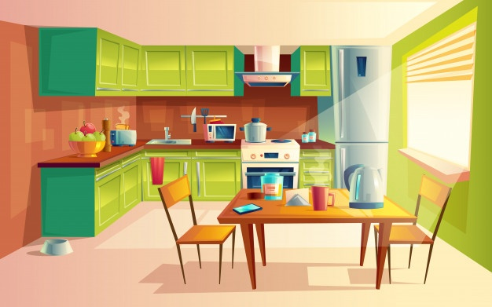
kitchen

Slide 7
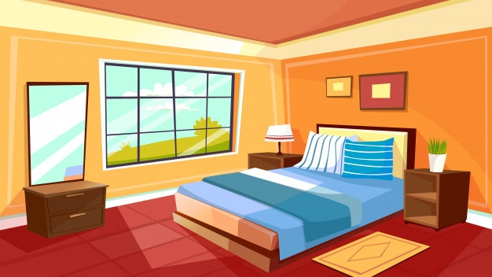
bedroom

Slide 8
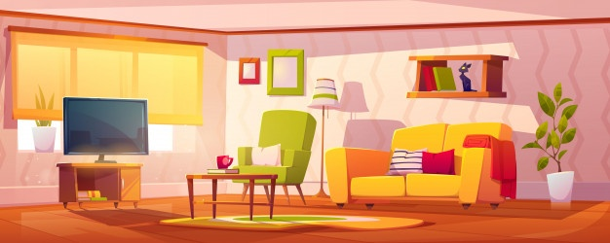
living room

Slide 9
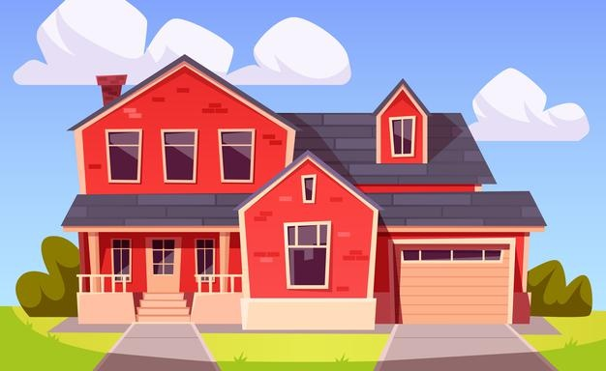
house

Slide 10
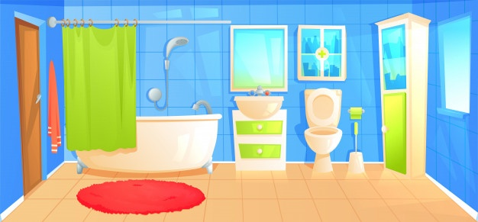
bathroom

Slide 11
AWESOME WORDS
Option 3

Slide 12
2
Look, listen and repeat.

Slide 13
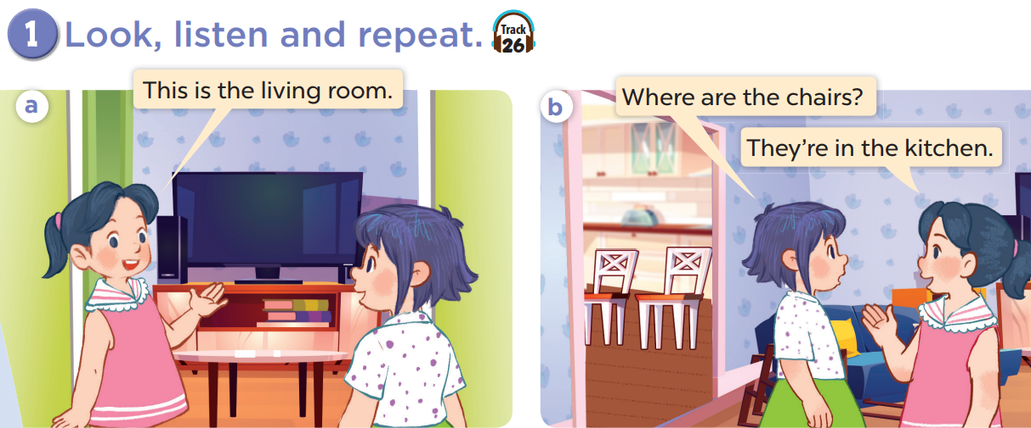

Slide 14
Work in pairs and act.

Slide 15
3
Listen, point and say.

Slide 16
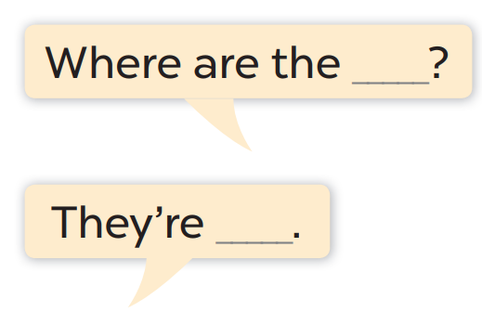
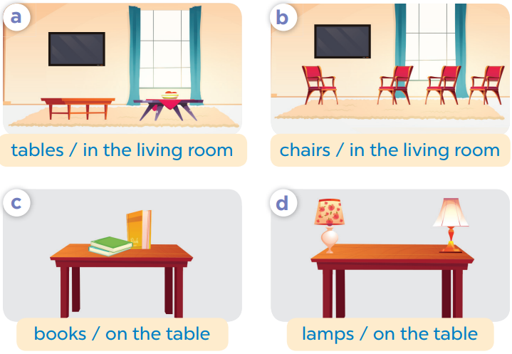
Work in pair, ask and answer.

Slide 17
4
Let’s talk.

Slide 18
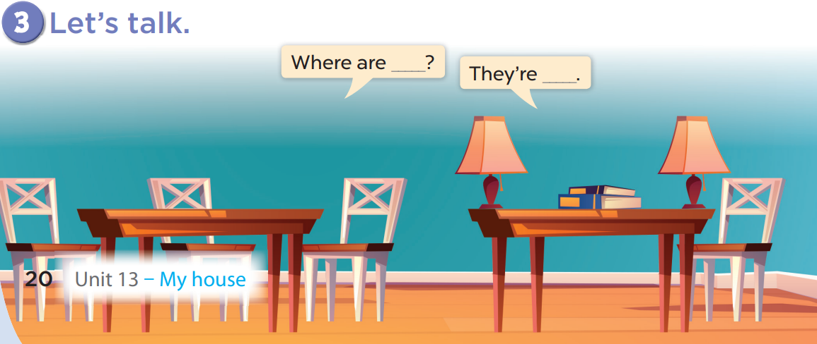
Work in pairs, ask and answer.

Slide 19
5
Fun corner and wrap-up

Slide 20
Lucky number
1
2
3
4
5
6
7
8
Notes:
Divide the class into 2 teams.
Each team takes turns choosing a number then answering the question.

Slide 21
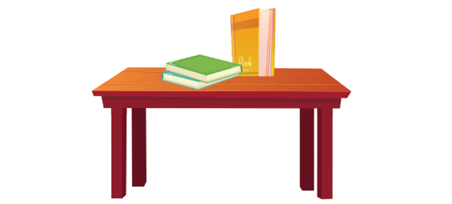
Where are the books?
They’re in the table.
They’re on the table.
Notes:
Click the home to go back.

Slide 22
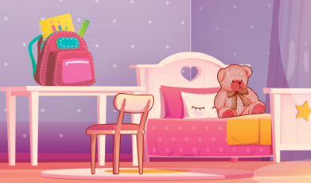
……….. is the bag?
What
How
Where
Notes:
Click the home to go back.

Slide 23
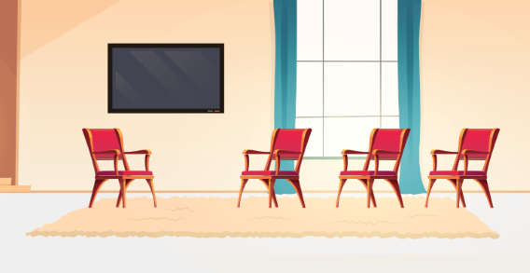
Where are the chairs?
They’re in the living room.
They’re on the living room.
Notes:
Click the home to go back.

Slide 24
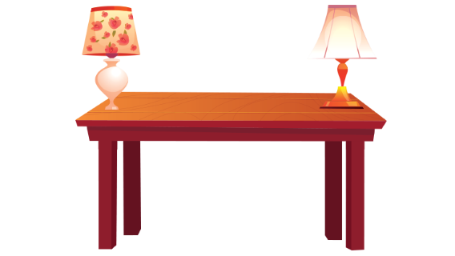
Where………………the lamps?
is
are
am
Notes:
Click the home to go back.

Slide 25
Where are the ……….?
books
table
book
Notes:
Click the home to go back.

