Slide 2
UNNT 6: OUR SCHOOL FACILITIES
LESSON 1: PART 4, 5, 6 ( P.45)

Slide 3
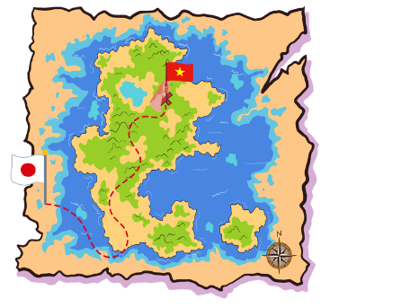
I. WARM UP

Slide 8
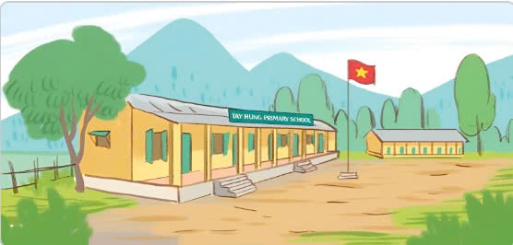
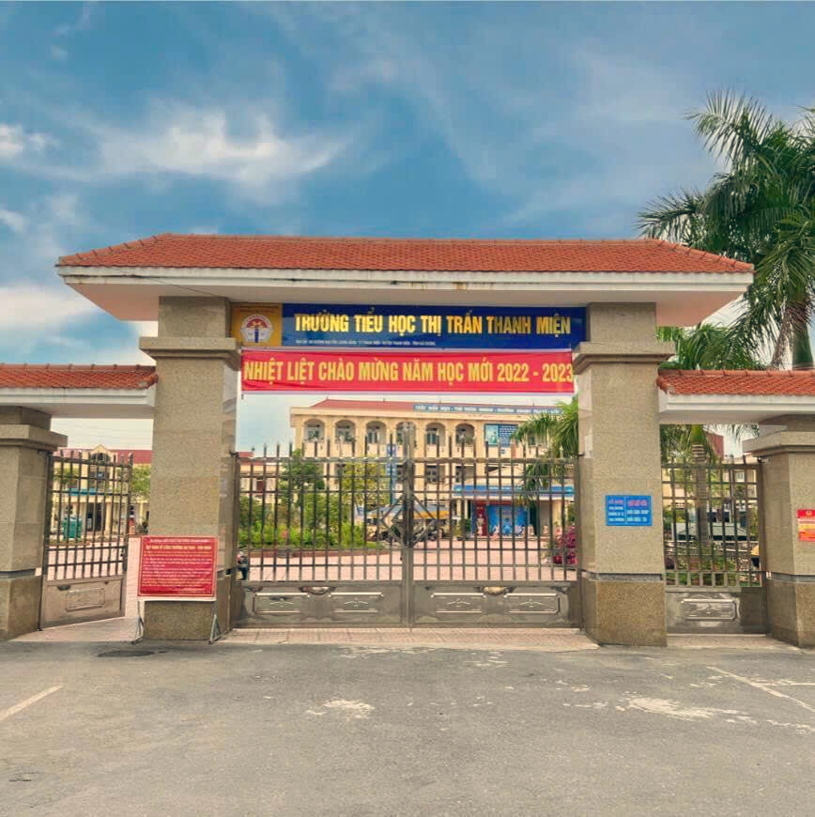
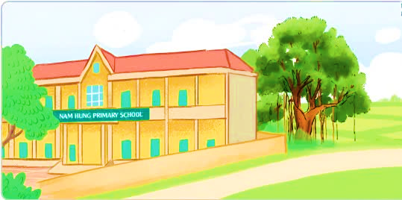
MOUNTAINS
CITY
TOWN
VILLAGE

Slide 9
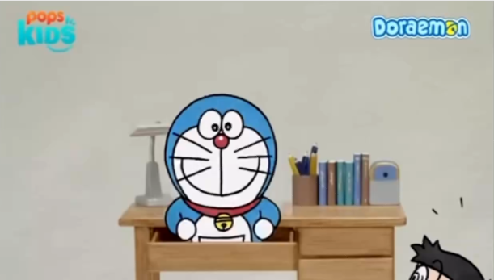

Slide 10
4. Listen and number

Slide 15
1

Slide 16
1
2

Slide 17
3
1
2

Slide 18
3
4
1
2

Slide 19
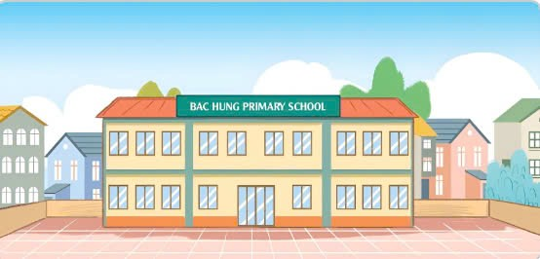
1. A: Where’s your school?
B: It’s in the __________________
2. A: Where’s your school?
B: It’s in ______________________
3. A: Where’s your________________?
B: It’s in ______________________
4. A: __________________ your school?
B: It’s ______________________

Slide 20
Game
Who is faster?
TEAM 1
TEAM 2

Slide 22
1. A: Where’s your school?
B: It’s in the __________________
village
2. A: Where’s your school?
B: It’s in ______________________
the town
3. A: Where’s your________________?
B: It’s in ______________________
school
the city
4. A: __________________ your school?
B: It’s ______________________
Where’s / where is
in the mountains

Slide 24
...
..
LET’S PLAY
Are you ready?

Slide 25
...
..
LET’S PLAY
Are you ready?

Slide 28
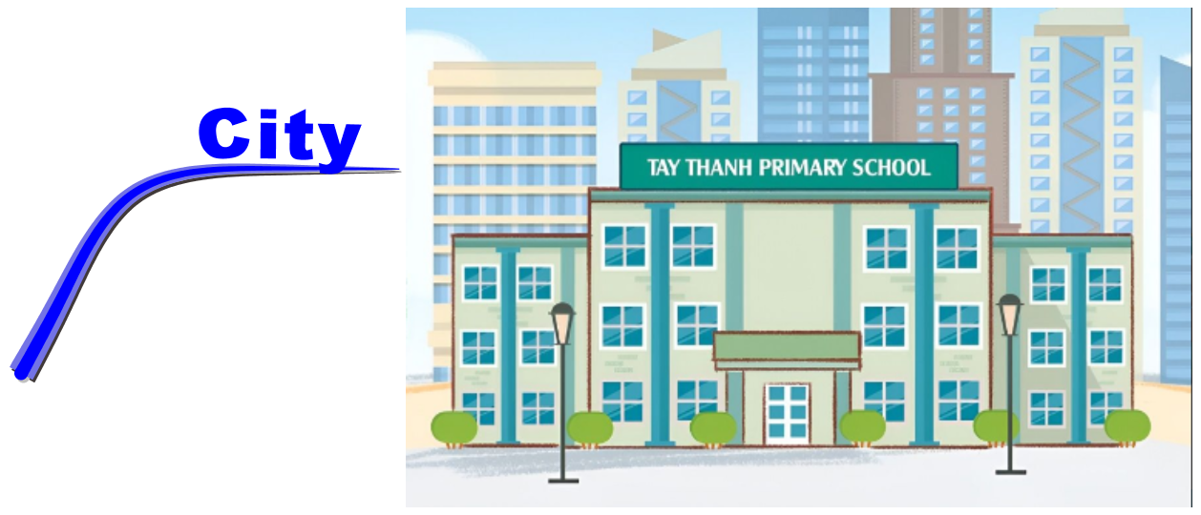
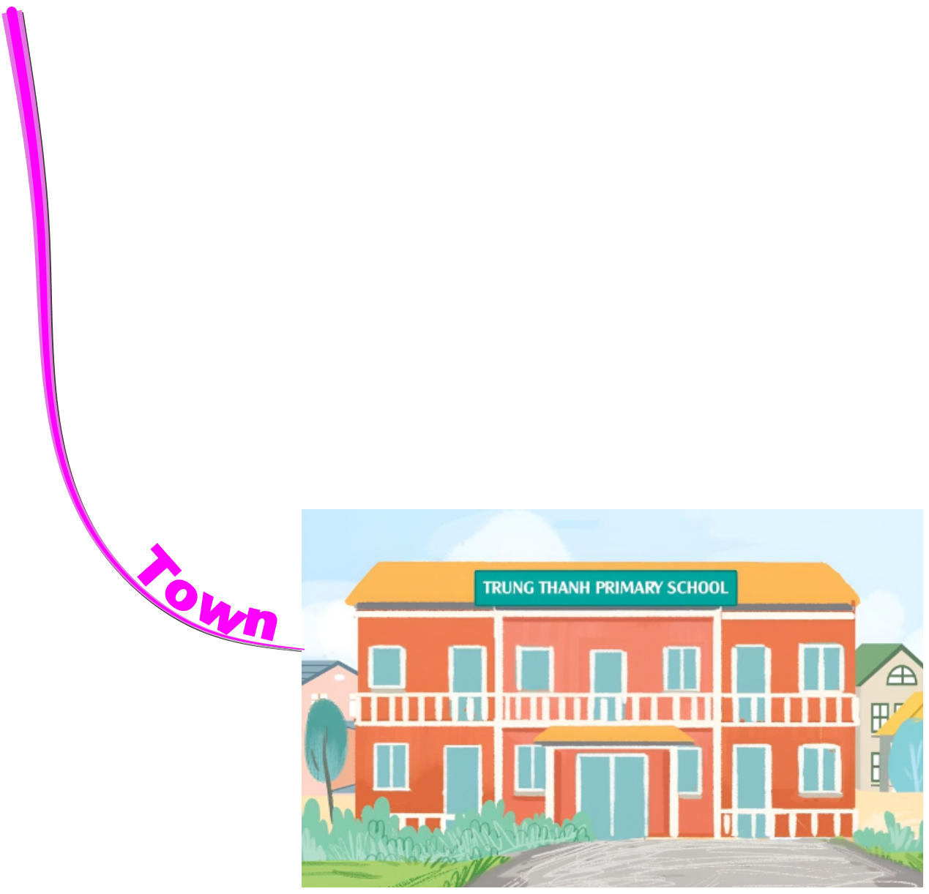
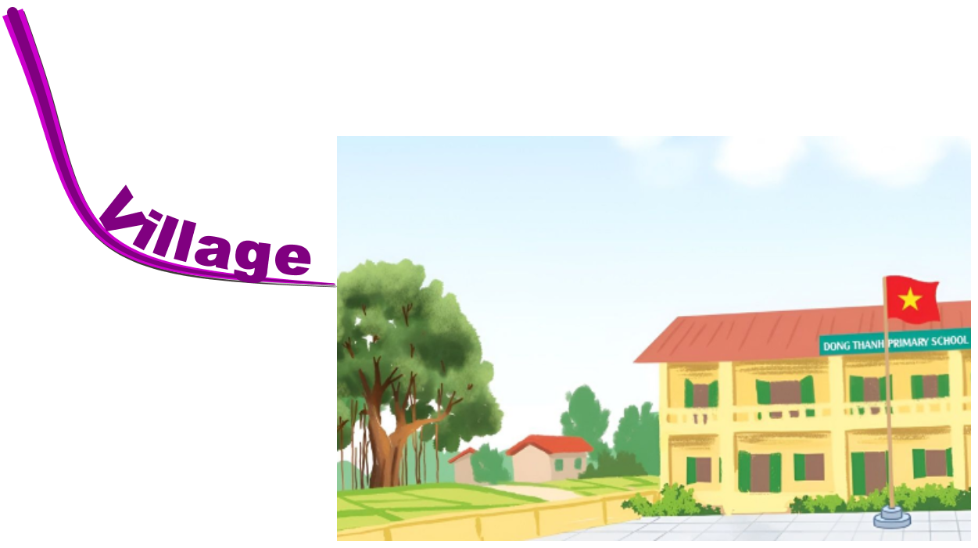
Summary

Slide 29
THANK
YOU

