Slide 1
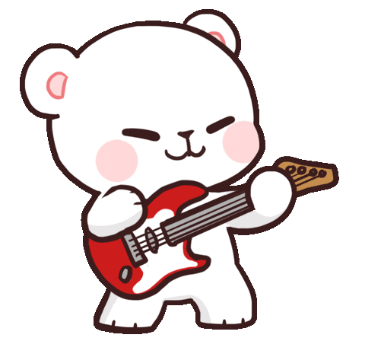
Welcome to our class!

Slide 2
Warm-up

Slide 3
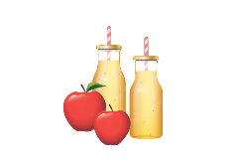
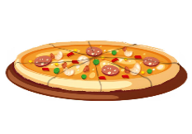
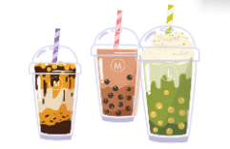
Monday, February 10th 2025
Unit 13
Our special days
Lesson 2 (1+2+3)

Slide 4
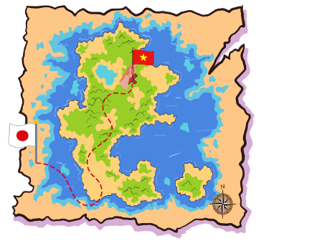
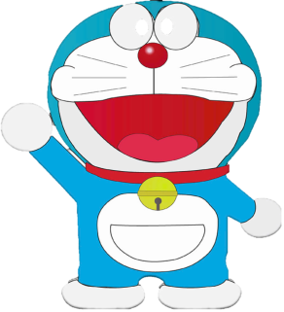
I. WARM UP

Slide 6
Look, listen and repeat.
Listen, point and say.
Let’s talk.

Slide 7
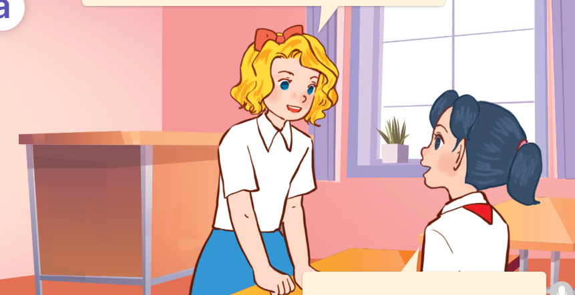
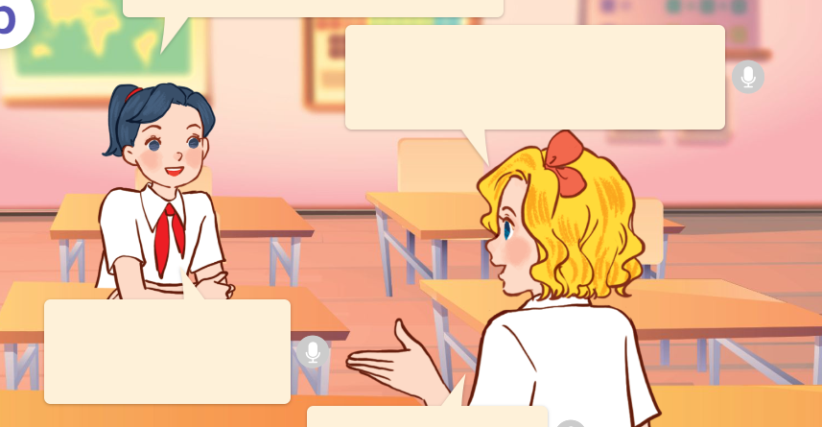
1. Look, listen and repeat.
Will you come to my
birthday party next Sunday?
Hi, Mai.
What drinks will you have at the party?
a
b
We’ll have fruit juice and milk tea.
Shall I bring some fruits?
Yes, I will.
Thanks!
Yes, please!
They’re in the classroom.
They’re talking about Mary’s birthday party.
What are they talking about?
Where are they?
Who are they?
They are Mary and Mai.
Click on the speaker / sentences to listen.

Slide 8
Cách hỏi ai đó sẽ ăn gì / uống gì ở bữa tiệc:
What food / drinks will you have at the party?
What food / drinks will you have at the party?
(Bạn sẽ ăn / uống gì trong bữa tiệc?)
We’ll have + ( food/ drinks.) ______.
( Chúng mình có ________.)

Slide 9
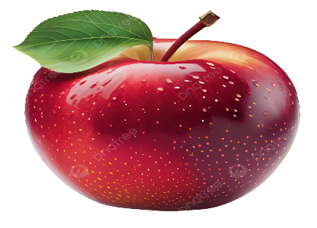
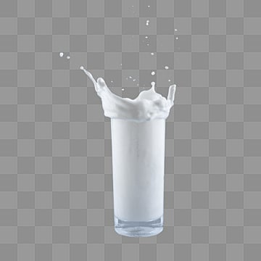
Unit 13 lesson 2 (1+2+3)
What food / drinks will you have at the party?
We’ll have ______.
milk tea

Slide 10
1.What/ at the party?/ food/ you have/ will/
2. drinks/ will/ What/ you have/ at the party?/
1.What food will you have at the party?
2. What drinks will you have at the party?

Slide 11
Vocabulary

Slide 12
Vocabulary
apple juice
/ˈæpl dʒuːs/
nước ép táo
Click on the English words to listen.

Slide 13
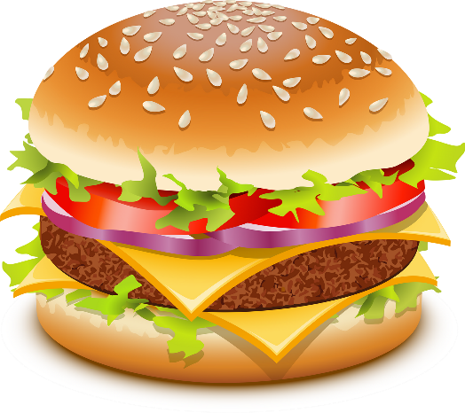
burger
/ˈbɜːɡə/
bánh mì kẹp thịt

Slide 14
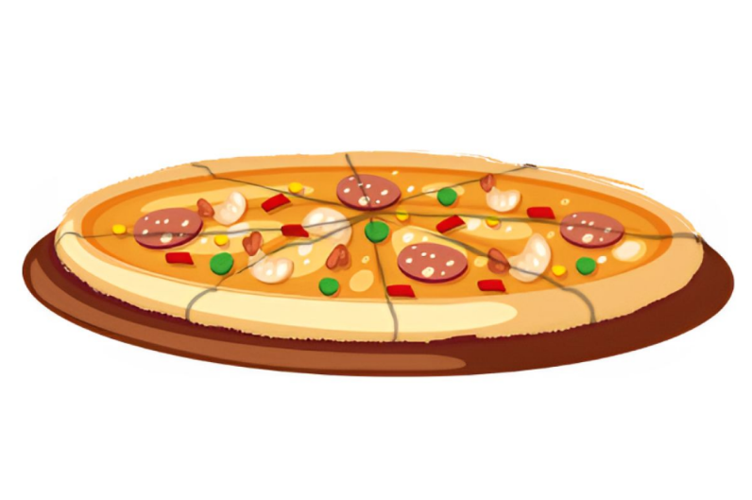
pizza
/ˈpɪːtsə/
bánh pizza

Slide 15
milk tea
/mɪlk tɪː/
trà sữa

Slide 16
Review
apple juice
burger
pizza
milk tea
Click on the English word to listen again.

Slide 17
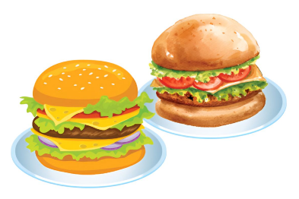
Unit 13 lesson 2 (1+2+3)
What food / drinks will you have at the party?
We’ll have ______.
apple juice
milk tea
burgers
pizza

Slide 18
2. Listen, point and say.
a
b
What food / drinks will you have at the party?
pizza
burgers
c
d
We’ll have ______.
we’ll = we will
milk tea
apple juice
Click on the words / phrases to listen again.

Slide 19
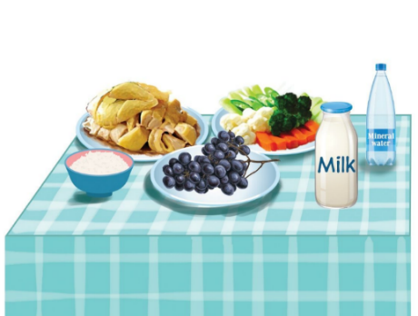
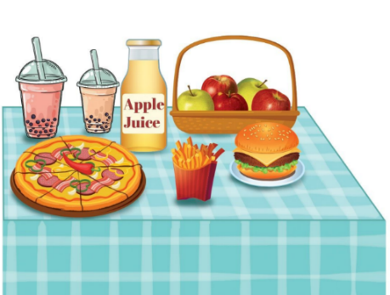
3. Let’s talk.
What food will you have at the party?
_____________.
What drinks will you have at the party?
______________.
What will you do at / after the party?
____________.

Slide 21
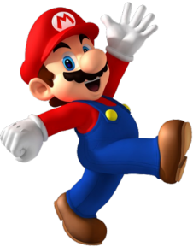
PLAY

Slide 22
B. milk tea
A. pizza
C. apple juice
A: What drinks will you have at the party?
B: We’ll have _______ .

Slide 23
B. pizza
A. apple juice
C. burgers
A: What food will you have at the party?
B: We’ll have _______ .

Slide 24
B. What drinks will you have at the party?
8/8
A. What food will you have at the party?
C. What will you do at Mid-Autumn Festival?
A: ___________________
B: We’ll have burgers.

Slide 25
B. burgers
A. pizza
C. milk tea
A: What food will you have at the party?
B: We’ll have _______ .

Slide 26
B.When - have
C.What - have
A.What - has
A: ____ drinks will you have at the party?
B: We’ll ___ milk tea.

Slide 27
Great!

Slide 28
Unit 13 lesson 2 (1+2+3)
What food / drinks will you have at the party?
We’ll have ______.
apple juice
milk tea
burgers
pizza

Slide 29
Homework
Learn by heart all the new words and the model sentences.
Read again the dialogue in part 1. Prepare for lesson 2 (4+5+6)

Slide 30
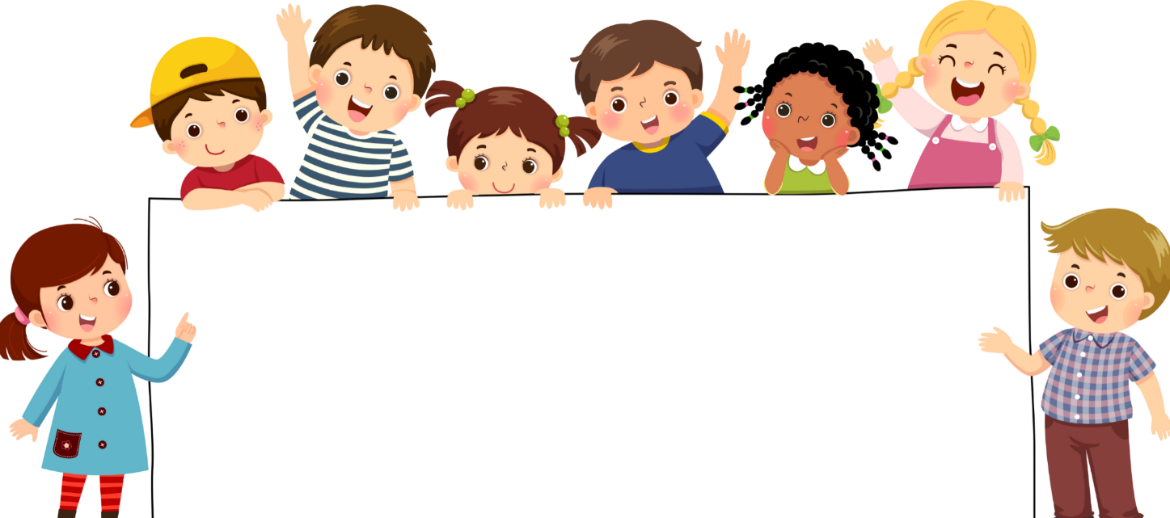
Goodbye!

