Slide 1

Welcome to
our class!

Slide 2
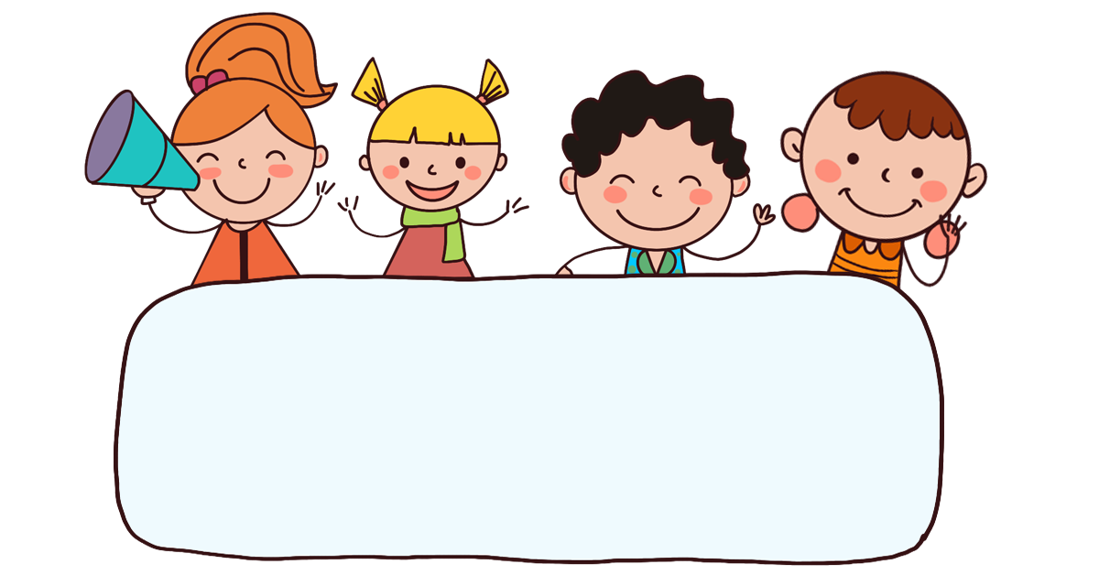
Warm-up

Slide 3
Let’s play!

Slide 4

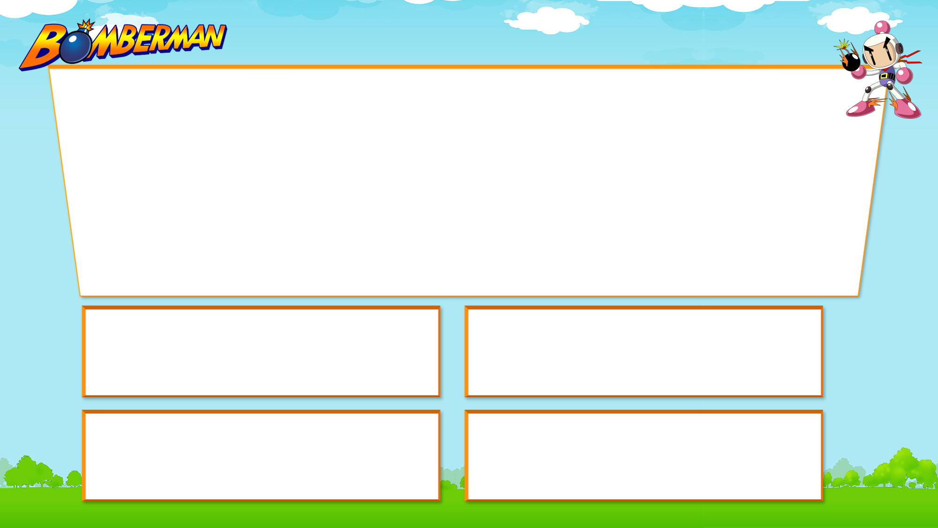
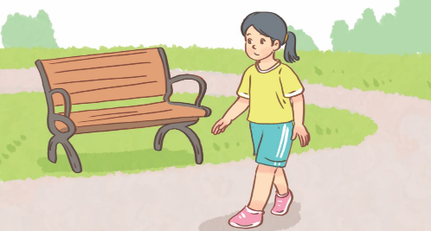


1/8
A: What do you like doing in your free time?
B: _______________________.
A. I like going for a walk.
B. I like playing the violin.
C. I like watering the flowers.
D. I like surfing the Internet.

Slide 5
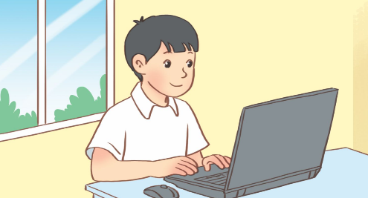
2/8
A: What does your brother like doing in his free time?
B: ________________.
A. I like surfing the Internet.
B. She likes surfing the Internet.
C. He likes watching cartoons.
D. He likes surfing the Internet.

Slide 6

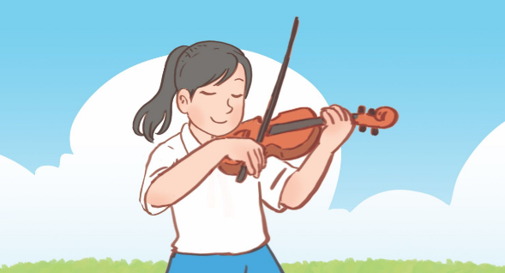
3/8
A: What do you do at the weekend?
B: ________________.
A. I usually play the violin.
B. I always go for a walk.
C. I always play the violin.
D. I rarely play the guitar.

Slide 7

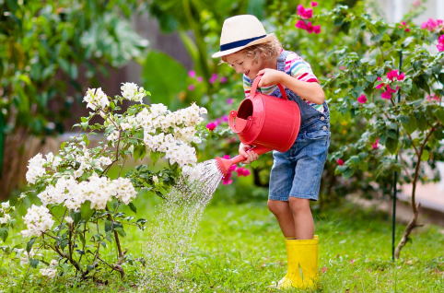
4/8
A: What do you do at the weekend?
B: ________________.
A. I usually read stories.
B. I sometimes water the flowers.
C. I always water the flowers.
D. I sometimes ride my bike.

Slide 8

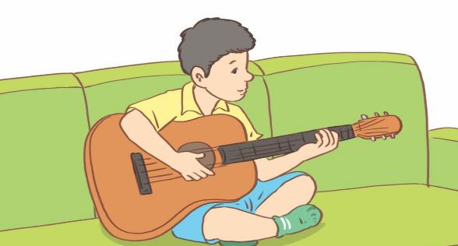
5/8
A: What do you do at the weekend?
B: ________________.
A. I usually play the violin.
B. I always listen to music.
C. I rarely play the guitar.
D. I never play the guitar.

Slide 9

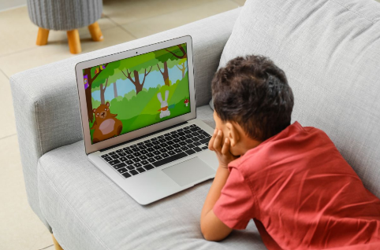
6/8
A: What do you do at the weekend?
B: ________________.
A. I often listen to music.
B. I often watch cartoons.
C. I rarely play table tennis.
D. I sometimes watch cartoons.

Slide 10
7/8
A: _________________________?
B: I like reading stories.
A. What do you like doing in your free time?
B. What does she do on Sundays?
C. What do you do at the weekend?
D. Can you tell me about yourself?

Slide 11

8/8
A: _____________________
B: I usually play football.
A. What do you do on Saturdays?
B. What’s your favourite sport?
C. What do you like doing in your free time?
D. What do you do at the weekend?

Slide 12
Great!

Slide 13

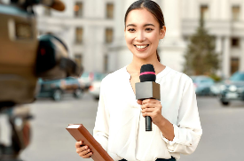
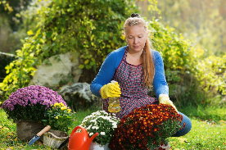
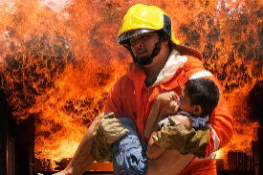

Monday, August 15th 2024
Unit 5
My future job
Lesson 1 (1+2+3)

Slide 14



Contents
Look, listen and repeat.
Listen, point and say.
Let’s talk.

Slide 15

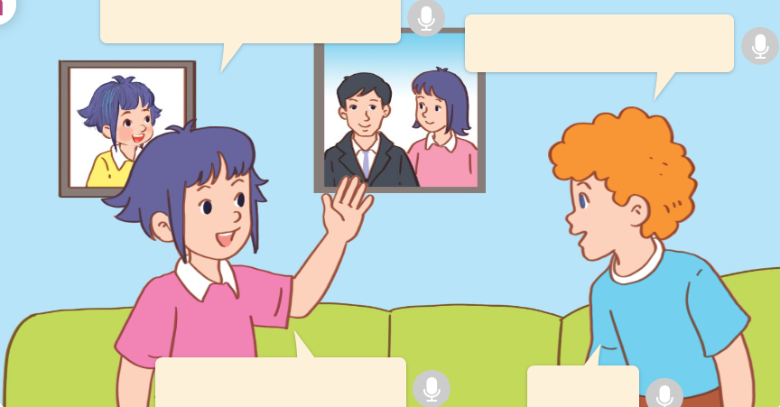
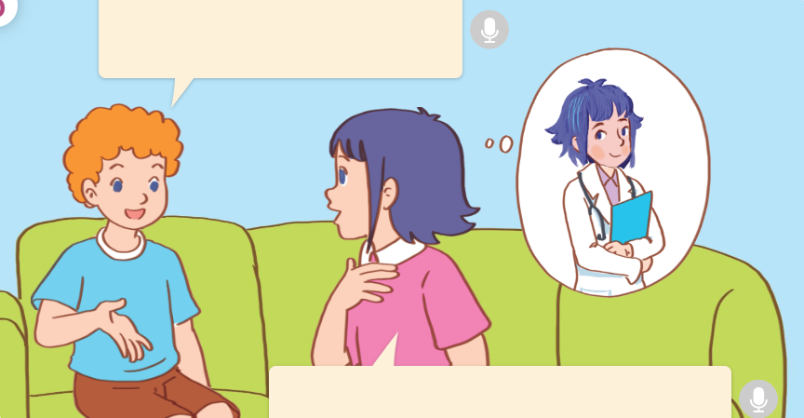
1. Look, listen and repeat.
What would you like to be in the future?
a
That’s my father.
b
What’s his job?
He’s a doctor.
Cool!
I’d like to be a doctor, too.
They’re talking about the future job.
What are they talking about?
They are Linh and Bill.
They’re at Linh’s house.
Where are they?
Who are they?
Click on the speaker / sentences to listen.

Slide 16
Vocabulary

Slide 17

Vocabulary
future
/ˈfjuː.tʃər/
tương lai
Click on the English words to listen.

Slide 18

firefighter
/ˈfaɪəfaɪtə/
lính cứu hỏa

Slide 19
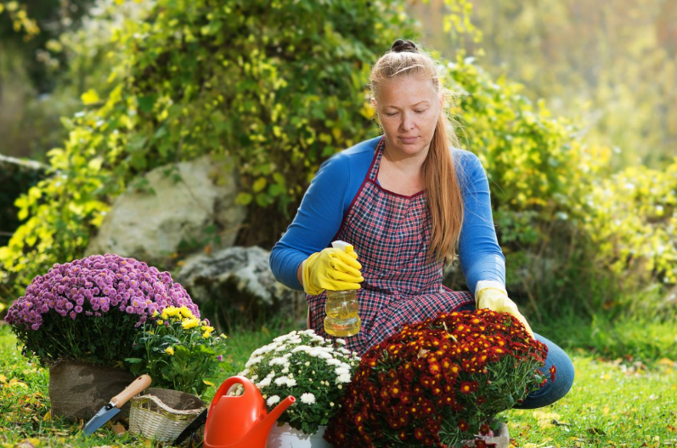
gardener
/ˈɡɑːdnə/
người làm vườn

Slide 20

reporter
/rɪˈpɔːtə/
phóng viên

Slide 21

writer
/ˈraɪtə/
nhà văn

Slide 22



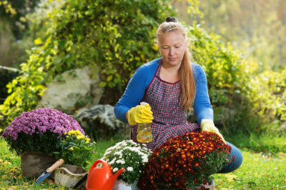

Review
future
firefighter
reporter
gardener
writer
Click on the English word to listen again.

Slide 23
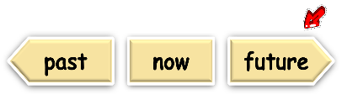




Vocabulary
1. future
: tương lai
2. firefighter
: lính cứu hỏa
3. gardener
: người làm vườn
4. reporter
: phóng viên
5. writer
: nhà văn
Click on the English word to listen again.

Slide 24

Checking vocabulary!

Slide 25
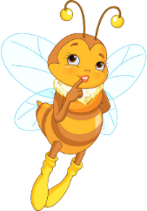
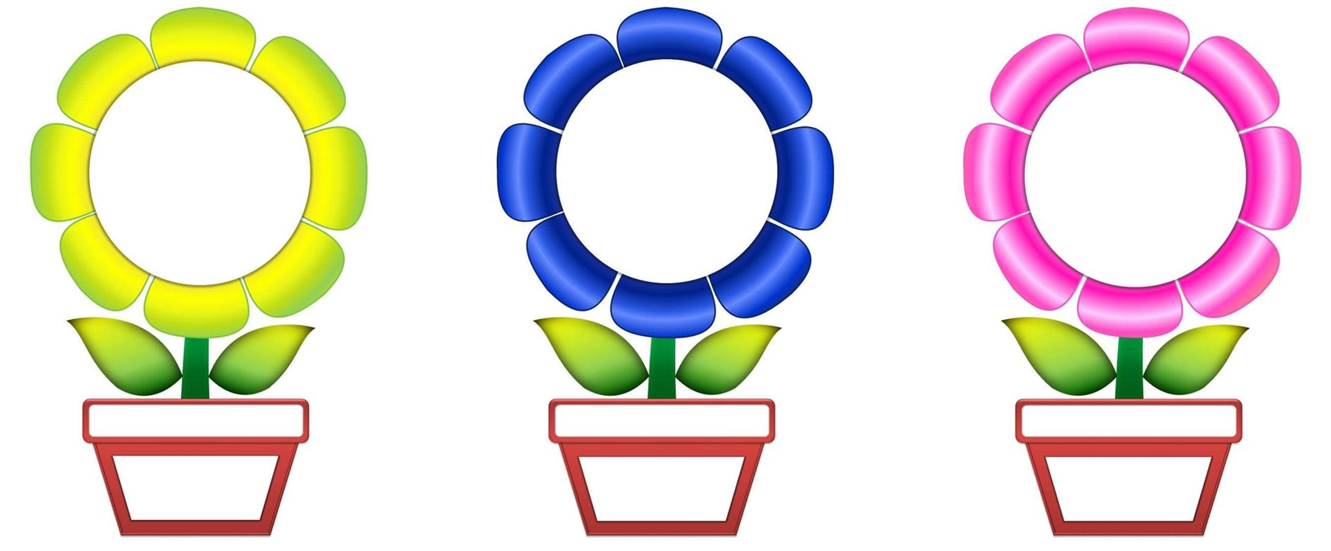


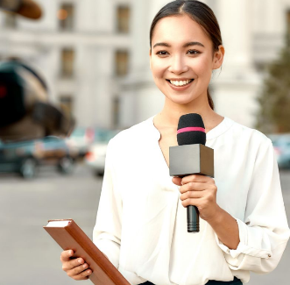
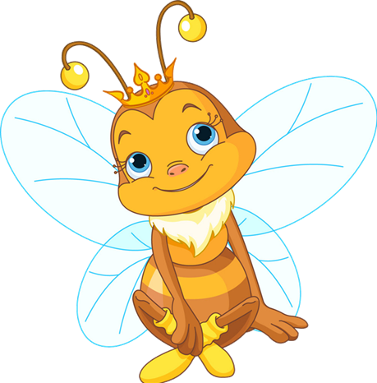
reporter
reporter
A
B
C
NEXT

Slide 26



firefighter
firefighter
A
B
C
NEXT

Slide 27



writer
writer
A
B
C
NEXT

Slide 28

future
future
A
B
C
NEXT

Slide 29



gardener
gardener
A
B
C
NEXT

Slide 30
Well done!

Slide 31
Structures

Slide 32




Cách hỏi ai đó trong tương lai muốn trở thành gì:
What would you like to be in the future?
( Bạn trở thành gì trong tương lai?)
I’d like to be a _______.
( Tôi muốn trở thành ________.)
Example:
What would you like to be in the future?
I’d like to be a reporter.

Slide 33
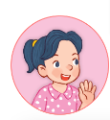





Unit 5 lesson 1 (1+2+3)
What would you like to be in the future?
I’d like to be a ______.
I’d = I would
firefighter
writer
reporter
gardener

Slide 34




2. Listen, point and say.
a
b
What would you like to be in the future?
firefighter
reporter
c
d
I’d like to be a _____.
I’d = I would
gardener
writer
Click on the words / phrases to listen again.

Slide 35


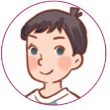
2. Listen, point and say.
a
firefighter
What would you like to be in the future?
I’d like to be a firefighter.
Click on the sentences to listen.

Slide 36



2. Listen, point and say.
b
reporter
What would you like to be in the future?
I’d like to be a reporter.

Slide 37

2. Listen, point and say.
c
gardener
What would you like to be in the future?
I’d like to be a gardener.

Slide 38

2. Listen, point and say.
d
writer
What would you like to be in the future?
I’d like to be a writer.

Slide 39
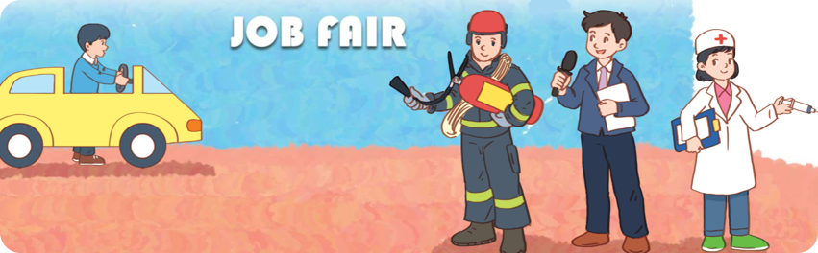
3. Let’s talk.
What would you like to be in the future?
_____________.

Slide 40

3. Let’s talk.
What would you like to be in the future?
____________________.
I’d like to be a taxi driver

Slide 41
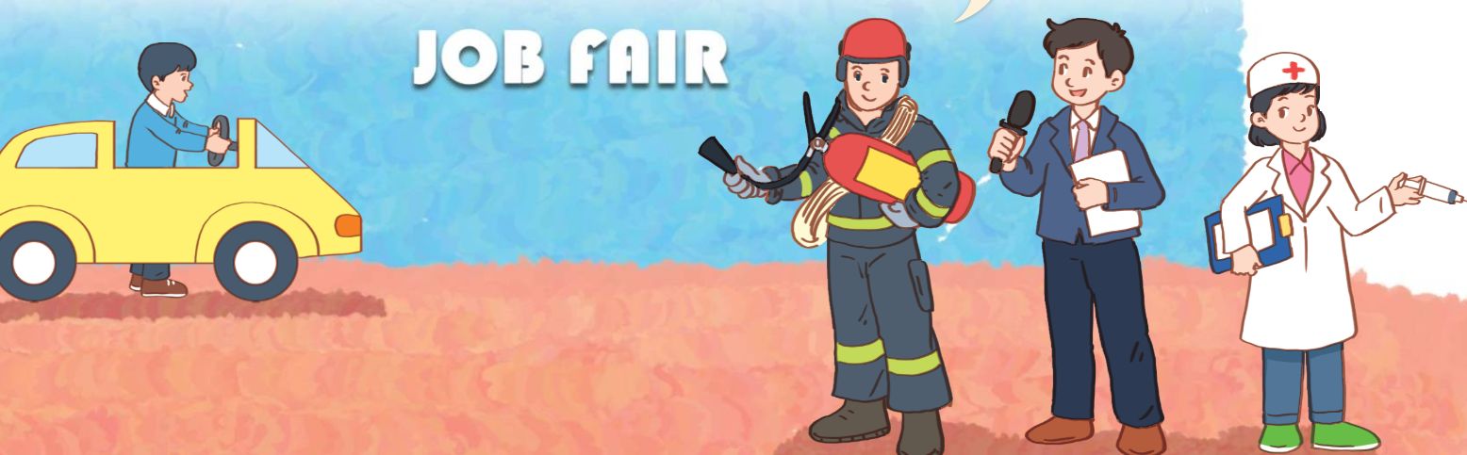
3. Let’s talk.
What would you like to be in the future?
I’d like to be a firefighter
____________________.

Slide 42
3. Let’s talk.
What would you like to be in the future?
I’d like to be a reporter
__________________.

Slide 43
3. Let’s talk.
What would you like to be in the future?
__________________.
I’d like to be a doctor

Slide 44
Fun corner
& wrap - up

Slide 45





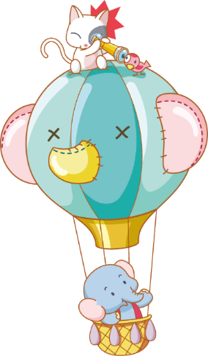
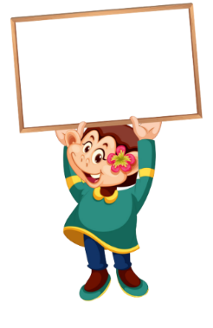



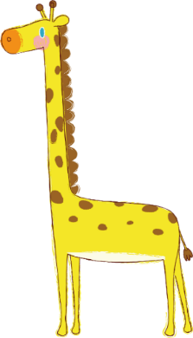

Luật chơi:
Chia lớp thành 2 đội
Bấm nút để quay, màu để dừng
Trả lời đúng được cộng điểm, nhường quyền trả lời cho đội bạn.
Kết thúc trò chơi đội nhiều điểm hơn sẽ chiến thắng.
PLAY

Slide 46
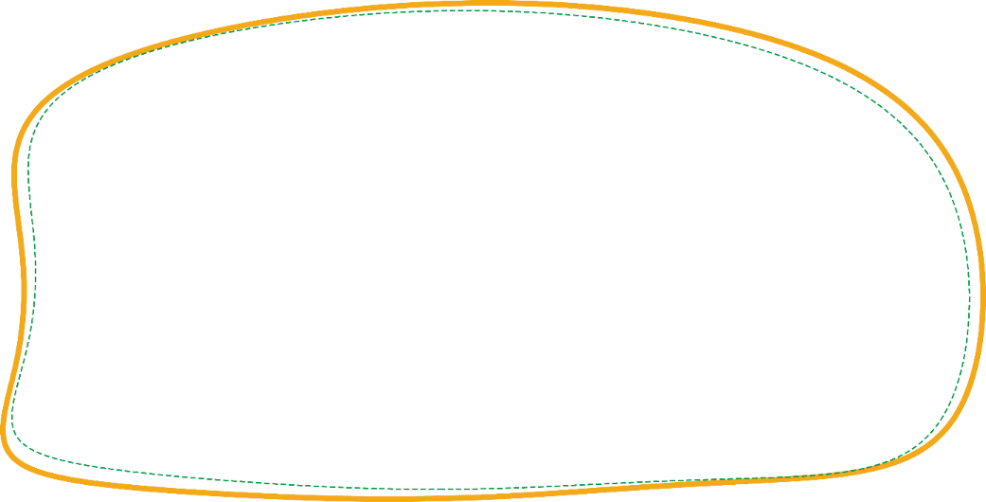

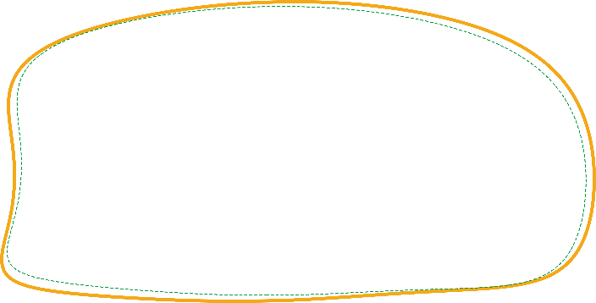


1/8
10
teacher
writer
A.
B.
QUESTION
actor
nurse
C.
D.

Slide 47

2/8
10
reporter
gardener
A.
B.
QUESTION
policeman
firefighter
C.
D.

Slide 48

3/8
20
reporter
firefighter
A.
B.
QUESTION
gardener
office worker
C.
D.

Slide 49

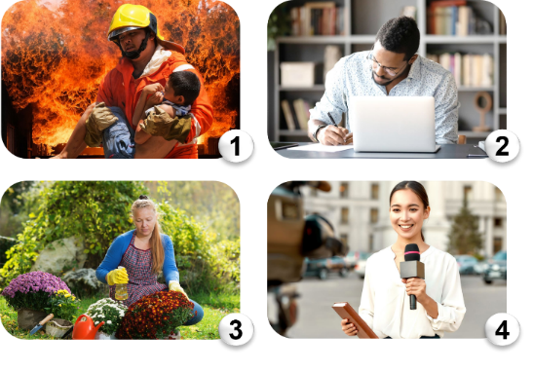
4/8
20
A.
B.
writer - gardener - reporter - firefighter
firefighter - reporter - writer - gardener
C.
D.
QUESTION
firefighter - writer - gardener - reporter
firefighter - gardener - reporter - writer

Slide 50


27
A: What would you like to be in the future?
B: ______________.
5/8
20
I’d like to be a reporter.
I’d like to be a firefighter.
A.
B.
QUESTION
I’d like to be a doctor.
I’d like to be a writer.
C.
D.

Slide 51
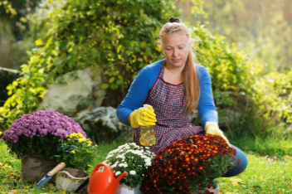
A: What would you like to be in the future?
B: ______________.
6/8
10
I’d like to be a writer.
I’d like to be a gardener.
A.
B.
QUESTION
I’d like to be a reporter.
I’d like to be a firefighter.
C.
D.

Slide 52
A: ________ you like to be a firefighter?
B: I’d like to be a doctor.
7/8
10
What is
What do
A.
B.
QUESTION
What does
What would
C.
D.

Slide 53
27
A: What would you like to be ____________?
B: I’d like to be a firefighter.
8/8
20
in the future
in the morning
A.
B.
QUESTION
at the weekend
last summer
C.
D.

Slide 54


Slide 55
Review
What would you like to be in the future?
I’d like to be a ______.
I’d = I would
firefighter
writer
reporter
gardener

Slide 56
Homework
Learn by heart all the new words and the model sentences.
Read again the dialogue in part 1.
Prepare for lesson 1 (4+5+6).

Slide 57
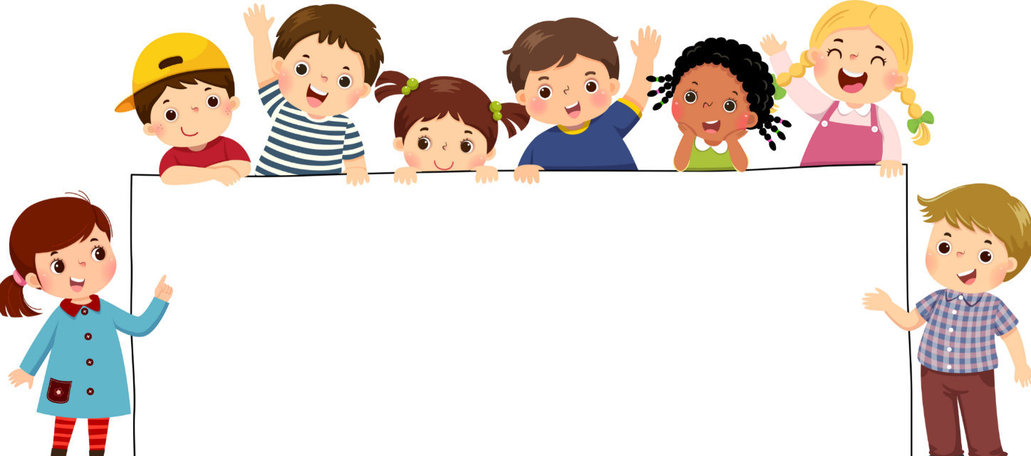
Goodbye!

