Slide 1
Welcome to my English class
GIÁO VIÊN: ĐẶNG THỊ THƠ

Slide 2
Warm up

Slide 3
Welcome to my school

Slide 4
Unit 6 Our school rooms
Lesson 1
Activity 1,2,3

Slide 5
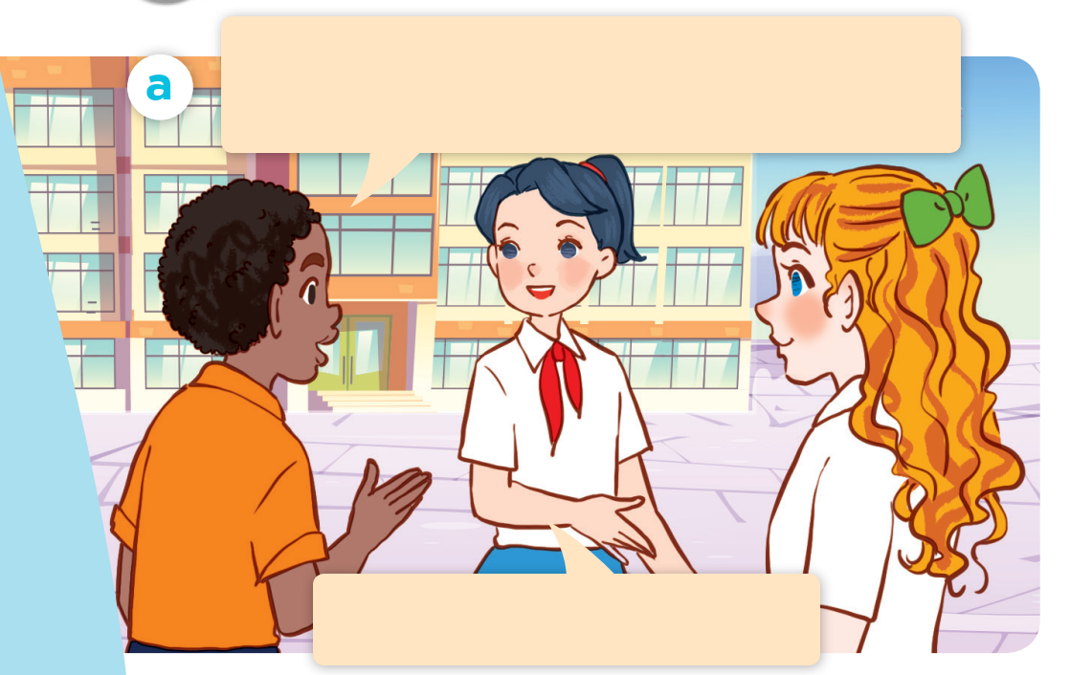
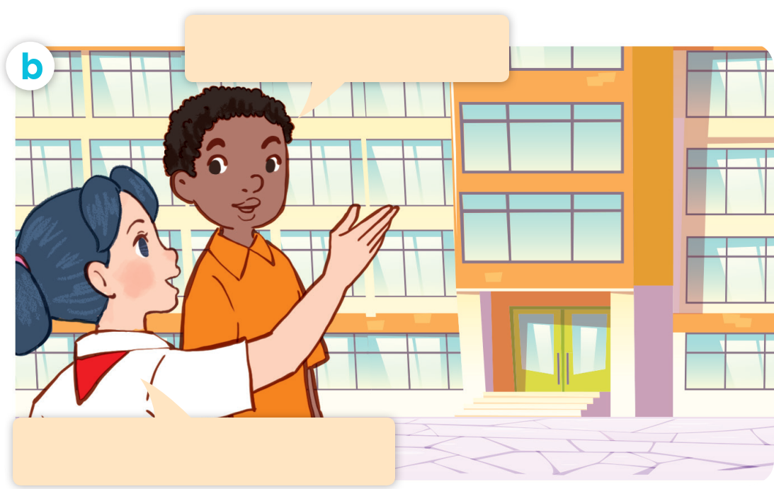
1. Look, listen and repeat.

Slide 6
Good morning. Could you show us around your school?
Yes, of course. Let’s go!

Slide 7
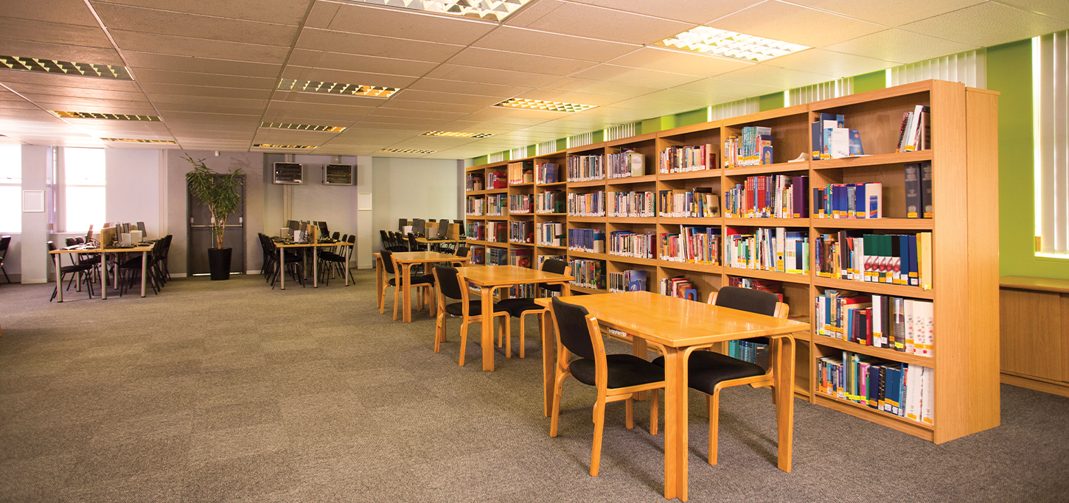
Library
Where’s the library?
second floor
It’s on the second floor.

Slide 8
1.Look, listen and repeat.
Good morning. Could you show us around your school?
Where’s the library?
Yes, of course. Let’s go!
It’s on the second floor.

Slide 9
Good morning. Could you show us around your school?
Yes, of course. Let’s go!

Slide 10
Where’s the library?
second floor
It’s on the second floor.

Slide 11
1.Look, listen and repeat.
Good morning. Could you show us around your school?
Where’s the library?
Yes, of course. Let’s go!
It’s on the second floor.

Slide 12
Structure:
Where’s the library?
It’s on the second floor.
second floor

Slide 13
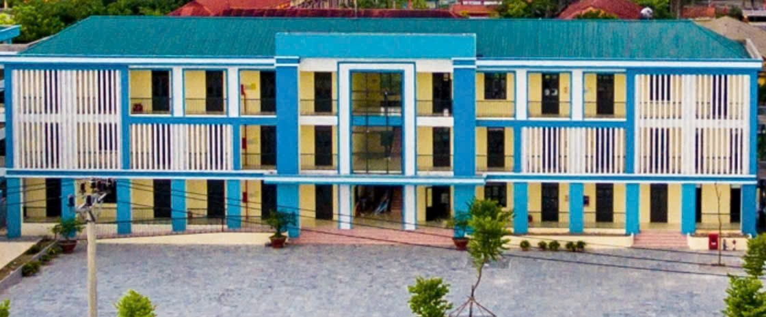
Vocabulary
Floor

Slide 14
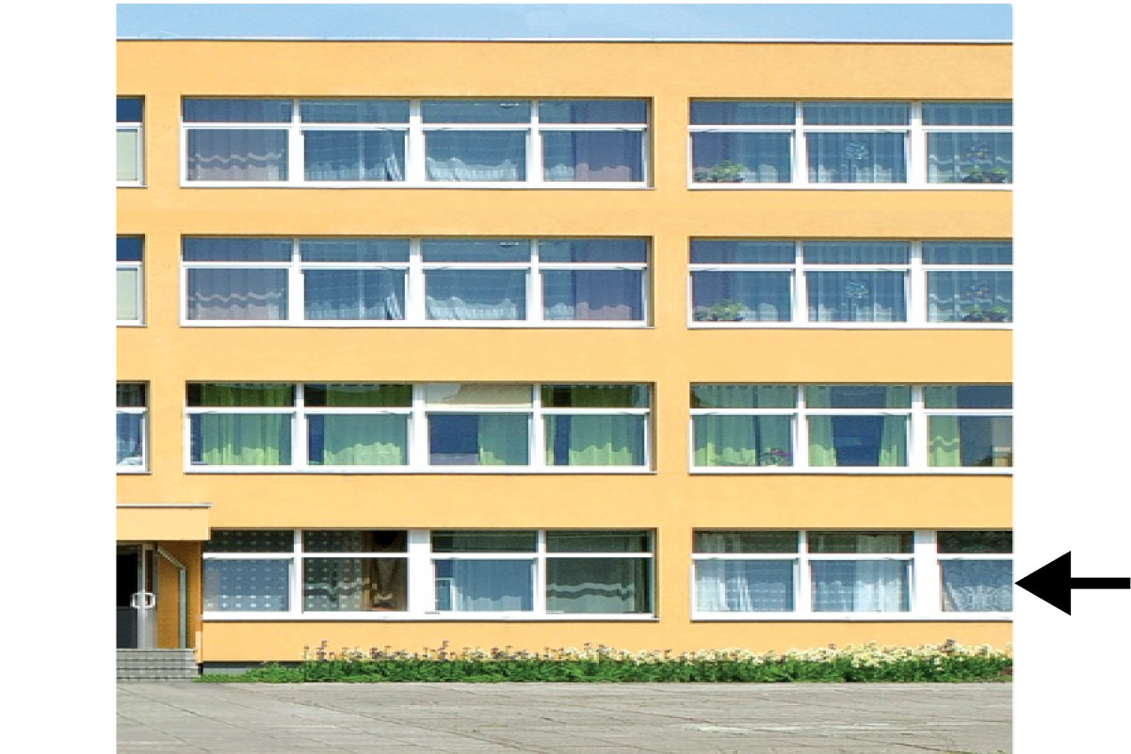
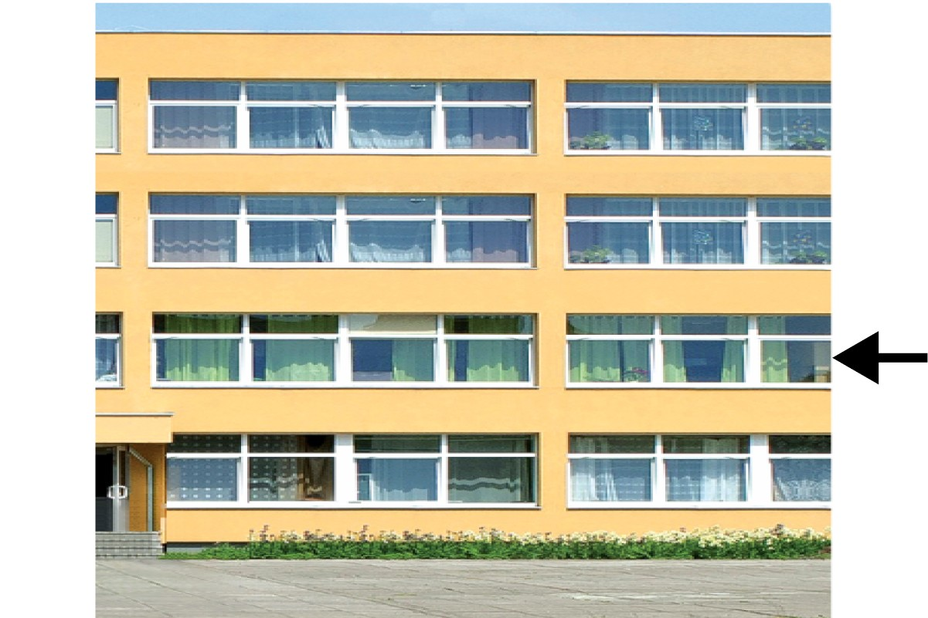
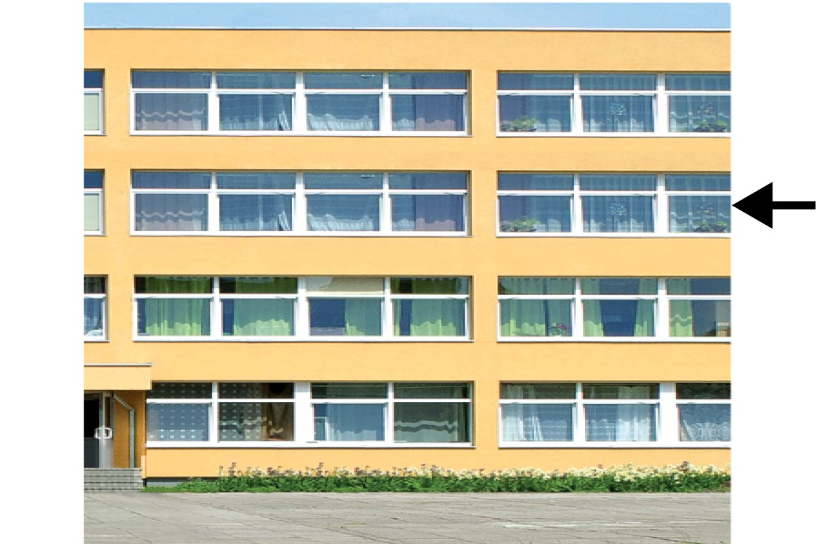
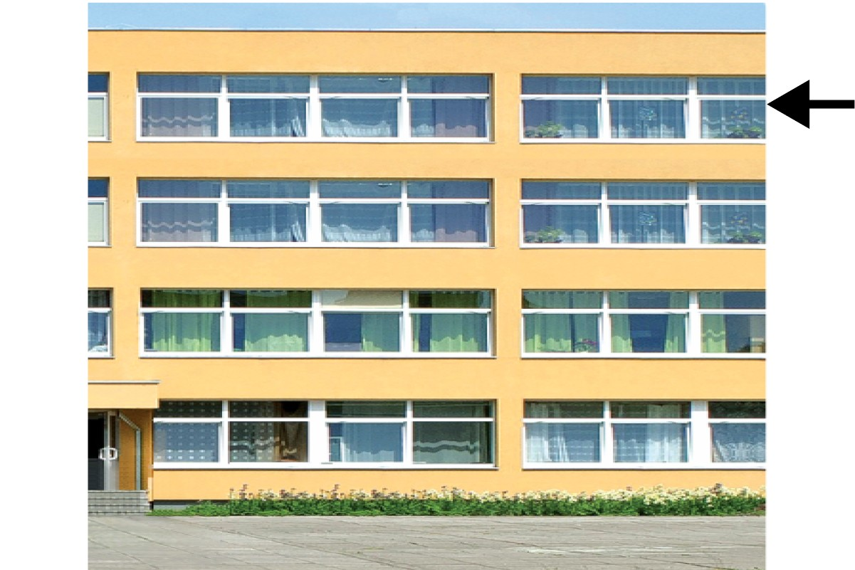
ground floor
first floor
second floor
third floor

Slide 15
Check vocabulary

Slide 16
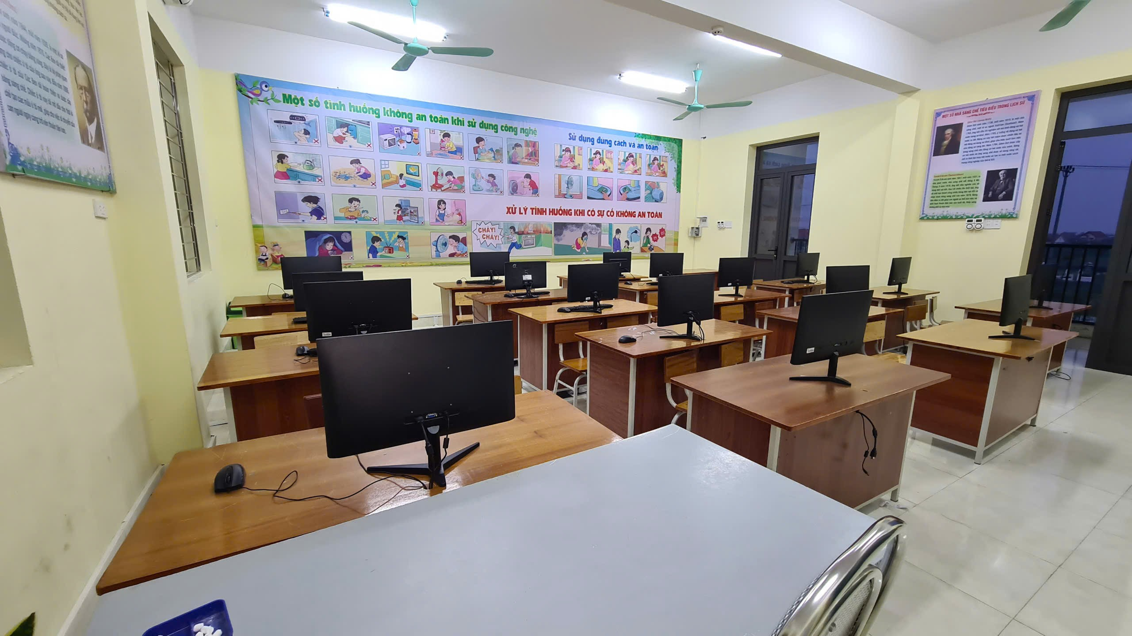
Computer room

Slide 17
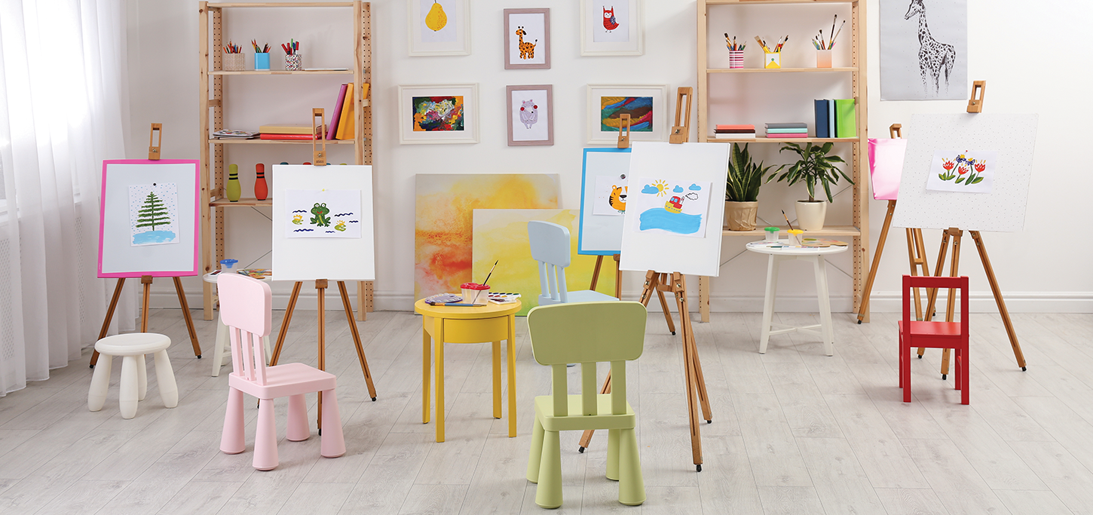
Art room

Slide 18
Library

Slide 19
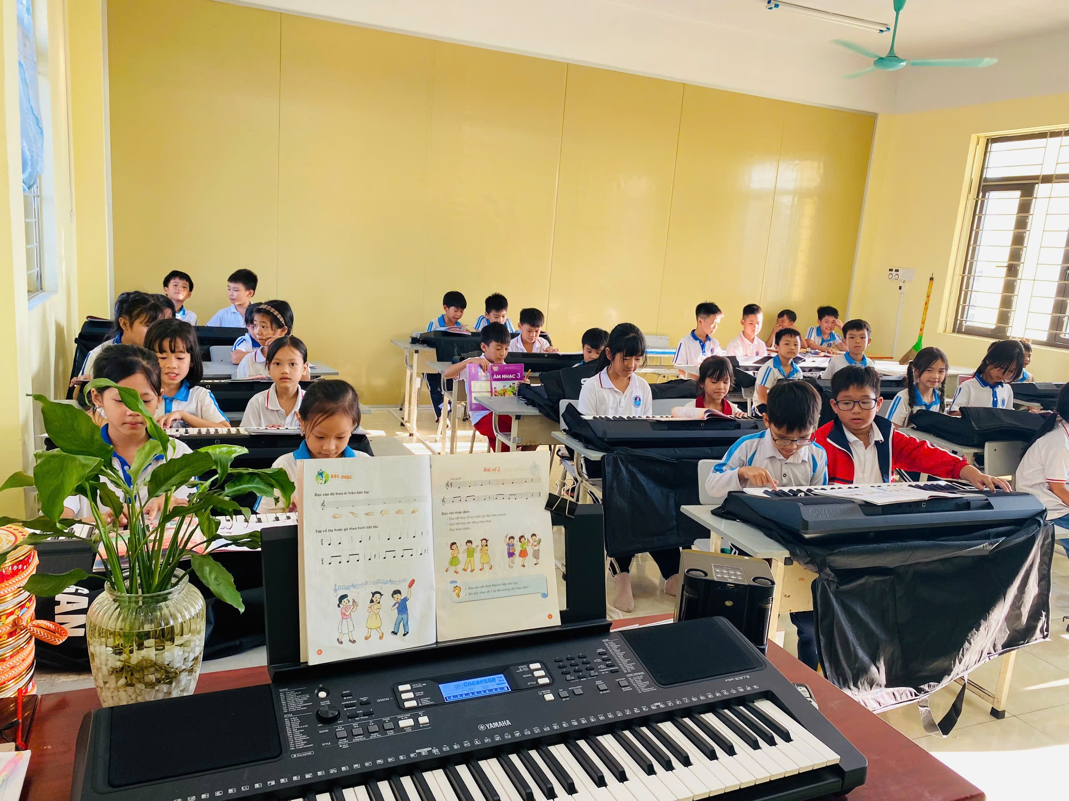
Music room

Slide 20
A. First floor
B. Third floor
C. Second floor

Slide 21
A. First floor
B. Second floor
C. Ground floor

Slide 22
A. Second floor
B. Ground floor
c. First floor
Next

Slide 23
A. Second floor
B. Ground floor
C. First floor

Slide 24
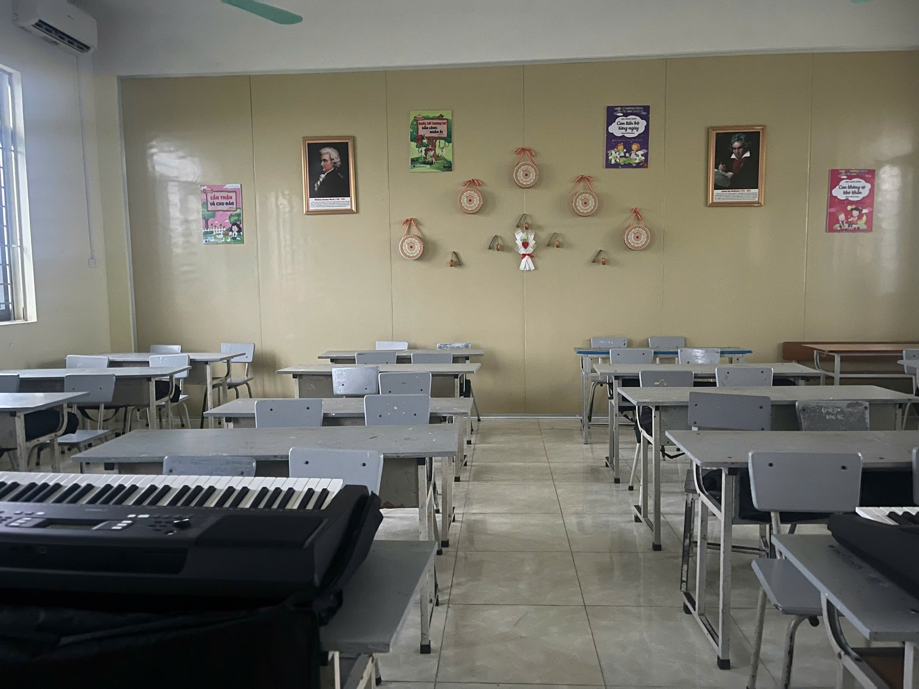
Computer room
Art room
library
Music room

Slide 25
ground floor
first floor
second floor
third floor

Slide 26
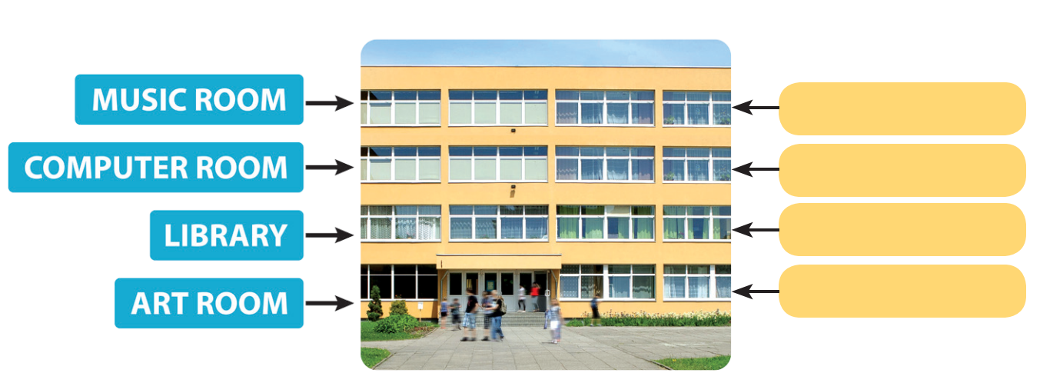
2. Listen, point and say.
Where’s the ____?
It’s on the ___.
third floor
second floor
first floor
ground floor

Slide 27
Art room
Ground floor

Slide 28
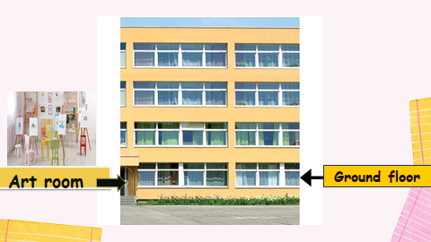
2. Listen, point and say.
art room
Where’s the_______?
It’s on the_________.
ground floor

Slide 29
Library
First floor
Where’s the___________?
It’s on the__________.
Library
First floor

Slide 30
Computer room
second floor
Where’s the___________?
It’s on the__________.
Computer room
second floor

Slide 31
Music room
Third floor
Where’s the___________?
It’s on the__________.
Music room
Third floor

Slide 32
2. Listen, point and say.
Where’s the ____?
It’s on the ___.
third floor
second floor
first floor
ground floor

Slide 33
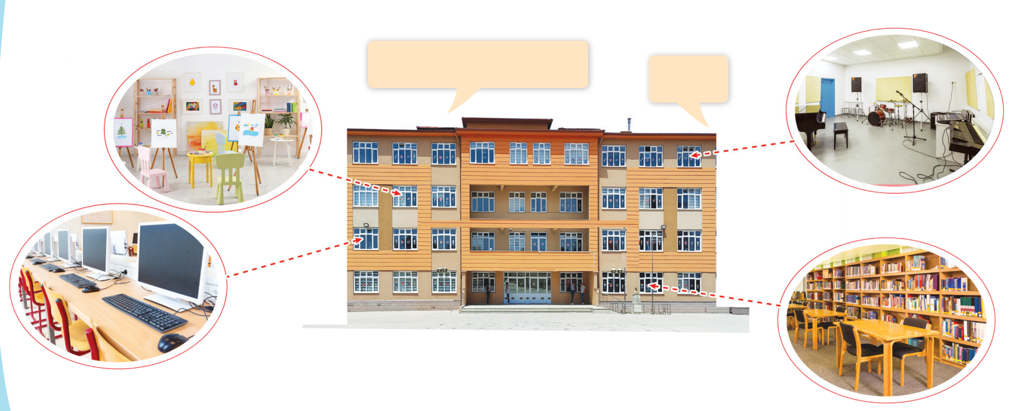
3. Let’s talk.
Where’s the _____?
_____.

Slide 34
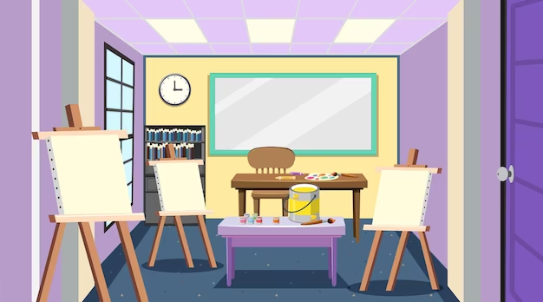
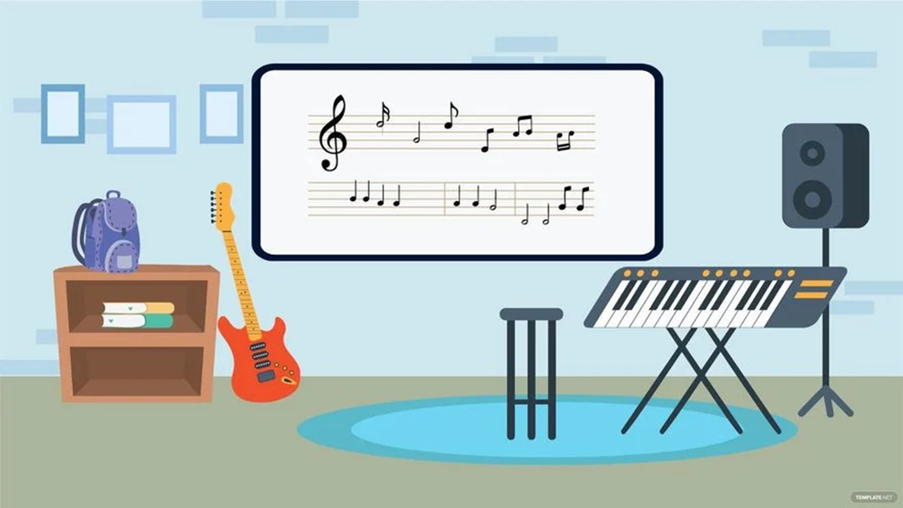
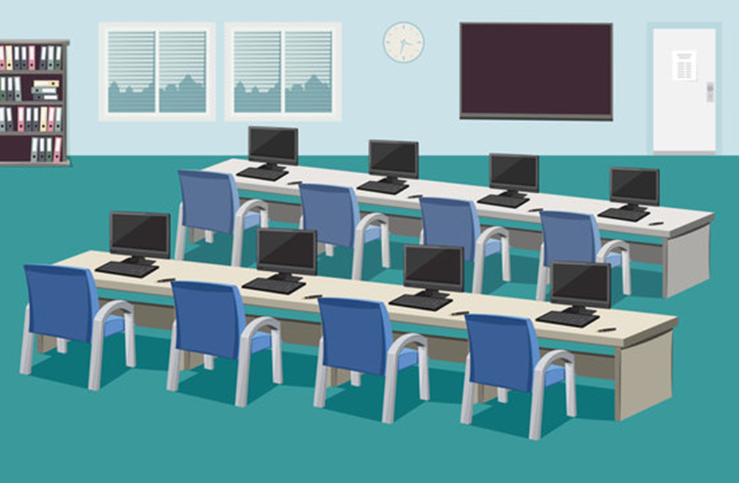
art room
Music room
second floor
second floor
computer room
library
first floor
ground floor

Slide 35
Thank you for listening

