Slide 1








WELCOME
TO OUR CLASS!
Presented by teacher Đinh Thị Hà

Slide 2


WARM UP
Look at the picture
Remember the position of things in the room.
Answer the question

Slide 3
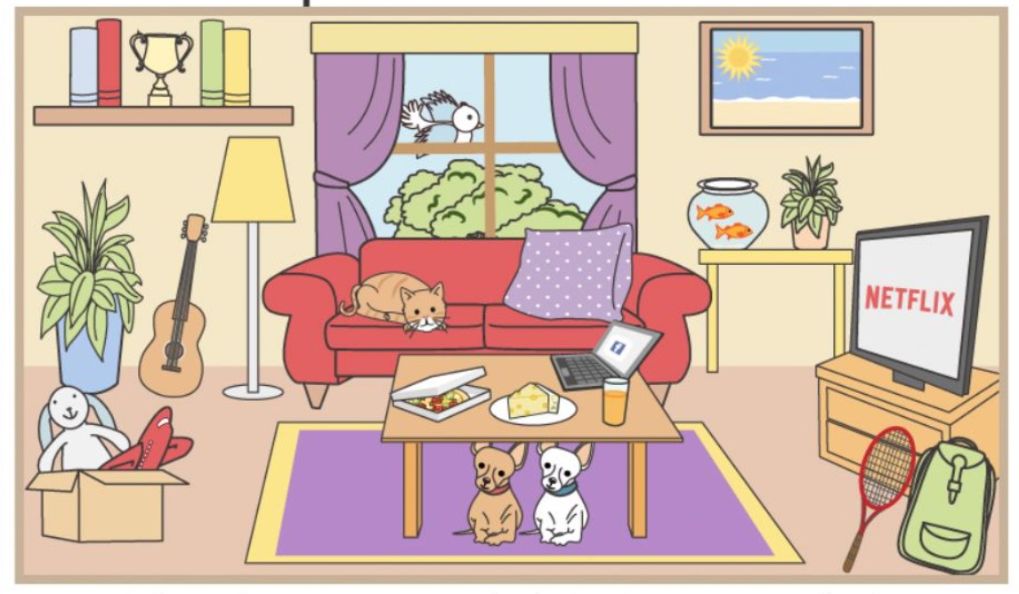


REMEMBER THE POSITION OF THINGS

Slide 4

Where is the cat?
A. On the sofa
B. Under the table
C. Next to the TV
A. On the sofa

Slide 5
Where is the table?
A. On the TV stand
B. In front of the sofa
C. Under the sofa
B. In front of the sofa

Slide 6
Where are two dogs?
Under the table
On the sofa
Next to the plants
A. Under the table

Slide 7
Where is the guitar?
In the box
Next to the sofa
Between the plant and the lamp
C. Between the plant and the lamp

Slide 8
Where is the rabbit toy?
Under the sofa
In the box
On the bookshelf
B. In the box

Slide 9
Where is the window?
On the table
In the box
Behind the sofa
C.Behind the sofa

Slide 10
rr
Thursday, October 31st, 2024
REVIEW FOR THE MID- TERM TEST
VOCABULARY & GRAMMAR

Slide 11


VOCABULARY

Slide 12
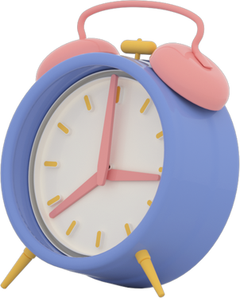

Vocabulary
Unit 1: MY NEW SCHOOL
School things and activities
Verb (play, do, have, study) + noun
Unit 2: MY HOUSE
Types of house
Rooms & furniture
Unit 3: MY FRIENDS
Body parts and appearance
Personality adjectives

Slide 13
1. Choose the correct answer
1. I always bring a ______ to class to write down my notes.
A. map B. eraser C. notebook D. ruler
2. I usually help my mom cook dinner in the ______.
A. bedroom B. bathroom C. kitchen D. living room
3. My dad keeps his clothes in a ______ in the bedroom.
A. sink B. fridges C. wardrobe D. oven
4. My best friend is very ______. He always makes everyone laugh.
A. creative B. shy C. quiet D. funny
5. My friend is very ______. She has long black hair and big brown eyes. A. beautiful B. helpful C. kind D. hard-working

Slide 14







Nhạc nền
Notes:
Thầy cô có thể bật/tắt nhạc nền bằng cách nhấp vào biểu tượng Nốt nhạc.
Thầy cô nhấp vào BẮT ĐẦU hoặc nhấp trái chuột để vào phần câu hỏi.

Slide 15










I always bring a ______ to class to write down my notes.
01
map
eraser
notebook
ruler

Slide 16
I usually help my mom cook dinner in the ______.
02
bedroom
bathroom
kitchen
living room

Slide 17
My dad keeps his clothes in a ______ in the bedroom.
03
sink
fridge
wardrobe
oven

Slide 18



My best friend is very ______. He always makes everyone laugh.
04
creative
quiet
shy
funny

Slide 19


My friend is very ______. She has long black hair and big brown eyes
05
Âm thanh
khi chọn Đúng
beautiful
helpful
Âm thanh
khi chọn Sai
kind
hard-working
Notes:
HD chỉnh sửa: Thầy cô nhập câu hỏi và các đáp án vào các ô (Căn chỉnh size chữ cho phù hợp với độ dài câu hỏi)
Thầy cô nhấp chuột phải hoặc phím -> để hiện câu hỏi và các đáp án
Sau khi HS chọn đáp án, thầy cô nhấp vào PHẦN ĐẤT chứa đáp án đó.
Sau khi ở phần kiểm tra đúng sai, thầy cô nhấp < để trở về câu hỏi.
Sau khi hoàn thành xong câu hỏi, thầy cô nhấp hình > hoặc chuột trái, phím -> để chuyển sang câu hỏi tiếp theo.

Slide 20
Look at the answers again
1. I always bring a ______ to class to write down my notes.
A. map B. eraser C. notebook D. ruler
2. I usually help my mom cook dinner in the ______.
A. bedroom B. bathroom C. kitchen D. living room
3. My dad keeps his clothes in a ______ in the bedroom.
A. sink B. fridges C. wardrobe D. oven
4. My best friend is very ______. He always makes everyone laugh.
A. creative B. shy C. quiet D. funny
5. My friend is very ______. She has long black hair and big brown eyes. A. beautiful B. funny C. kind D. helpful

Slide 21
GRAMMAR

Slide 22


Present Simple & Present continuous
She walks to school from Mondays to Fridays.
She is walking to school now.
Mondays
→
Fridays
now
When something often happens or is fixed, we use the present simple.
When something is happening now, we use the present continuous.

Slide 23

Form:
Present simple
(+) S + V(s/es).
(-) S + don’t/doesn’t + V.
(?) (WH-q words) + do/ does + S + V?
Present continuous
(+) S + am/is/are + V-ing.
(-) S + am/is/are + not + V-ing.
(?) (WH-q words) + am/is/are + S + V-ing?

Slide 24
2. Choose the correct answer
1. Mai’s house _____ very big.
A. am B. are C. is D. be
2. His friends usually ________ to music on his phone.
A. listen B. listens C. to listen D. listening
3. The man _______ a conversation on the phone now.
A. have B. has C. is having D. are having
4. _________ Minh play badminton every afternoon?
A. Does B. Do C. Are D. Is
5. _________ a book on Mary’s desk.
A. There is B. There are C. There D. Is
Notes:
Dùng câu 5 link qua slide tiếp

Slide 25
Adverbs of frequency
I always go to school on time.
I always go to school on time.
Mi

Slide 26

Adverbs of frequency
100%
always
90%
usually
50%
sometimes
5%
rarely
0%
never
- To show HOW OFTEN something happens.
- BEFORE the main verb.
Notes:
Hỏi: When do we use adverbs of frequency? => In present simple tense

Slide 27
REMEMBER:
Adverbs of frequency.
Possessive case: Noun‘s
We use adverbs of frequency with the present simple
We use ‘s after singular noun
We use ‘s after a proper name.

Slide 28
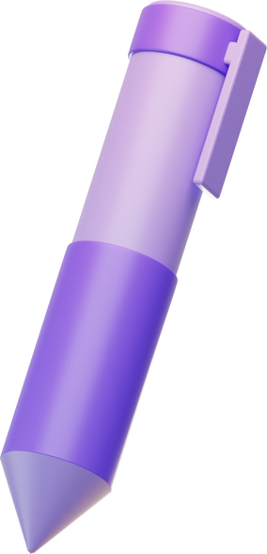



GAME
RACE SENTENCE
Work in groups of 4-6
Look at the words/ phrases
Rearrange them and write on your poster
Stick on the BB when finishing

Slide 29

3. Rearrange the words/ phrases to make a meaningful sentence.
1. often / They / to / walk/school.
2. John’s / is/ This / desk/.
3. teacher’s / desk / are / there / on / two notebooks/.
4.always / She / early / gets /.
5. are/never/They/late/for/school/.

Slide 30
Check your answer
They often walk to shool.
This is John’s desk.
There are two notebooks on teacher’s desk.
She always gets up early.
They are never late for school.

Slide 31
Wrap up
What have we learned today?
School things & activities
Verb (play, do, go, have )+ nouns
Vocabulary
Types of house, rooms, and furniture
Body parts, appearance, and personality adjective
Grammar
present simple present continuous
Possessive case
Preposition of places.

Slide 32
Homework
Review the vocabulary and grammar points again
Prepare for the mid-term test

Slide 33
Thank You

