Slide 1
UNIT 1: MY NEW SCHOOL
Lesson 2: A closer look 1

Slide 2
Table of contents
01
02
Vocabulary
Pronunciation
I
II

Slide 3
01
Vocabulary
I

Slide 4


Ex 1: Listen and repeat the words.
school lunch
English
history
homework
exercise
science
football
lessons
music

Slide 5
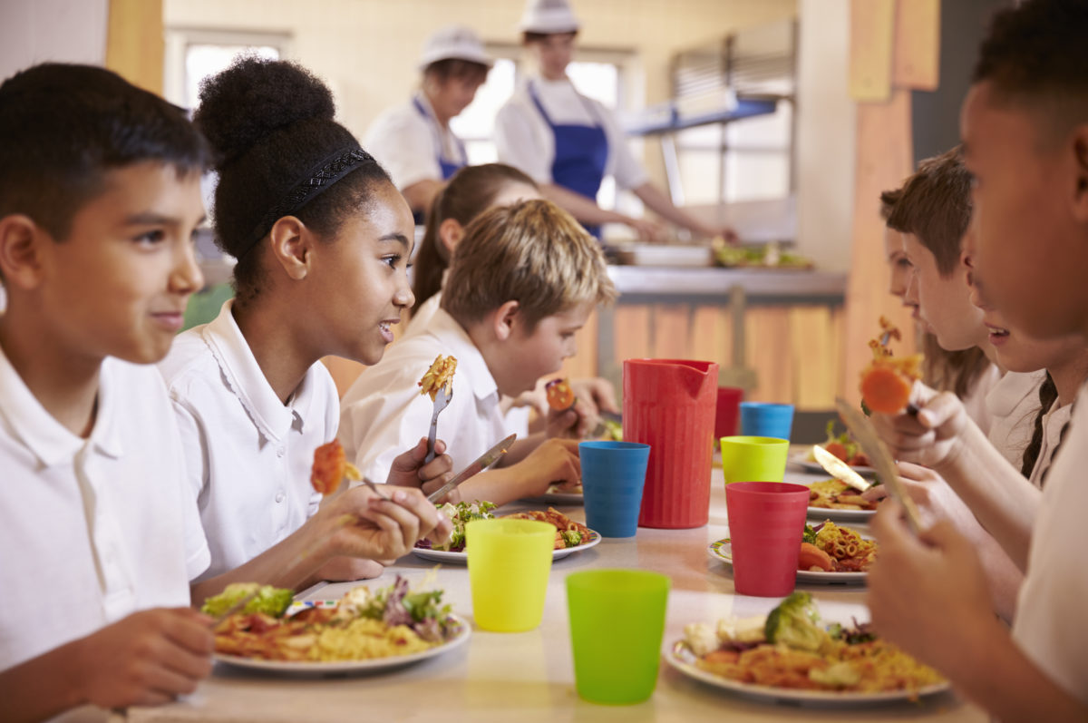
School lunch (N)
Bữa trưa ở trường học
I have school lunch.
(Tôi ăn trưa ở trường.)

Slide 6

Homework (N)
Bài tập về nhà
I do homework after school.
(Tôi làm bài tập về nhà sau giờ học.)

Slide 7

Football (N)
Bóng đá
He plays football.
(Anh ấy chơi bóng đá.)

Slide 8
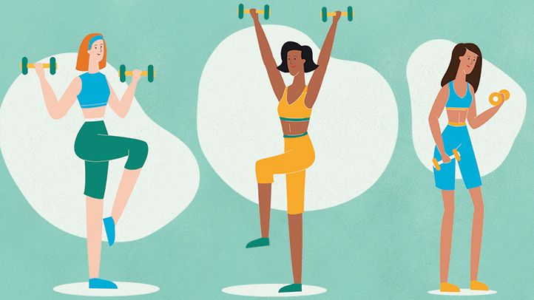
Exercise (N)
Tập thể dục
They do exercise every day.
(Họ tập thể dục mỗi ngày.)

Slide 9

Math (N)
Toán
I study Math.
(Tôi học Toán.)

Slide 10

Science (N)
Khoa học
I’m learning Science on Mondays.
(Tôi học Khoa học vào mỗi thứ hai.)

Slide 11
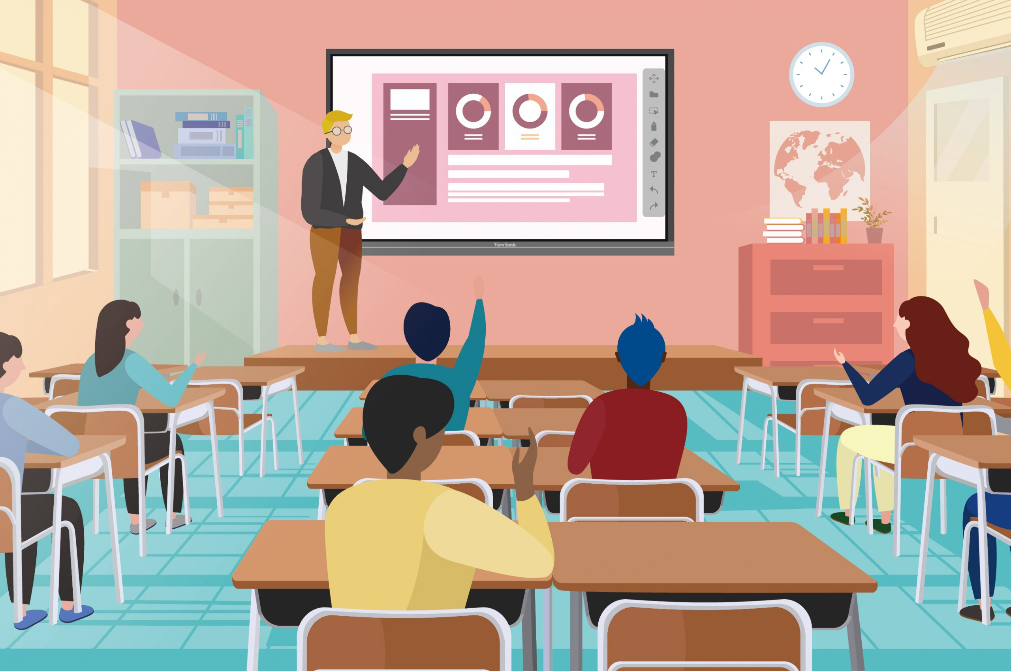
Classroom (N)
Lớp học
Our classroom is large.
(Lớp học của chúng tôi rộng.)

Slide 12
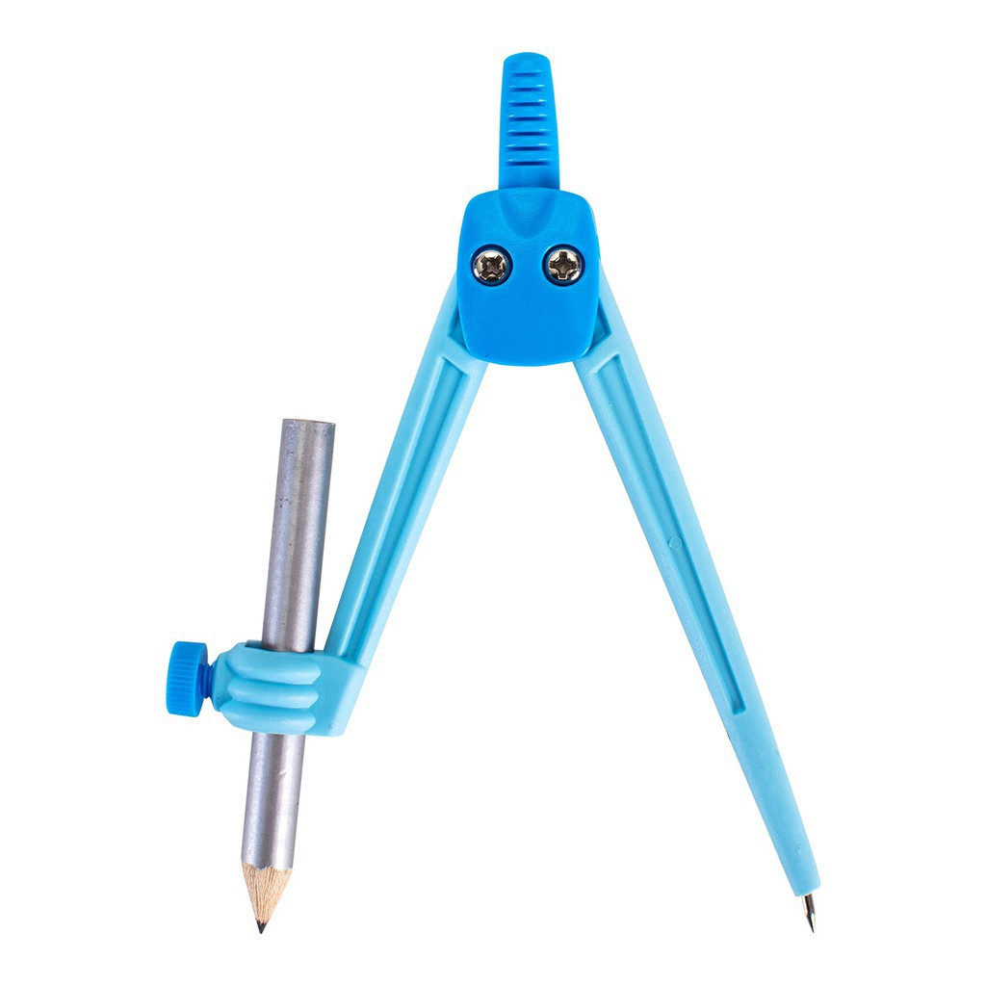
Compass (N)
Com-pa
My brother has a new compass.
(Anh trai tôi có một chiếc com-pa mới.)

Slide 13

Lesson (N)
Bài học
The art lesson starts at nine o'clock.
(Bài học mĩ thuật bắt đầu lúc 9 giờ.)

Slide 14

Ex 2: Work in pairs. Put the words in Ex 1 in the correct columns.
play | do | have | study
football
homework
school lunch
English
music
exercise
lessons
history
science

Slide 15
Ex 3: Put one of these words in each blank.
lessons
science
homework
football
exercise
1. Vy and I often do our ______________ after school.
2. Nick plays ___________ for the school team.
3. Mrs Nguyen teaches all my history __________.
4. They are healthy. They do __________ every day.
5. I study maths, English and __________ on Mondays.

Slide 16
Pronunciation
01
II
/ɑ:/ and /ʌ/

Slide 17
Ex 4: Listen and repeat. Pay attention to the sounds /ɑː/ and /ʌ/.
/ɑː/ | /ʌ/
smart art cartoon class | subject study Monday compass

Slide 18
Ex 5: Listen and repeat. Then listen again and underline the words with the sounds /ɑː/ and /ʌ/.
1. My brother has a new compass.
2. Our classroom is large.
3. They look smart on their first day at school.
4. The art lesson starts at nine o'clock.
5. He goes out to have lunch every Sunday

Slide 19
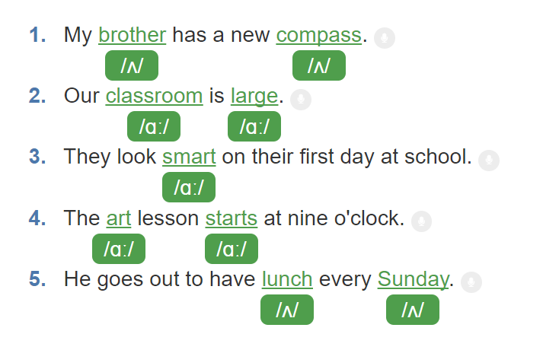
Ex 5: Listen and repeat. Then listen again and underline the words with the sounds /ɑː/ and /ʌ/.

Slide 20
Thank you!

