Slide 1

UBND HUYỆN NAM SÁCH
TRƯỜNG THCS NAM TRUNG
CHÀO MỪNG QUÝ THẦY CÔ ĐẾN DỰ GIỜ
HỘI THI GIÁO VIÊN DẠY GIỎI CẤP HUYỆN KHỐI THCS
NĂM HỌC 2024-2025
Môn: TIẾNG ANH, LỚP 6C
Giáo viên dạy: Phạm Thị Thanh Đầm

Slide 2

WARM-UP
HOT SEAT GAME
Cách chơi:
2 bạn ngồi vào “ghế nóng”, quay mặt xuống lớp học, lưng đối diện với bảng.
1 bạn nhìn vào tranh trên bảng và dùng hành động để miêu tả lại cho bạn ngồi “ghế nóng” đoán từ đó.
Thời gian chơi: 3 phút, bạn nào đoán đúng nhiều hơn sẽ chiến thắng.

Slide 3
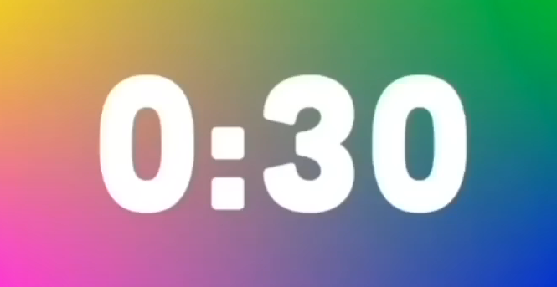

PLAY
FOOTBALL

Slide 4

LISTEN TO MUSIC

Slide 5
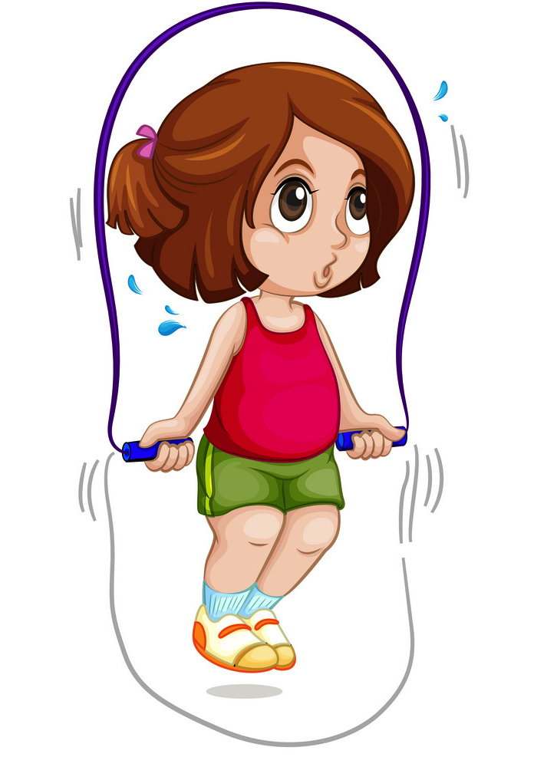
SKIP ROPE

Slide 6
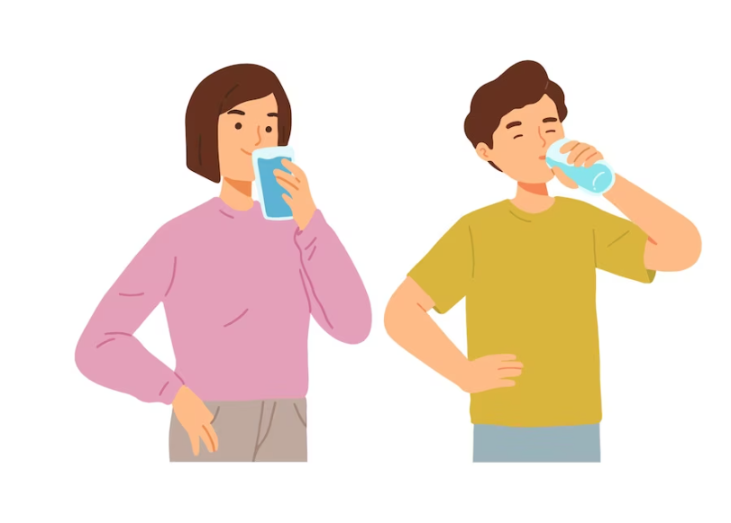
DRINK WATER

Slide 7

WATCH TV

Slide 8

PLAY VIDEO GAMES

Slide 9
PLAY FOOTBALL
LISTEN TO MUSIC
SKIP ROPE
DRINK WATER
WATCH TV
PLAY VIDEO GAMES

Slide 10
Thursday, October 31st, 2024
Period 25: REVISION FOR THE FIRST-MID TERM TEST
I. VOCABULARY

Slide 11






Period 25: REVISION FOR THE FIRST-MID TERM TEST
hall
bathroom
I. VOCABULARY
hall
bathroom
living room
kitchen
living room
kitchen
Matching
bedroom
bedroom
c.
bedroom
d.
bathroom
b.
living room
e.
kitchen
a.
hall

Slide 12
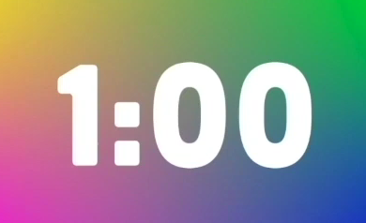
Period 25: REVISION FOR THE FIRST-MID TERM TEST
BOARD RACE GAME
Cách chơi:
+ Lần lượt từng học sinh của mỗi đội lên viết từ liên quan đến các chủ đề đã học. Sau đó quay về đưa phấn cho bạn lên viết tiếp.
+ Thời gian trong 1 phút. Đội nào viết được nhiều từ đúng nhất, đội đó sẽ thắng.
2 teams

Slide 13
Period 25: REVISION FOR THE FIRST-MID TERM TEST
I. VOCABULARY
EX1: Choose the correct answer
1. I have a new _______, but I don’t wear it every day.
A. uniform B. pencil case C. notebook
2. You can borrow books from the school _______.
A. yard B. garden C. library
3. Nick is very ______________. He makes everyone laugh!
A. confident B. funny C. active
4. He is a _____ person. He cares about everybody.
A. caring B. friendly C. clever
5. My grandpa’s ______________ is in a tall building.
A. stilt house B. town house C. apartment

Slide 14
Period 25: REVISION FOR THE FIRST-MID TERM TEST
II. GRAMMAR
1. Present simple tense
takes
He usually … ... the bus to school.
A. takes B. is taking

Slide 15
Period 25: REVISION FOR THE FIRST-MID TERM TEST
II. GRAMMAR
FORM (Present simple tense)
Positive | S + Vo / V(s/es) + …
Negative | S + don’t / doesn’t + Vo + …
Interrogative | Do / Does + S + Vo + …?
WH questions | WH + do /does + S + Vo + …?
Notes | *Use do / don’t with: I, you, we, they and plural noun forms. *Use does / doesn’t with: she, he, it and singular noun forms.

Slide 16
Period 25: REVISION FOR THE FIRST-MID TERM TEST
II. GRAMMAR
1. Present simple tense
2. Present continuous tense
She is walking to school now.

Slide 17
Period 25: REVISION FOR THE FIRST-MID TERM TEST
II. GRAMMAR
FORM (Present continuous tense)
Positive | S + am/ is/ are + V-ing…
Negative | S + am not/ isn’t/ aren’t + V-ing…
Interrogative | Am/ Is/ Are + S + V-ing…?
WH questions | Wh + am/ is/ are + S + V-ing…?

Slide 18
Period 25: REVISION FOR THE FIRST-MID TERM TEST
II. GRAMMAR
EX2: Choose the correct answer
1. ______________ interested in the English lessons.
A. I am usually B. I usually am C. usually I am
2. She is a good student. She ______________ does her homework on time.
A. never B. rarely C. usually
3. It’s cold. The students ______________ warm clothes.
A. wear B. wears C. are wearing
4. Phuong is very good at English and history, but she _____ maths much.
A. doesn’t like B. not like C. don’t like
5. Look! The girls are ______________ rope in the playground.
A. dancing B. playing C. skipping

Slide 19
Period 25: REVISION FOR THE FIRST-MID TERM TEST
II. GRAMMAR
1. Present simple tense
2. Present continuous tense
3. Prepositions of place

Slide 20
Matching the words with the meaning
1. trong
on
5. bên cạnh
2. trước
in front of
between
4. ở giữa
in
next to
3. trên

Slide 21
Period 25: REVISION FOR THE FIRST-MID TERM TEST
II. GRAMMAR
EX3: Using suitable prepositions to complete the sentences
in
1. The students are ___ the school library.
between
2. The table is _________the sofa and the armchairs.
on
3. There are some pictures ______ the wall.
in front of
4. My brother is standing______ me, so I can’t watch TV.

Slide 22
4. Prossessive case
Period 25: REVISION FOR THE FIRST-MID TERM TEST
II. GRAMMAR
1. Present simple tense
2. Present continuous tense
3. Prepositions of place

Slide 23
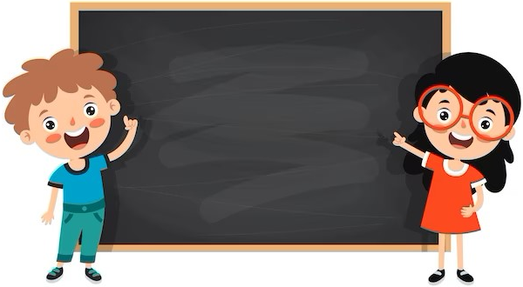
STRUCTURE
Name’s + noun
Example: Mai’s pen
Singular noun’s + noun
Example: teacher’s book

Slide 24
WRAP-UP
Choose the correct answers
1. What tense(s) have we learned and reviewed?
A. Present Continuous B. Present Pimple C. Both A&B
2. Her mum is cooking lunch ………. the kitchen at the moment.
A. in B. in front of C. on
3. Whose book is this? – It’s ……….
A. Nam B. Nam’s C. Nams
4. We ………. football every afternoon.
A. usually play B. play usually C. plays
5. He ………. English now.
A. learning B. is learning C. learns

Slide 25

HOMEWORK
Prepare well for the first-mid term test.

Slide 26






Website: hoclieu.vn
Fanpage: facebook.com/www.tienganhglobalsuccess.vn/

