Slide 1

MY FRIENDS
U N I T 3
Lesson 6: Skills 2

Slide 2
OBJECTIVES
01
LISTENING
02
WRITING
After this lesson, students will be able to:
Listen for specific information about best friends
Write a diary entry about best friends
Notes:
;
–.

Slide 3
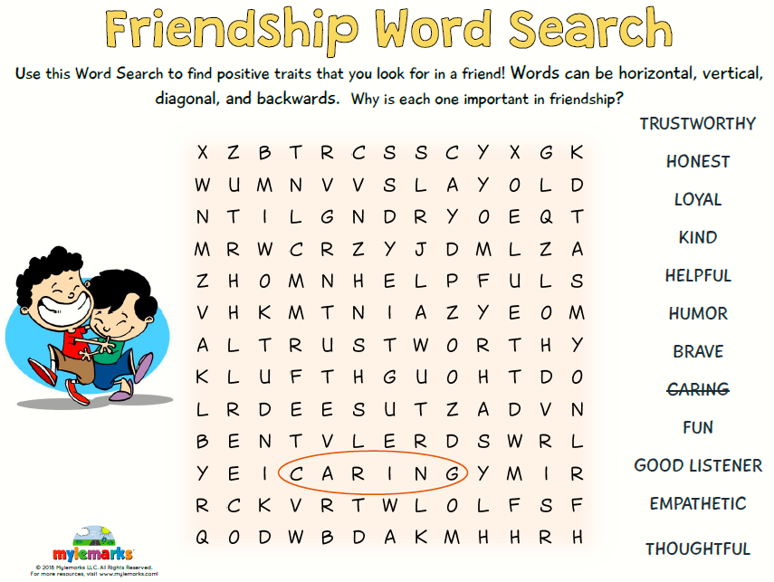

Slide 4
01
L I S T E N I N G

Slide 5
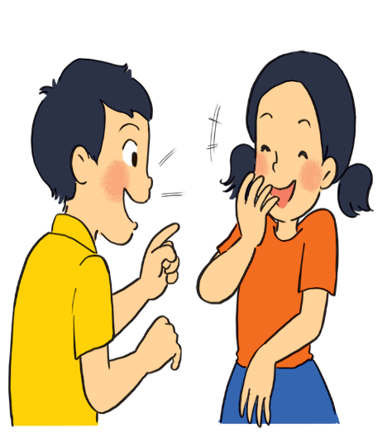
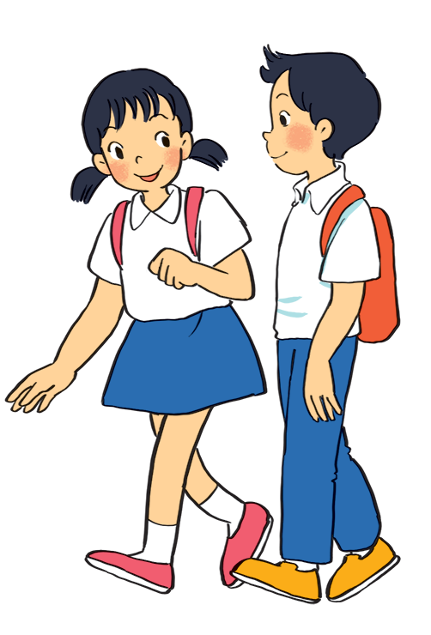
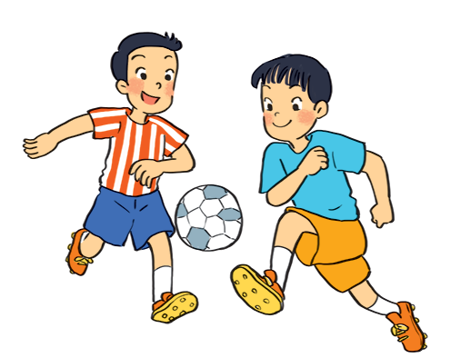
1. What are the students doing in each picture?
a
c
b
They are talking.
They are playing football.
They are walking.

Slide 6
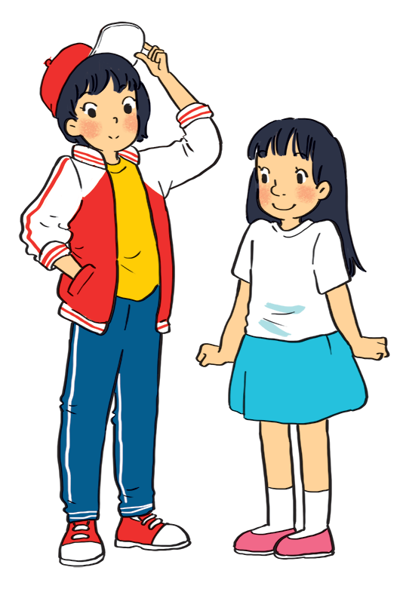
These are Mi and Minh’s best friends. One of them is Lan. The other is Chi. Describe these two girls.
tall
red cap
short
white T-shirt
white jackets
blue jeans
skirt
red sneaker
long black hair
short hair
big nose
small nose
big mouth
small mouth
…
…

Slide 7

2. Listen to Mi and Minh talking about their best friends. Look at the picture below and say which one is Lan and which one is Chi.
My best friend is Lan. … She’s tall and slim. She has short black hair and a small mouth.
Chi
Lan
→ Lan is the girl wearing a red and white jacket and a red cap.
Chi is my best friend…She’s short with long black hair and a big nose.
→ Chi is the girl wearing a white T-shirt and a blue skirt.

Slide 8
3. Listen again and check. Fill each blank with a word / number you hear.
3. Underline and guess the words to fill in the blank with a word / number.
1. Mi and Lan are studying in class ________.
2. Lan has short ________ hair and a small ________.
3. Lan is active and ________.
4. Chi's hair is long and black, and her nose is ________.
5. Chi is ________ to Minh.
1. My best friend is Lan. She studies with me in class 6A.
6A
black
2. She has short black hair and a small mouth.
mouth
friendly
3.She’s very active and friendly.
4. She’s short with long black hair and a big nose.
big
kind
5. I like her because she’s kind to me.
Notes:
Mi: My best friend is Lan. She studies with me in class 6A. She’s tall and slim. She has short black hair and a small mouth. She’s very active and friendly. She likes playing sports and has many friends. Look, she’s playing football over there!
Minh: Chi is my best friend. We’re in class 6B. She’s short with long black hair and a big nose. I like her because she’s kind to me. She helps me with my English. She’s also hard-working. She always does her homework before class. Look, she’s going to the library.

Slide 9
02
W R I T I N G

Slide 10
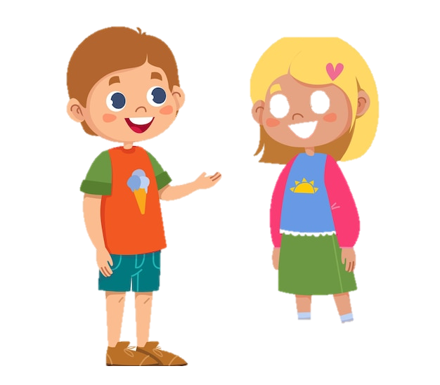
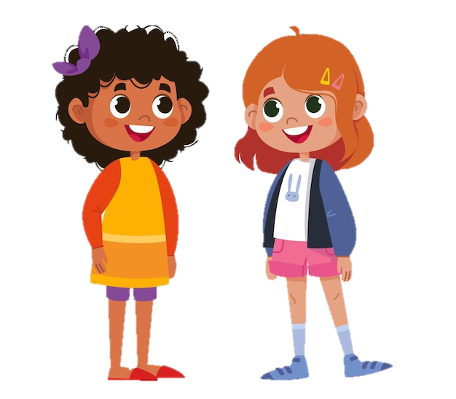

4. Work in pairs. Ask and answer about best friends. Use these notes to help you.
1. What's his / her name?
_____________________
2. What does he / she look like?
______________________
3. What's he / she like?
______________________
4. Why do you like him / her?
______________________
What's his name?
He is Liam.

Slide 11
4. Work in pairs. Ask and answer about best friends. Use these notes to help you.
1. What's his/ her name?
→ His/ Her name is ________
2. What does he/ she look like?
He/ She is___________
He/ She has___________
3. What's he/ she like?
→ He/ She is ___________
4. Why do you like him/ her?
→ I like him/ her because_____

Slide 12
Sample
1. What's his / her name?
_____________________
2. What does he/ she look like?
______________________
3. What is he/ she like?
______________________
4. Why do you like him/ her?
______________________
→ His name is Liam.
→ He is tall and handsome. He has short brown hair and blue eyes.
→ He is confident and funny. He learns things quickly and easily. He always makes us laugh.
→ I like him because we usually play and share things together.

Slide 13
4. Work in pairs. Ask and answer about best friends. Use these notes to help you.
1. What's his/ her name?
→ His/ Her name is ________
2. What does he/ she look like?
He/ She is___________
He/ She has___________
3. What's he/ she like?
→ He/ She is ___________
4. Why do you like him/ her?
→ I like him/ her because_____

Slide 14

5. Write a diary entry of about 50 words about your best friend. Use the answers to the questions in 4.
1. What's his / her name?
_____________________
2. What does he / she look like?
______________________
3. What's he / she like?
______________________
4. Why do you like him / her?
______________________
Dear Diary,
My best friend is ____________
__________________________
__________________________
__________________________
I like ______________ because
_________________________
__________________________

Slide 15
1. What's his / her name?
_____________________
2. What does he/ she look like?
______________________
3. What is he/ she like?
______________________
4. Why do you like him/ her?
______________________
→ His name is Liam.
Sample
→ He is tall and handsome. He has short brown hair and blue eyes.
Dear Diary,
My best friend is Liam. He is tall and handsome. He has short brown hair and blue eyes. He is confident and funny. He learns things quickly and easily. He always makes us laugh.
I like him because we usually play and share things together.
→ He is confident and funny. He learns things quickly and easily. He always makes us laugh.
→ I like him because we usually play and share things together.

Slide 16
5. Write a diary entry of about 50 words about your best friend. Use the answers to the questions in 4.
1. What's his/ her name?
→ His/ Her name is ________
2. What does he/ she look like?
He/ She is___________
He/ She has___________
3. What's he/ she like?
→ He/ She is ___________
4. Why do you like him/ her?
→ I like him/ her because_____
Dear Diary,
My best friend is ____________
__________________________
__________________________
__________________________
I like ______________ because
_________________________
__________________________

Slide 17
Swap and check.
 | Yes | No
Describe about the best friend’s appearance
Describe about the best friend’s personality
Tell the reasons why he/ she like his/ her
Begin with a capital letter (My friend ……)
Have correct spelling
All sentences have verbs

Slide 18
W R A P - U P
What have we learnt in the lesson today?
□ listen for specific information about best friends
□ use the present continuous to talk about things happening now;
□ read for specific information about friends and summer camps;
□ write a diary entry about best friends
✓
✓

Slide 19
T H A N K S

