Slide 1
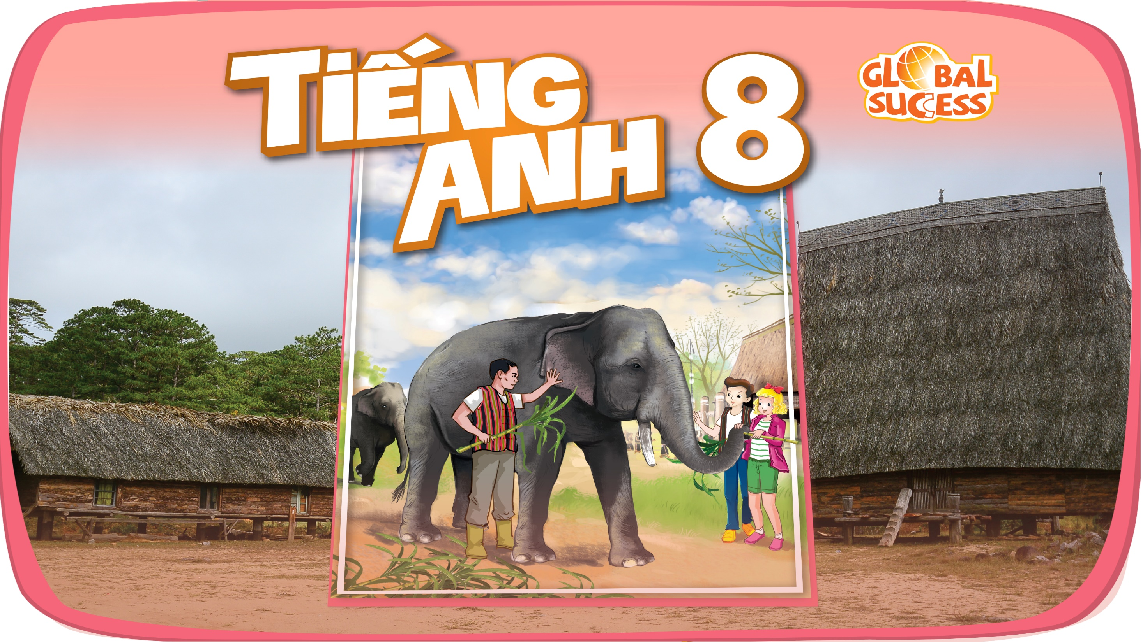

Slide 2
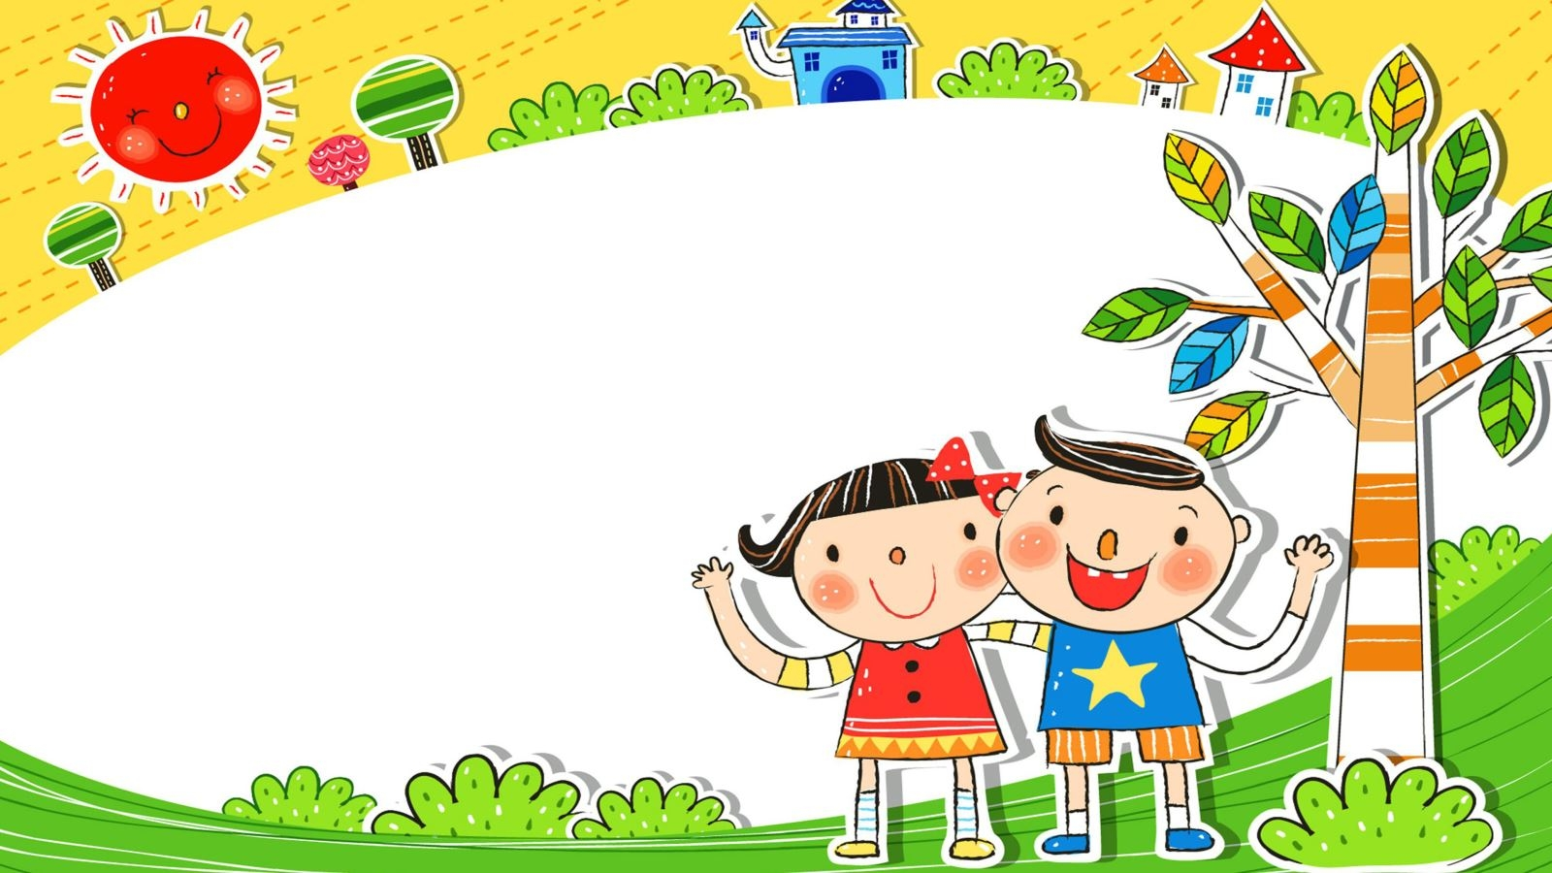
GOOD MORNING!

Slide 3
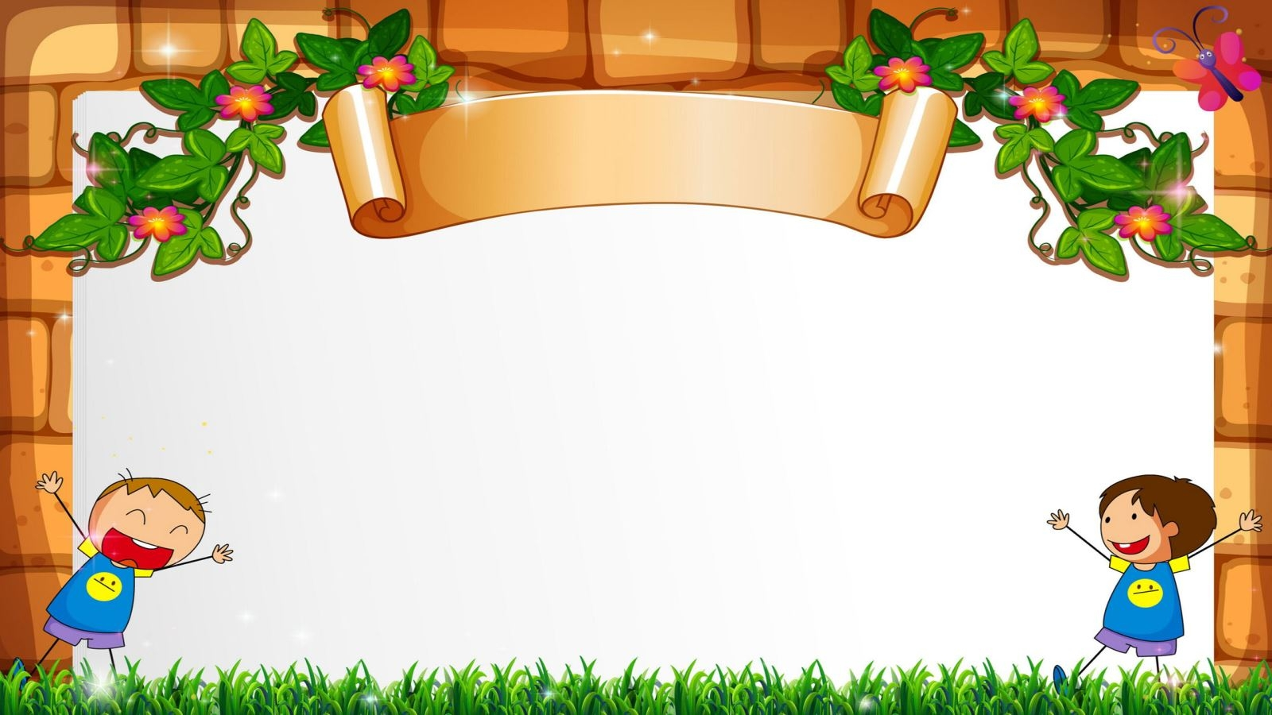
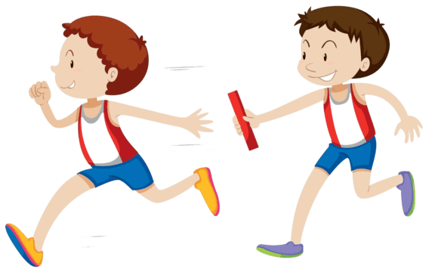
RELAY GAME

Slide 4
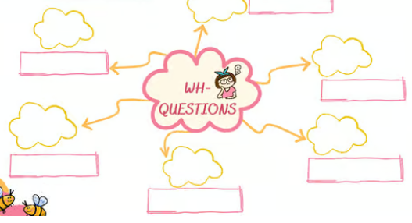

Slide 5
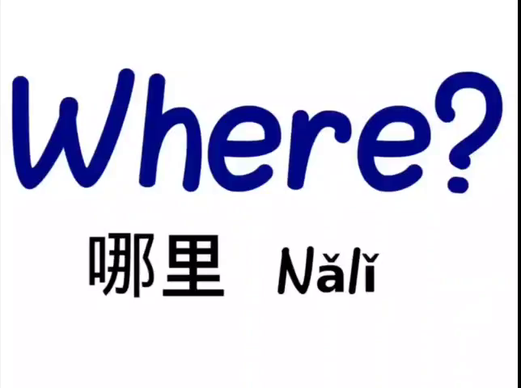

Slide 6
WHAT
HOW
WHO
WHY
WHEN
WHERE

Slide 7


Unit
4
ETHNIC GROUPS OF VIET NAM
Unit
ETHNIC GROUPS OF VIET NAM
LESSON 3: A CLOSER LOOK 2
LESSON 3: A CLOSER LOOK 2
Unit
HOBBIES

Slide 8

I. YES/ NO AND WH- QUESTIONS
1. YES/NO QUESTION
are
Eg1: They are studying Unit 4.
-> Are they studying Unit 4?
Eg2: Many teachers attended the lesson yesterday.
-> Did many teachers attend the lesson yesterday?
attended
attend
TOBE | AUX VERBS
+) S + TOBE + O ... . | +) S + V + O ....
?) TOBE + S + O...?
?) DO/DOES/DID/WILL/CAN... + S + Vo....?

Slide 9
Ex1
Work in groups. Change the sentences into Yes / No questions.
play
1. Women play an important role in a Jrai family.
→ Do women play an important role in a Jrai family?
is
2. Mua sap is a popular folk dance of the Thai people.
→ Is mua sap a popular folk dance of the Thai people?
3. We didn’t have boarding schools for minority students in 1950.
didn’t have
→ Did you have boarding schools for minority students in 1950?
attended
4. I attended the Ban Flower Festival in Dien Bien last year.
→ Did you attend the Ban Flower Festival in Dien Bien last year?
5. We will watch a documentary about the Khmer.
will
→ Will you watch a documentary about the Khmer?

Slide 10
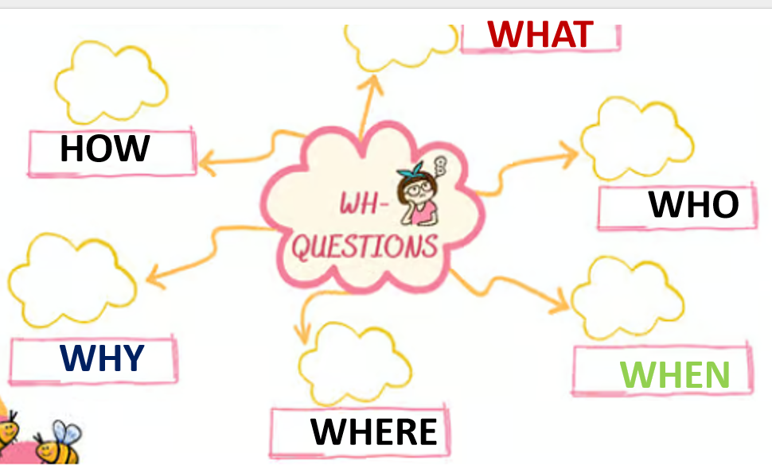
2. WH-QUESTIONS
When did the teachers attend the lesson?
Whq + aux V(do/does..) + S + Vo...?
Whq + tobe + S + O...?
Eg: A: ______ is the Ban Flower Festival?
B: It’s in spring.
A. When B. Why
in spring.
When

Slide 11
2. WH-QUESTIONS
Ex2
Work in pairs. Choose the correct question word for each question below.
1. A: ______ do you like best about Sa Pa?
B: I like its local markets best.
A. Why B. What
2. A: ______ can we find the most beautiful terraced fields?
B: In Mu Cang Chai.
A. When B. Where
3. A: ______ is the Ban Flower Festival?
B: It’s in spring.
A. When B. Why

Slide 12
2. WH-QUESTIONS
2
Choose the correct question word for each question below.
4. A: ______ tall is an average stilt house?
B: About 5 - 6 metres tall.
A. How B. What
5. A: ______ festival is more important for the Kinh: the Mid-Autumn or the Lunar New Year?
B: The Lunar New Year.
A. What B. Which

Slide 13
II. COUNTABLE AND UNCOUNTABLE NOUNS

Slide 14
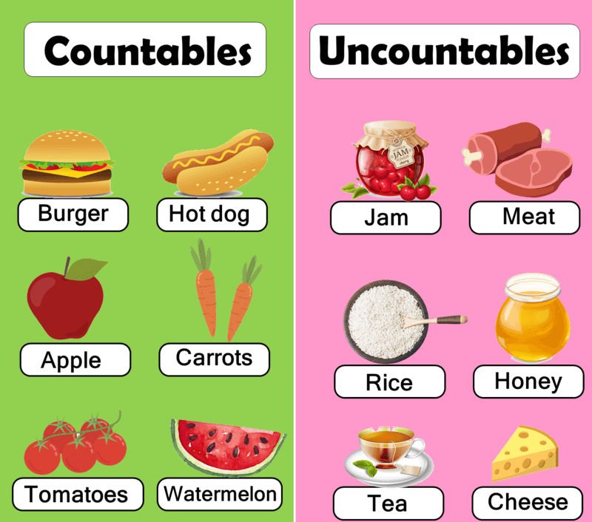
II. COUNTABLE AND UNCOUNTABLE NOUNS

Slide 15
II. COUNTABLE AND UNCOUNTABLE NOUNS
NOUNS
Countable
Uncountable
Singular
Plural
a
an
a lot of
many
some
few/ (only)a few
a lot of
much
some
little/ (only)
a little
books
rice
eg: a book
an apple

Slide 16
COUNTABLE AND UNCOUNTABLE NOUNS
3
Fill in the blank with a, much, many, a little, or a few. (Ex4-p43)
1. My uncle has _____coffee plantation in Kon Tum.
2. How _______ ethnic groups live on the Hoang Lien Son mountain range?
3. There are only _______ waterwheels left in my village.
4. You should add ________ more water to your noodles. It’s a bit dry.
5. How ______ information about the Van Kieu have you collected?

Slide 17




TRÒ CHƠI HỘP QUÀ BÍ MẬT
Gift box secret game

Slide 18












Slide 19








GIFT BOX NUMBER 1: a, much, many, a little, or a few?
My uncle has _____coffee plantation in Kon Tum.
a
9 Điểm
go home

Slide 20
GIFT BOX NUMBER 2: a, much, many, a little, or a few?
How _______ ethnic groups live on the Hoang Lien Son mountain range?
many
1 tràng pháo tay
GO HOME

Slide 21
GIFT BOX NUMBER 3: a, much, many, a little, or a few?
There are only _______ waterwheels left in my village.
a few
10 Điểm
GO HOME

Slide 22
GIFT BOX NUMBER 4: a, much, many, a little, or a few?
You should add ________ more water to your noodles. It’s a bit dry.
a little
GO HOME
10 điểm

Slide 23
GIFT BOX NUMBER 5: a, much, many, a little, or a few?
How ______ information about the Van Kieu have you collected?
much
9 Điểm
GO HOME

Slide 24
COUNTABLE AND UNCOUNTABLE NOUNS
3
Fill in the blank with a, much, many, a little, or a few. (Ex4- p43)
1. My uncle has _____coffee plantation in Kon Tum.
2. How _______ ethnic groups live on the Hoang Lien Son mountain range?
3. There are only _______ waterwheels left in my village.
4. You should add ________ more water to your noodles. It’s a bit dry.
5. How ______ information about the Van Kieu have you collected?
a
many
a few
a little
much

Slide 25
II. COUNTABLE AND UNCOUNTABLE NOUNS
4
Write C (countable) or U (uncountable) for the underlined words. (Ex3-p43)
Some minority (1) groups are farmers. They do not have much (2) land and they use simple farming techniques. After finding an (3) area for a garden, the men cut the (4) trees down and burn them. The (5) ash they collect helps enrich the soil. They then grow a few (6) crops like rice and corn.
____
2. ____
3. ____
4. ____
5. ____
6. ____
C
U
C
C
U
C

Slide 26
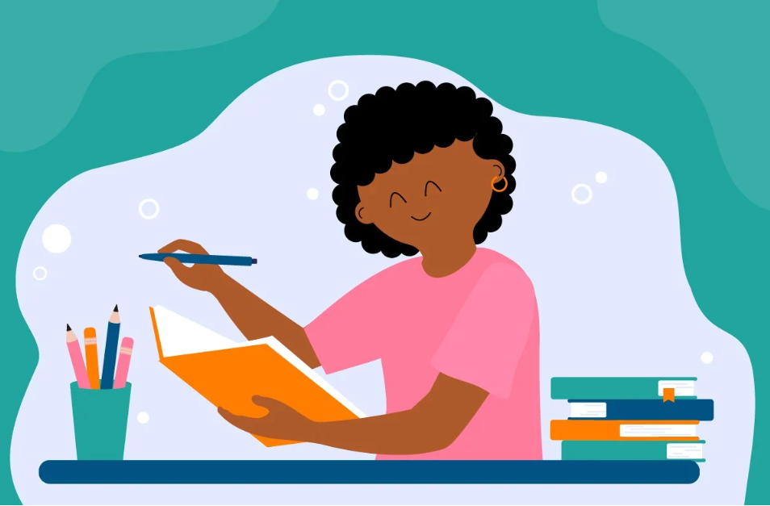
III. CONSOLIDATION
1
Wrap-up
Grammar: - Yes / No and Wh-questions
- Countable and uncountable nouns

Slide 27

III. CONSOLIDATION
2
Homework
- Learn by heart the structures.
- Do exercises in the workbook.
- Prepare for Lesson 4 – Communication.

Slide 28

Website: hoclieu.vn
Fanpage: facebook.com/www.tienganhglobalsuccess.vn/

