Slide 1
GOOD AFTERNOON!

Slide 2


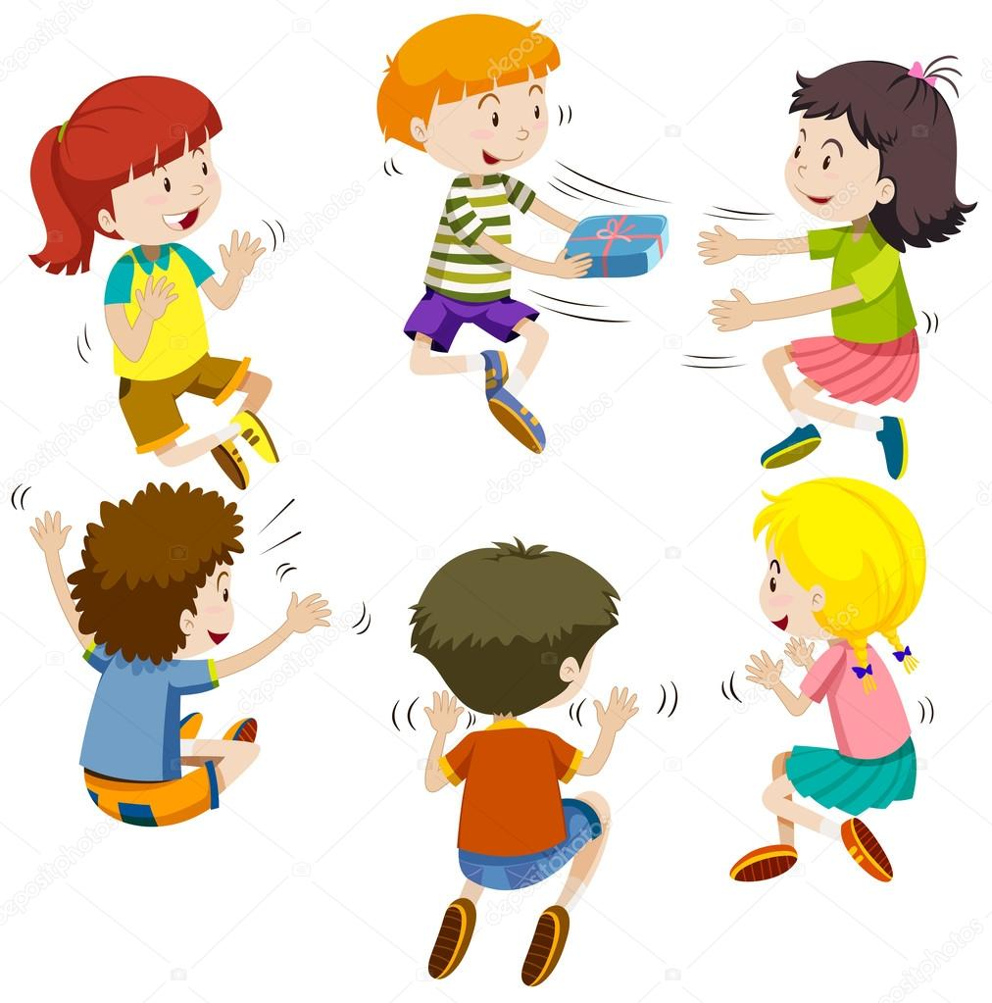
PASS THE PRESENT
TV
PROGRAMMES
1
2
4
5
NEXT

Slide 3

PASS THE PRESENT
TV PROGRAMMES
1
2
3
4

Slide 4
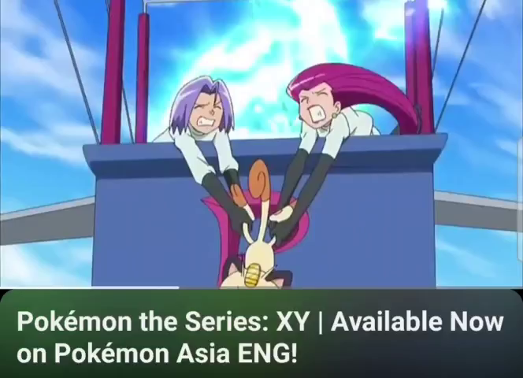
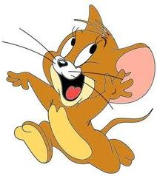
WHAT PROGRAMME IS IT?
CARTOON

Slide 5
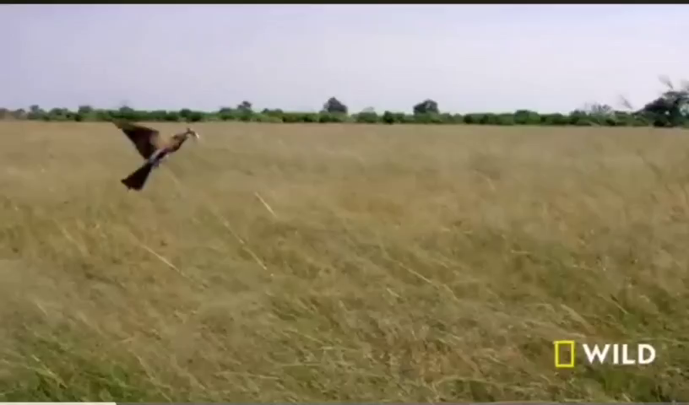
WHAT PROGRAMME IS IT?
ANIMAL

Slide 6
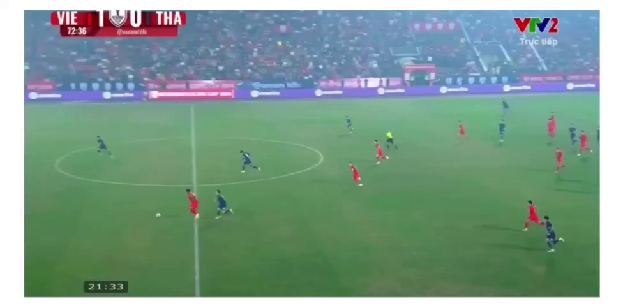
WHAT PROGRAMME IS IT?
SPORTS

Slide 7
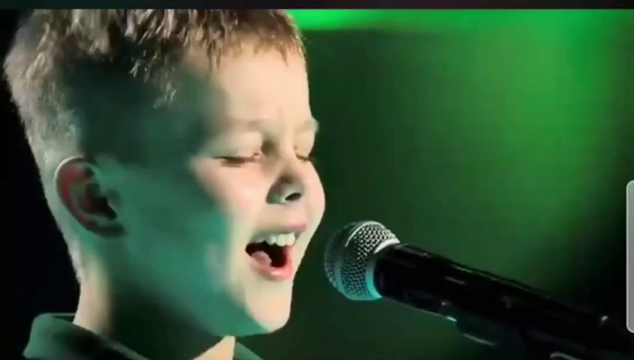
WHAT PROGRAMME IS IT?
THE VOICE KIDS/ TALENT SHOW

Slide 8
WHAT PROGRAMME IS IT?
CARTOON

Slide 9
WHAT PROGRAMME IS IT?
ANIMAL

Slide 10
WHAT PROGRAMME IS IT?
SPORTS

Slide 11
WHAT PROGRAMME IS IT?
THE VOICE KIDS/ TALENT SHOW

Slide 12

Unit 7: TELEVISION
Lesson 4: Communication
Class: 6A
Teacher: Nguyen Thi Hoa
From: Nam Hong Secondary school

Slide 13
Unit 7: TELEVISION - Lesson 4: Communication
I. EVERYDAY ENGLISH
Asking for and giving the information about TV programmes
1. Listen and read the conversation. Pay atttention to the highlighted words.

Slide 14

Unit 7: TELEVISION - Lesson 4: Communication
1. Listen and read the conversation. Pay atttention to the highlighted words.
﻿A: What’s your favourite TV programme?
B: The animal programme.
A: Why do you like it?
B: Because I can see the animals in
their real life.

Slide 15
Unit 7: TELEVISION - Lesson 4: Communication
1. Listen and read the conversation. Pay atttention to the highlighted words.
﻿A: What’s your favourite TV programme?
B: The animal programme.
A: Why do you like it?
B: Because I can see the animals in
their real life.
=> Ask and give the information about TV programmes

Slide 16
Unit 7: TELEVISION - Lesson 4: Communication
2. Work in pairs. Make a similar conversation about your favourite TV programme.
﻿A: What’s your favourite TV programme?
B: The animal programme.
A: Why do you like it?
B: Because I can see the animals in their real life.
Eg1: sports / a big fan of sports.
Eg 2: comedy / make me laugh.
Eg 3: game show / interesting and educational programme.

Slide 17
Unit 7: TELEVISION - Lesson 4: Communication
2. Work in pairs. Make a similar conversation about your favourite TV programme.
Example 1
A: What’s your favourite TV programme?
B: The sports programme.
A: Why do you like it?
B: Because I am a big fan of sports.
A: What time is it on?
B: It’s on at 7:30 p.m. on VTV3.
A: How often do you watch it?
B: I watch it every weekend.

Slide 18

﻿A: What’s your favourite TV programme?
B: The _________ programme.
A: Why do you like it?
B: Because ______________________
comedy
it makes me laugh.

Slide 19
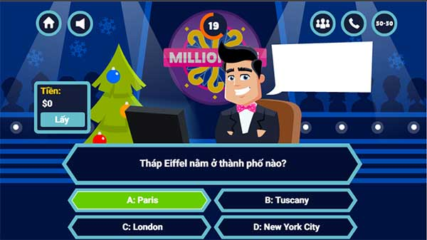
﻿A: What’s your favourite TV programme?
B: The _____________ programme.
A: Why do you like it?
B: Because ______________________
game show
it is interesting

Slide 20
Unit 7: TELEVISION - Lesson 4: Communication
Asking for and giving the information about TV programmes
2. Work in pairs. Make a similar conversation about your favourite TV programme.
﻿A: What’s your favourite TV programme?
B: The animal programme.
A: Why do you like it?
B: Because I can see the animals in their real life.
Eg1: sports / a big fan of sports.
Eg 2: comedy / make me laugh.
Eg 3: game show / interesting.

Slide 21
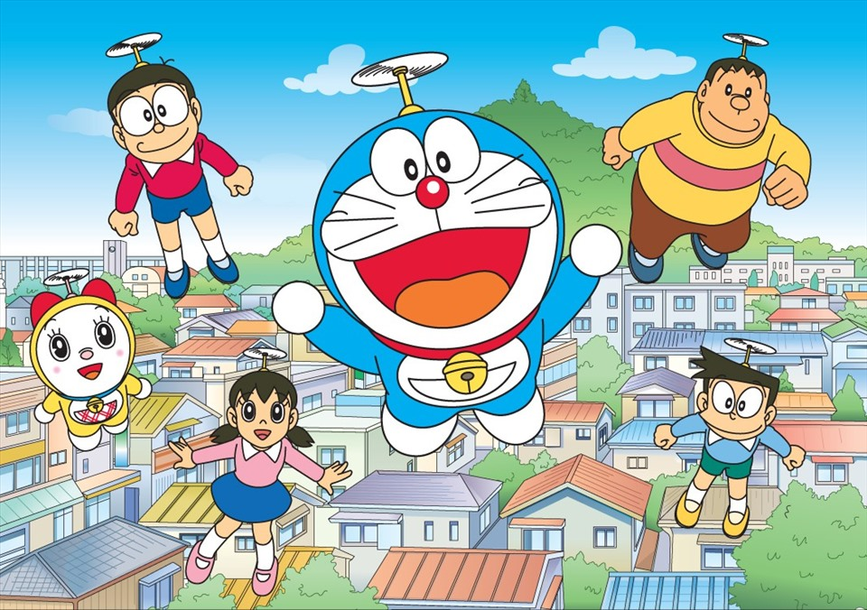

Unit 7: TELEVISION - Lesson 4: Communication
I. EVERYDAY ENGLISH
II. TV PROGRAMMES
3. Work in groups. Discuss and complete the facts with the countries in the box.

Slide 22
Unit 7: TELEVISION - Lesson 4: Communication
3. Work in groups. Discuss and complete the facts with the countries in the box.
The USA Viet Nam Japan Iceland
1. Pokemon cartoons are from ________.
2. Bibi in ________ shows international and Vietnamese cartoons.
3. In ________, there was no TV on Thursdays before 1986.
4. Discovery Channel makes education fun for children in ________.
5. Tran Thanh is a famous MC and actor in _____.

Slide 23



LUCKY WHEEL
30
20
1
2
3
40
10
50
x2
4
5
6
60
70
TURN
NEXT

Slide 24




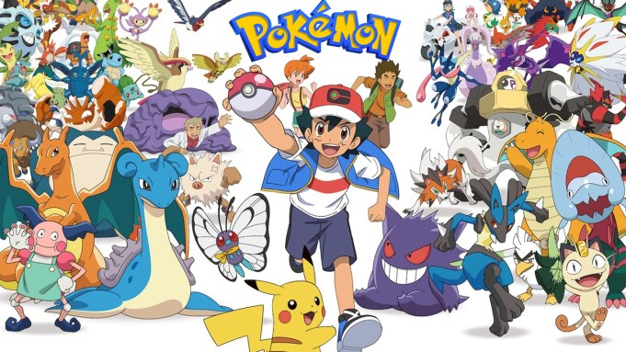


Question 1: Pokemon cartoons are from___________.
A. Japan
B. Viet Nam
C. The USA
D. Iceland
BACK

Slide 25

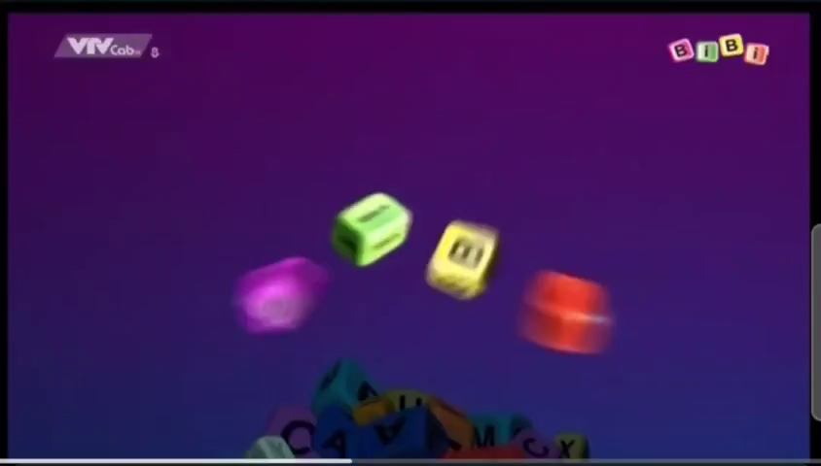
Question 5?
Question 2: Bibi in _______ shows international and Vietnamese cartoons.
A. Japan
B. Viet Nam
C. the USA
D. Iceland
BACK

Slide 27
Question 3: In _____, there was no TV on Thursday before 1986.
A. Iceland
B. Viet Nam
C. The USA
D. Japan
BACK

Slide 28
Question 6?
Question 4: Discovery Channel makes education fun for children in ________.
A. Japan
B. Viet Nam
C. Iceland
D. The USA
BACK

Slide 29


lucky

Slide 30
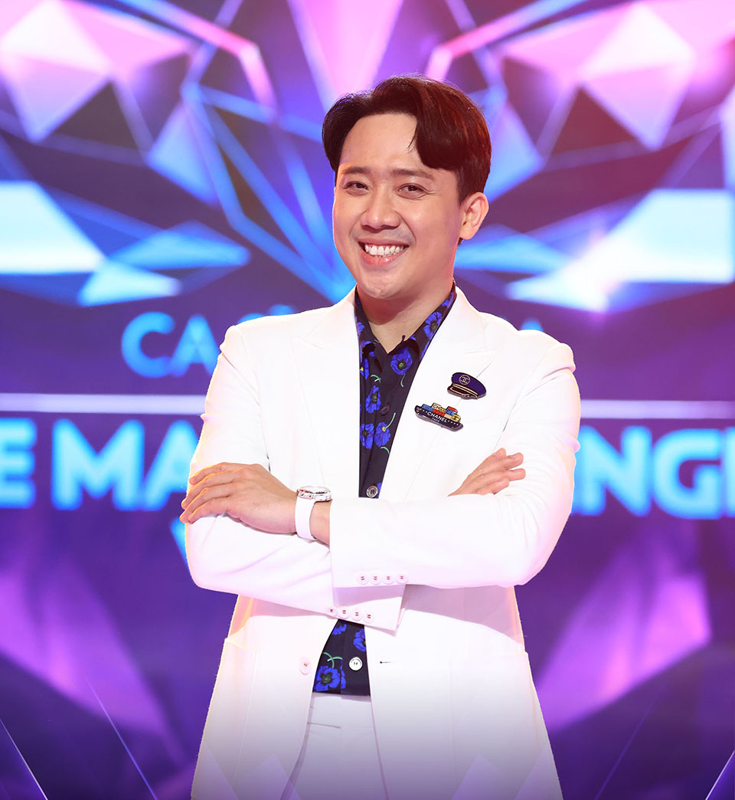
Question 6?
Question 7: Tran Thanh is a famous MC and actor in _____.
A. Japan
B. The USA
C. Iceland
D. Viet Nam
BACK

Slide 31
Unit 7: TELEVISION - Lesson 4: Communication
3. Work in groups. Discuss and complete the facts with the countries in the box.
The USA Viet Nam Japan Iceland
1. Pokemon cartoons are from Japan.
2. Bibi in Viet Nam shows international and Vietnamese cartoons.
3. In Iceland, there was no TV on Thursdays before 1986.
4. Discovery Channel makes education fun for children in the USA.
5. Tran Thanh is a famous MC and actor in Viet Nam.

Slide 32
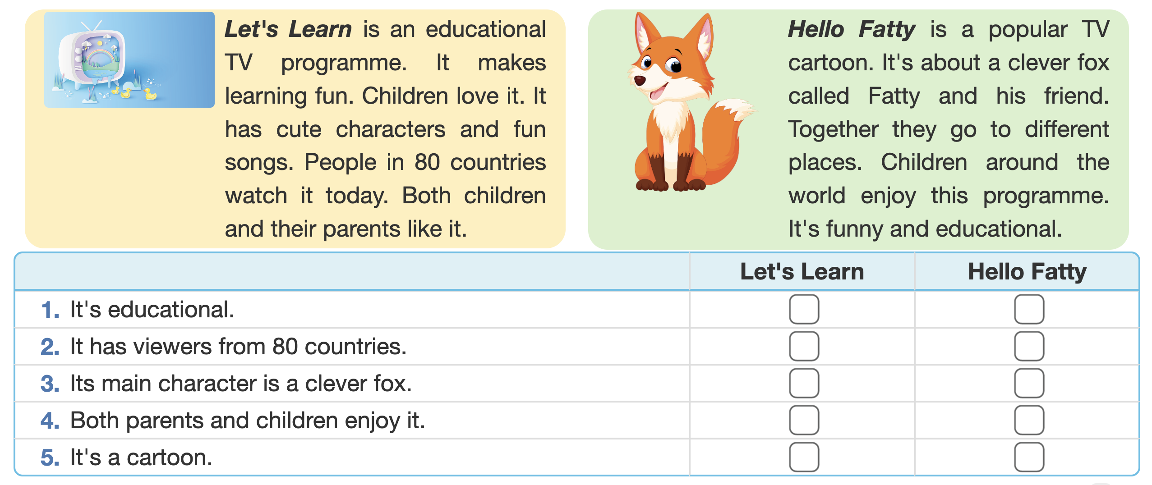
Unit 7: TELEVISION - Lesson 4: Communication
4. Read about two TV programmes and tick the correct programme in the table.

Slide 33


4. Read about two TV programmes and tick the correct programme in the table.
educational
 | Let’s learn | Hello Fatty
1. It’s educational
2. It has viewers from 80 countries.
3. Its main character is a clever fox.
4. Both parents and children enjoy it.
5. It’s a cartoon.
80 countries
Both children
and thei
parents
cartoon
a clever fox
educational

Slide 34
Unit 7: TELEVISION - Lesson 4: Communication
5. Work in groups. Tell your group which programme you prefer and why.
Example:
I like Let’s learn because it has cute characters and fun songs.

Slide 35


SPORTS : BIG FAN OF SPORTS / WATCH 5 TIMES A WEEK
HELLO FATTY: POPULAR CARTOON / FUNNY AND EDUCATIONAL
TV PROGRAMMES
LET’S LEARN: EDUCATIONAL / CUTE CHARACTERS AND FUN SONGS / WATCH WITH MY MOTHER
CARTOON: INTERESTING / WATCH WITH MY SISTER
WE LIKE ............................................BECAUSE .......................................

Slide 36
Unit 7: TELEVISION - Lesson 4: Communication
I. EVERYDAY ENGLISH
II. TV PROGRAMMES
III. HOMEWORK
1. Make conversations to ask and give information about TV programmes.
1. Do exercises in workbook
33. Prepare Lesson 5: Skills 1

Slide 37
THANK YOU

