Slide 1

Hello everyone !!!
WARMLY WELCOME TO OUR CLASS!

Slide 2
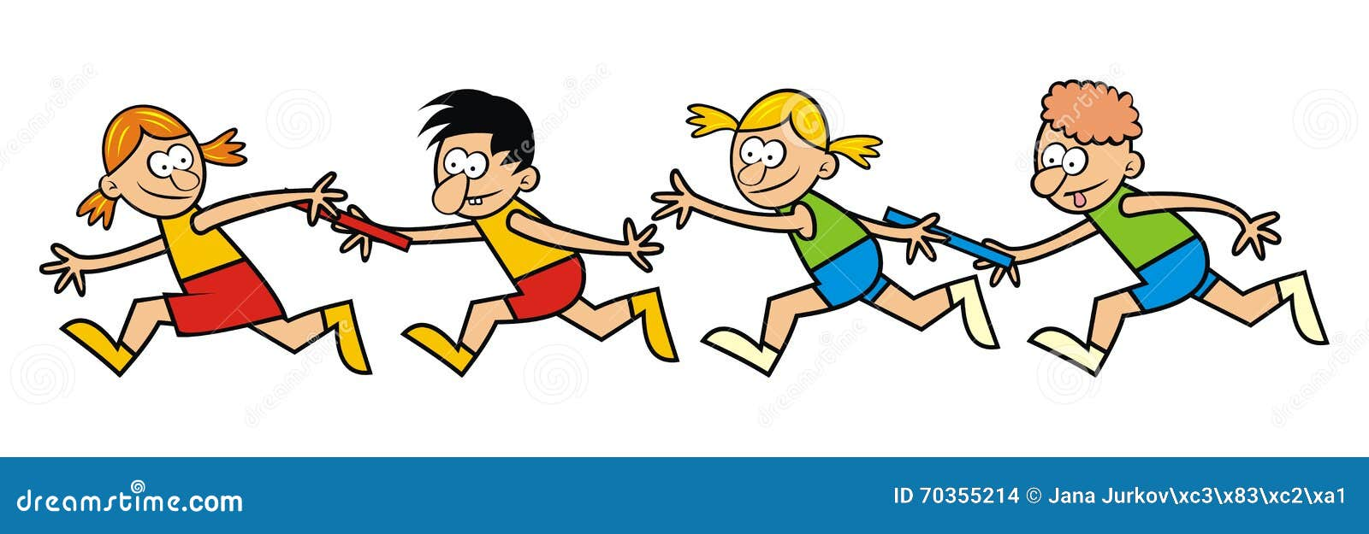
* WARM-UP
RELAY GAME
- There are 2 teams: 5 students/ 1 team.
- You will stick the words to the board in the correct columns
- The team with the most correct answers will be the winner

Slide 3



RELAY GAME
do puzzles, plough a field, bully, peer pressure, unload rice, leisure activities, be interested in, combine harvester, browse the websites
UNIT 1: LEISURE TIME | UNIT 2: LIFE IN THE COUNTRYSIDE | UNIT 3: TEENAGERS

Slide 4
UNIT 1- | UNIT 2: | UNIT 3: TEENAGERS
- be interested in - leisure activities - do puzzles | - combine harvester - unload rice - plough a field | - browse the websites - peer pressure - bully
LEISURE TIME
LIFE IN THE
COUNTRYSIDE

Slide 5
Period 23: REVIEW 1
LANGUAGE
Teacher: Nguyen Thi Hoa
From: Nam Hong Secondary school

Slide 6


ENGLISH 8- PERIOD 23: REVIEW 1- LANGUAGE
I. VOCABULARY
II. PRONUNCIATION
III. GRAMMAR

Slide 7
ENGLISH 8- PERIOD 23: REVIEW 1- LANGUAGE
I. VOCABULARY
UNIT 1- | UNIT 2: | UNIT 3: TEENAGERS
- be interested in - leisure activities - do puzzles - be fond of .... | - combine harvester - unload rice - plough a field - catch fish .... | - browse the websites - peer pressure - bully - teens’ use of social media...
LEISURE TIME
LIFE IN THE
COUNTRYSIDE

Slide 8

ENGLISH 8- PERIOD 23: REVIEW 1- LANGUAGE
I. VOCABULARY
Task 1 (Ex2-p38): Work in pairs. Circle the correct answer A, B, or C.
is
1. Mi is _____ gardening in her free time.
A. in B. into C. to
2. Mai is interested _____ building websites for her friends.
A. of B. with C. in
3. Minh is not fond of _____ puzzles because he thinks it takes a lot of time.
A. making B. doing C. building
4. I'm not keen on _____ our class photos to the forum.
A. uploading B. surfing C. messaging
5. While l was _____ some websites, I saw an advertisement about a resort.
A. creating B. browsing C. uploading
gardening
interested
fond of
puzzles
keen on
photos
forum
websites

Slide 9
ENGLISH 8- PERIOD 23: REVIEW 1- LANGUAGE
Task 2 ( Ex3-p38): Complete the sentences with the words from the box.
bully trained hospitable pressure focus
1. People in my village are very ______________ to all visitors.
2. Parents in our village don’t put much _________ on their children to do well at school.
3. In my school, we can _______ on study and play, and do not have to worry about bullies.
4. The best ________player in our chess club will not be able to join the competition.
5. If a boy uses his strength to frighten weaker peers, he is a ______.

Slide 10
WORKSHEET
Task 2 (Ex 3- P38): Complete the sentences with the words from the box.
CONTENT | MARK
1. People in my village are very ______________ to all visitors. | ….……./ 2 points
2. Parents in our village don’t put much _________ on their children to do well at school. | ….……./ 2 points
3. In my school, we can _______ on study and play, and do not have to worry about bullies. | ….……./ 2 points
4. The best ________player in our chess club will not be able to join the competition. | ….……./ 2 points
5. If a boy uses his strength to frighten weaker peers, he is a ______. | ….……./ 2 points
Group : ............Total: …………………/10 points

Slide 11
ENGLISH 8- PERIOD 23: REVIEW 1- LANGUAGE
Task 2 (Ex3- p38): Complete the sentences with the words from the box.
bully trained hospitable pressure focus
hospitable
1. People in my village are very ______________ to all visitors.
2. Parents in our village don’t put much _________ on their children to do well at school.
3. In my school, we can _______ on study and play, and do not have to worry about bullies.
4. The best ________player in our chess club will not be able to join the competition.
5. If a boy uses his strength to frighten weaker peers, he is a ______.
pressure
focus
trained
bully

Slide 12

ENGLISH 8- PERIOD 23: REVIEW 1- LANGUAGE
II. PRONUNCIATION
/ʊ/
Unit 1:
Sounds:
/u:/
/ə/
Unit 2:
Sounds:
/ɪ/
/ɔɪ/
Unit 3:
Sounds:
/ʊə/

Slide 13
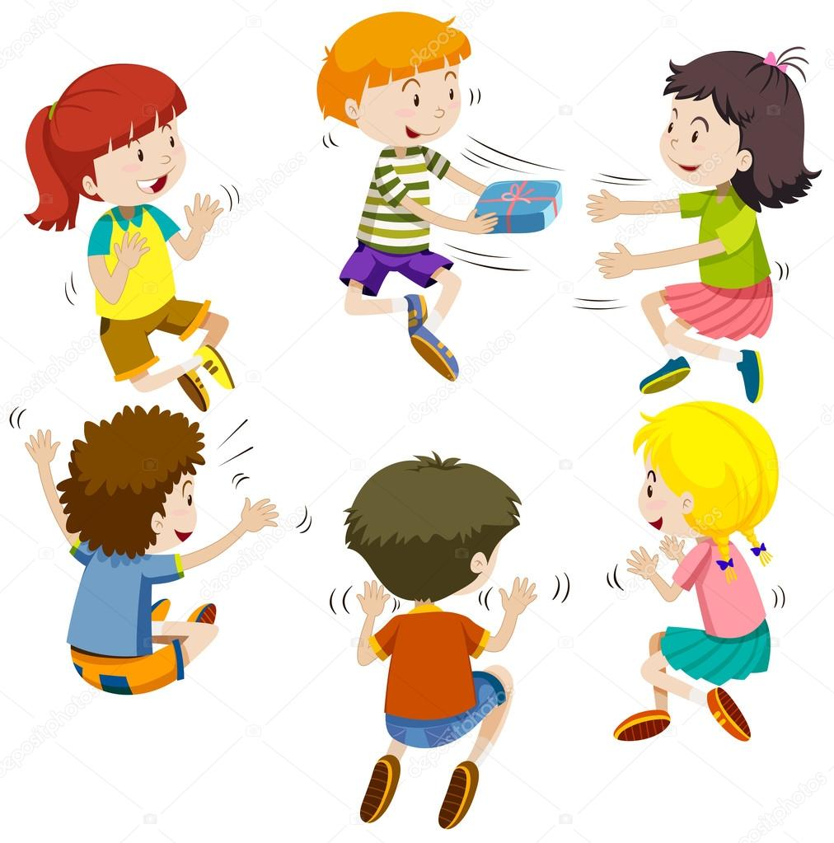
ENGLISH 8- PERIOD 23: REVIEW 1- LANGUAGE
Task 3( Ex 1- p38): Circle the word whose underlined part is pronounced differently from the others.
1. A. good B. cool C. foot D. cook
2. A. June B. rude C.truth D. put
3. A. village B. buffalo C. cottage D. shortage
4. A. ensure B. insure C. picture D. surely
5. A. avoid B. doing C. choice D. join
/ɡʊd/
/kuːl/
/fʊt/
/kʊk/
/dʒuːn/
/ruːd/
/truːθ/
/pʊt/
/ˈvɪl.ɪdʒ/
/ˈbʌf.ə.ləʊ/
/ˈkɒt.ɪdʒ/
/'∫ɔ:tɪdʒ/
/ɪnˈʃʊər/
/ˈʃʊəli/
/ɪnˈʃʊər/
/ˈpɪk.tʃər/
/əˈvɔɪd/
/ˈduːɪŋ/
/tʃɔɪs/
/dʒɔɪn/

Slide 14
ENGLISH 8- PERIOD 23: REVIEW 1- LANGUAGE
III. GRAMMAR
Verbs of liking/ disliking + Ving:
love, like, fancy, prefer, dislike, hate, detest...
- Unit 1:
Verbs of liking/ disliking + to V/ Ving:
like, love, hate, prefer.
S+ V + short adv + er + than ....
- Unit 2:
- Comparative forms of adverbs
S+ V +more + long adv+ than ....
Simple sentences:
one independent clause
- Unit 3:
Compound sentences:
two or more independent clauses

Slide 15
ENGLISH 8- PERIOD 23: REVIEW 1- LANGUAGE
III. GRAMMAR
Task 4 (Ex 4- p38): Choose the correct answer A, B, or C.
1. Mai dislikes ______ her pictures to Facebook. She prefers not to show them to others.
A. to upload B. uploading C. upload
2. We enjoy ____ photos of different types of scenery, so we took a camera with us.
A. taking B. to take C. take
3. She did the puzzles ______ than I did, so I won the competition.
A. slowly B. slower C. more slowly
4. Tom worked ______ than Mi; therefore, he got better results in the exams.
A. hardly B. harder C. more hard
5. Now they all chat with each other ____ than before because they have smartphones.
A. more frequently B. frequent C. frequently
GAME

Slide 16

WHO IS FASTER?

Slide 17




5
4
1
1. Mai dislikes ______ her pictures to Facebook. She prefers not to show them to others.
3
2
A. to upload
B. uploading
C. upload

Slide 18
5
4
1
2. We enjoy ______ photos of different types of scenery, so we took a camera with us.
3
2
A. taking
B. to take
C. take

Slide 19
5
4
1
3. She did the puzzles ______ than I did, so I won the competition.
3
2
A. slowly
B. slower
C. more slowly

Slide 20
5
4
1
4. Tom worked ______ than Mi; therefore, he got better results in the exams.
3
2
A. hardly
B. harder
C. more hard

Slide 21
5
4
1
5. Now they all chat with each other ______ than before because they have smartphones
3
2
A. more frequently
B. frequent
C. frequently

Slide 22
ENGLISH 8- PERIOD 23: REVIEW 1- LANGUAGE
III. GRAMMAR
Task 4 (Ex 4- p38): Choose the correct answer A, B, or C.
1. Mai dislikes ______ her pictures to Facebook. She prefers not to show them to others.
A. to upload B. uploading C. upload
2. We enjoy ____ photos of different types of scenery, so we took a camera with us.
A. taking B. to take C. take
3. She did the puzzles ______ than I did, so I won the competition.
A. slowly B. slower C. more slowly
4. Tom worked ______ than Mi; therefore, he got better results in the exams.
A. hardly B. harder C. more hard
5. Now they all chat with each other ____ than before because they have smartphones.
A. more frequently B. frequent C. frequently

Slide 23
ENGLISH 8- PERIOD 23: REVIEW 1- LANGUAGE
III. GRAMMAR
Task 5 (Ex5- p38): Underline the correct bold word in each sentence.
1. Minh is interested in painting, so / but yesterday he decided to join the arts and crafts club. 2. Life in the city seems to be more comfortable, otherwise / but I prefer life in the countryside.
3. She tries to focus more on her studies; therefore / otherwise, she won’t pass her exams. 4. During harvest time, farmers have to get up earlier, and / so they have to work harder. 5. Parents now have higher expectations of their children; therefore / so, children are under more pressure than before.

Slide 24
IV. CONSOLIDATION
Sounds:
/ʊ/ and …..
/u:/
Pronunciation
Sounds:
/ə/ and …..
/ɪ/
Sounds:
/ɔɪ/ and …..
/ʊə/
activities
Leisure …………..................
Unit 1-2-3
Vocabulary
likes
dislikes
Expressions about ............. and ................
countryside
Life in the .....................
school clubs
Teen ...................., teens’ use of....................., and teen .........
social media
stress
Ving/ to V
Grammar
Verbs of liking/disliking+ ............................
adverbs
Comparative forms of ................................
Simple
compound
.............. sentences and ................... sentences

Slide 25

ENGLISH 8- PERIOD 23: REVIEW 1- LANGUAGE
V. HOMEWORK:
- Do exercies on page 38 again.
- Prepare Review 1 (Skills)

