Slide 2
MATCHING
A
B
1. narrow
2. noisy
3. slim
4. cheap
5. modern
6. convenient
7. interesting
8. expensive
9. crowded
10. peaceful
a. rẻ
b. chật, hẹp
c. đông đúc
d. thuận lợi
e. ồn ào
f. đắt
g. thanh mảnh
h. hiện đại
i. thú vị
j. thanh bình

Slide 3
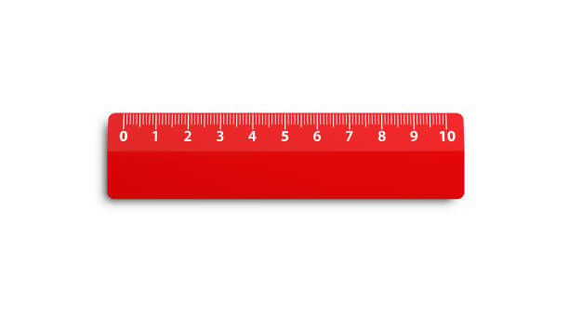
Comparative adjectives
Who is taller ?
(TÍNH TỪ SO SÁNH HƠN)
taller
long
Tom
Jim
tall
longer
5 dollars
expensive
8 dollars
more expensive

Slide 4
Unit 4: My Neighbourhood – A closer look 2
grammar
Comparative adjectives (TÍNH TỪ SO SÁNH HƠN)
1. Short adjectives (tính từ ngắn)
Tom
one syllable: tall, large, big, small, long, short, …
(1 âm tiết)
Jim
Example: Tom is taller than Jim.
S1
be
adj+er
than
S2
= Jim is shorter than Tom.
Structure: S1 + to be + short adj + er + than + S2

Slide 5
Unit 4: My Neighbourhood – A closer look 2
grammar
Comparative adjectives (TÍNH TỪ SO SÁNH HƠN)
1. Short adjectives (tính từ ngắn)
NOTE: | Adjective (Adj) | Comparative (so sánh)
RULE (quy tắc)
fast
faster
Adj + er
large
larger
Adj-e + r
one syllable
Tận cùng là 1 phụ âm, trước nó là 1 nguyên âm, phải gấp đôi phụ âm đó rồi mới thêm er.
slim
slimmer
two syllables
noisy
noisier
Adj-y → Adj + ier
Two syllables ending with :
ow, er, le, et
narrow
narrower
clever
cleverer
simple
Adj-ow/er/le/et + er
simpler
quiet
quieter

Slide 6
Unit 4: My Neighbourhood – A closer look 2
grammar
Comparative adjectives (TÍNH TỪ SO SÁNH HƠN)
1. Short adjectives (tính từ ngắn)
Than – “than” is used to make comparisons:
My bag is heavier than yours

Slide 7
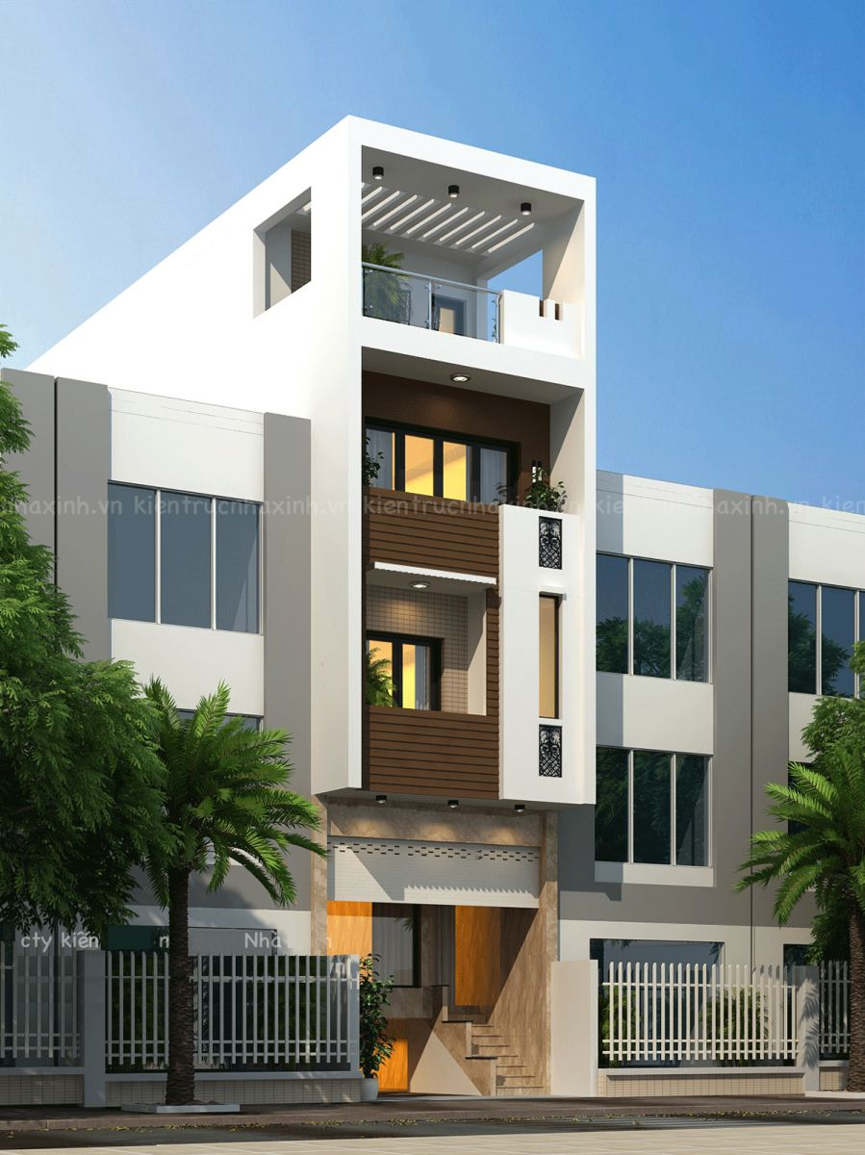
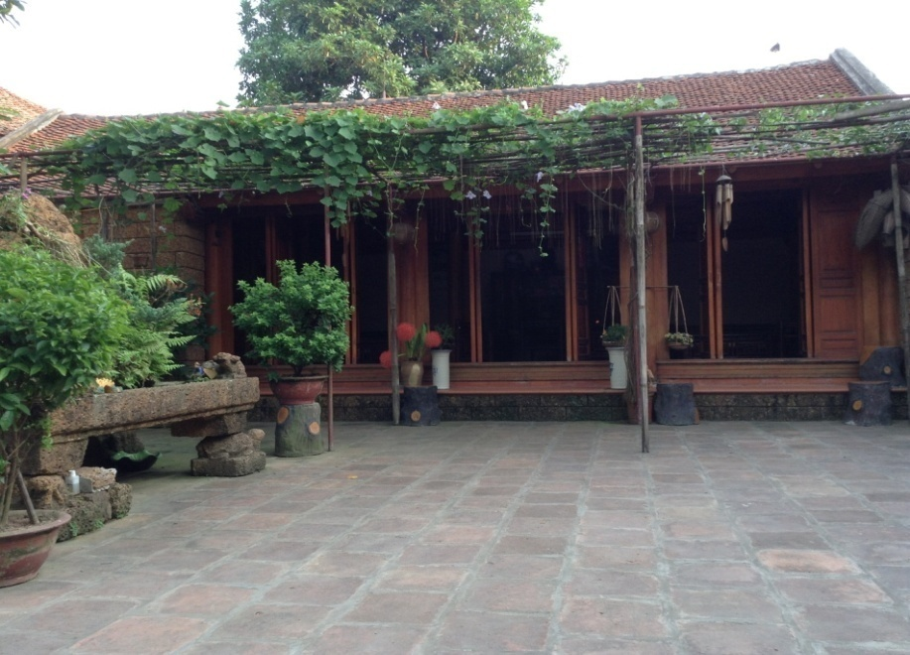
Unit 4: My Neighbourhood – A closer look 2
grammar
Comparative adjectives (TÍNH TỪ SO SÁNH HƠN)
2. Long adjectives (tính từ dài)
two or more syllables: modern, interesting, convenient, expensive, …
Ex1: The city house is more modern than the country house.
Ex2: The city house is more expensive than the country house.
Structure: S1 + tobe + more + long adj + than + S2

Slide 8
Unit 4: My Neighbourhood – A closer look 2
grammar
Comparative adjectives (TÍNH TỪ SO SÁNH HƠN)
NOTE: | Adjective | Comparative (so sánh hơn)
RULE (quy tắc)
one syllable
fast
faster
+ er
large
larger
+ r
two syllables that ending with “y”
noisy
noisier
y → ier
Two, three or more syllables
modern
more modern
more + adj
exciting
more exciting
Than – “than” is used to make comparisons:

Slide 9
Unit 4: My neighbourhood – A closer look 2
grammar
Comparative adjectives (TÍNH TỪ SO SÁNH HƠN)
Các trường hợp đặc biệt
good  better (tốt , giỏi  tốt hơn, giỏi hơn)
bad ◻ worse (tệ  tệ hơn)
many/much  more (nhiều  nhiều hơn)
little  less (ít  ít hơn)
far  farther/further (xa  xa hơn)
old  older/elder (lớn tuổi  lớn tuổi hơn)

Slide 10
Unit 4: My Neighbourhood – A closer look 2
1. Complete the following sentences with the comparative form of the adjectives in brackets.
1.This building is ……………. than that building. (tall)
2. My neighbourhood is ………………than your neighbourhood.(noisy)
3. The square in Ha Noi is ………..… than the square in Hoi An.(big)
4. Living in the countryside is ……………..… than living on a city. (peaceful)
5. Is living in a city ……………….. than living in the countryside? (exciting)
slimmer
Model: Ann is ………………than Laura. (slim)
taller
noisier
bigger
more peaceful
more exciting

Slide 11
Unit 4: My Neighbourhood – A closer look 2
2: Read and complete Vy’s letter to her friend.
Dear Nick,
How are you?
Ha Noi is beautiful! But it is too busy and polluted for me. I’m at Cua Lo Beach now. I’m having a great time. The weather is (0. hot) …….. and (1. dry)…..…. than that in Ha Noi. The houses are (2. small).……… and the buildings are (3.old) ………than the buildings in Ha Noi. The streets are (4. wide) ….….. with less traffic. I love the food here. The seafood here is (5.delicious) ………………….and
(6. cheap) ………... than the seafood in Ha Noi.
Well, outside the sun is shining so I'm off to get some fresh air.
See you soon,
Vy
hotter
drier
smaller
older
wider
more delicious
cheaper

Slide 12
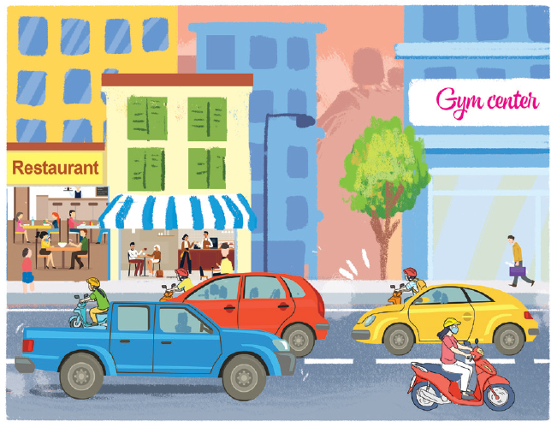
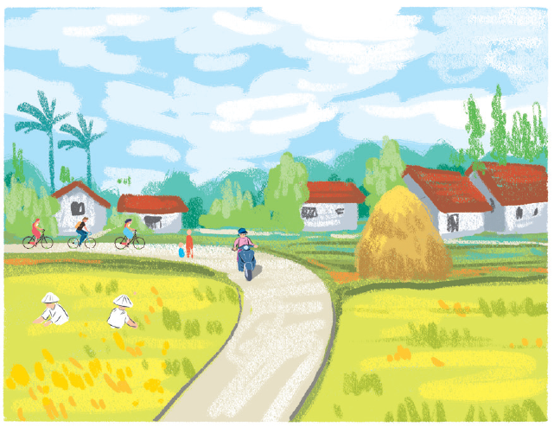
Unit 4: My Neighbourhood – A closer look 2
3. Look at the pictures of the two neighbourhoods: Binh Minh and Long Son. Compare two neighbourhoods. You can use the adjectives below.
noisy
crowded
quiet
peaceful
modern
busy
boring
Example:
Binh Minh is noisier than Long Son.
Binh Minh is more crowded than Long Son.
Binh Minh is more modern than Long Son.
Binh Minh is busier than Long Son.
Binh Minh
Long Son
quieter than
Long Son is … ………….. Binh Minh.
Long Son is more peaceful than Binh Minh.
Long Son is more boring than Binh Minh.

Slide 13
Unit 4: My Neighbourhood – A closer look 2
4. Work in pairs. Ask and answer questions about Binh Minh and Long Son
neighbourhoods using the pictures in 3.
noisy
crowded
quiet
peaceful
modern
busy
boring
Example:
A: Is Binh Minh noisier than Long Son?
B: Yes, it is.
A: Is Long Son more modern than Binh Minh?
B: No, it isn’t.
Binh Minh
Long Son

Slide 14
Unit 4: My Neighbourhood – A closer look 2
4. Work in pairs. Ask and answer questions about Binh Minh and Long Son
neighbourhoods using the pictures in 3.
noisy
crowded
quiet
peaceful
modern
busy
boring
Example:
A: Is Binh Minh more crowded than Long Son?
B: Yes, it is.
A: Is Binh Minh…………………………………?
B: No, it isn’t.
quieter than Long Son
Binh Minh
Long Son

Slide 15
Unit 4: My Neighbourhood – A closer look 2
4. Work in pairs. Ask and answer questions about Binh Minh and Long Son
neighbourhoods using the pictures in 3.
noisy
crowded
quiet
peaceful
modern
busy
boring
A: Is Long Son ..…………………………………..?
B: Yes, it is.
A: Is Long Son………………………………………?
B: No, it isn’t.
Example:
more peaceful than Binh Minh
more modern than Binh Minh
Binh Minh
Long Son

Slide 16
Who is faster?
Question 1
Question 6
Question 2
Question 7
Question 3
Question 8
Question 4
Question 9
Question 5
Question 10

Slide 17
Who is faster?
Question 1
Is Ho Chi Minh city is ________than Ha Noi? (big)
big
bigger
more big
Finish
1
2
3
4
5
6
7
8
9
Key
Home
10s

Slide 18
Who is faster?
Question 2
Is a house in the city ________ than a house in the countryside ? (expensive)
expensive
expensiver
more expensive
Finish
1
2
3
4
5
6
7
8
9
Key
Home
10s

Slide 19
Who is faster?
Question 3
Is a sofa __________than a chair ? (comfortable)
more comfortable
comfortabler
comfortable
Finish
1
2
3
4
5
6
7
8
9
Key
Home
10s

Slide 20
Who is faster?
Question 4
Is Hoi An _________ than Hue? (historic)
historic
more historic
historicer
Finish
1
2
3
4
5
6
7
8
9
Key
Home
10s

Slide 21
Who is faster?
Question 5
Living in a house is_________ than living in a flat. (convenient)
more convenient
convenient
convenienter
Finish
1
2
3
4
5
6
7
8
9
Key
Home
10s

Slide 22
Who is faster?
Question 6
The buildings in Ha Noi are_________ than the buildings in Hai Duong. (old)
old
more old
older
Finish
1
2
3
4
5
6
7
8
9
Key
Home
10s

Slide 23
Who is faster?
Question 7
The streets in Nam Sach are _________ than the streets in Thanh Ha. (wide)
wide
wider
more wide
Finish
1
2
3
4
5
6
7
8
9
Key
Home
10s

Slide 24
Who is faster?
Question 8
Is the seafood here _________ than the seafood in Ha Noi. (delicious)
delicious
deliciouser
more delicious
Finish
1
2
3
4
5
6
7
8
9
Key
Home
10s

Slide 25
Who is faster?
Question 9
The weather in Hai Duong is_________ than that in Ha Noi. (dry)
more dry
dry
drier
Finish
1
2
3
4
5
6
7
8
9
Key
Home
10s

Slide 26
Who is faster?
Question 10
Are your streets_________ than ours? (narrow)
narrower
narrow
more narrower
Finish
1
2
3
4
5
6
7
8
9
Key
Home
10s

Slide 27
HOMEWORK
- Revise the lesson
- Prepare for Unit 4: Communication.

