Slide 1



















Slide 2
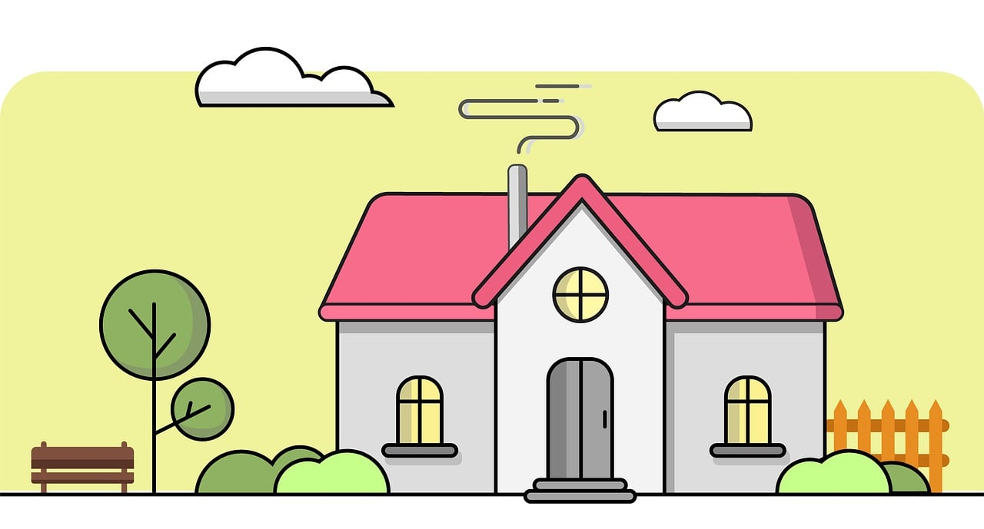

UNIT 4: AT HOME
Lesson 1 – Part 1, 2, 3

Slide 3






Table of contents
01
05
Warm - up
02
04
Presentation
Further Practice
03
Practice
Wrap-up

Slide 4





01
Warm up

Slide 5


Slide 6






Slide 7
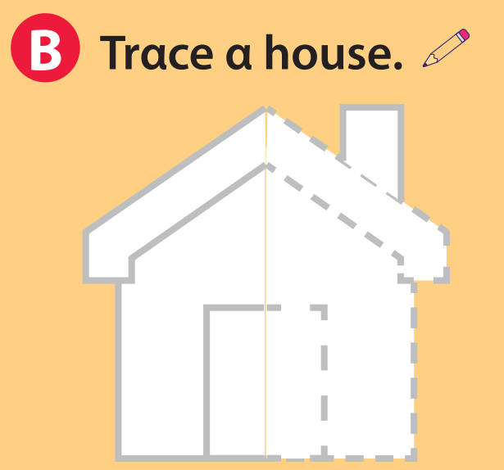


Slide 8
02
Presentation

Slide 9



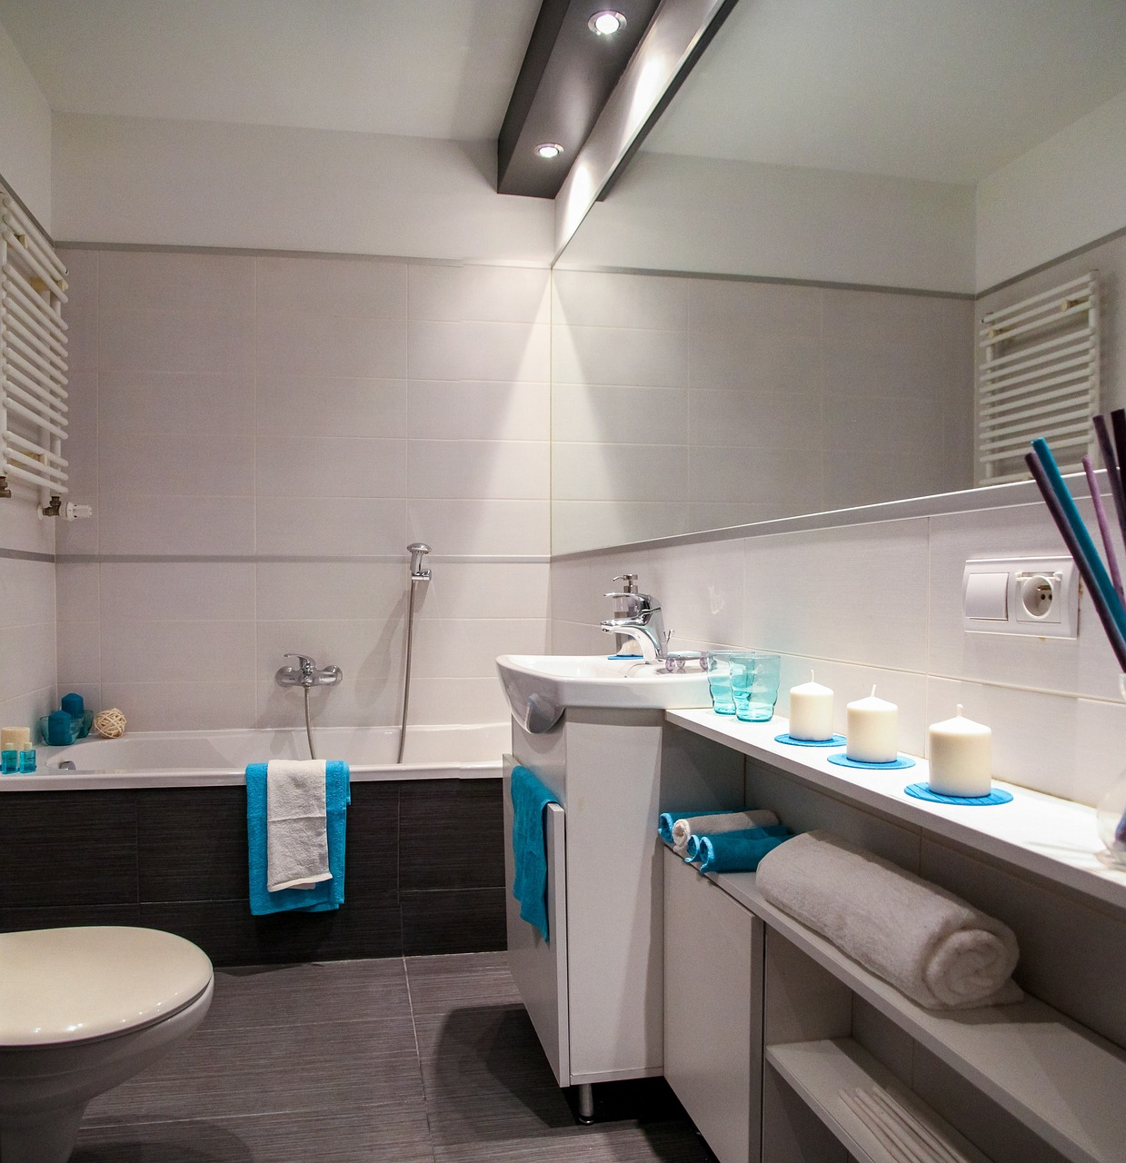
bathroom

Slide 10
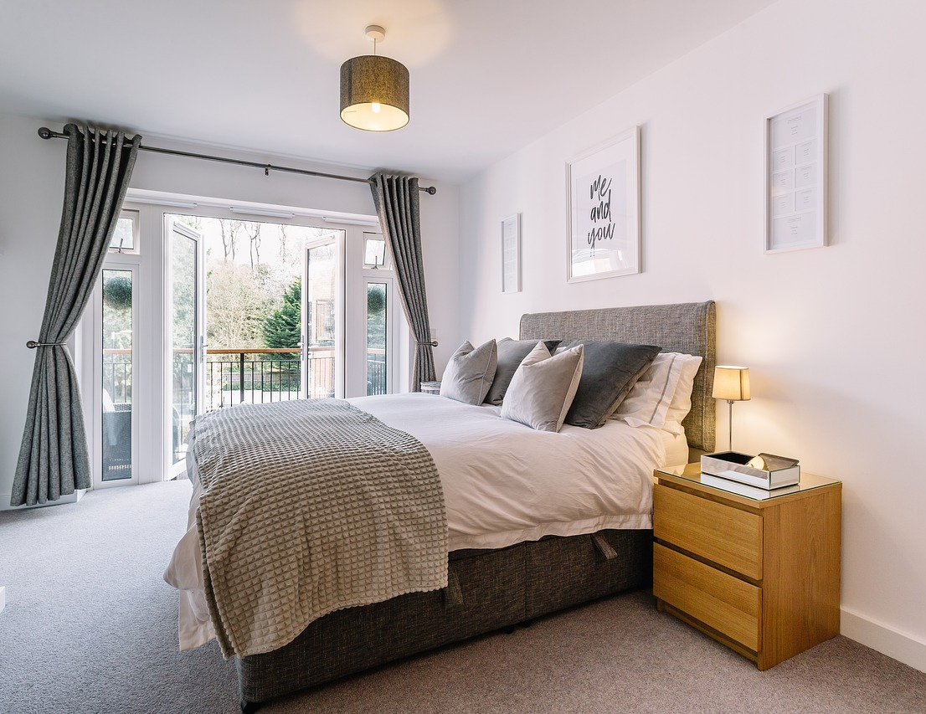
bedroom

Slide 11
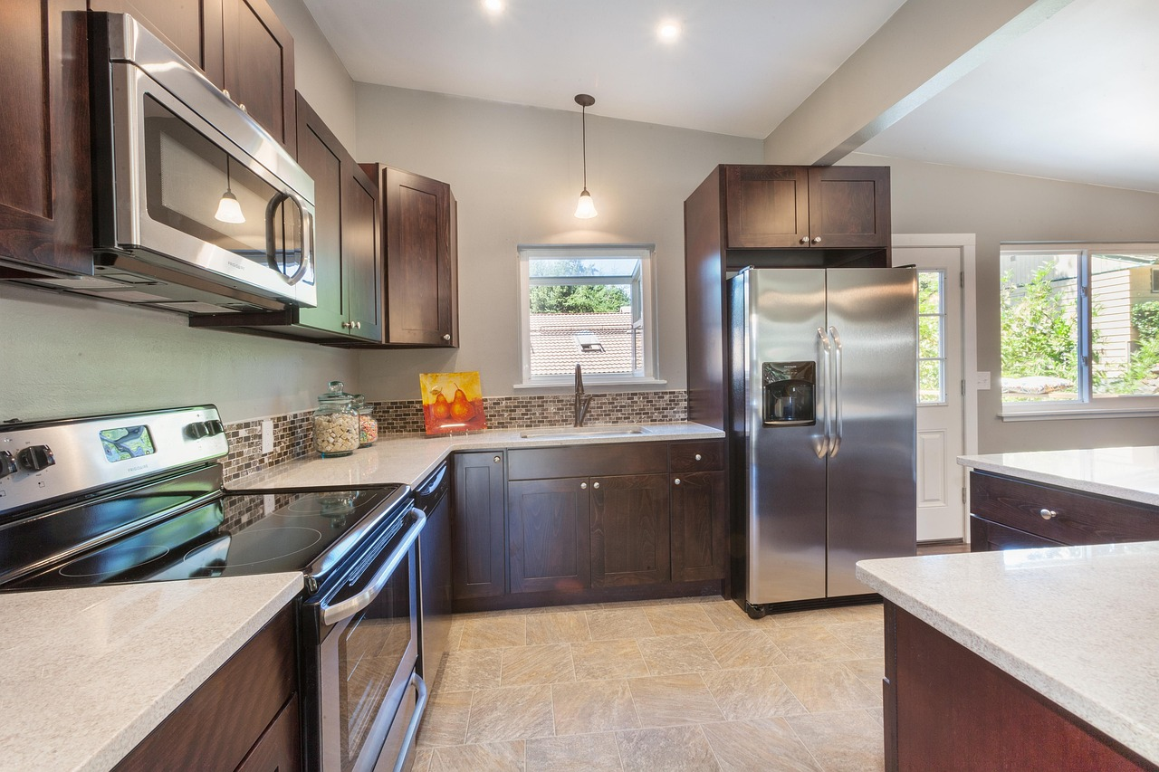
kitchen

Slide 12
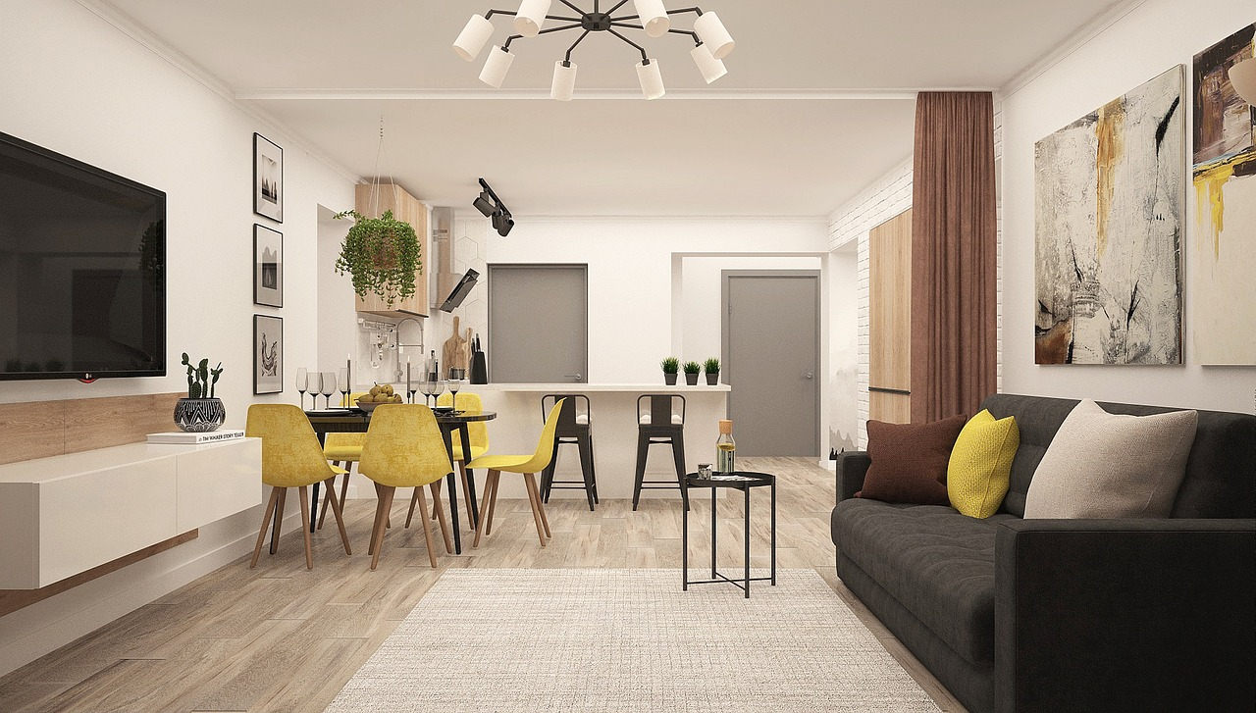
living room

Slide 13
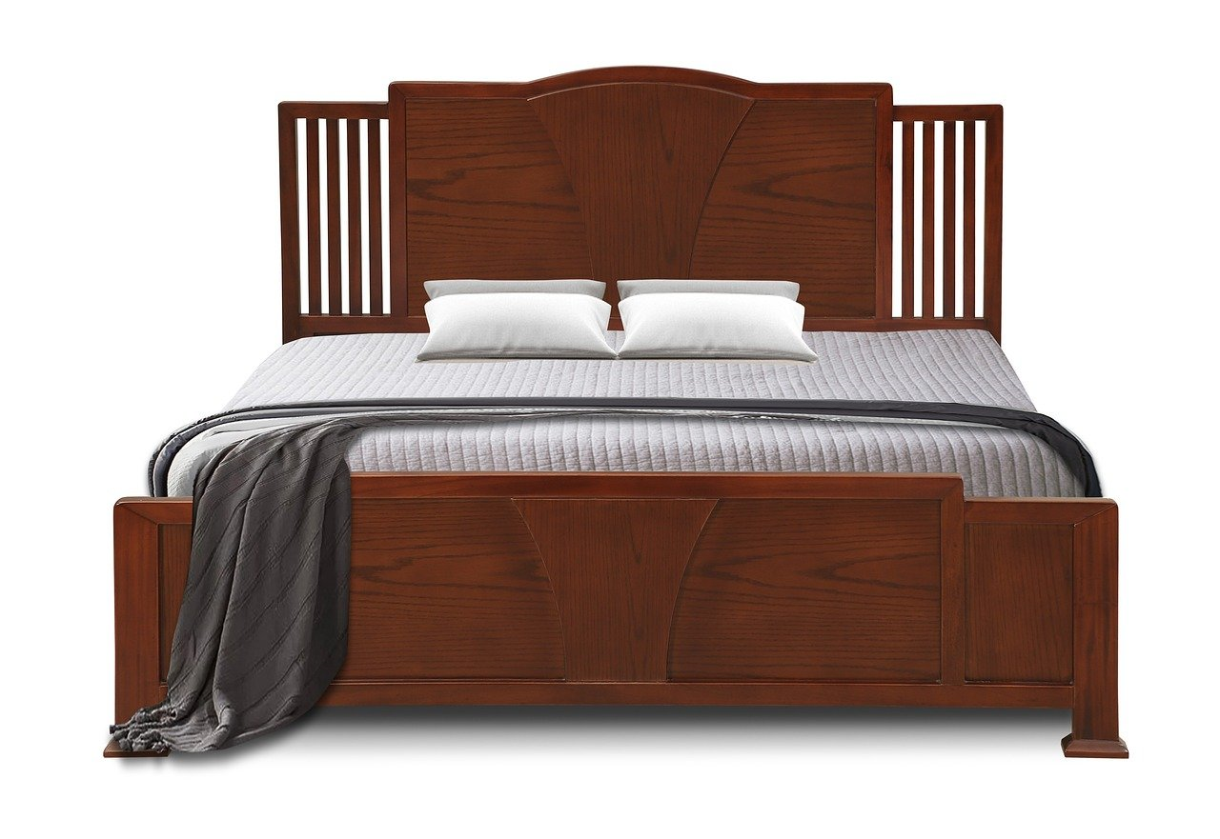
bed

Slide 14
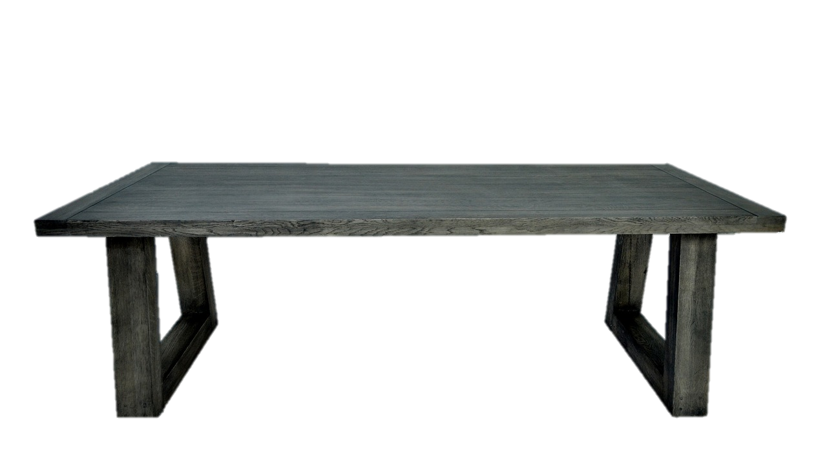
table

Slide 15
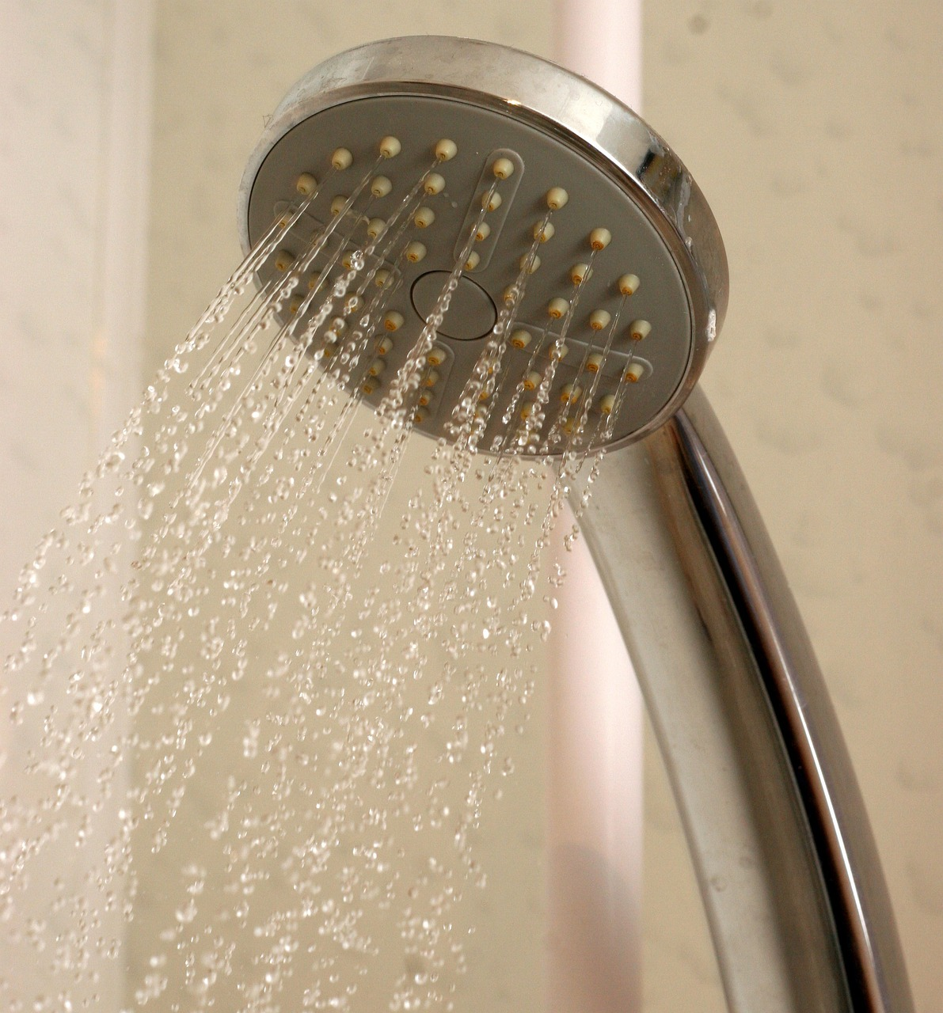
shower

Slide 16
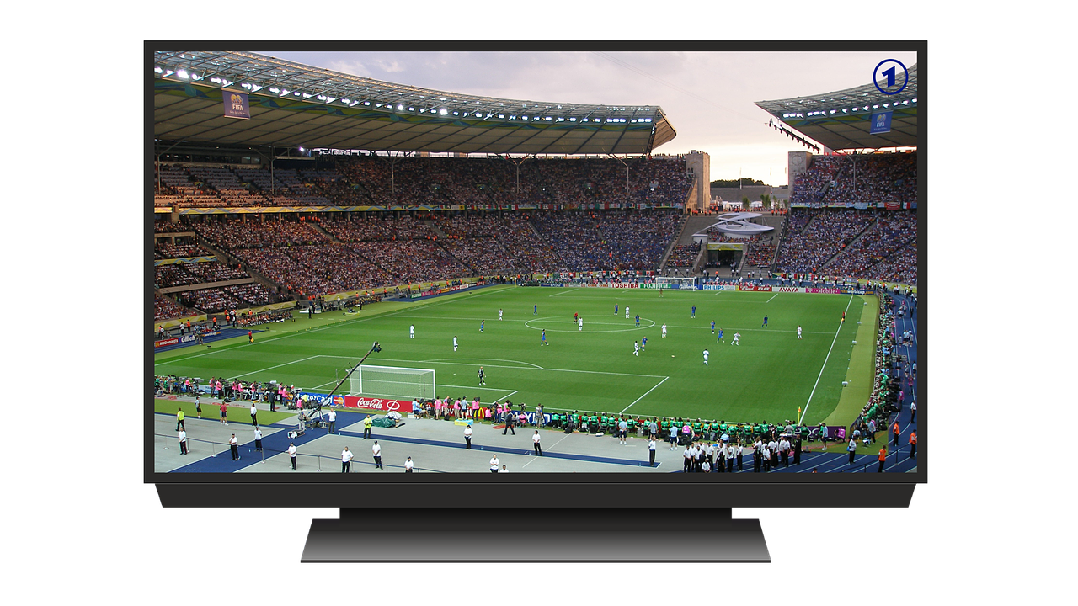
TV

Slide 17
03
Practice

Slide 18



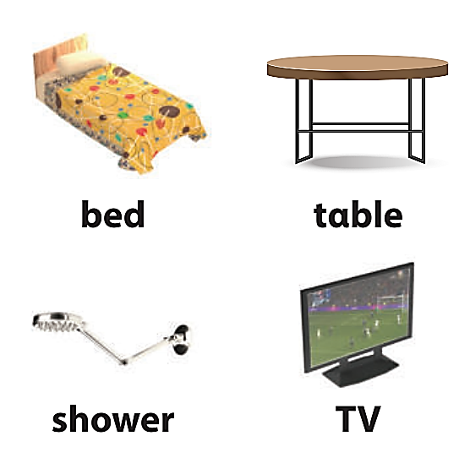
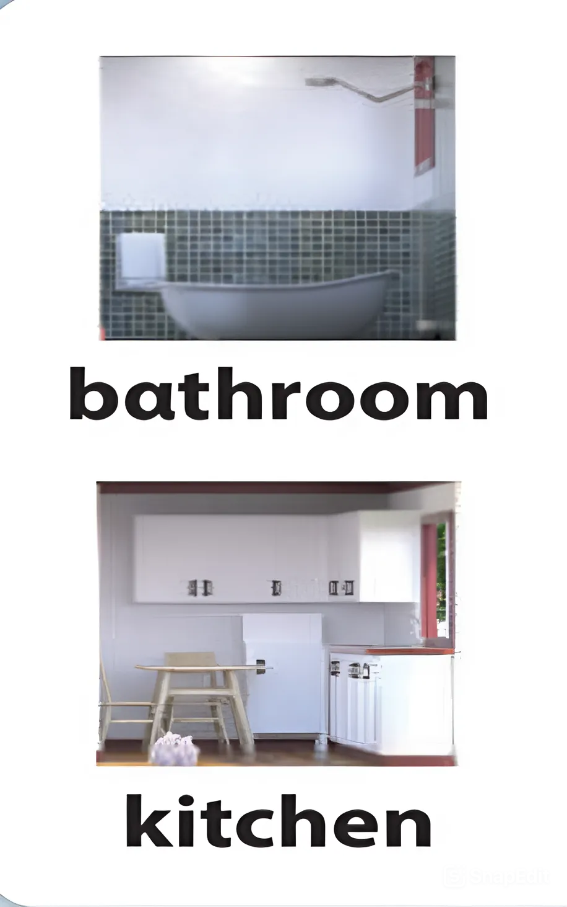
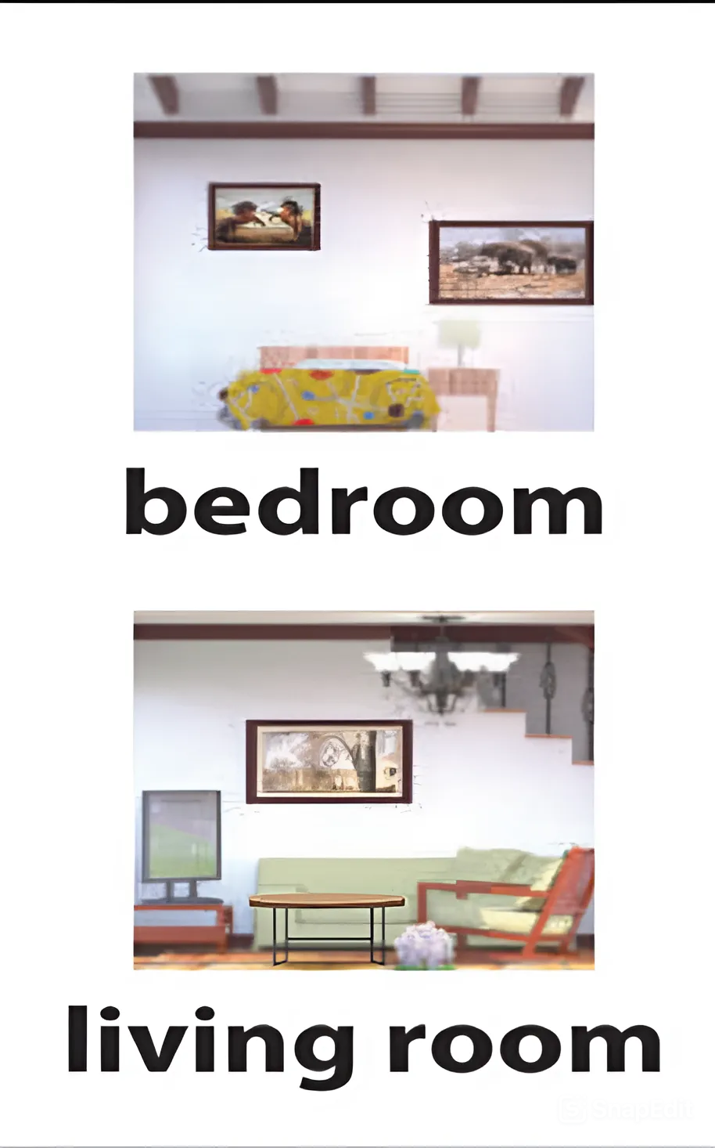


Slide 19


Slide 20
Look and say
kitchen

Slide 21
Look and say
shower

Slide 22
Look and say
bathroom

Slide 23
Look and say
TV

Slide 24
Look and say
living room

Slide 25
Look and say
table

Slide 26

Look and say
bed

Slide 27
Look and say
bedroom

Slide 28
04
Further practice

Slide 29


Slide 30

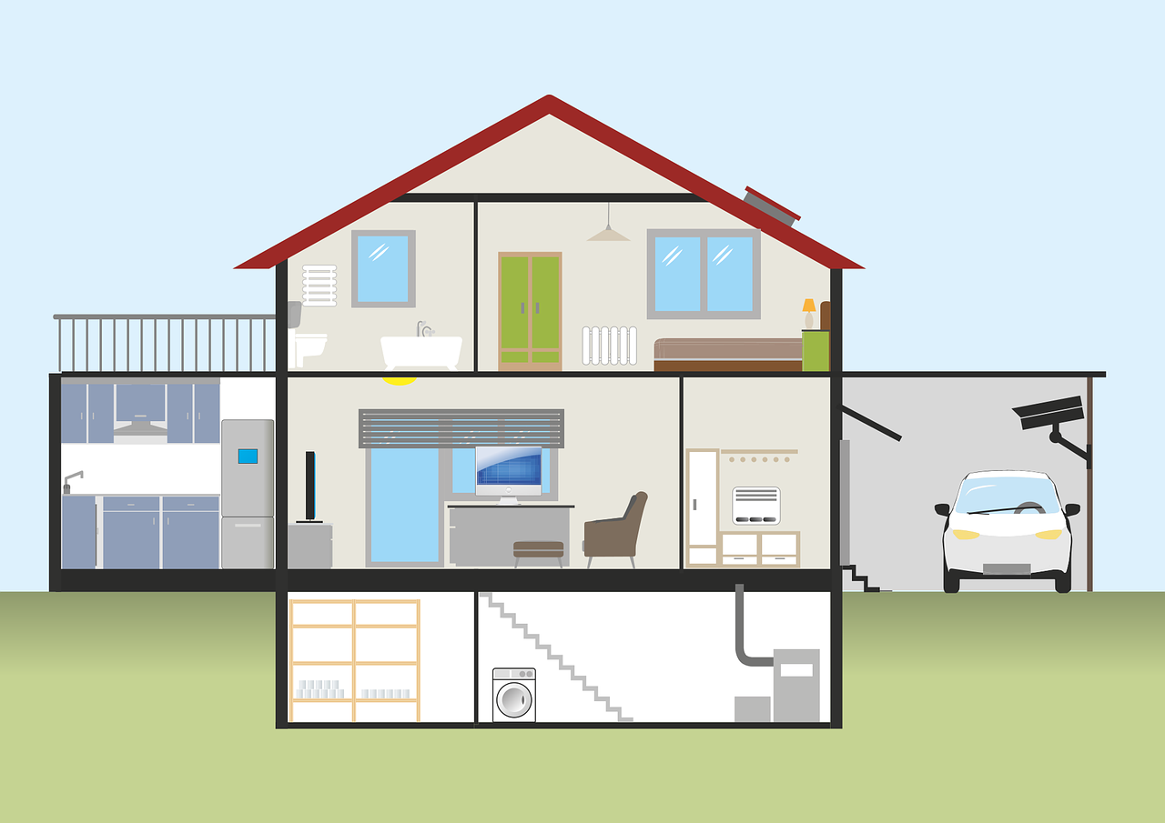

Look and say
What room is it?
It’s a bathroom.
What room is it?
It’s a bedroom.
It’s a kitchen.
What room is it?
What room is it?
It’s a living room.

Slide 31


Look and say
It’s a shower.
What is it?
What is it?
What is it?
It’s a bed.
It’s a TV.
What is it?
What is it?
It’s a table.

Slide 32
05
Wrap-up and Assessment

Slide 33
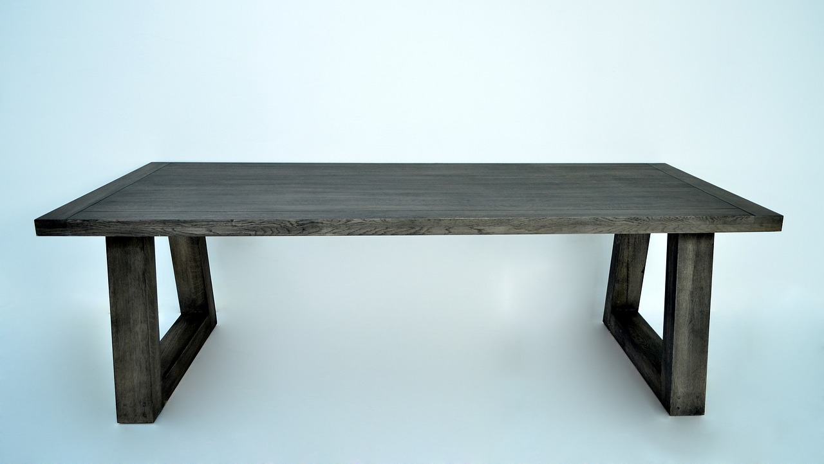
Match
bedroom
shower
living room
kitchen
TV
bed
bathroom
table

Slide 34
What have we learnt today?

Slide 35







Thank you
& good bye!

