Slide 1









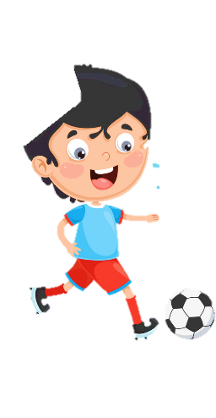












Welcome to my class 3A
Friday, March 7th 2025
Unit 8: My Town
Lesson 2 (4,5,6)

Slide 2

Hello song

Slide 4
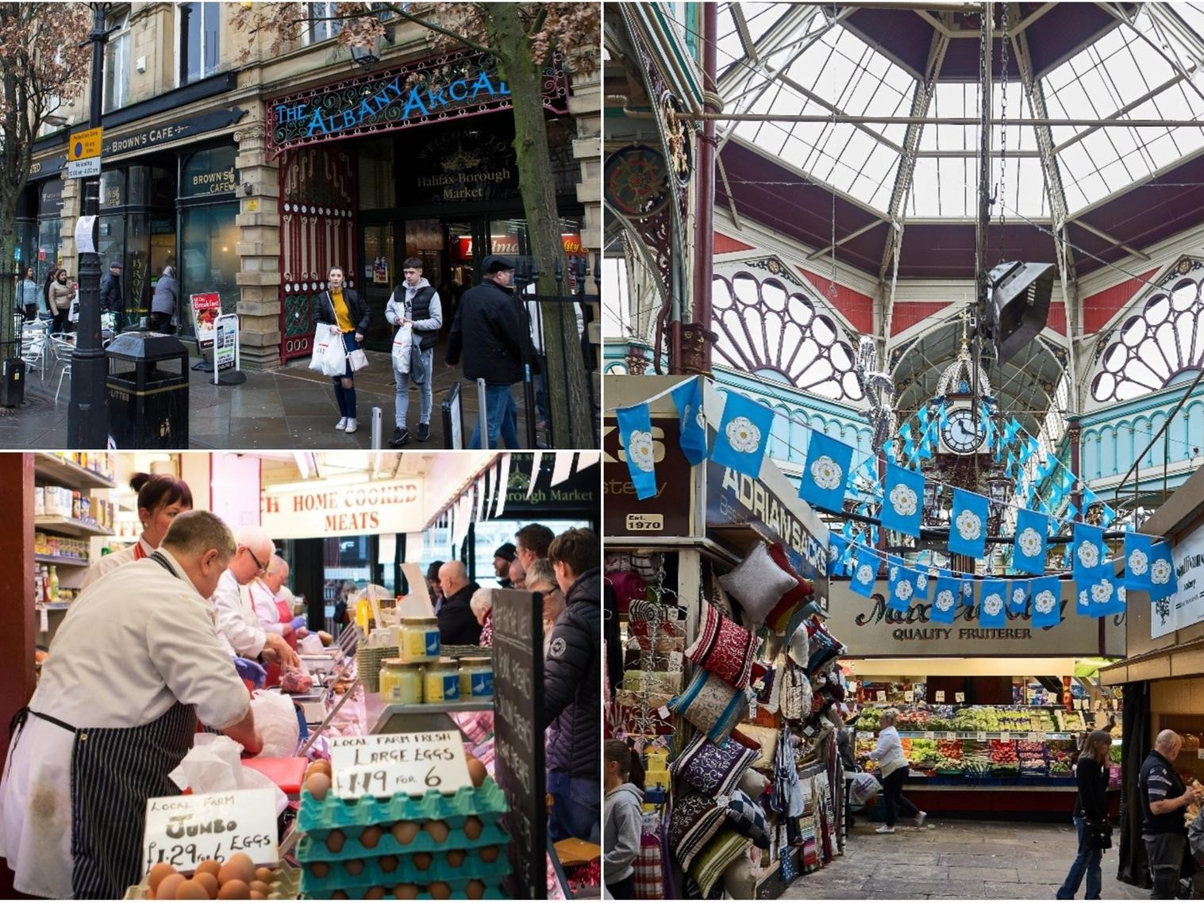
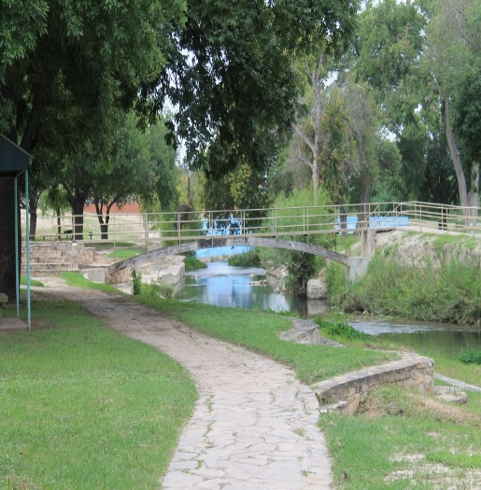
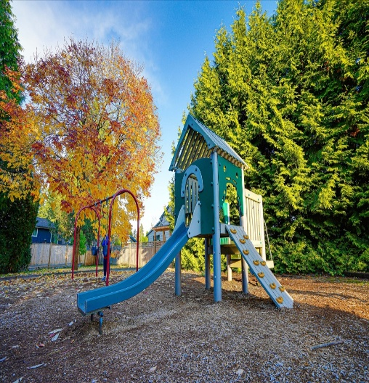
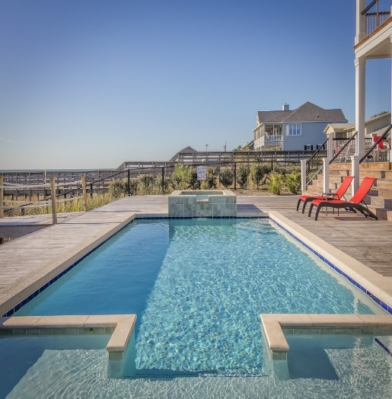
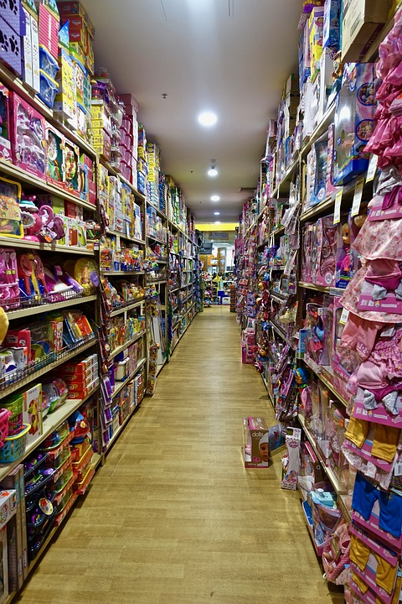
in the library
in the museum
at the theater
at the zoo
in the park
at the playground
in the pool
at the
toy shop
at the market

Slide 5






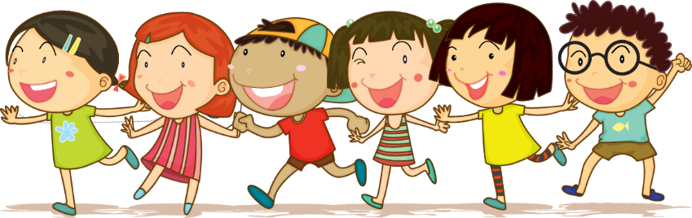



1 Warm up

Slide 6
Puzzle word
1
w | r | i | t | e
2
j | u | m | p
3
s | w | i | m
4
d | a | n | c | e
5
r | u | n
6
r | e | a | d
Next
Notes:
T clicks to numbers (1-6) to show the hints, clicks the puzzles to show the answers.

Slide 7
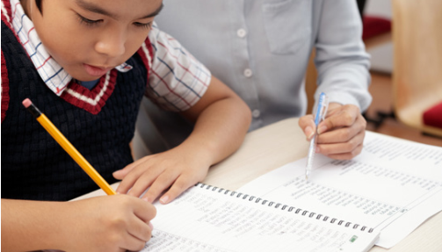
write
Back

Slide 8
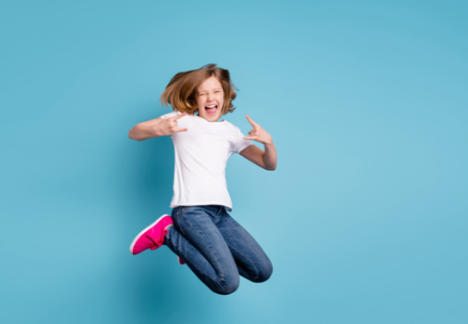
jump
Back

Slide 9
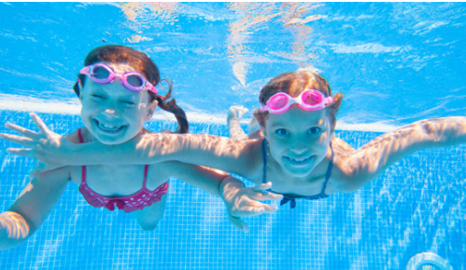
swim
Back

Slide 10
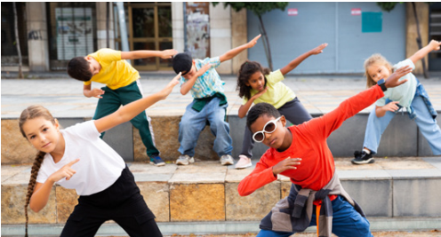
dance
Back

Slide 11
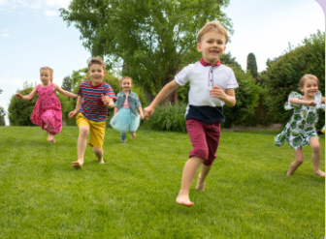
run
Back

Slide 12

read
Back

Slide 13
2 Presentation

Slide 14
in the library
in the museum
at the theater
at the zoo
in the park
at the playground
in the pool
at the
toy shop
at the market

Slide 15


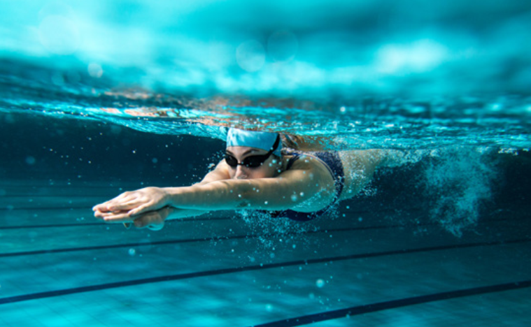
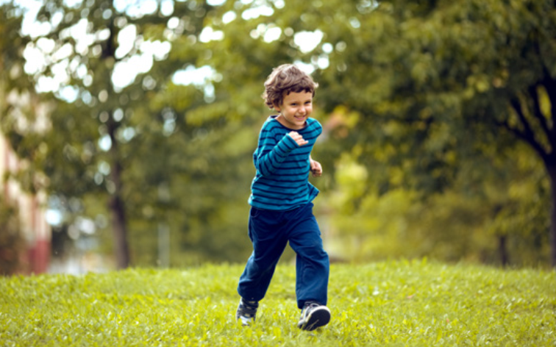
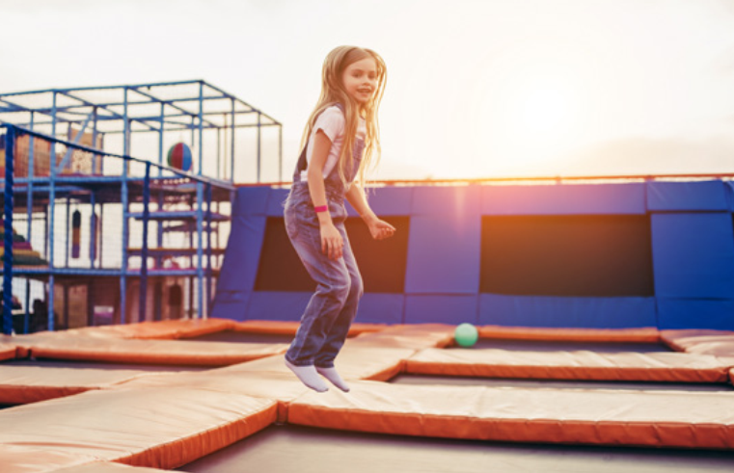
swimming
running
jumping

Slide 16

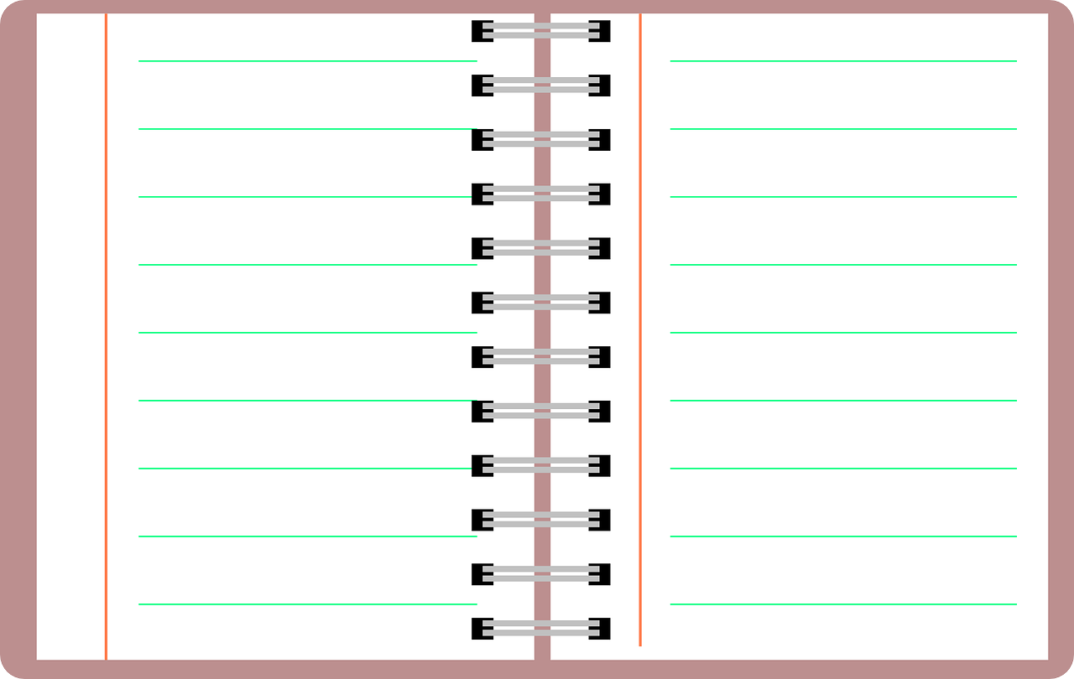
New structure
What are you doing?
I’m ____________.
What is he doing?
He’s __________.
What is she doing?
She’s __________.

Slide 17
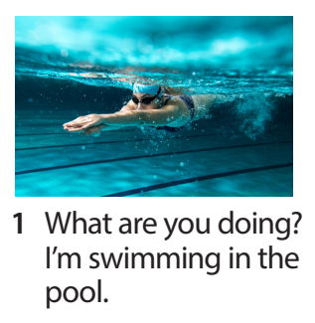
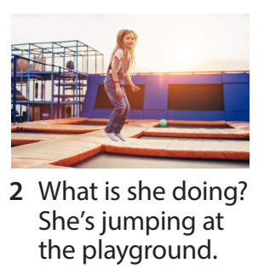
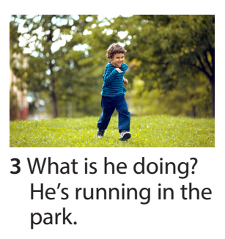
Task 4 Listen and repeat.

Slide 18

What are you doing? I’m ___
swimming
jumping
running

Slide 19
What is she/he doing? She’s ___
He’s
swimming
jumping
running

Slide 20
3 Practice

Slide 21
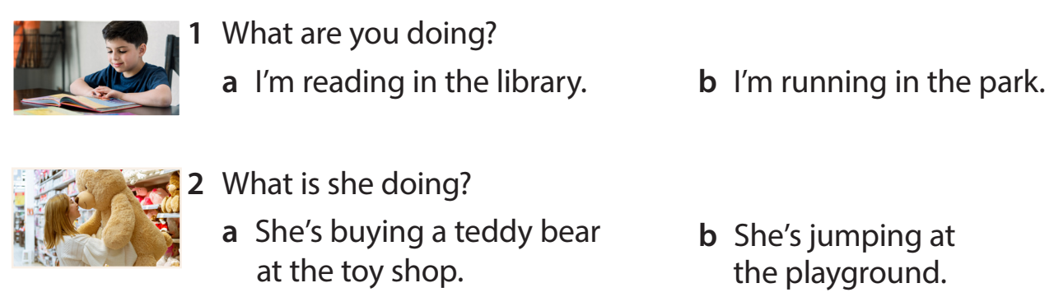
Task 5 Look and read. Circle and say.

Slide 22
4 Production

Slide 23
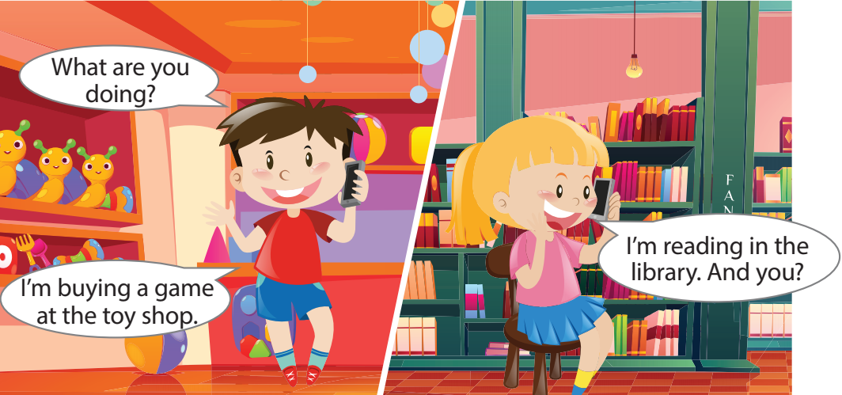
Task 6 Let’s talk.
Notes:
- Allow them enough time to make their own and practise the dialogue.
- Ask some volunteers to go to the broard to make a phone call( one is in the class, one is out of the class.)

Slide 24
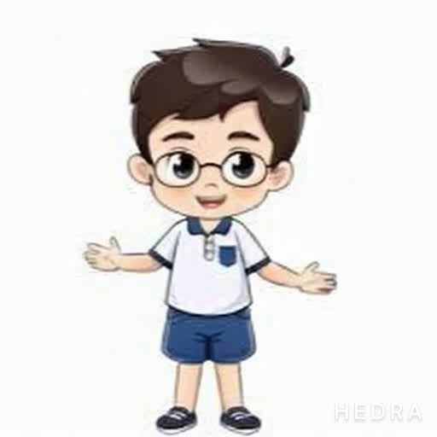
Hi guys, I’m Minh. I’m in class 3A at Gia Khanh primary school. Now I’m reading in the library. What about you? What are you doing?

Slide 25
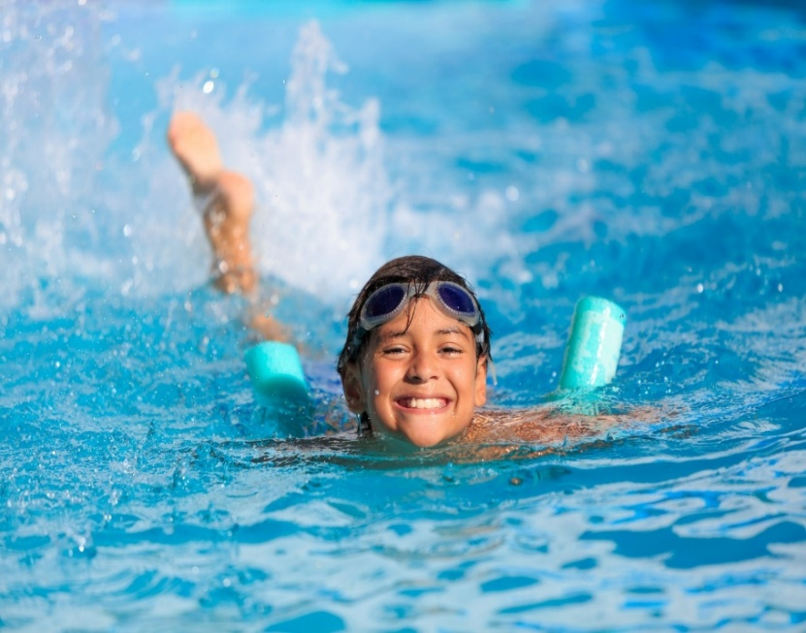
Hi guys, I’m Minh. I’m in class 3A at Gia Khanh primary school. Now I’m reading in the library. What about you? What are you doing?

Slide 26
5 Assessment

Slide 27
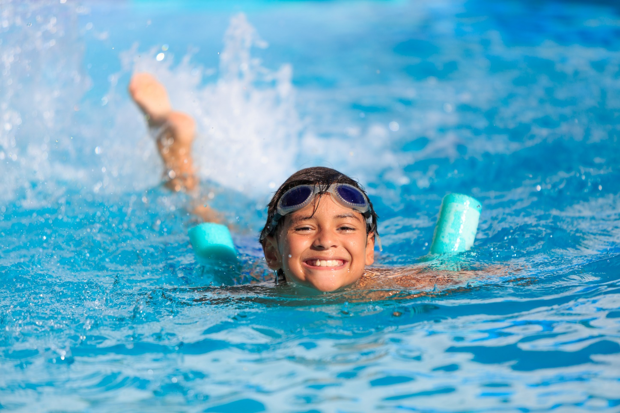
What is he doing?
A. He’s swimming in the pool.
B. I’m swimming in the pool
C. She’s swimming in the pool .

Slide 28
What is she doing?
I’m jumping.
He’s jumping.
She’s jumping.

Slide 29
What is he doing?
A. She’ running in the park.
B. He’ running in the park.
C. I’m running in the park.

Slide 30
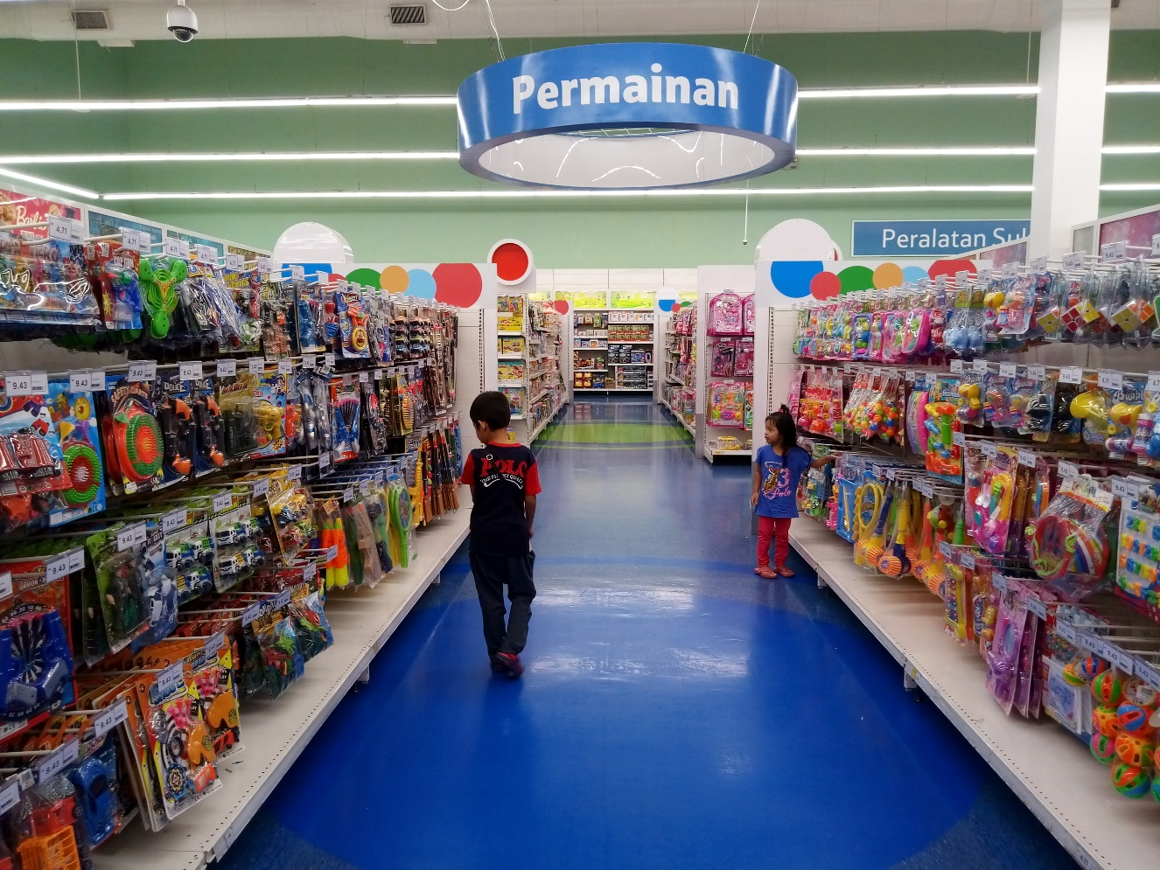
Fill in the blank.
We’re ______ balls at the toy shop now.
buying

Slide 31




Thank you & goodbye!

Slide 32
New structure
What are you doing?
I’m ____________.
What is he doing?
He’s __________.
What is she doing?
She’s __________.
What are they doing?
They’re__________.

Slide 33
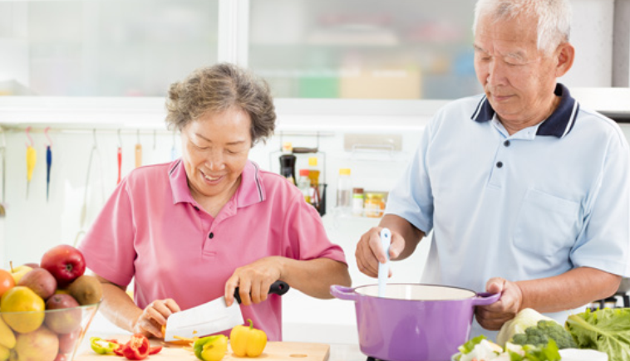
Fill in the blank.
They ’re ______ in the kitchen.
cooking

