Slide 1





















Unit 3
COLOURS
Lesson 2 Grammar

Slide 2





Table of contents
01
02
Warm-up
Presentation
05
04
Wrap-up & Assessment
Production
03
Practice

Slide 3










1 Warm-up

Slide 4








Slide 5
2 Presentation

Slide 6

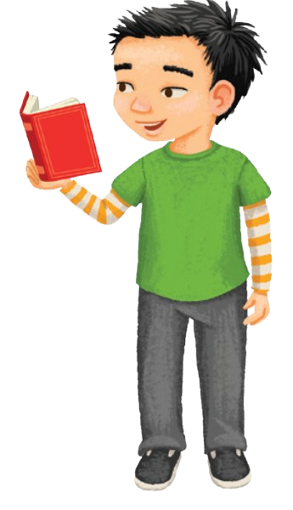
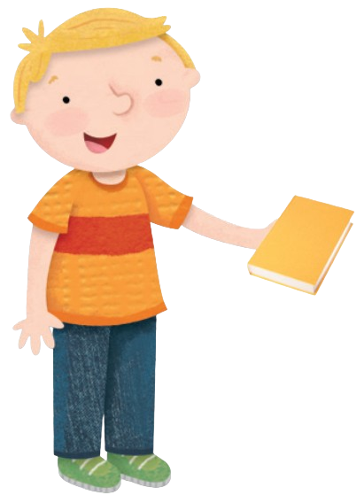
A. Listen and repeat.
It’s yellow.
It’s red.

Slide 7
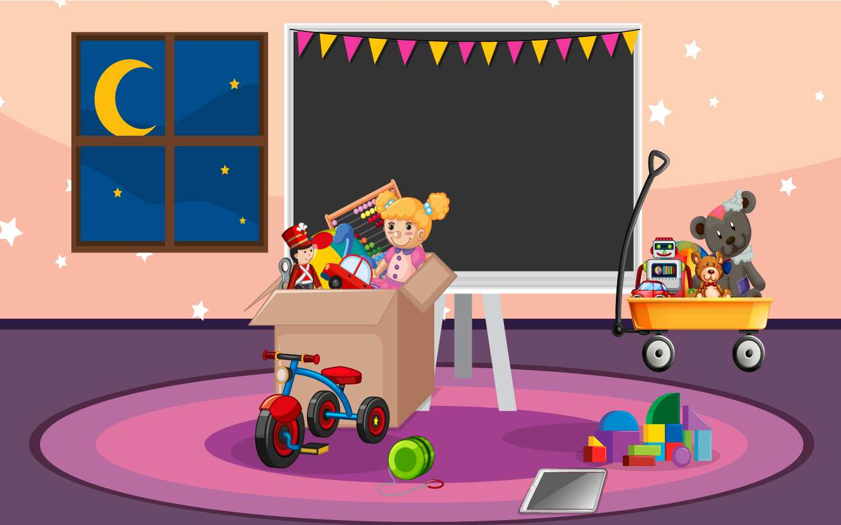
Look at the picture and say.

Slide 8
red
It’s ___.

Slide 9

blue
It’s ___.

Slide 10
green
It’s ______.

Slide 11
black
It’s ______.

Slide 12
It’s ______.
yellow

Slide 14
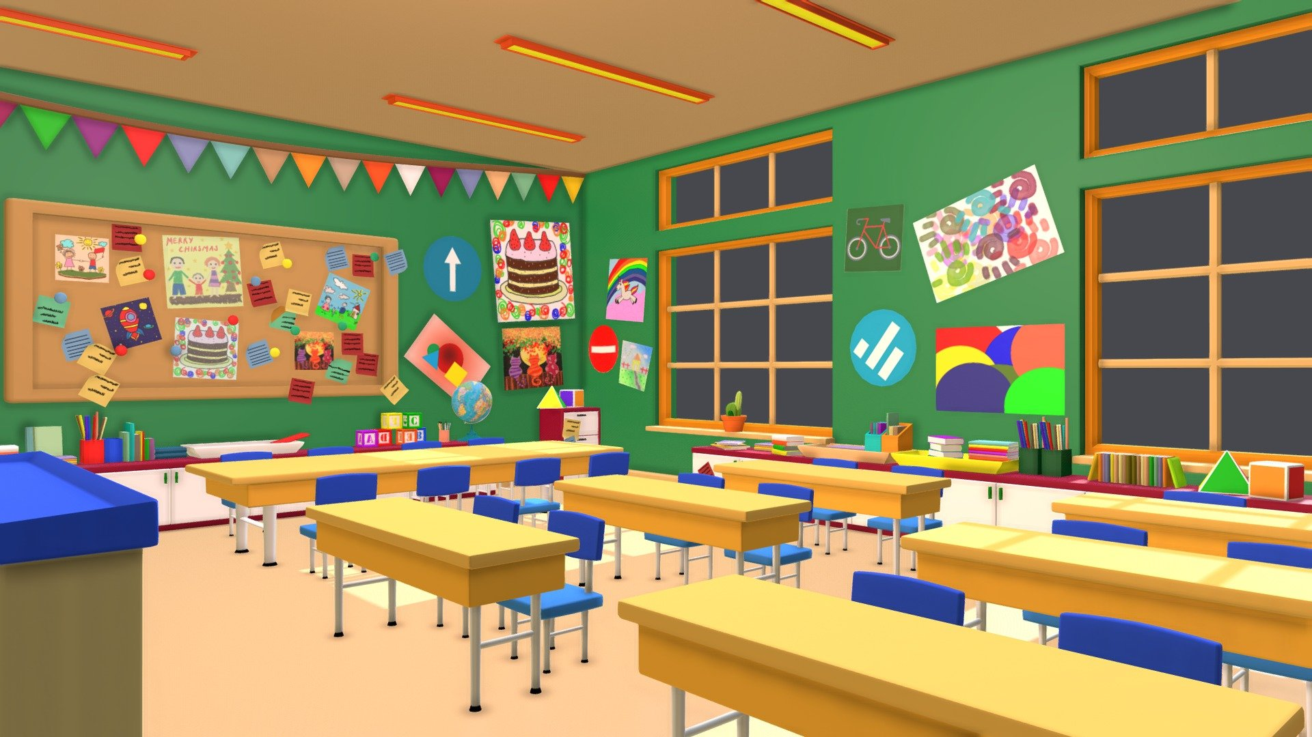
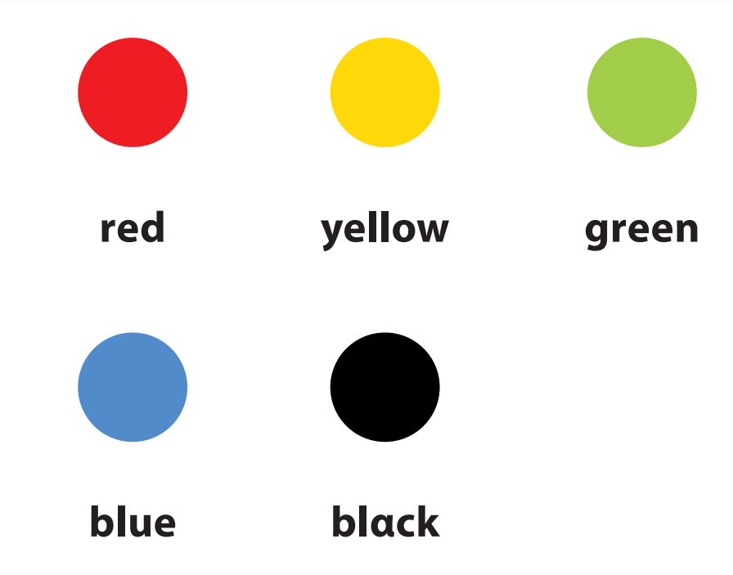
It’s

Slide 15
3 Practice

Slide 16

Let’s play a game!

Slide 17












BLIND BOX

Slide 18




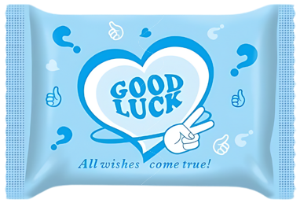


NEXT
Notes:
Chọn 1 túi mù “blind box”
Trả lời câu hỏi
Click vào hình món quà để nhận quà/điểm
Sau khi nhận quà, click vào nút “home” để quay trở lại slide này
Click “next” để chuyển sang phần 4 Production

Slide 19







It’s _______.
A. red
B. yellow
C. green
D. blue
Notes:
Click the present to see the points

Slide 20



It’s ______.
A. green
B. blue
C. red
D. black
Notes:
Click the present to see the points

Slide 21

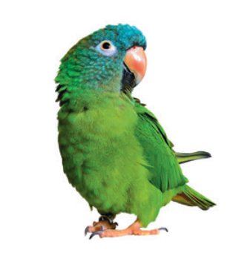


It’s ______.
A. green
B. black
C. red
D. yellow
Notes:
Click the present to see the points

Slide 22
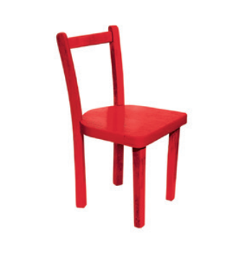
It’s ______.
A. blue
B. red
C. yellow
D. green
Notes:
Click the present to see the points

Slide 23
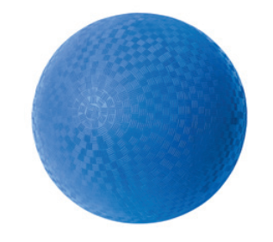
It’s ______.
A. red
B. green
C. black
D. blue
Notes:
Click the present to see the points

Slide 24



Congratulation!
+ 1 TURN TO PLAY
HOME

Slide 25
Congratulation!
+ 5 POINTS
HOME
Notes:
Click “home” to get back to the game slide

Slide 26
Congratulation!
+ 15 POINTS
HOME

Slide 27




Congratulation!
+ 3 POINTS
HOME

Slide 28
Congratulation!
+ 7 POINTS
HOME

Slide 29

Congratulation!
+ 4 POINTS
HOME

Slide 30
Congratulation!
+ 20 POINTS
HOME

Slide 31
Congratulation!
+ 10 POINTS
HOME

Slide 32
4 Production

Slide 33
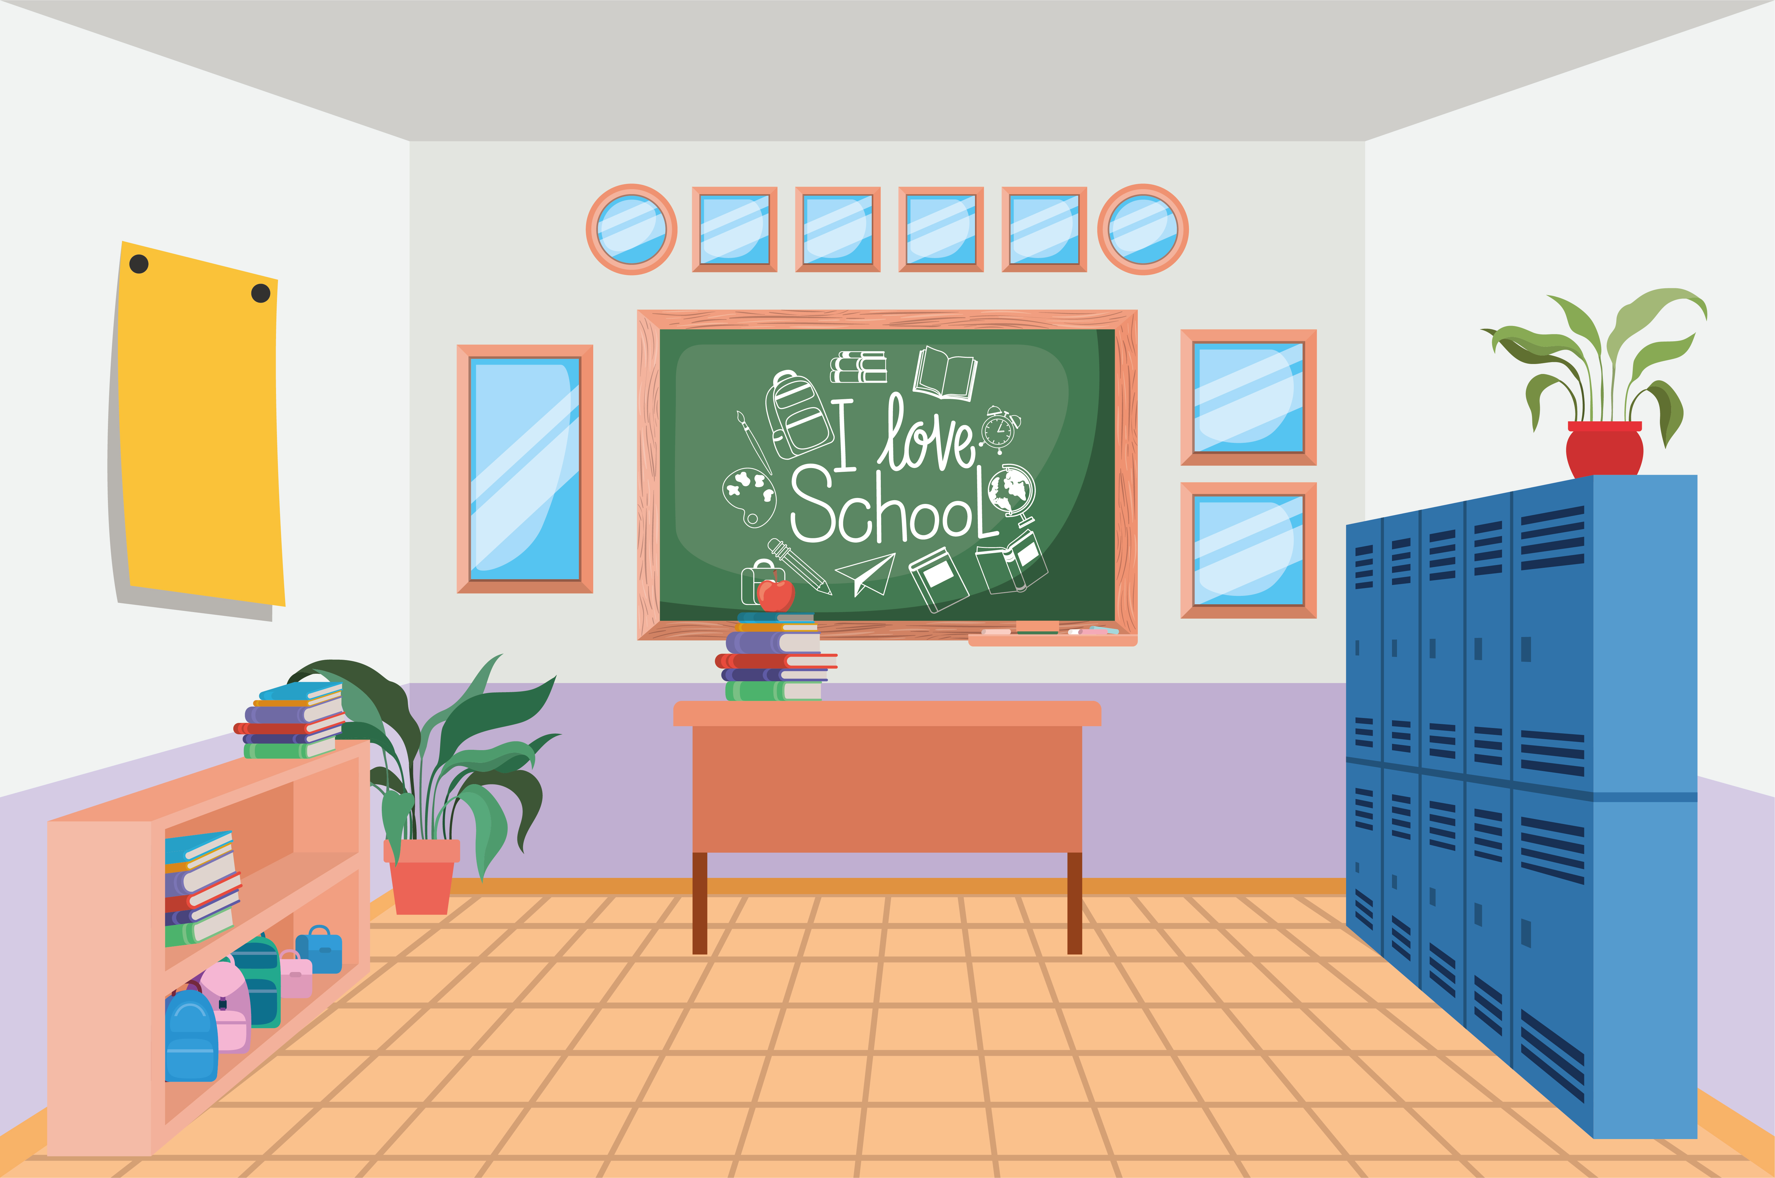
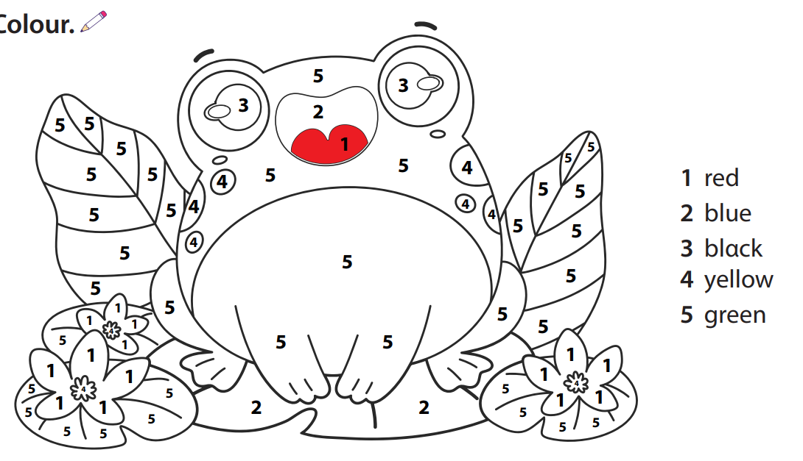
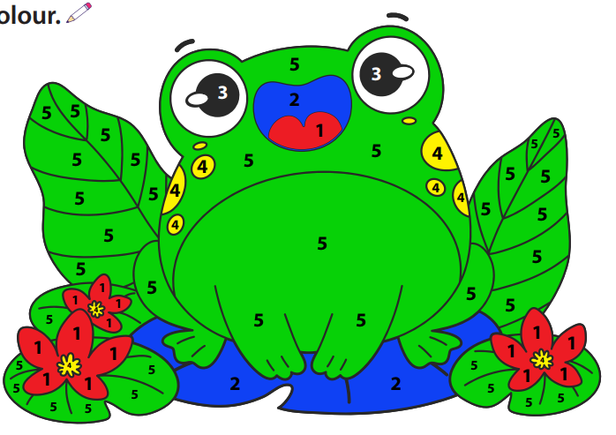
C. Colour and say.
It’s _____.

Slide 34
5 Wrap-up & Assessment

Slide 35
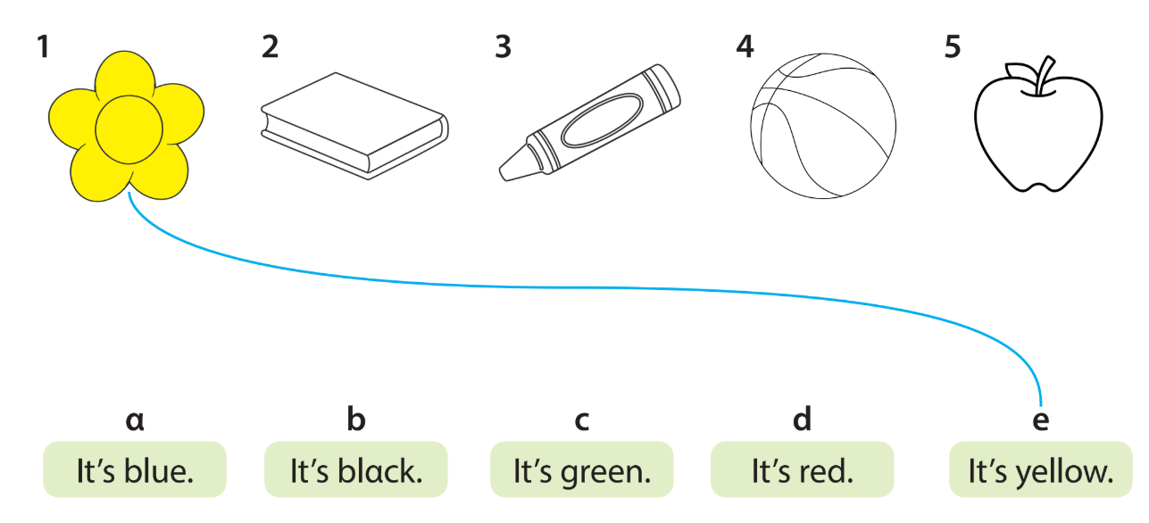
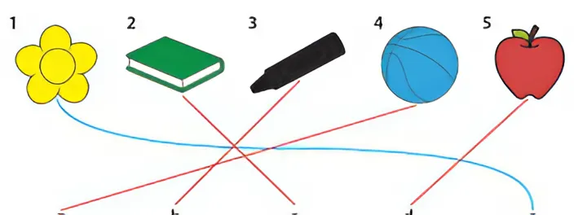
Listen and match.

Slide 36
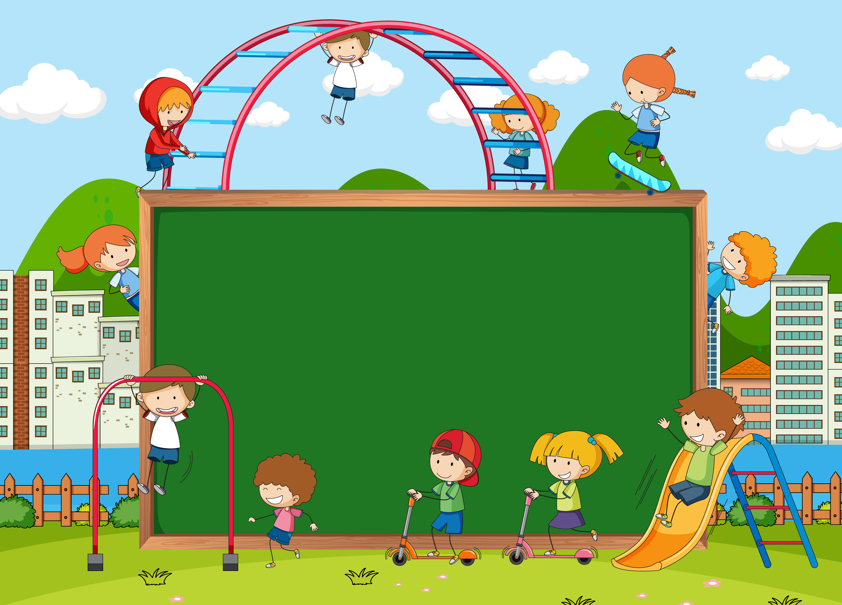
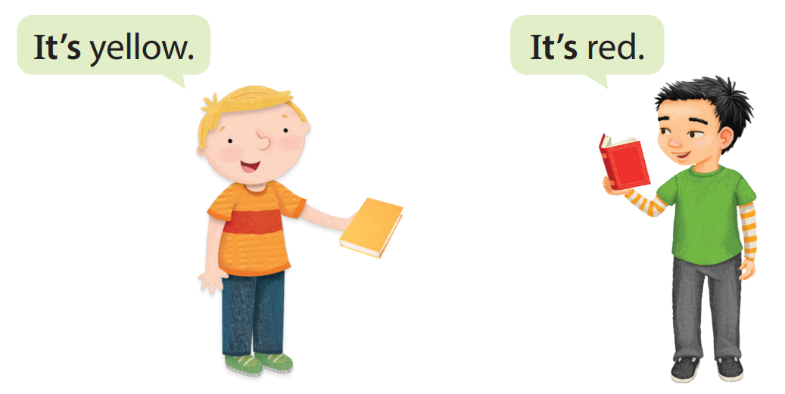
Unit 3:
COLOURS
What have we learnt today?

Slide 37




Thank you & goodbye!

