Slide 3
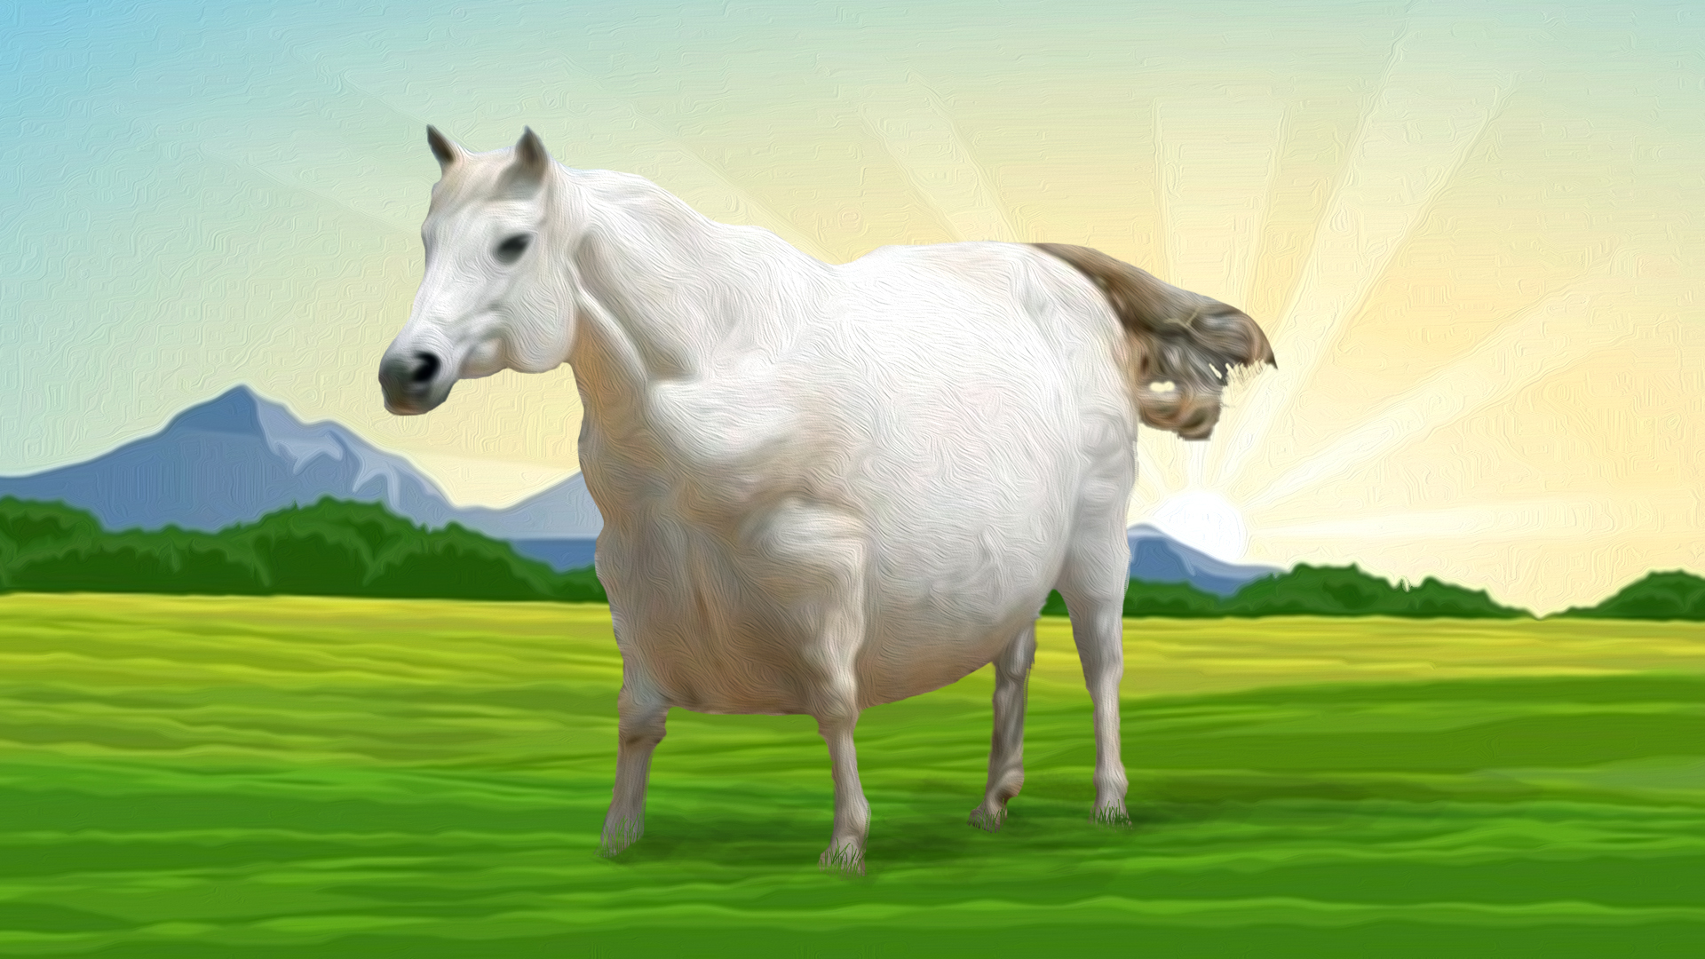
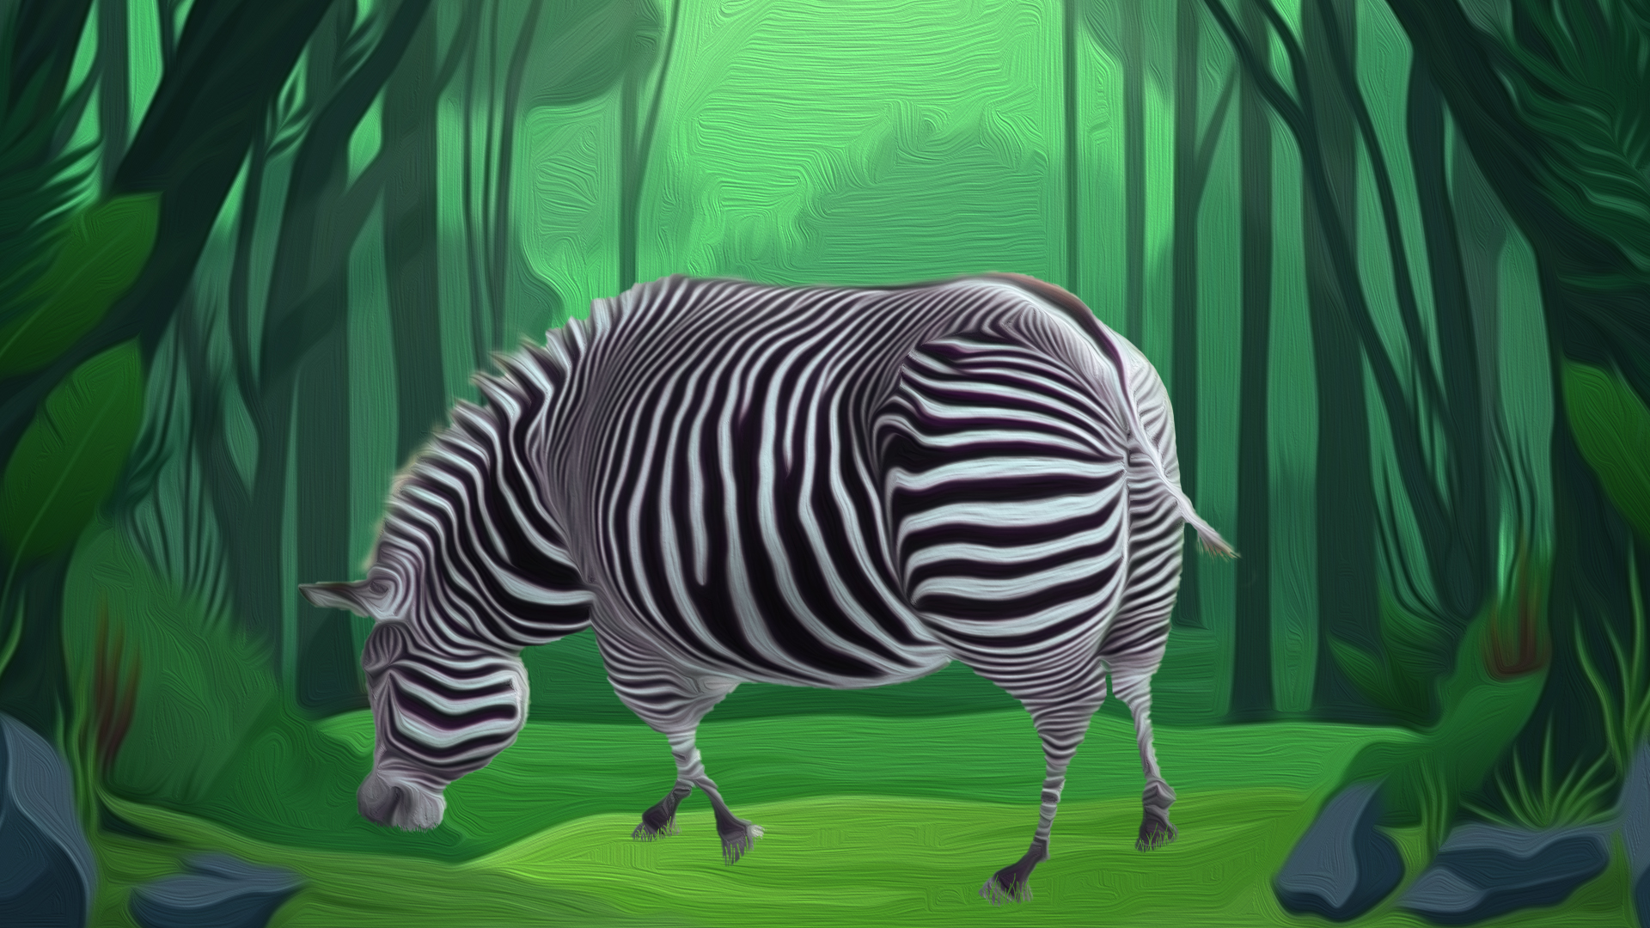
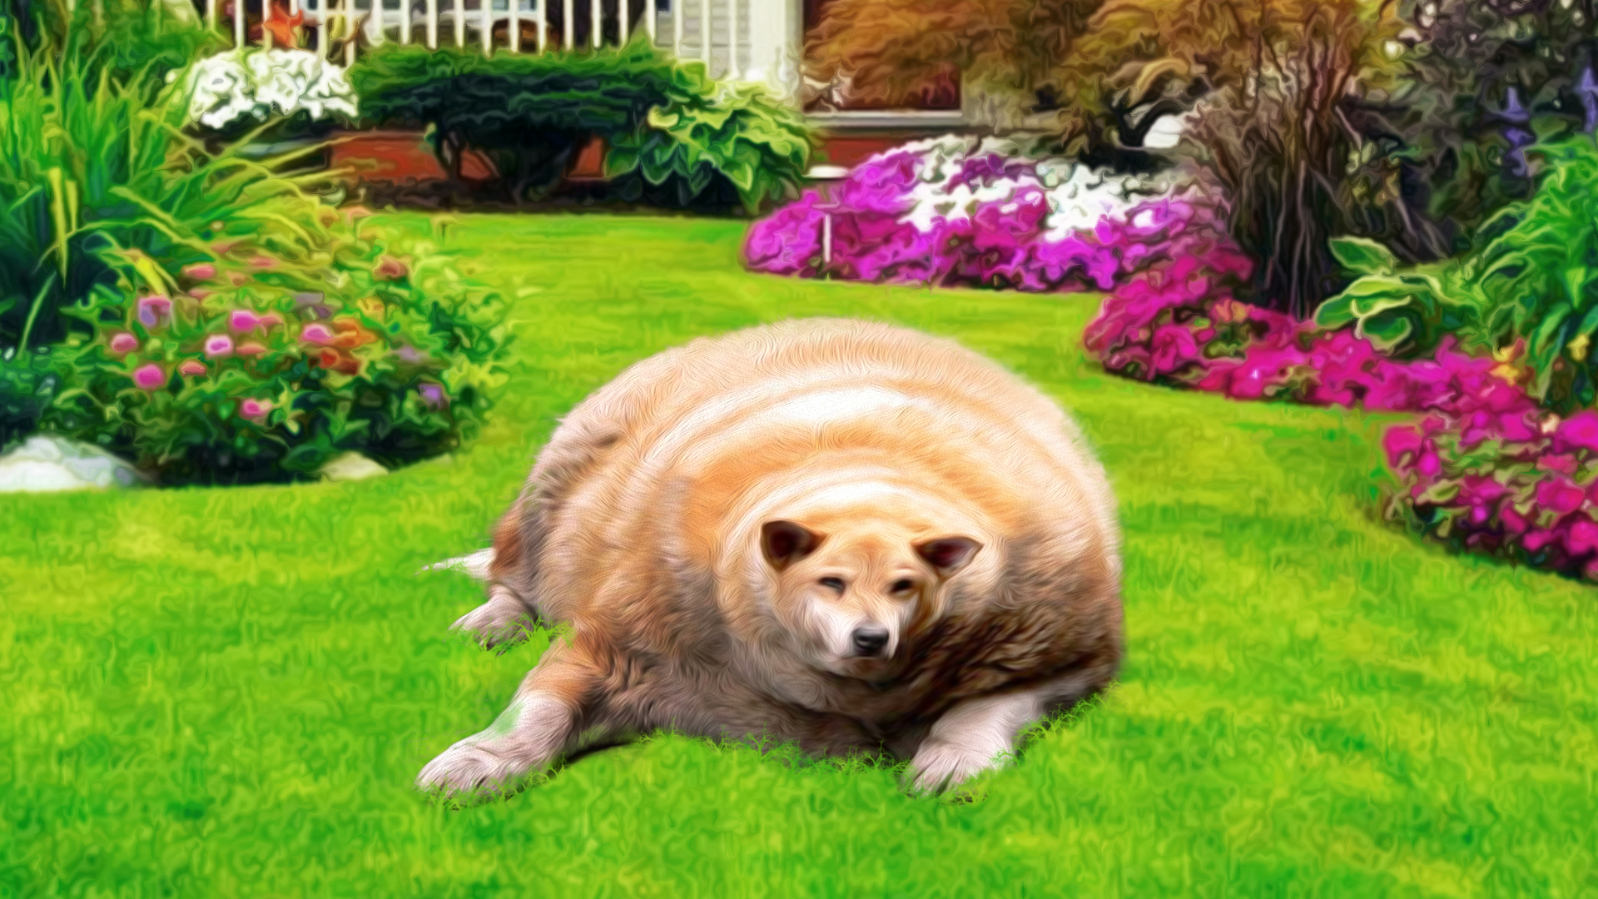
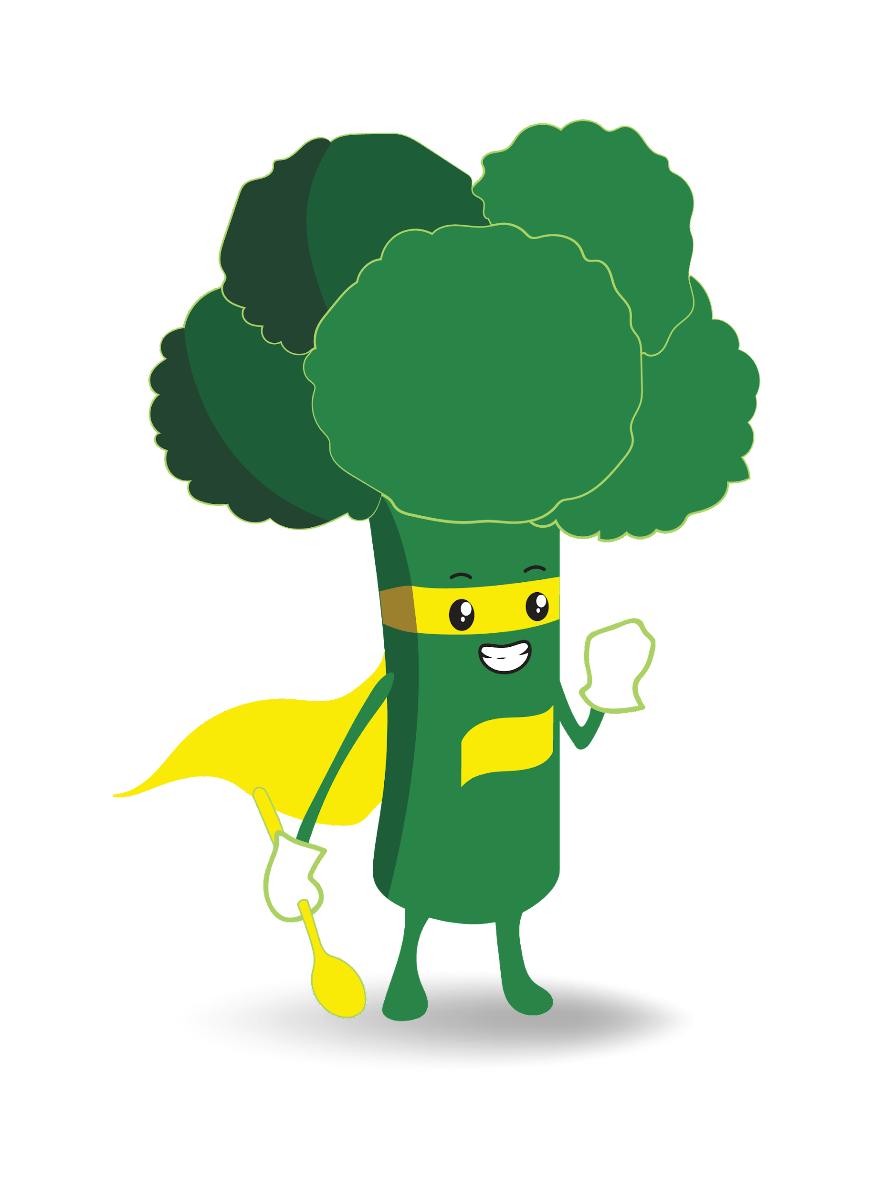

Slide 4
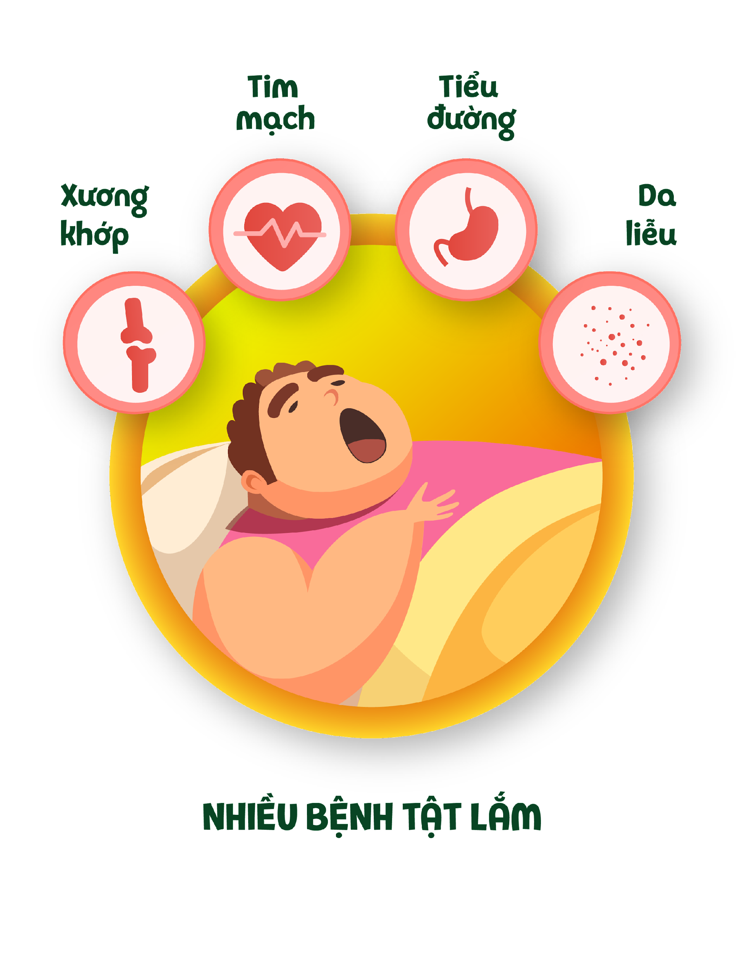

Slide 6
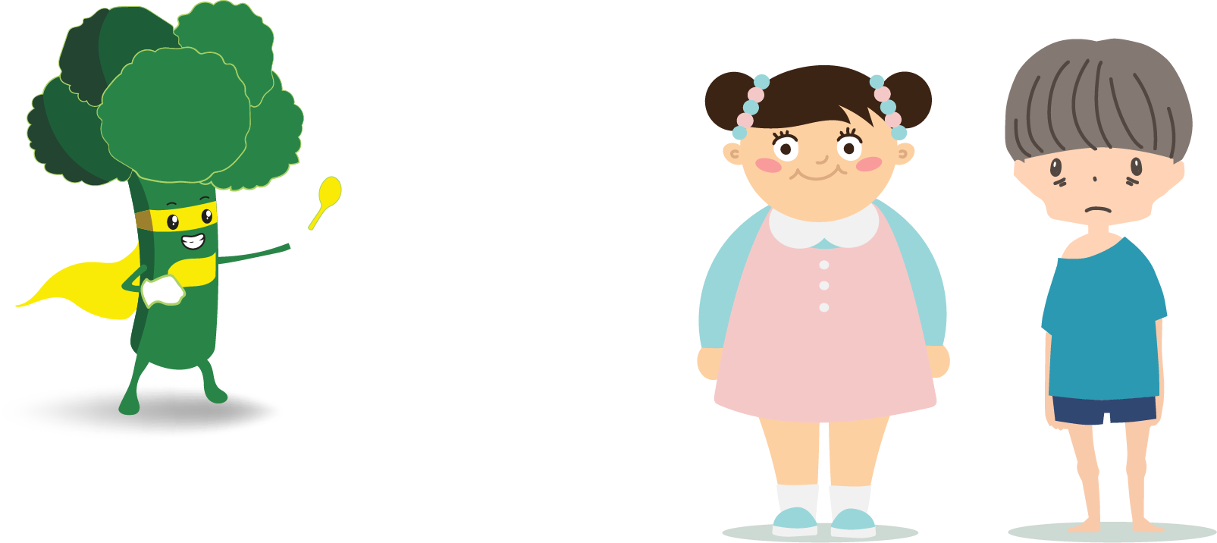

Slide 8
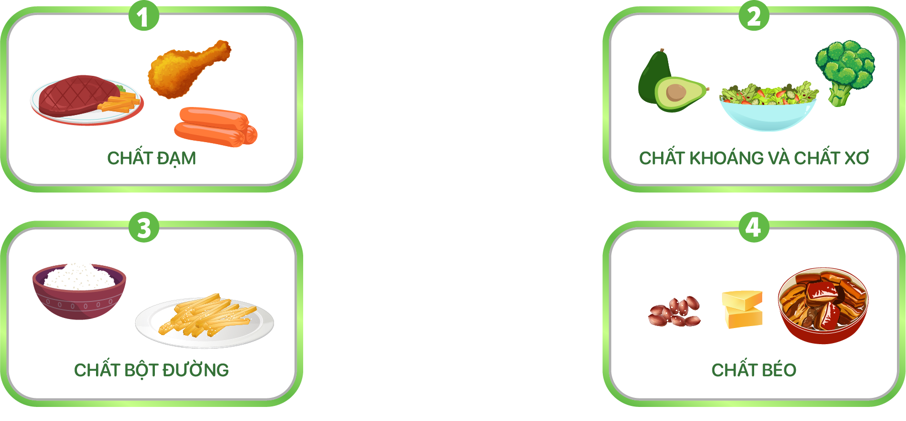

Slide 9
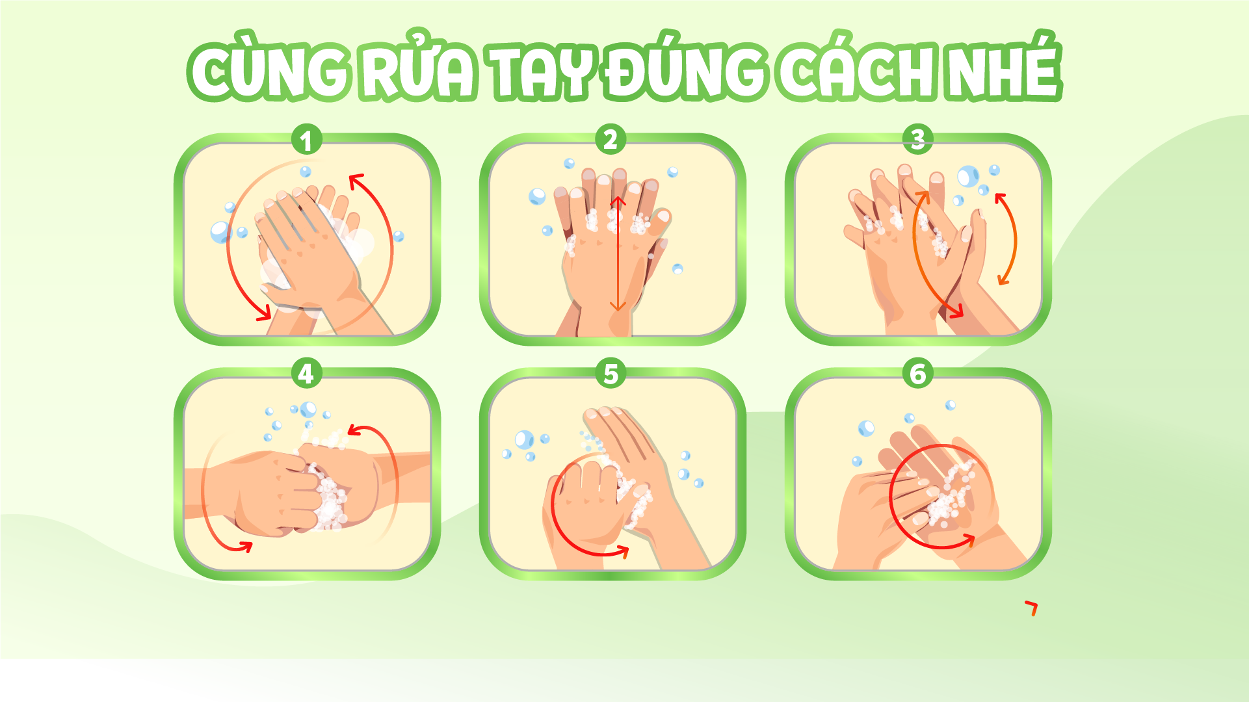

Slide 11
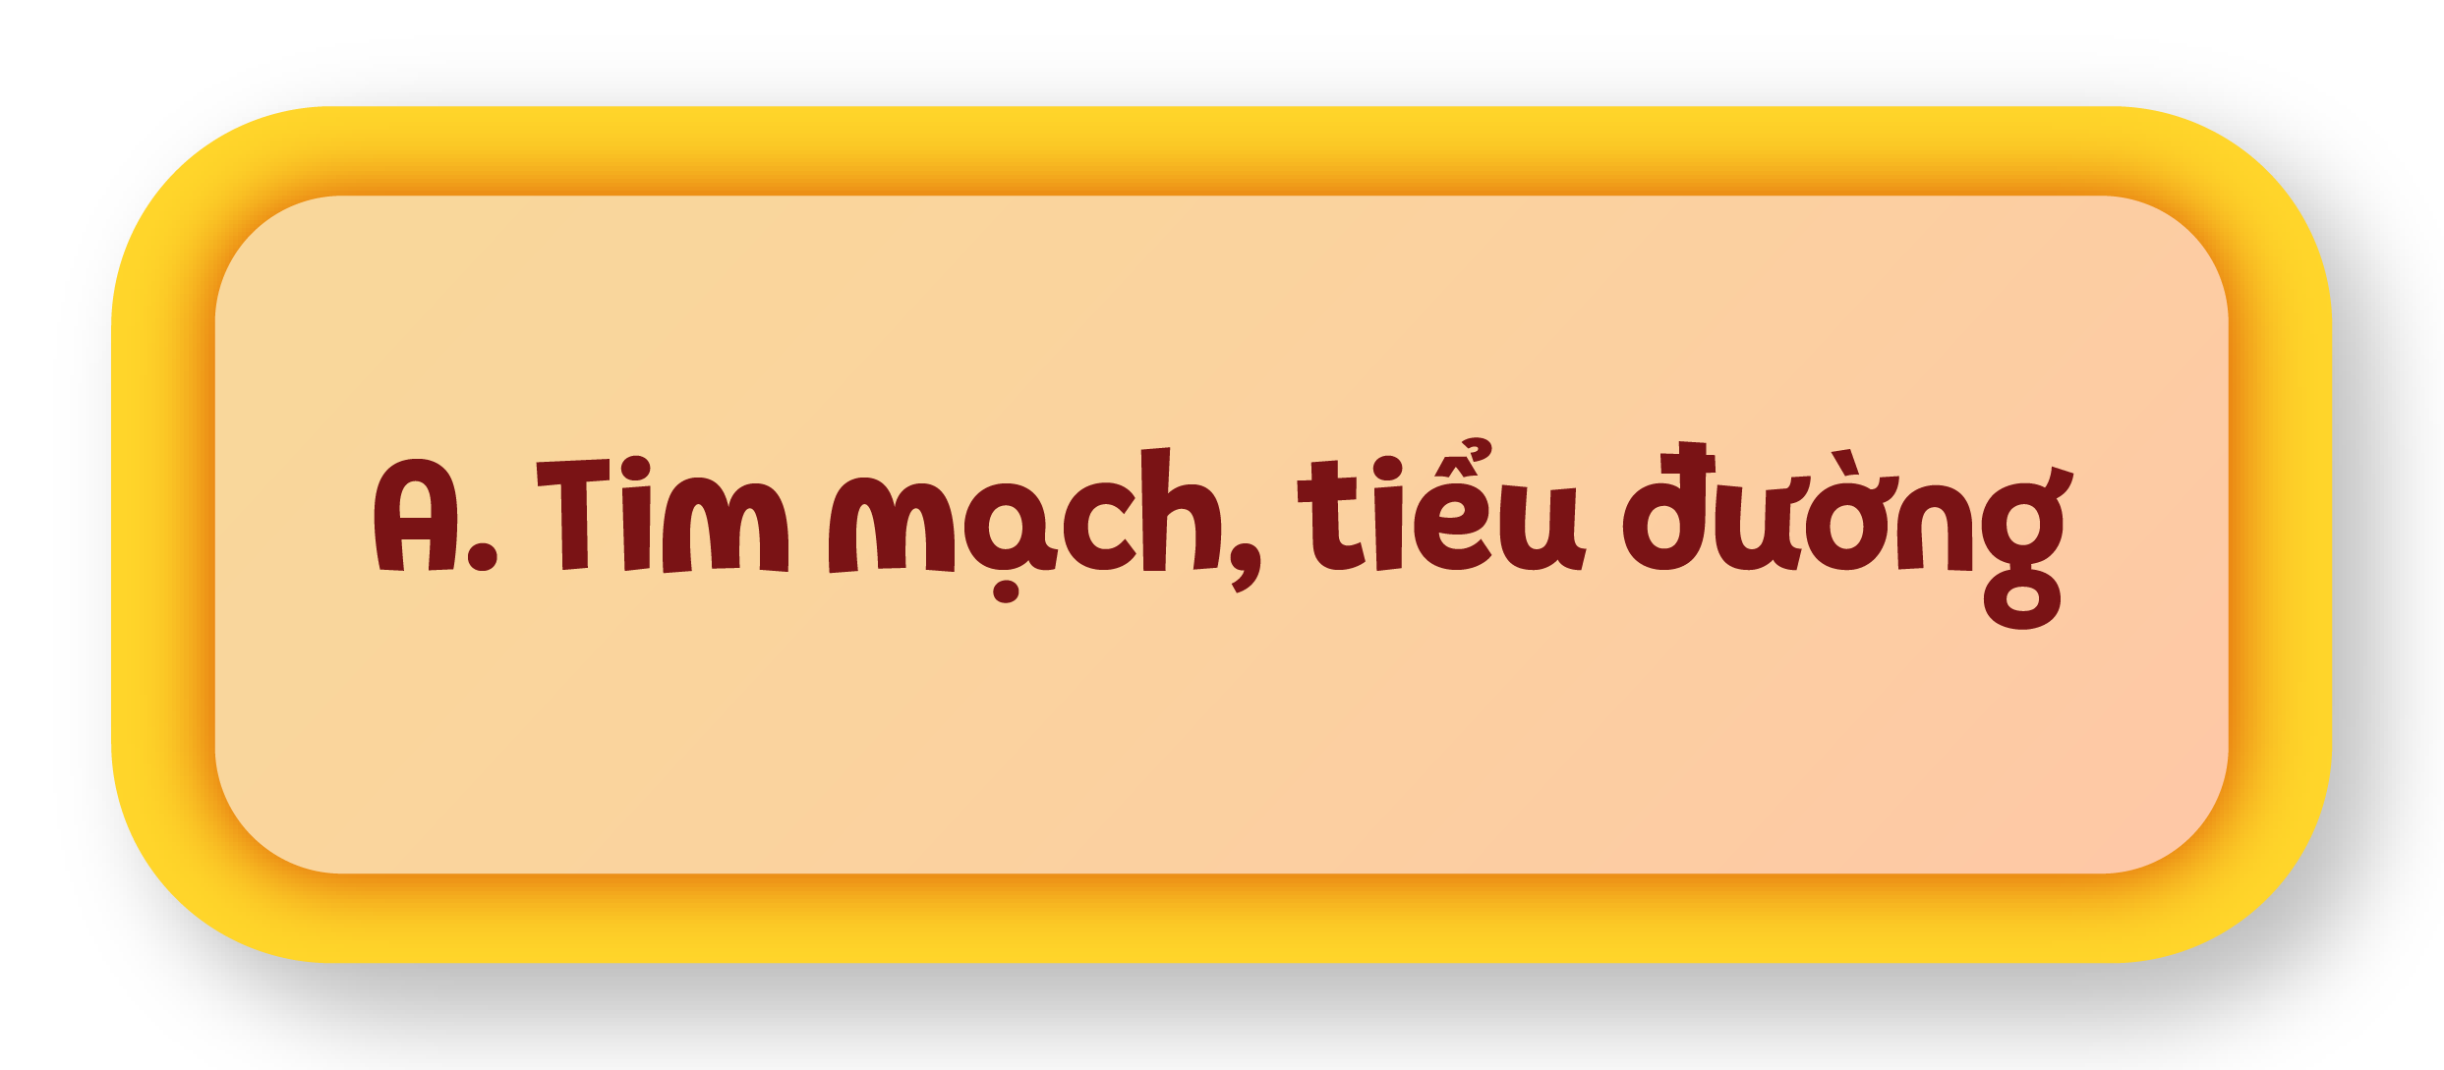
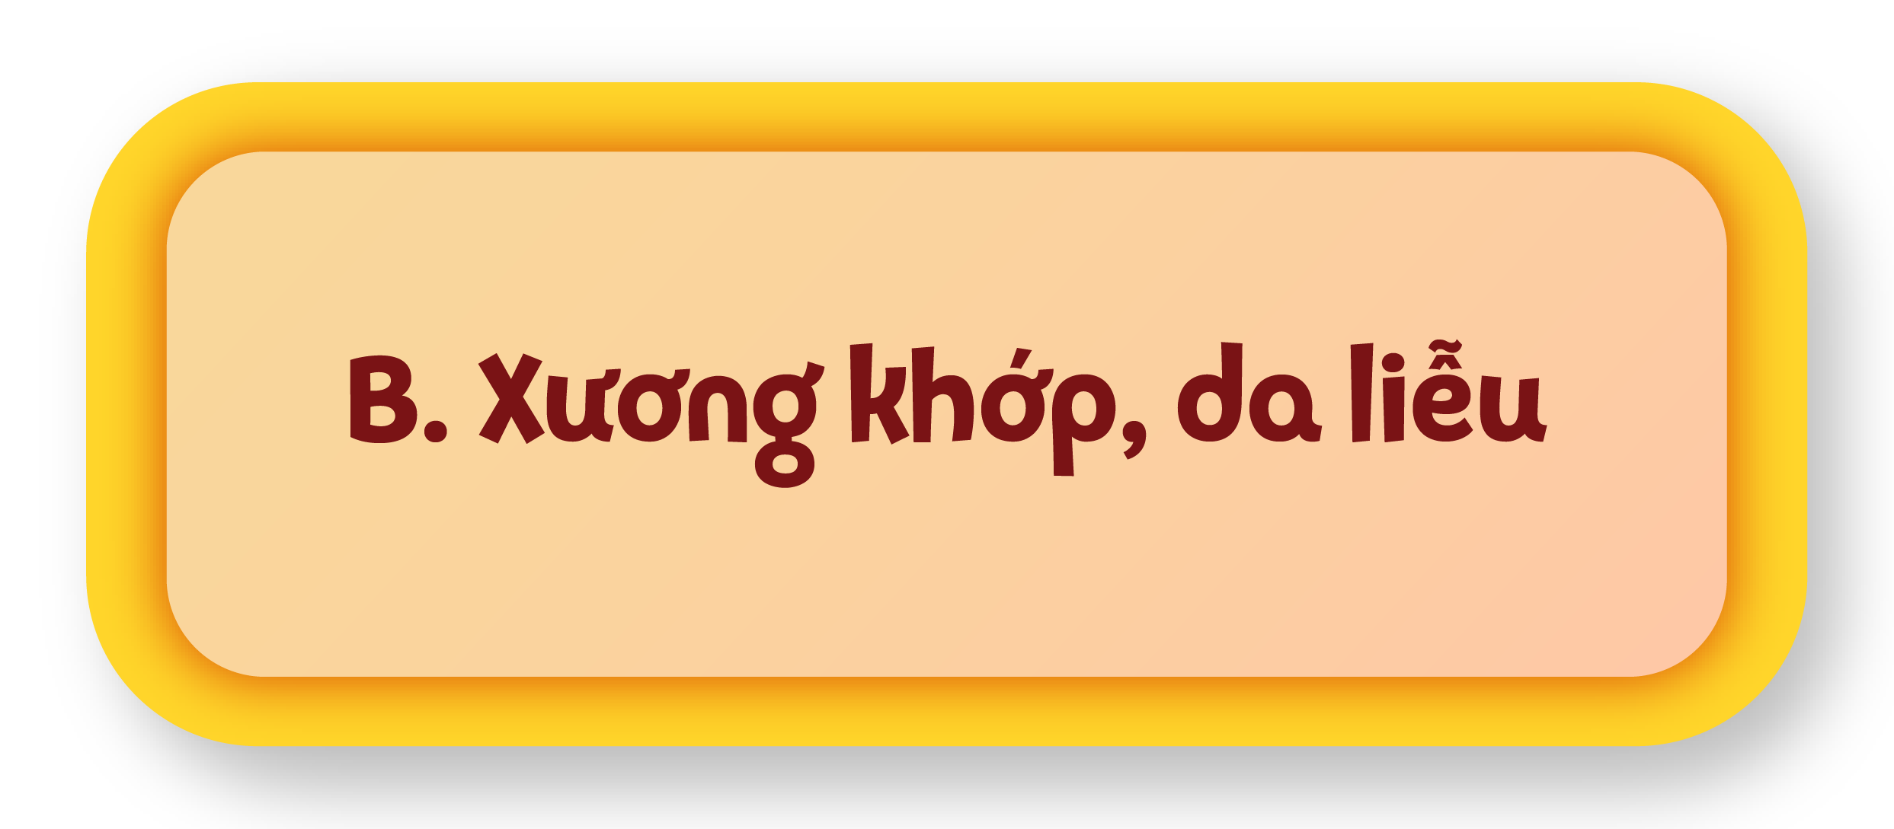
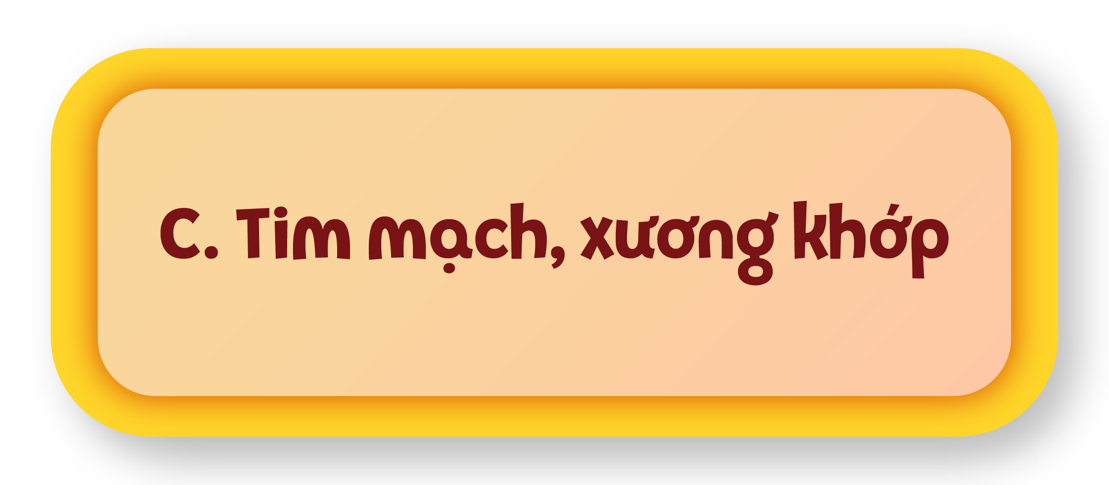
00:09
00:08
00:07
00:06
00:05
00:04
00:03
00:02
00:01
00:15
00:14
00:13
00:12
00:11
00:10
Kết thúc
Bắt đầu

Slide 12
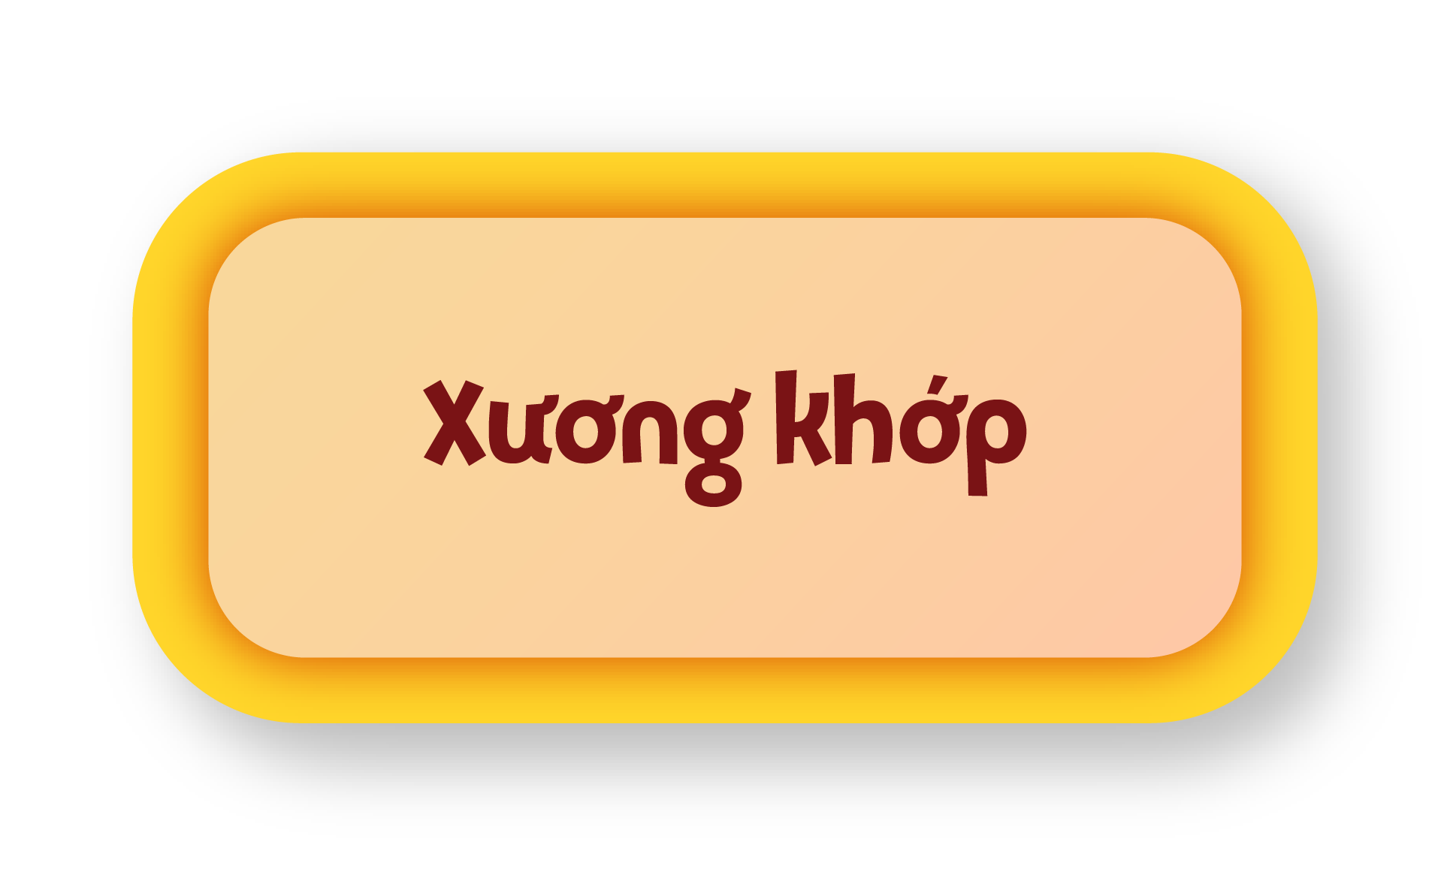
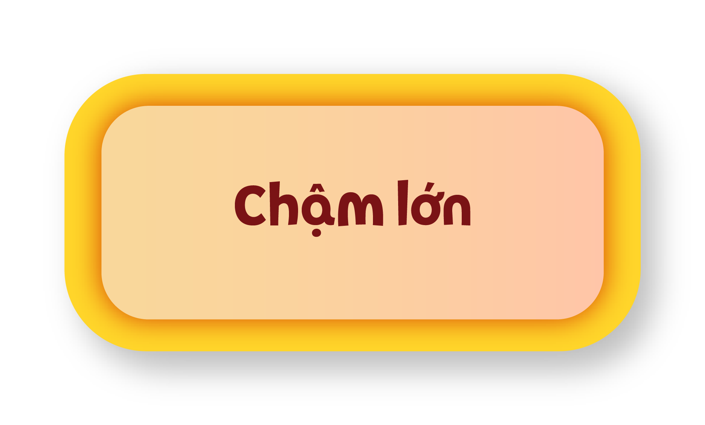
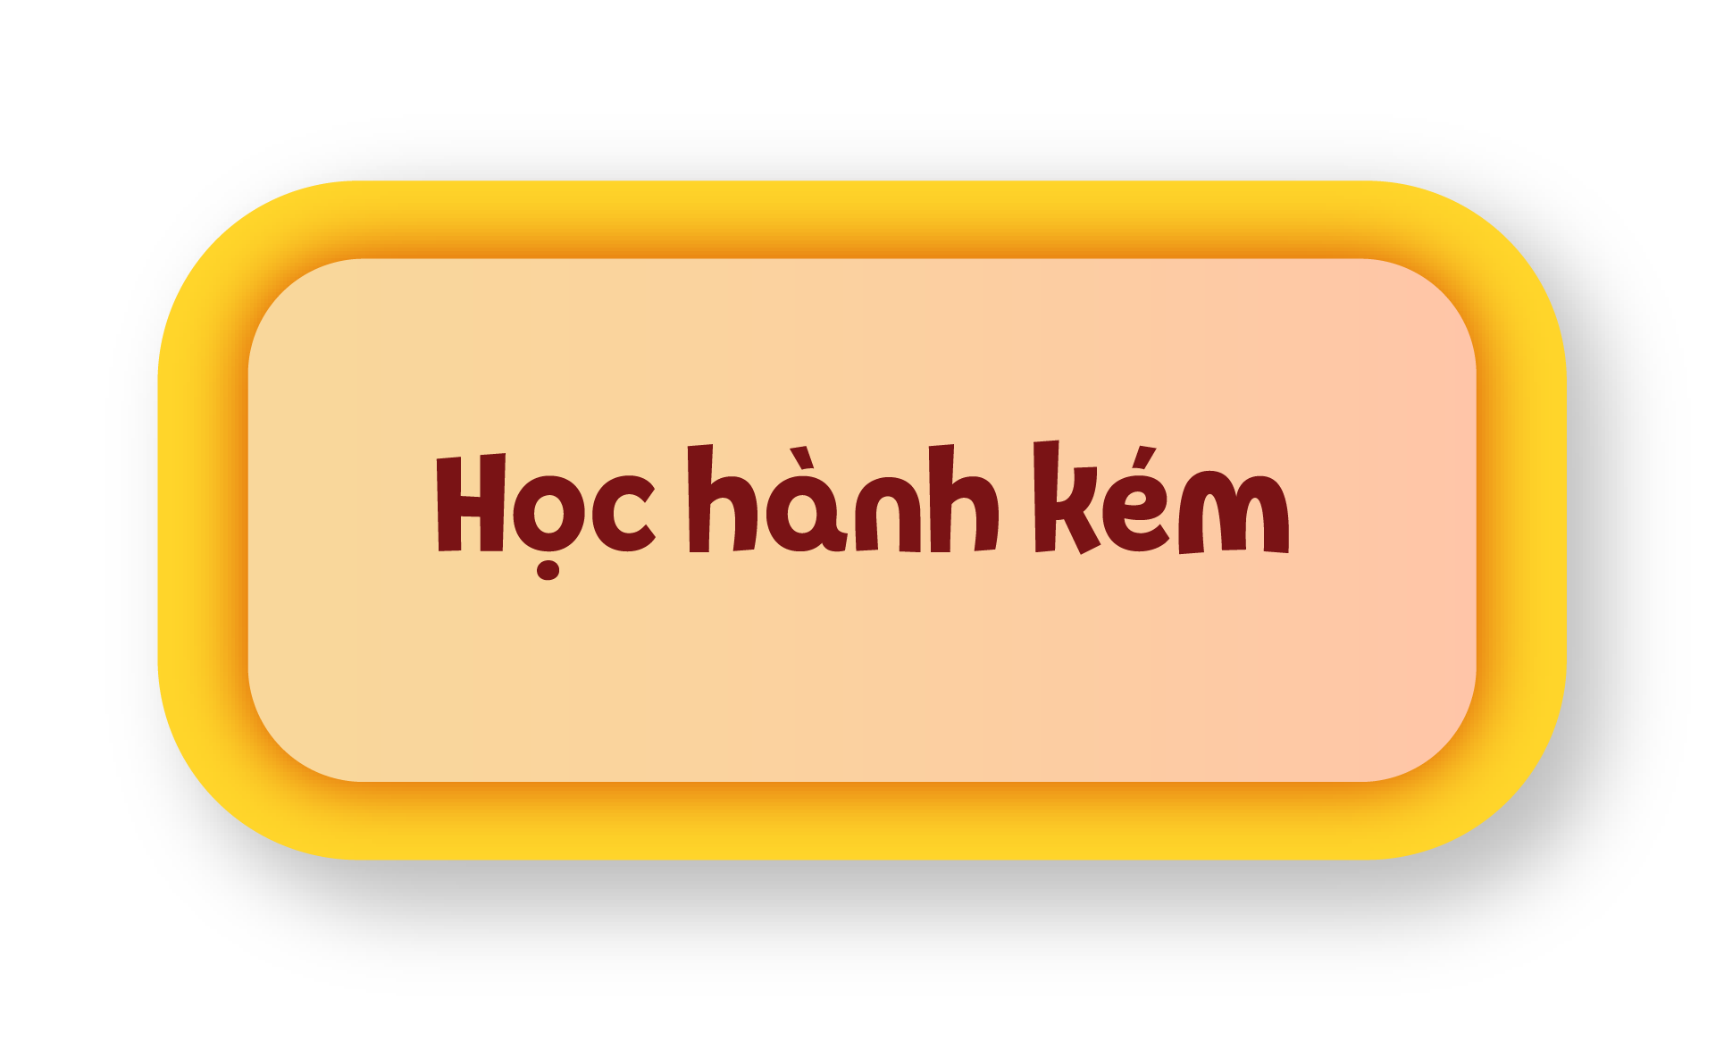
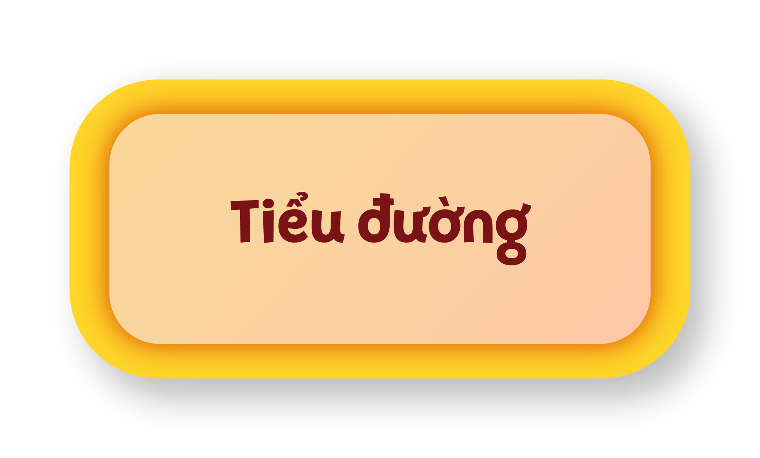
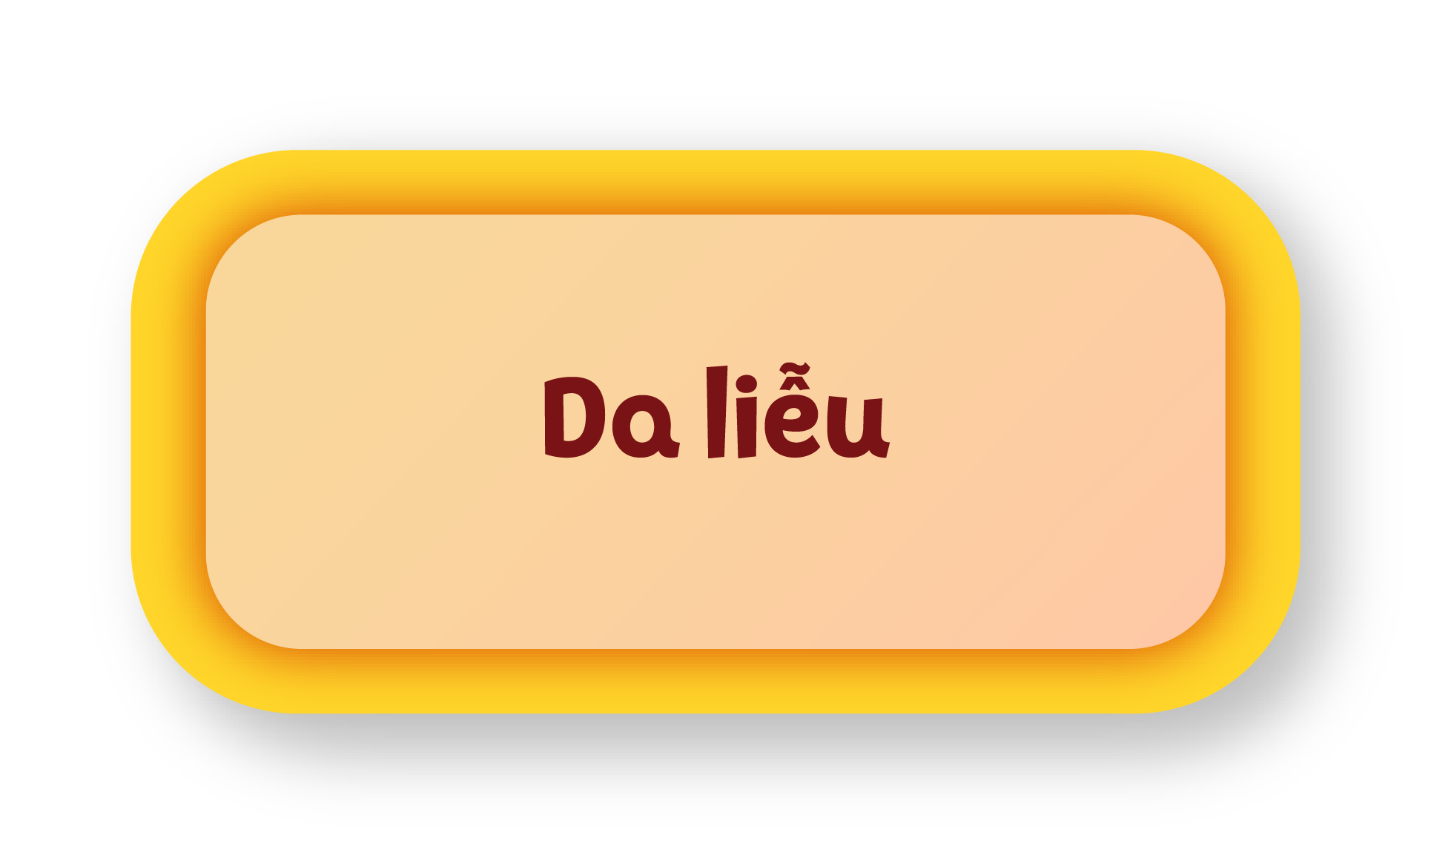
00:09
00:08
00:07
00:06
00:05
00:04
00:03
00:02
00:01
00:15
00:14
00:13
00:12
00:11
00:10
Kết thúc
Bắt đầu

Slide 13
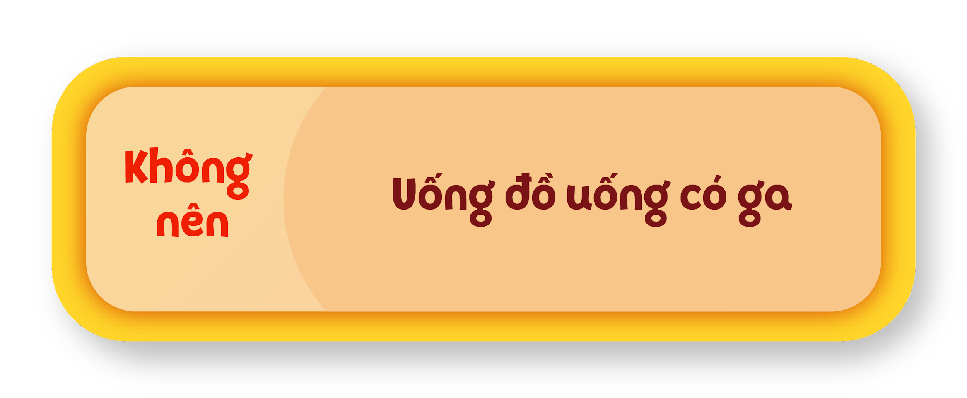
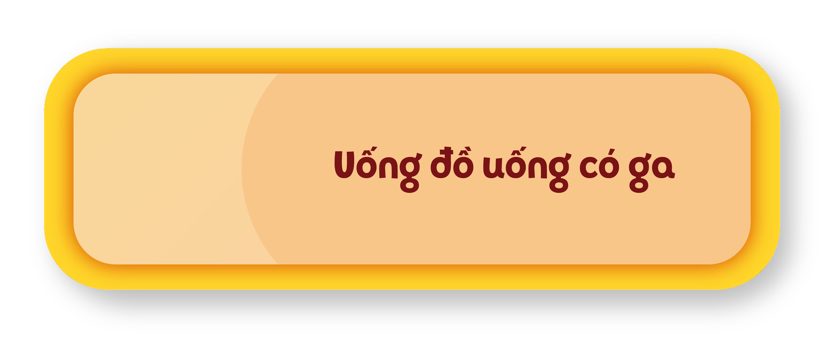
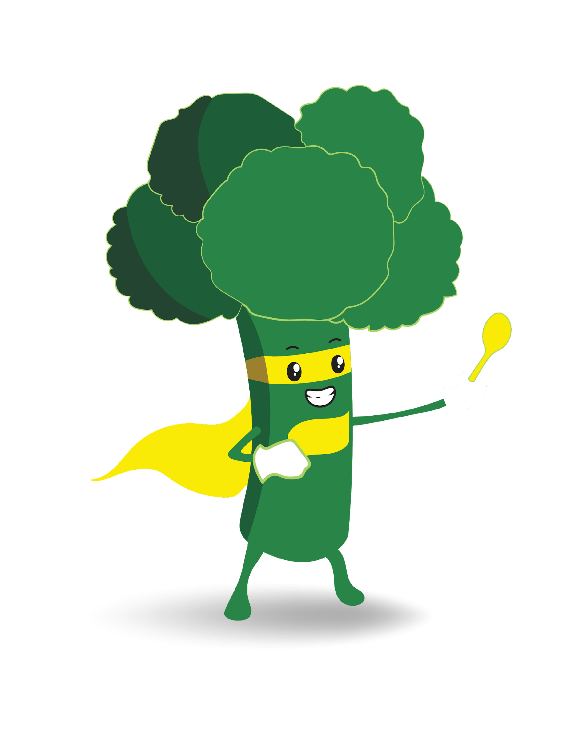
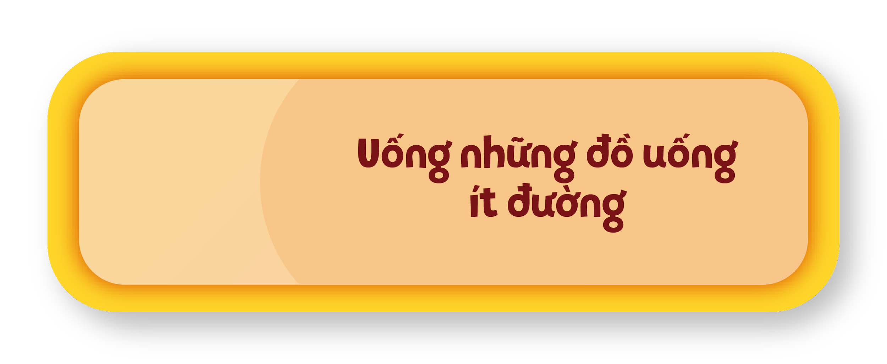
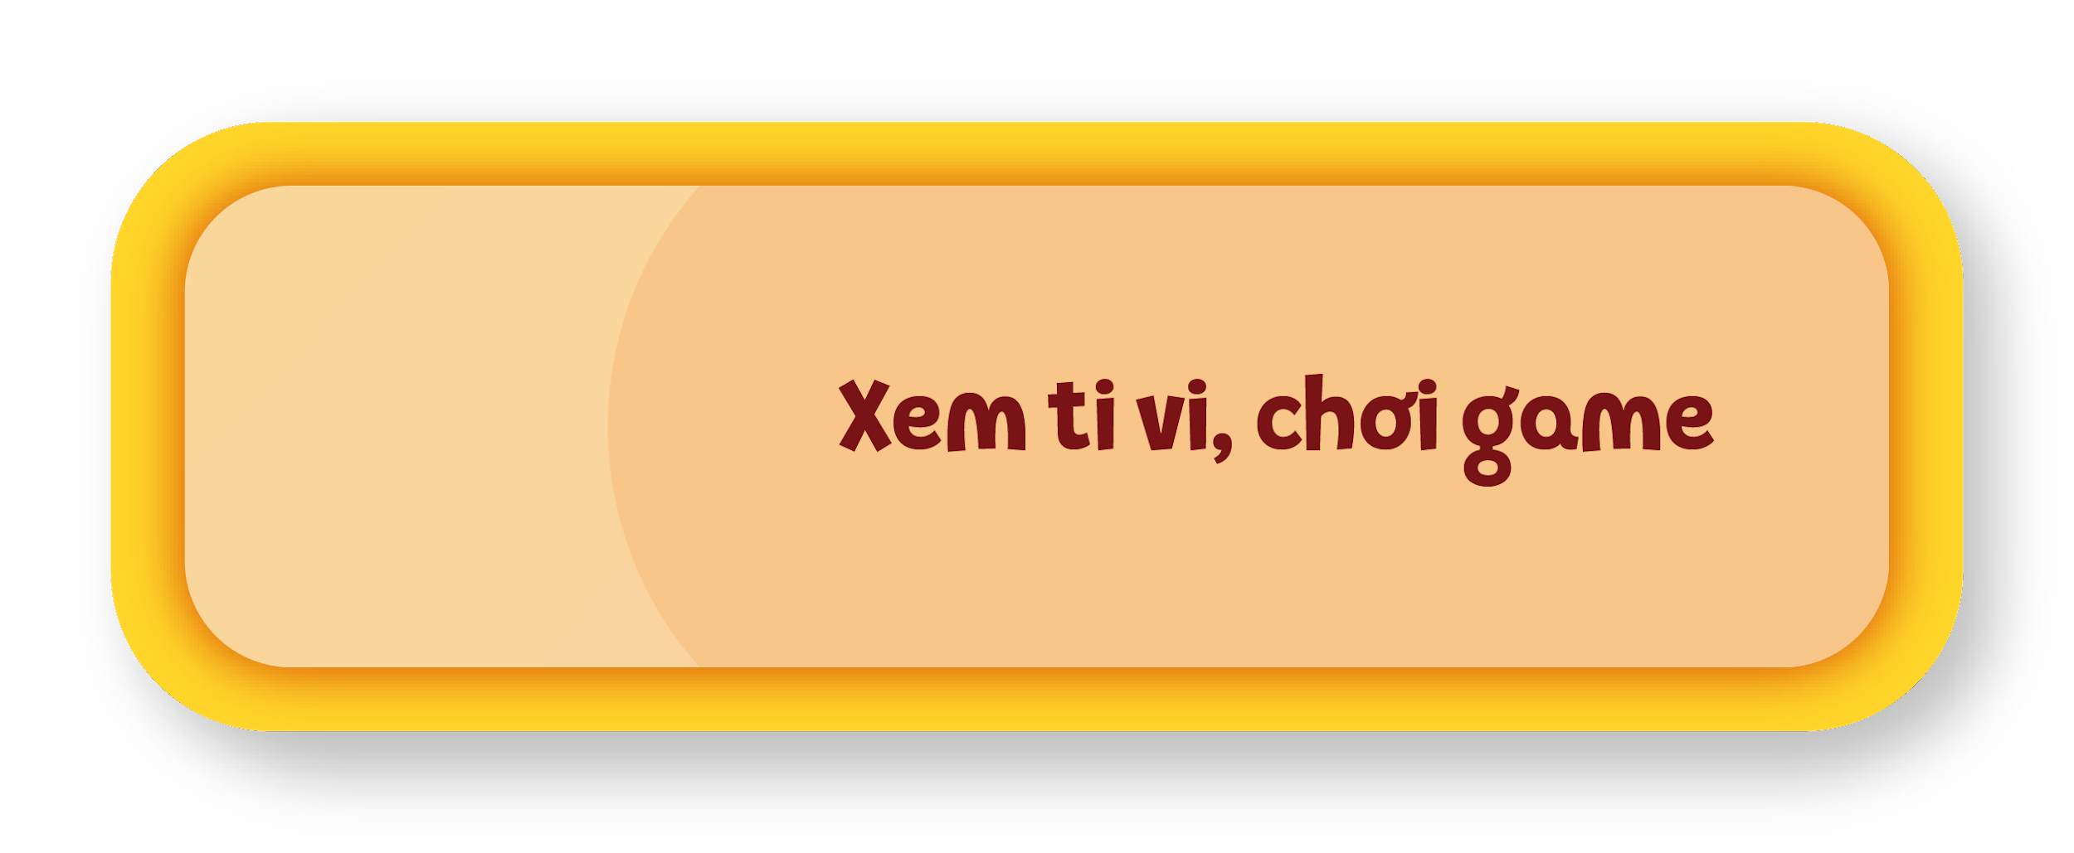
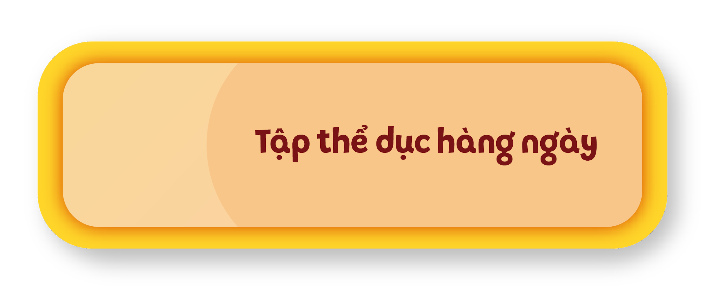
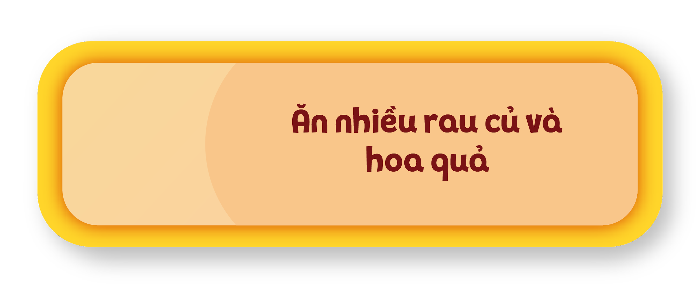
00:09
00:08
00:07
00:06
00:05
00:04
00:03
00:02
00:01
00:15
00:14
00:13
00:12
00:11
00:10
Kết thúc
Bắt đầu

Slide 14
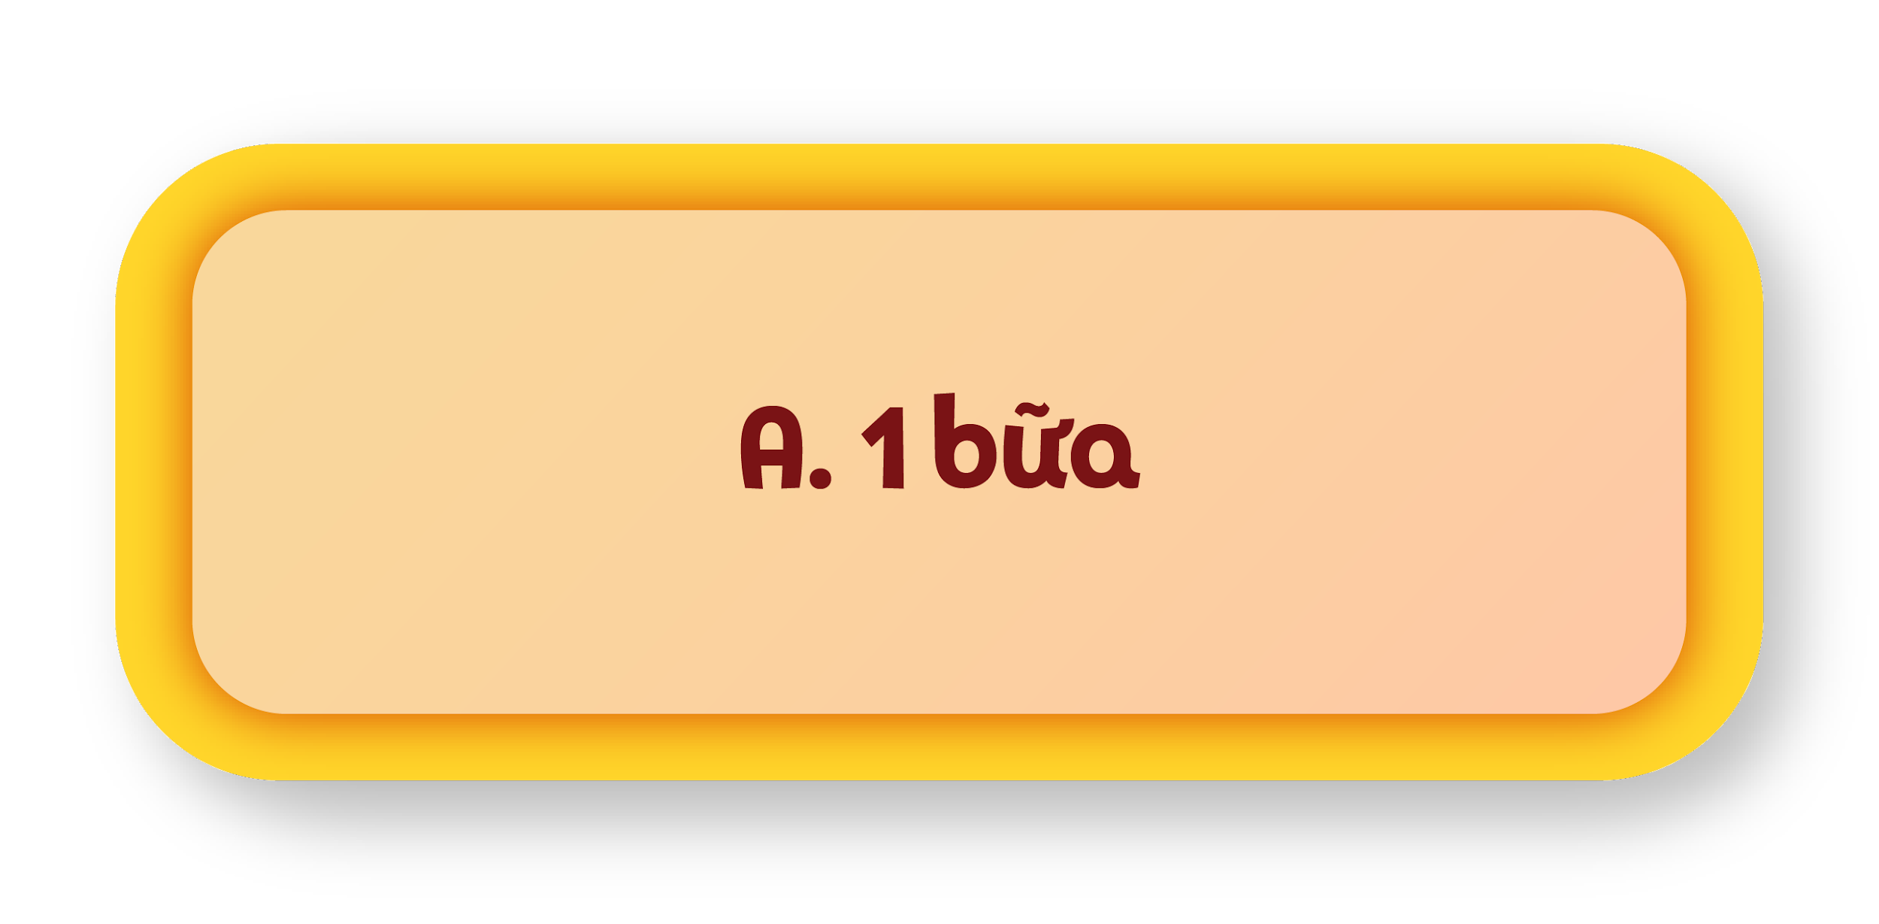
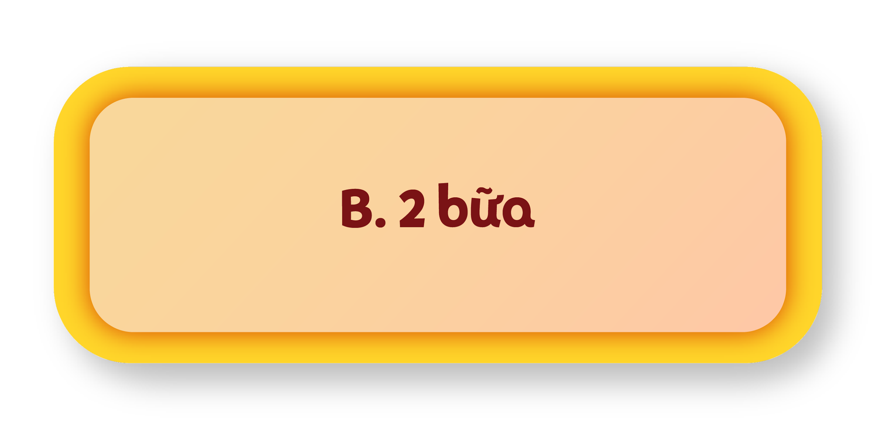
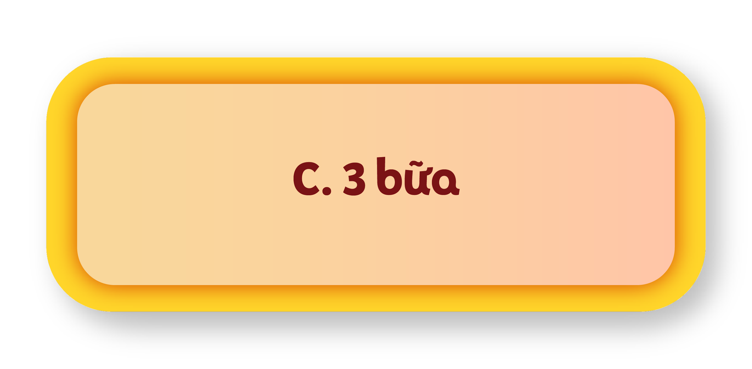
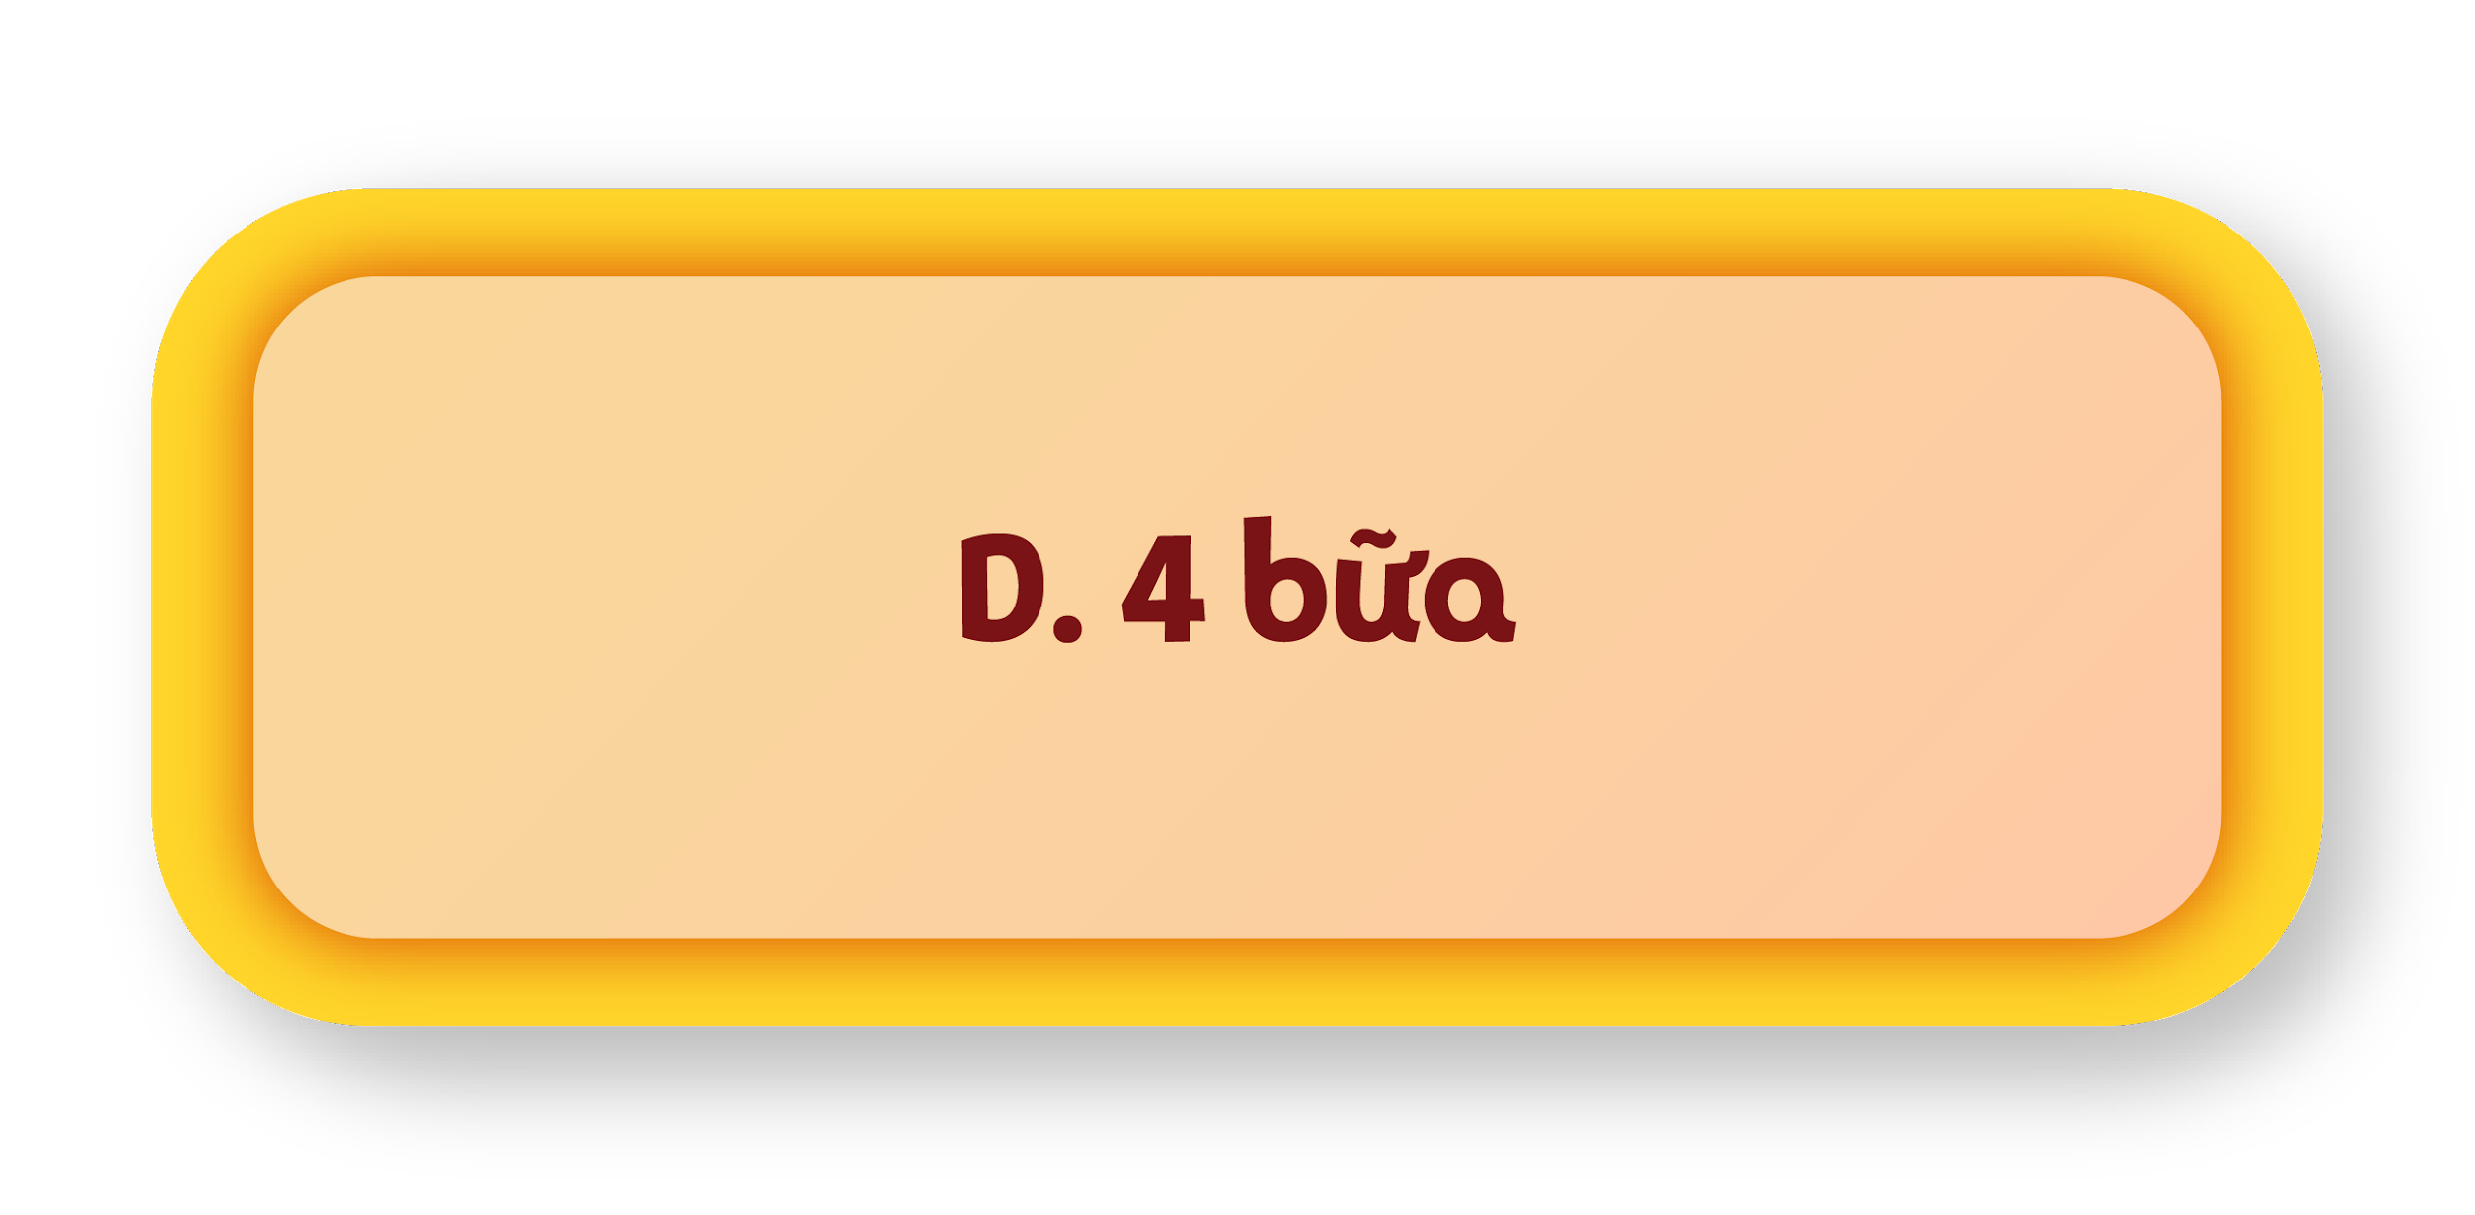
00:09
00:08
00:07
00:06
00:05
00:04
00:03
00:02
00:01
00:15
00:14
00:13
00:12
00:11
00:10
Kết thúc
Bắt đầu

Slide 15
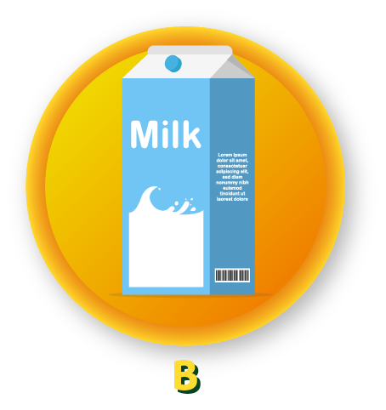
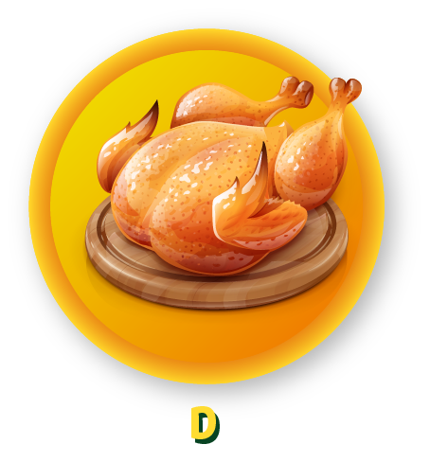
00:09
00:08
00:07
00:06
00:05
00:04
00:03
00:02
00:01
00:15
00:14
00:13
00:12
00:11
00:10
Kết thúc
Bắt đầu

Slide 16
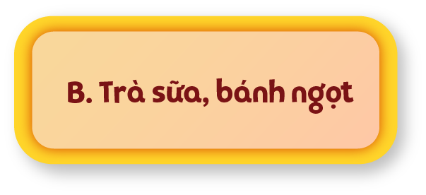
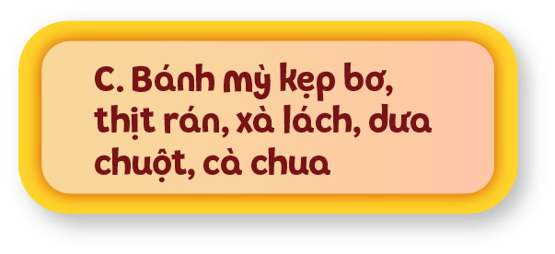
00:09
00:08
00:07
00:06
00:05
00:04
00:03
00:02
00:01
00:15
00:14
00:13
00:12
00:11
00:10
Kết thúc
Bắt đầu

Slide 17
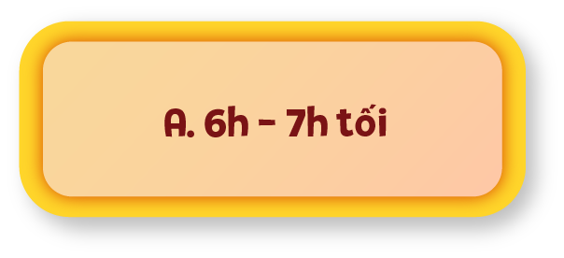
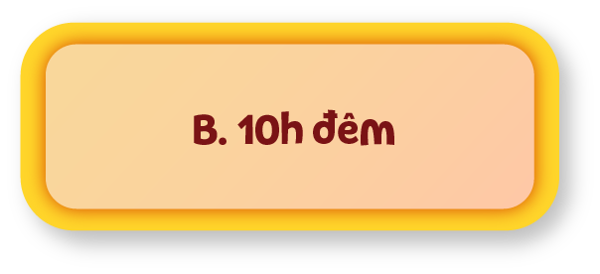
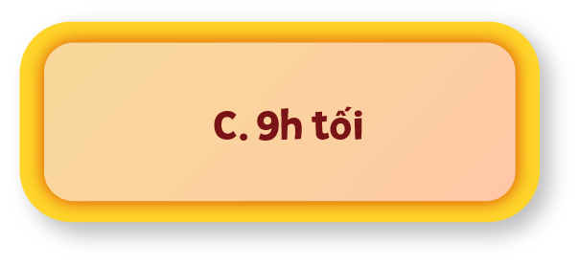
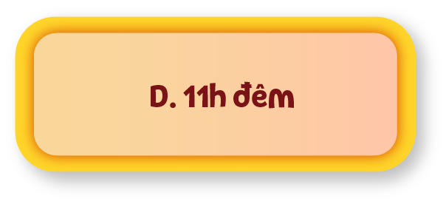
00:09
00:08
00:07
00:06
00:05
00:04
00:03
00:02
00:01
00:15
00:14
00:13
00:12
00:11
00:10
Kết thúc
Bắt đầu

Slide 18
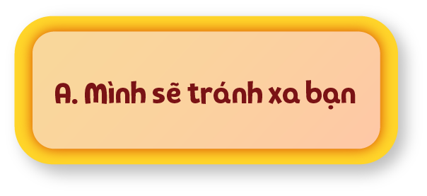
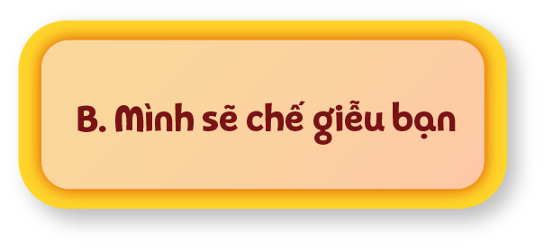
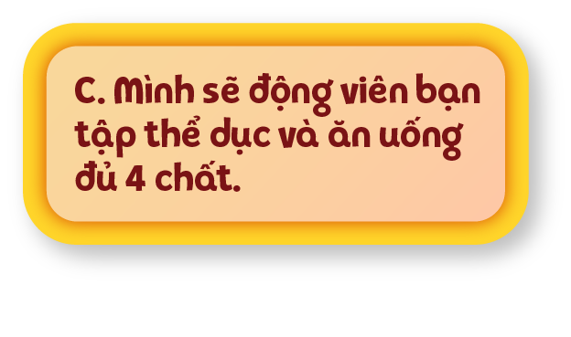
00:09
00:08
00:07
00:06
00:05
00:04
00:03
00:02
00:01
00:15
00:14
00:13
00:12
00:11
00:10
Kết thúc
Bắt đầu

