Slide 3
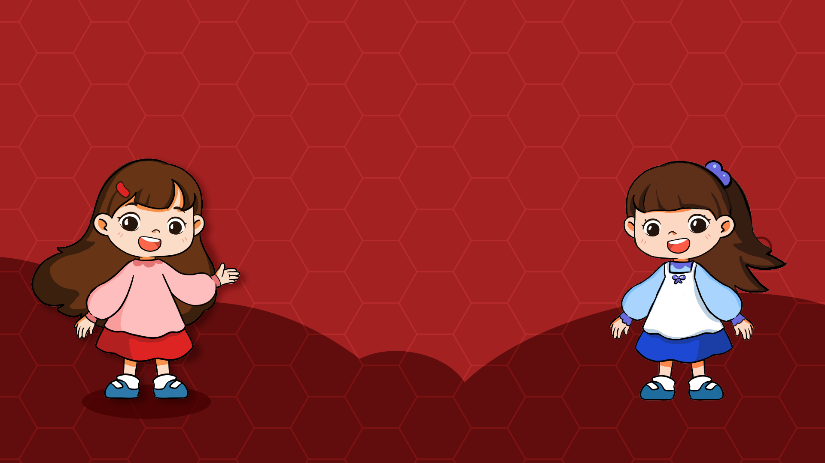

Slide 5
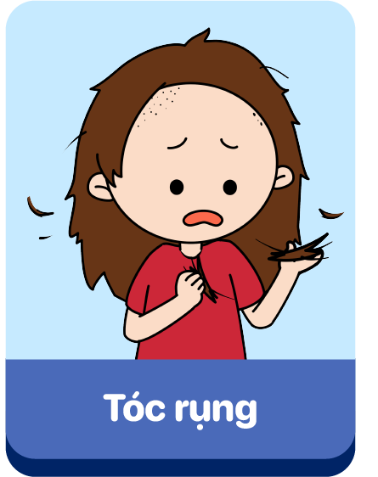
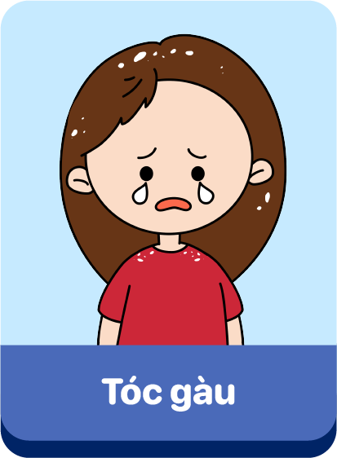
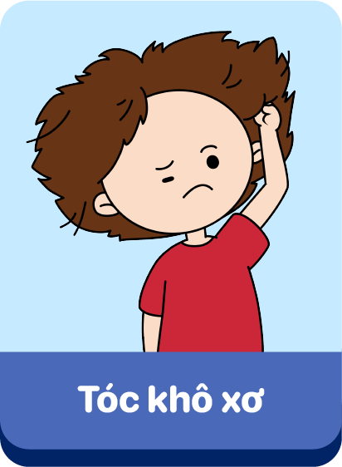
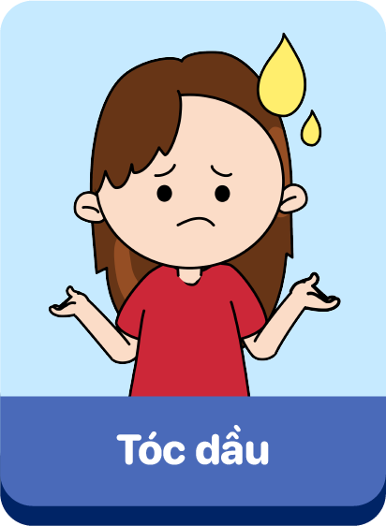

Slide 6
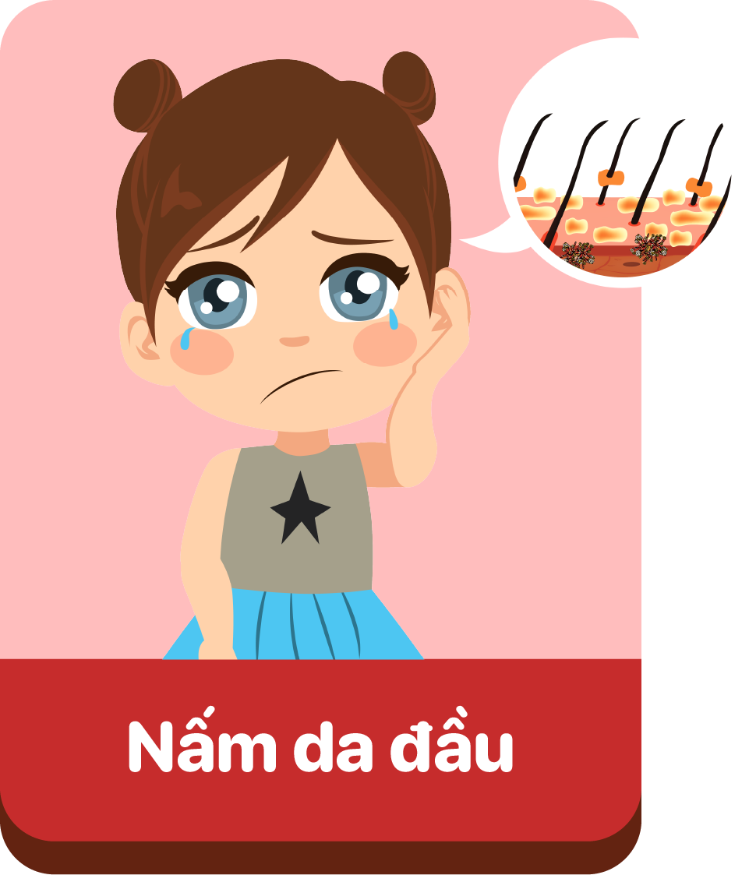

Slide 7
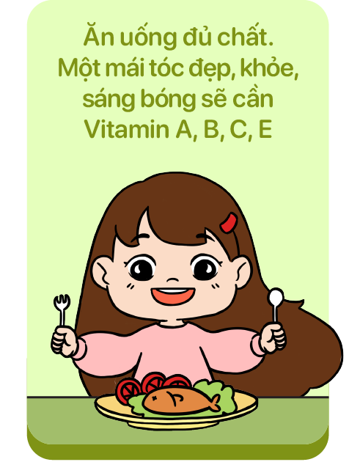
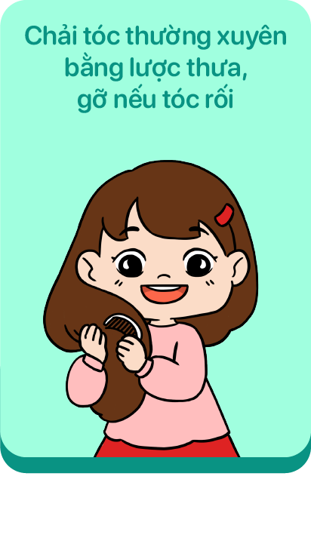
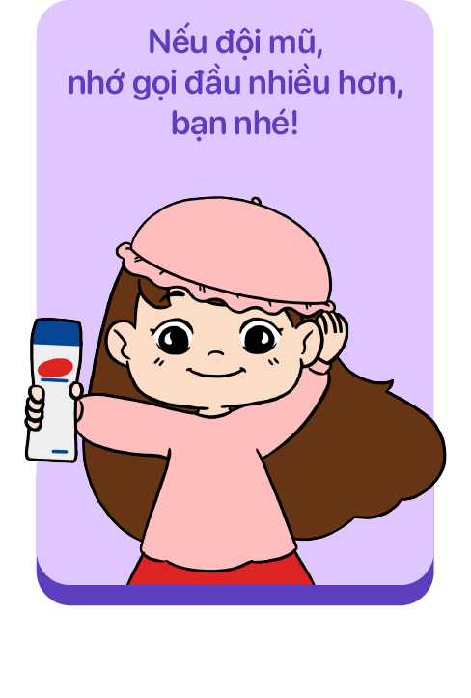
^

Slide 8
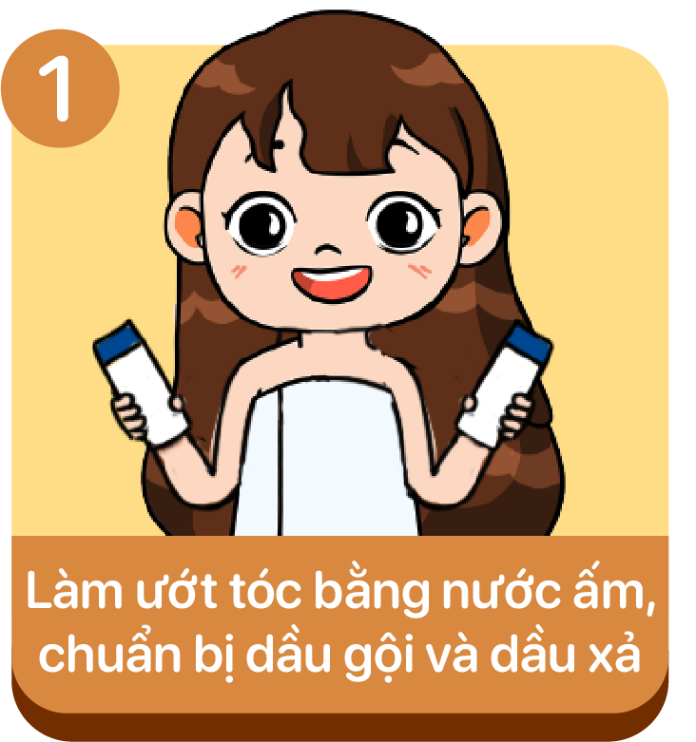
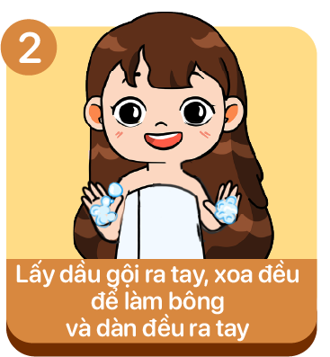
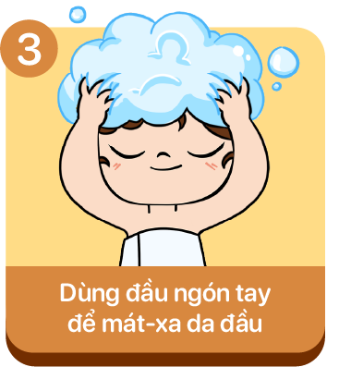
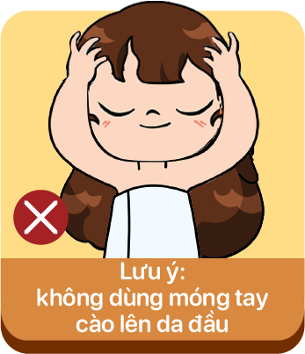
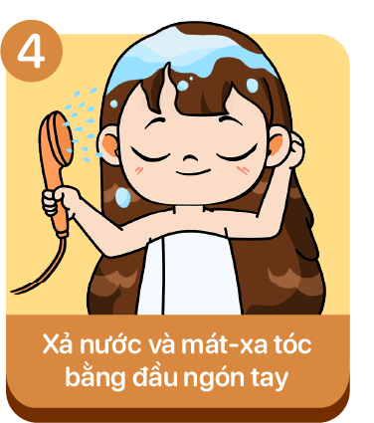
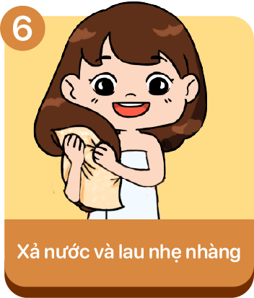

Slide 10
BẮT ĐẦU
00:15
00:14
00:13
00:12
00:11
00:10
00:09
00:08
00:07
00:06
00:05
00:04
00:03
00:02
00:01
Kết thúc
CÂU 1

Slide 11
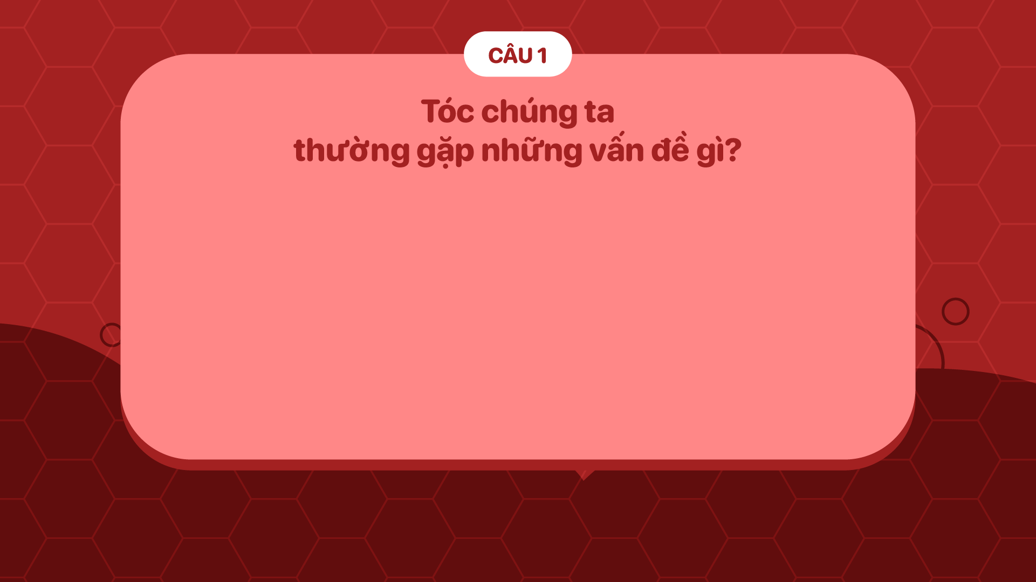
BẮT ĐẦU
00:15
00:14
00:13
00:12
00:11
00:10
00:09
00:08
00:07
00:06
00:05
00:04
00:03
00:02
00:01
Kết thúc
CÂU 2

Slide 12
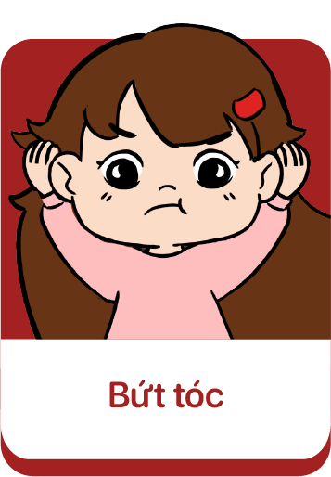
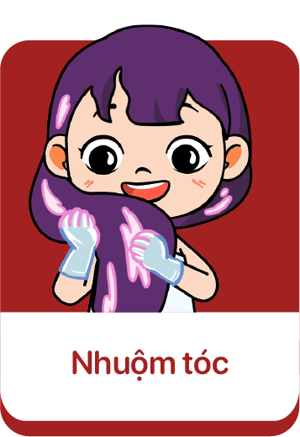
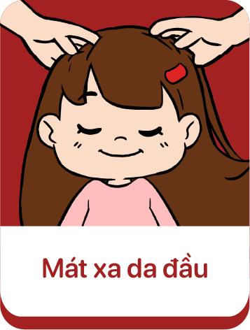
BẮT ĐẦU
00:15
00:14
00:13
00:12
00:11
00:10
00:09
00:08
00:07
00:06
00:05
00:04
00:03
00:02
00:01
Kết thúc

Slide 13
BẮT ĐẦU
00:15
00:14
00:13
00:12
00:11
00:10
00:09
00:08
00:07
00:06
00:05
00:04
00:03
00:02
00:01
Kết thúc

Slide 14
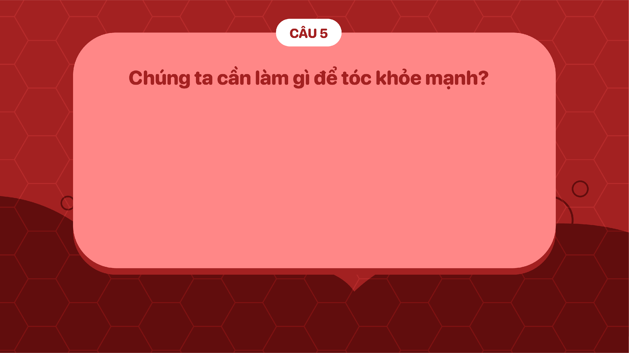
BẮT ĐẦU
00:15
00:14
00:13
00:12
00:11
00:10
00:09
00:08
00:07
00:06
00:05
00:04
00:03
00:02
00:01
Kết thúc

Slide 15
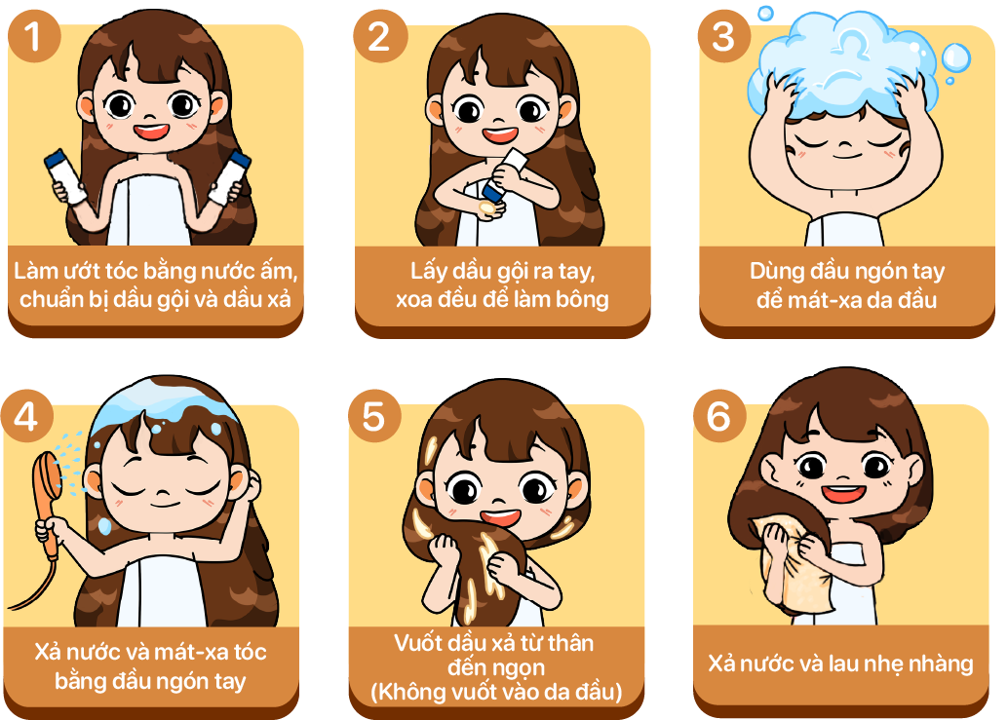
BẮT ĐẦU
00:15
00:14
00:13
00:12
00:11
00:10
00:09
00:08
00:07
00:06
00:05
00:04
00:03
00:02
00:01
Kết thúc

Slide 16
BẮT ĐẦU
00:15
00:14
00:13
00:12
00:11
00:10
00:09
00:08
00:07
00:06
00:05
00:04
00:03
00:02
00:01
Kết thúc

Slide 17
BẮT ĐẦU
00:15
00:14
00:13
00:12
00:11
00:10
00:09
00:08
00:07
00:06
00:05
00:04
00:03
00:02
00:01
Kết thúc

Slide 18
BẮT ĐẦU
00:15
00:14
00:13
00:12
00:11
00:10
00:09
00:08
00:07
00:06
00:05
00:04
00:03
00:02
00:01
Kết thúc

Slide 19
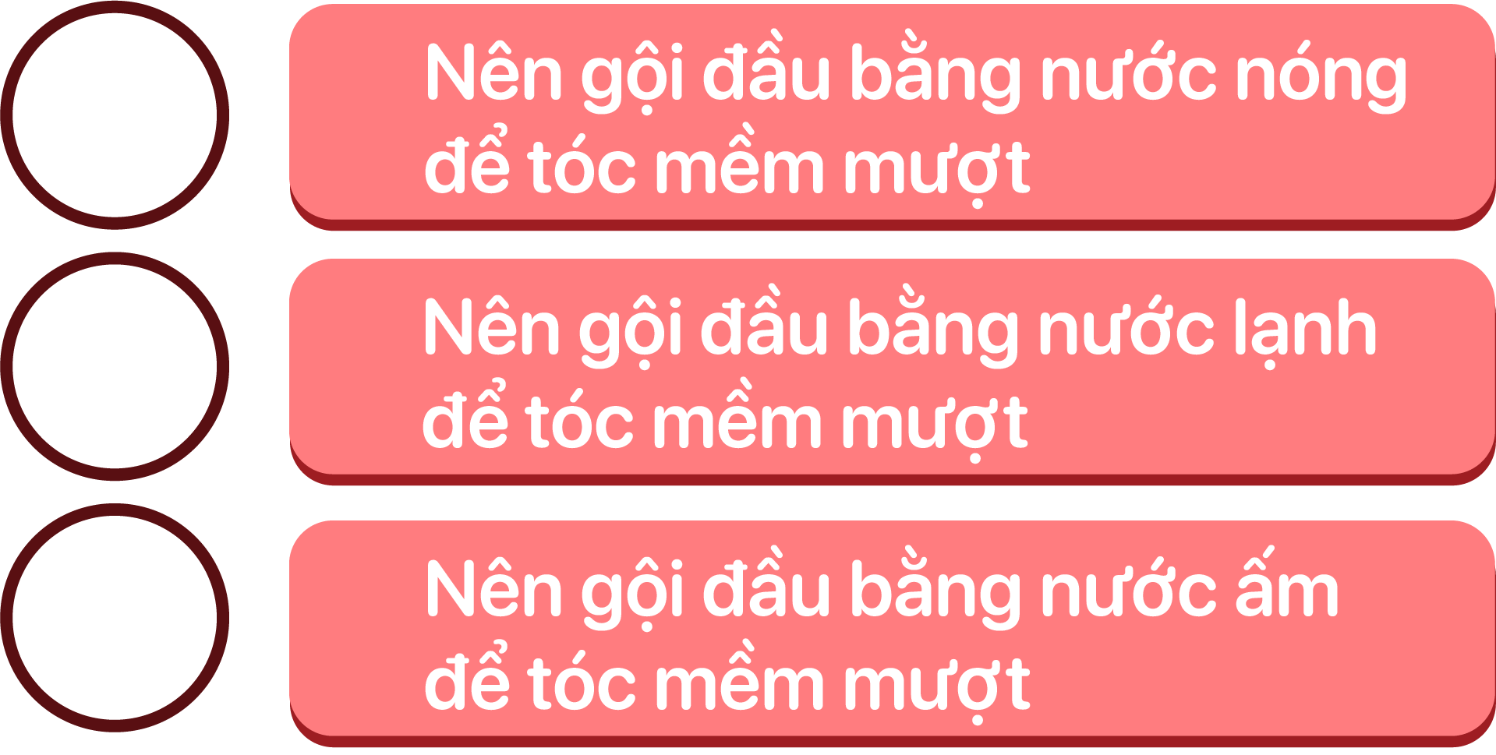
BẮT ĐẦU
00:15
00:14
00:13
00:12
00:11
00:10
00:09
00:08
00:07
00:06
00:05
00:04
00:03
00:02
00:01
Kết thúc

