Slide 4
2
18
20
19
28
1
2

Slide 5
32
30
31
29

Slide 6
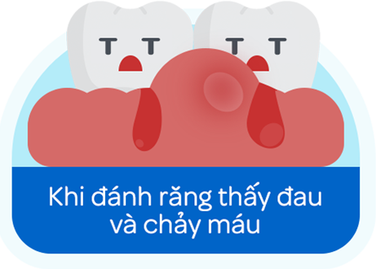
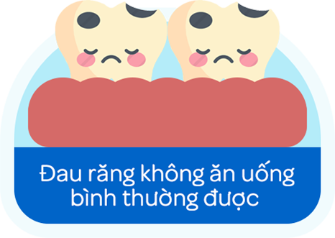
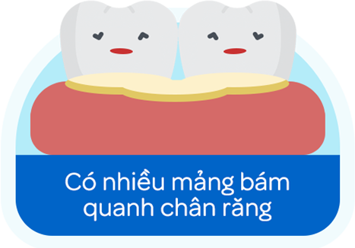

Slide 7
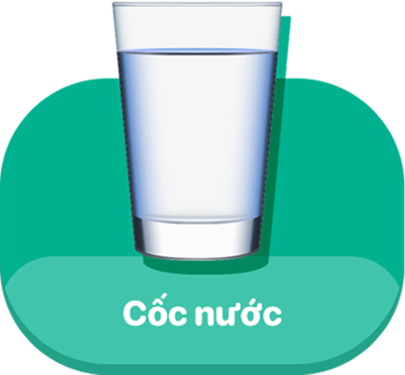

Slide 9
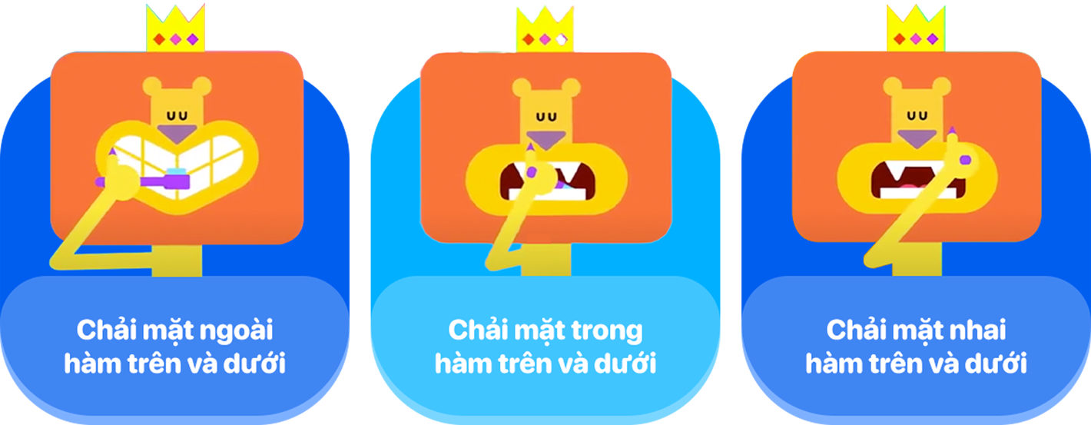

Slide 10
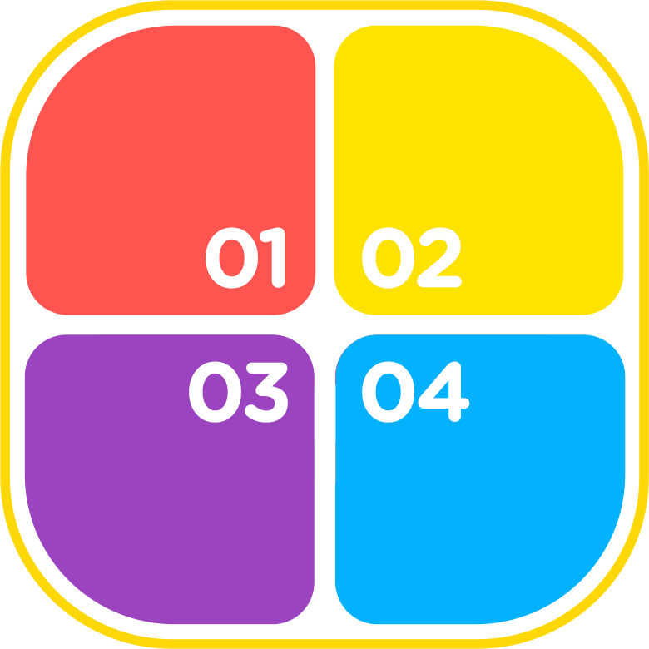

Slide 11
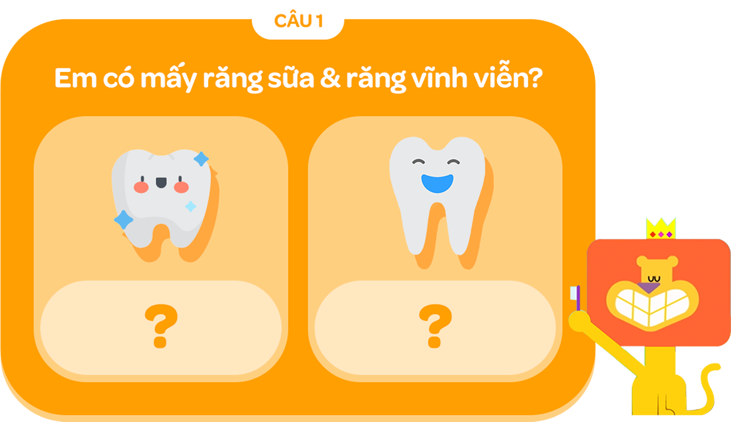
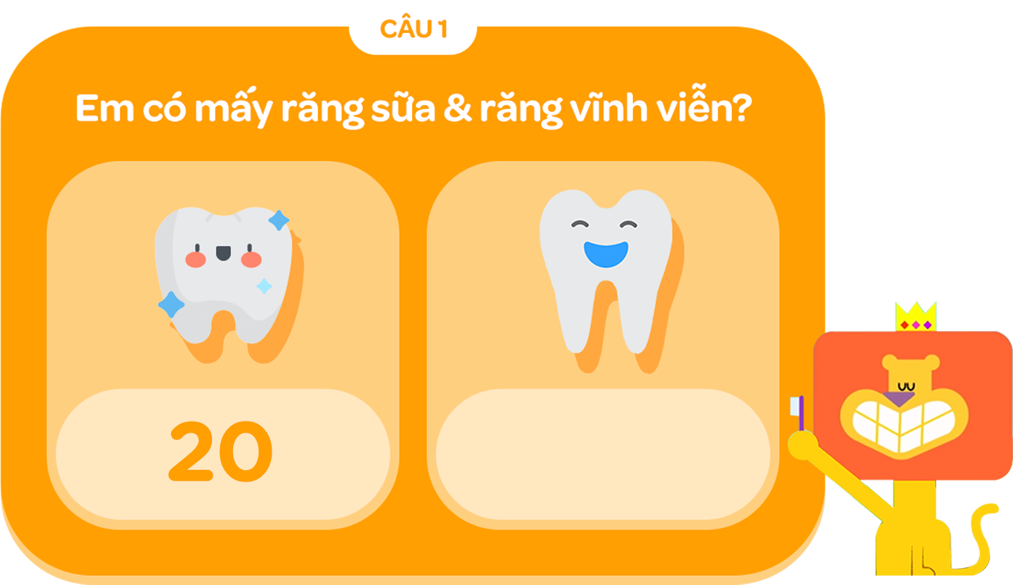
00:04
00:09
00:06
00:10
00:14
00:13
00:12
00:15
00:01
00:11
00:07
00:03
00:02
00:05
00:08
KẾT THÚC
BẮT ĐẦU

Slide 13
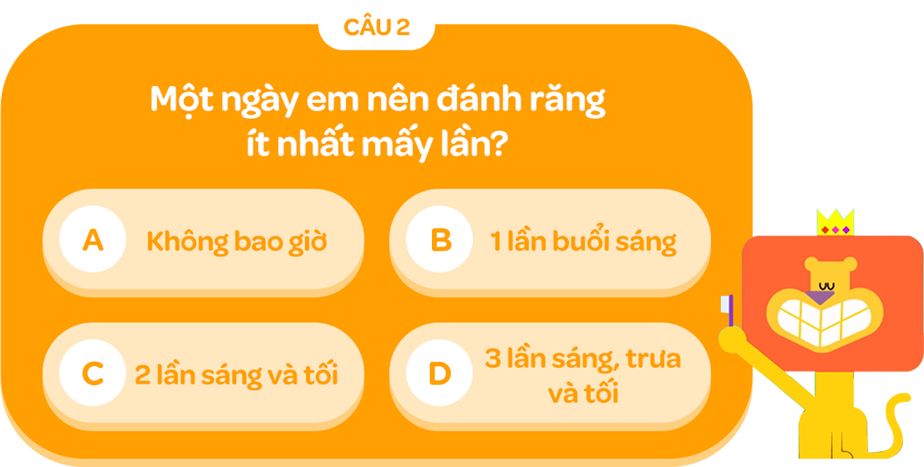
00:04
00:09
00:06
00:10
00:14
00:13
00:12
00:15
00:01
00:11
00:07
00:03
00:02
00:05
00:08
KẾT THÚC
BẮT ĐẦU

Slide 15
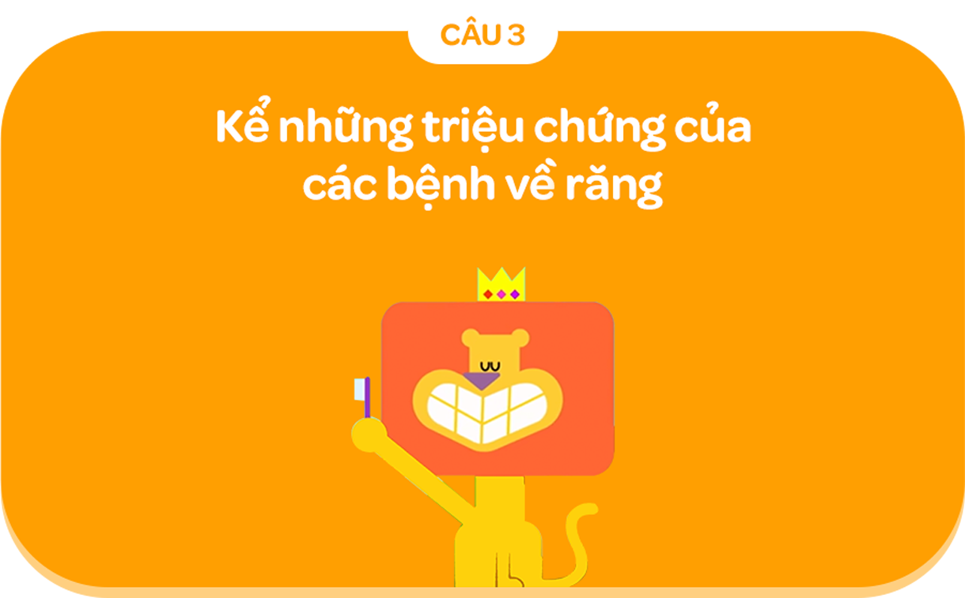
00:04
00:09
00:06
00:10
00:14
00:13
00:12
00:15
00:01
00:11
00:07
00:03
00:02
00:05
00:08
KẾT THÚC
BẮT ĐẦU

Slide 17
00:04
00:09
00:06
00:10
00:14
00:13
00:12
00:15
00:01
00:11
00:07
00:03
00:02
00:05
00:08
KẾT THÚC
BẮT ĐẦU

