Slide 1

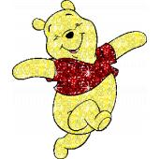
Pha Lai Primary School
Welcome to our class – 5D
Teacher: Nguyen Thi Hien

Slide 2



Unit: 4
FREE TIME
Lesson 1: Task 4, 5, 6

Slide 3







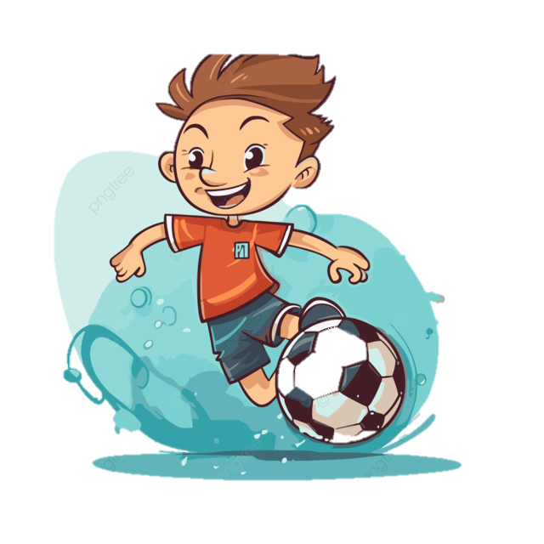
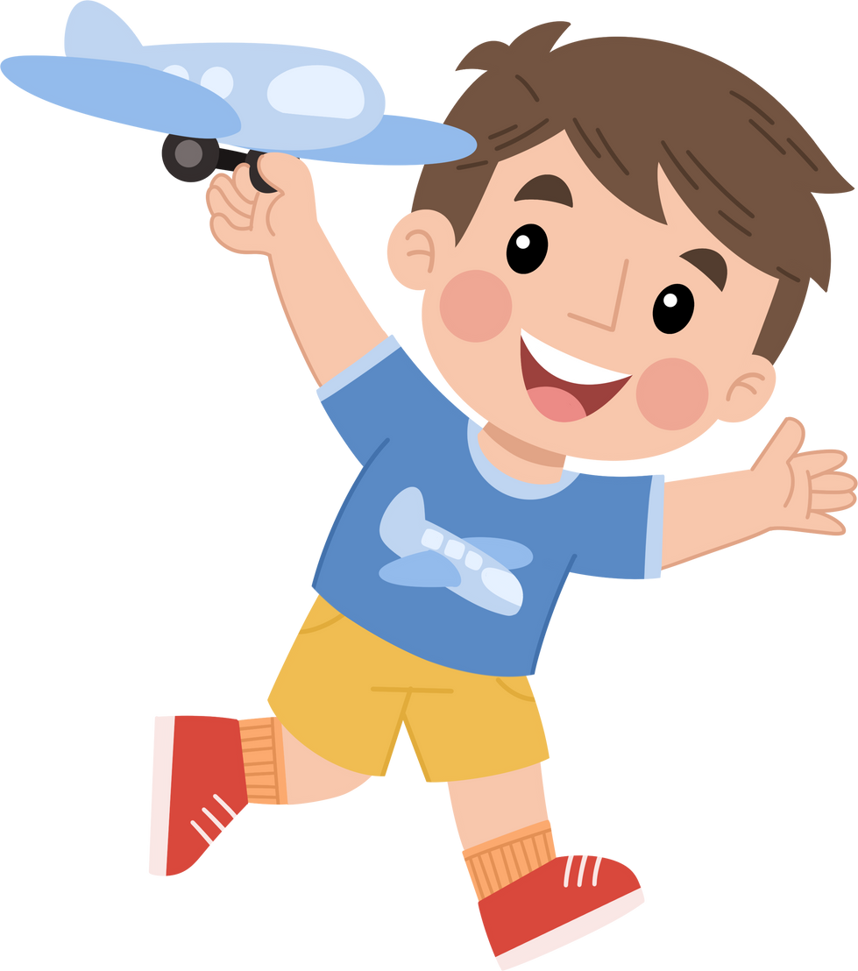



Table of contents
01
02
Warm-up
Presentation
05
04
Production
Wrap-up &
Assessment
03
Practice

Slide 4
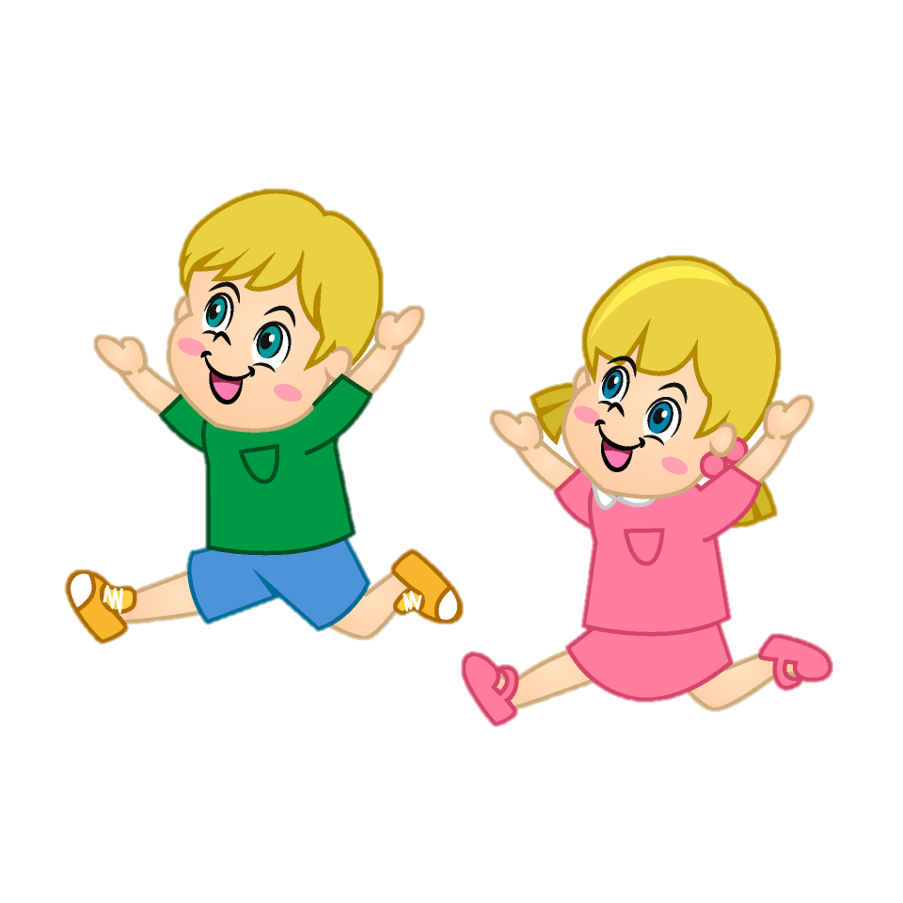
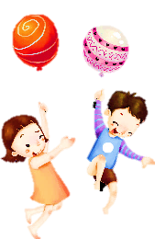

Warm-up
01

Slide 5





LUCKY WHEEL
1
2
3
1 candy
2 stars
4 stars
1 candy
stop
study
4
5
6
5 stars
10 stars
1 candy
15stars
SPIN

Slide 6

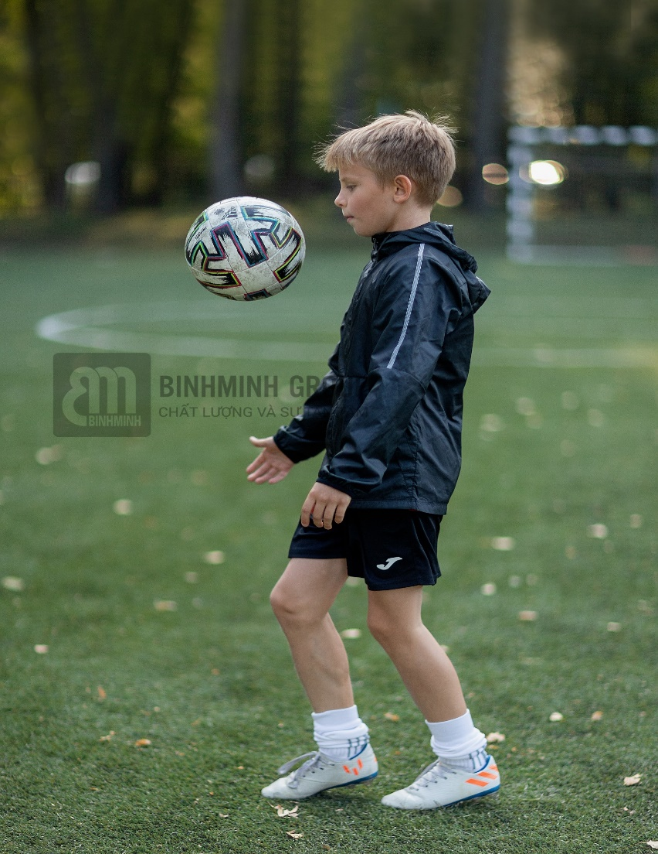
What is the boy doing?
He is playing football.
BACK

Slide 7
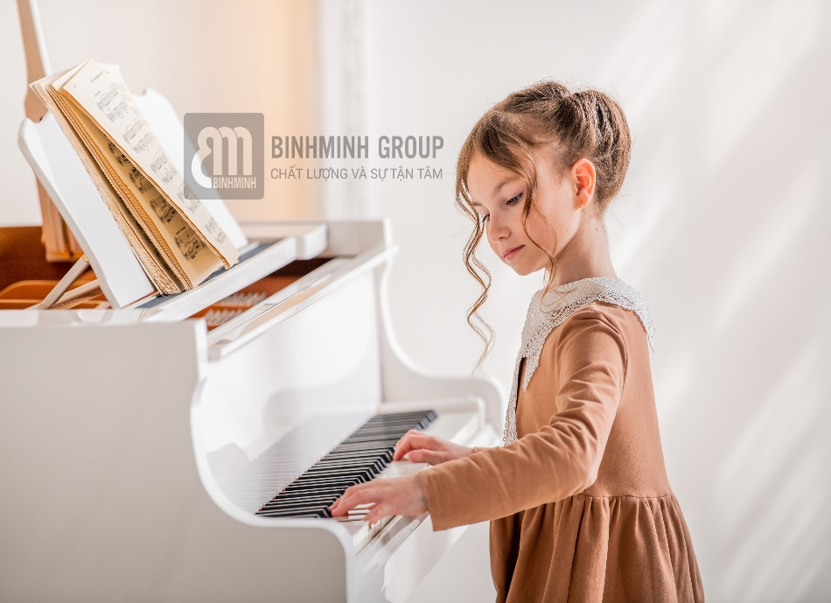
What is the girl doing?
She is playing the piano.
BACK

Slide 8
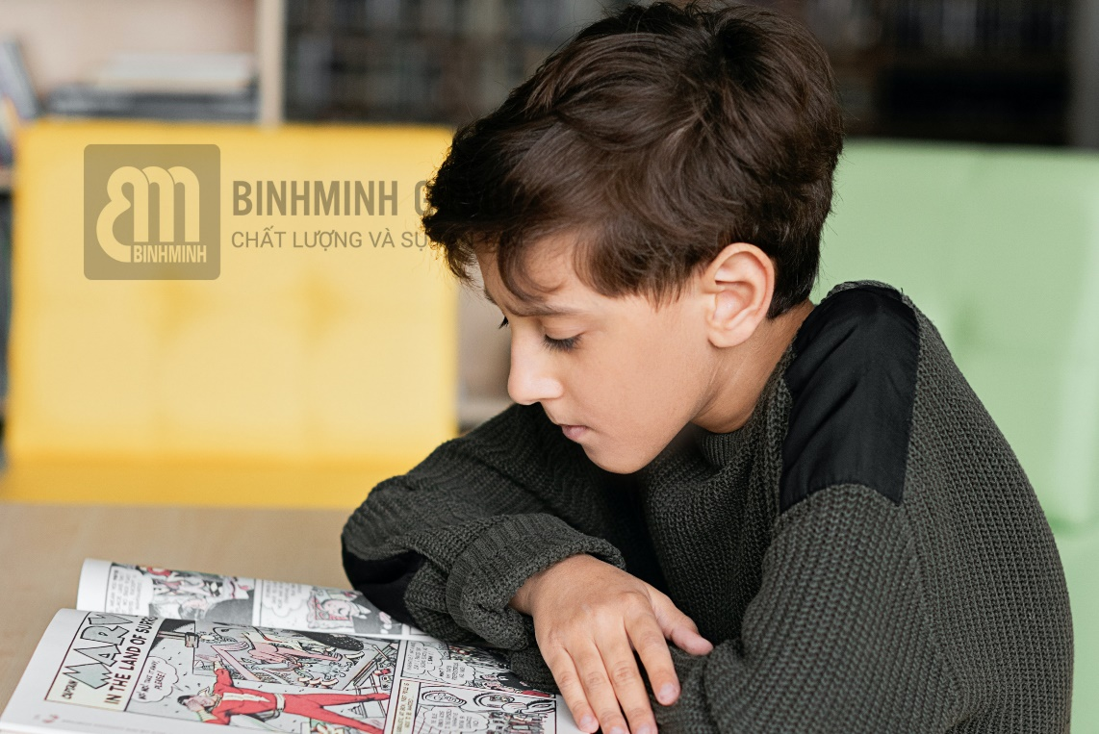
What is the boy doing?
He is reading comic books.
BACK

Slide 9
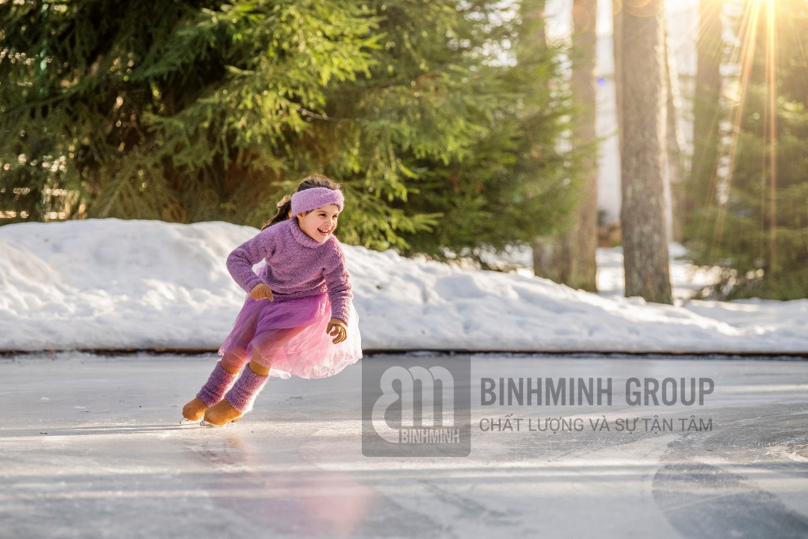
What is the girl doing?
She is going ice-skating.
BACK

Slide 10
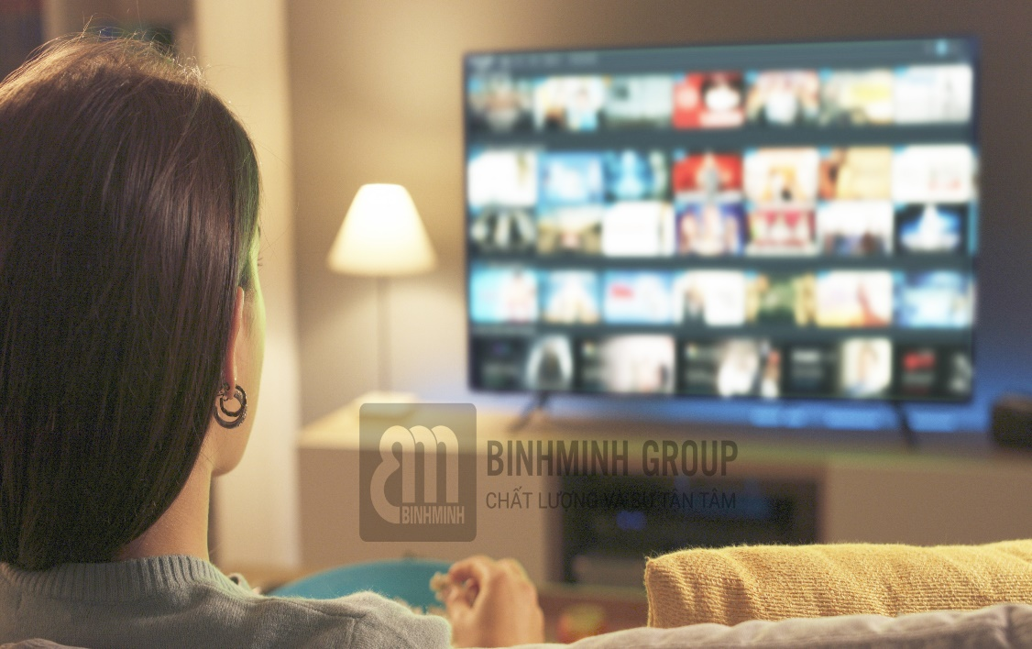
What is the girl doing?
She is watching movies.
BACK

Slide 11
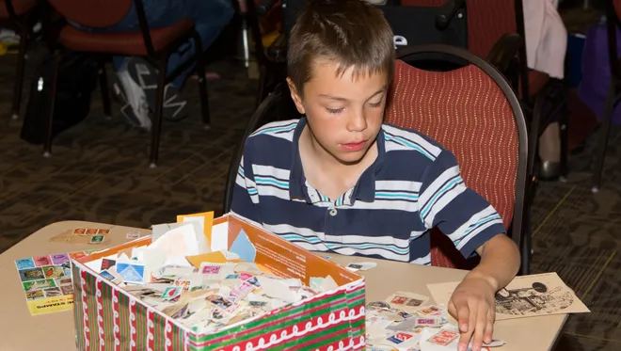
What is the boy doing?
He is collecting stamps.
BACK

Slide 12
Presentation
02

Slide 13



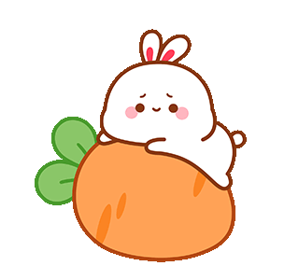
I like playing football.
I love playing outside.
I enjoy reading comic books.

Slide 14
like / love / enjoy + V-ing
I/You/We/They + like/love/enjoy + V-ing

Slide 15
- She playing the piano.
like /
likes
She/He/It + likes/loves/enjoys + V-ing

Slide 16
Good at
I am good at playing soccer.
S + is/am/are + good at + V-ing

Slide 17
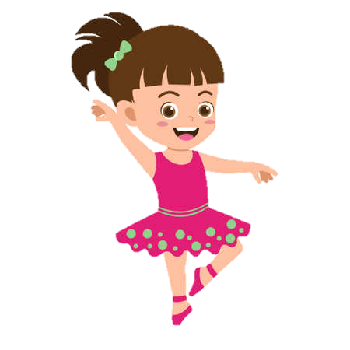

Is she good at dancing?
Yes, she is.

Slide 18

To be + S + good at + V-ing?
Yes, S + to be.
x No, S + to be + not.

Slide 19
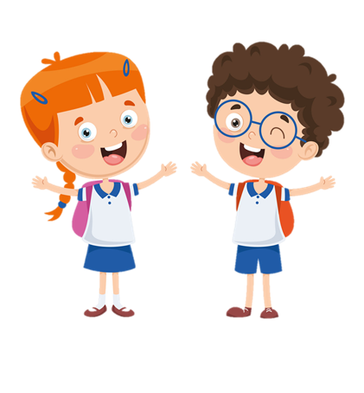
What do you like doing?
I like playing football.

Slide 20
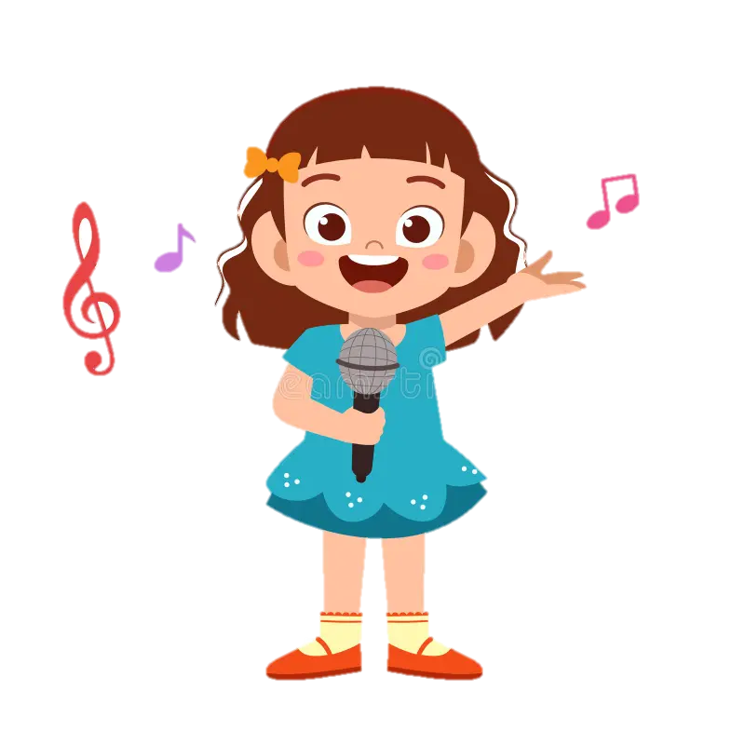
What is she good at?
She is good at singing.

Slide 21


The
Game
little
Bee

Slide 22

Find the mistake :
He like watching the TV.
s
A. like
B. watching
C. He
D. the TV
Notes:
Click vào bông hoa để ra đáp án, và click choột để sửa từ

Slide 23
Fill in the blank:
What is she ……… at?
good
A. like
B. good
C. enjoy
D. love

Slide 24
Find the mistake:
What is he like doing?
__
does
A. What
B. like
C. doing
D. is

Slide 25
Fill in the blank:
I ……. good at making a paper bird.
am
A. is
B. are
C. am
D. at

Slide 26
Are you good at making cakes, too?
Yes, I am.
A. Yes, I am
B. No, I am
C. Yes, he is.
D. No, he isn’t.

Slide 27
Is she good at swimming, too?
X No, she isn’t.
A. Yes, he is.
B. No, he isn’t.
C. Yes, she isn’t.
D. No, she isn’t.

Slide 28
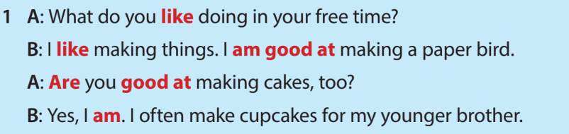
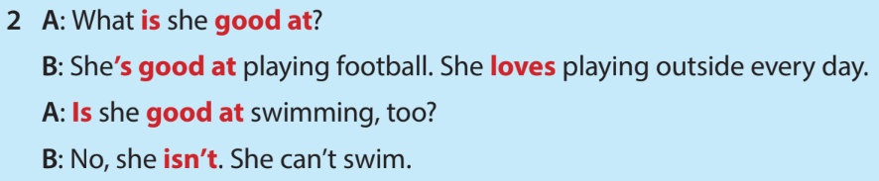



4 Listen and read.

Slide 29
Practice
03

Slide 30



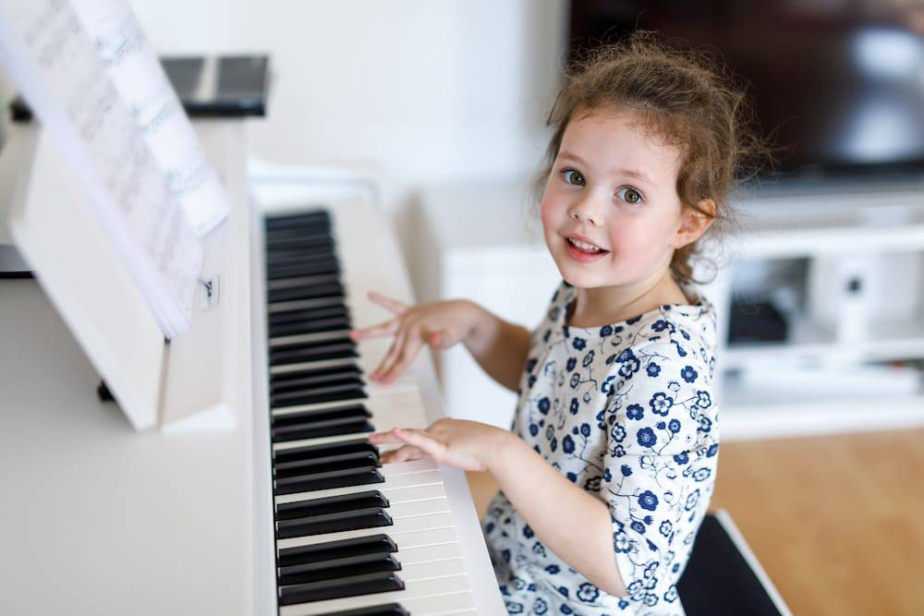
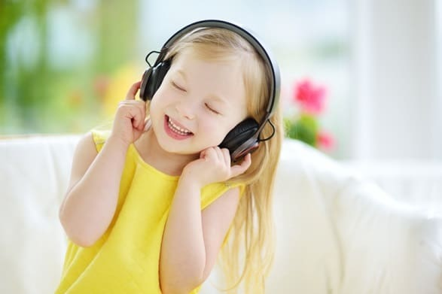
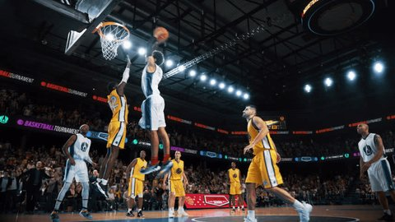
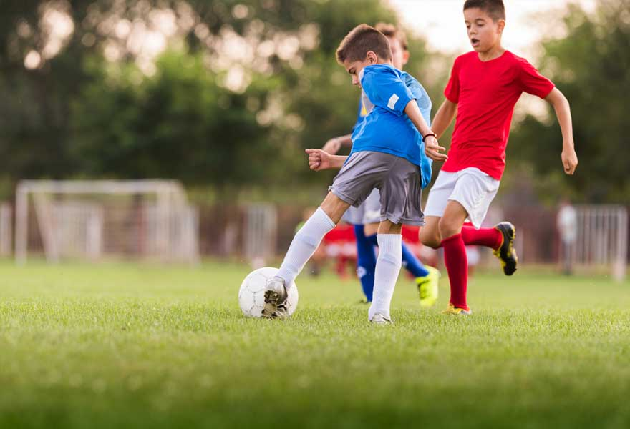


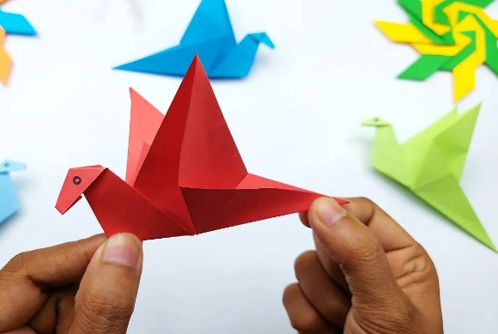
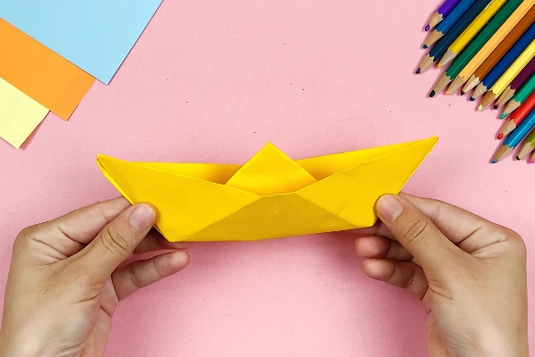
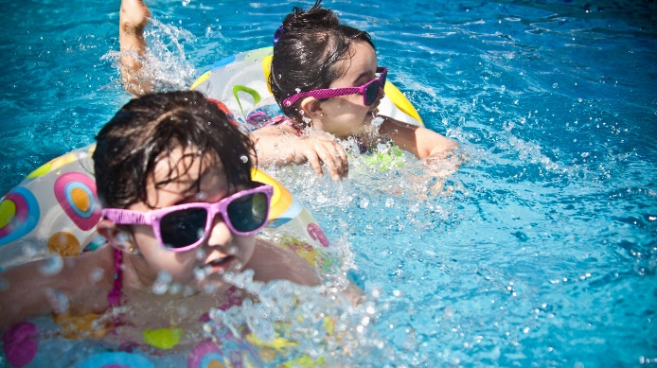
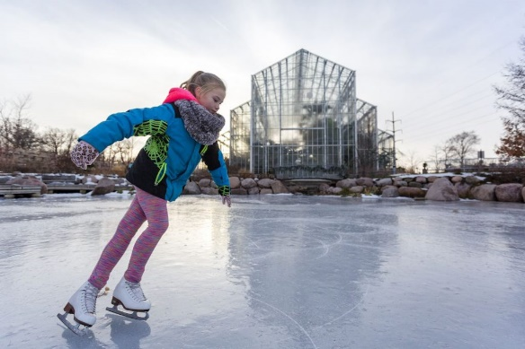
5 What are they good at?
Listen and tick ( ) or cross ( X ).
X
X
X
X

Slide 31
Production
04

Slide 32

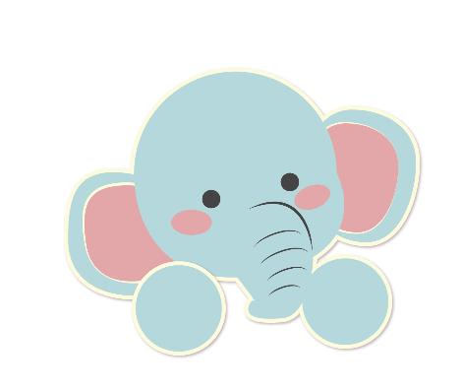
6 Let’s talk.
Love
love like enjoy be good at make
collect go play watch read

Slide 33
6 Let’s talk.
I love reading comic books, but I don’t like watching movies.
Are you good at swimming, too?
Yes, I am. I go swimming every Sunday.
What do you love doing?
I’m good at playing the piano.
What are you good at?

Slide 34
Wrap-up &
Assessment
05

Slide 35
Small activity: Look, read and match.
1. What is he good at? | a. She likes playing the piano.
2. What do you like doing in your free time? | b. No, she isn’t. She isn’t good at swimming.
3. Is she good at collecting stamps? | c. Yes, she is. She is good at collecting stamps.
4. What does she like doing? | d. He is good at playing football.
5. Is she good at swimming? | e. I like singing and dancing in my free time.
1-d
2-e
3-c
4-a
5-b

Slide 36
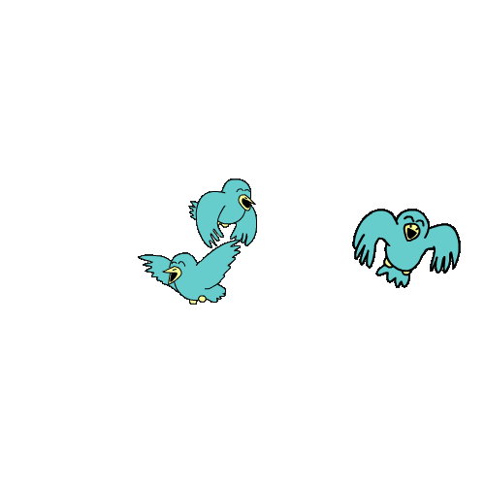

Unit 4: Free time
Lesson 1 – Part 4,5,6
What have we learnt today?
Vocabulary:
Learn and use new grammar:
to be + good at/ love + V-ing .

Slide 37
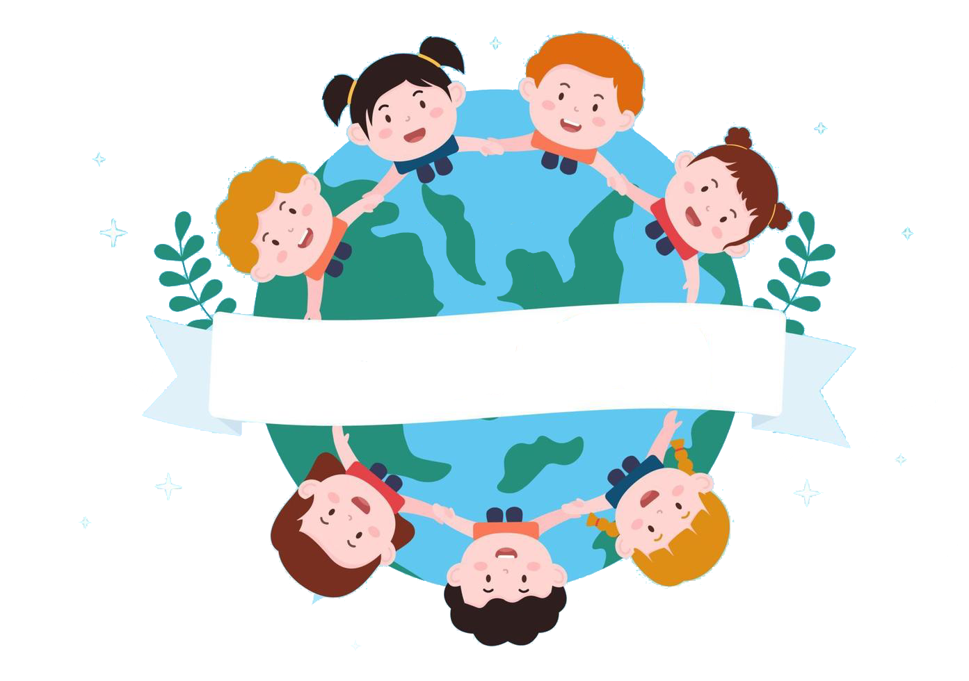
Thank you
& goodbye!

