Slide 1


Pha Lai Primary School
Welcome to our class – 4D
Teacher: Nguyen Thi Hien

Slide 2
Warm-up
Choose the best answer

Slide 3
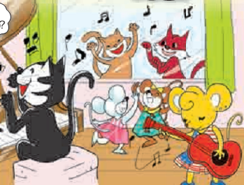
1.Where is Mary from?
Vietnam
America
England

Slide 4
2.What can Mary do?
Play the guitar
Play chess
Play football

Slide 5
3.What can Miu do?
Play the guitar
Play the piano
Play football

Slide 6
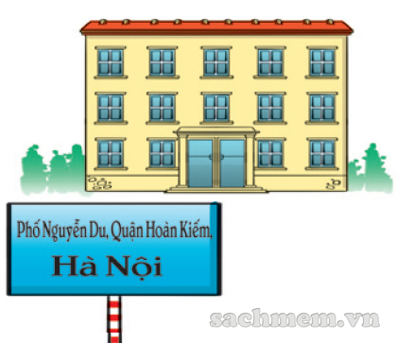

Slide 7

Sunday, November 7th 2022
Unit 6: Where’s your school?

Slide 8
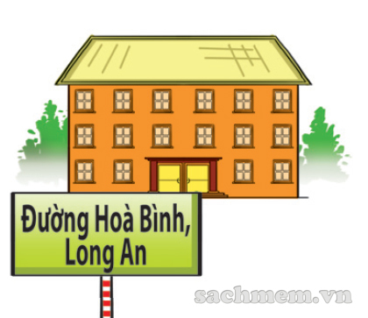

I, Vocabulary
1.Road : đường

Slide 9

2.street : phố, đường phố

Slide 10
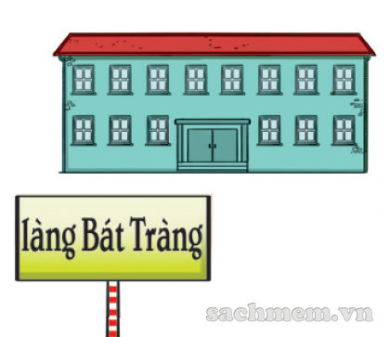
3.village : làng

Slide 11
1.district : quận, huyện

Slide 12

4.study : học

Slide 13
Checking the Vocabulary
Road Street Village District study | học Quận, huyện Phố, đường phố Đường làng
1+ 2+ 3+ 4+ 5+

Slide 14
Checking the Vocabulary
Road Street Village District study | học Quận, huyện Phố, đường phố Đường làng
1. D 2. C 3. E 4. B 5. A

Slide 15
Answer: 1+D 2+C 3+E 4+B 5+A
Road Street Village District study | học Quận, huyện Phố, đường phố Đường làng

Slide 16
II, Structures
Hỏi và trả lời về địa điểm của trường học
Where’s your school?
(trường bạn ở đâu vậy?)
- It’s in + địa điểm.
Ex: Where’s your school ?
It’s in Huong Son Road.

Slide 17
Where’s your school?
-> It’s in + place (địa điểm)
place
District
Road
Street
Village

Slide 18
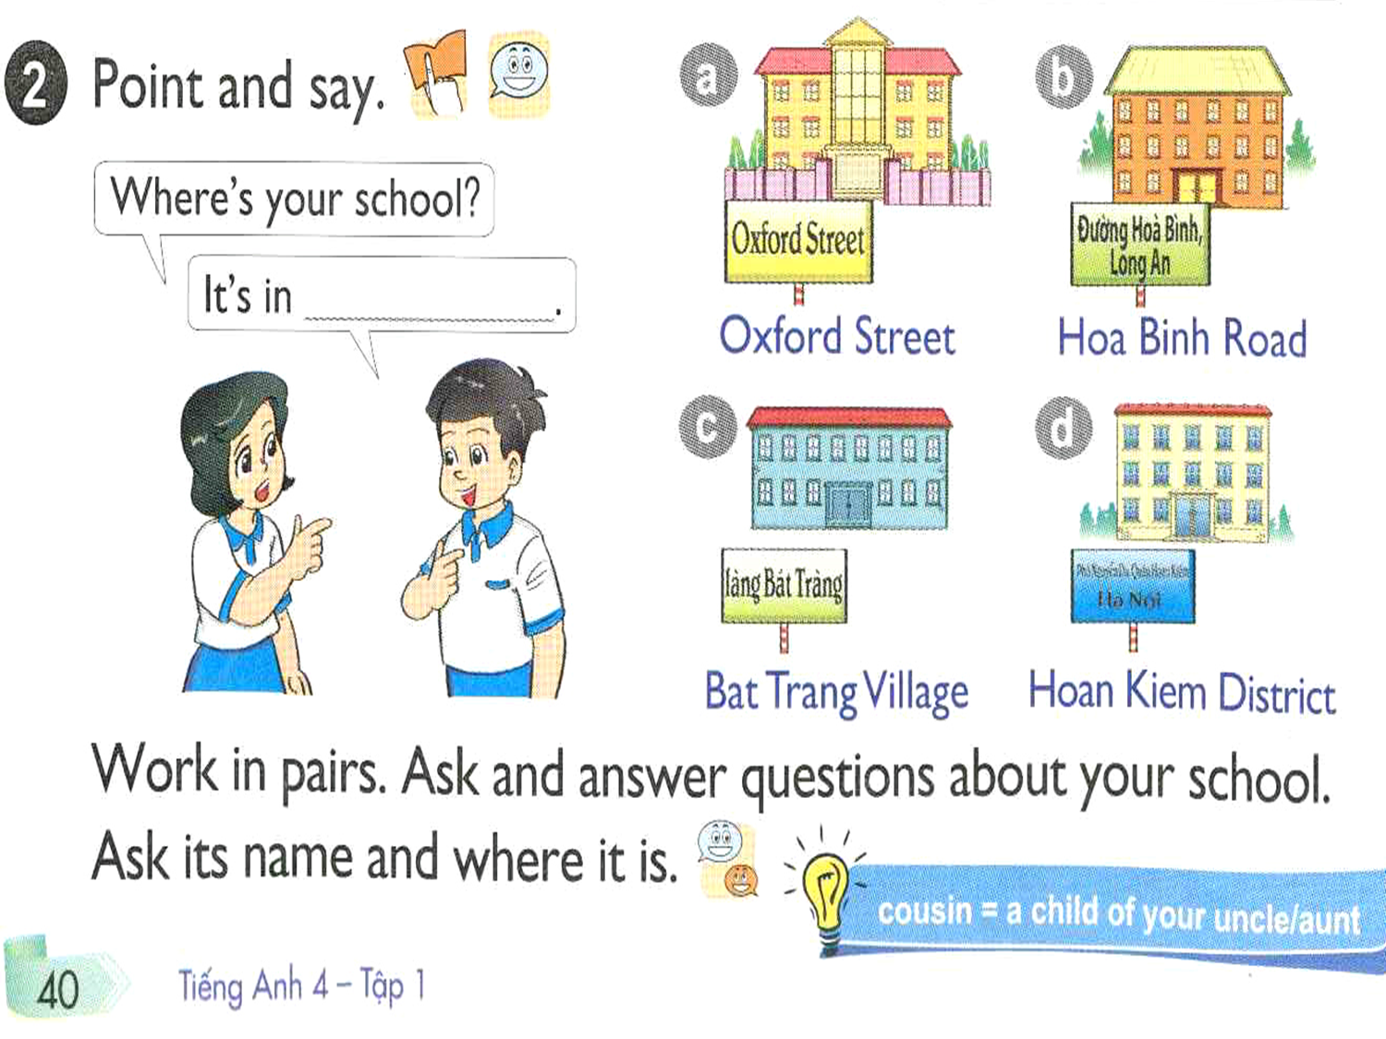

Slide 19
Practice
Where’s your school?
-> It’s in ………………………..
a. Oxford Street
b. Hoa Binh Road
c. Bat Trang Village
d.Hoan Kiem District

Slide 20
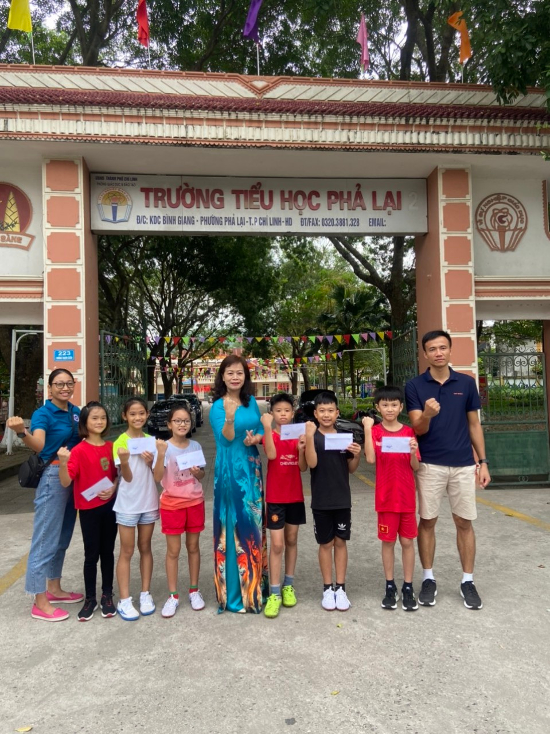

Slide 21
What is the name of your school?
It’s Pha Lai Primary school

Slide 22
Where’s your school?
It’s in Binh Giang street

Slide 23
Where’s your school?
-> It’s in
Binh Giang street
Maths
Binh Giang street

Slide 24
Where’s your school?
-> It’s in
Hoa Binh Road

Slide 25
Where’s your school?
-> It’s in
Tran Phu street
Đường (phố) Trần Phú

Slide 26
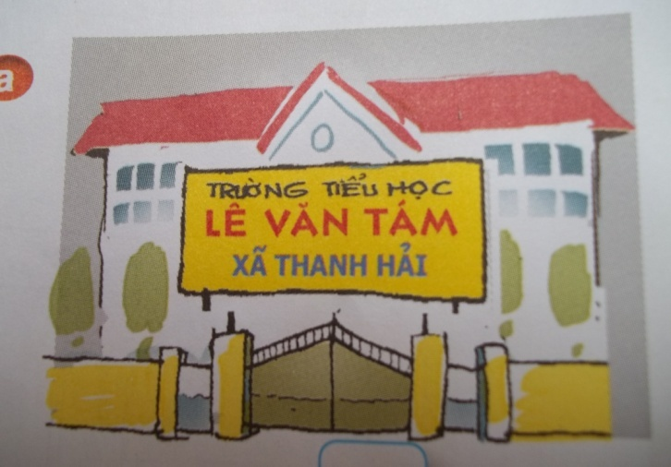

Where’s your school?
Thanh Hai Village
It’s in.......................

Slide 27
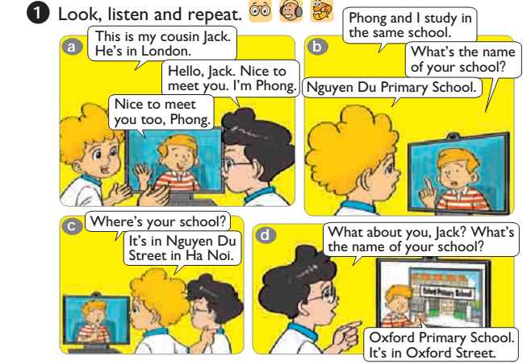
III, Skills: 1, Listening

Slide 28
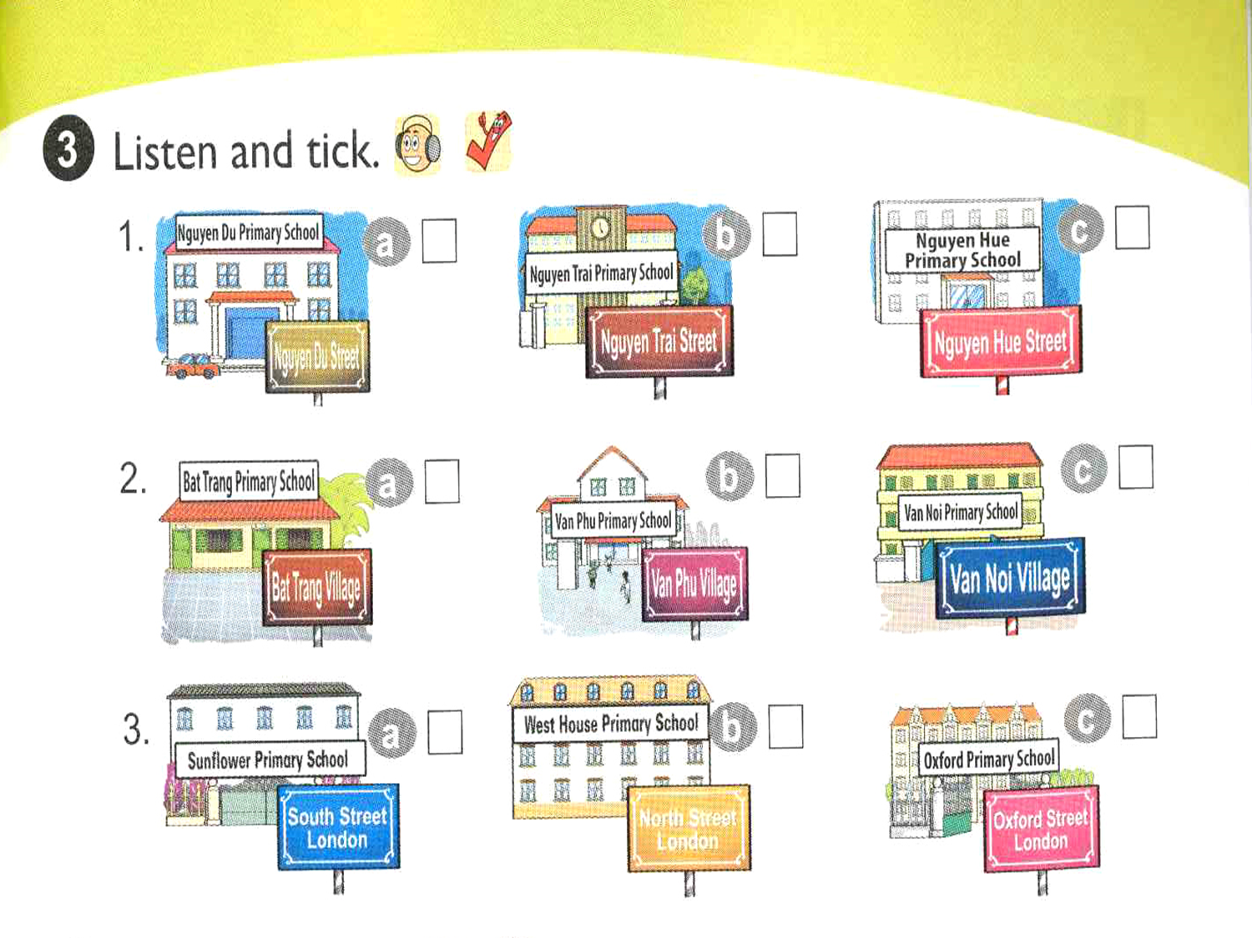
V
V
V

Slide 29
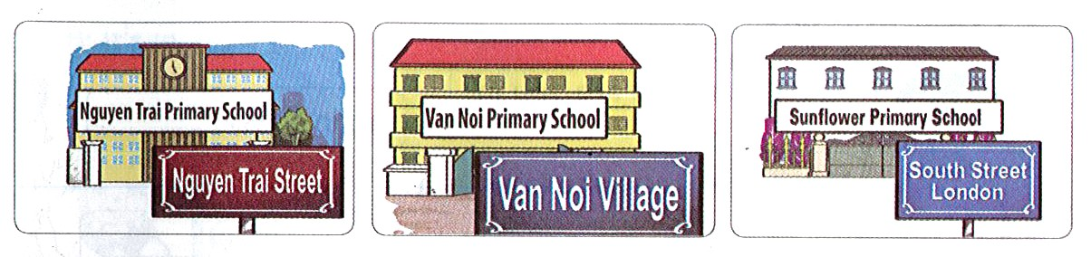
4. Look and write.
1.My school is in ……
………………………………………
is in
2.His school is….....
…………………………………….
3.Her school……………
…………………………………….
Nguyen Trai Street
in Van Noi Village
South Street London

Slide 30
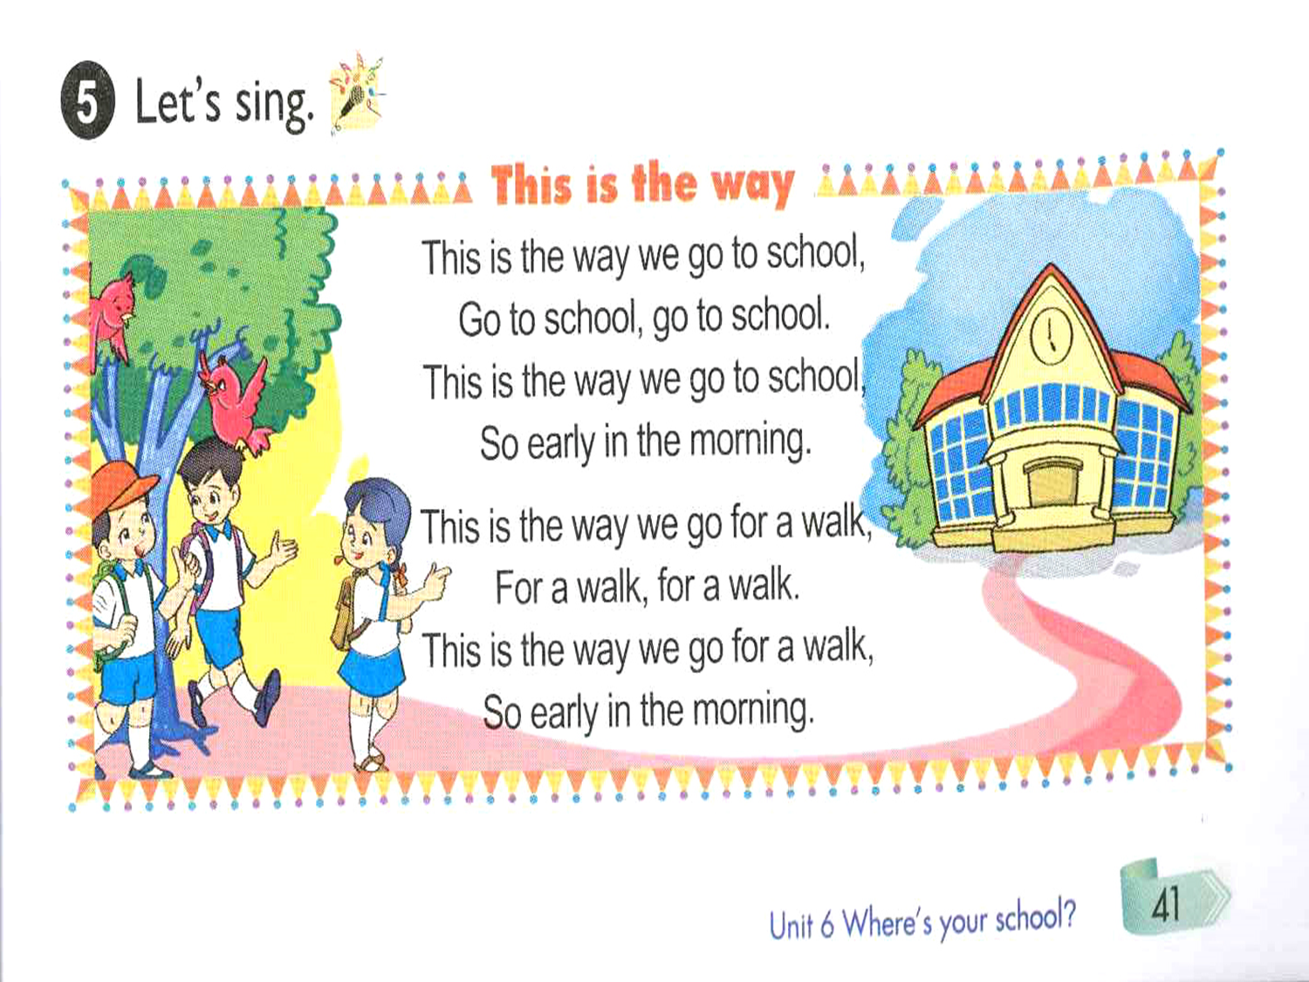

Slide 31



Play game
Ring The Golden Bell

Slide 32
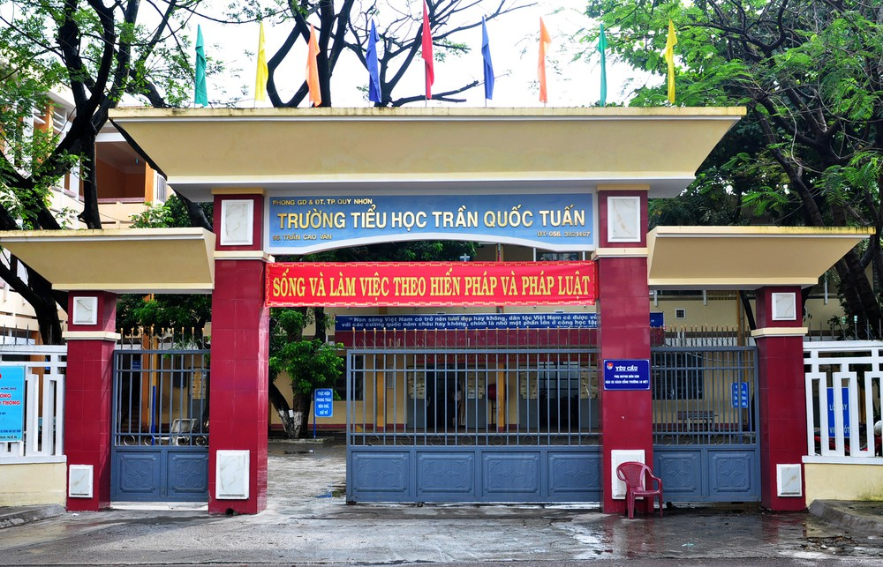

Ring The Golden Bell
Question 1
What’s the name of this school?
Tran Quoc Tuan
primary school
It’s............................
12
9
3
Street
Hết giờ
Hết giờ
Hết giờ
6

Slide 33
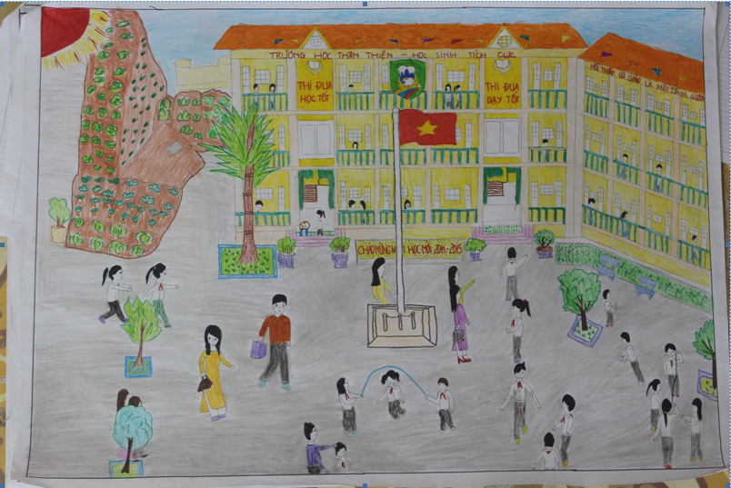
Ring The Golden Bell
12
Question 2
9
3
Hết giờ
6
Can you draw a school?
Yes,........../ No,..........
I can
I can’t
What’s the name of it?
Nguyen Khuyen primary school.
It’s…………………………………………….

Slide 34
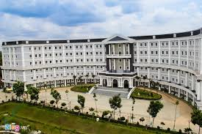
Ring The Golden Bell
Question 3
What is it?
It’s a............
school
primary school
Is it big?
yes, it is
12
9
3
Hết giờ
6

Slide 35
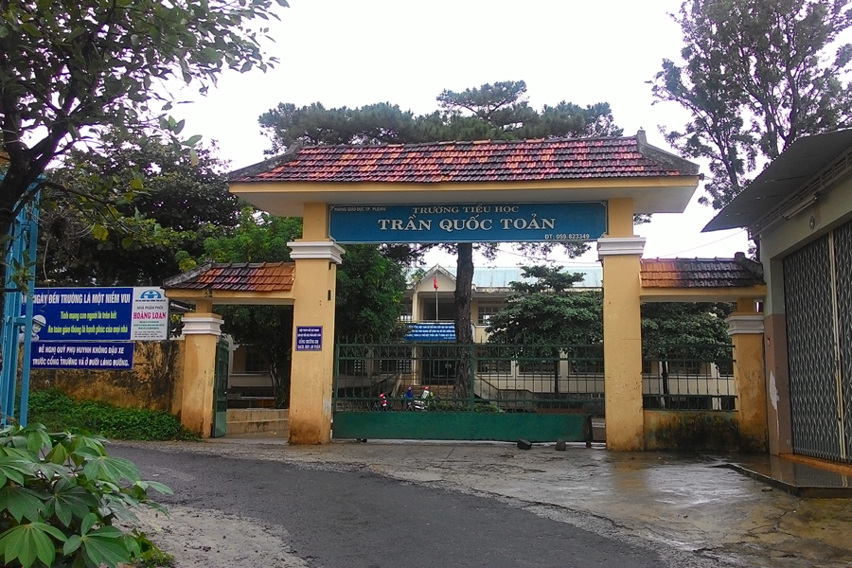
Ring The Golden Bell
Question 4
Where is the school?
Bao Loc District
It’s in.............................
12
Hết giờ
Bao Loc District
Village
9
3
6

Slide 36
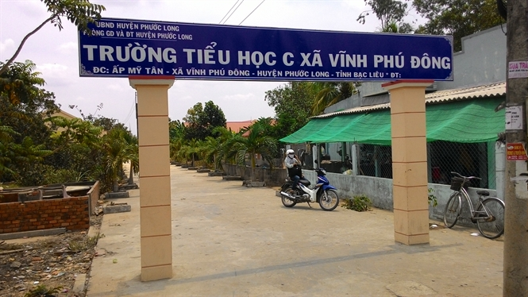
Ring The Golden Bell
Question 5
Is the school in the village?
Yes, it is
........................
Hết giờ
12
9
3
6

Slide 40

III. Homework
- Learn by heart the vocabulary.
Practise the sentence pattern.
Prepare Unit 6: lesson 2.

