Slide 1


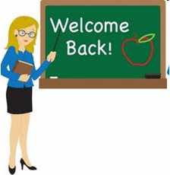
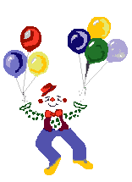


Welcome to our class
5 B
Pha lai Primary School
Teacher: DUONG THI YEN

Slide 2


Thursday, November 2nd 2023
Unit 6: How many lessons do you have today?
Lesson 2: 1, 2, 3.

Slide 3
Unit 6
HOW MANY LESSONS
DO YOU HAVE TODAY?
Lesson 2 :part 1,2,3

Slide 4
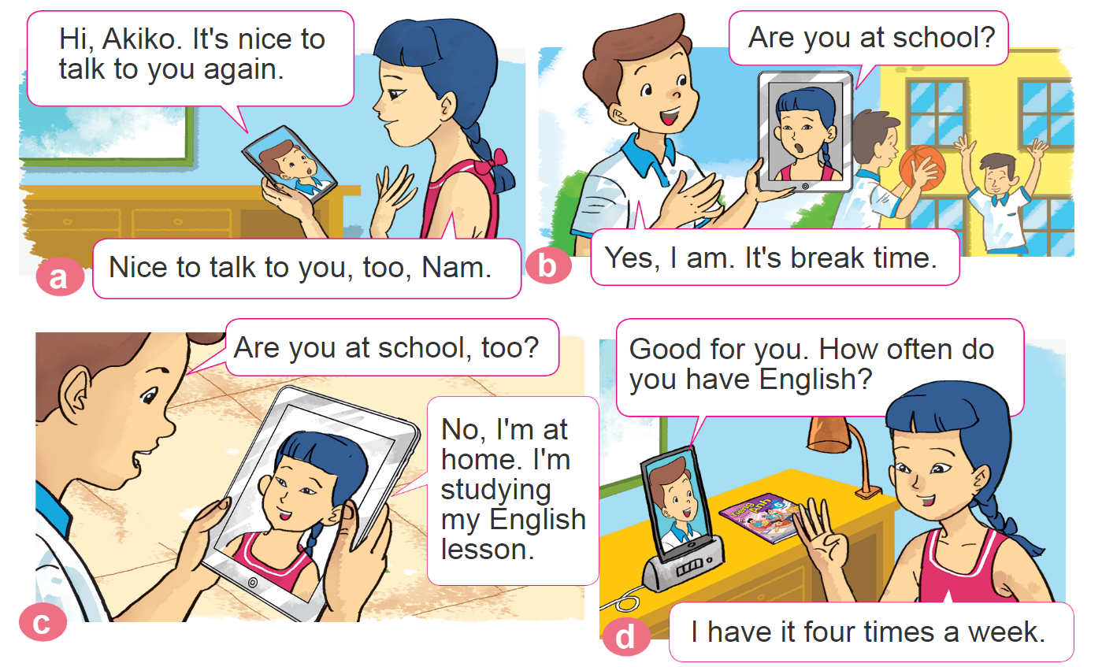

1. Look, listen and repeat.

Slide 5
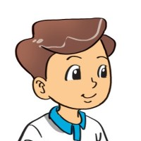
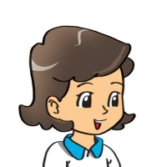




2. Point and say
How often do you have _________ ?
I have it _________.
every schoolday
once a week
twice a week
four times a week

Slide 6
Vocabulary.
once a week /wʌns ə wiːk/ 1 lần 1 tuần
twice a week /twaɪs ə wiːk/ 2 lần một tuần
three times a week /θriː taɪmz ə wiːk/ 3 lần một tuần
four times a week /fɔː taɪmz ə wiːk/ 4 lần một tuần
every schoolday /ˈevri sku:ldeɪ/ mỗi ngày học

Slide 7
Model sentences
How often do you have Music?
I have it once a week.
Maths
every schoolday
Music
once a week
Science
twice a week
Vietnamese
four times a week

Slide 8

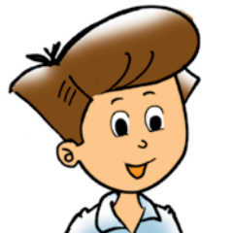



3. Let’s talk
How many lessons do you have today?
I have______.
I have it ______.
How often do you have _________?
+ adv
+ môn học
(Tớ học nó ________)
(Bạn học môn _______
thường xuyên như thế nào?)

Slide 9












Ms Huyền Phạm
0936.082.789
Ms Huyền Phạm
0936.082.789
Ms Huyền Phạm
0936.082.789
Ms Huyền Phạm - 0936.082.789 – YOUTUBE: MsPham. Facebook: Dạy và học cùng công nghệ.
Ms Huyền Phạm
0936.082.789
Notes:
Ms Huyền Phạm - 0936.082.789 – YOUTUBE: MsPham. Facebook: Dạy và học cùng công nghệ.

Slide 10
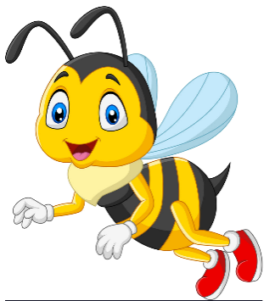
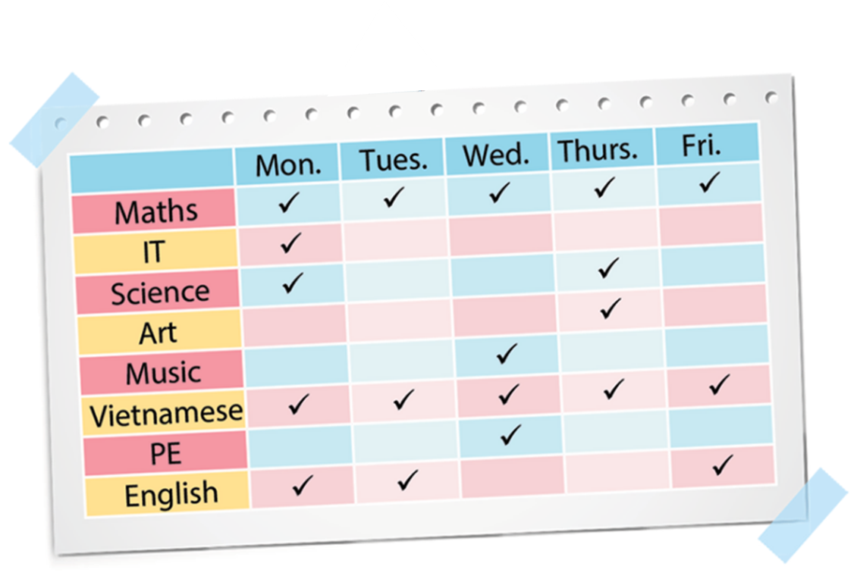





How often do you have IT?
Next
I have it
everyday.
I have it twice
a week.
I have it
once a week.
I have it
one a week.
Notes:
Ms Huyền Phạm - 0936.082.789 – YOUTUBE: MsPham. Facebook: Dạy và học cùng công nghệ.

Slide 11
How often do you have Maths?
Next
I have it
once a week.
I have everyday.
I it have everyday.
I have it everyday.
Notes:
Ms Huyền Phạm - 0936.082.789 – YOUTUBE: MsPham. Facebook: Dạy và học cùng công nghệ.

Slide 12
How often do you have English?
Next
I have it
once a week.
I have it
twice a week.
I have it three times a week.
I have it
everyday.
Notes:
Ms Huyền Phạm - 0936.082.789 – YOUTUBE: MsPham. Facebook: Dạy và học cùng công nghệ.

Slide 13
How often do you have Science?
Next
I have it
twice a week.
I have it
once a week.
I have it three times a week.
I have it
everyday.
Notes:
Ms Huyền Phạm - 0936.082.789 – YOUTUBE: MsPham. Facebook: Dạy và học cùng công nghệ.

Slide 14
How often do you have Music?
Next
I have it
once a week.
I have it
twice a week.
I have it three times a week.
I have it
everyday.
Notes:
Ms Huyền Phạm - 0936.082.789 – YOUTUBE: MsPham. Facebook: Dạy và học cùng công nghệ.

Slide 15
How often do you have Art?
Next
I have it
twice a week.
I have it
once a week.
I have it
everyday.
I have it three times a week.
Notes:
Ms Huyền Phạm - 0936.082.789 – YOUTUBE: MsPham. Facebook: Dạy và học cùng công nghệ.

Slide 16
How often do you have Vietnamese?
Next
I have it
once a week.
I have it three times a week.
I have it
twice a week.
I have it
everyday.
Notes:
Ms Huyền Phạm - 0936.082.789 – YOUTUBE: MsPham. Facebook: Dạy và học cùng công nghệ.

Slide 17
How often do you have PE?
Next
I have it three times a week.
I have it
once a week.
I have it
everyday.
I have it
twice a week.
Notes:
Ms Huyền Phạm - 0936.082.789 – YOUTUBE: MsPham. Facebook: Dạy và học cùng công nghệ.

Slide 18
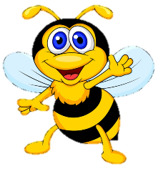







Notes:
Ms Huyền Phạm - 0936.082.789 – YOUTUBE: MsPham. Facebook: Dạy và học cùng công nghệ.

Slide 19
Best wishes to all of you.
Good bye. See you soon.

