Slide 2
Review 2
Lesson 3 – Period 3

Slide 3










Classroom Rules

Slide 4



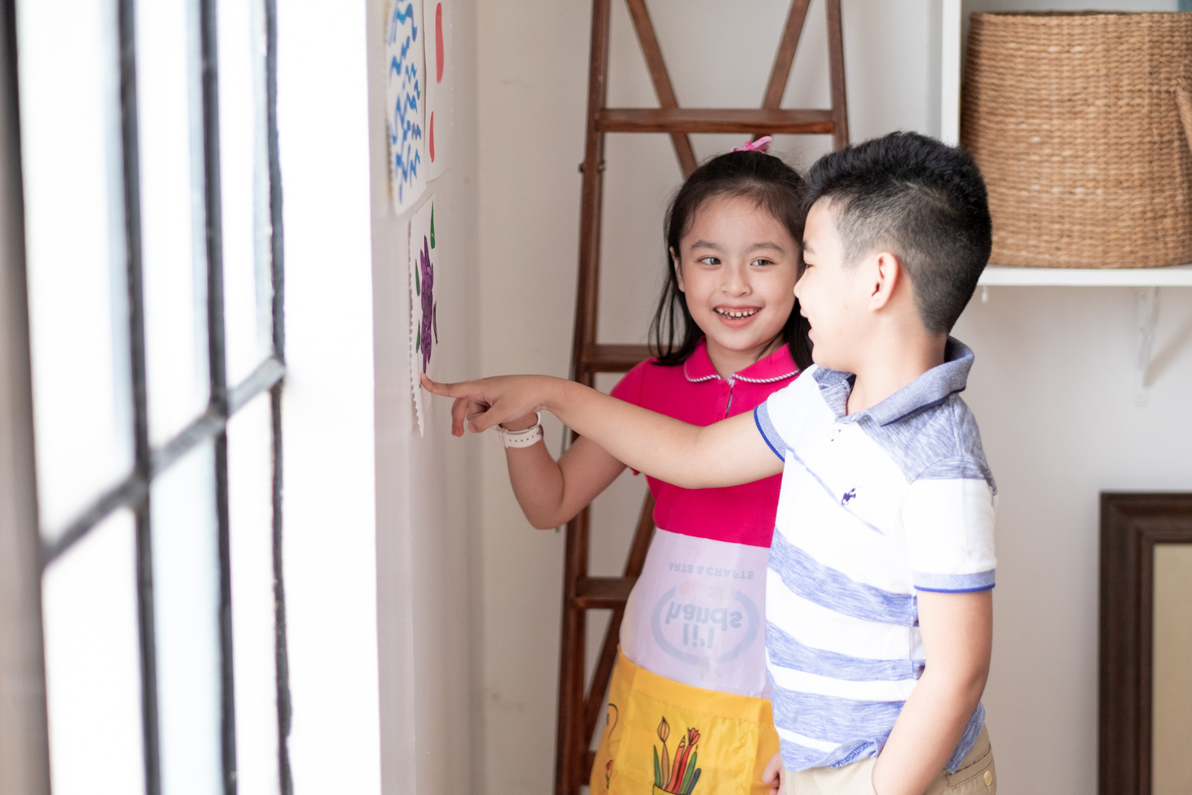



Rule 1
Listen to
your friend
talking in front.

Slide 5








Rule 2
Raise your hand
if you have a question.

Slide 6




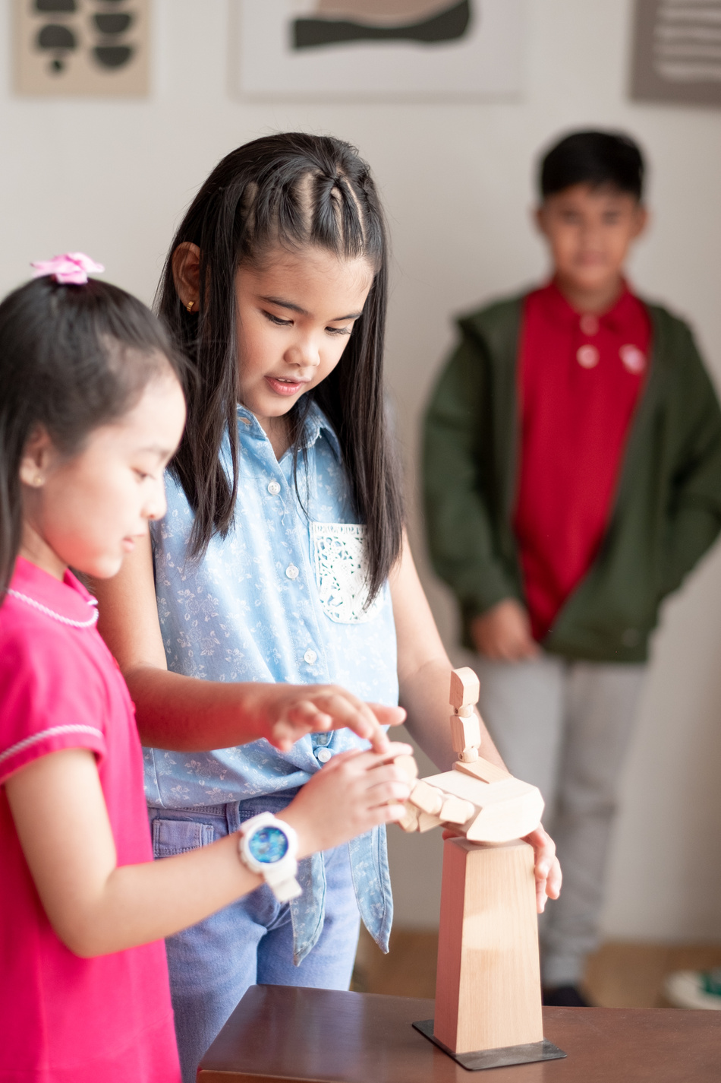


Rule 3
Wait for
your turn.

Slide 7

Table of contents
1. Warm up and review.
2. Activity 6: Read and tick.
3. Activity 7: Find the words.
4. Activity 8: Write the words.
5. Fun corner and wrap-up.

Slide 8

01
Warm-up and Review
Notes:
Listen to a letter. Say a word related to the letter.

Slide 9




Listen and chant.
V, v, van.
V, v, van.
V, v, van.
V, v, van.
This is a van.
This is a van.
This is a van.
This is a van.
V, v, village.
V, v, village.
V, v, village.
V, v, village.
This is a village.
This is a village.
This is a village.
This is a village.
V, v, volleyball.
V, v, volleyball.
V, v, volleyball.
V, v, volleyball.
This is a volleyball.
This is a volleyball.
This is a volleyball.
This is a volleyball.

Slide 10

02
Activity 6
Read AND tick

Slide 11








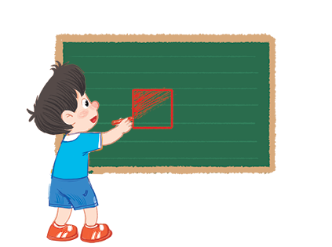
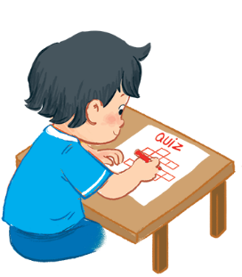



Read and tick.
1
2
3
A: Is there a box?
B: Yes, there is.
A: Can you draw a van?
B: Yes, I can.
A: What’s he doing?
B: He’s doing a quiz.

Slide 12



1
A: Is there a box?
B: Yes, there is.


Slide 13


2
A: Can you draw a van?
B: Yes, I can.


Slide 14
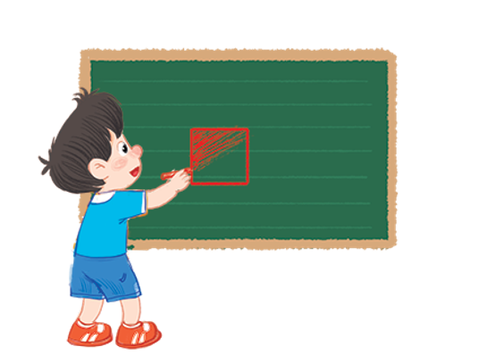

3
A: What’s he doing?
B: He’s doing a quiz.


Slide 15
03
Activity 7
Find the words

Slide 16


Find the words.
a | m | s | w | y | j | t | q
q | e | j | e | l | l | y | u
u | v | i | l | l | a | g | e
j | a | q | v | b | o | x | s
u | n | e | q | u | i | z | z
i | e | l | i | s | h | k | t
c | g | s | q | u | a | r | e
e | r | f | o | f | o | x | m
square
quiz
box
fox
juice
jelly
van
village

Slide 17
04
Activity 8
Write the words

Slide 18



Write the words.
v
i l l a g e
s
q u a r e
v
o l l e y b a l l
b
o x
j
u i c e
j
e l l y

Slide 19
05
Fun corner and wrap-up

Slide 20

Option 1
Option 2

Slide 21


Making
sentences
Notes:
- Divide the class into two teams.
- Nominate one pupil in each team as a leader. The leader says a sentence and the other members have to stand in a line, holding the word cards (draw/ van / you/ Can/ a/?) to make a sentence, e.g. Can you draw a van?
- Set a time limit for the teams to play the game.
- Invite two teams to the front of the class to play the game.
- Have the class give comments and announce the winner. The team that makes more correct sentences will win. Praise the winner.

Slide 22


Can
you
draw
a
van?
a
Can
draw
van ?
you

Slide 23
What’s
he
doing?
What’s
doing ?
he

Slide 24
He’s
doing
a
quiz.
a
doing
quiz.
He’s

Slide 25
Is
there
a
box?
a
there
box ?
Is

Slide 26
What’s
she
doing?
What’s
doing ?
she

Slide 27


Slide 28


10
9
8
Flashcard walk
7
6
5
4
3
2
1
TEAM A & B
Notes:
GV click vào ô câu hỏi để hiện flashcard, sau khi HS trả lời đúng sẽ được lên 1 nấc thang kế bên. Thời gian chơi trong vòng 2 phút.

Slide 29
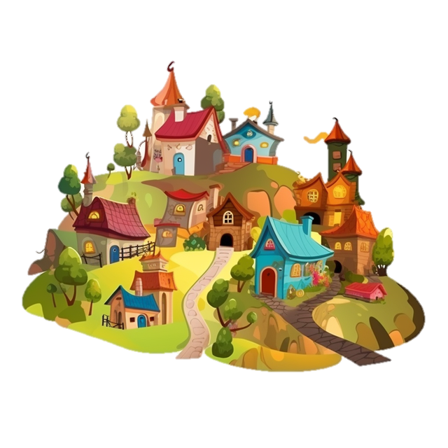









Excellent
10
9
8
7
Question 10
Question 9
Question 8
Question 7
Question 6
Question 5
Question 4
Question 3
Question 2
Question 1
6
5
4
3
2 : 00
1 : 59
1 : 58
1 : 57
1 : 56
1 : 55
1 : 54
1 : 53
1 : 52
1 : 51
1 : 50
1 : 49
1 : 48
1 : 47
1 : 46
1 : 45
1 : 44
1 : 43
1 : 42
1 : 41
1 : 40
1 : 39
1 : 38
1 : 37
1 : 36
1 : 35
1 : 34
1 : 33
1 : 32
1 : 31
1 : 30
1 : 29
1 : 28
1 : 27
1 : 26
1 : 25
1 : 24
1 : 23
1 : 22
1 : 21
1 : 20
1 : 19
1 : 18
1 : 17
1 : 16
1 : 15
1 : 14
1 : 13
1 : 12
1 : 11
1 : 10
1 : 09
1 : 08
1 : 07
1 : 06
1 : 05
1 : 04
1 : 03
1 : 02
1 : 01
1 : 00
0 : 59
0 : 58
0 : 57
0 : 56
0 : 55
0 : 54
0 : 53
0 : 52
0 : 51
0 : 50
0 : 49
0 : 48
0 : 47
0 : 46
0 : 45
0 : 44
0 : 43
0 : 42
0 : 41
0 : 40
0 : 39
0 : 38
0 : 37
0 : 36
0 : 35
0 : 34
0 : 43
0 : 32
0 : 31
0 : 30
0 : 29
0 : 28
0 : 27
0 : 26
0 : 25
0 : 24
0 : 23
0 : 22
0 : 21
0 : 20
0 : 19
0 : 18
0 : 17
0 : 16
0 : 15
0 : 14
0 : 13
0 : 12
0 : 11
0 : 10
0 : 09
0 : 08
0 : 07
0 : 06
0 : 05
0 : 04
0 : 03
0 : 02
0 : 01
2
0 : 00
1
TEAM A
Notes:
GV click vào ô câu hỏi để hiện flashcard, sau khi HS trả lời đúng sẽ được lên 1 nấc thang kế bên. Thời gian chơi trong vòng 2 phút.

Slide 30
Excellent
10
9
8
7
Question 10
Question 9
Question 8
Question 7
Question 6
Question 5
Question 4
Question 3
Question 2
Question 1
6
5
4
3
2 : 00
1 : 59
1 : 58
1 : 57
1 : 56
1 : 55
1 : 54
1 : 53
1 : 52
1 : 51
1 : 50
1 : 49
1 : 48
1 : 47
1 : 46
1 : 45
1 : 44
1 : 43
1 : 42
1 : 41
1 : 40
1 : 39
1 : 38
1 : 37
1 : 36
1 : 35
1 : 34
1 : 33
1 : 32
1 : 31
1 : 30
1 : 29
1 : 28
1 : 27
1 : 26
1 : 25
1 : 24
1 : 23
1 : 22
1 : 21
1 : 20
1 : 19
1 : 18
1 : 17
1 : 16
1 : 15
1 : 14
1 : 13
1 : 12
1 : 11
1 : 10
1 : 09
1 : 08
1 : 07
1 : 06
1 : 05
1 : 04
1 : 03
1 : 02
1 : 01
1 : 00
0 : 59
0 : 58
0 : 57
0 : 56
0 : 55
0 : 54
0 : 53
0 : 52
0 : 51
0 : 50
0 : 49
0 : 48
0 : 47
0 : 46
0 : 45
0 : 44
0 : 43
0 : 42
0 : 41
0 : 40
0 : 39
0 : 38
0 : 37
0 : 36
0 : 35
0 : 34
0 : 43
0 : 32
0 : 31
0 : 30
0 : 29
0 : 28
0 : 27
0 : 26
0 : 25
0 : 24
0 : 23
0 : 22
0 : 21
0 : 20
0 : 19
0 : 18
0 : 17
0 : 16
0 : 15
0 : 14
0 : 13
0 : 12
0 : 11
0 : 10
0 : 09
0 : 08
0 : 07
0 : 06
0 : 05
0 : 04
0 : 03
0 : 02
0 : 01
2
0 : 00
1
TEAM B
Notes:
GV click vào ô câu hỏi để hiện flashcard, sau khi HS trả lời đúng sẽ được lên 1 nấc thang kế bên. Thời gian chơi trong vòng 2 phút.

Slide 31
Website: hoclieu.vn
Fanpage: facebook.com/www.tienganhglobalsuccess.vn

