Slide 1
Unit 2: time and daily routine
Lesson 3- period 5

Slide 2
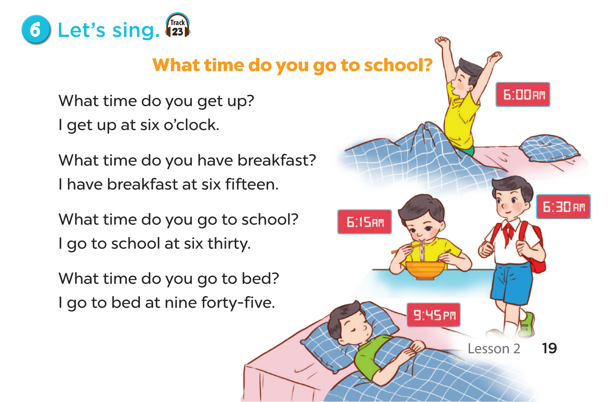


Slide 3
02
Listen and repeat

Slide 4
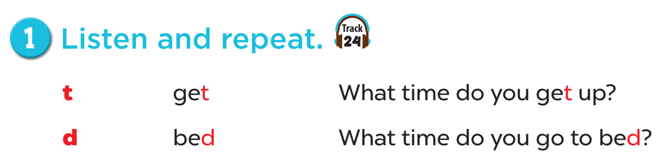

Slide 5
03
Listen and circle

Slide 6
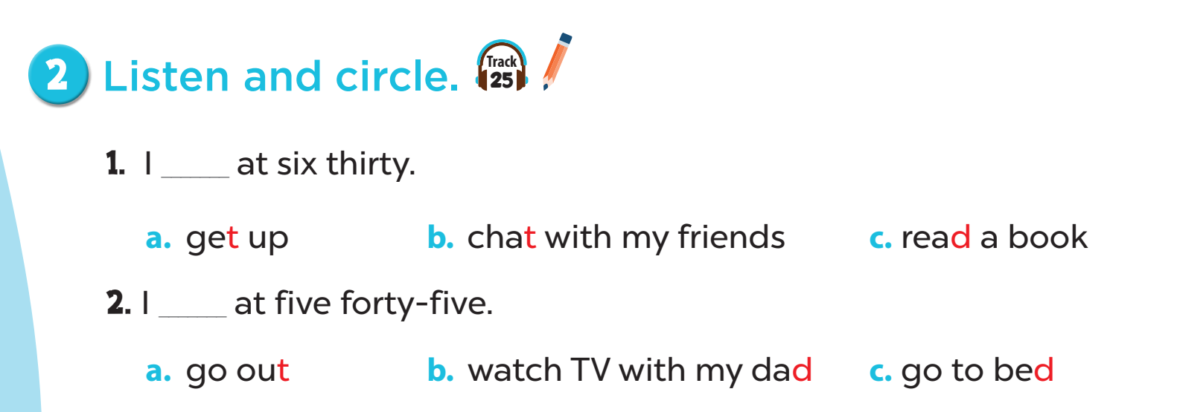

Slide 7


Slide 8
04
Let’s chant

Slide 9
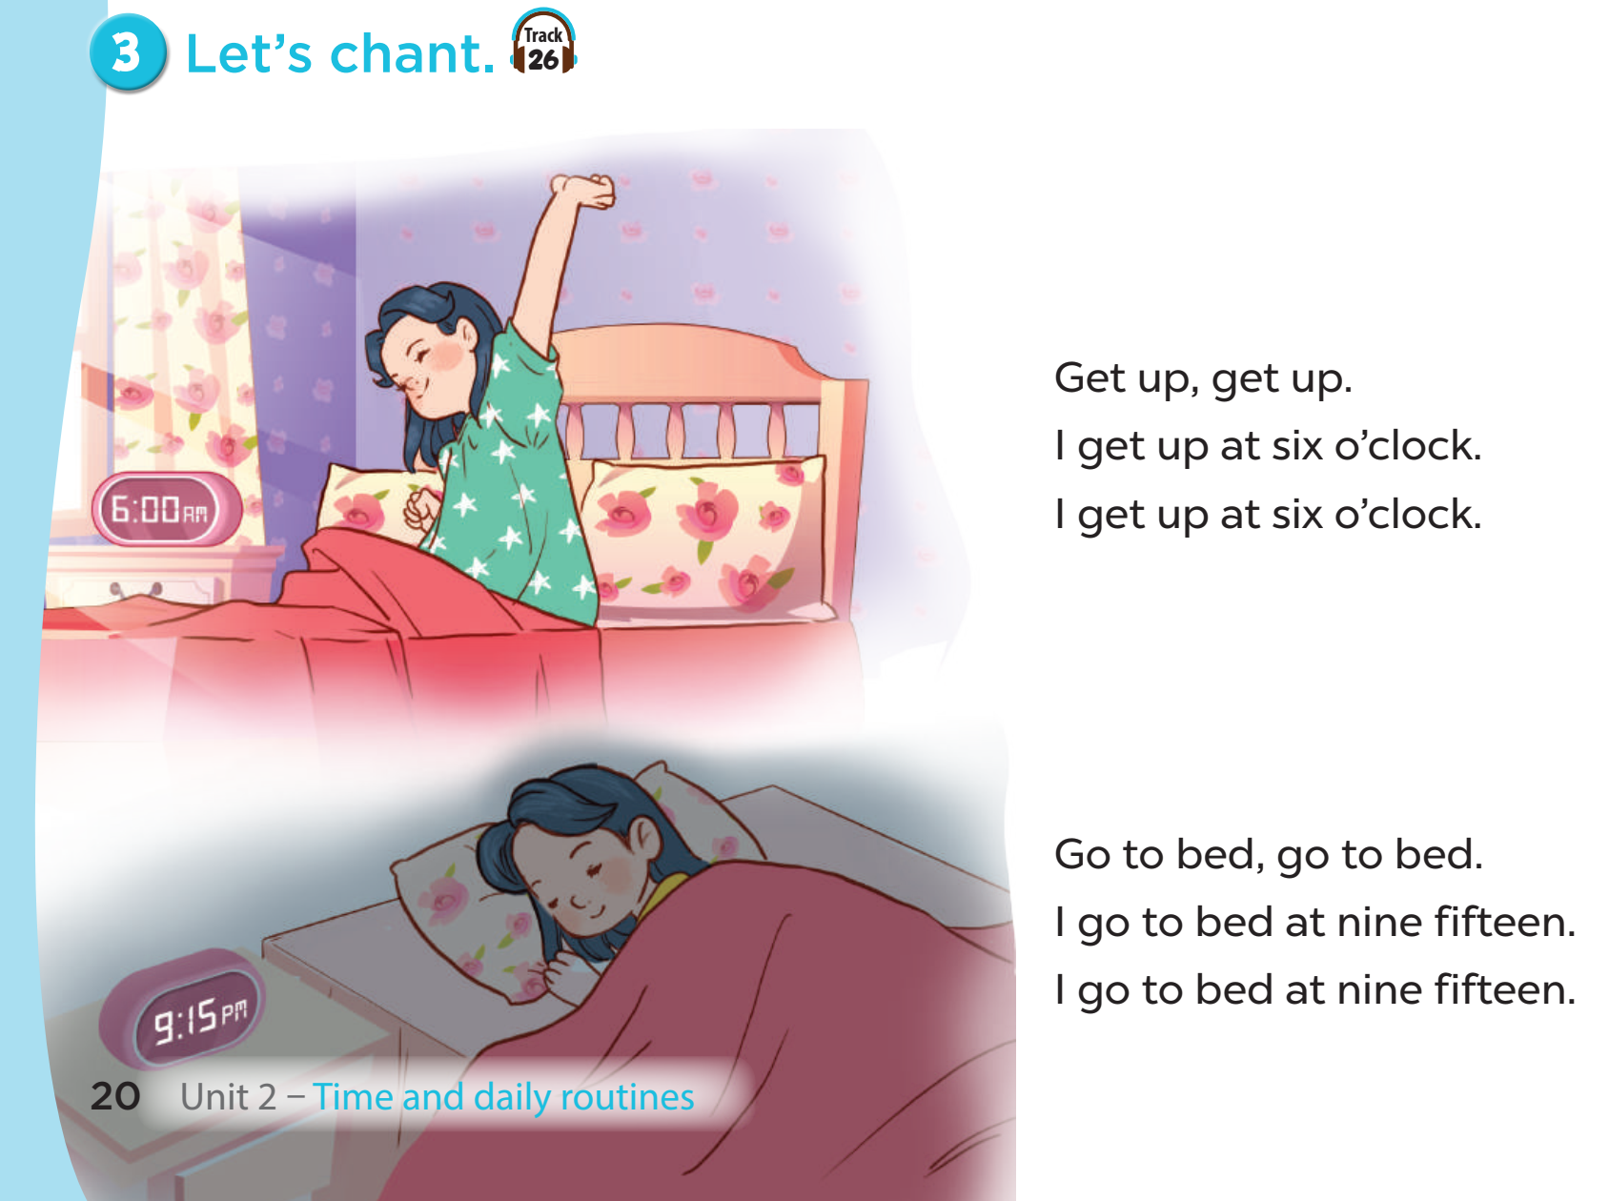

Slide 10
05
Wrap-up and fun time

Slide 11
TIGER
DONKEY
TEACHER
DUCK
SPIN AND SAY
TUB
T
DUCK
D
DOG
GET
BED
TIGER
Click the needle to start and then again to stop the wheel. Then click on the selected section.
Notes:
Let’s students spin and practice the words which contain the target sounds

