Slide 1
Unit 2: time and daily routine
Lesson 2- period 4

Slide 2
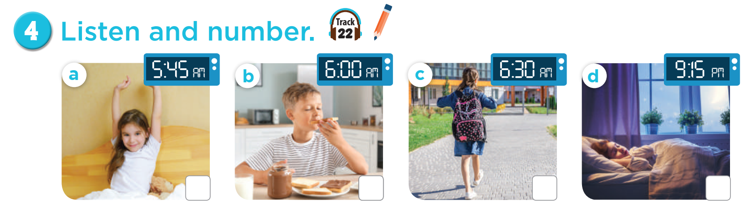
SLAP THE BOARD
Notes:
Teacher can read the action or time

Slide 3


Slide 4
3
4
2
1

Slide 5
03
Look, complete and read

Slide 6
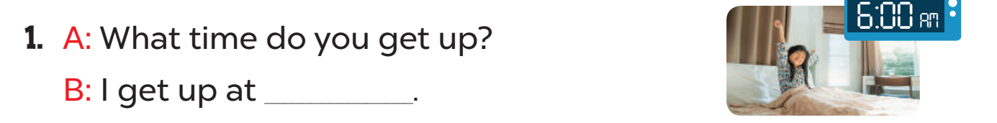
6 o’clock.

Slide 7
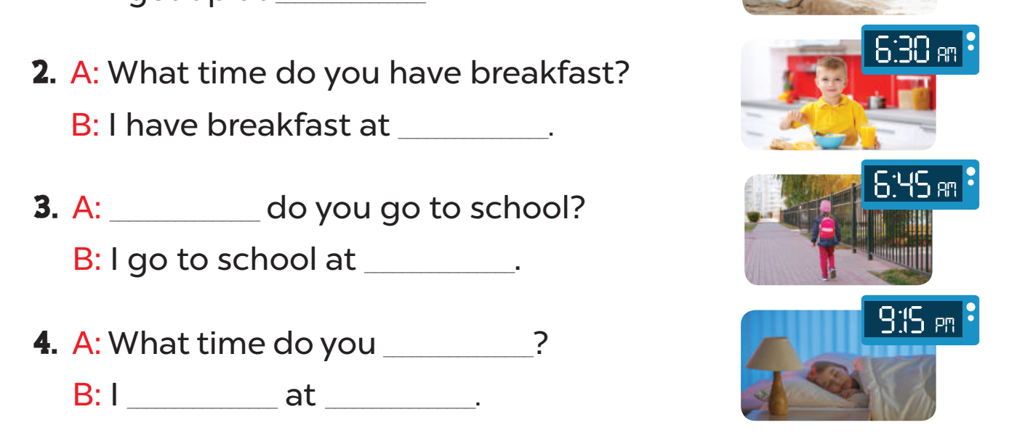

Slide 8
six thirty
What time
six forty-five
go to bed
go to bed
nine fifteen

Slide 9
04
Let’s sing

Slide 10
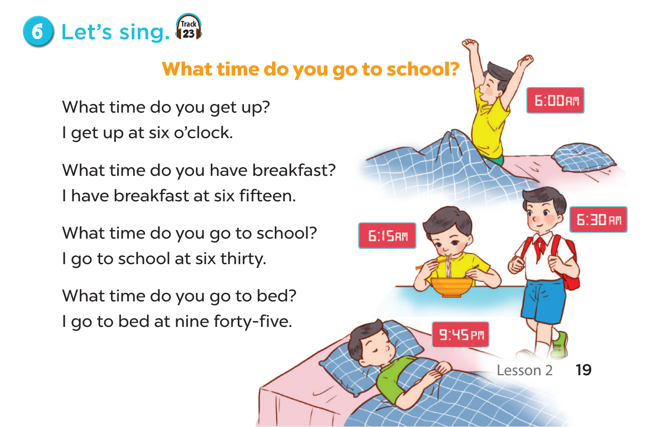

Slide 11
05
Wrap-up and fun time

Slide 12
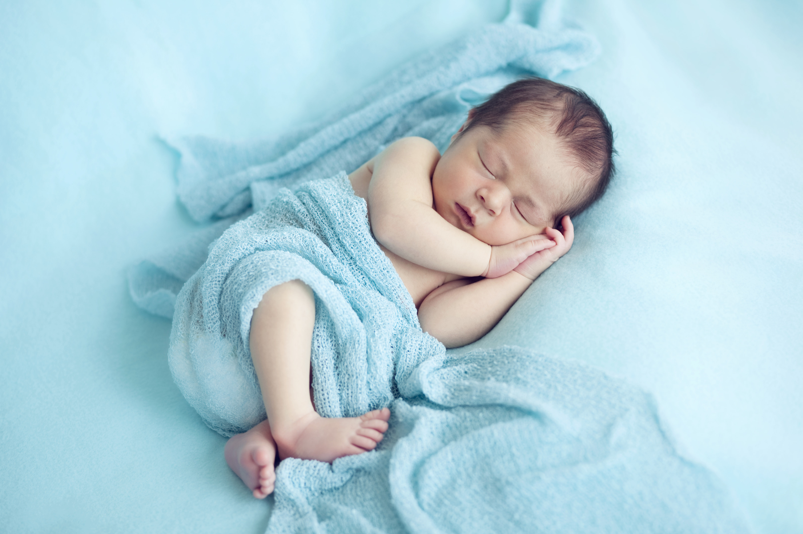

What/bed?/go/
time/you/do/to
Check
What time do you go to bed?

Slide 13
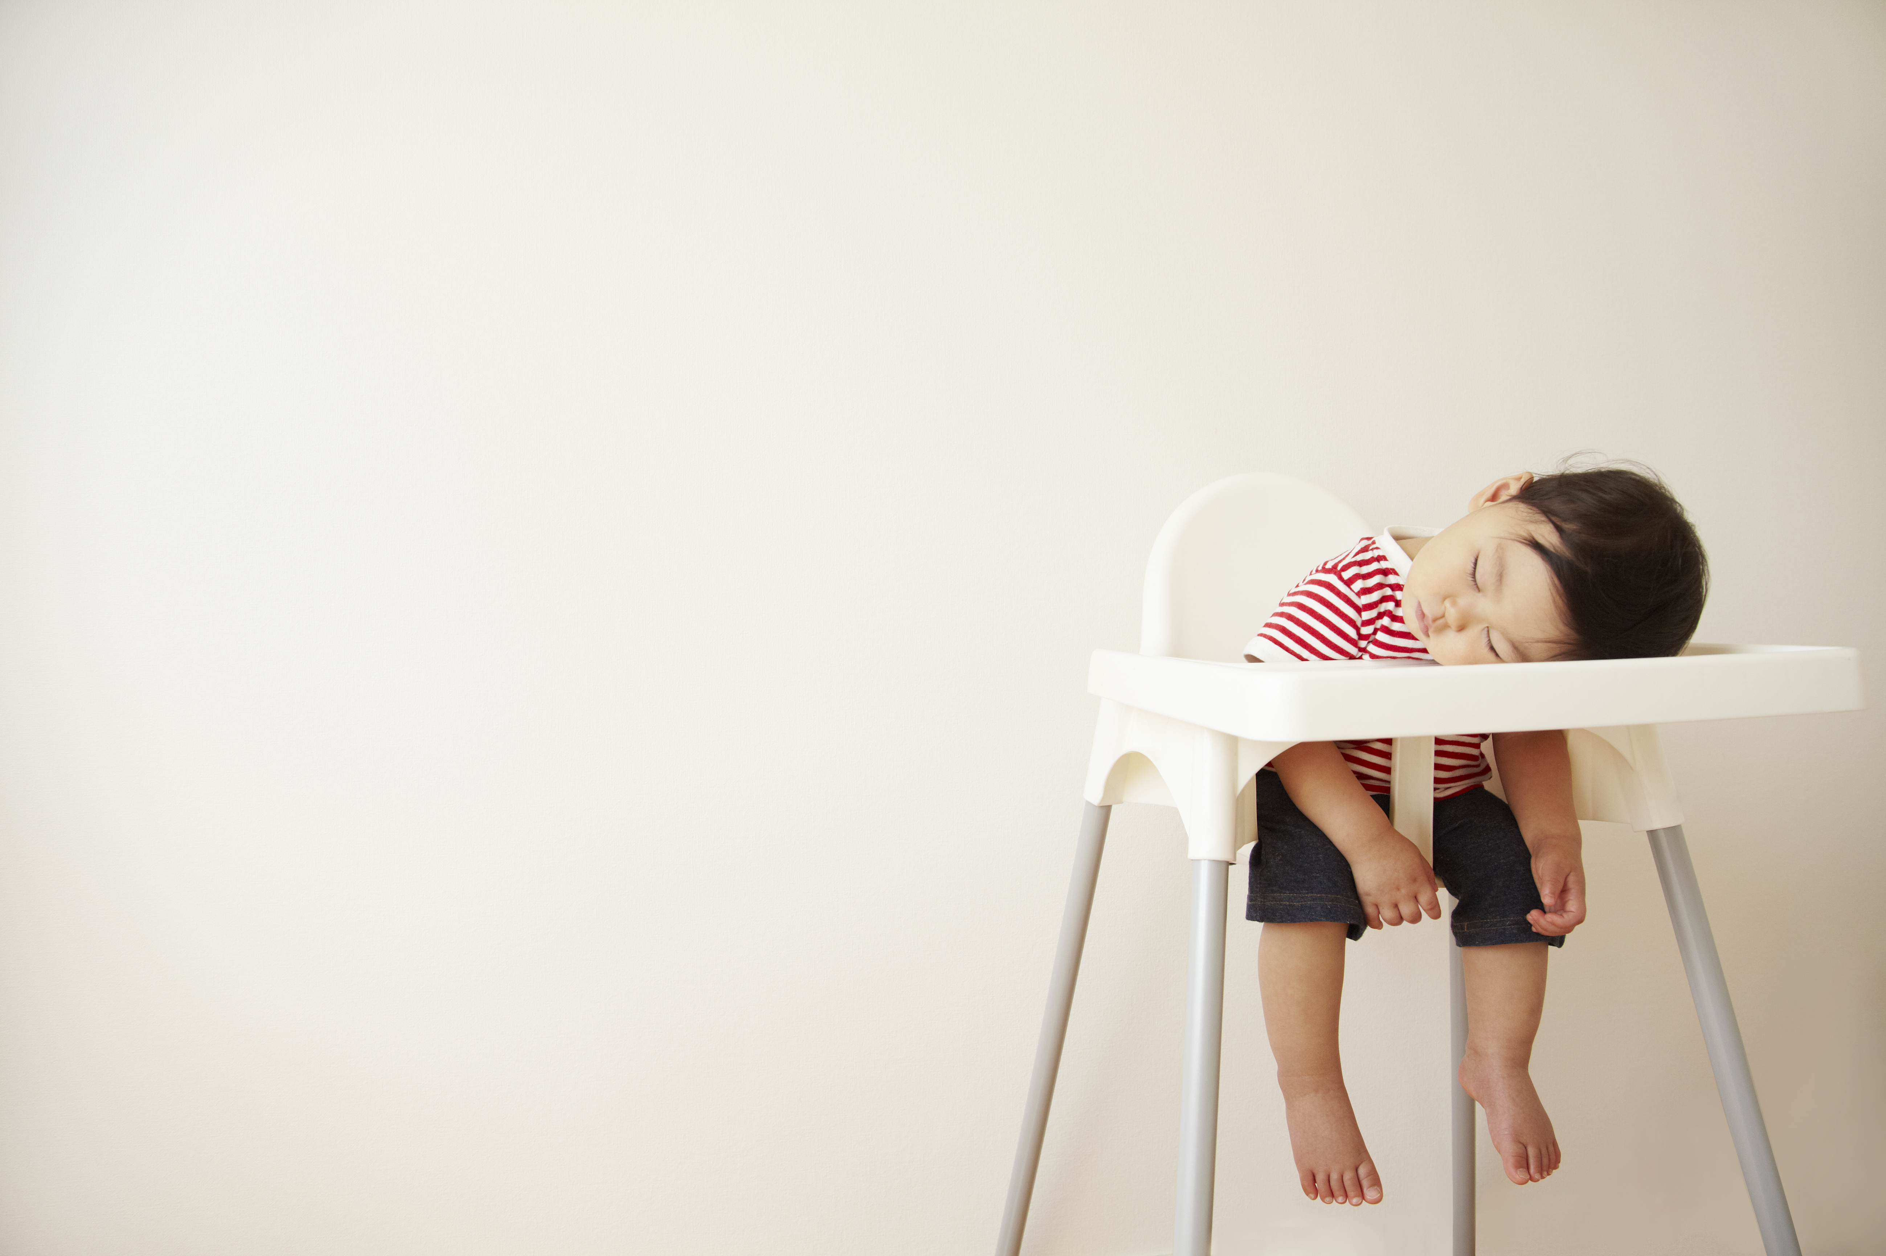
nine/fifteen/I/
go/to/at/bed
Check
I go to bed at nine fifteen.

Slide 14
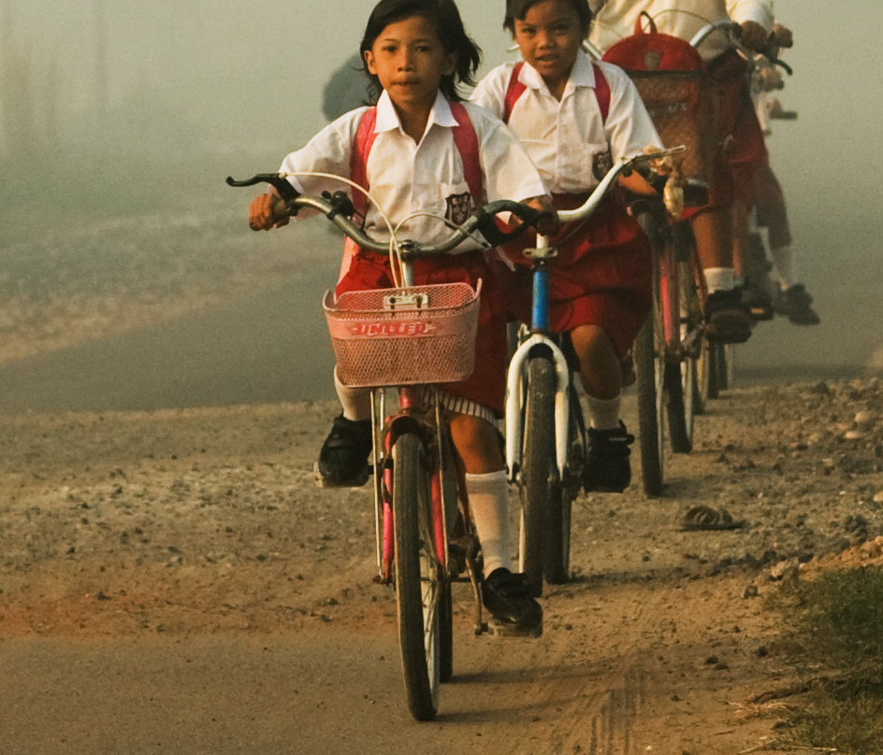
I/ six/forty-five/
school/to/go/at
Check
This Photo by Unknown Author is licensed under CC BY-NC-ND
This Photo by Unknown Author is licensed under CC BY
I go to school at six forty-five.

Slide 15
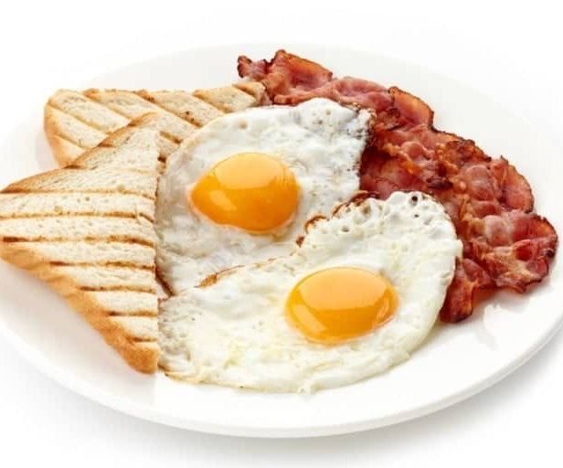
I/breakfast/at/
have/five/thirty.
Check
This Photo by Unknown Author is licensed under CC BY-SA
I have breakfast at five thirty.

Slide 16

End

