Slide 1
Unit 2: time and daily routine
Lesson 1- period 1

Slide 2
Table of Contents
01
02
03
04
Warm-up
Look, listen and repeat
Listen, point and say
Let’s talk
Wrap-up & fun conner
05

Slide 3
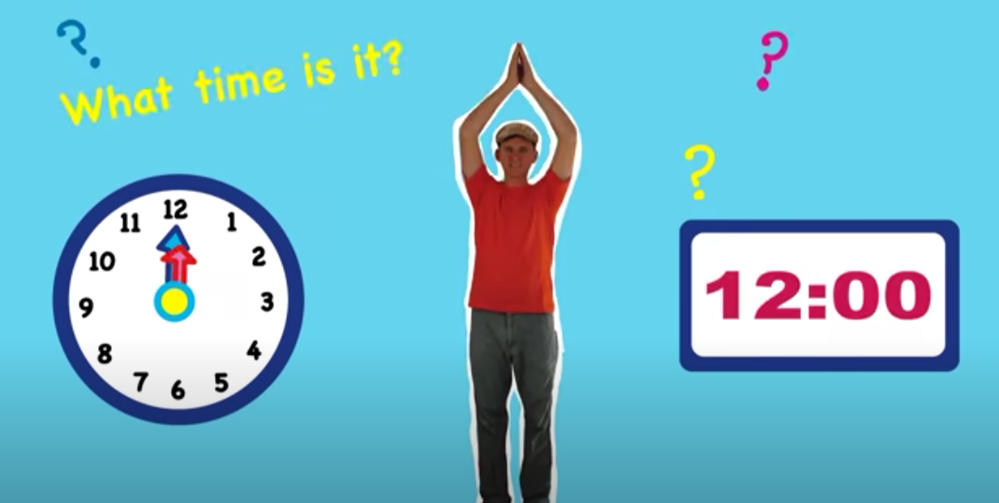
Notes:
https://www.youtube.com/watch?v=0Yq_rztquuU

Slide 4
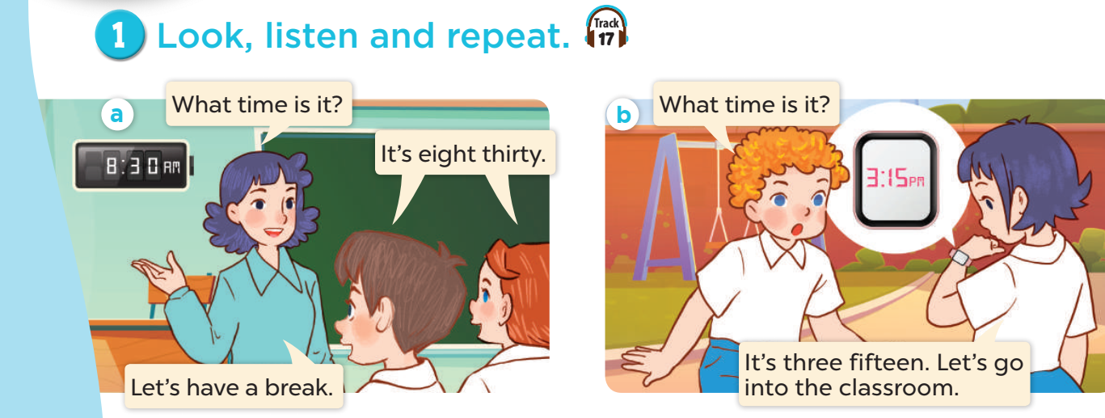


Slide 5
vocabulary

Slide 6
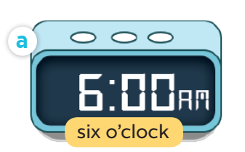

Slide 7
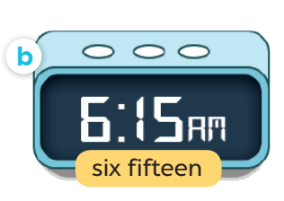

Slide 8
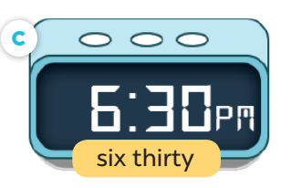

Slide 9
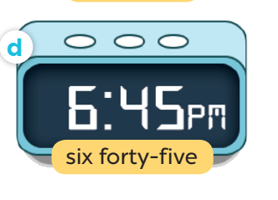

Slide 10
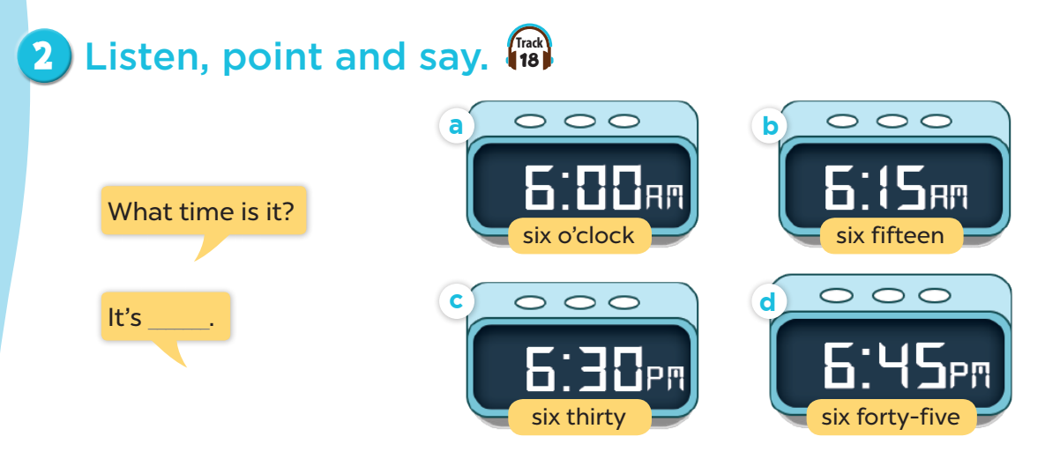

Slide 11
What time is it?
I six o’clock.

Slide 12
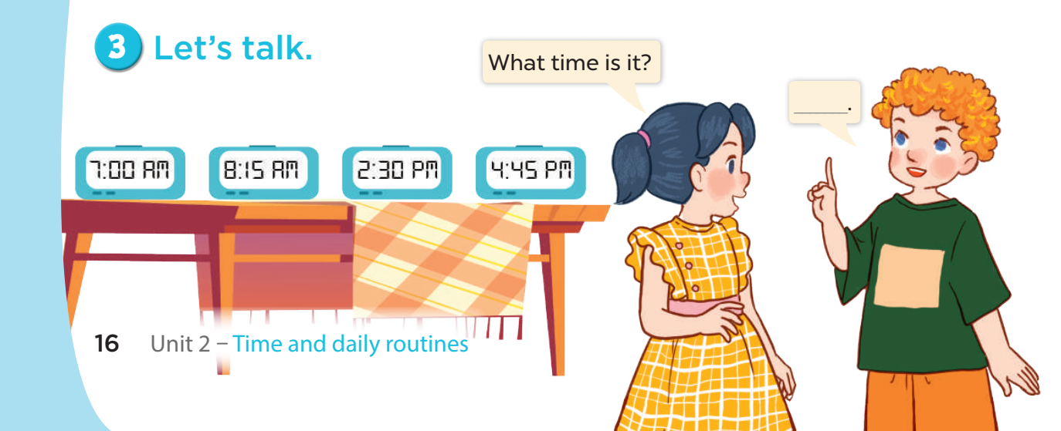

Slide 13



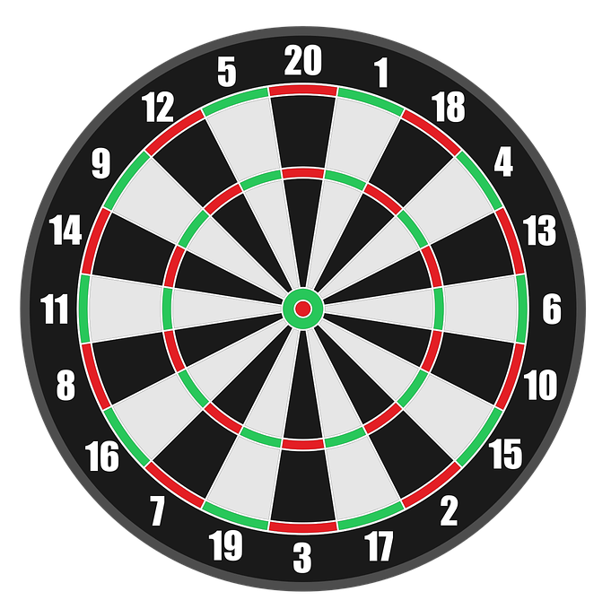

PLAY

Slide 14

What time is it?
It’s ……………..
+50
Seven thirty
Seven o’clock
Six o’clock
Next

Slide 15
What time is it?
It’s ……………..
+50
Eight fifteen
Eight fifty
Eight five
Next

Slide 16
What time is it?
It’s ……………..
+25
Two three
Two thirty
Two thirteen
Next

Slide 17
What time is it?
It’s ……………..
+25
Four fifteen
Four forty
Four forty-five
Next

Slide 18
WELL DONE!
EXIT

