Slide 1


Slide 2










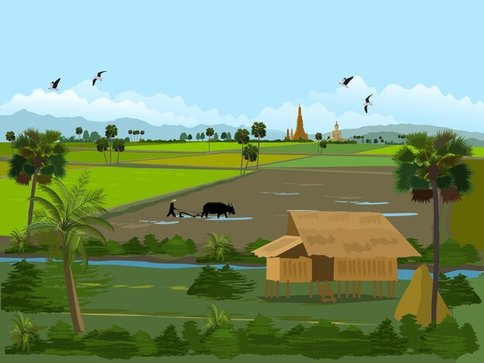
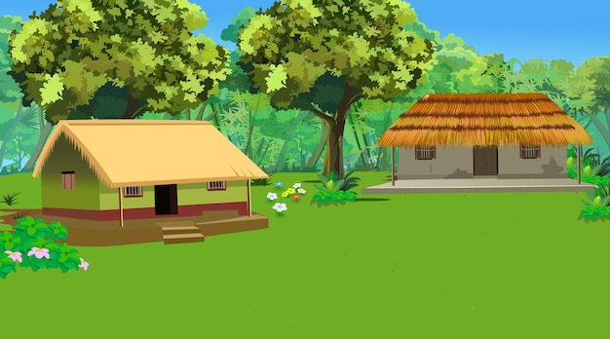

Unit

Slide 3










Classroom Rules

Slide 4



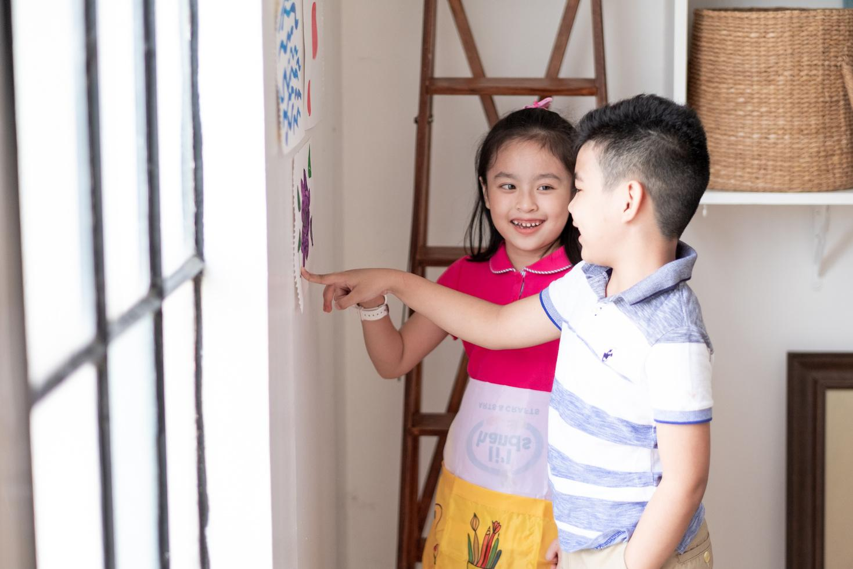



Rule 1
Listen to
your friend
talking in front.

Slide 5






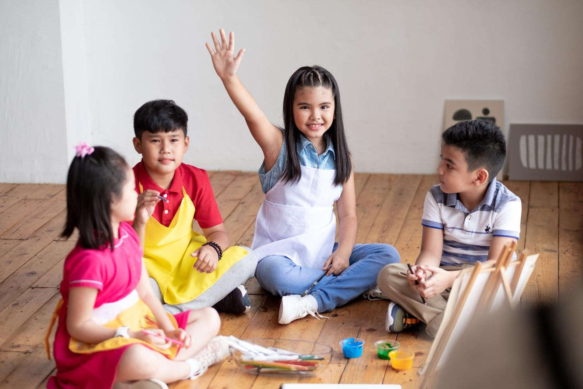

Rule 2
Raise your hand
if you have a question.

Slide 6




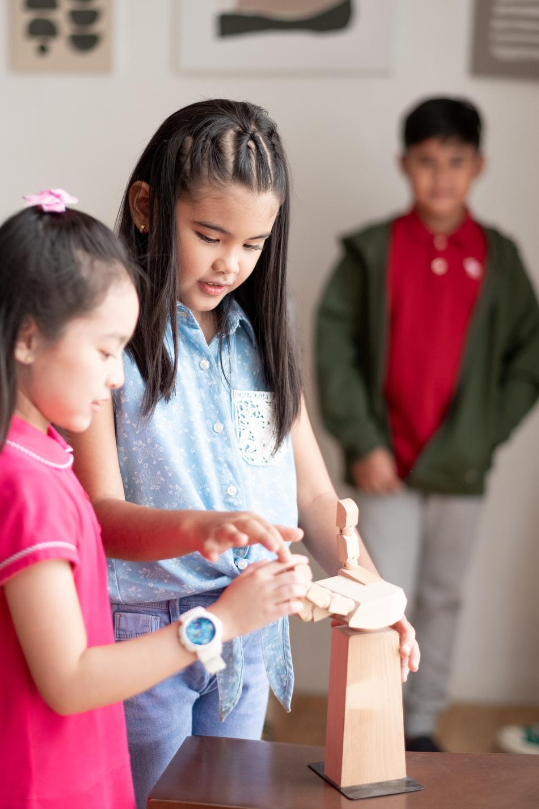


Rule 3
Wait for
your turn.

Slide 7

Table of contents
1. Warm-up and review.
2. Activity 6: Listen and repeat.
3. Activity 7: Let’s talk.
4. Activity 8: Let’s sing.
5. Fun corner and wrap-up.

Slide 8
01
Warm-up
&
Review

Slide 9

Hot seat

Slide 10
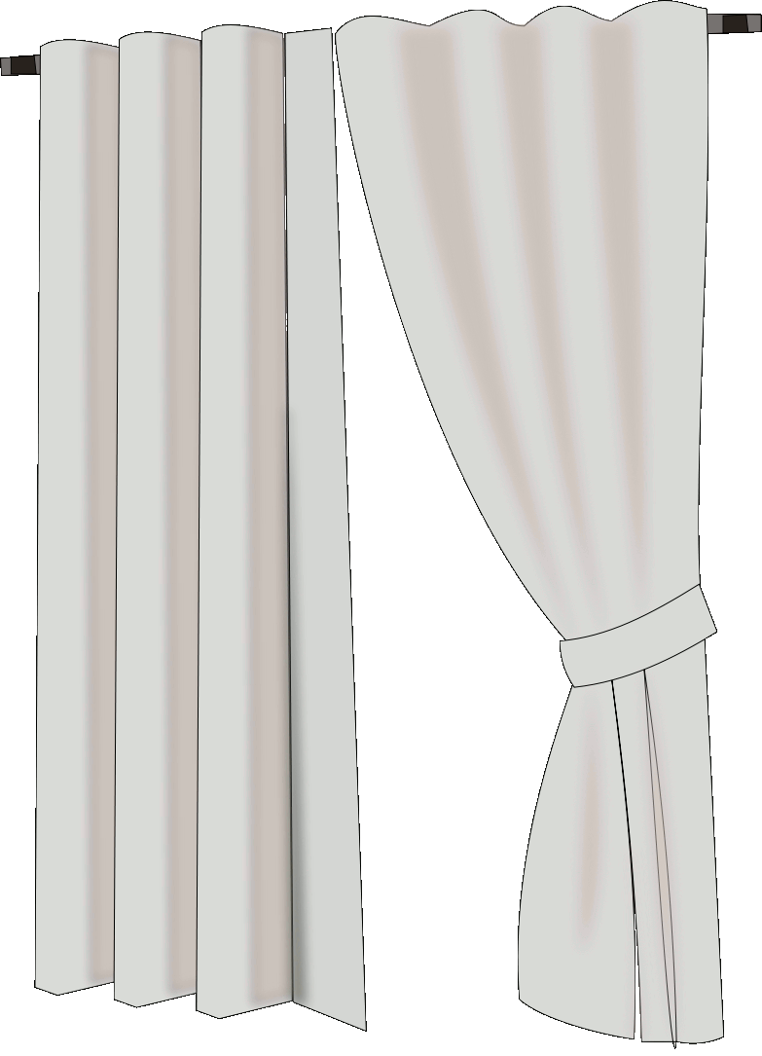


Ready !
van

Slide 11

Ready !
volleyball

Slide 12
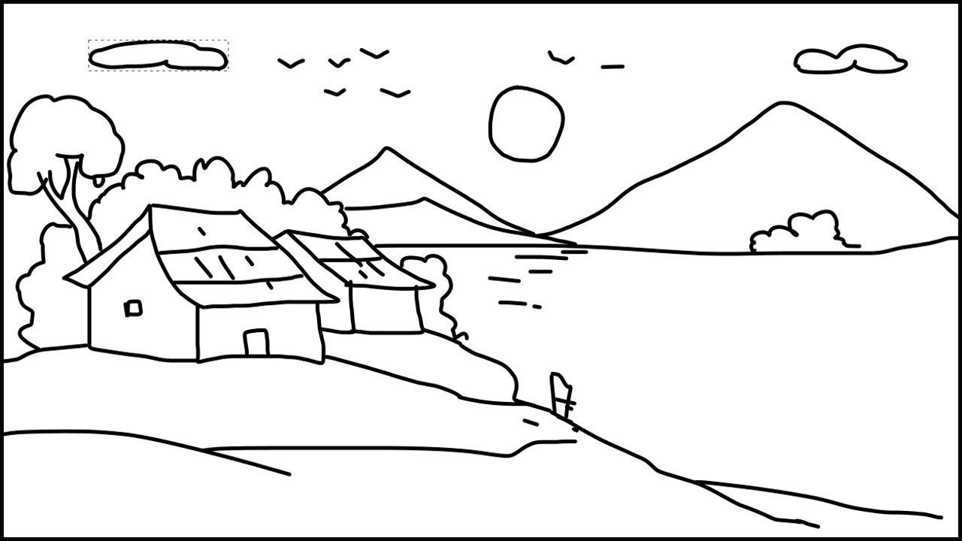
Ready !
village

Slide 13
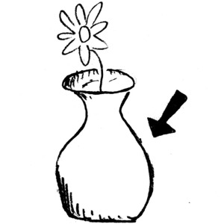
Ready !
vase

Slide 14

Ready !
violin

Slide 15


Slide 16
02
Activity 6
Listen and repeat

Slide 17



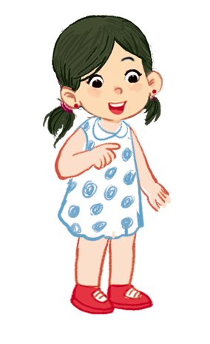

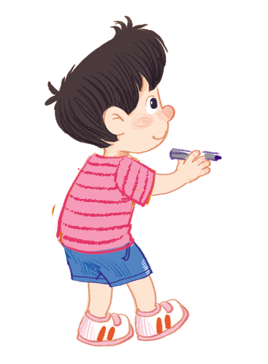

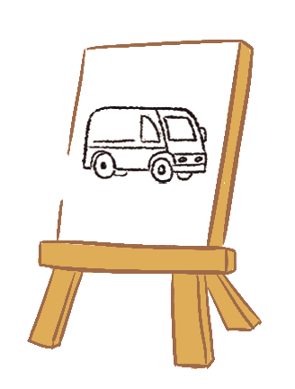



Listen and repeat.
Can you draw a van?
Can you draw a van?
Can you draw a van?
Can you draw a van?
No, I can’t.
No, I can’t.
No, I can’t.
No, I can’t.
Yes, I can.
Yes, I can.
Yes, I can.
Yes, I can.

Slide 18
03
Activity 7
Let’s talk

Slide 19



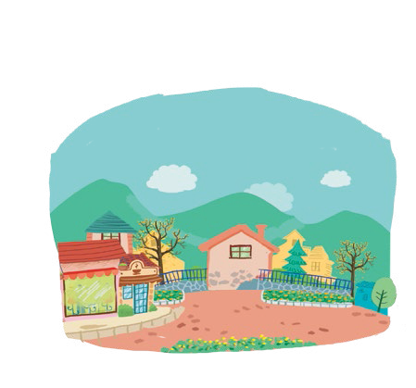
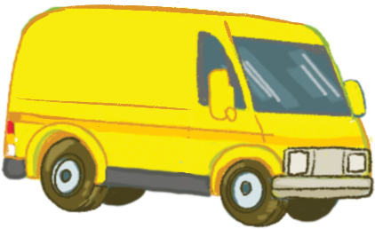


Let’s talk.
Can you draw a _____?
Yes, ______.
No, ______.
a
b
c
d

Slide 20
Can you draw a _____?
Yes, ______.
No, ______.
a

Slide 21

Can you draw a _____?
Yes, ______.
No, ______.
b

Slide 22
Can you draw a _____?
Yes, ______.
No, ______.
c

Slide 23
Can you draw a _____?
Yes, ______.
No, ______.
d

Slide 24
04
Activity 8
Let’s sing

Slide 25
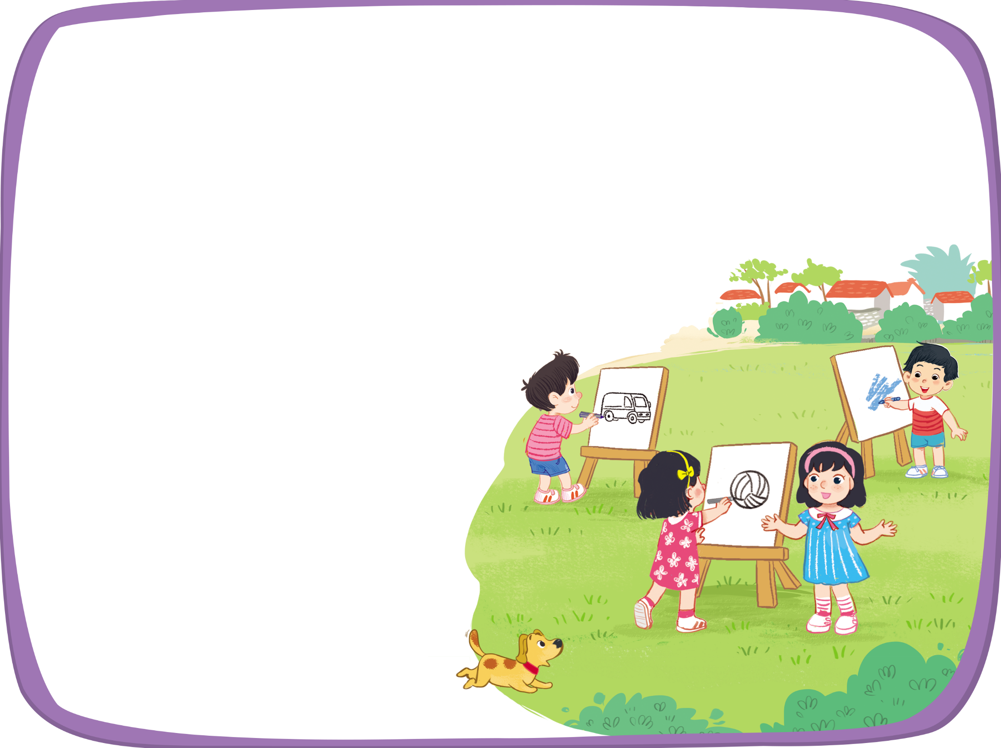


Let’s sing!
Can you draw a van?
Can you draw a van?
Can you draw a van?
Can you draw a van?
Yes, I can.
Yes, I can.
Yes, I can.
Yes, I can.
Can you draw a volleyball?
Can you draw a volleyball?
Can you draw a volleyball?
Can you draw a volleyball?
Yes, I can.
Yes, I can.
Yes, I can.
Yes, I can.
Can you draw a village?
Can you draw a village?
Can you draw a village?
Can you draw a village?
No, I can’t.
No, I can’t.
No, I can’t.
No, I can’t.

Slide 26
05
Fun corner
and
Wrap-up

Slide 27


Option 1
Option 2

Slide 28




Notes:
- Step 1: Ask pupils to say the word correct with the picture (van, village, volleyball).
- Step 2: Click on the right can.
- Step 3: Keep the game until pupils say the correct words.

Slide 29
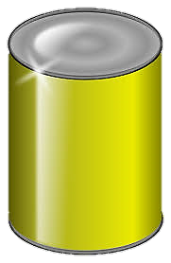
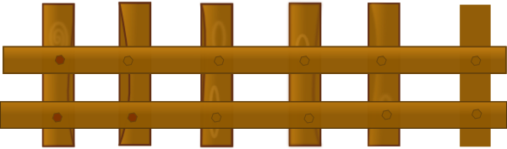


1/6
van
volleyball
village
NEXT
Click on the right can

Slide 30
2/6
village
volleyball
van
NEXT
Click on the right can

Slide 31
3/6
village
vase
volleyball
NEXT
Click on the right can

Slide 32
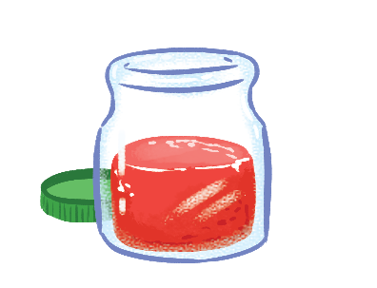
4/6
juice
jelly
jam
NEXT
Click on the right can

Slide 33

5/6
cake
pizza
milk
NEXT
Click on the right can

Slide 34
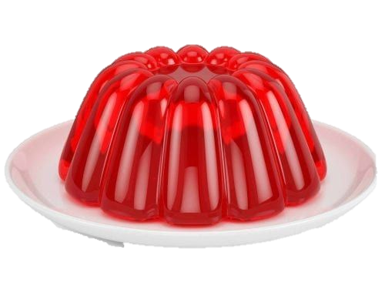
6/6
juice
jelly
jam
Click on the right can

Slide 36



Team boys
Ask & Answer
Team girls
9
8
7
5
6
4
0
1
3
9
2
8
7
5
6
4
0
1
0
1
2
9
8
7
6
5
4
9
8
7
5
6
4
1
3
3
0
2
3
1
2
3
4
5
2
SPIN AGAIN
12
1
11
2
10
SPIN STOP
3
9
4
8
5
7
6
Click twice the SPIN/STOP button to stop the pointer
Notes:
GV click vào nút spin để ghi điểm cho hai đội chơi. VD: team boy quay vào ô số 10 thì sẽ được 10 điểm
Divide the class into two teams (boys and girls) to complete the task.
- Hold up a flashcard about the letter V/v for Team A making a question, and say “Yes/ No” for Team B answering the question.
- Ask Team A to make the question “Can you draw a van?” to ask Team B when the teacher shows them a flashcard.
- Have Team B answer the question from Team A “Yes, I can. / No, can’t.”.
- Ask two teams to take turns asking and answering the questions.
- Check pupils’ pronunciation as the class.

Slide 37






Can you draw a ____?
Yes, ____ / No, ____

Slide 38


Can you draw a ________?
Yes, ____ / No, ____

Slide 39

Can you draw a _________?
Yes, ____ / No, ____

Slide 40

Can you draw a _______?
Yes, ____ / No, ____

Slide 41

Can you draw a ________?
Yes, ____ / No, ____

Slide 43
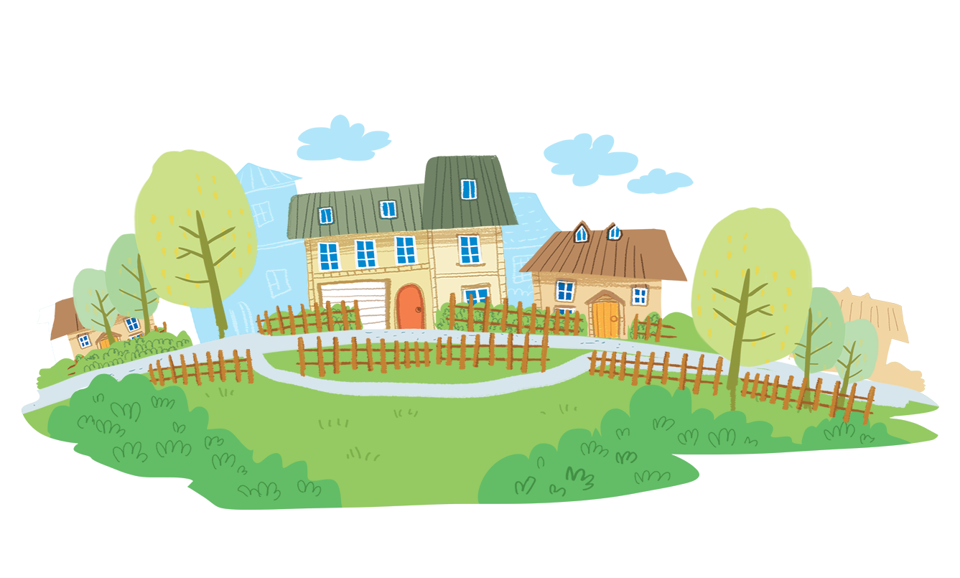
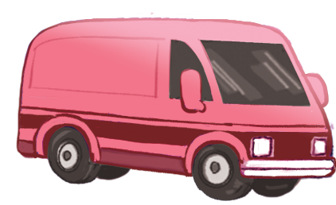
Time to say goodbye!
v

Slide 44

Website: hoclieu.vn
Fanpage: facebook.com/www.tienganhglobalsuccess.vn

