Slide 2
Unit 5: In the classroom
Lesson 2- Period 2

Slide 3










Class Rules

Slide 4



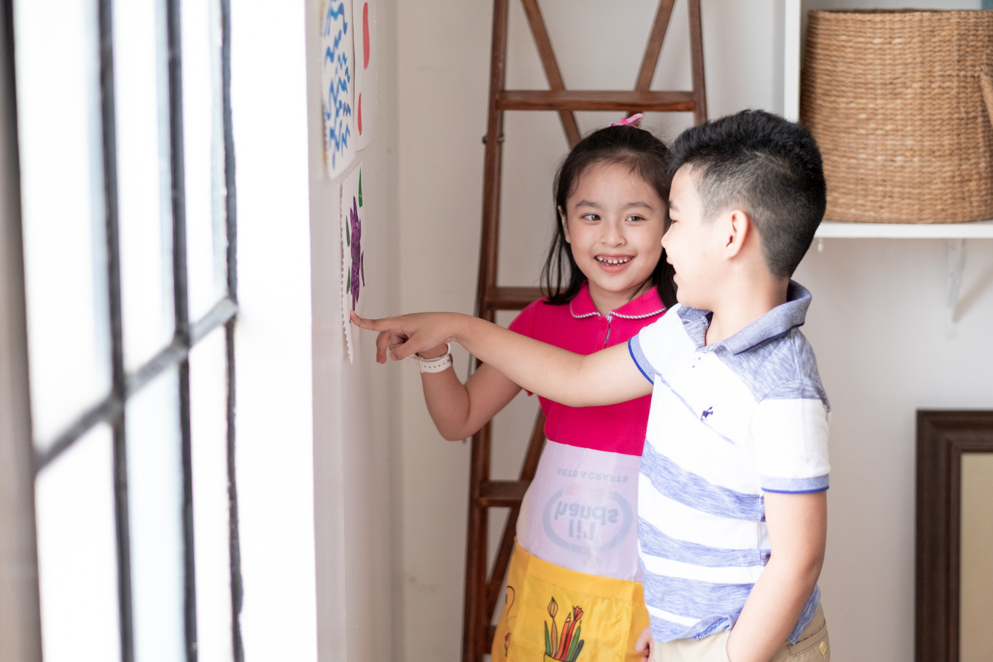



Rule 1
Listen to
your friend
talking in front.

Slide 5








Rule 2
Raise your hand
if you have a question.

Slide 6




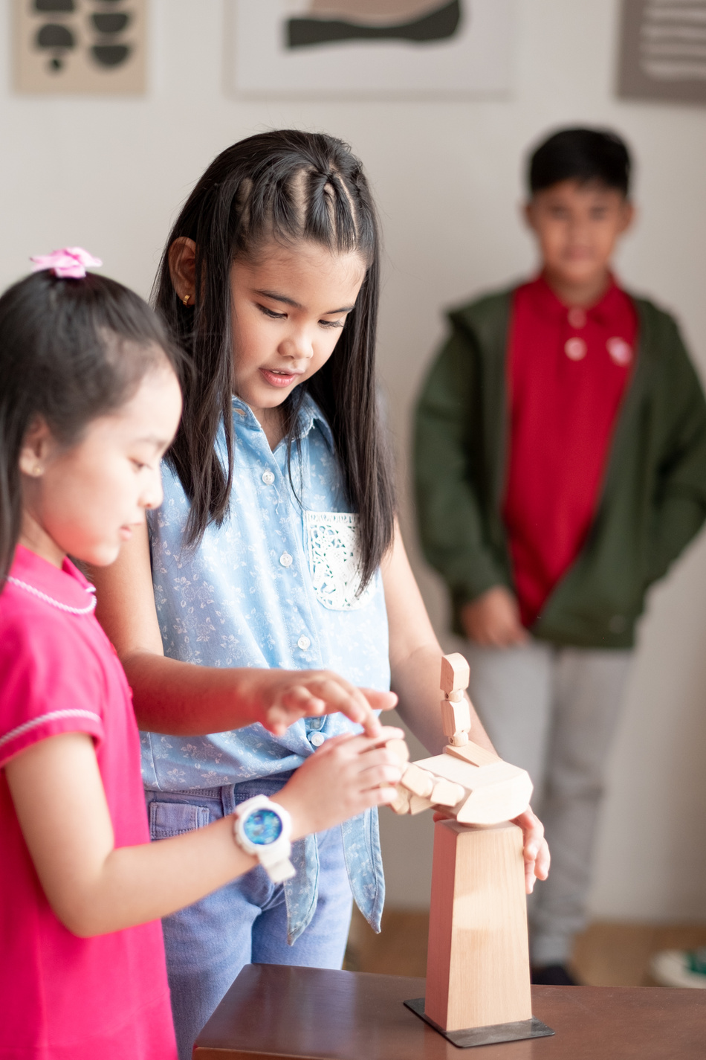


Rule 3
Wait for
your turn.

Slide 7
Table of contents
1. Warm-up and review
2. Activity 3: Listen and chant
3. Activity 4: Listen and tick
4. Activity 5: Look and write
5. Fun corner and wrap-up

Slide 8

01
Warm-up
and review

Slide 9






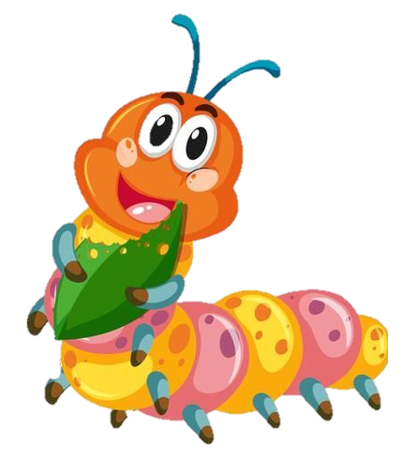



Game: “Bees find flowers”
square
quiz
red
Notes:
Click the flower to choose the word

Slide 10
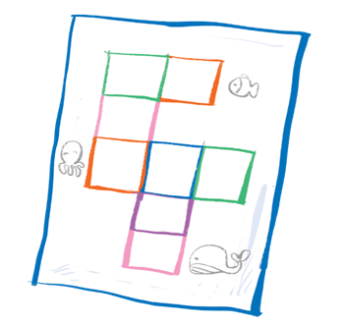

Game: “Bees find flowers”
square
quiz
question

Slide 11


Game: “Bees find flowers”
square
queen
question

Slide 12

CONGRATULATIONS!

Slide 13
02
Activity 3
Listen and chant.

Slide 14

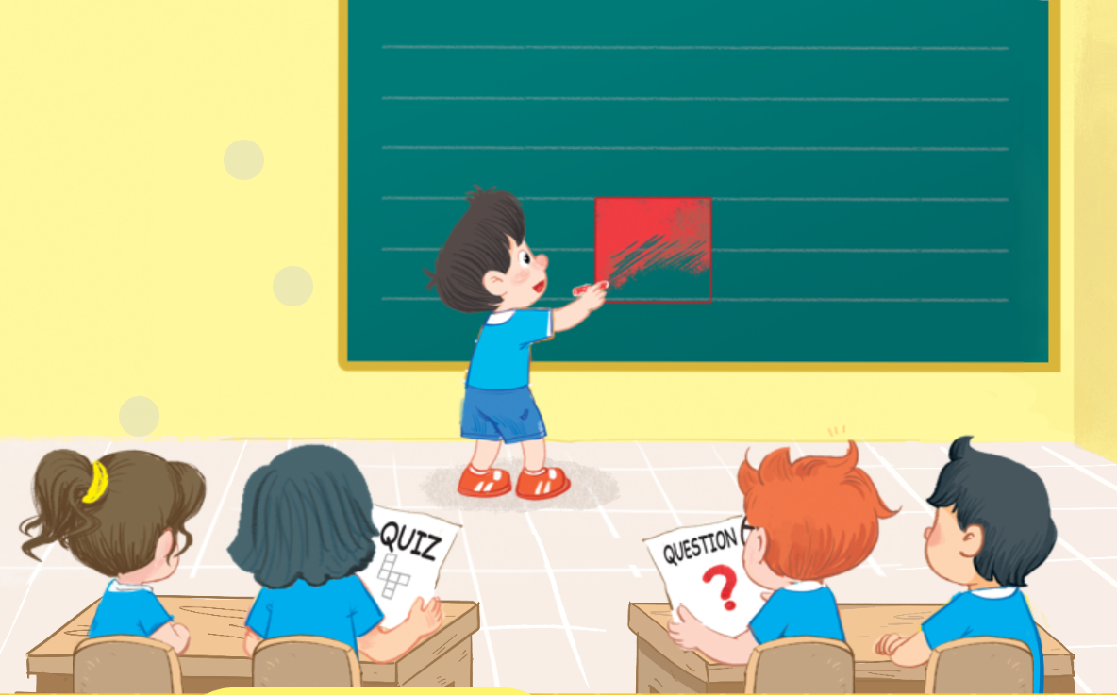
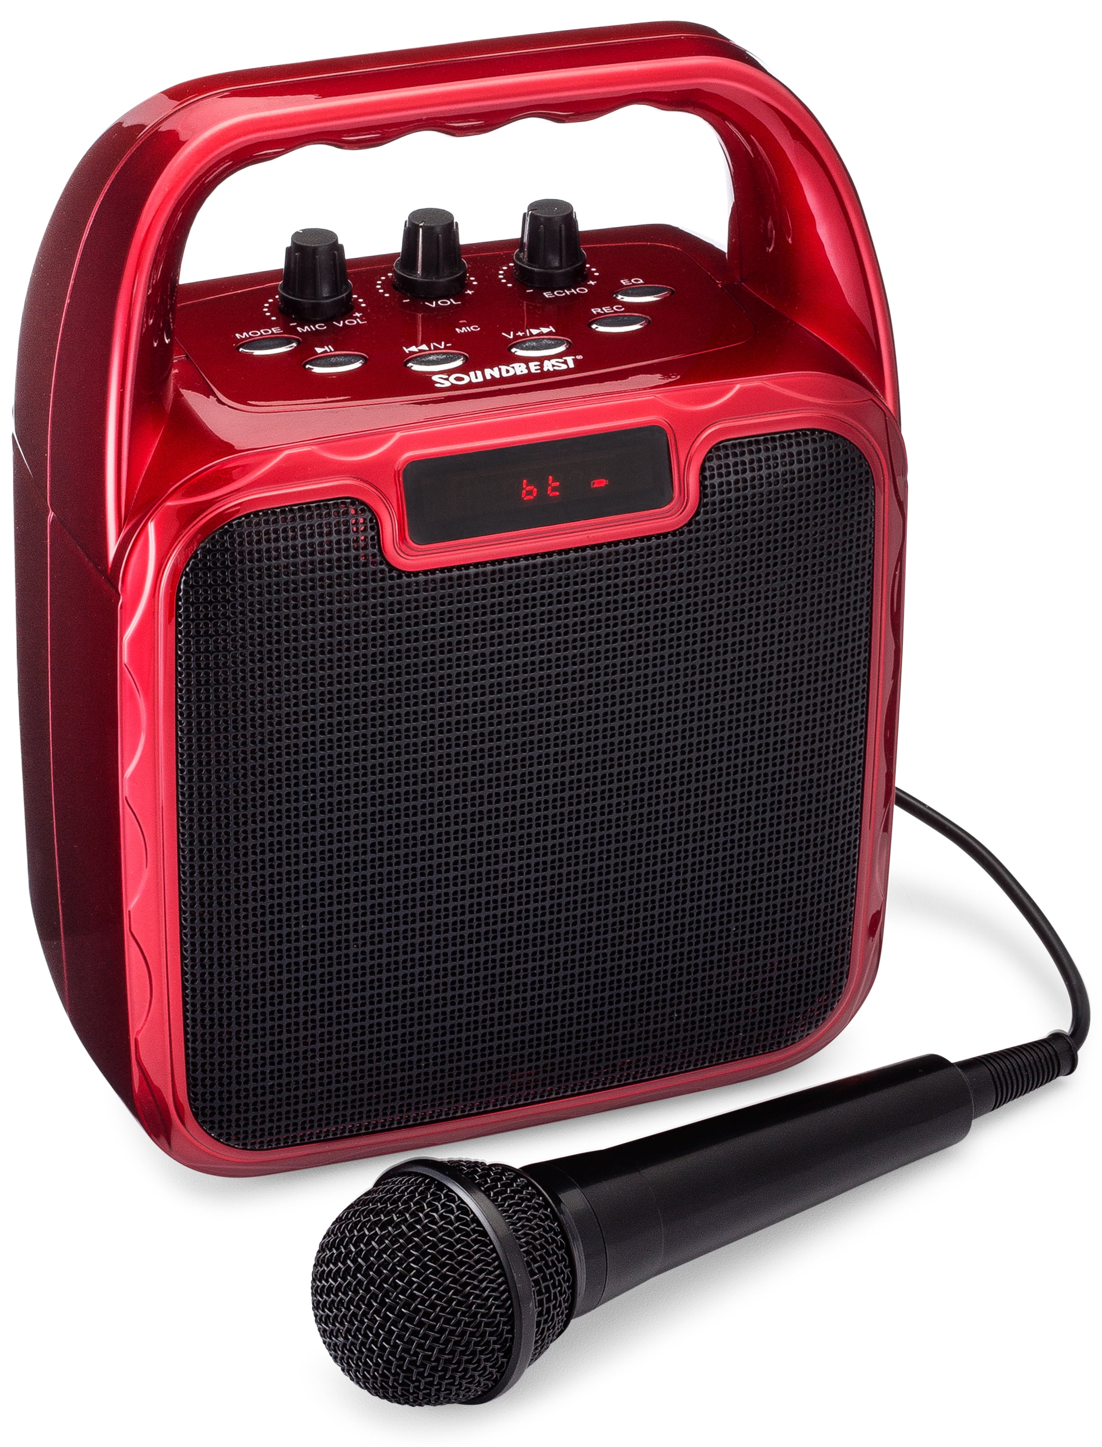
3. Listen and chant.

Slide 15
3. Listen and chant.
Q, q, a square.
He’s colouring a square.
Q, q, a question.
He’s answering a question.
Q, q, a quiz.
She’s doing a quiz.
SPIN WHEEL

Slide 16



Slide 17
03
Activity 4
Listen and tick.

Slide 18


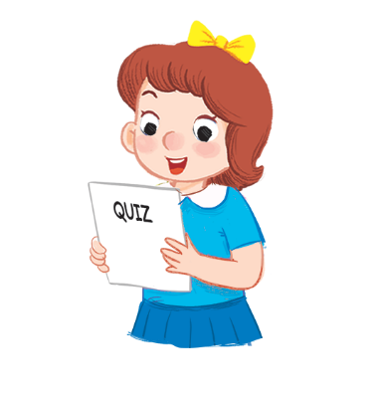




4.Listen and tick.
1
2

Slide 19


4.Listen and tick.
1


Slide 20


4.Listen and tick.
2


Slide 21
04
Activity 5
Look and write.

Slide 22


5. Look and write.

Slide 23

5. Look and write.

Slide 24
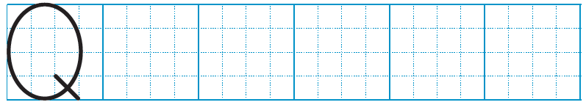

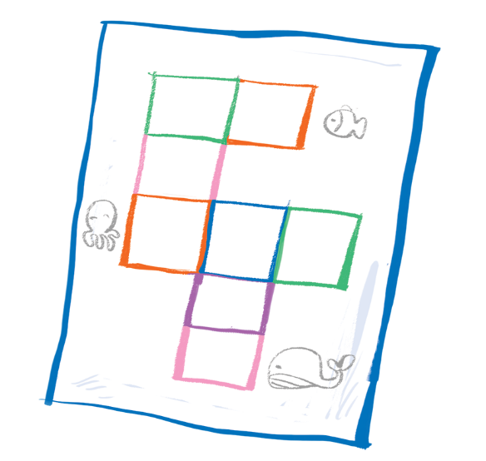


5. Look and write.
q
q
uiz
q
uestion
s uare

Slide 25
05
Fun corner
and wrap-up

Slide 26

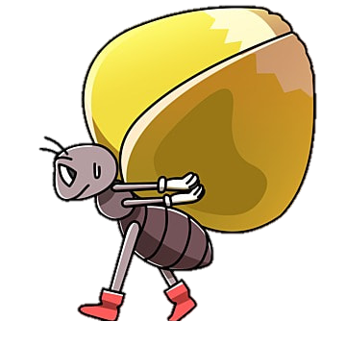



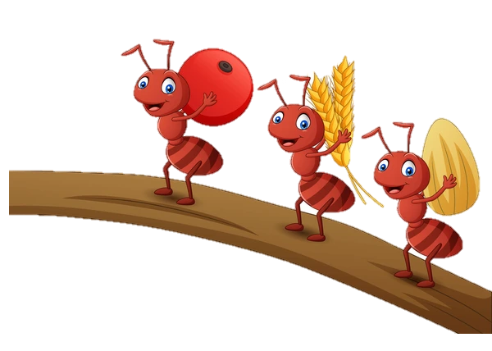
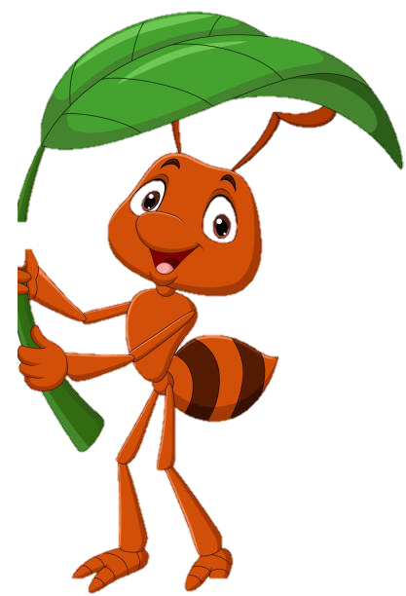
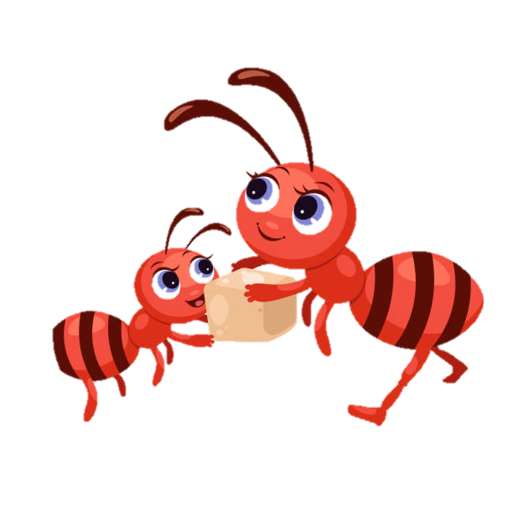
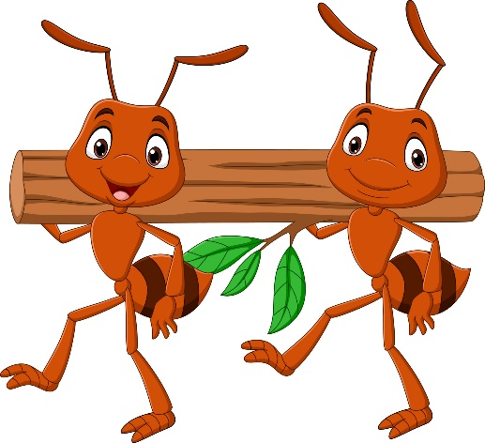
Game: “Slow motion”
quiz
Notes:
Click the ant to see the picture
Click the picture to see the word
Click the word to hear the sound

Slide 27

Game: “Slow motion”
square
Notes:
Click the ant to see the picture
Click the picture to see the word
Click the word to hear the sound

Slide 28

Game: “Slow motion”
question
Notes:
Click the ant to see the picture
Click the picture to see the word
Click the word to hear the sound

Slide 30


Slide 31
Website: hoclieu.vn
Fanpage: facebook.com/www.tienganhglobalsuccess.vn

