Slide 2
Unit 5: In the classroom
Lesson 1 –Period 1

Slide 3










Class Rules

Slide 4



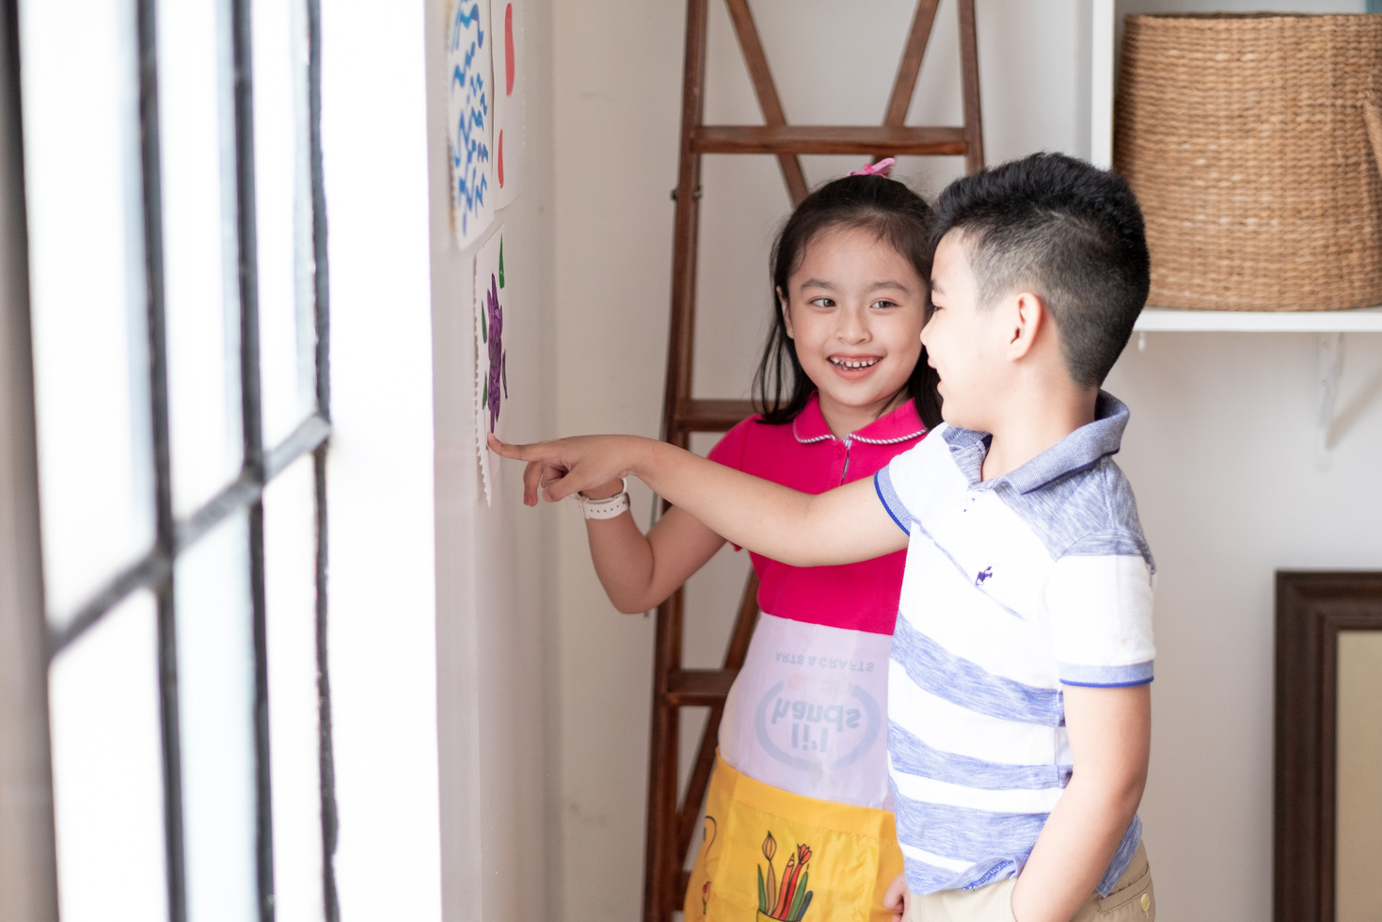



Rule 1
Listen to
your friend
talking in front.

Slide 5








Rule 2
Raise your hand
if you have a question.

Slide 6




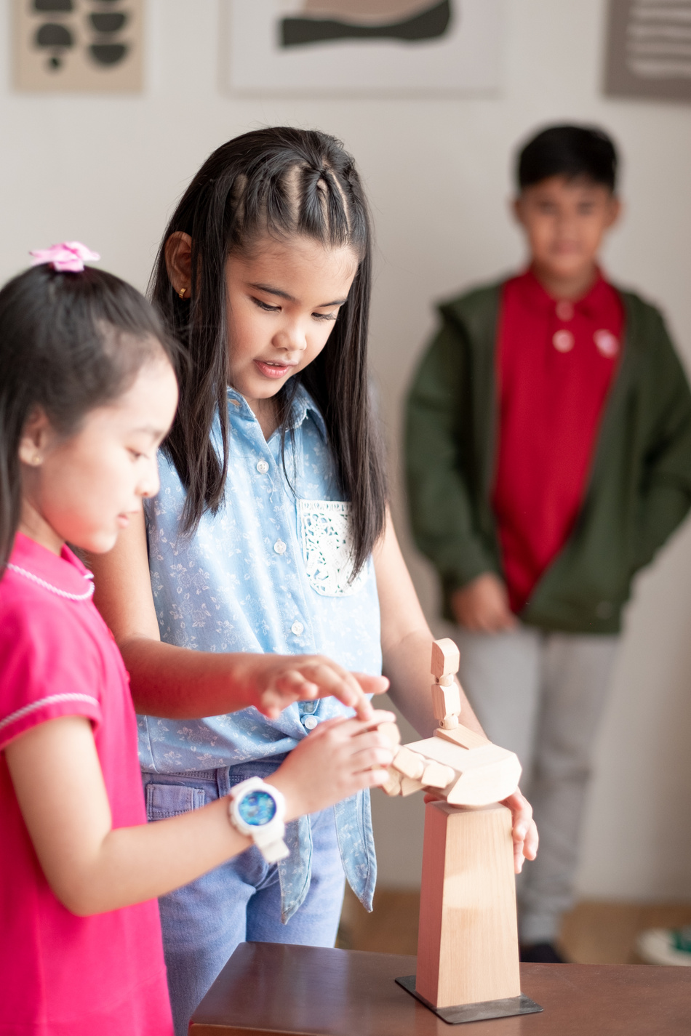


Rule 3
Wait for
your turn.

Slide 7



Unit
Table of contents
1. Warm-up/Review
2. Activity 1: Listen and repeat.
3. Activity 2: Point and say.
4. Fun corner and Wrap-up

Slide 8



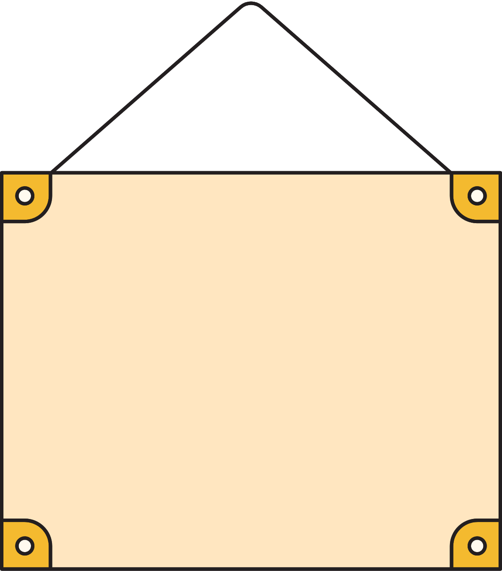
01
Warm-up & review
Game: “Crossword puzzle”

Slide 9







Game: “Crossword puzzle”
6
R
2
O
S
3
5
R
A
I
N
B
O
W
A
4
S
A
N
D
1
R
I
V
E
R
L
A
Score

Slide 10












SCORE
Team 1
Team 2
Winner
1
2
Notes:
Click Team 1/ 2 to get point (presents)

Slide 11
Congratulation!
Team 1

Slide 12
Congratulation!
Team 2

Slide 13
02
Avtivity 1
Listen and repeat

Slide 14





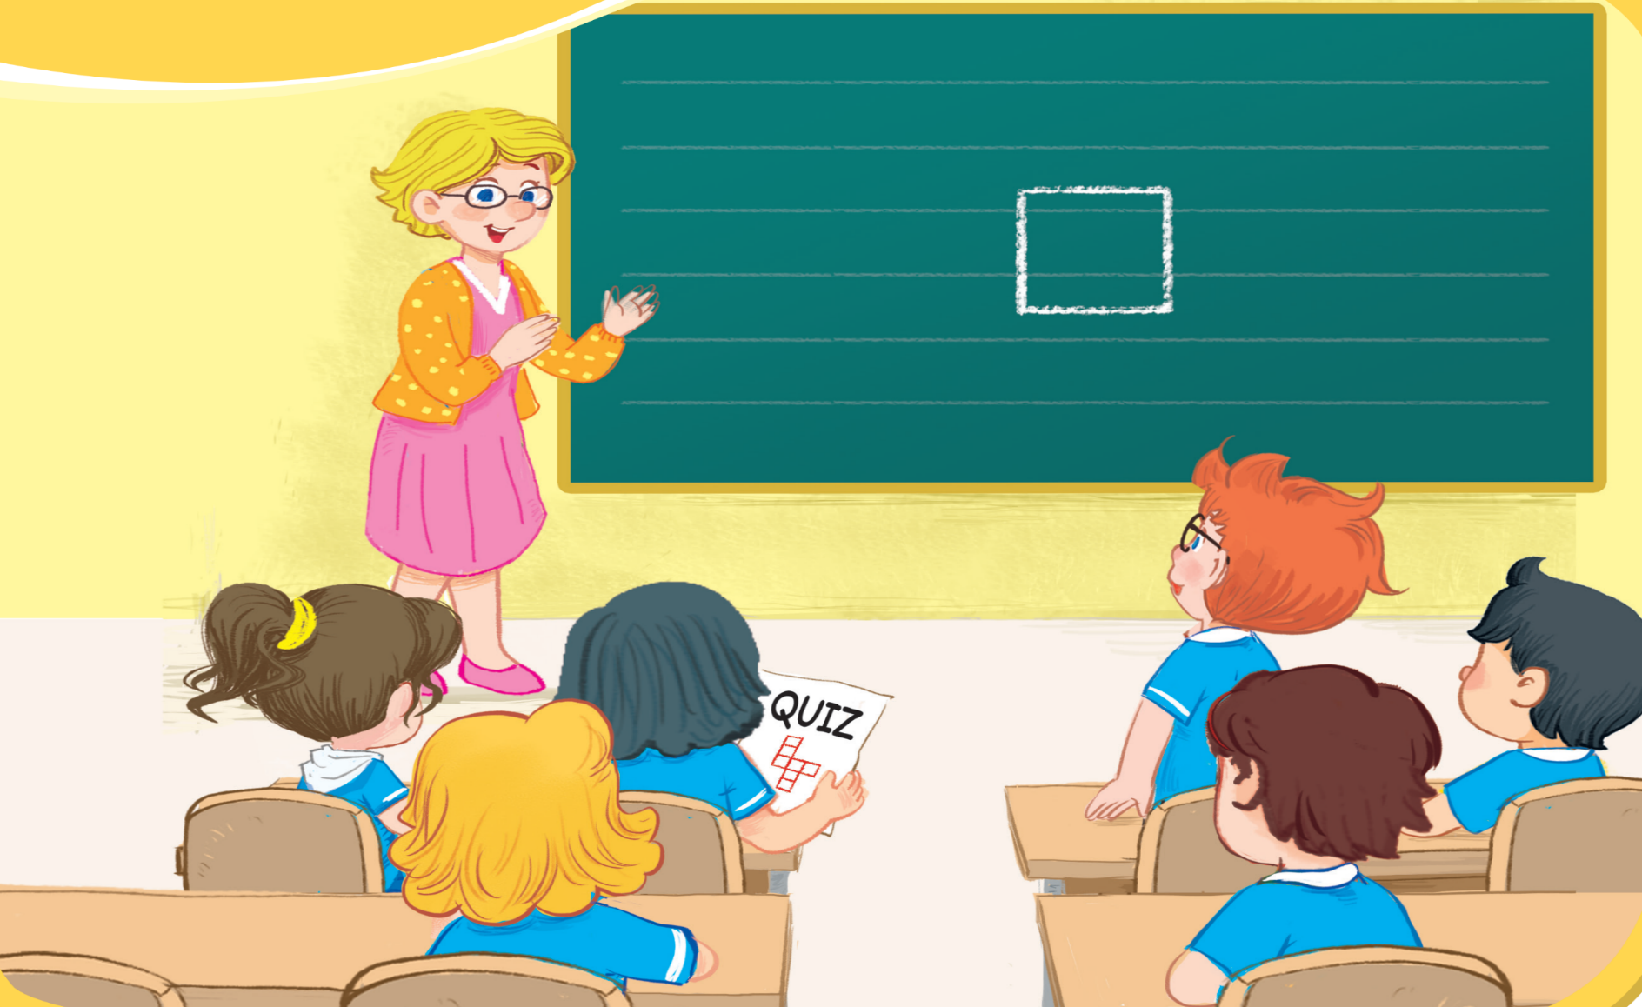

Unit
1. Listen and repeat.

Slide 15






Unit
1. Listen and repeat.
question
square
quiz

Slide 16
Unit
Look and say aloud
q
question

Slide 17

Unit
Look and say aloud
q
square

Slide 18
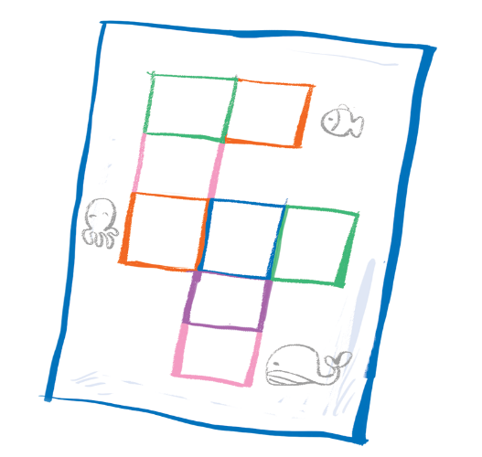
Unit
Look and say aloud
q
quizz

Slide 19
03
Avtivity 2
Point and say

Slide 20

Unit
2. Point and say.
question
square
quiz

Slide 21
04
Fun corner/ Wrap-up

Slide 22
Game: “Whispers”

Slide 23


Game: “Whispers”
q
Notes:
Click the hot-air balloon to see the picture
Click the picture to hear the sound

Slide 24
Game: “Whispers”
q
Notes:
Click the hot-air balloon to see the picture
Click the picture to hear the sound

Slide 25
Game: “Whispers”
q
Notes:
Click the hot-air balloon to see the picture
Click the picture to hear the sound

Slide 26

Game: “Whispers”

Slide 27

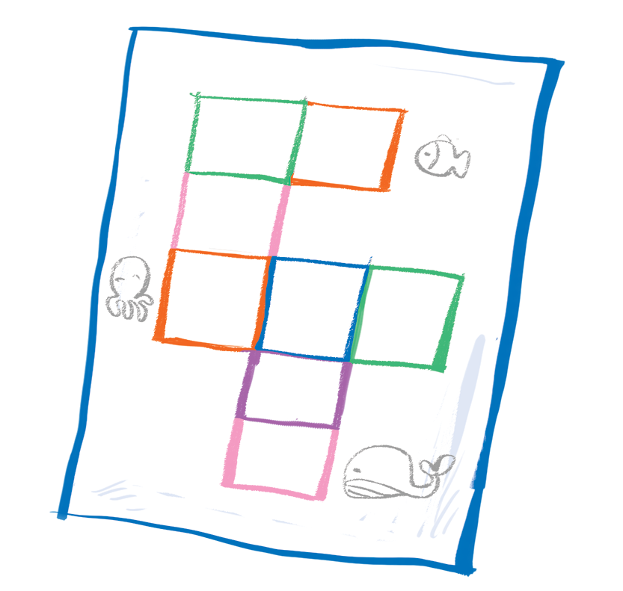
Time to say goodbye!
q

Slide 28


Slide 29
Website: hoclieu.vn
Fanpage: facebook.com/www.tienganhglobalsuccess.vn

