Slide 2

Warm-up
Notes:
Game: Hungry Bobby
Goals:
- Help pupils feel happy at the beginning of the lesson.
- Review vocabulary of previous lesson.
Time limit: 5 mins
- Teacher shows a picture covered partly by a wheel turning 360* clockwise.
- Teacher calls 1 pupil from each team in a turn. Pupils look and say the word. Faster team gets 2 stars, the others get 1 star.
- Teacher has whole class read the word out loud at the end of a turn.

Slide 3

Guessing game

Slide 4
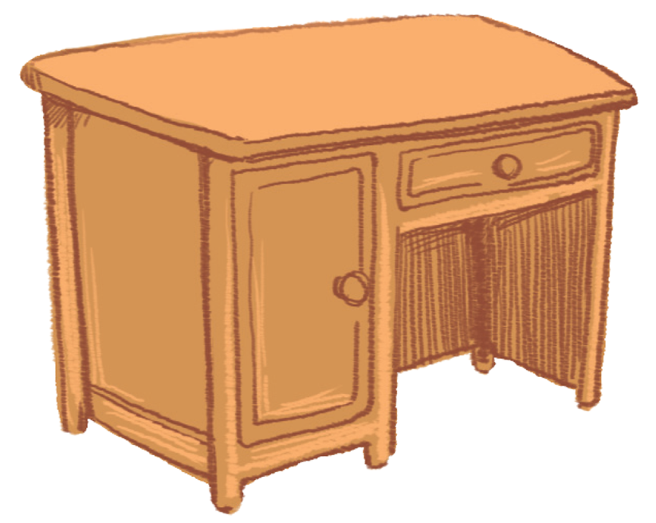
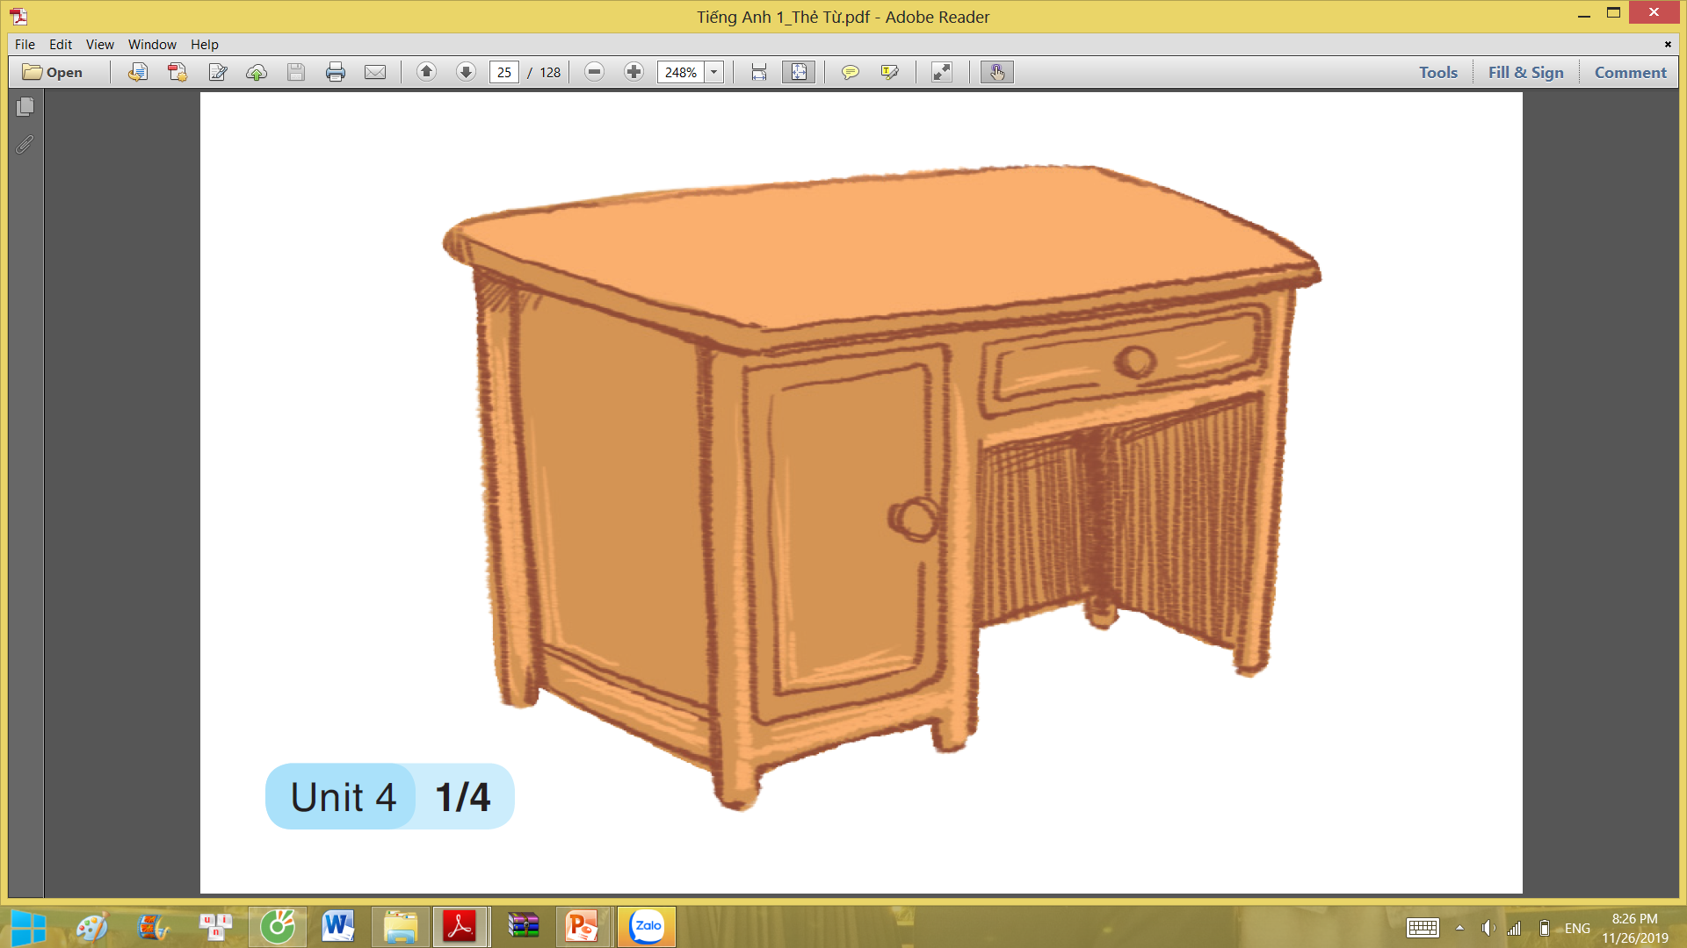
desk

Slide 5

dog

Slide 6
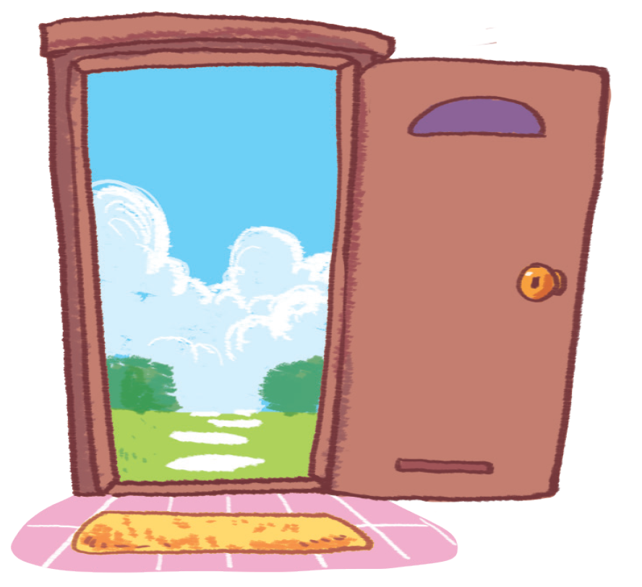
door

Slide 7
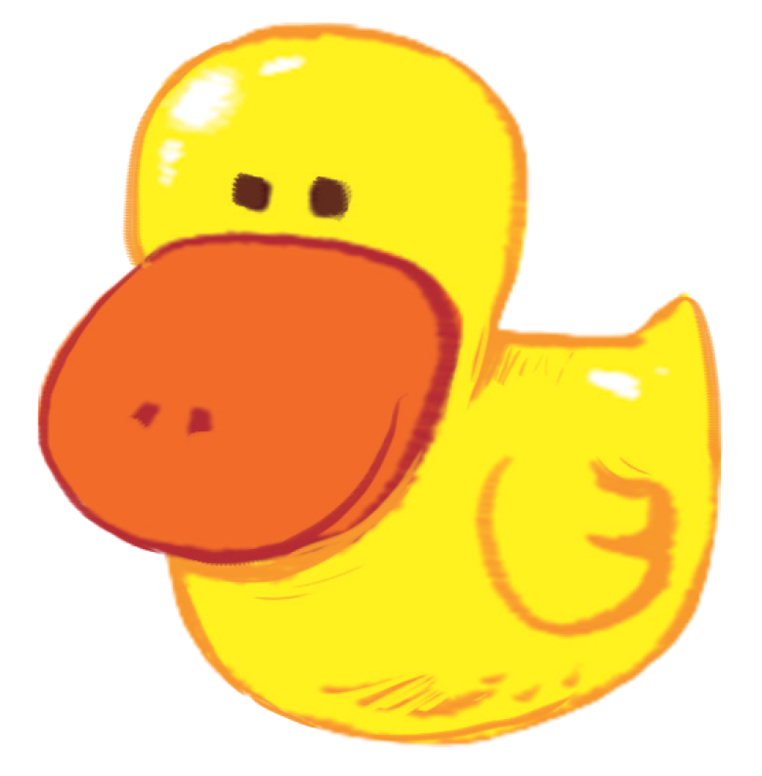
duck

Slide 8
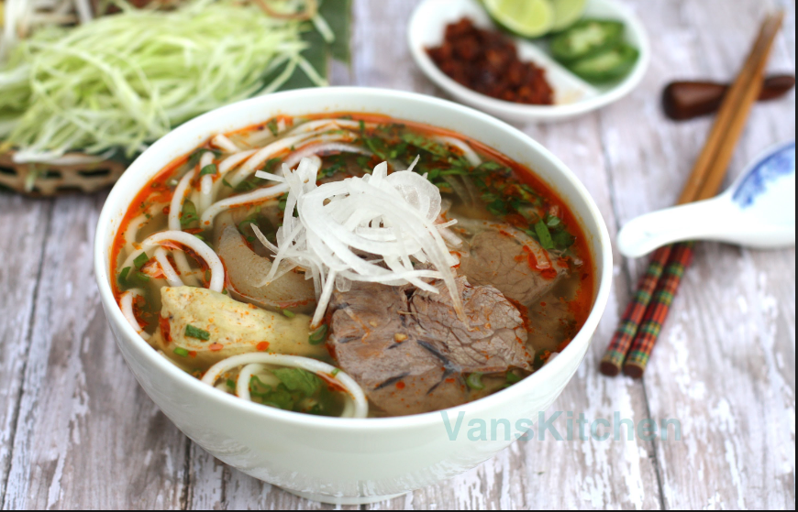
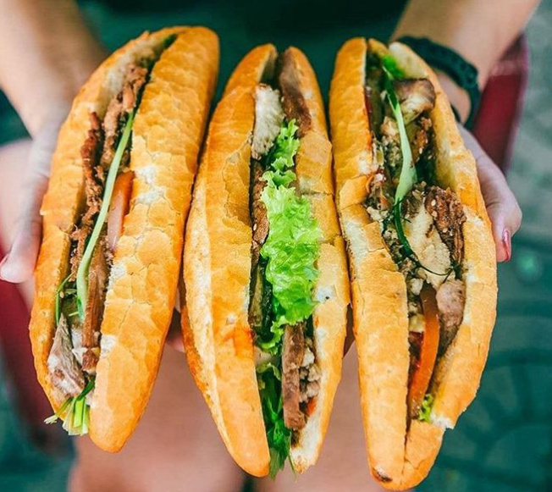
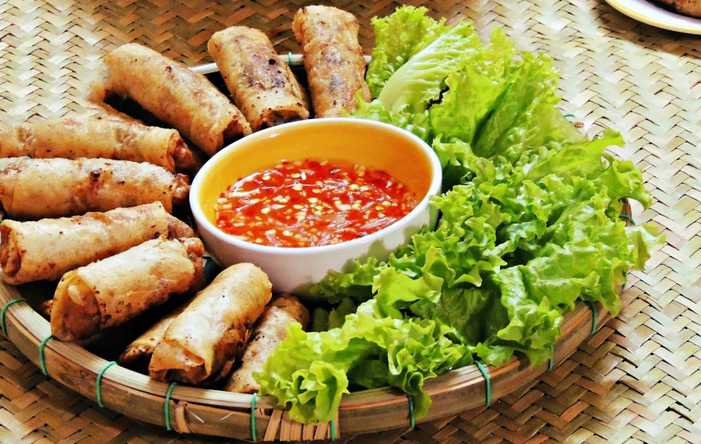
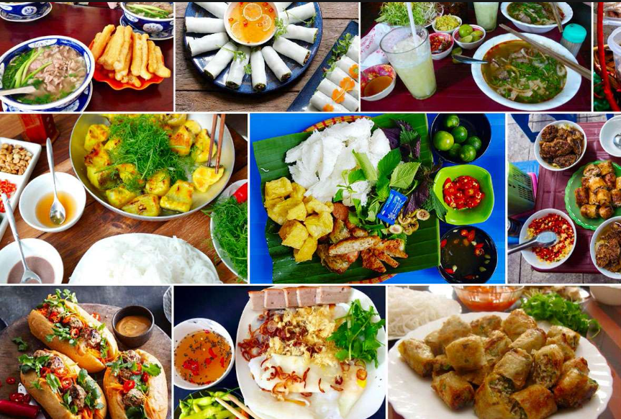
Bánh mì ,phở, nem rán - món ăn nổi tiếng ở Việt Nam. .

Slide 9
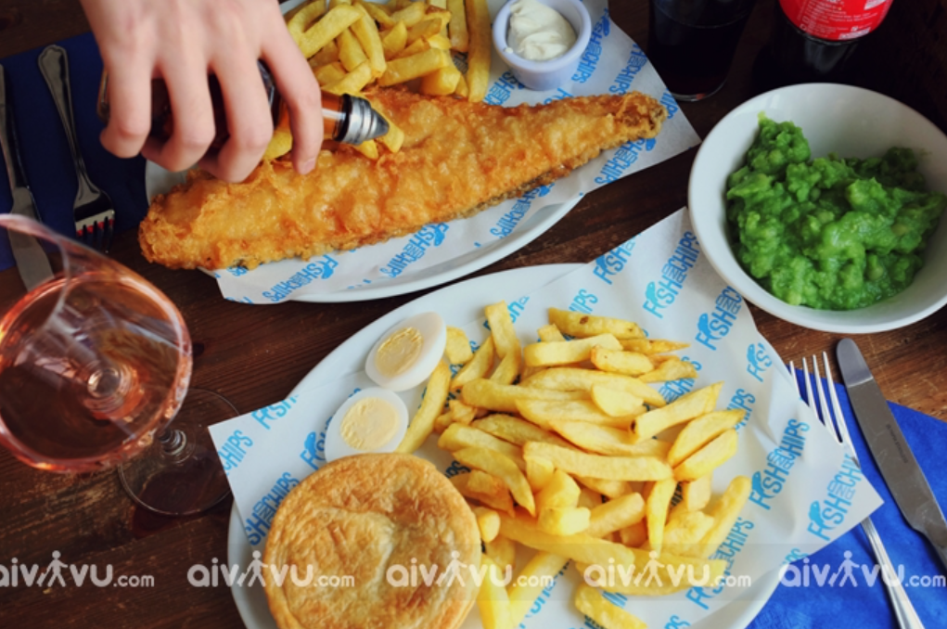
Fish And Chips- món ăn nổi tiếng ở Anh .

Slide 10

Unit 5 – Lesson 1 At the fish and chip shop
Notes:
By the end of the unit, pupils will be able to:
- pronounce the sound of the letter I/i in isolation and in the words chicken, chips, fish and milk correctly.
- say the sound of the letter I/i and the words chicken, chips, fish and milk in a chant.
- recognize the words in different situations when listening.
- use I like _____ to talk about someone’s favourite food/drinks.
- trace the letter I/i.
sing a song with the structure “I like _____.”
Lesson 1
By the end of lesson 1, pupils will be able to:
pronounce the sound of the letter I/i in isolation and in the words chicken, chips, fish and milk correctly.
point to the letter I/i and food/drinks (chicken, chips, fish and milk) in the picture and say the sound of the letter I/i , the words chicken, chips, fish, milk.

Slide 11

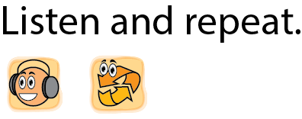

Notes:
Listen and repeat is divided into 3 steps.
Goals:
Pupils identify and pronounce /i/
Pupils identify and pronounce the sound /i/ in four new words: fish, chips, milk, chicken

Slide 12

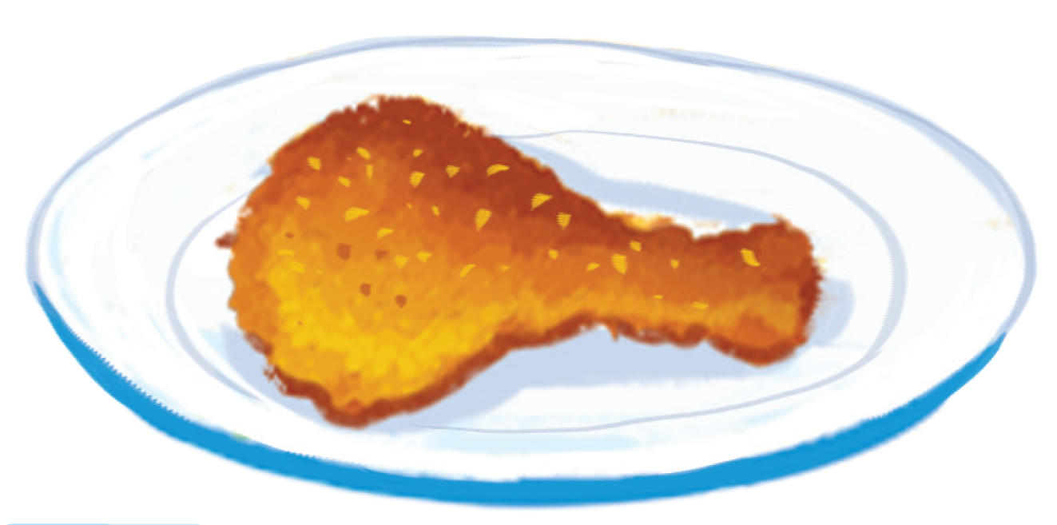
chicken
Notes:
Step 2: Listen and repeat vocabulary
Time limit: 5 mins
Goal: Pupils are able to identify and pronounce 4 words: fish, chips, milk, chicken correctly.
Teacher shows pictures on slide and says the words. (Teacher may pronounce each sound of the word separately, for example f-i-sh).
Pupils listen to teacher and repeat.
Step 3: Quick check
Time limit: 4 mins
Teacher checks pronunciation (as teams).
Teacher sticks flashcards and word cards on the board randomly. Teacher has pupils go to the board and put word cards under the matching flashcards.
Teacher checks pronunciation individually. Teacher points to a picture and has a pupil say the word.

Slide 13
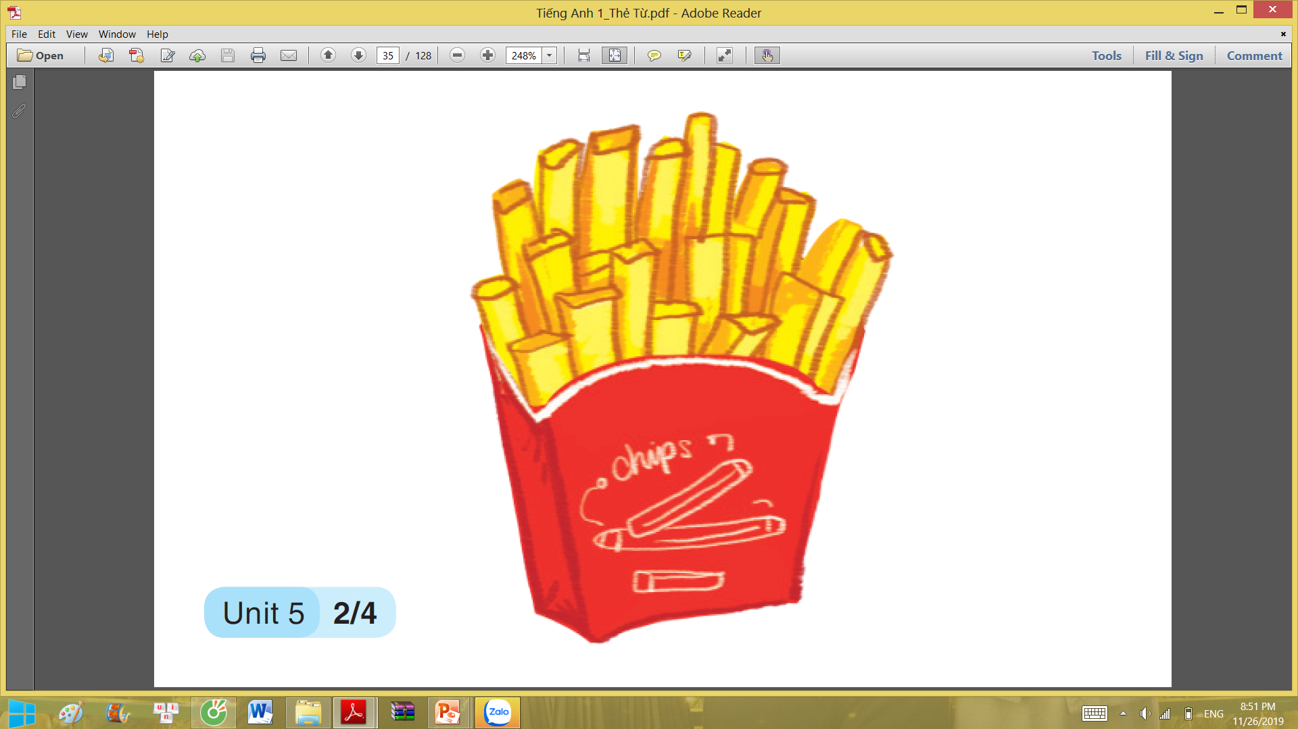
chips

Slide 14
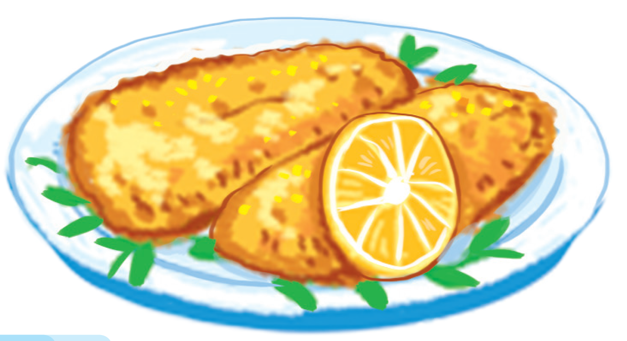
fish

Slide 15
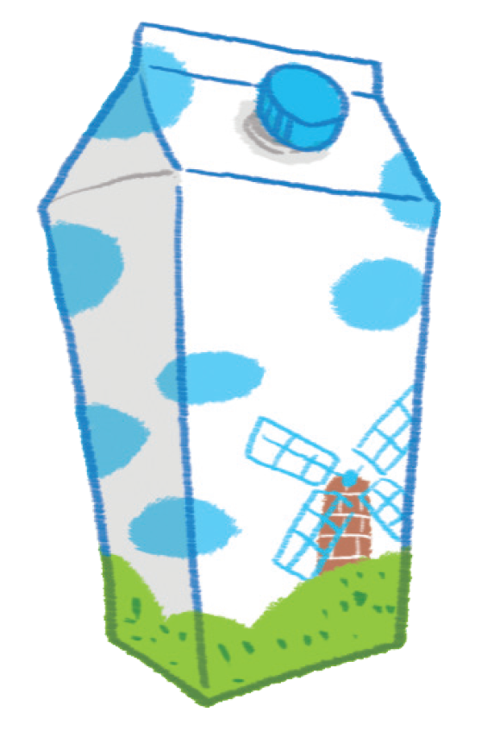
milk
https://youtu.be/SaUN-LmhqyE

Slide 16


chicken
chips
fish
i
milk

Slide 17

Slap the board

Slide 18



Notes:
Goal:
Pupils will be able to point to the letter I/i and food/drinks (chicken, chips, fish and milk) in the picture and say the sound of the letter I/i , the words chicken, chips, fish, milk.
Step 1: Listen, point and repeat
Goals: Pupils are able to point to the correct picture and pronounce the words.
Time limit: 3 mins
Teacher plays the audio.
1st time: Pupils listen and point only.
2nd time: Pupils listen, point and repeat.
Pupils repeat the words as a class and teams.
Step 2: Listen, point and repeat (in pairs)
Time limit: 3 mins
Pupils work in pairs: 1 pupil points, 1 pupil says the words.
Teacher goes around the class and gives feedback on pupils’ pronunciation.

Slide 19
LET’S PLAY GAME
Notes:
Game: What’ s missing?
Time limit: 6 mins
Teacher shows on slide 4 pictures. Teacher may have pupils read all the words. After that, a picture will disappear. Pupils guess the word.
Teacher gives star if pupils are correct.
Note: In some slides there are only words, in other there are both words and pictures.

Slide 20




chicken
chips
milk
fish

Slide 21
chicken
chips
milk
fish

Slide 22
chicken
chips
milk
fish

Slide 23
chicken
chips
milk
fish

Slide 24
chicken
chips
milk
fish

Slide 25
chicken
chips
milk
fish

Slide 26
chicken
chips
milk
fish

Slide 27
chicken
milk
chips
fish

Slide 28
chicken
milk
chips
fish

Slide 29
chicken
milk
chips
fish

Slide 30
Wrap- up
Notes:
Goal:
Pupils will be able to point to the letter I/i and food/drinks (chicken, chips, fish and milk) in the picture and say the sound of the letter I/i , the words chicken, chips, fish, milk.
Step 1: Listen, point and repeat
Goals: Pupils are able to point to the correct picture and pronounce the words.
Time limit: 3 mins
Teacher plays the audio.
1st time: Pupils listen and point only.
2nd time: Pupils listen, point and repeat.
Pupils repeat the words as a class and teams.
Step 2: Listen, point and repeat (in pairs)
Time limit: 3 mins
Pupils work in pairs: 1 pupil points, 1 pupil says the words.
Teacher goes around the class and gives feedback on pupils’ pronunciation.

Slide 31

Goodbye
Notes:
Teacher shows the vocabulary of the lesson on slide.
Pupils say goodbye.

Slide 32

Goodbye

Slide 33
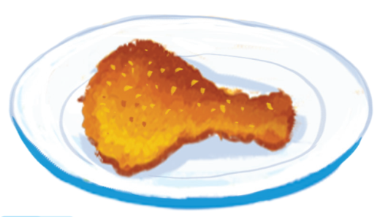
Goodbye

Slide 34

Goodbye

Slide 35
Website: hoclieu.vn
Fanpage: facebook.com/www.tienganhglobalsuccess.vn

