Slide 2








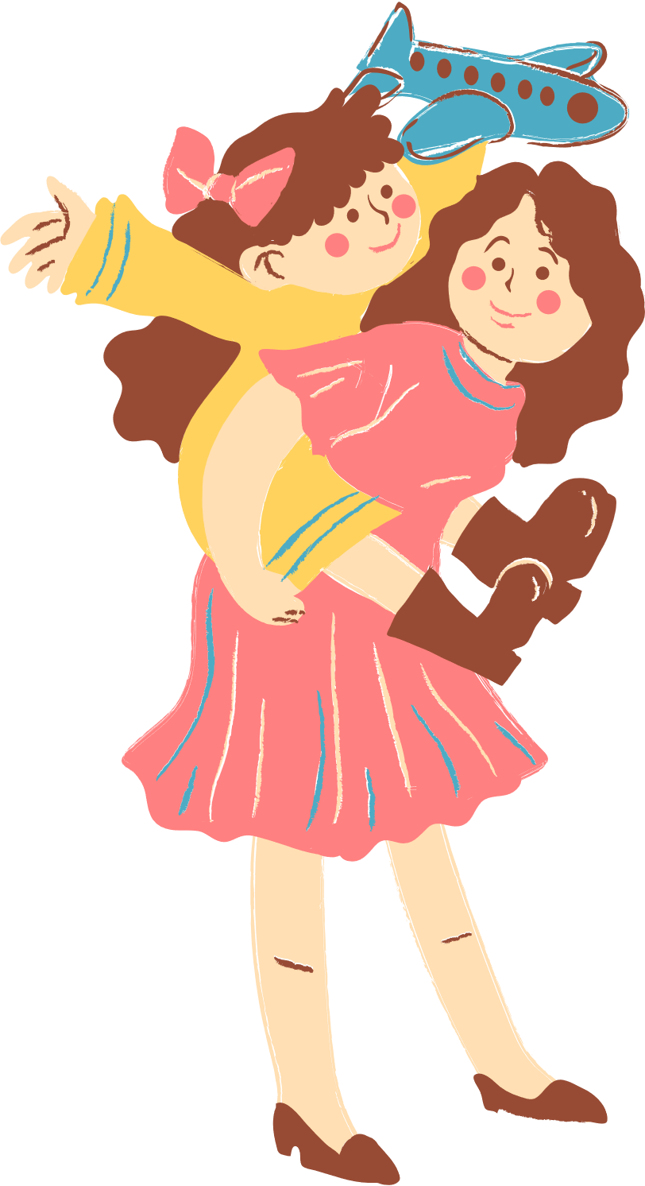
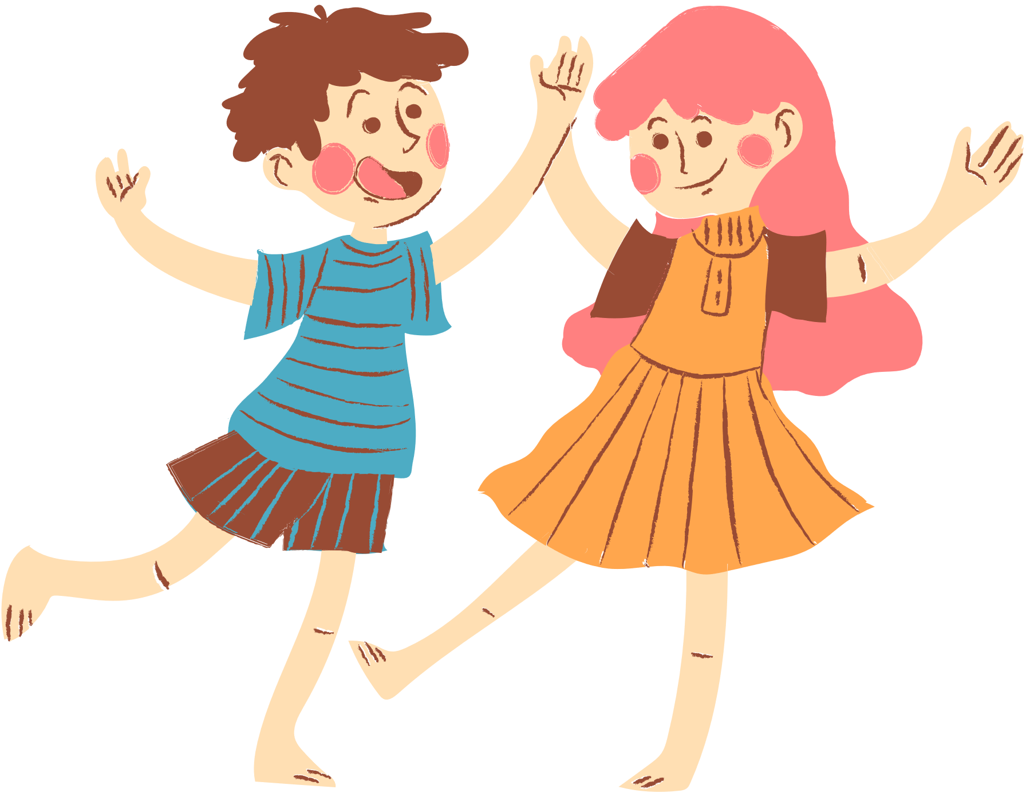
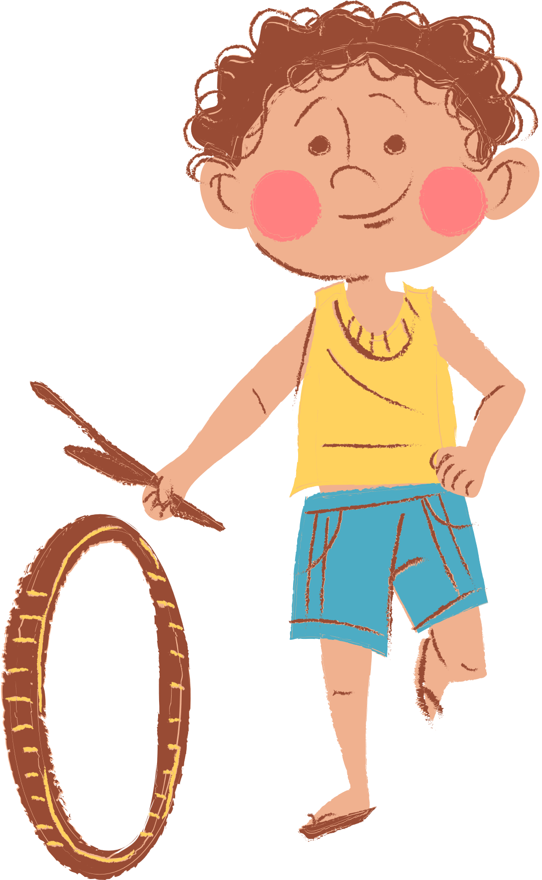
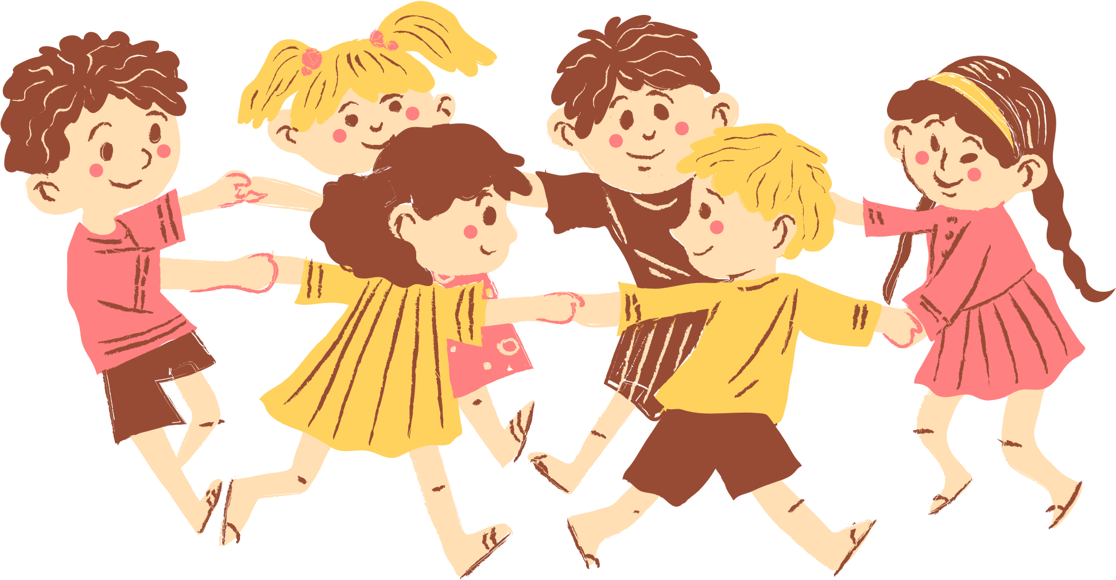
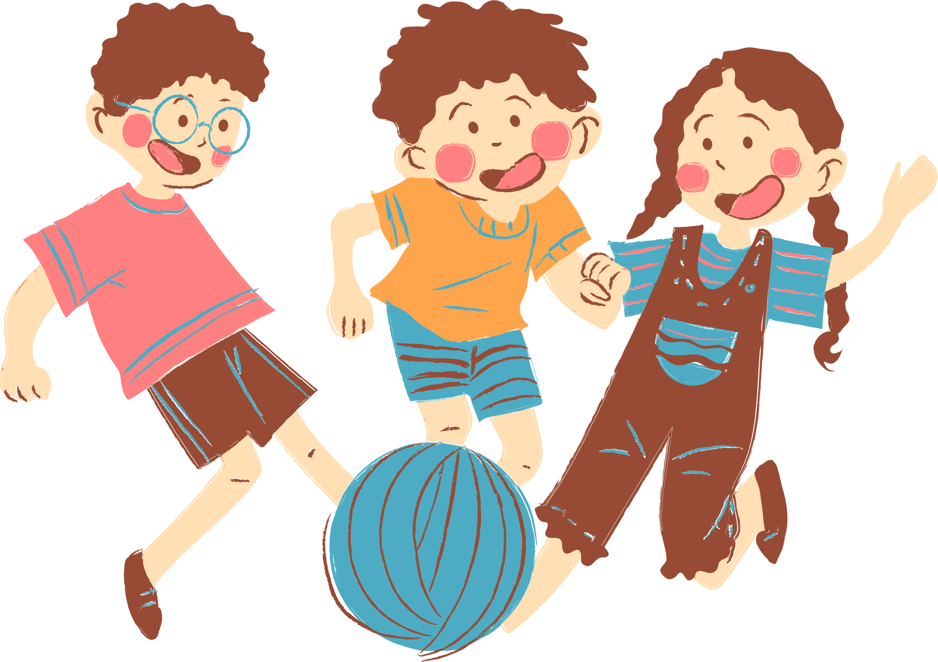
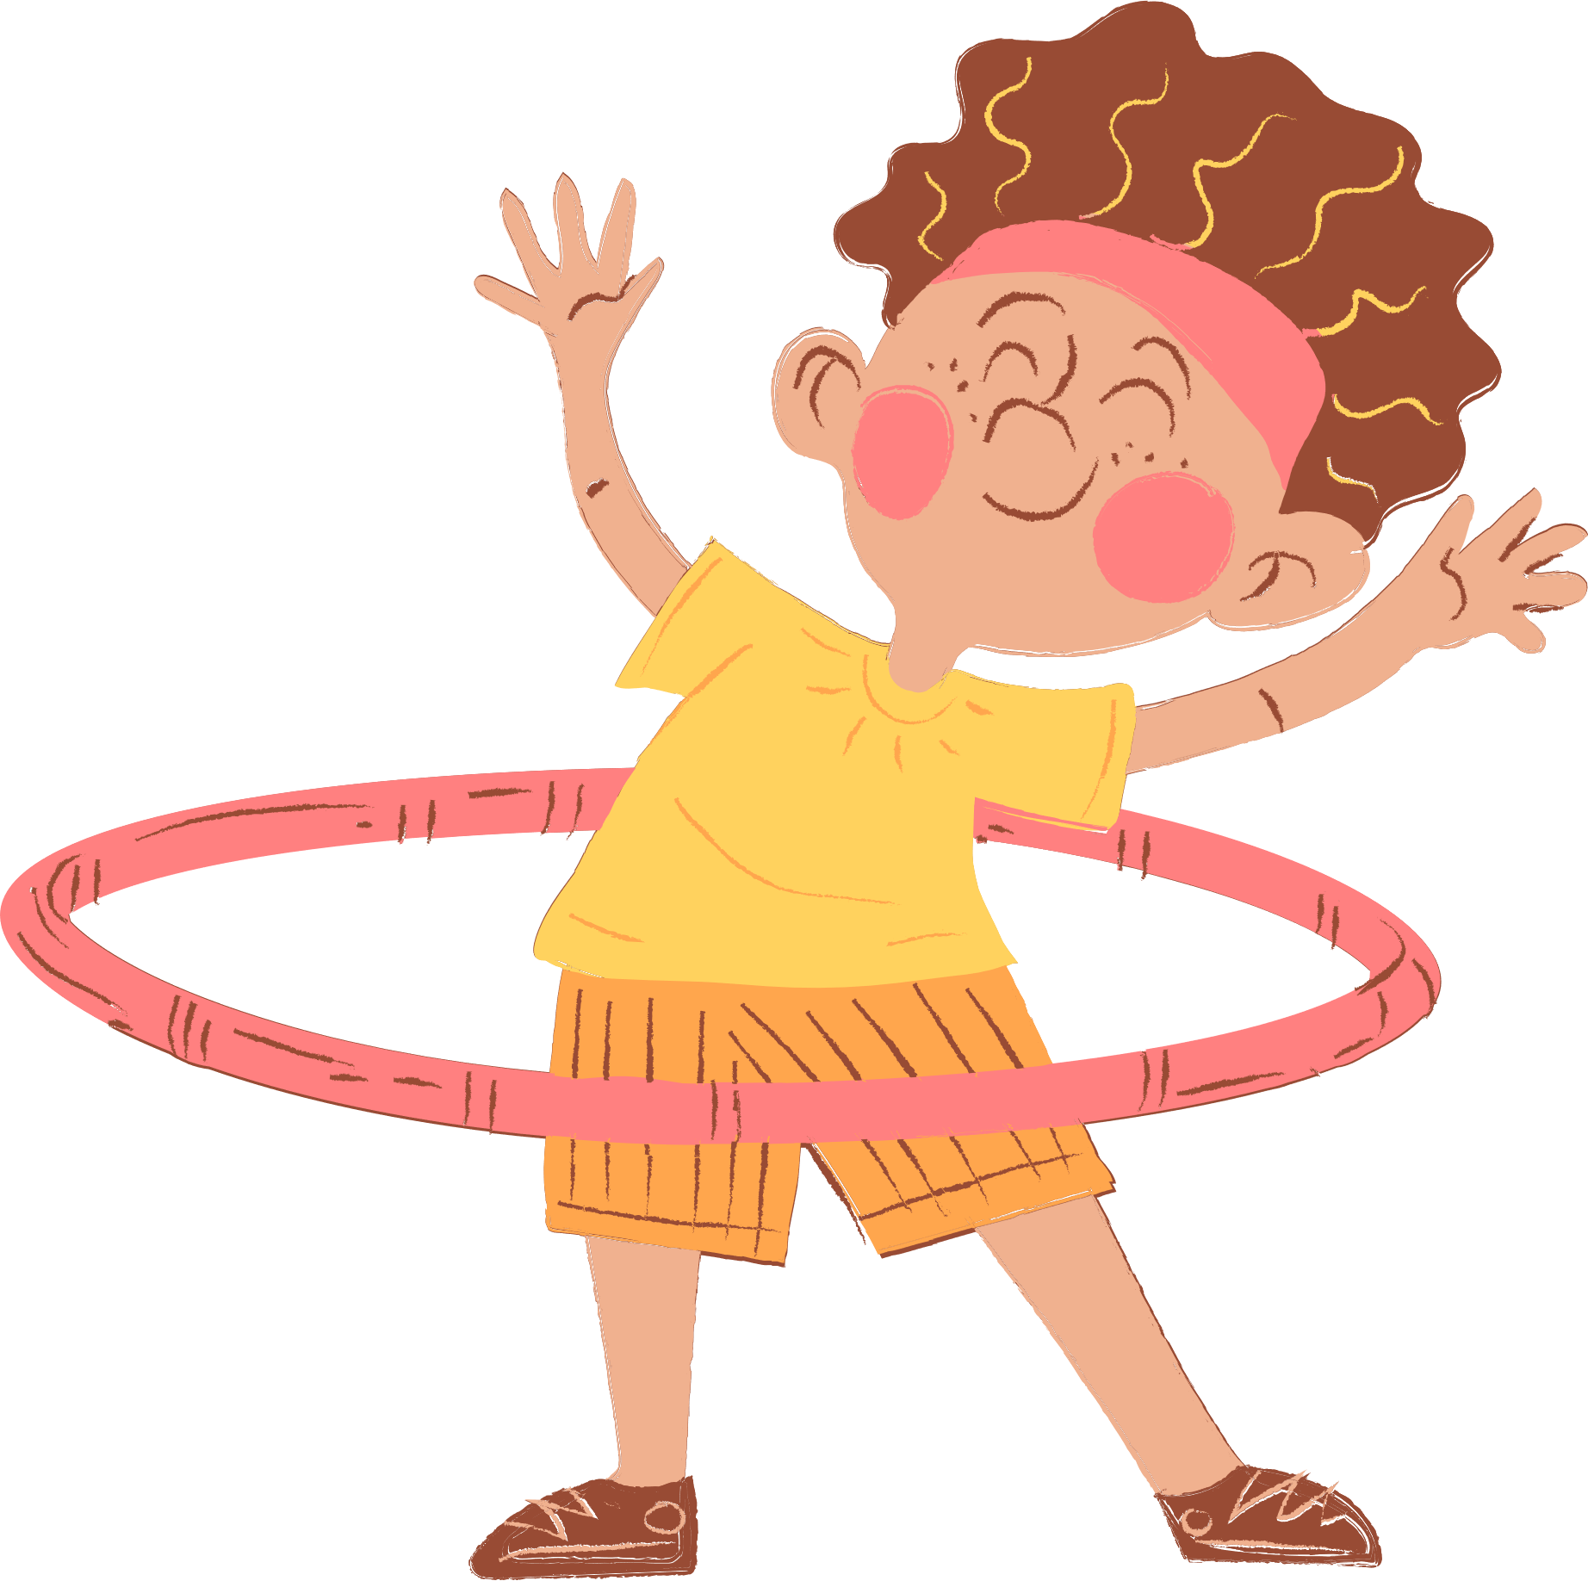
4
Our Free-time Activities
Lesson 1 - Period 1

Slide 3






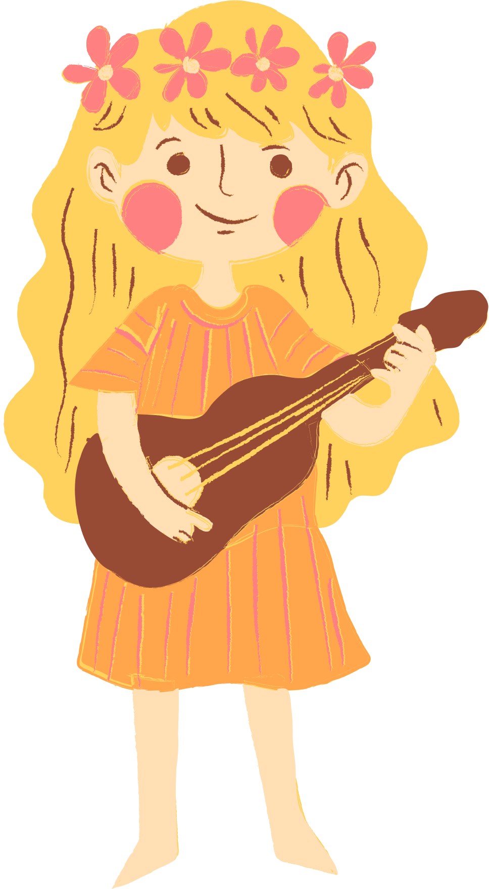
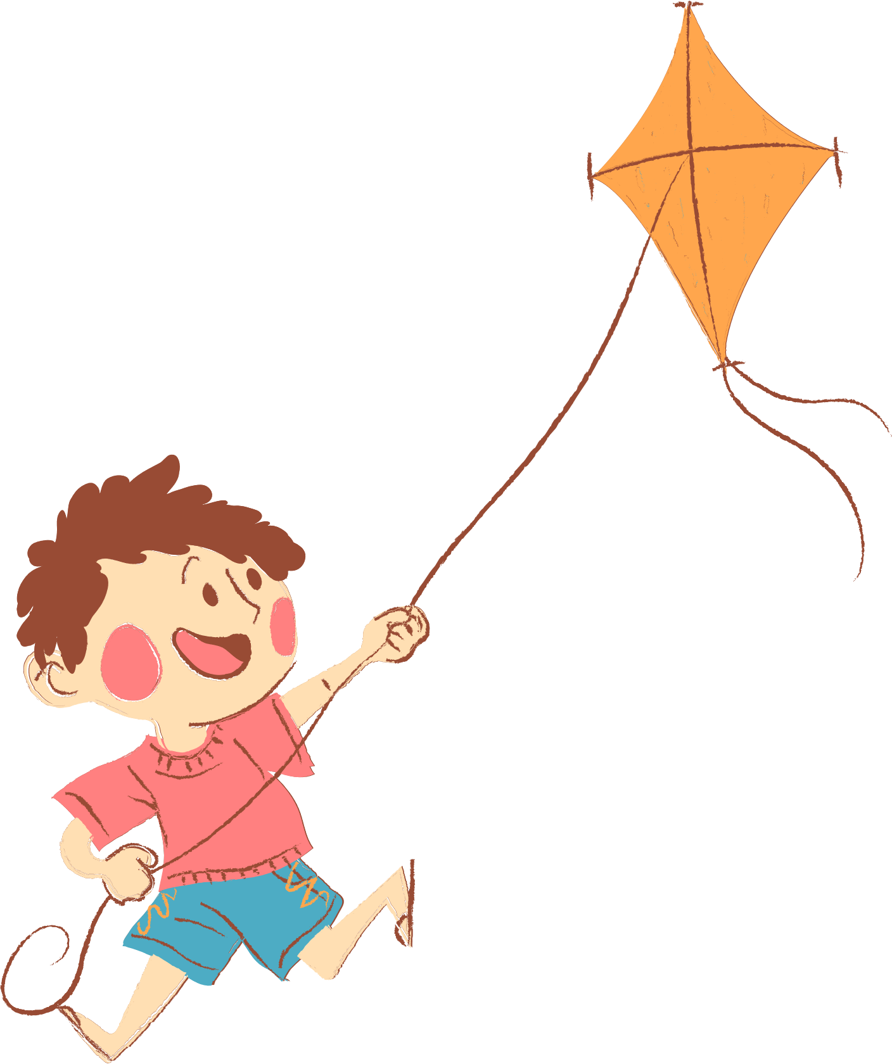
01. Warm-up
02. Look, listen and repeat.
03. Listen, point and say.
04. Let’s talk.
05. Wrap-up

Slide 4
01. Warm-up:
Sing a song.

Slide 5
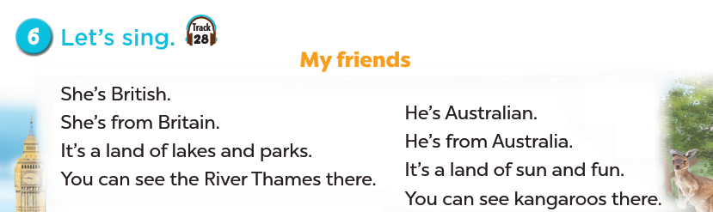


Slide 6
Do you go to school in the evenings or at weekends?
What do you do when you are free?

Slide 7
02. Look, listen and repeat.

Slide 8
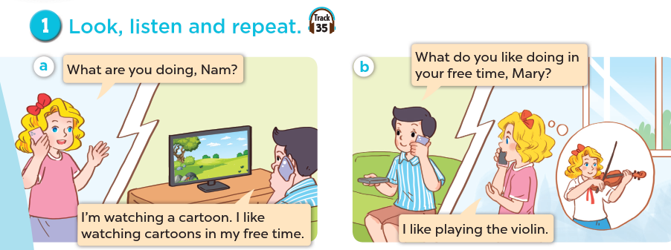
What are the people doing?
What are they talking about?
Listen and repeat.

Slide 9
03. Listen, point and say.

Slide 10
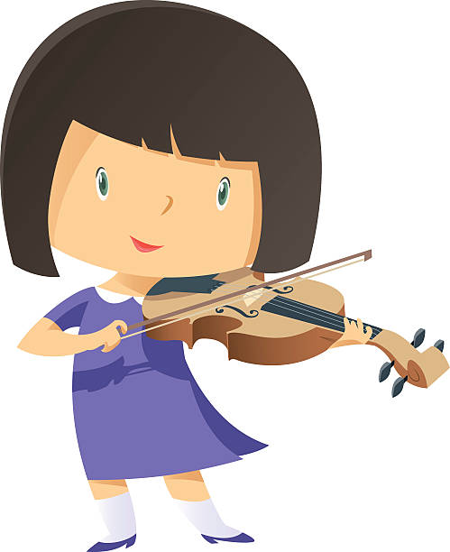
play the violin

Slide 11
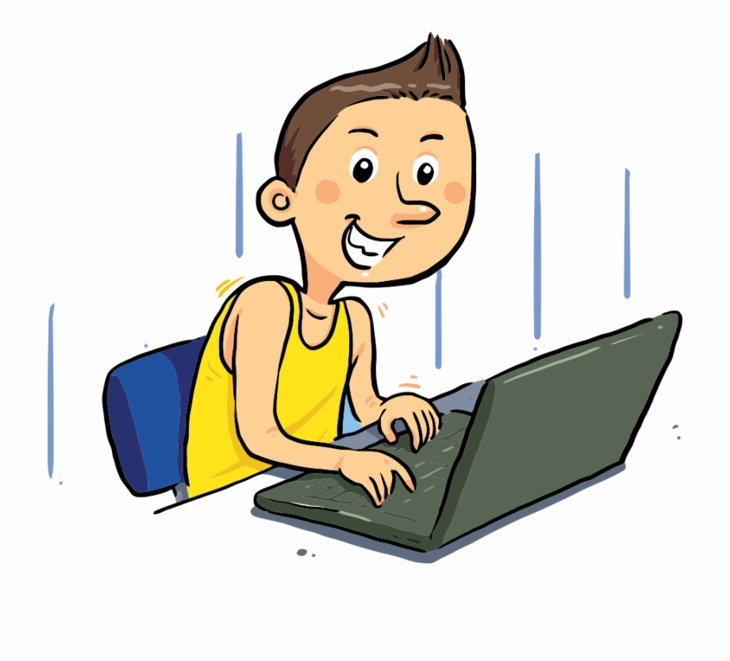
surf the Internet

Slide 12
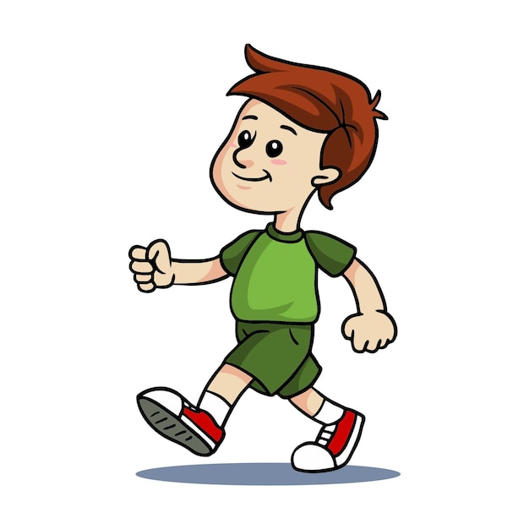
go for a walk

Slide 13
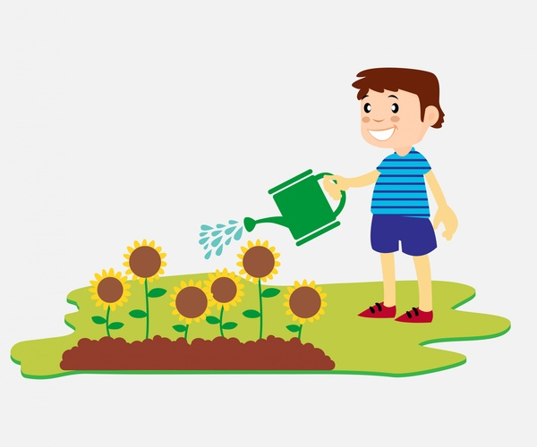
water the flowers

Slide 14
Look and guess.

Slide 15
surf the Internet

Slide 16
play the violin

Slide 17
water the flowers

Slide 18
go for a walk

Slide 19
Remember:

Slide 20
V-ing
play
surf
go
water
playing
surfing
going
watering

Slide 21
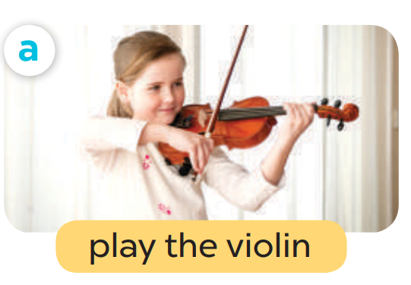
What do you like doing in your free time?
I like playing the violin.

Slide 22
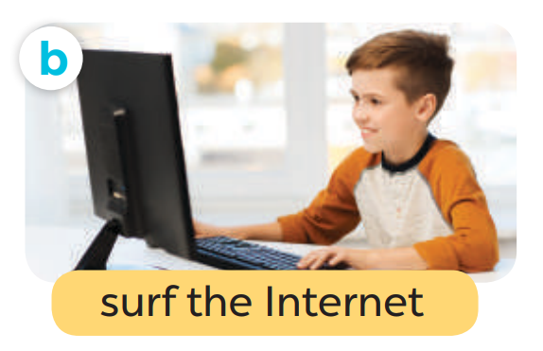
What do you like doing in your free time?
I like surfing the Internet.

Slide 23
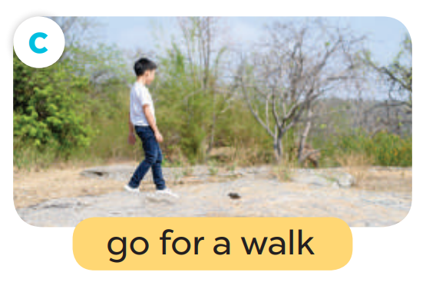
What do you like doing in your free time?
I like going for a walk.

Slide 24

What do you like doing in your free time?
I like watering the flowers.

Slide 25
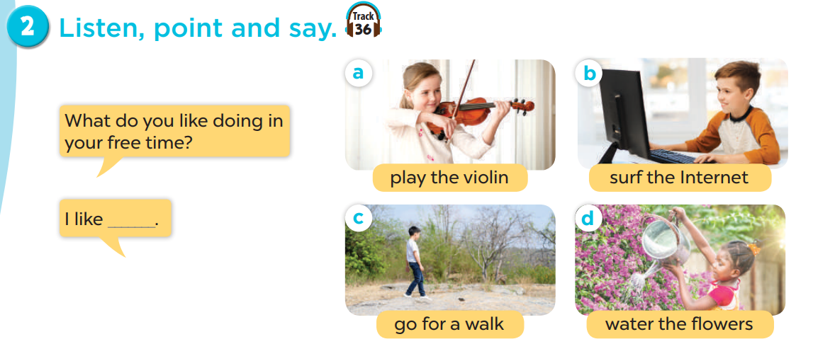
Listen, point and say.
Act it out.

Slide 26
05. Let’s talk.

Slide 27
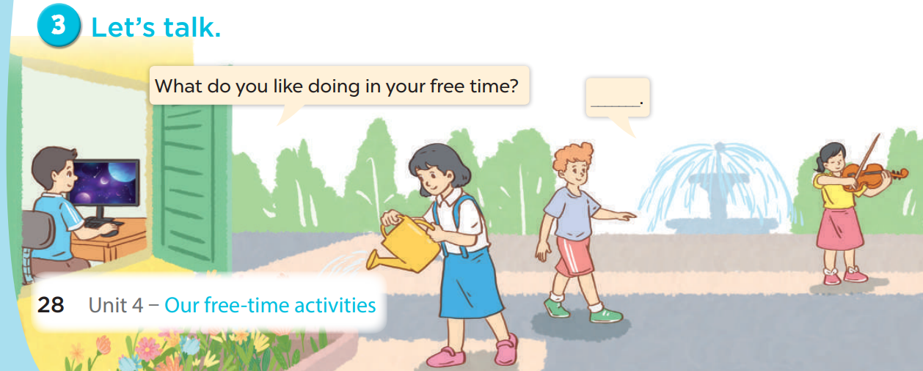
Work in pairs. Ask and answer.
What do you like doing in your free time?
I like _____.

Slide 28
04.Wrap-up
Game

Slide 29


1
2
3
4
6
5

Slide 30
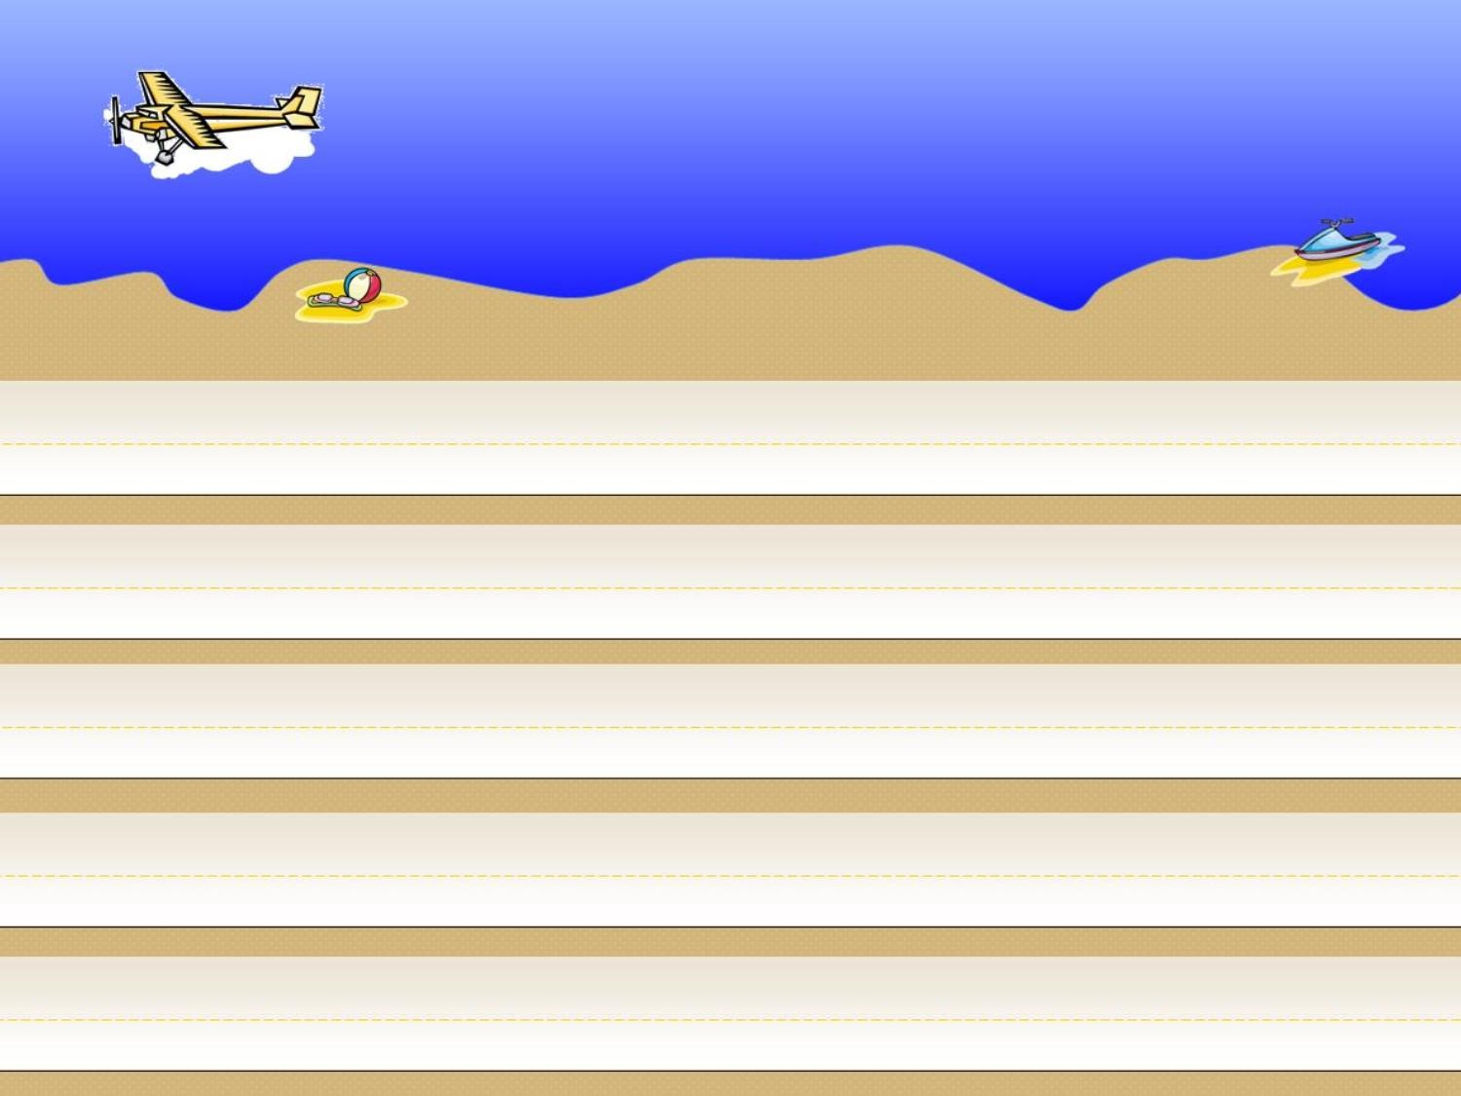



Click to Make
Yellow Car Move
Click to Make
Orange Car Move
Notes:
Click the red car to back to slide 25th

Slide 31
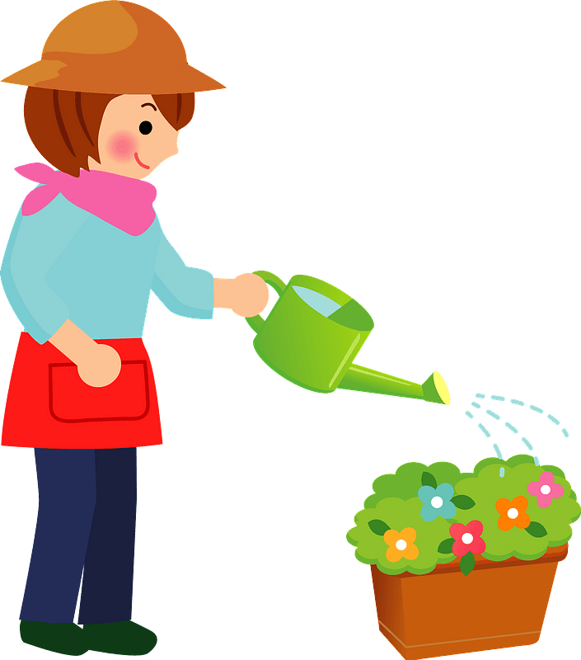


What do you like doing in your free time?
I like watering the flowers.
Notes:
Press the spacebar or down arrow to reveal the answer.
Press the X to go back to the letter slide (wrong answer), press the question box to go the reward slide (correct answer).

Slide 32

What do you like doing in your free time?
I like playing the violin.
Notes:
Press the spacebar or down arrow to reveal the answer.
Press the X to go back to the letter slide (wrong answer), press the question box to go the reward slide (correct answer).

Slide 33

What do you like doing in your free time?
I like surfing the Internet.
Notes:
Press the spacebar or down arrow to reveal the answer.
Press the X to go back to the letter slide (wrong answer), press the question box to go the reward slide (correct answer).

Slide 34

What do you like doing in your free time?
I like going for a walk.
Notes:
Press the spacebar or down arrow to reveal the answer.
Press the X to go back to the letter slide (wrong answer), press the question box to go the reward slide (correct answer).

Slide 35
I like ……………… the Internet.
surfing
going
playing
A. surfing
Notes:
Press the spacebar or down arrow to reveal the answer.
Press the X to go back to the letter slide (wrong answer), press the question box to go the reward slide (correct answer).

Slide 36
I like going …………………. .
the Internet
the flowers
for a walk
C. for a walk
Notes:
Press the spacebar or down arrow to reveal the answer.
Press the X to go back to the letter slide (wrong answer), press the question box to go the reward slide (correct answer).

Slide 37
Website: hoclieu.vn
Fanpage: https://www.facebook.com/tienganhglobalsuccess.vn/

