Slide 2
My foreign friends
Unit 3
Lesson 3 – Period 6

Slide 3
Table of contents
01
Warm up and review
02
Read and complete.
03
Let’s write.
05
Fun corner and wrap-up
04
Project

Slide 4
01
Warm-up and review

Slide 5
LISTEN, SING and CLAP.
My friends
Notes:
- Spend a few minutes revising the previous lesson by having pupils sing the song on page 23.
- Play the song for pupils to listen and sing in chorus.
- Play the song again for pupils to sing in chorus and clap hands to reinforce the activity.

Slide 6
Let’s SING in the front.
Notes:
- Invite one pupil or a group to perform the song in front of the class.

Slide 8
02
Read and complete.

Slide 9
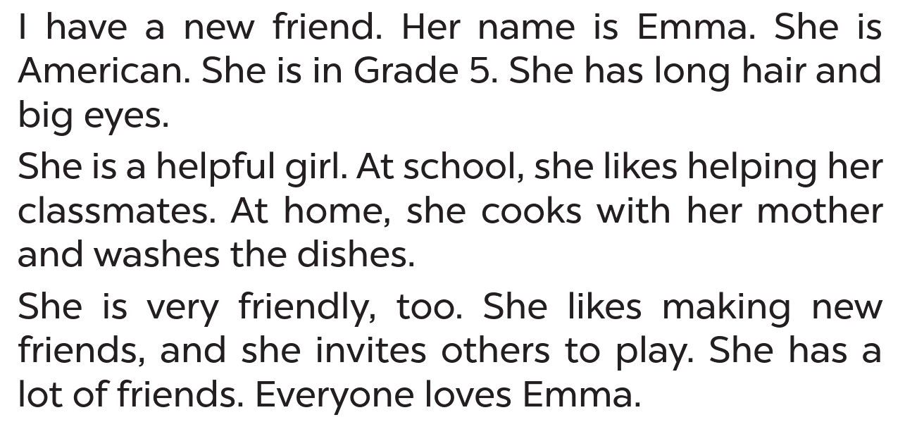
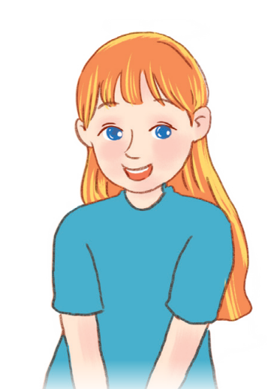
LISTEN and READ
Page 27
Emma
Notes:
Step 1: Introduce Emma and the text about her.
Ask pupils to read the text silently.

Slide 10
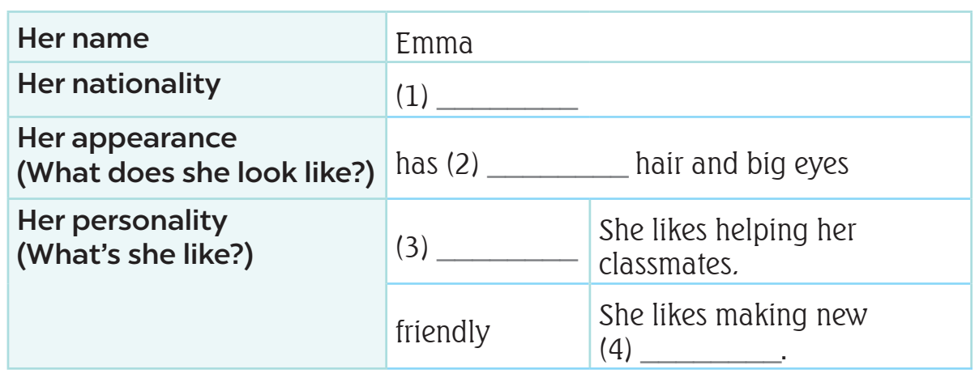
LISTEN and READ
What’s
the information?
main
information
Notes:
In weaker classes, explain that in the first column, they are main information you need to find about Emma such as her name, her nationality, her appearance, and personality. The second column is the information about Emma.

Slide 11
READ and ANSWER.
Notes:
Step 2: Do blank 1 as an example. First, have pupils read the information in the table and decide what information they need (nationality). Then, have pupils find the information about Emma’s nationality in the text. Write the word to fill in blank 1.
- Ask pupils to guess what the blanks 2, 3 and 4 are.

Slide 12
READ and ANSWER
nationality
Emma
Notes:
Step 2: Do blank 1 as an example. First, have pupils read the information in the table and decide what information they need (nationality). Then, have pupils find the information about Emma’s nationality in the text. Write the word to fill in blank 1.
- Ask pupils to guess what the blanks 2, 3 and 4 are.

Slide 13
READ and ANSWER.
American
Notes:
Step 2: Do blank 1 as an example. First, have pupils read the information in the table and decide what information they need (nationality). Then, have pupils find the information about Emma’s nationality in the text. Write the word to fill in blank 1.
Step 3: Set a time limit for pupils to do the task independently. Go around the classroom and offer help where necessary.

Slide 14
SWAP YOUR BOOKS.
Notes:
Step 4: Get pupils to swap their books with a partner and check their answers before checking as a class. Explain the type of information they need for each gap, e.g. For gap 2, you need a word to describe Emma’s hair. For gap 3, you need a word to tell what Emma is like. For gap 4, it is an example to show that Emma is friendly. Look for the word meeting in the reading.

Slide 15
Let’s check!
long
Notes:
Step 2: Do blank 1 as an example. First, have pupils read the information in the table and decide what information they need (nationality). Then, have pupils find the information about Emma’s nationality in the text. Write the word to fill in blank 1.
Step 3: Set a time limit for pupils to do the task independently. Go around the classroom and offer help where necessary.

Slide 16
Let’s check!
helpful
Notes:
Step 2: Do blank 1 as an example. First, have pupils read the information in the table and decide what information they need (nationality). Then, have pupils find the information about Emma’s nationality in the text. Write the word to fill in blank 1.
Step 3: Set a time limit for pupils to do the task independently. Go around the classroom and offer help where necessary.

Slide 17
Let’s check!
friends
Notes:
Step 2: Do blank 1 as an example. First, have pupils read the information in the table and decide what information they need (nationality). Then, have pupils find the information about Emma’s nationality in the text. Write the word to fill in blank 1.
Step 3: Set a time limit for pupils to do the task independently. Go around the classroom and offer help where necessary.

Slide 18
ASK and ANSWER about Emma.
American
dishes
hair
friendly
classmate
Notes:
Extension (For advanced level): Ask pupils to choose five keywords about Emma (American, hair, classmates, dishes, and friendly). Have pupils work in pairs and talk about Emma.

Slide 20
03
Let’s write.

Slide 21
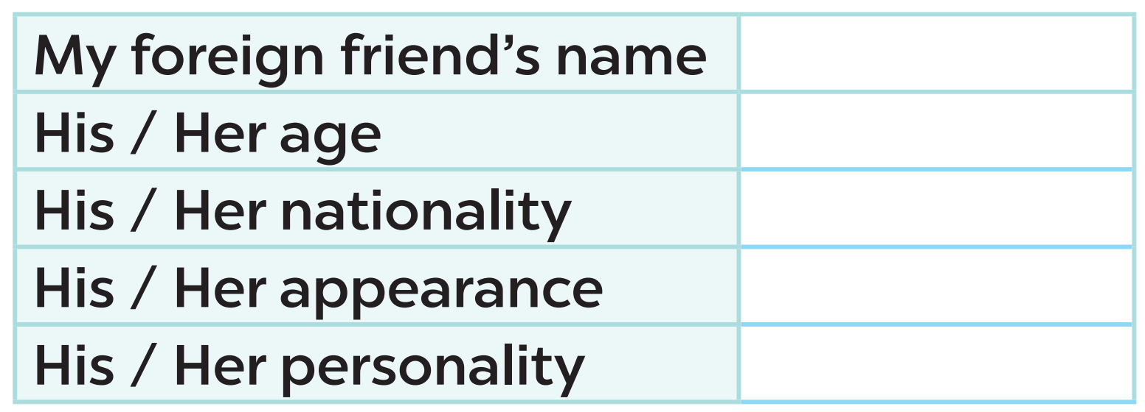
READ and ANSWER
Notes:
Step 1: Tell the class the goal of the activity and explain that they should read and fill in the form with the information about a foreign friend. Check comprehension.
- Ask pupils to guess the answers first.

Slide 22
READ and ANSWER
Lisa
Notes:
Step 2: Have pupils fill in the first blank together as an example. Ask them to read the first line in the form and elicit possible answers. Then have them write the answer in the gap.

Slide 24
04
Project

Slide 25
Let’s CHECK your POSTERS!
5 countries
nationalities
Notes:
Ask pupils to check their posters which have been prepared before. In the poster, there are the names of five countries and their nationality adjectives. If possible, there is some information about the countries such as people, flags, maps.

Slide 26
WORK in GROUPS.
Talk about your poster!!!!
Notes:
Step 2: Have groups put the posters on the desk and practice the presentation. Encourage all members in the group to present. Go around the classroom and offer help where necessary.

Slide 27
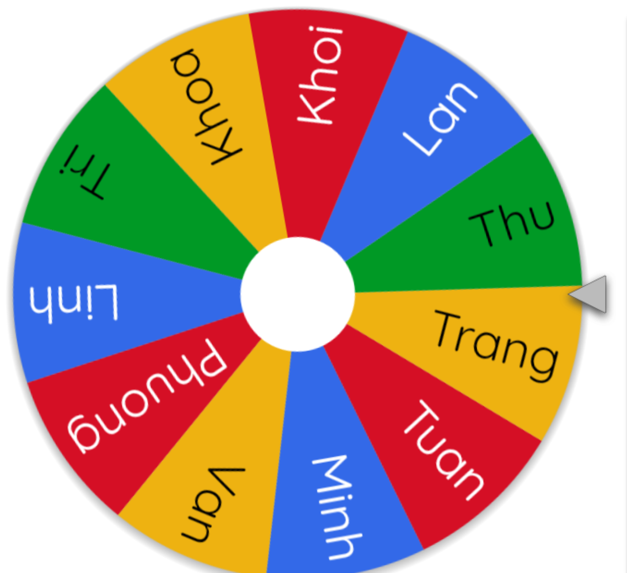
LET’S SPIN!
Notes:
Step 3: Get two groups to work together and take turns giving their presentations. Invite a few groups to show their poster and give their presentations in front of the class. Praise good performances.

Slide 29
05
Fun corner
and wrap-up

Slide 30
Game
WHO’S FASTER?
friendly
helpful
active
clever

Slide 31
TEAM 1 and TEAM 2
friendly
clever
active
helpful

Slide 33
Website: hoclieu.vn
Fanpage: facebook.com/www.tienganhglobalsuccess.vn

