Slide 2





My foreign friends
Unit 3
Lesson 3 – Period 5

Slide 3
Table of contents
01
Warm up and review
02
Listen and repeat.
03
Circle, listen and check.
05
Fun corner and wrap-up
04
Let’s chant.

Slide 4


01
Warm-up and review

Slide 5


Describing people's
APPEARANCE
and
PERSONALITY

Slide 6


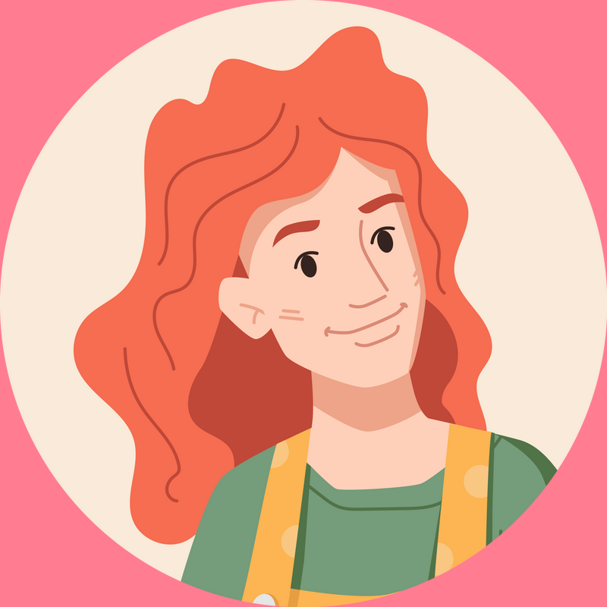

She has long and red hair.

Slide 7

She has long and red hair.

Slide 8


He has long and brown hair.
He is big and fat.
He has short and brown hair.

Slide 9
He has long and brown hair.
He is big and fat.
He has short and brown hair.

Slide 10
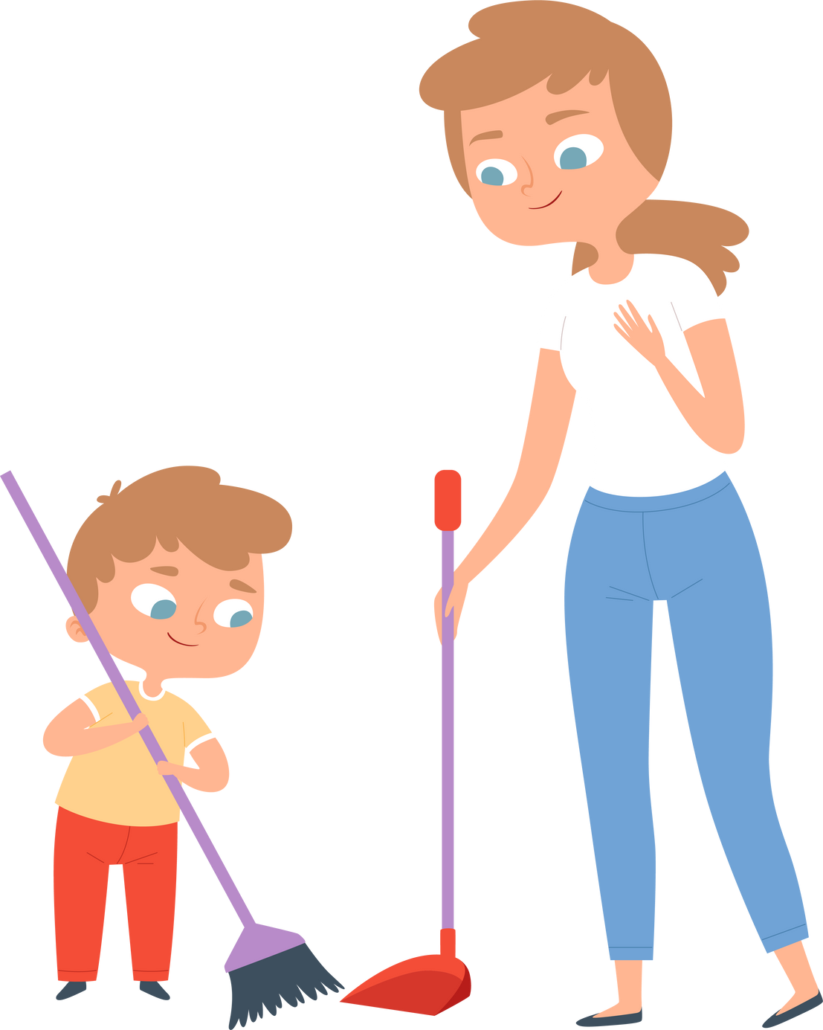
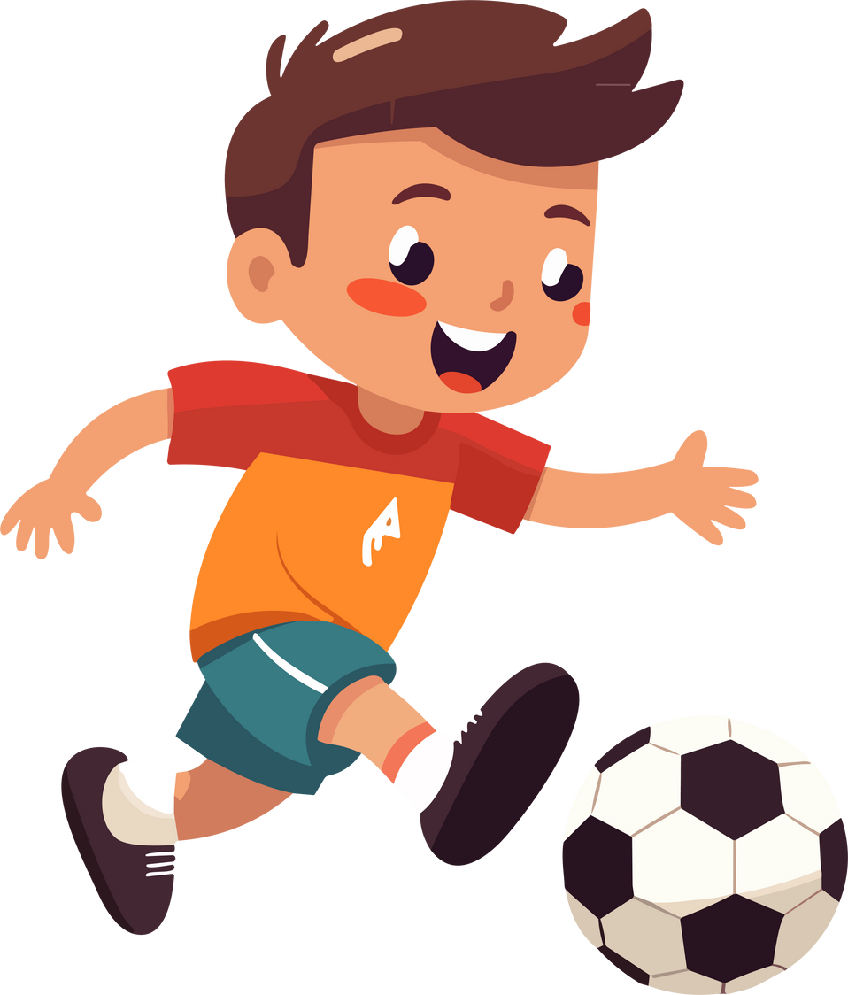
He is very active.

Slide 11
He is very active.

Slide 12

My sister has eyes.

Slide 13
big
My sister has eyes.

Slide 14


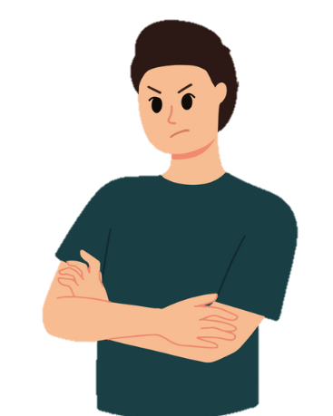
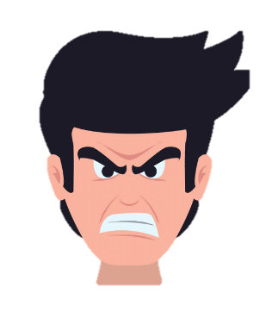
My brother is friendly.

Slide 15
My brother is friendly.

Slide 16


My little brother is helpful.
My little brother is clever.
My little brother is active.

Slide 17
My little brother is helpful.
My little brother is clever.
My little brother is active.

Slide 18
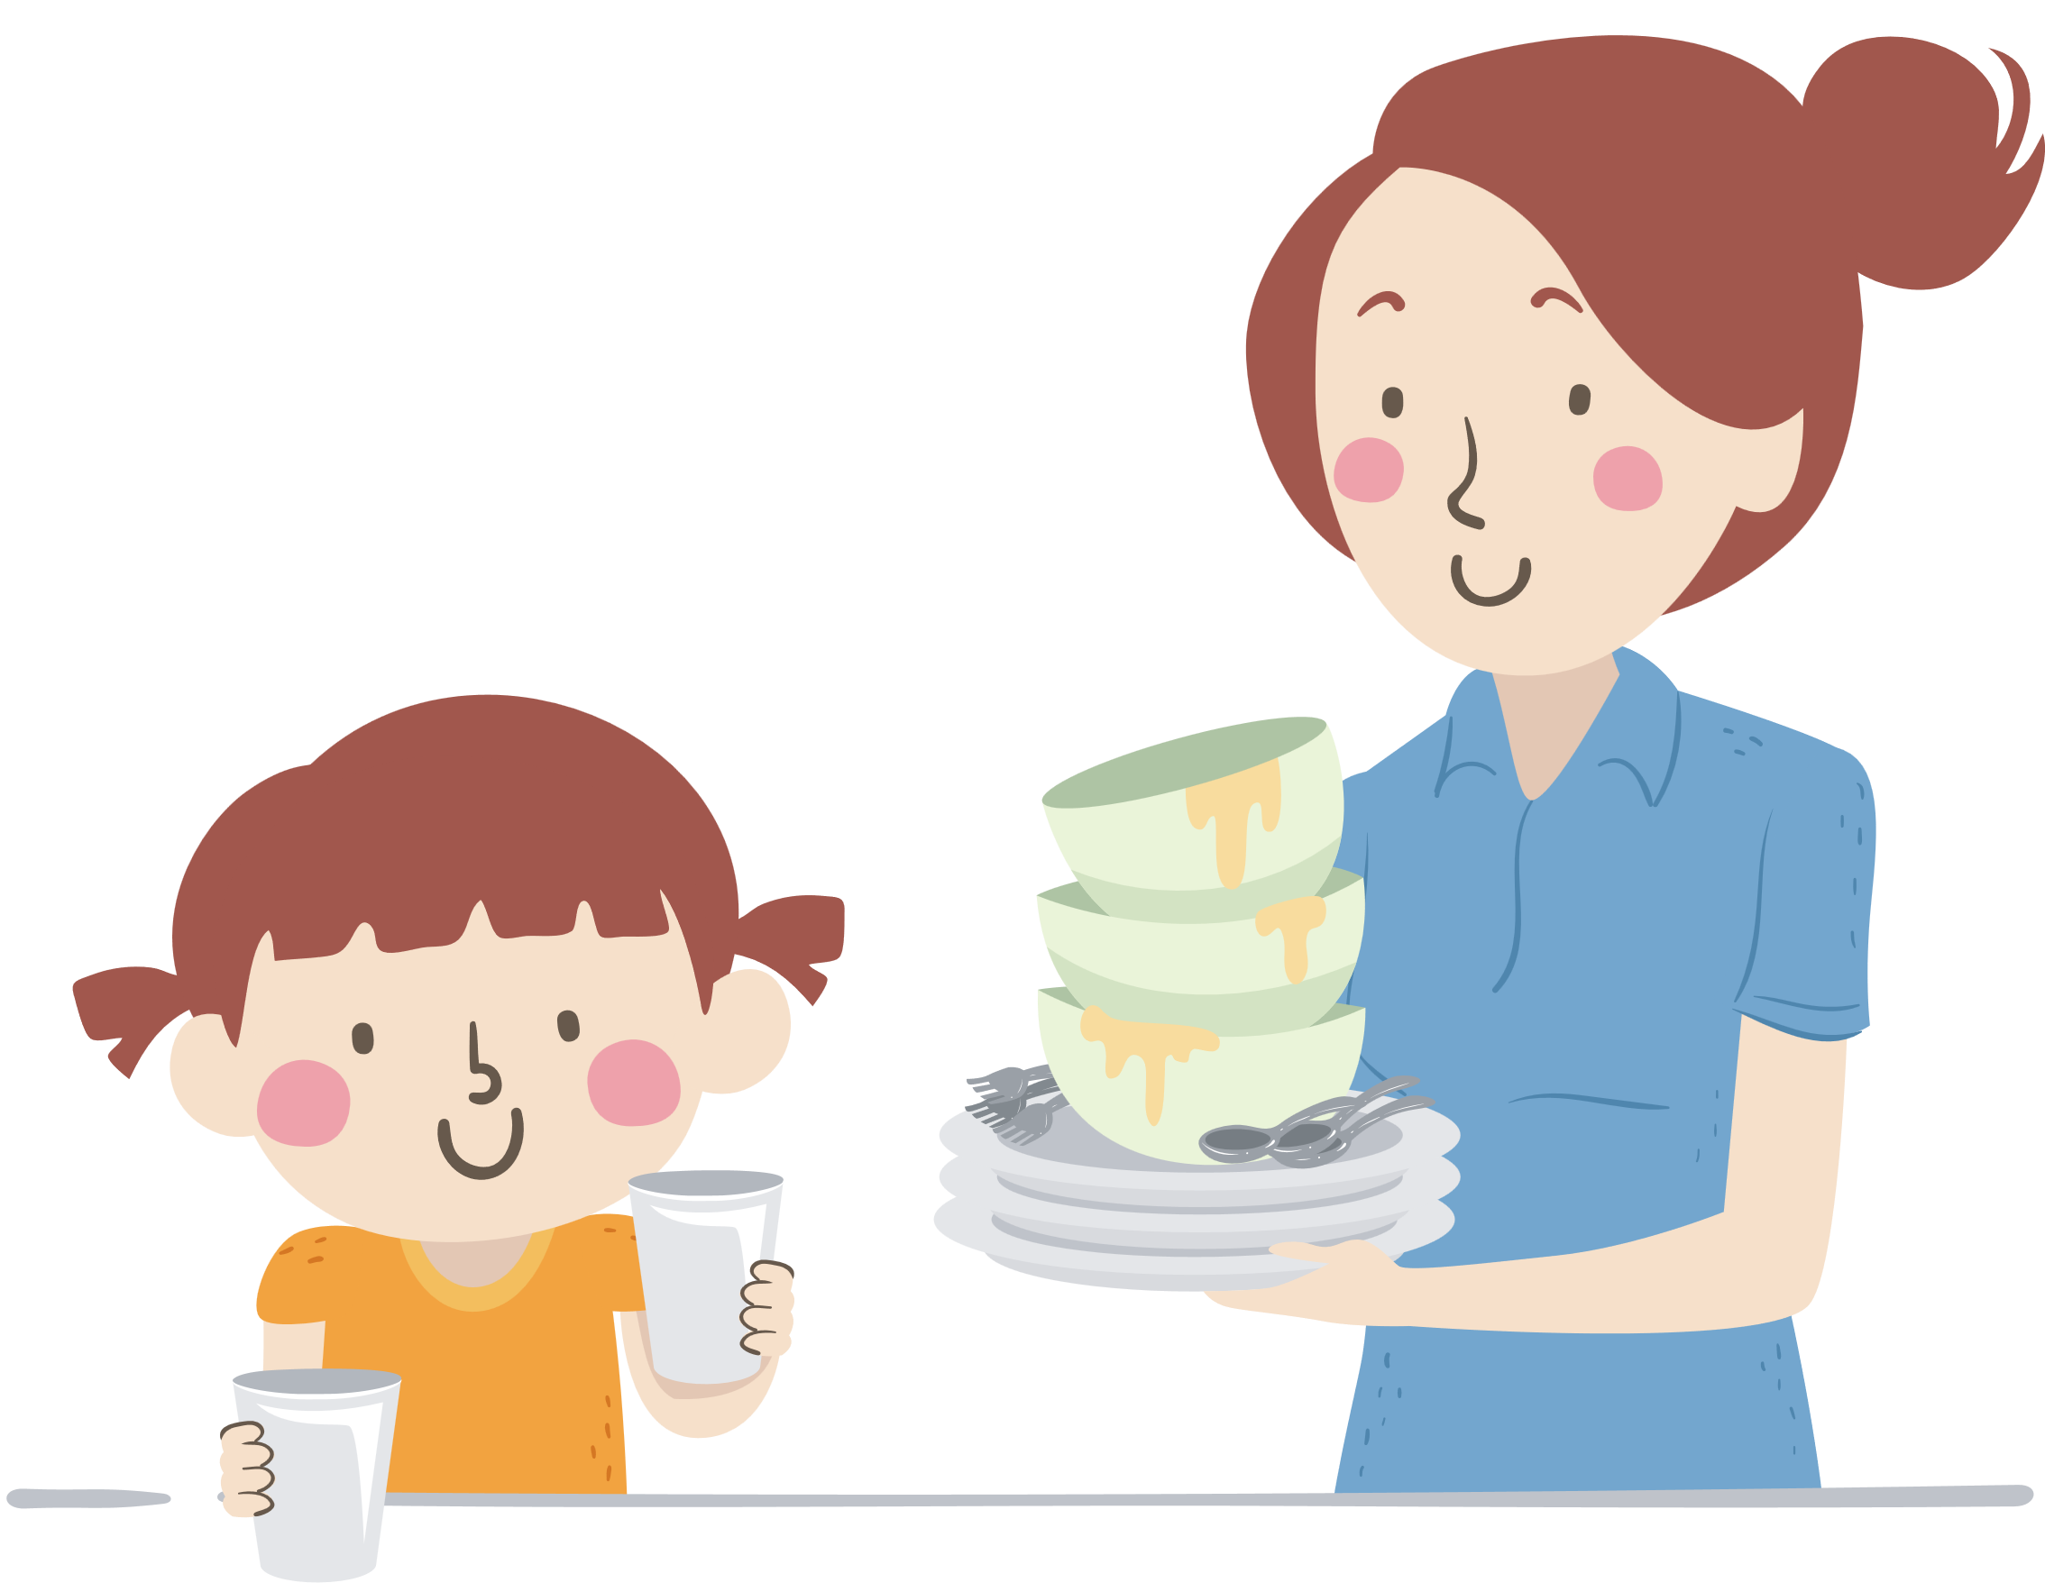
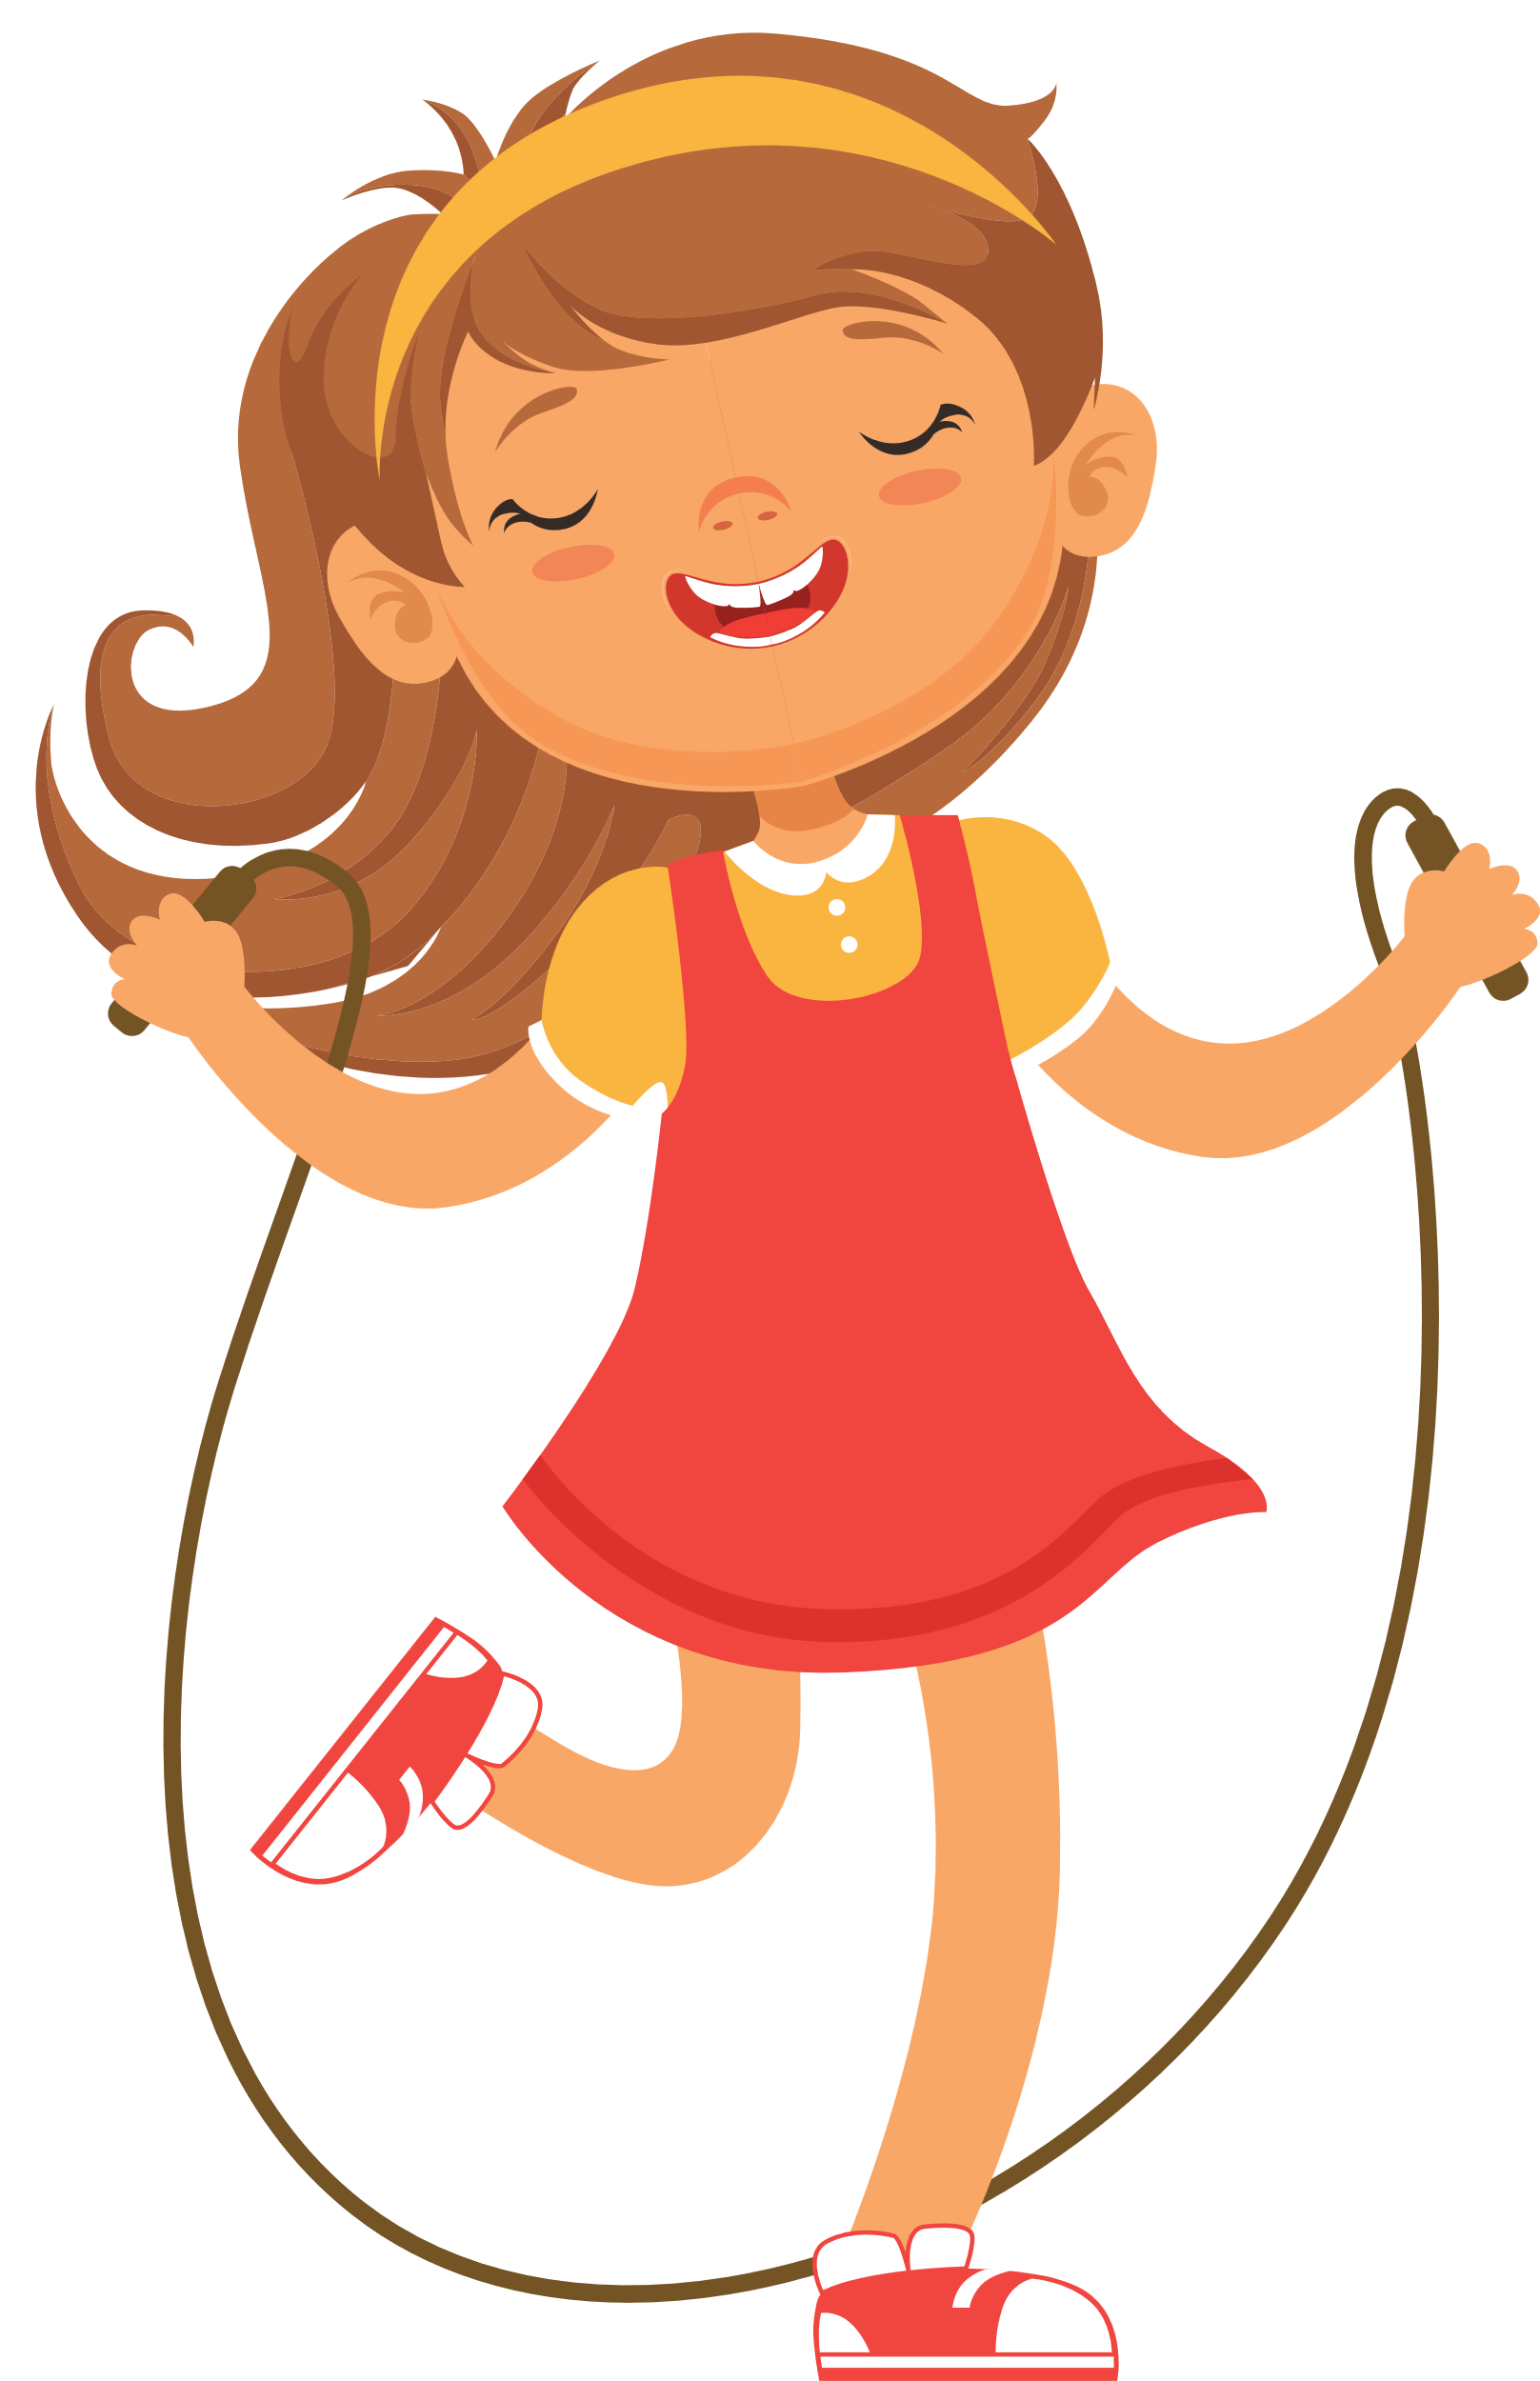
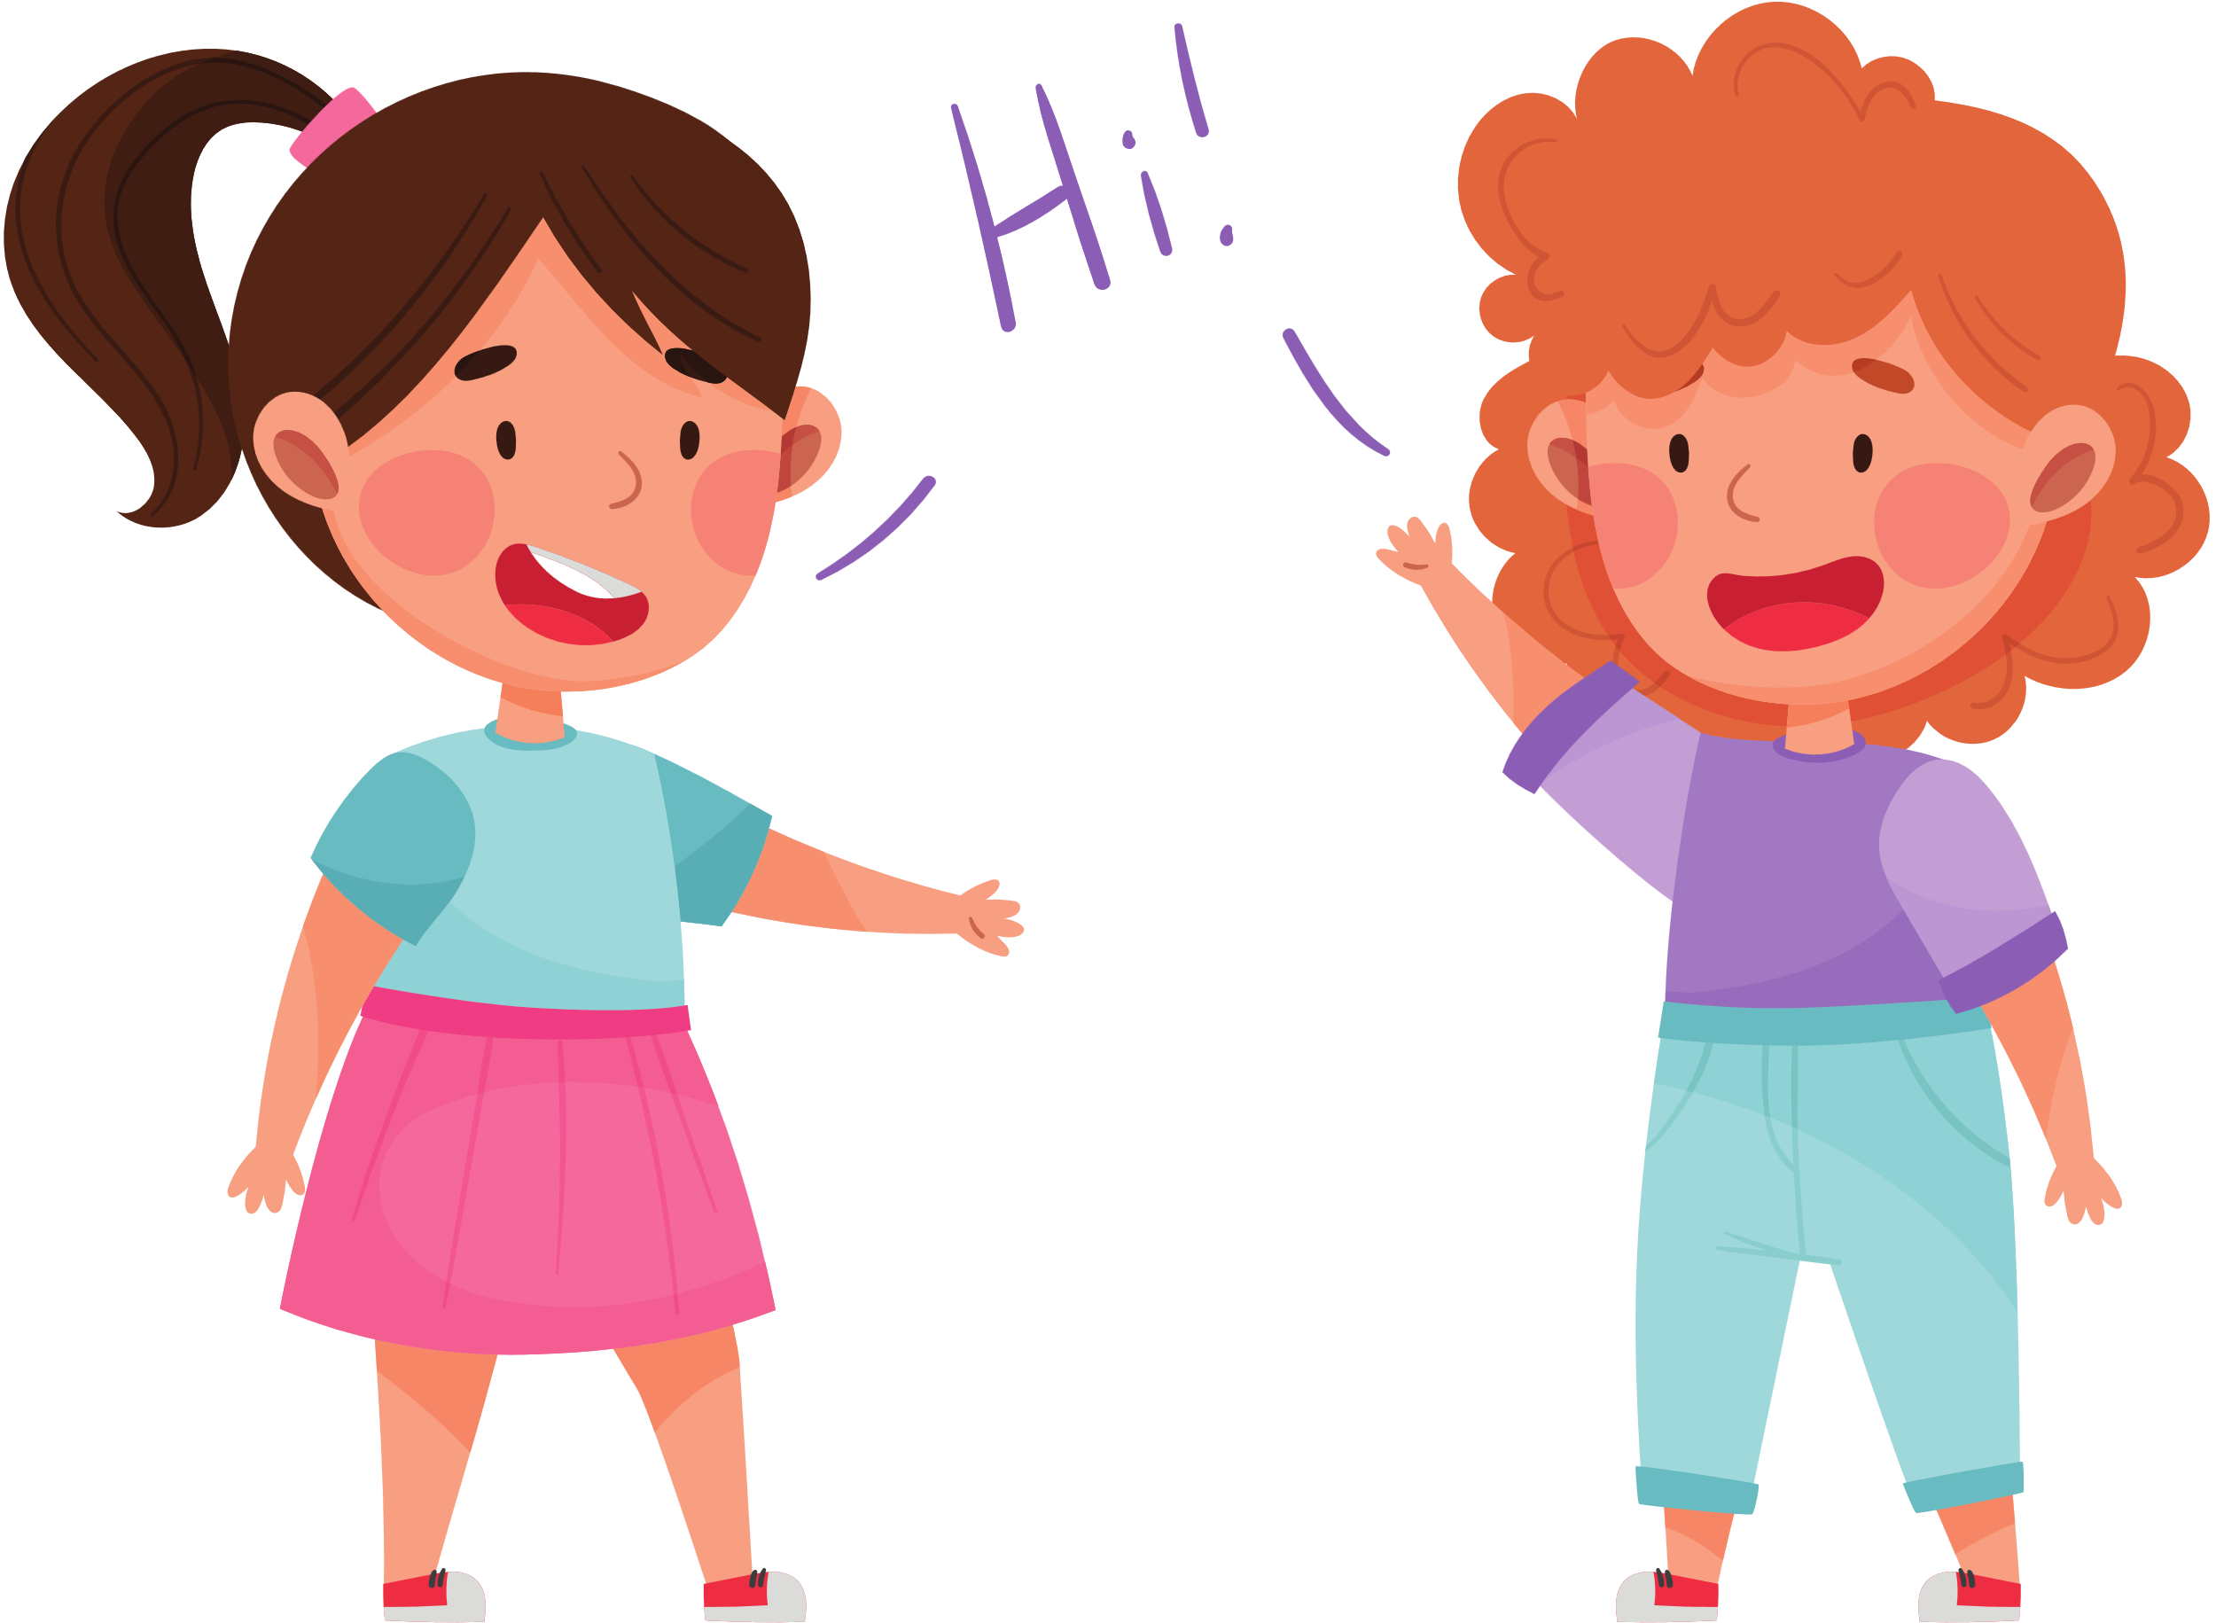
My younger sister is helpful.

Slide 19
My younger sister is helpful.

Slide 20





Slide 21
02
Listen and repeat.

Slide 22
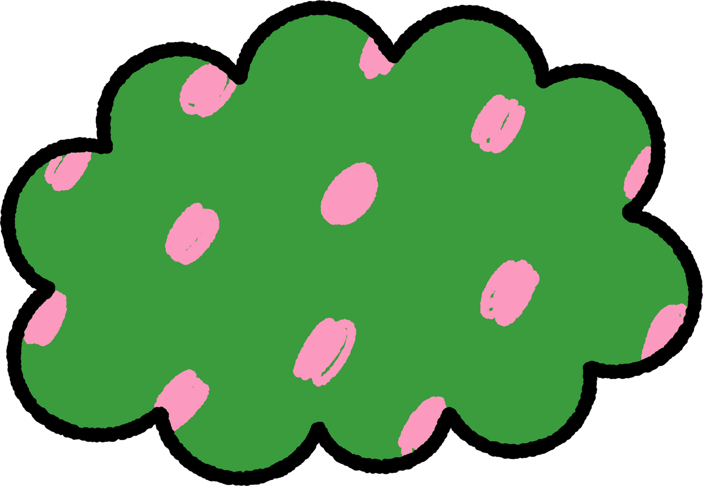




LISTEN, POINT and REPEAT
‘active
He’s ‘active.
Notes:
Step 1: Have pupils point at the word ‘active’ and the sentence He’s active. Play the recording of the word and sentence for them to listen and repeat in chorus and individually until they feel confident. Correct their pronunciation where necessary.
Step 2: Invite a few pupils to listen and repeat the stressed word and the sentence in front of the class. Praise good pronunciation.

Slide 23
LISTEN, POINT and REPEAT
‘friendly
She’s ‘friendly.
Notes:
Step 3: Repeat Steps 1 and 2 for the word ‘friendly’ and the sentence She’s friendly. Go around the classroom and correct their pronunciation if necessary.

Slide 24



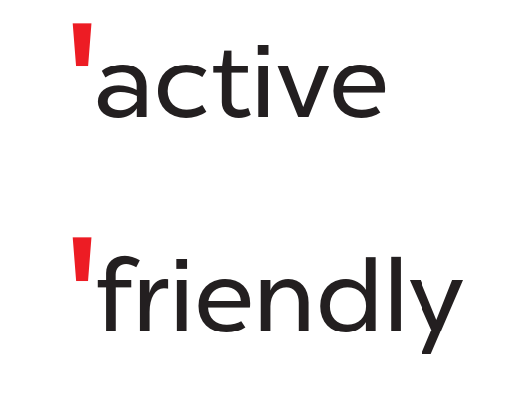
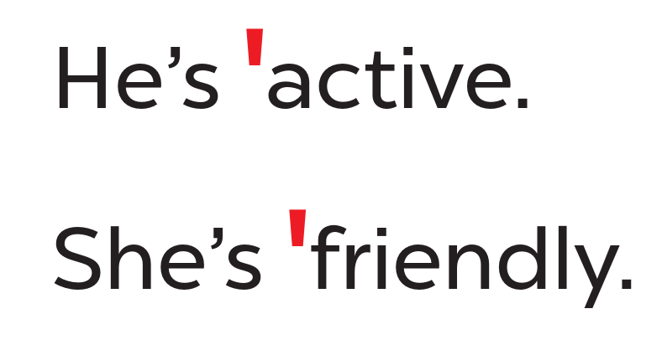


WORK in PAIRS
Notes:
Step 4: Let pupils work in pairs or groups, say the words, and read the sentences until they feel confident.

Slide 25
03
Circle, listen and check.

Slide 26




READ and CIRCLE.
a. friendly
b. fifteen
c. active
a. sixteen
b. eighteen
c. clever
a. helpful
b. about
c. nineteen
Notes:
Step 1: Tell pupils the goal of the activity. Explain that this is an ‘odd one out’ activity. Pupils read three options and circle the word which has a different stress pattern from the other two words.
Step 2: Give pupils a time limit to do the task individually. Have them read the words and odd out the ones that have the stress different from the other two.

Slide 27

SWAP YOUR BOOKS
Notes:
Then get pupils to swap books with a partner to check their answers.

Slide 28
LISTEN and CHECK.
a. friendly
b. fifteen
c. active
a. sixteen
b. eighteen
c. clever
a. helpful
b. about
c. nineteen
Notes:
Step 3: Play the recording and have pupils listen and check the options. Correct the answers where necessary.
- Click to appear the yellow arrow when starting listening.

Slide 29



LOOK and SAY aloud.
friendly
helpful
active
clever
She’s active.
He’s friendly.
He’s clever.
She’s helpful.
Notes:
Step 4: Invite a few pupils to read aloud the words in front of the class. Correct the word stress where necessary.

Slide 31
04
Let’s chant.

Slide 32

LOOK and SAY.
play basketball
active
Notes:
Step 1: Have pupils look at the picture and state activity the characters do and the words to show their personality.

Slide 33
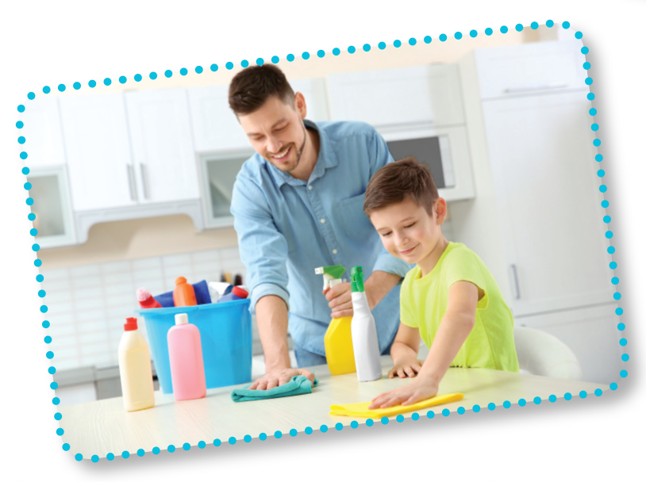
LOOK and SAY.
clean the table
helpful
Notes:
Step 1: Have pupils look at the picture and state activity the characters do and the words to show their personality.

Slide 34
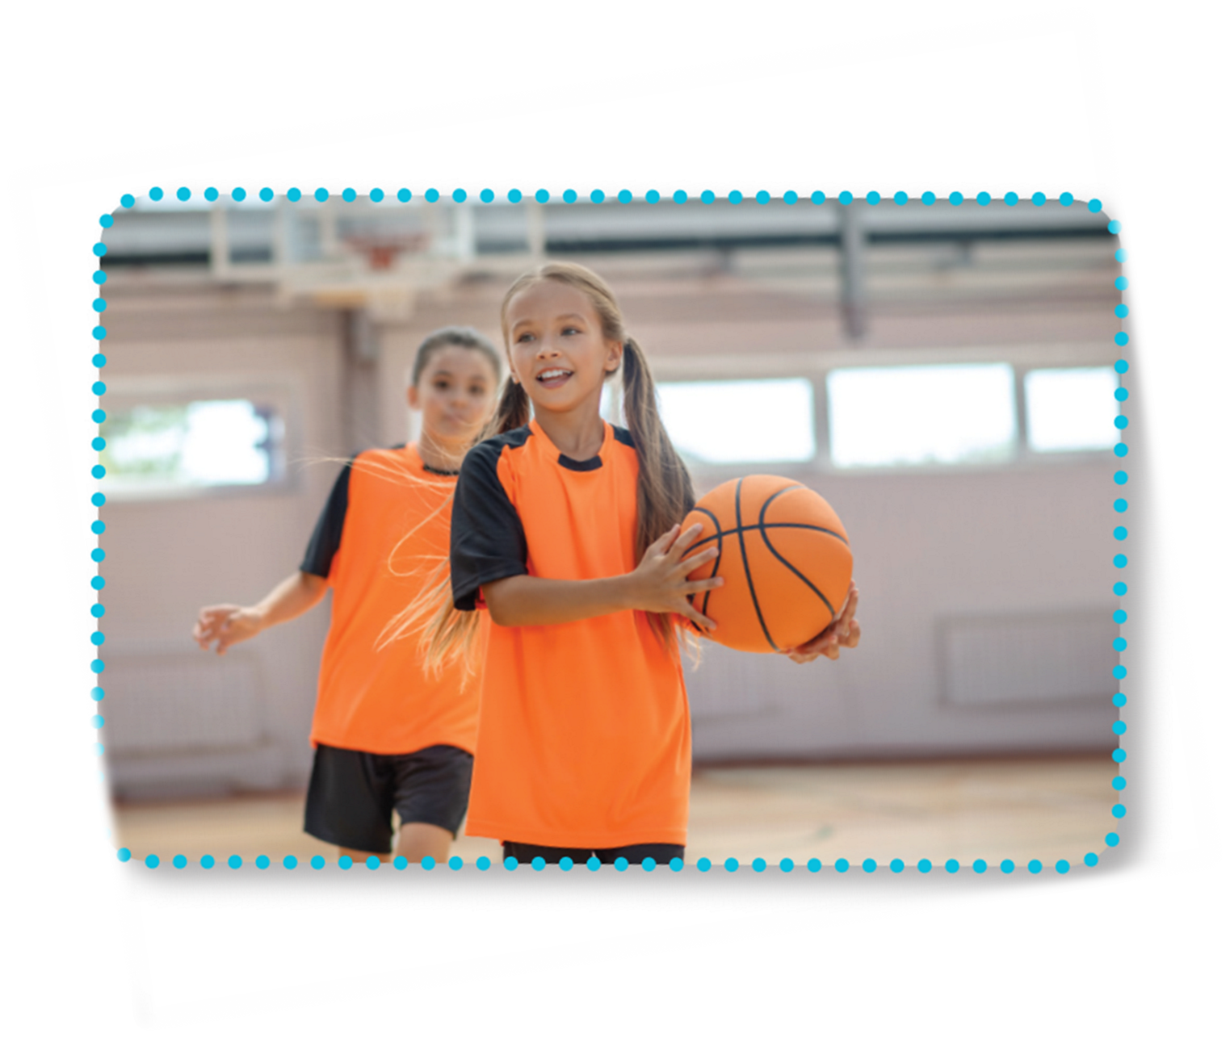

LOOK and READ.
Is she active?
Yes, she is.
Is she friendly?
Yes, she is.
She’s active and friendly.
Notes:
Step 2: Have pupils read the first verse of the chant and draw their attention to the stress of the words active and friendly as in words and in sentences. Check comprehension.

Slide 35
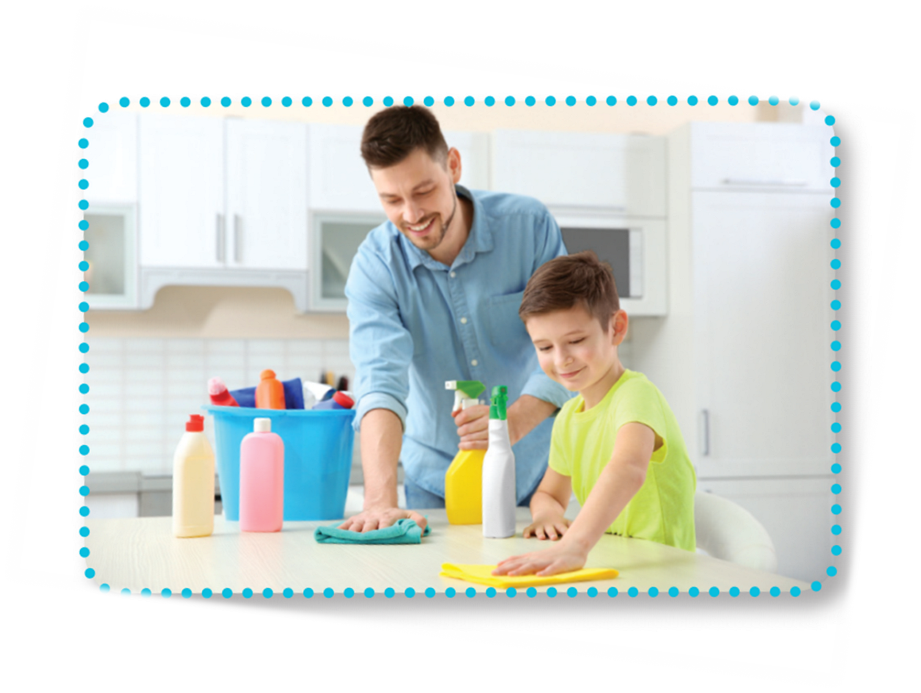
LOOK and READ.
Is he helpful?
Yes, he is.
Is he clever?
Yes, he is.
He’s helpful and clever.
Notes:
Step 2: Have pupils read the first verse of the chant and draw their attention to the stress of the words active and friendly as in words and in sentences. Check comprehension.

Slide 36

LISTEN and POINT.
Is she active?
Yes, she is.
Is she friendly?
Yes, she is.
She’s active and friendly.
Notes:
Step 3: Play the recording of the first verse for pupils to listen. Play it again, line by line, for pupils to listen and repeat. Draw their attention to the rhythm, word stress and pronunciation. Encourage them to clap or do actions while chanting.

Slide 37
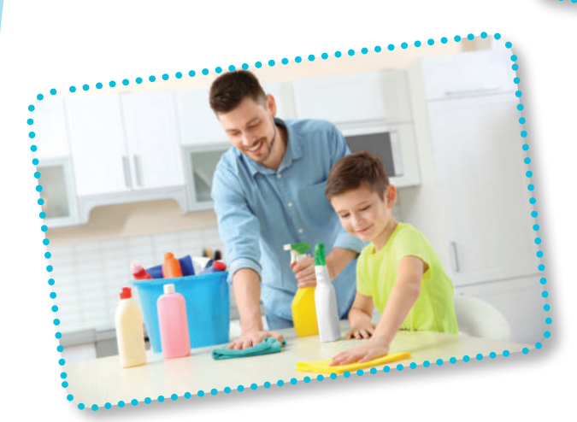
LISTEN and POINT
Is he helpful?
Yes, he is.
Is he clever?
Yes, he is.
He’s helpful and clever.
Notes:
Step 2: Have pupils read the first verse of the chant and draw their attention to the stress of the words active and friendly as in words and in sentences. Check comprehension.

Slide 38

LISTEN and REPEAT
Is she active?
Yes, she is.
Is she friendly?
Yes, she is.
She’s active and friendly.
Notes:
Play it again, line by line, for pupils to listen and repeat. Draw their attention to the rhythm, word stress and pronunciation. Encourage them to clap or do actions while chanting.

Slide 39
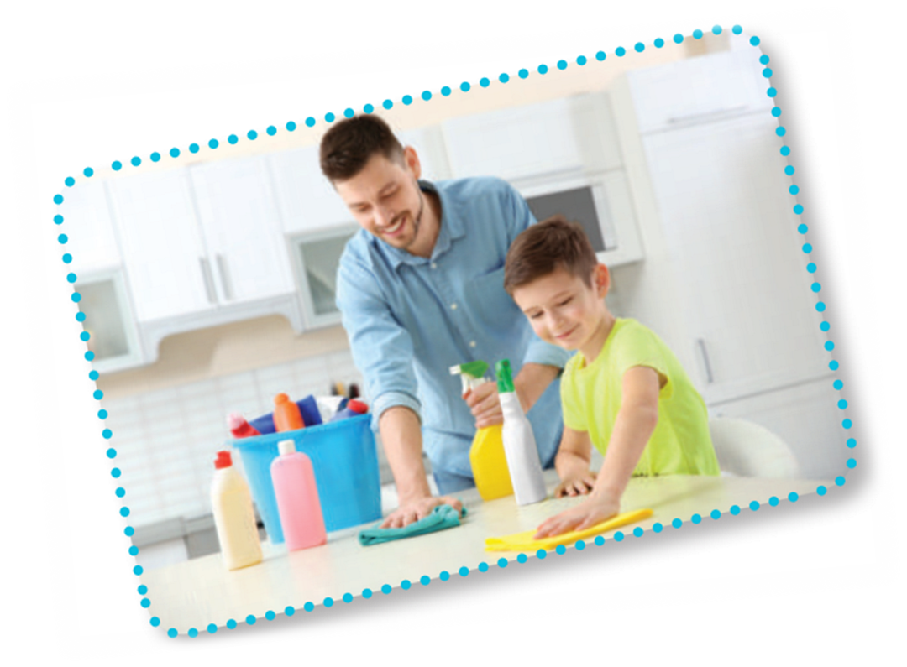
LISTEN and REPEAT
Is he helpful?
Yes, he is.
Is he clever?
Yes, he is.
He’s helpful and clever.
Notes:
Play it again, line by line, for pupils to listen and repeat. Draw their attention to the rhythm, word stress and pronunciation. Encourage them to clap or do actions while chanting.

Slide 40

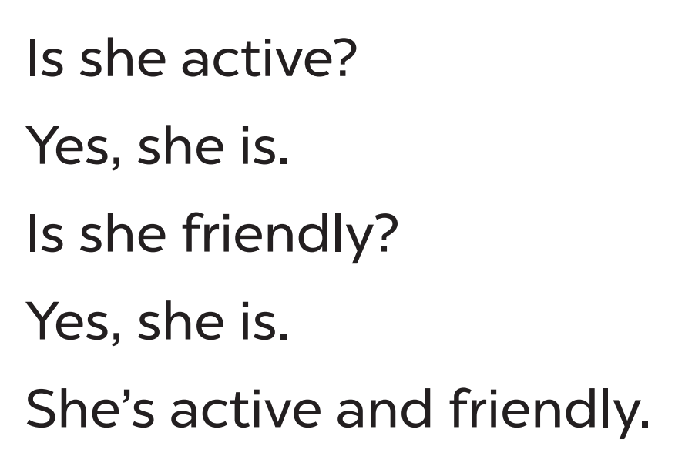
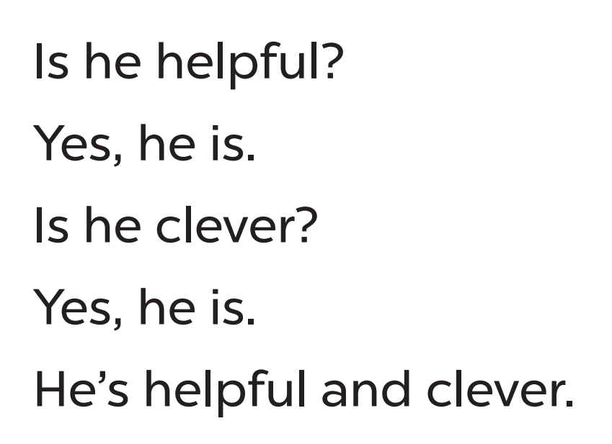
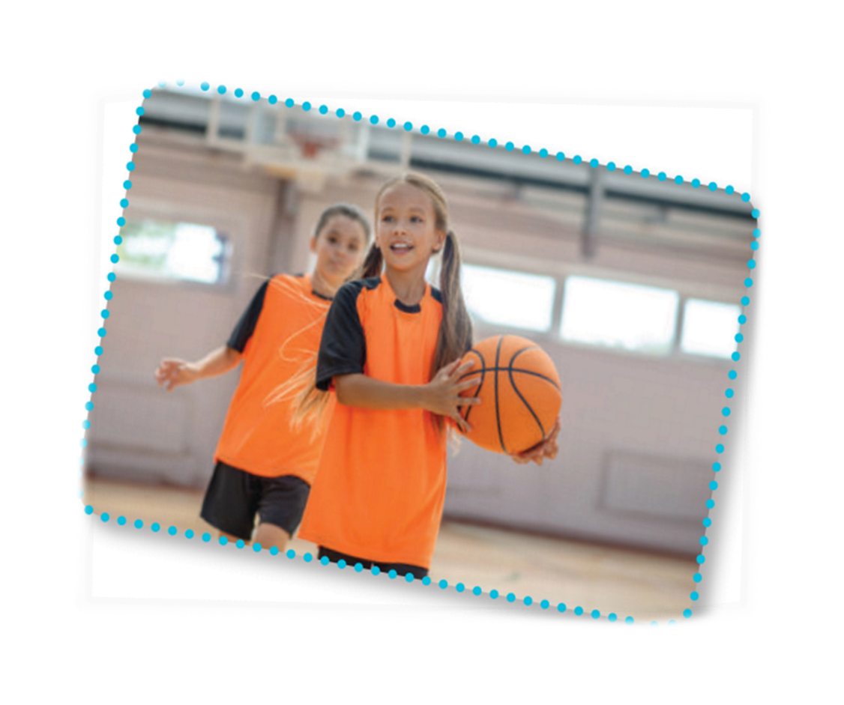
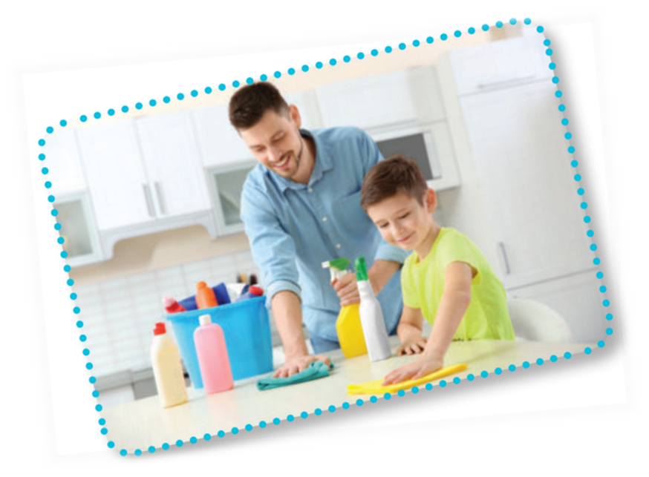
CHANT and CLAP
Notes:
Step 5: Play the recording all the way through for pupils to chant and clap their hands.

Slide 41




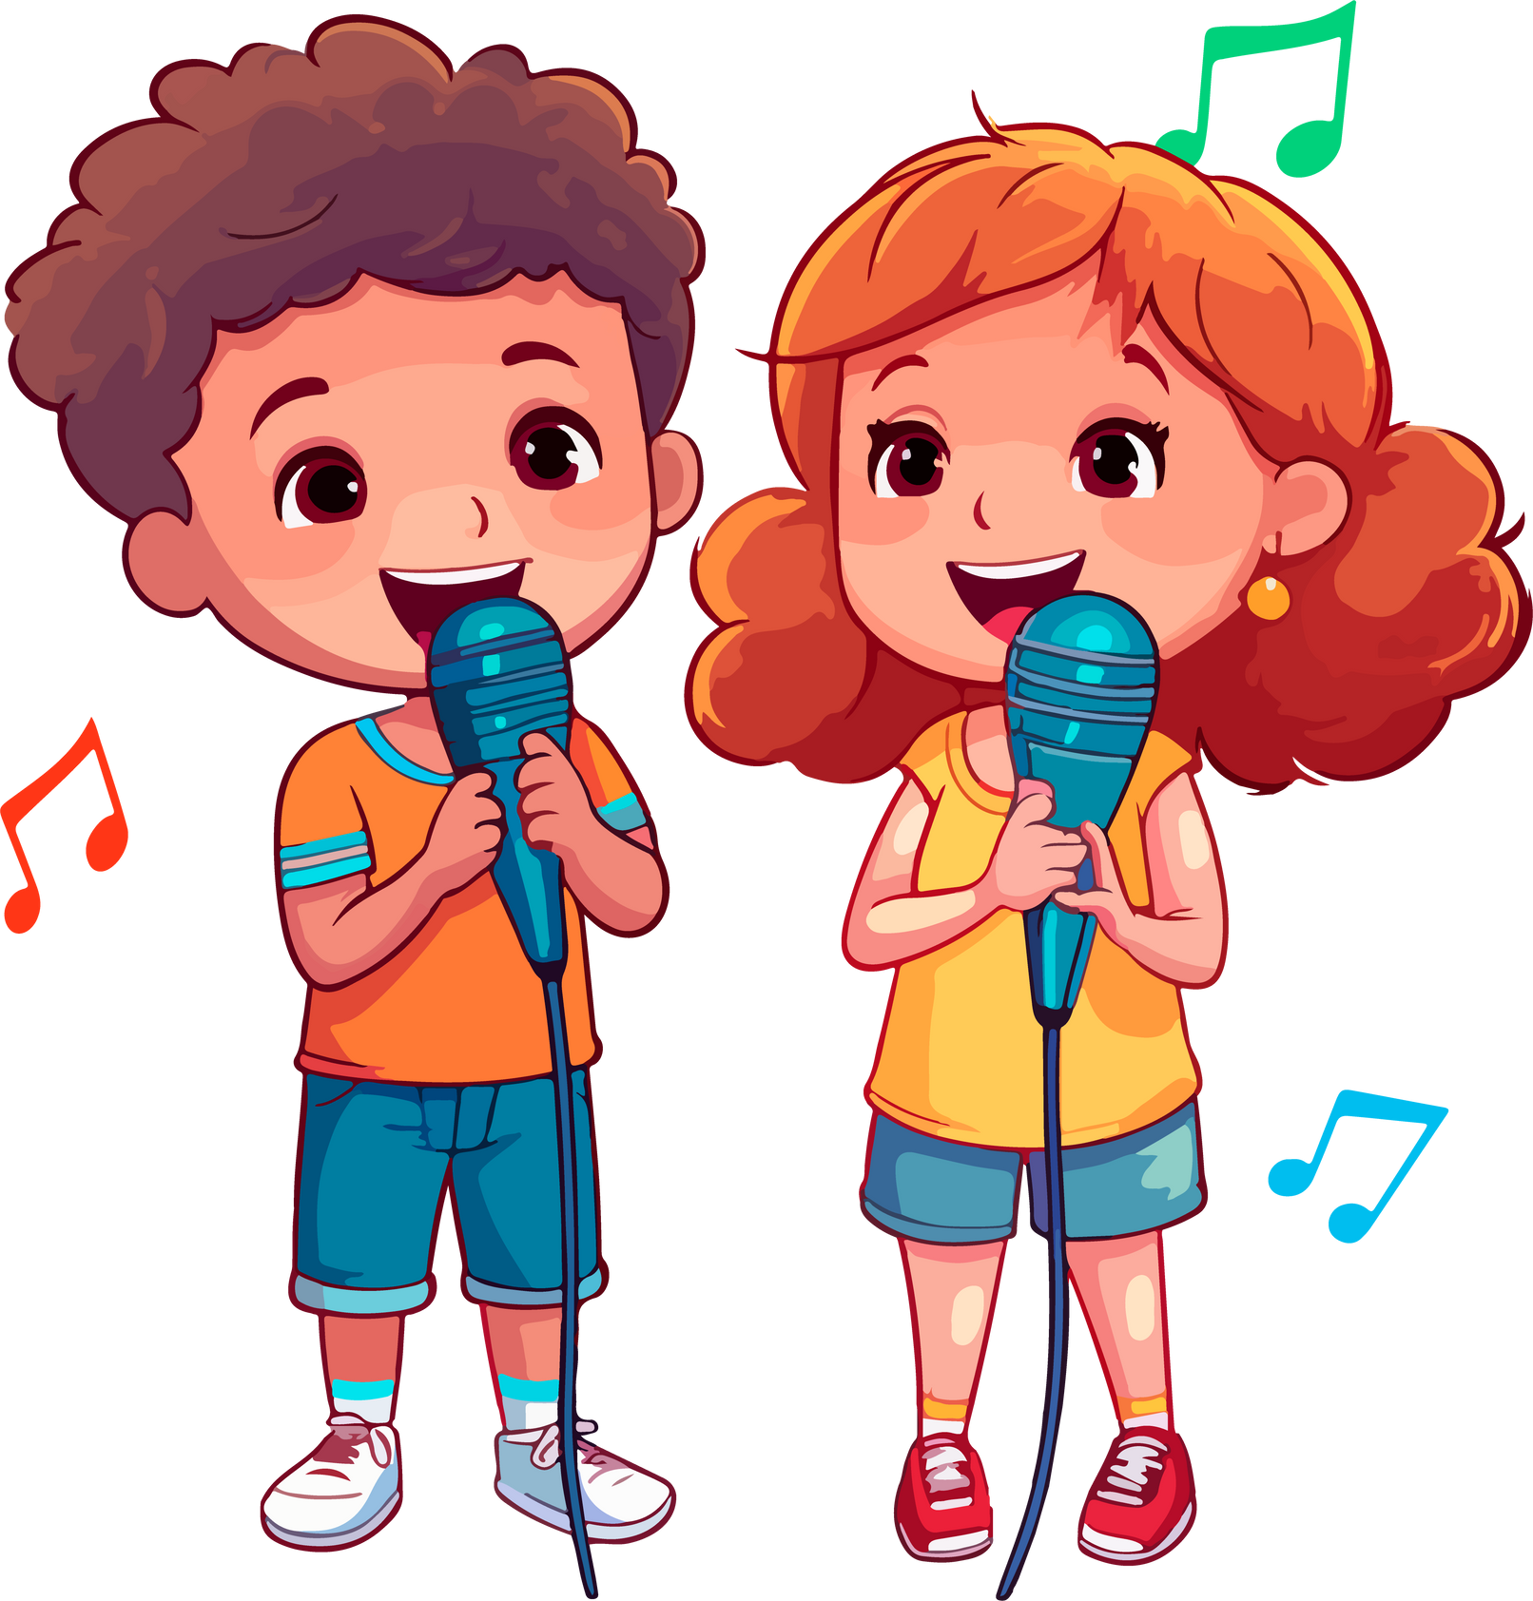


Let’s CHANT in the front.
Notes:
Step 5: Invite a few groups to the front of the class to sing the song. The class may sing along to reinforce the activity.

Slide 42
PRACTICE the new chant.
happy
busy
quiet
tidy
gentle
Is she active?
Is he helpful?
Yes, she is.
Yes, he is.
Is she friendly?
Is he clever?
Yes, she is.
Yes, he is.
She’s active and friendly.
He’s helpful and clever.
Notes:
Extension (For consolidation): Replace two adjectives in the chant with other adjectives which have the stress on the first syllable for example, happy, busy, quiet, tidy, gentle. Have pupils practice the new chant.

Slide 44
05
Fun corner
and wrap-up

Slide 45






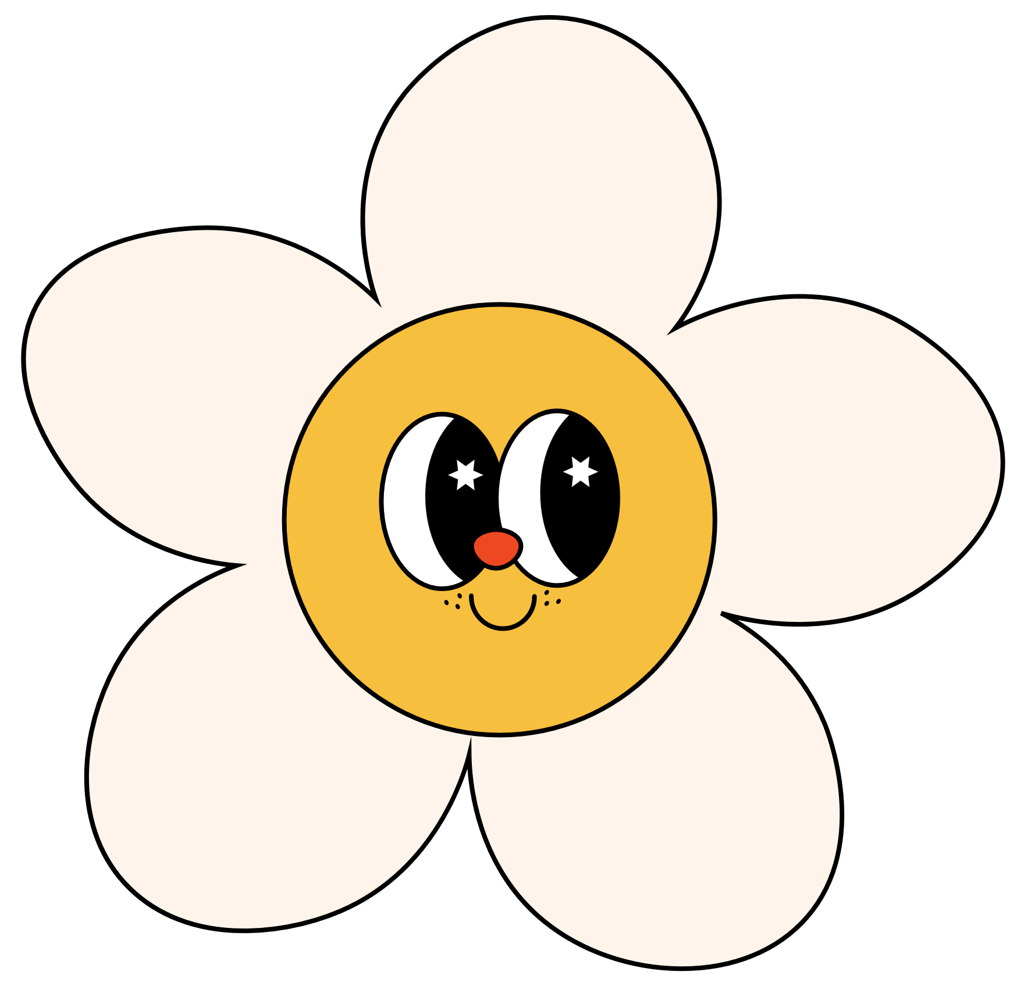

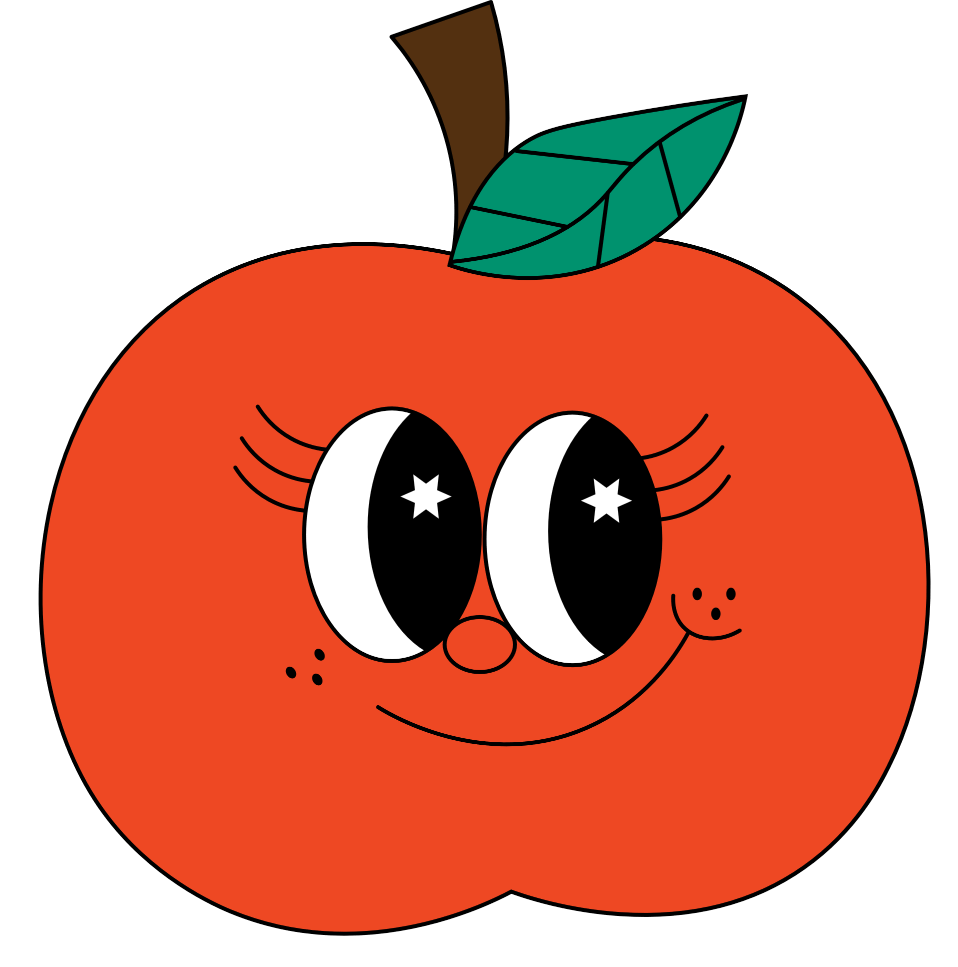


Let’s talk about your beloved ones!
Have fun!
Notes:
Game: A happy circle
- Write the question and answer on the board.
- Explain that they are going to make a circle, then ask and answer questions about their friends’ personality.
- Put pupils in groups of six.
- Model the game. Have two pupils of each group make questions and answers about their friends’ personalities.
e.g. Pupil A: What’s Mai (she) like?
Pupil B: She’s helpful.
- Have the class play the game.
- Invite one or two groups to perform in front of the class. Praise pupils to encourage their performance.

Slide 46








What is like?
Let’s talk about the friend sitting at your left.

Slide 47






What is like?
Let’s talk about the friend sitting at your right.

Slide 48






What is like?
Let’s talk about the friend behind you.

Slide 49


What is like?
Let’s talk about the friend in front of you.

Slide 50

What is like?
Let’s talk about your favourite teacher.

Slide 51
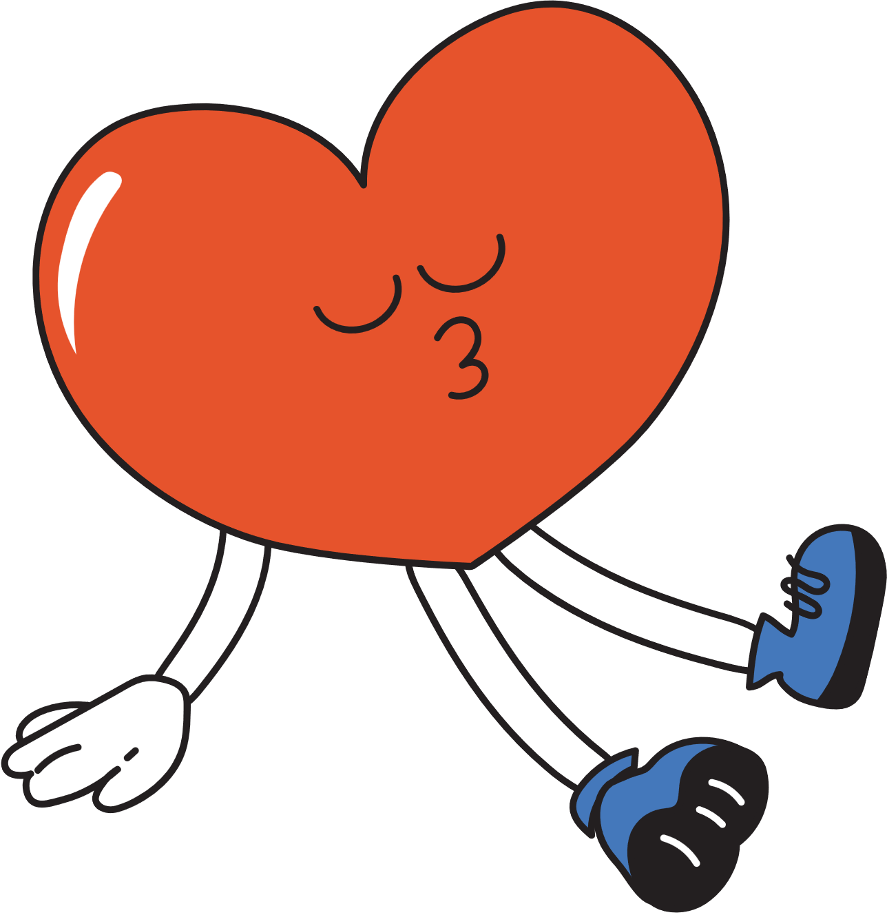

Good job!

Slide 52
Website: hoclieu.vn
Fanpage: facebook.com/www.tienganhglobalsuccess.vn

