Slide 2









Our Home
Lesson 3 - Period 6

Slide 3

Table of contents
01
02
03
Read and tick True or False.
Let’s write.
Warm-up and review
04
05
Project
Fun corner and wrap-up

Slide 4






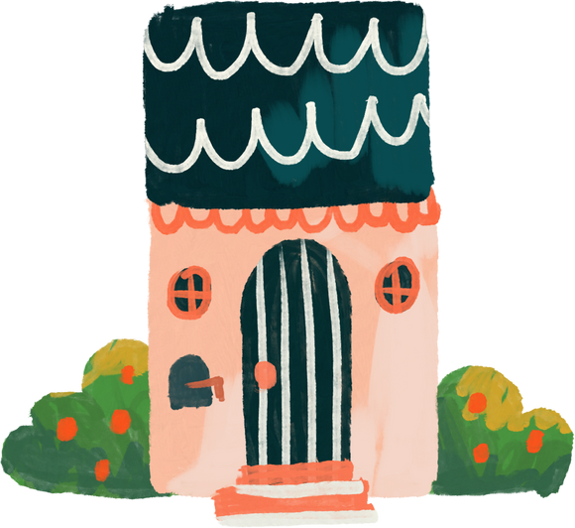

01
Warm-up and review

Slide 5
Who’s faster?

Slide 6

house

Slide 7

flat

Slide 8

tower

Slide 9

building

Slide 10
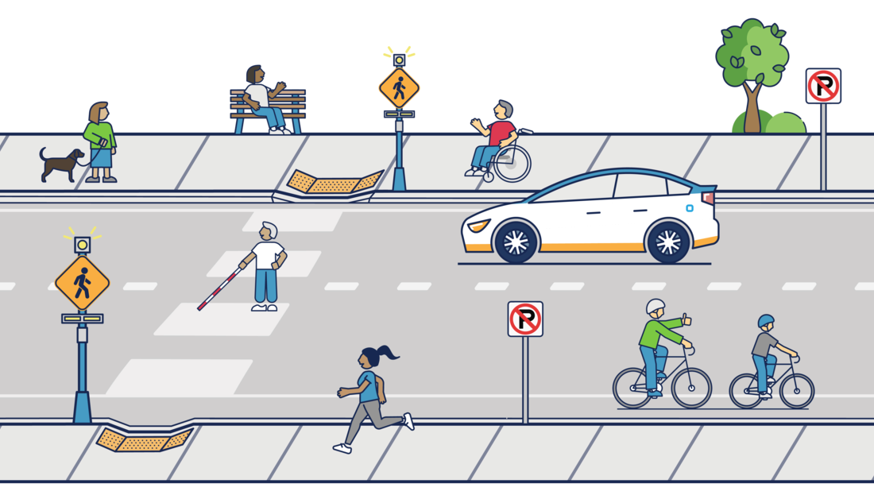
street

Slide 11
02
Read and tick True or False.

Slide 12
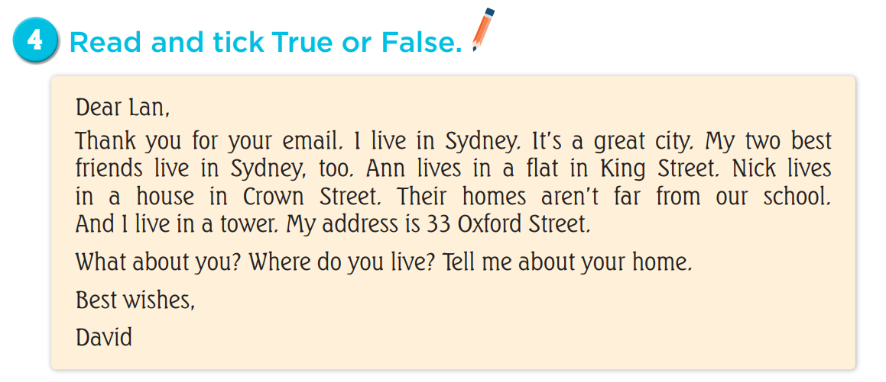

Slide 13
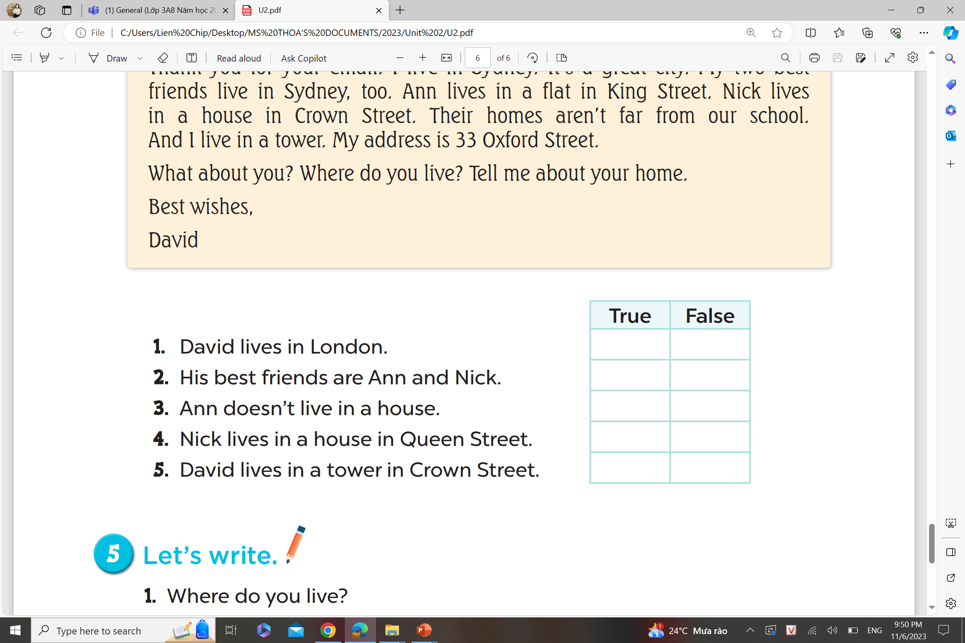


Slide 18
03
Let’s write.

Slide 19
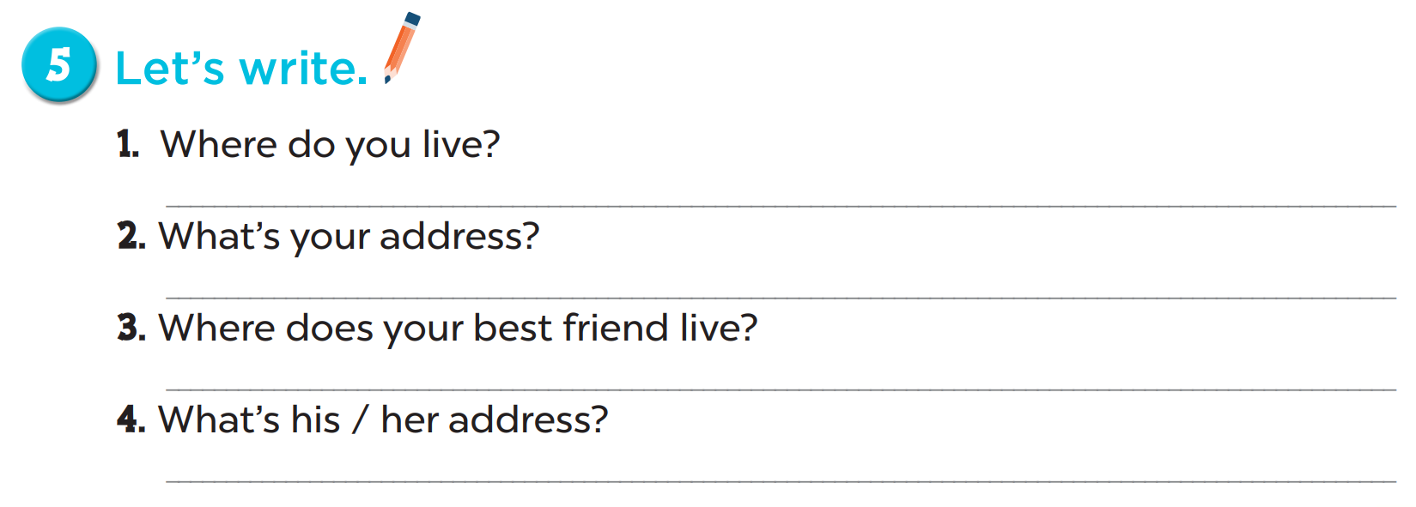

Slide 20
1. Where do you live?
2. What’s your address?
3. Where does your best friend live?
4. What’s his / her address?
I live in …
My address is …
He / She lives in …
Her / His address is …

Slide 21
04
Project

Slide 22
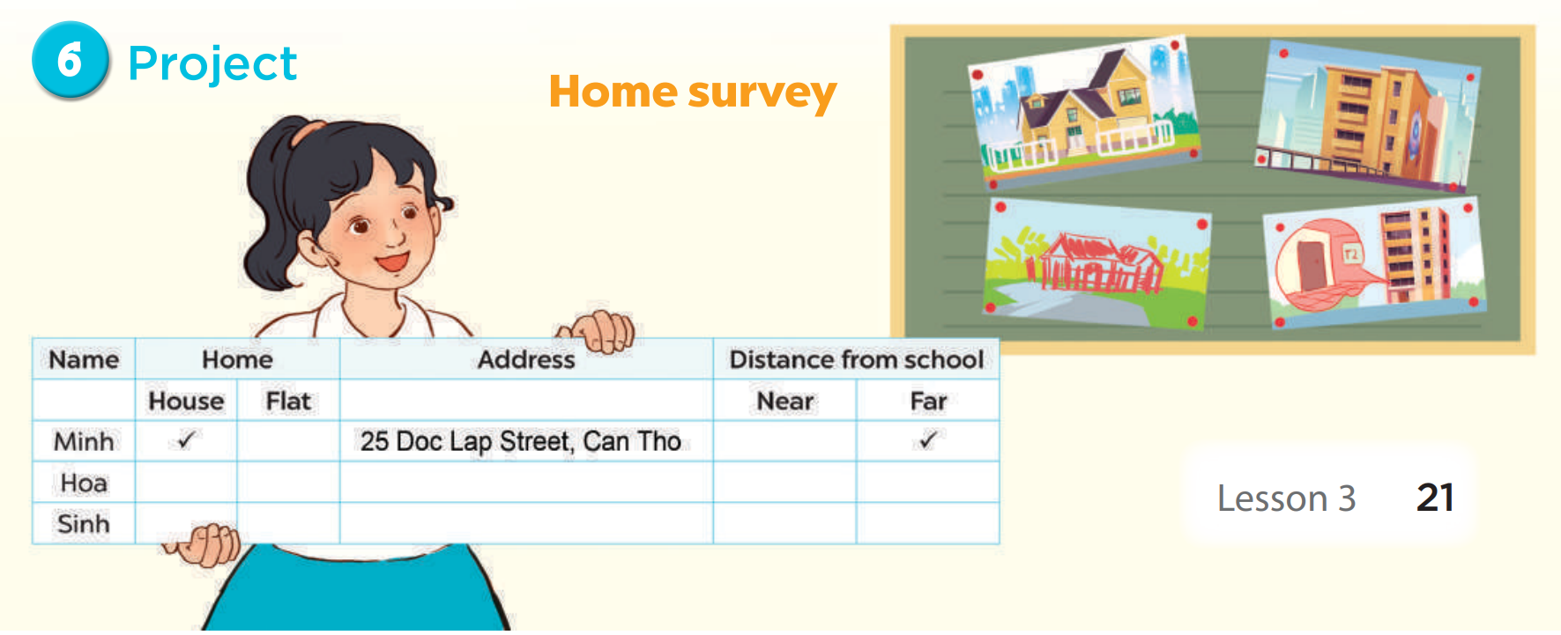

Slide 23
05
Fun corner and wrap-up

Slide 24

mystery box

Slide 25

Choose to keep the box
or give it to another team!

Slide 26











Slide 27



Do you live in that building?
Yes, I do.
Notes:
Press the spacebar or down arrow to reveal the answer.
Press the X to go back to the letter slide (wrong answer), press the question box to go the reward slide (correct answer).

Slide 28
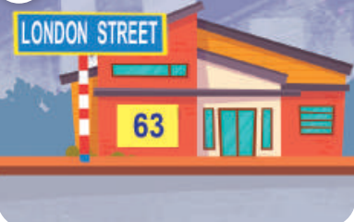
What is your address?
It’s 63 London Street.
Notes:
Press the spacebar or down arrow to reveal the answer.
Press the X to go back to the letter slide (wrong answer), press the question box to go the reward slide (correct answer).

Slide 29
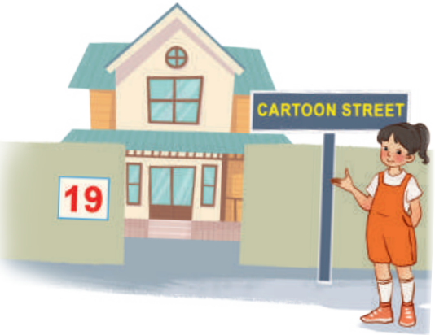
Where do you live?
I live at 19 Cartoon Street.
Notes:
Press the spacebar or down arrow to reveal the answer.
Press the X to go back to the letter slide (wrong answer), press the question box to go the reward slide (correct answer).

Slide 30
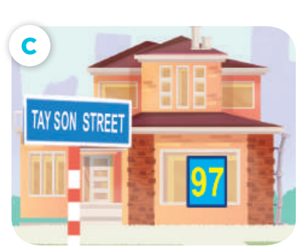
What is your address?
It’s 97 Tay Son Street.
Notes:
Press the spacebar or down arrow to reveal the answer.
Press the X to go back to the letter slide (wrong answer), press the question box to go the reward slide (correct answer).

Slide 31

Do you live in this house?
No, I don’t.
Notes:
Press the spacebar or down arrow to reveal the answer.
Press the X to go back to the letter slide (wrong answer), press the question box to go the reward slide (correct answer).

Slide 32

Where do you live?
I live at 15 Balloon Street.
Notes:
Press the spacebar or down arrow to reveal the answer.
Press the X to go back to the letter slide (wrong answer), press the question box to go the reward slide (correct answer).

Slide 33
Do you live in that tower?
No, I don’t.
Notes:
Press the spacebar or down arrow to reveal the answer.
Press the X to go back to the letter slide (wrong answer), press the question box to go the reward slide (correct answer).

Slide 34

Where do you live?
I live at 16 Cartoon Street.
Notes:
Press the spacebar or down arrow to reveal the answer.
Press the X to go back to the letter slide (wrong answer), press the question box to go the reward slide (correct answer).

Slide 35


Keep or give the
mystery box?
+100
Notes:
Ask the student(s) if they want to keep the box or give it to another student/team.
Click the question block to reveal the reward/punishment.
Press the Mario icon in the corner to go back to the letter slide.

Slide 36
Keep or give the
mystery box?
+200
Notes:
Ask the student(s) if they want to keep the box or give it to another student/team.
Click the question block to reveal the reward/punishment.
Press the Mario icon in the corner to go back to the letter slide.

Slide 37
Keep or give the
mystery box?
+300
Notes:
Ask the student(s) if they want to keep the box or give it to another student/team.
Click the question block to reveal the reward/punishment.
Press the Mario icon in the corner to go back to the letter slide.

Slide 38
Keep or give the
mystery box?
+400
Notes:
Ask the student(s) if they want to keep the box or give it to another student/team.
Click the question block to reveal the reward/punishment.
Press the Mario icon in the corner to go back to the letter slide.

Slide 39
Keep or give the
mystery box?
+500
Notes:
Ask the student(s) if they want to keep the box or give it to another student/team.
Click the question block to reveal the reward/punishment.
Press the Mario icon in the corner to go back to the letter slide.

Slide 40
Keep or give the
mystery box?
-100
Notes:
Ask the student(s) if they want to keep the box or give it to another student/team.
Click the question block to reveal the reward/punishment.
Press the Mario icon in the corner to go back to the letter slide.

Slide 41


Keep or give the
mystery box?
Change points
Notes:
Ask the student(s) if they want to keep the box or give it to another student/team.
Click the question block to reveal the reward/punishment.
Press the Mario icon in the corner to go back to the letter slide.

Slide 42


Steal
200 pts!
Keep or give the
mystery box?
Notes:
Ask the student(s) if they want to keep the box or give it to another student/team.
Click the question block to reveal the reward/punishment.
Press the Mario icon in the corner to go back to the letter slide.

Slide 43
Website: hoclieu.vn
Fanpage: facebook.com/www.tienganhglobalsuccess.vn

