Slide 1
Unit 2: time and daily routine
Lesson 1- period 2

Slide 2
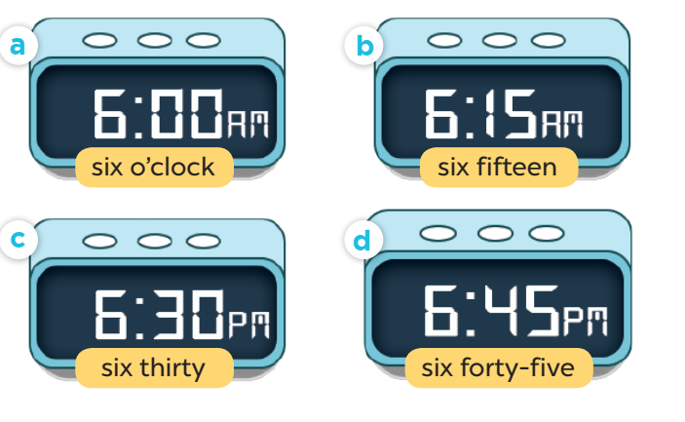
Slap the board

Slide 3
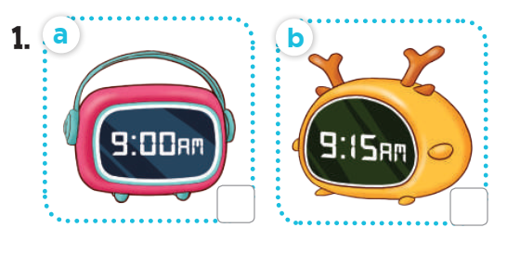

Slide 4
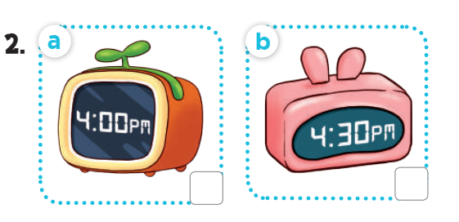

Slide 5
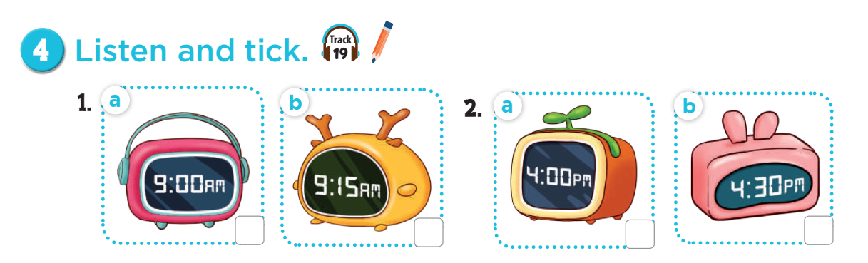


Slide 6


Slide 7
03
Look, complete and read

Slide 8
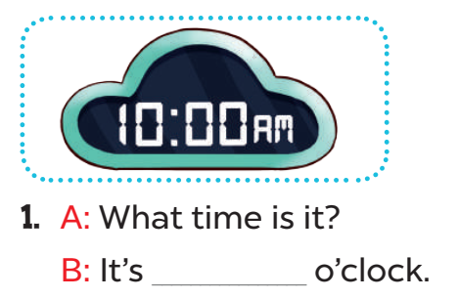
ten

Slide 9
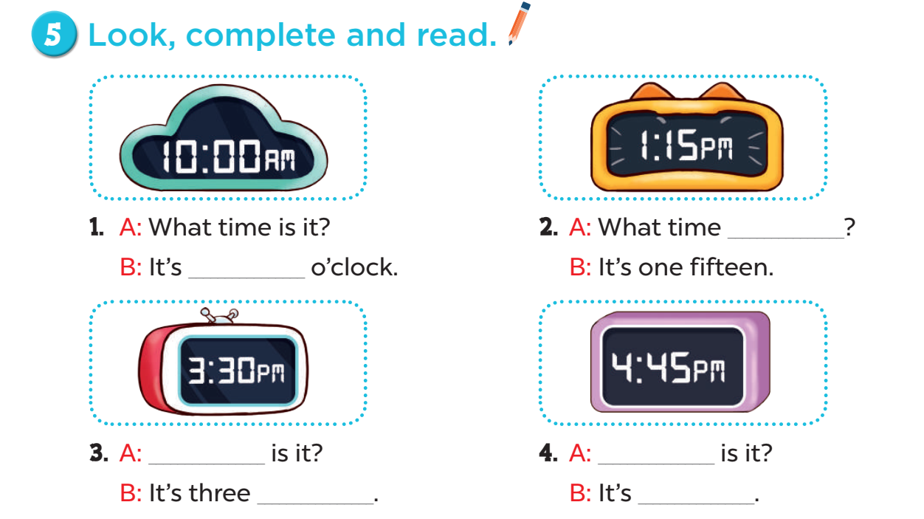

Slide 10
is it
ten
What time
What time
thirty
four forty-five

Slide 11
04
Let’s play

Slide 12
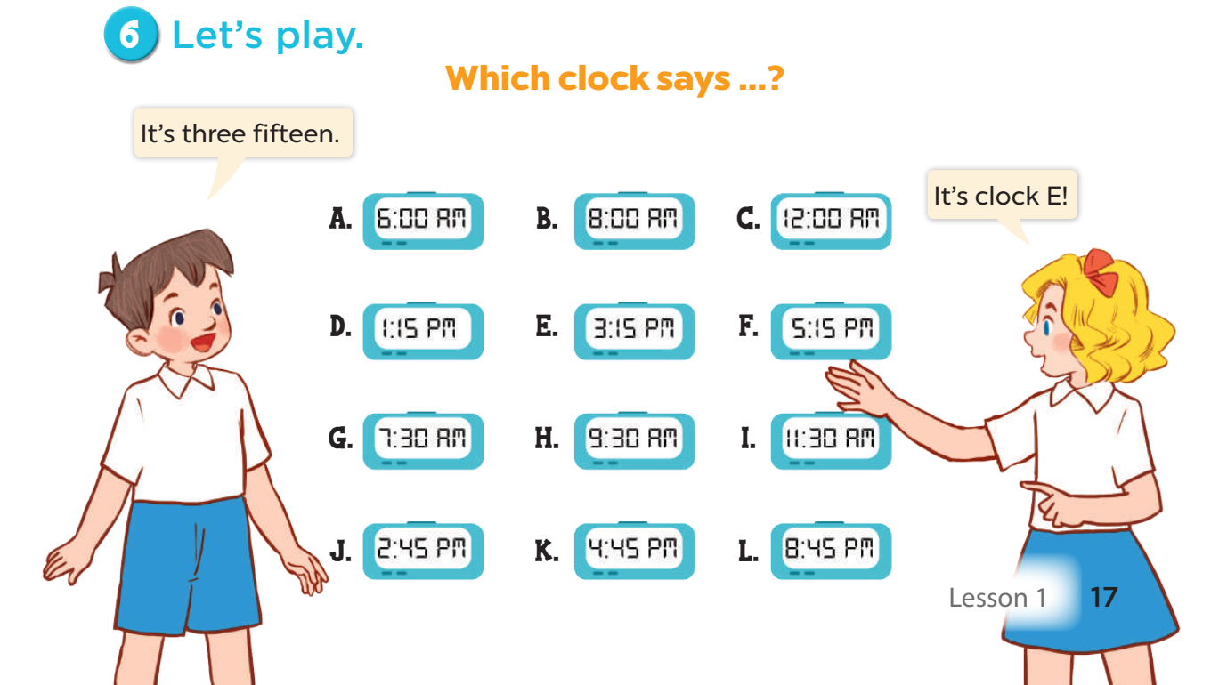

Slide 13
05
Wrap up and fun time

Slide 14


What/ it?/ is/ time
Check
What time is it?

Slide 15
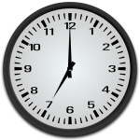
It/seven/is/
c’clock.
Check
It is seven o’clock.

Slide 16

six/ It’s/ o’clock.
Check
It’s six o’clock.

Slide 17
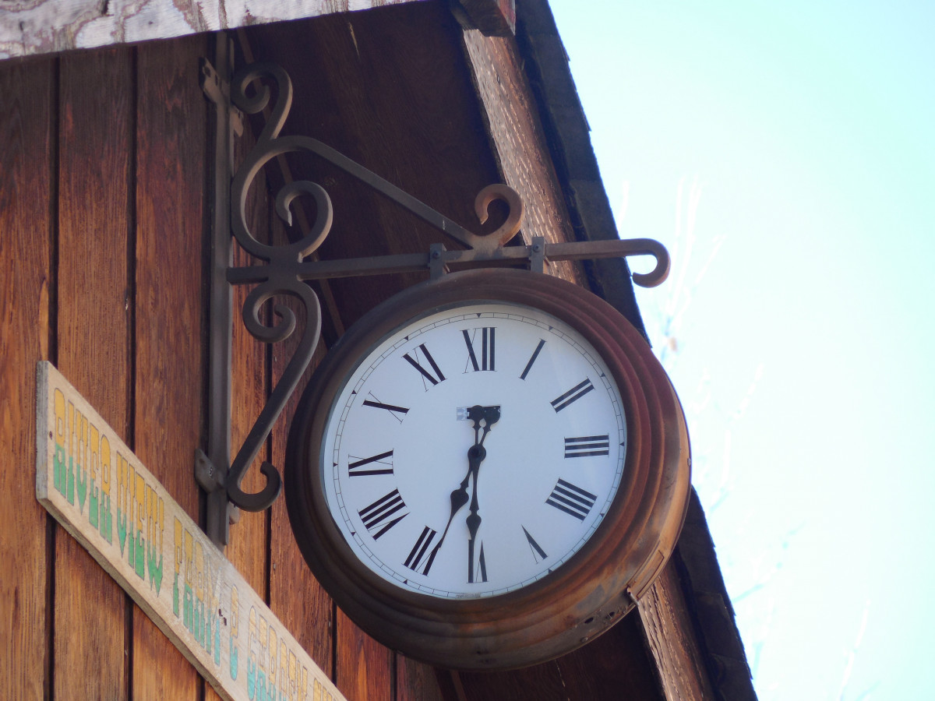
six/thirty./It’s
Check
This Photo by Unknown Author is licensed under CC BY-NC
It’s six thirty.

Slide 18

End

