Slide 1


Slide 2







Unit 13:
In the maths class
Lesson 1

Slide 3










Class Rules

Slide 4







Rule 1
Listen to
your friend
talking in front.

Slide 5








Rule 2
Raise your hand
if you have a question.

Slide 6




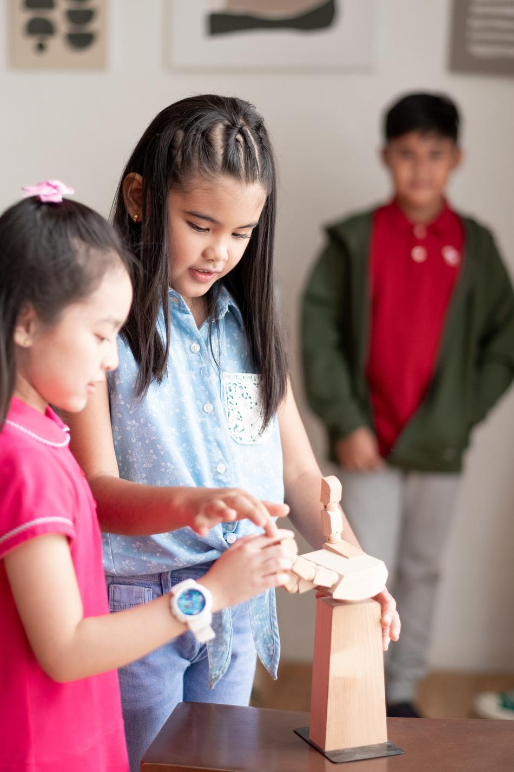


Rule 3
Wait for
your turn.

Slide 7









Table of Contents
  Warm-up and review.
  Listen and repeat.
  Point and say.
  Fun corner and wrap-up.

Slide 8




Warm-up and Review

Slide 9







COUNT WITH ME

Slide 10

1
one

Slide 11

2
two

Slide 12

3
three

Slide 13
4
four

Slide 14

5
five

Slide 15

6
six

Slide 16
7
seven

Slide 17

8
eight

Slide 18

9
nine

Slide 19

10
ten

Slide 20
Listen and repeat

Slide 21
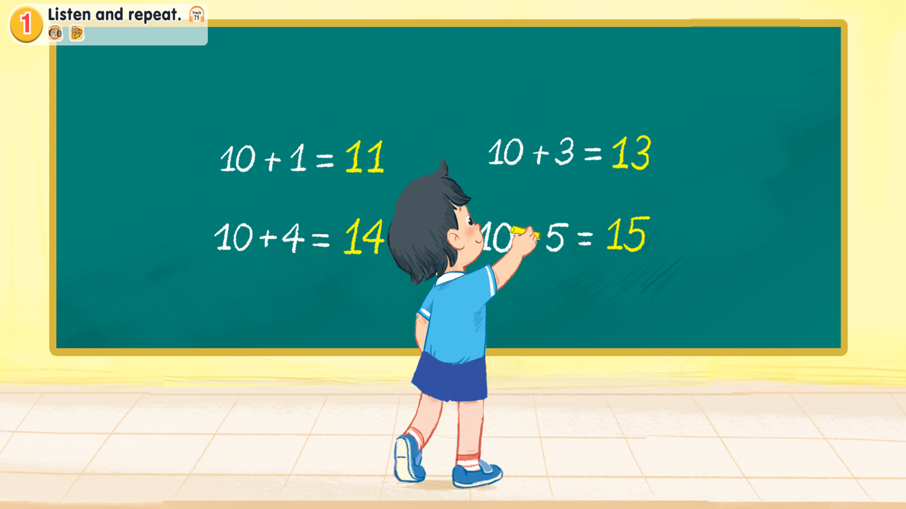
Look and say
Notes:
Step 1: Draw pupils’ attention to the picture (say “Look at the picture.”). Ask questions to help them identify the context (see Input).

Slide 22

1.Listen and repeat.
Notes:
Step 2: Have pupils point to the letter N/n (say “Point to the letter N.”). Explain that the name of the letter N/n is different to its sound (say “Listen. /en/ /n/.”).
Step 3: Play the recording of the name and sound of the letter N/n and encourage pupils to repeat (say “Listen and repeat.”). Do this several times, with pupils repeating both individually and in chorus. Correct their pronunciation if necessary, and praise them when their pronunciation is good.

Slide 23
1.Listen and repeat.
eleven
Notes:
Step 4: Have pupils look at the number 11 (say “Look at the number eleven”). Then have them point to the word eleven (say “Point to the word eleven.”). Draw their attention to the colour of the letter n (say “Look at the colour of the letter n. It is red.”).
Step 5: Play the recording of eleven and encourage pupils to repeat (say “Listen and repeat.”). Do this several times, with pupils repeating both individually and in chorus. Correct their pronunciation if necessary, and praise them when their pronunciation is good.

Slide 24
1.Listen and repeat.
eleven
thirteen
fourteen
fifteen
Notes:
Step 6: Repeat Steps 4 and 5 for thirteen, fourteen and fifteen.
Step 7: Play the recording in full and encourage pupils to repeat the name and sound of the letter N/n, eleven, thirteen, fourteen and fifteen both individually and in chorus.

Slide 25
Point and say

Slide 26
2. Point and say.
Notes:
Step 1: Have pupils point to the letter N/n and correctly pronounce its name and sound (say “Point to the letter N. Say /en/. Now say /n/.”).

Slide 27
2. Point and say.
eleven
thirteen
fourteen
fifteen
Notes:
Step 2: Have pupils point to and correctly pronounce eleven (say “Point to eleven. Say eleven.”). Do this several times, with pupils repeating both individually and in chorus. Correct their pronunciation if necessary, and praise them when their pronunciation is good.
Step 3: Repeat Step 2 for thirteen, fourteen and fifteen.

Slide 28
Work in pairs
eleven
thirteen
fourteen
fifteen
Notes:
Step 4: Put pupils into pairs or groups for further practice of Steps 1 to 3. Go around the class to offer help or correct pupils’ pronunciation, if necessary.

Slide 29
Fun corner and wrap-up

Slide 30


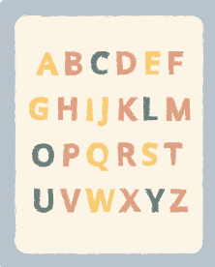




NUMBER RACE GAME

Slide 31
NUMBER RACE GAME
eleven
thirteen
fourteen
fifteen

Slide 32
THANK YOU FOR PLAYING!

Slide 33

Website: hoclieu.vn
Fanpage: facebook.com/www.tienganhglobalsuccess.vn

