Slide 2
Review 3
4. Read and tick.
5. Draw a zebra or a zebu.
Then ask your friend.
6. Wirte the words.

Slide 3
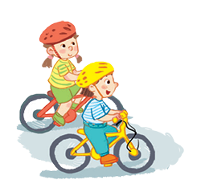
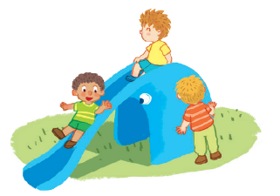
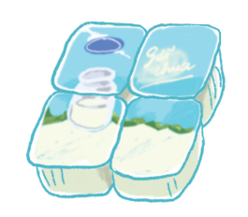
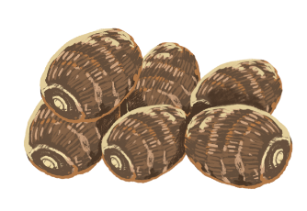
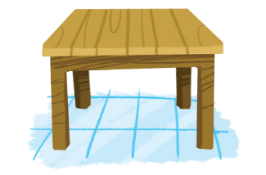
Read and tick.
1
2
3
The grapes are on the table.
A: What do you want?
B: I want some yogurt.
They’re sliding.

Slide 4
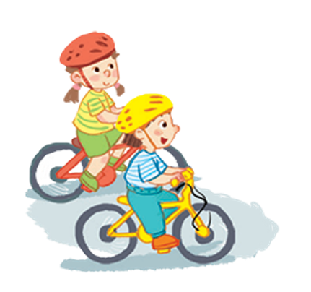
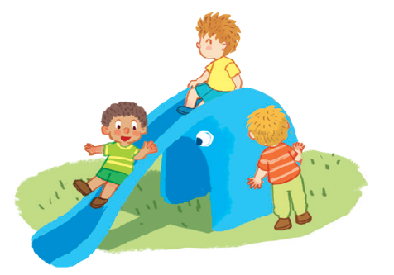
1
They’re sliding.


Slide 5
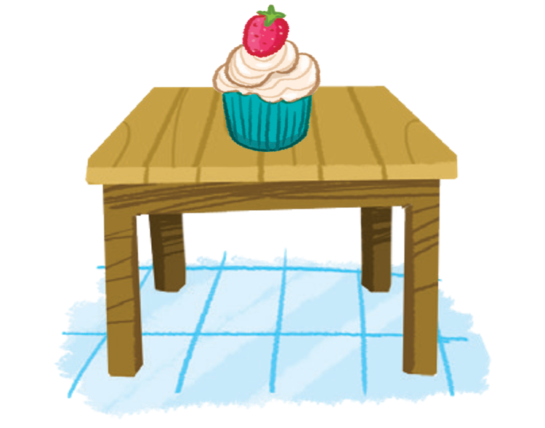
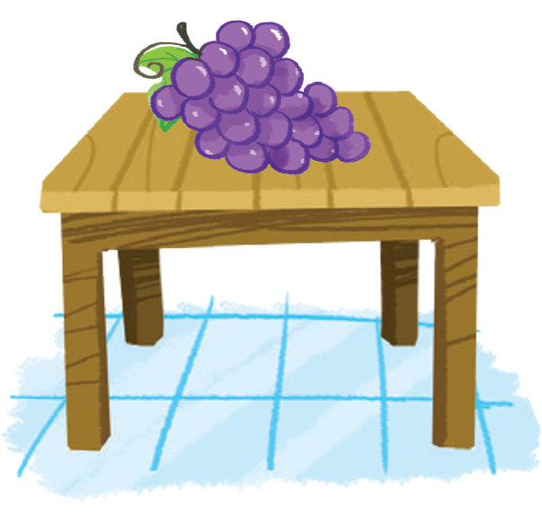
2
The grapes are on the table.


Slide 6
3
A: What do you want?
B: I want some yogurt.


Slide 7
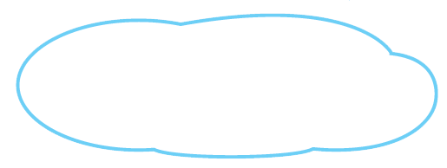
Draw a zebra or a zebu. Then ask your friend.
Do you like the ?
Yes, .
No, .

Slide 8
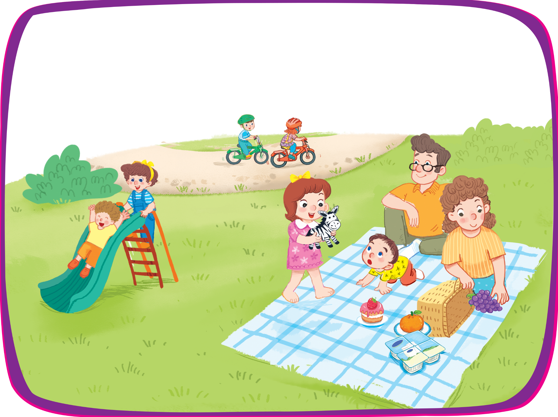
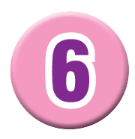
Write the words.
r
riding
zebra
z
s
sliding
c
cake
grapes
g
y
yogurt

