Slide 2






REVIEW 3
Period 1 – Phil and Sue

Slide 3


TABLE OF CONTENTS
1.
Warm-up and review.
2.
Listen and repeat.
3.
Look again and circle.
4.
Fun corner and wrap-up.

Slide 4


Warm-up
and review.
1

Slide 5
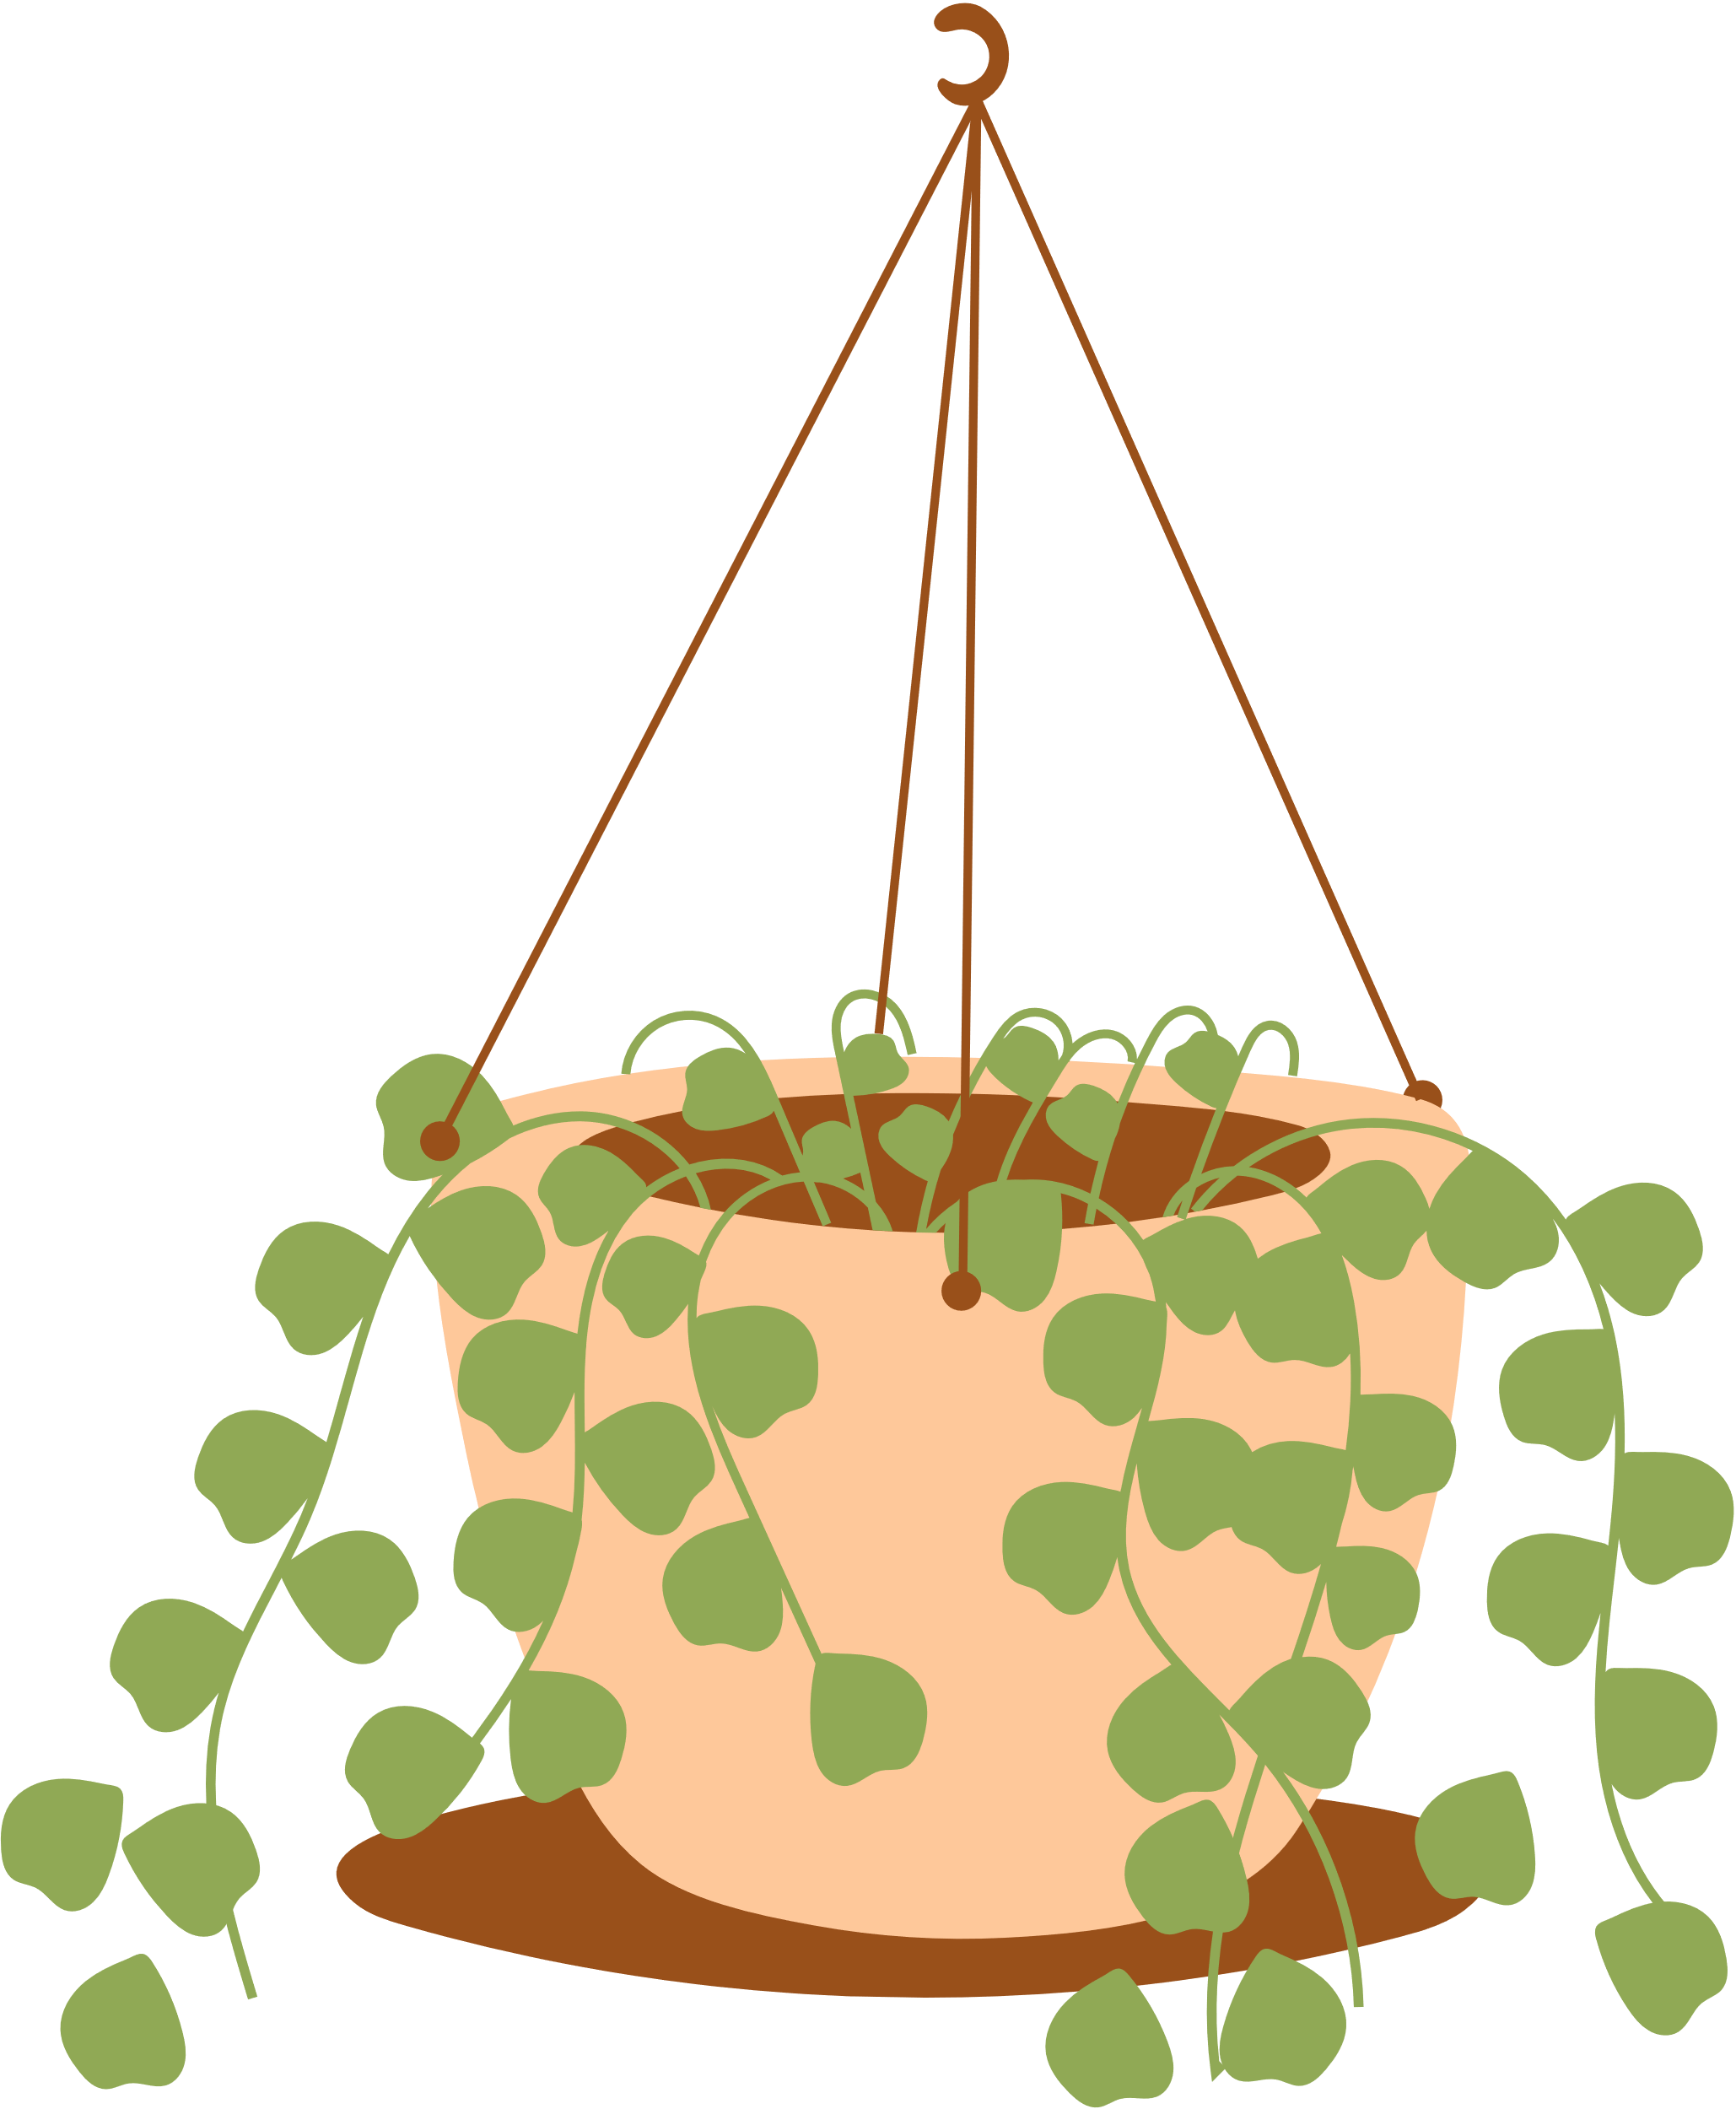










LUCKY FLOWERS
Notes:
Click the flowers to link to the Question slides.
Click the tree to end the game.

Slide 6







grapes
Notes:
Click the red flower to back to the Flower slide.

Slide 7

cake
Notes:
Click the red flower to back to the Flower slide.

Slide 8
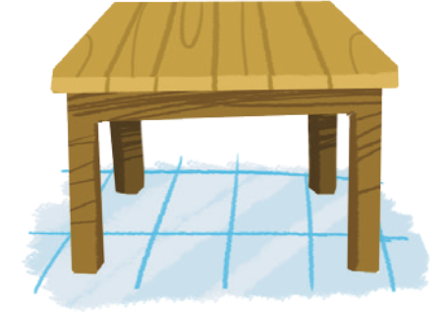
table
Notes:
Click the red flower to back to the Flower slide.

Slide 9
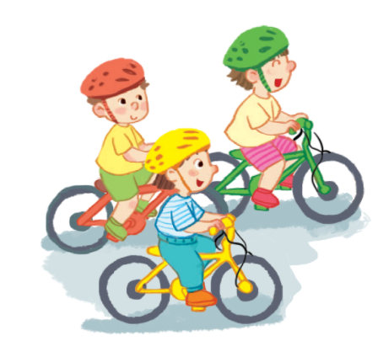
riding
Notes:
Click the red flower to back to the Flower slide.

Slide 10

Notes:
Click the red flower to back to the Flower slide.

Slide 11
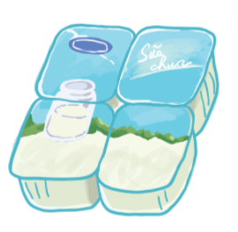
yogurt
Notes:
Click the red flower to back to the Flower slide.

Slide 12
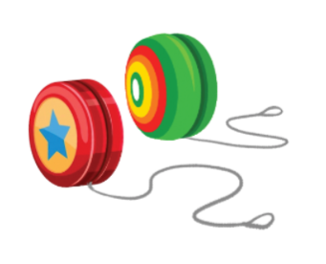
yo-yos
Notes:
Click the red flower to back to the Flower slide.

Slide 13





Thank you
for playing!

Slide 14

2
Listen
and repeat.

Slide 15





LOOK and ANSWER.

Slide 16
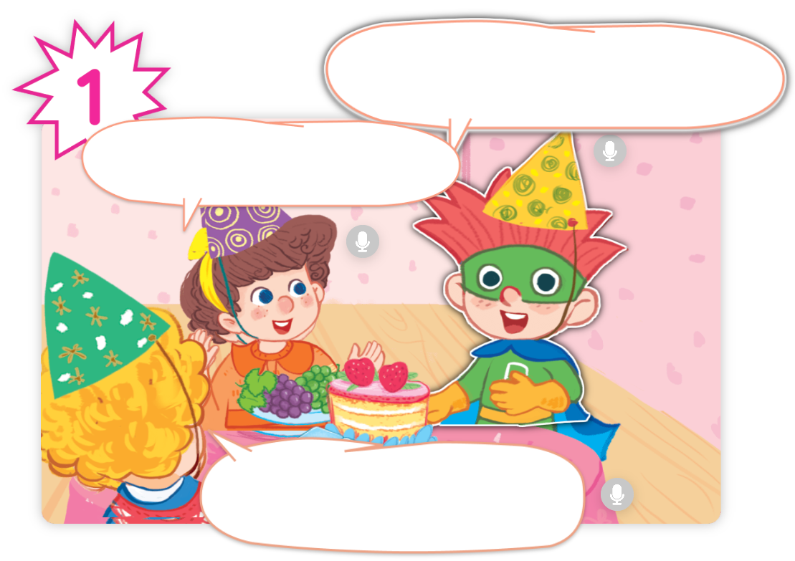
LOOK and ANSWER.

Slide 17
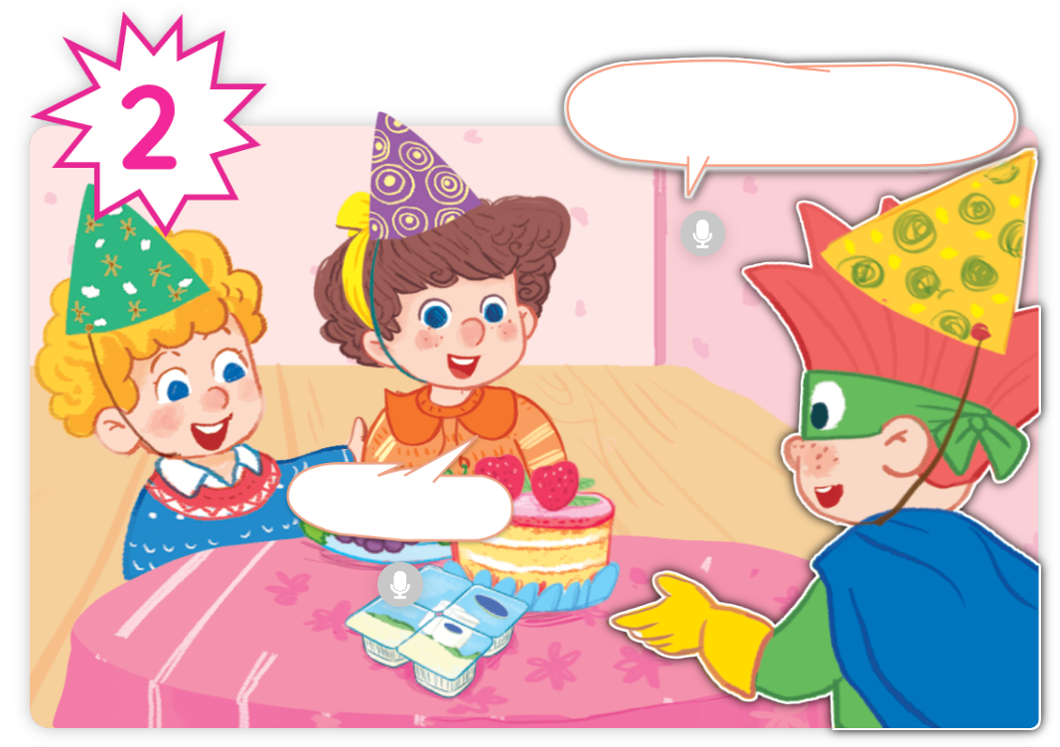
LOOK and ANSWER.

Slide 18
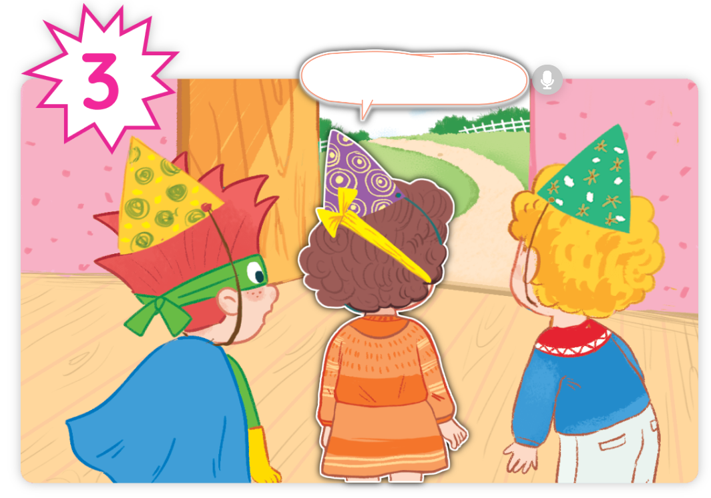
LOOK and ANSWER.

Slide 19
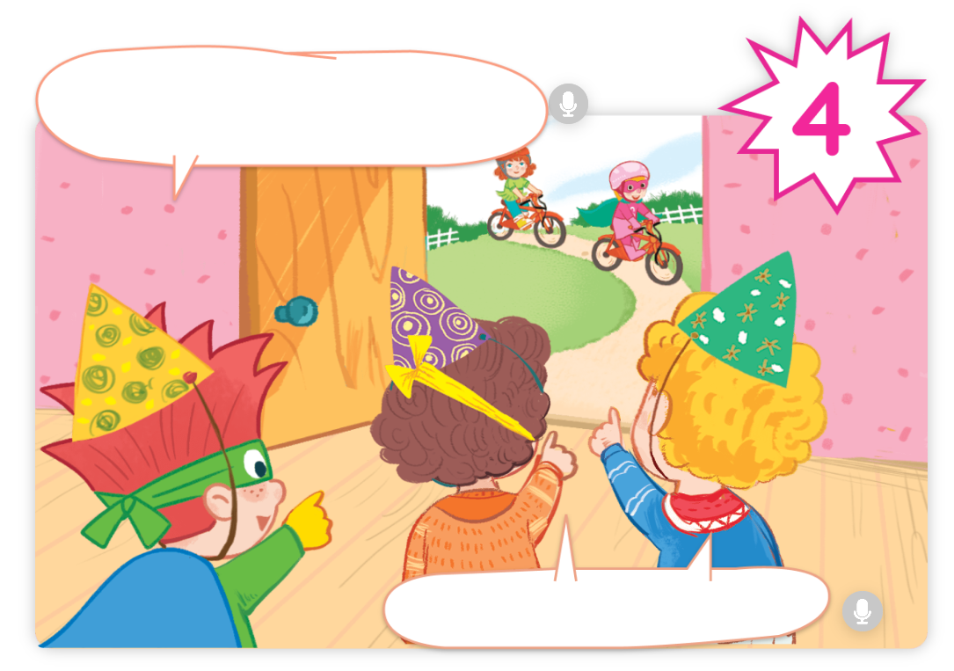
LOOK and ANSWER.

Slide 20


LISTEN and REPEAT.

Slide 21


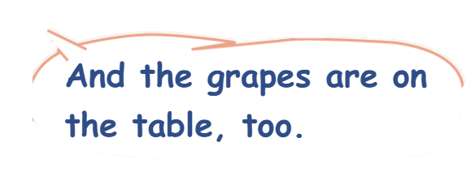
LISTEN and REPEAT.

Slide 22


LISTEN and REPEAT.

Slide 23

LISTEN and REPEAT.

Slide 24


LISTEN and REPEAT.

Slide 25
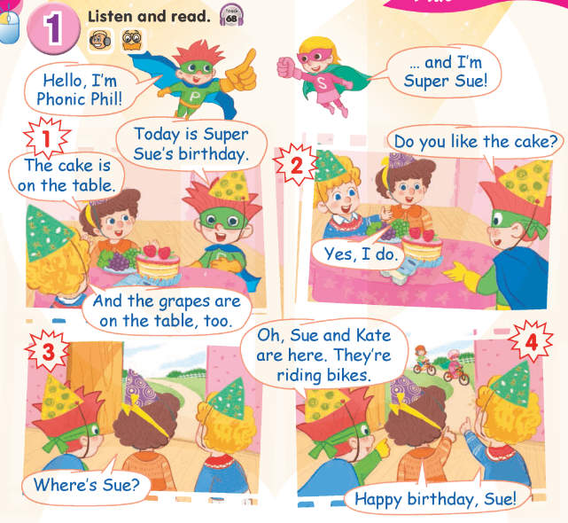

Work in pairs.

Slide 26
Good Job!

Slide 27
3
Look again
and circle.

Slide 28
Point and say.
grapes

Slide 29
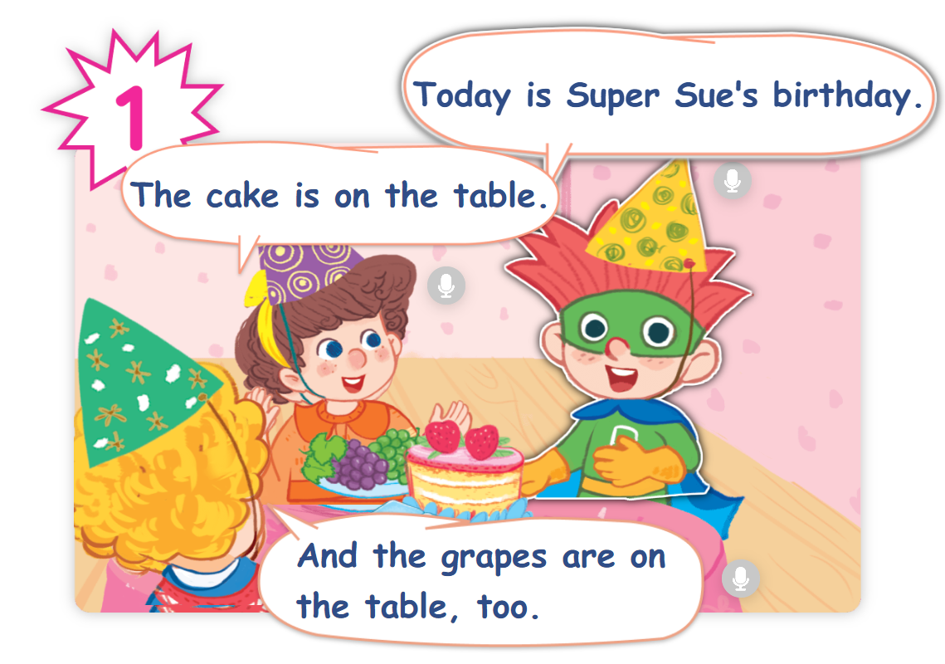
Find “grapes” in the story.

Slide 30
Point and say.
yogurt

Slide 31
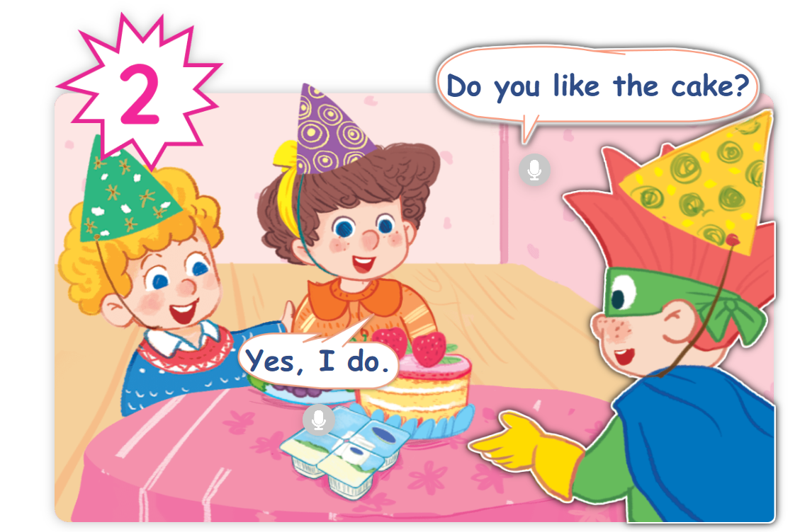
Find “yogurt” in the story.

Slide 32
Point and say.
cake

Slide 33
Find “cake” in the story.

Slide 34
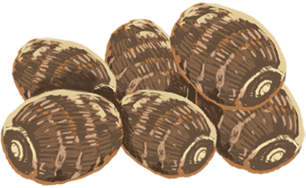
Point and say.
yams

Slide 35
Find “yams” in the story.
✗

Slide 36
Point and say.
riding

Slide 37
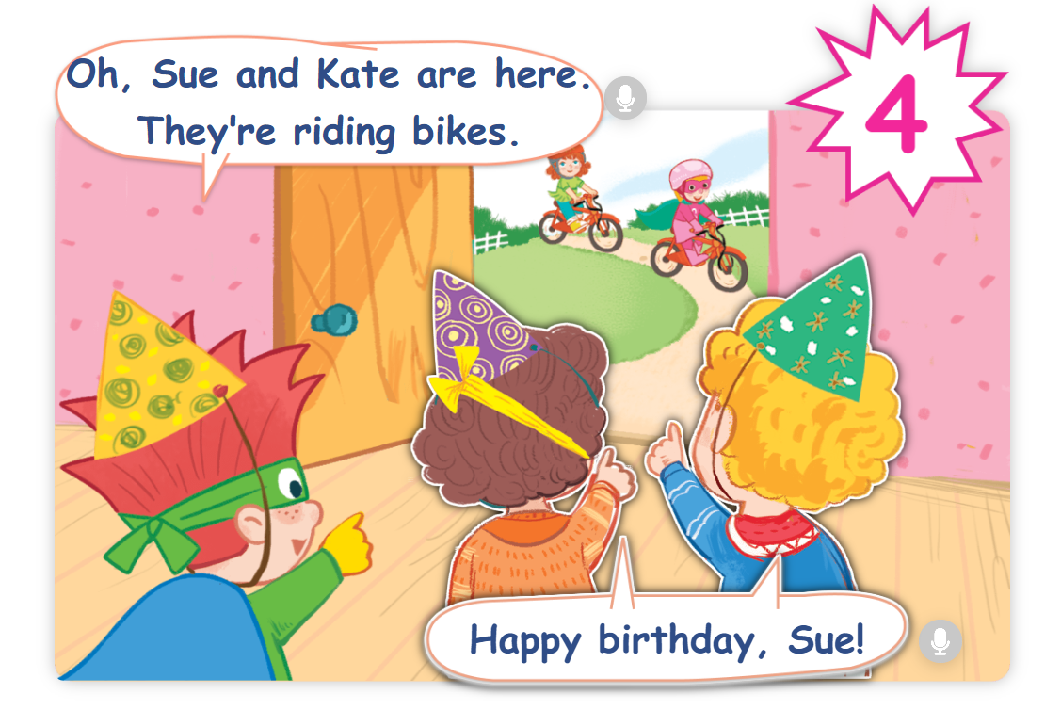
Find “riding” in the story.

Slide 38
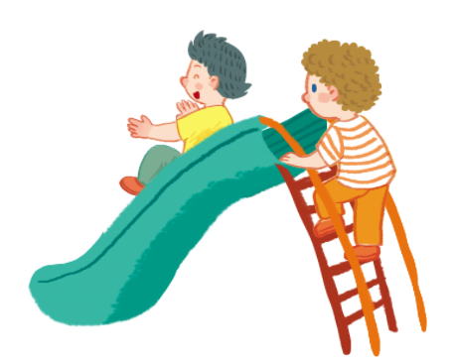
Point and say.
sliding

Slide 39
Find “sliding” in the story.
✗

Slide 40
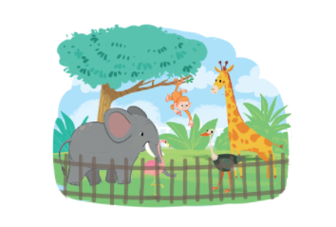
Point and say.
zoo

Slide 41
Find “zoo” in the story.
✗

Slide 42
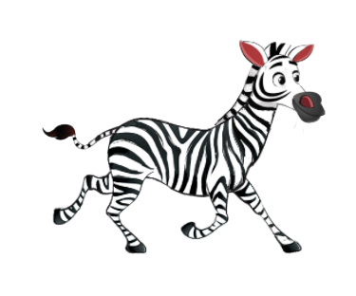
Point and say.
zebra

Slide 43
Find “zebra” in the story.
✗

Slide 44
Good Job!

Slide 45
4
Fun corner
and wrap-up.

Slide 46




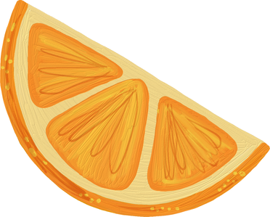


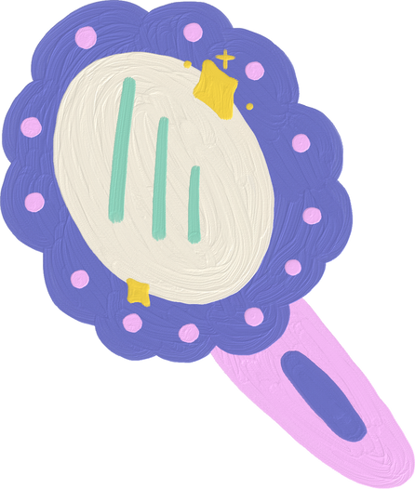
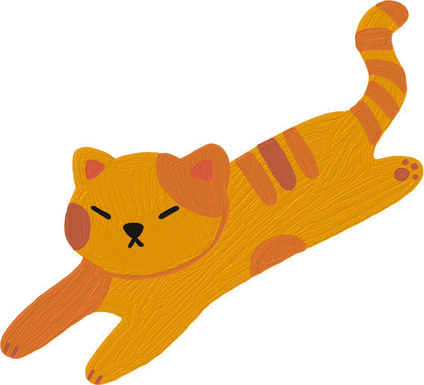

Spell it!
Game

Slide 47

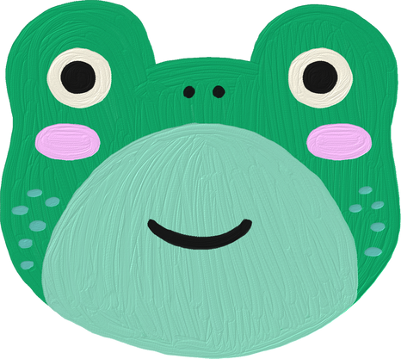
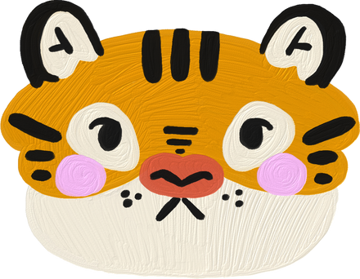
Are You
Ready?

Slide 48

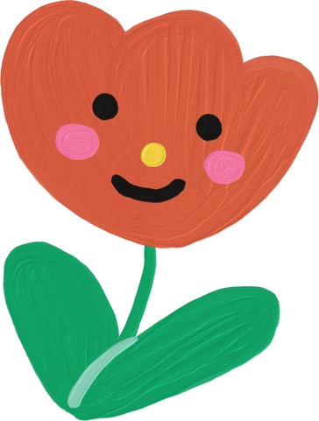
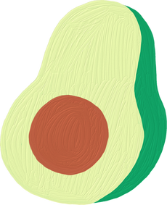
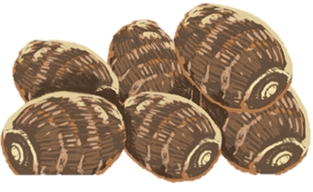
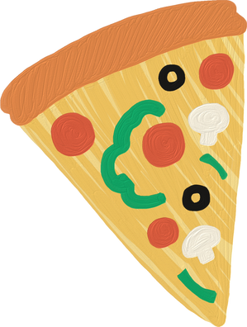


Question 1
A
Y
M
S

Slide 49
Answer
yams

Slide 50
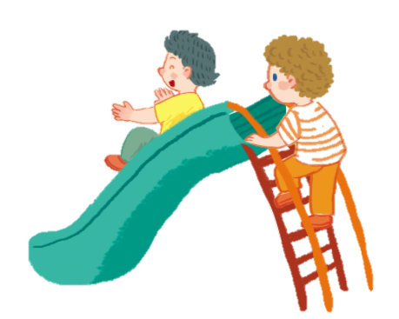
Question 2
D
l
N
S
L
I
G

Slide 51
Answer
sliding

Slide 52
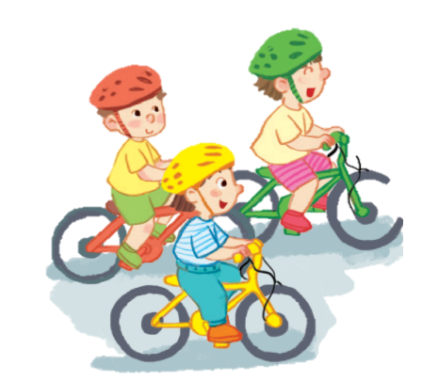
Question 3
D
I
G
R
I
N

Slide 53
Answer
riding

Slide 54
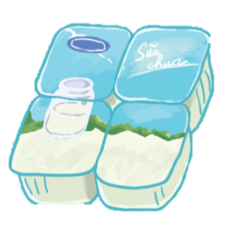
Question 4
G
O
U
Y
R
T

Slide 55
Answer
yogurt

Slide 56

Question 5
E
P
G
R
A
S

Slide 57
Answer
grapes

Slide 58

Question 6
A
K
E
C

Slide 59
Answer
cake

Slide 60
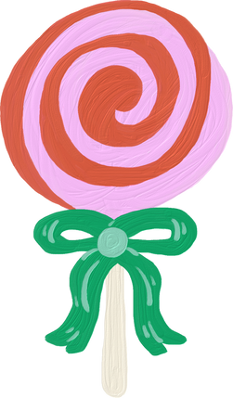

Thank you
for Playing!

