Slide 2










Unit 12:
At the café
Lesson 1

Slide 3











TABLE OF CONTENTS
  Warm-up and review.
  Listen and repeat.
  Point and say.
  Fun corner and wrap-up.

Slide 4






Warm-up and Review

Slide 5










BUTTERFLY
CATCHING
GAME

Slide 6





NEXT
Notes:
Click a butterfly to choose

Slide 7

sliding
Notes:
Click the picture to go back

Slide 8
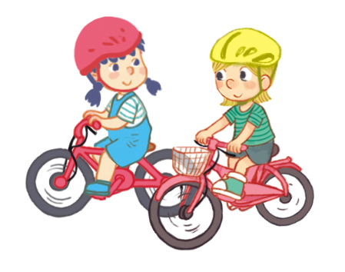
riding
Notes:
Click the picture to go back

Slide 9

driving
Notes:
Click the picture to go back

Slide 10

THANK YOU
FOR
PLAYING!

Slide 11
Listen and repeat

Slide 12
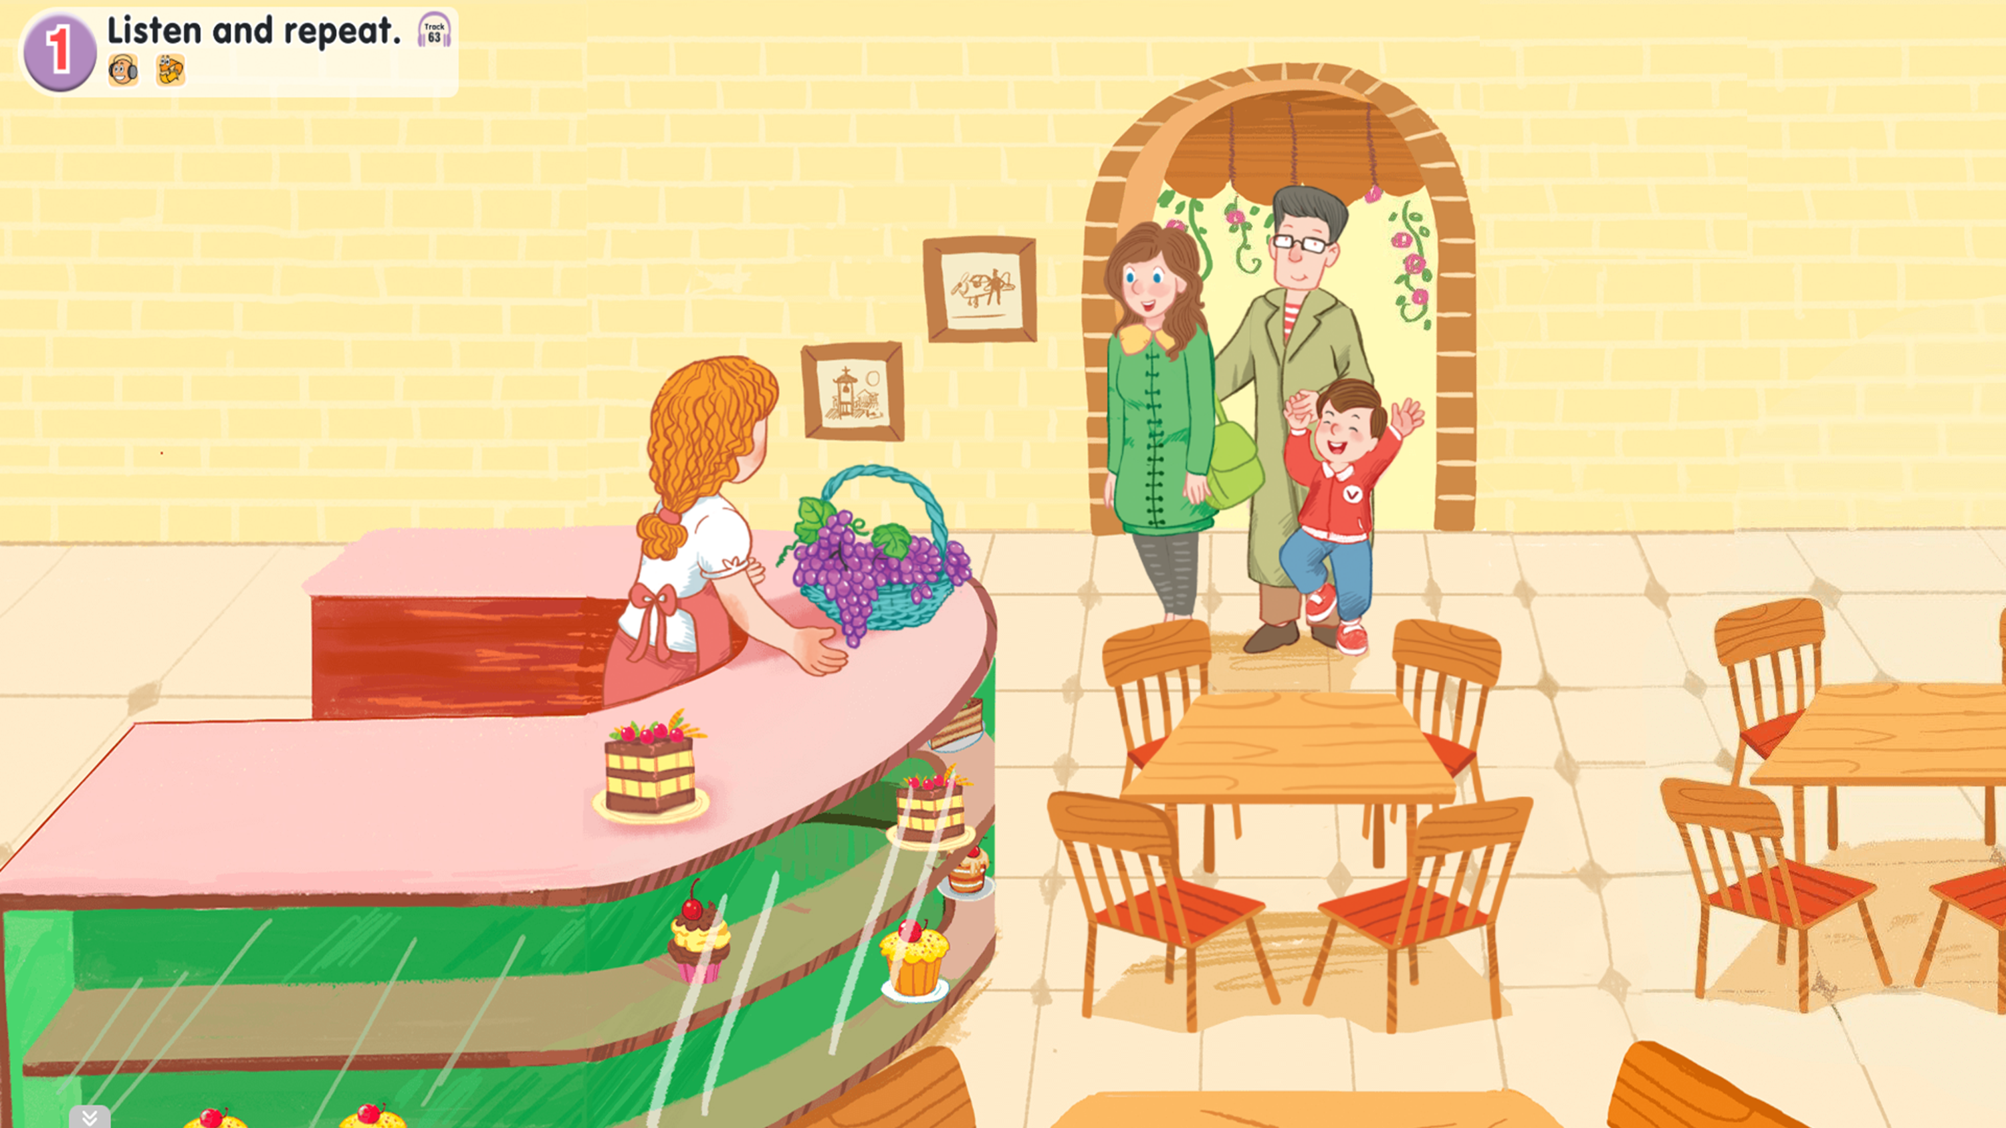
Look and say

Slide 13


1. Listen and repeat.

Slide 14
1. Listen and repeat.
grapes
table
cake

Slide 15
1. Listen and repeat.
grapes
table
cake

Slide 16
Point and say

Slide 17
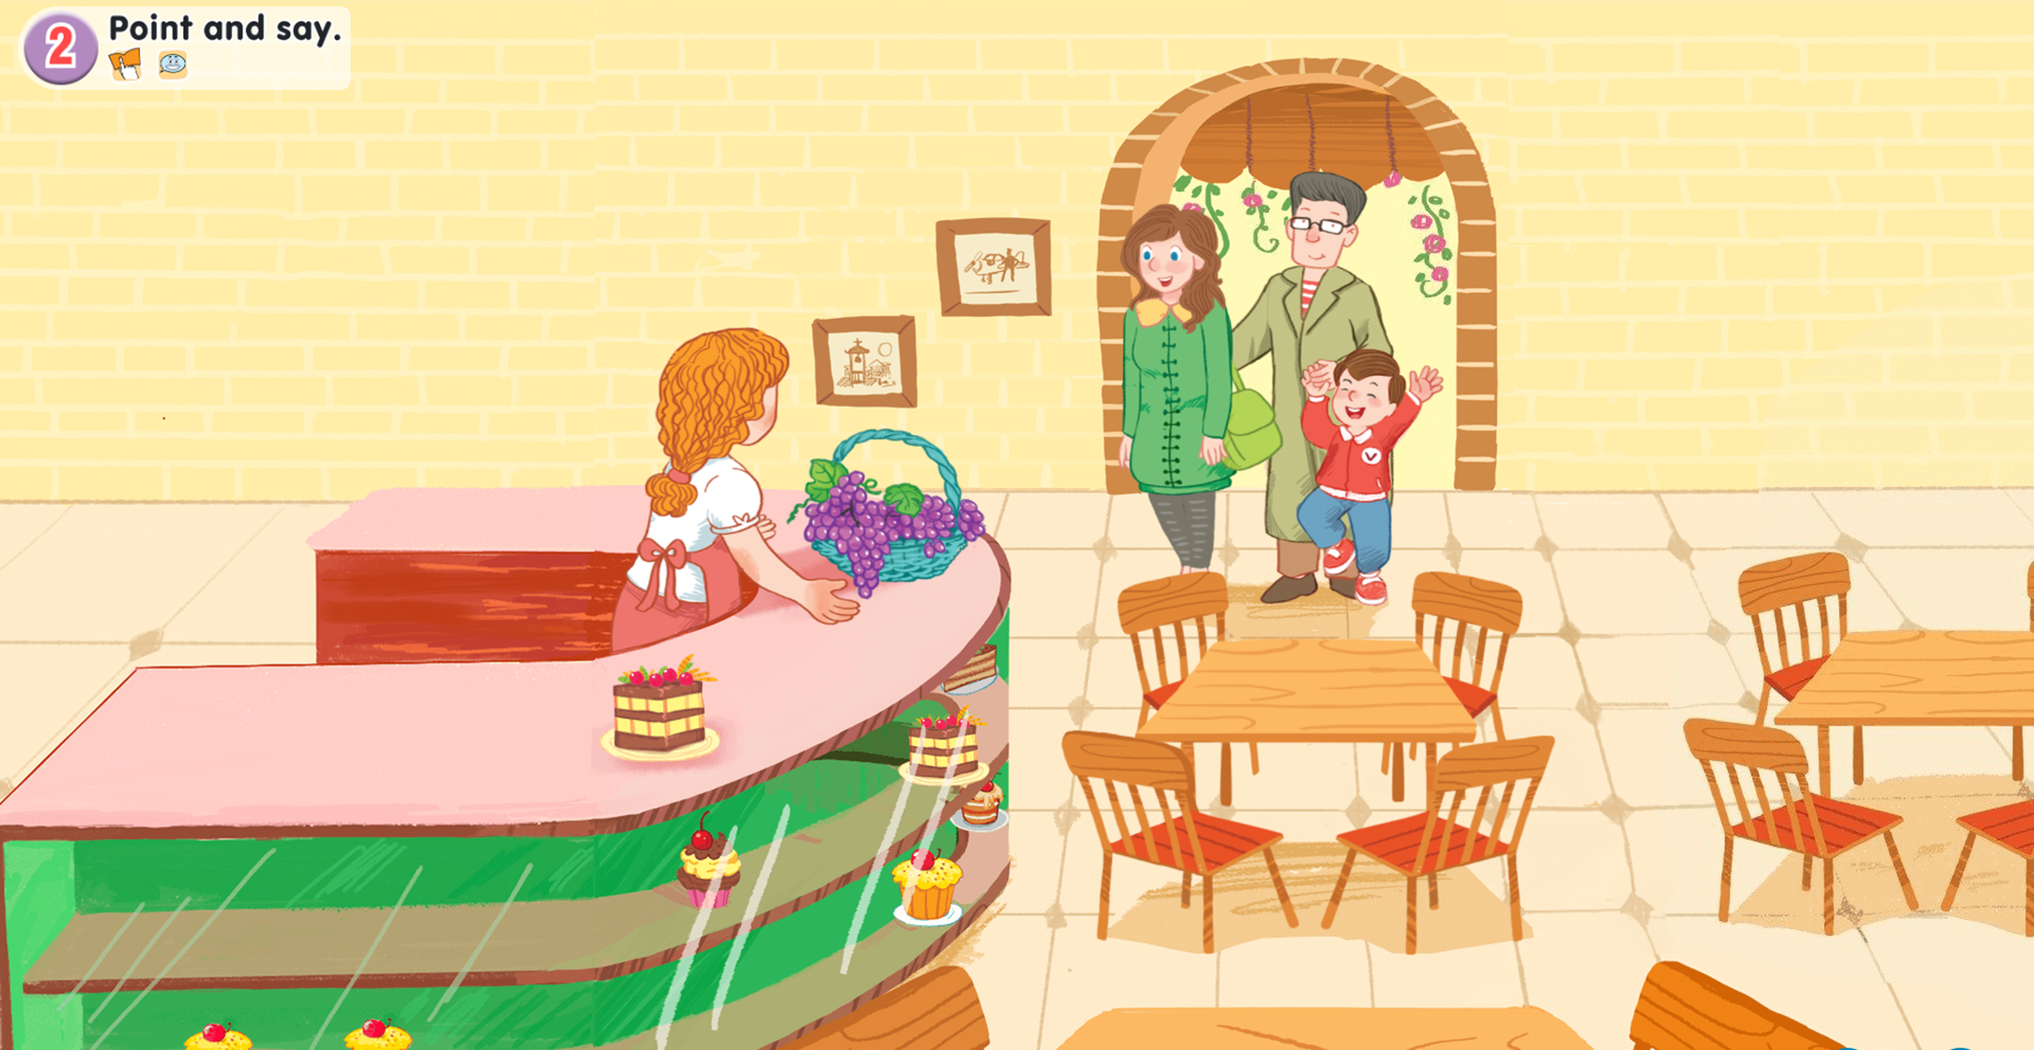
2. Point and say.

Slide 18
2. Point and say.
grapes
table
cake

Slide 19
Work in pairs
grapes
table
cake

Slide 20
Fun corner and wrap-up

Slide 21







Spell it!

Slide 22


Use the letters to spell the word.
s
A
R
P
G
E

Slide 23
The word is ...
G
R
A
P
E
S

Slide 24
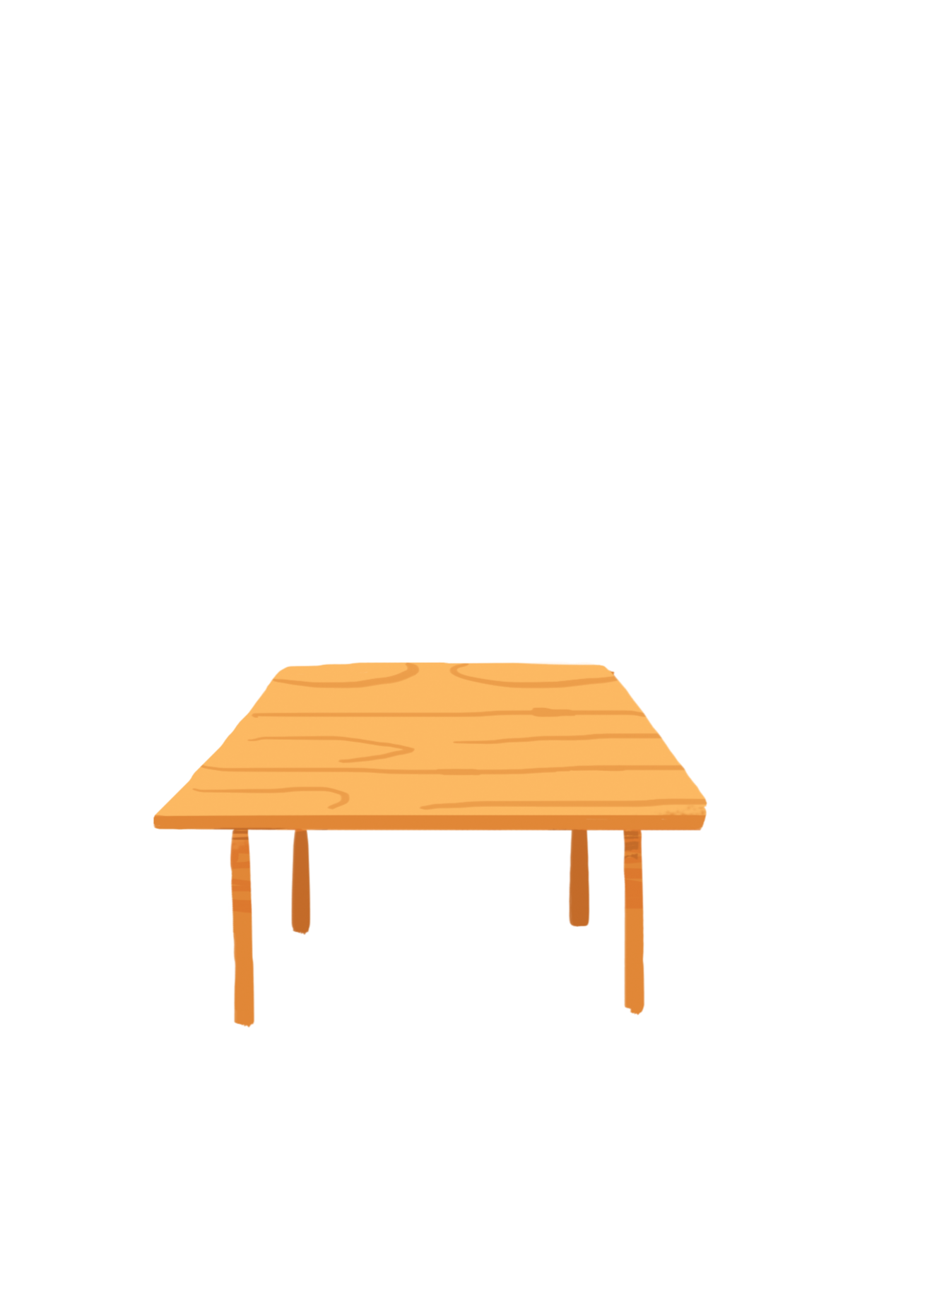
Use the letters to spell the word.
L
E
B
A
T

Slide 25
The word is ...
T
A
B
L
E

Slide 26

Use the letters to spell the word.
K
E
A
C

Slide 27
The word is ...
C
A
K
E

Slide 28


THANK YOU!

Slide 29
Website: hoclieu.vn
Fanpage: facebook.com/www.tienganhglobalsuccess.vn

