Slide 2









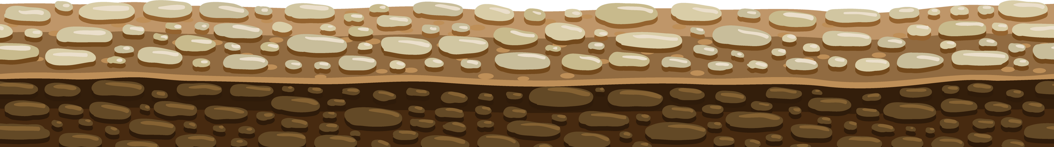
Unit 12:
At the café
Lesson 3

Slide 3












TABLE OF CONTENTS
  Warm-up and review.
  Listen and repeat.
  Let’s talk.
  Let’s sing.
  Fun corner and wrap-up.

Slide 4






Warm-up and Review

Slide 5















Quiz Time

Slide 6





Choose the correct letter
gr_pes
a

Slide 7


Order the letters
k a c e
cake

Slide 8




Look and choose

Slide 9
Thank you
For
Playing!

Slide 10
Listen and repeat

Slide 11


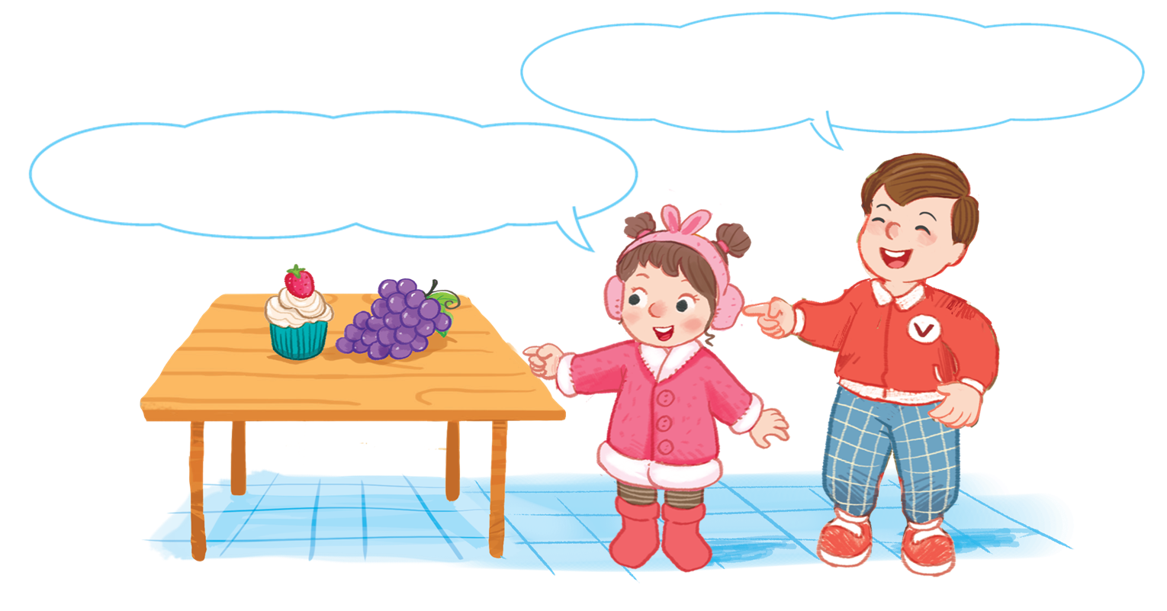


Look and say

Slide 12



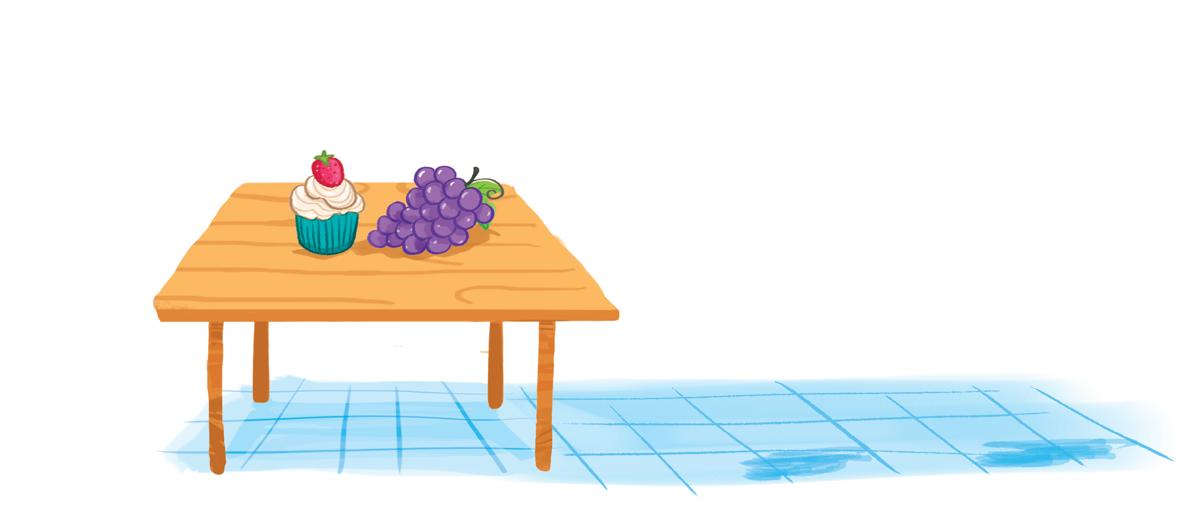
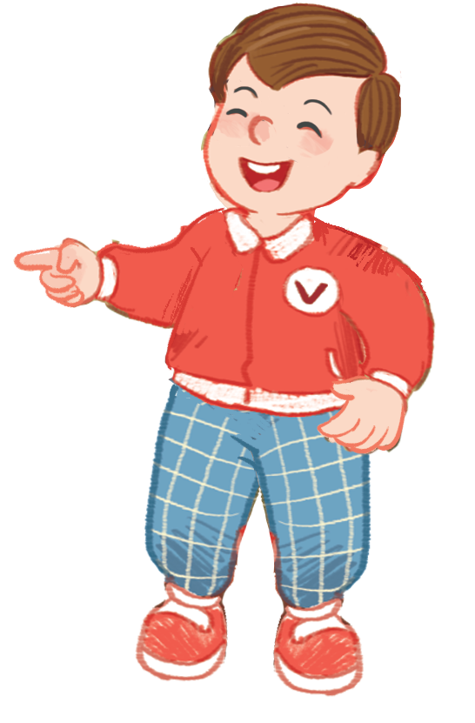
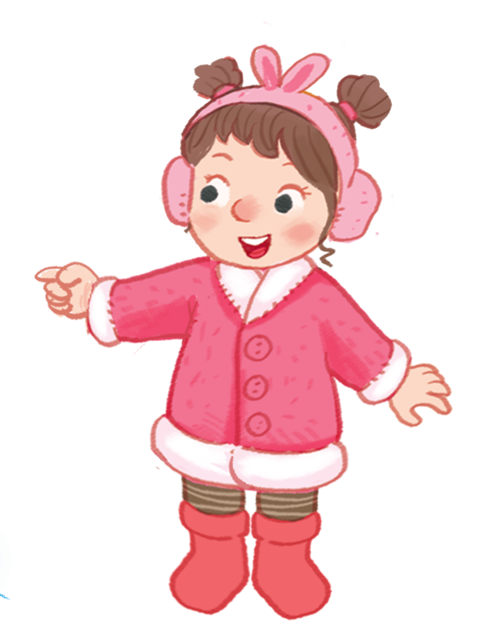
6. Listen and repeat.
The grapes are on the table.
The grapes are on the table.
The grapes are on the table.
The grapes are on the table.
The cake is on the table.
The cake is on the table.
The cake is on the table.
The cake is on the table.

Slide 13
Let’s talk

Slide 14


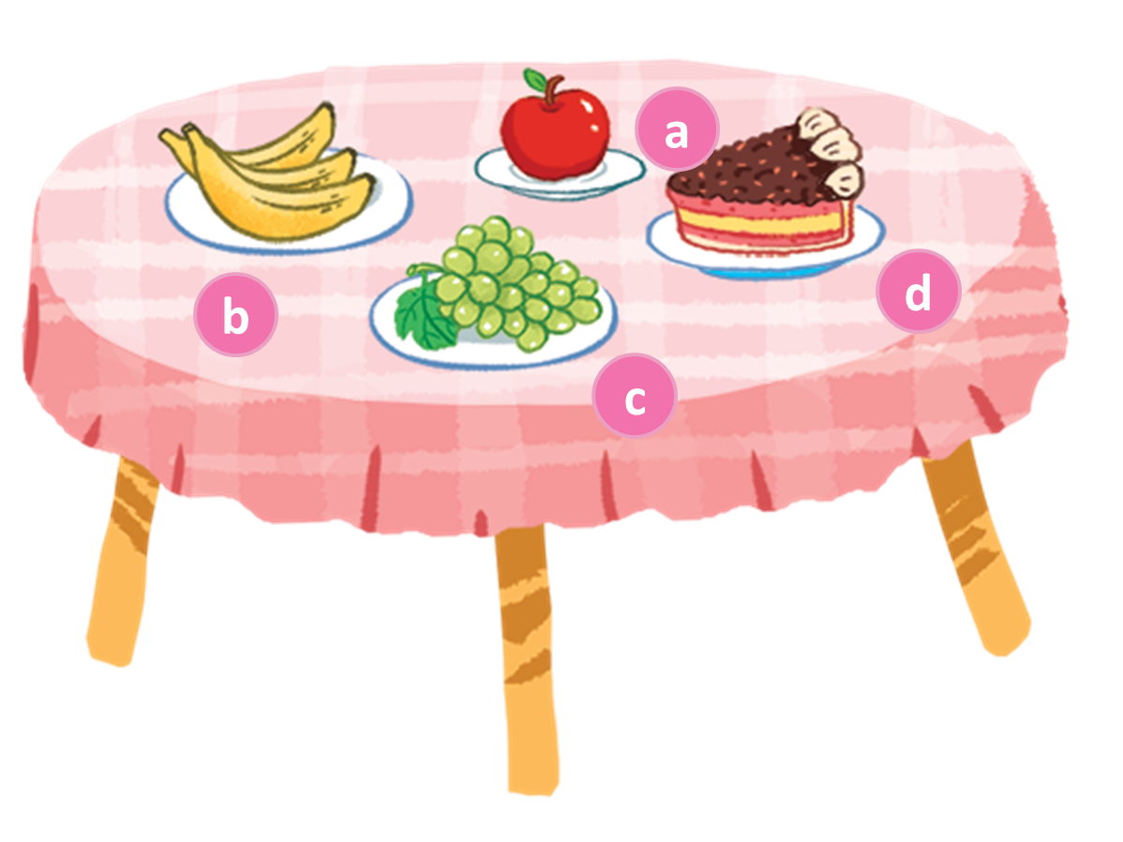


Look and say
Notes:
Look at the table and say the food on the table

Slide 15

7. Let’s talk.
The apple is on the table.
The cake is on the table.

Slide 16
7. Let’s talk.
The bananas are on the table.
The grapes are on the table.

Slide 17
7. Let’s talk.
The apple is on the table.
The cake are on the table.

Slide 18
Let’s sing

Slide 19
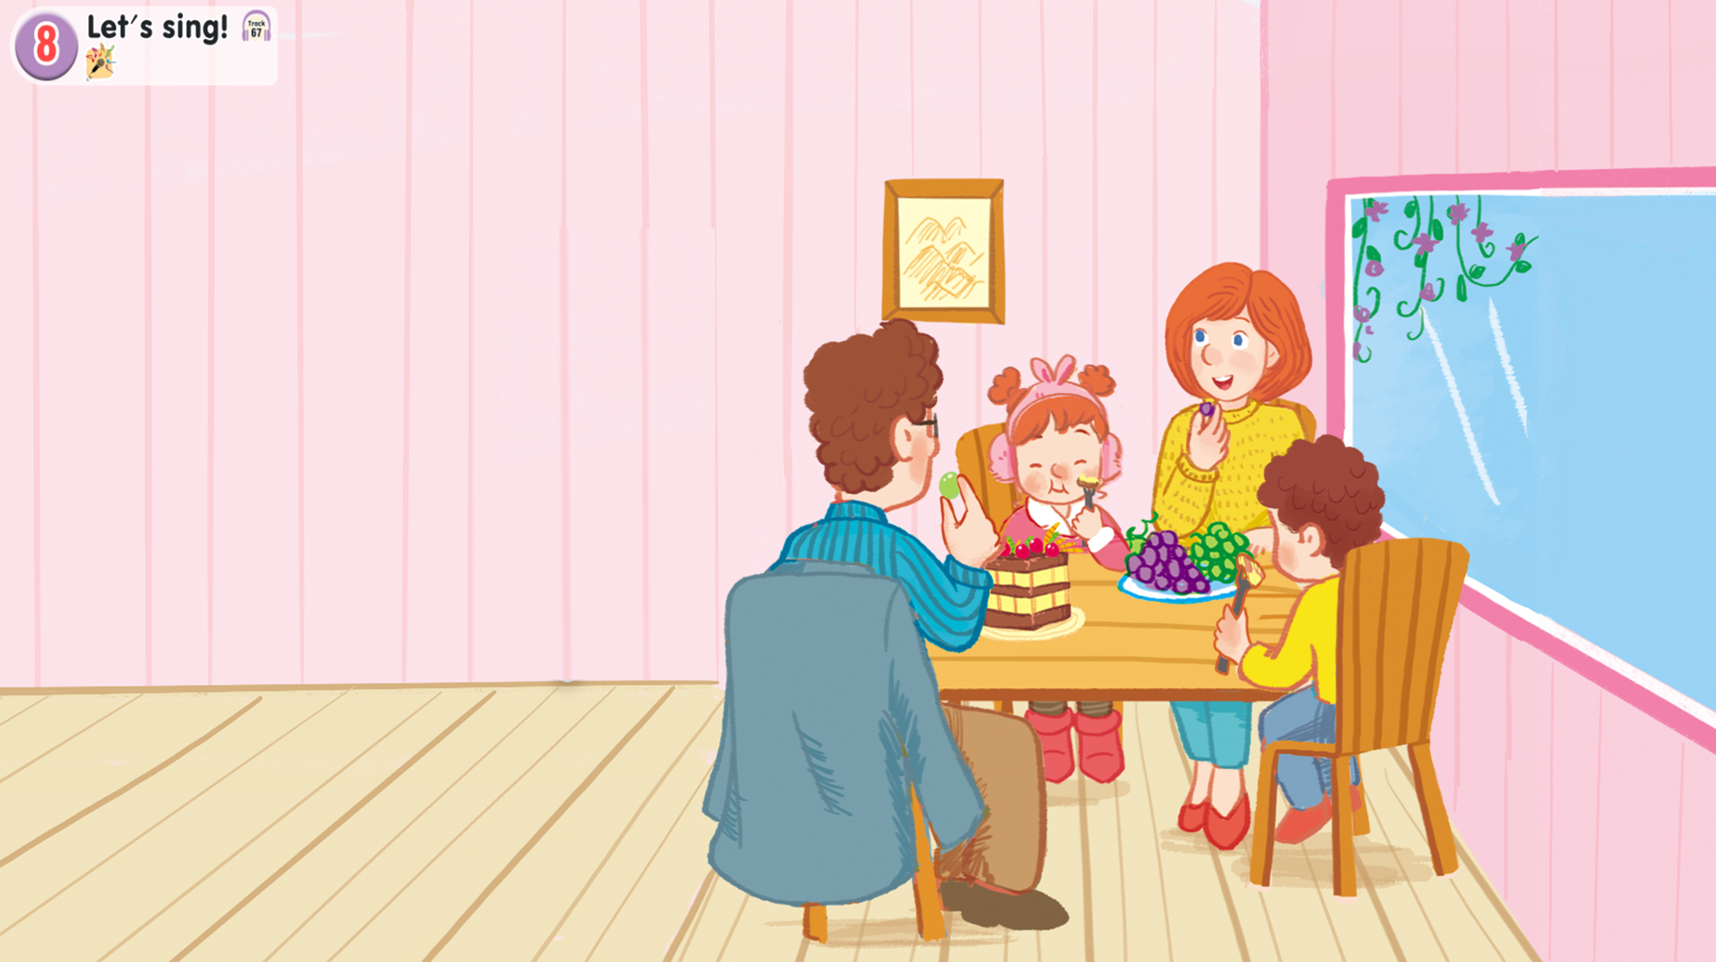
Look and say

Slide 20

Watch a video song

Slide 21
8. Let’s sing.
Look at the cake.
Look at the cake.
Look at the cake.
Look at the cake.
The cake is on the table.
The cake is on the table.
The cake is on the table.
The cake is on the table.
Look at the grapes.
Look at the grapes.
Look at the grapes.
Look at the grapes.
The grapes are on the table.
The grapes are on the table.
The grapes are on the table.
The grapes are on the table.
We’re having a cake.
We’re having a cake.
We’re having a cake.
We’re having a cake.
We’re having grapes.
We’re having grapes.
We’re having grapes.
We’re having grapes.

Slide 22
Work in groups
Look at the cake.
Look at the cake.
The cake is on the table.
The cake is on the table.
Look at the grapes.
Look at the grapes.
The grapes are on the table.
The grapes are on the table.
We’re having a cake.
We’re having a cake.
We’re having a cake.
We’re having grapes.
We’re having grapes.

Slide 23
Fun corner and wrap-up

Slide 24







GAME
SECRET BOXES

Slide 25



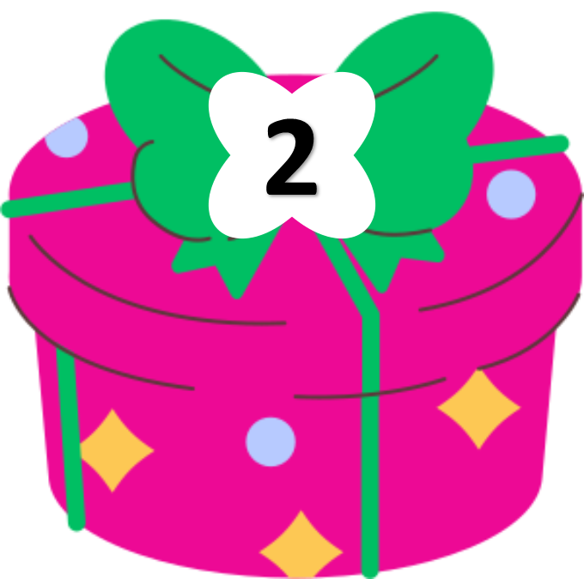

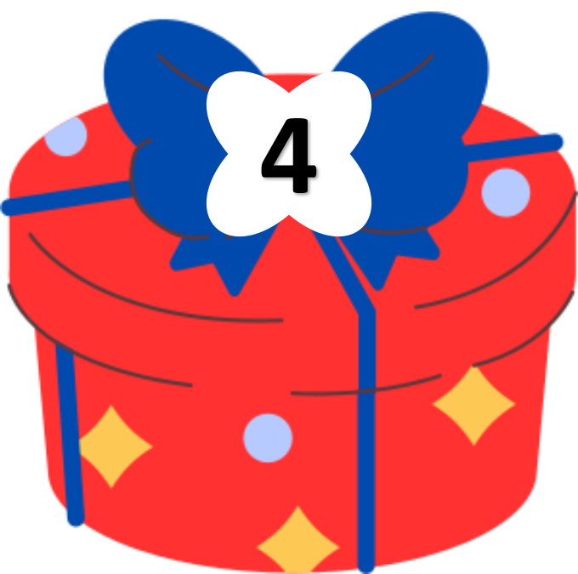


Notes:
Click the leaf on the right to continue the next slide

Slide 26




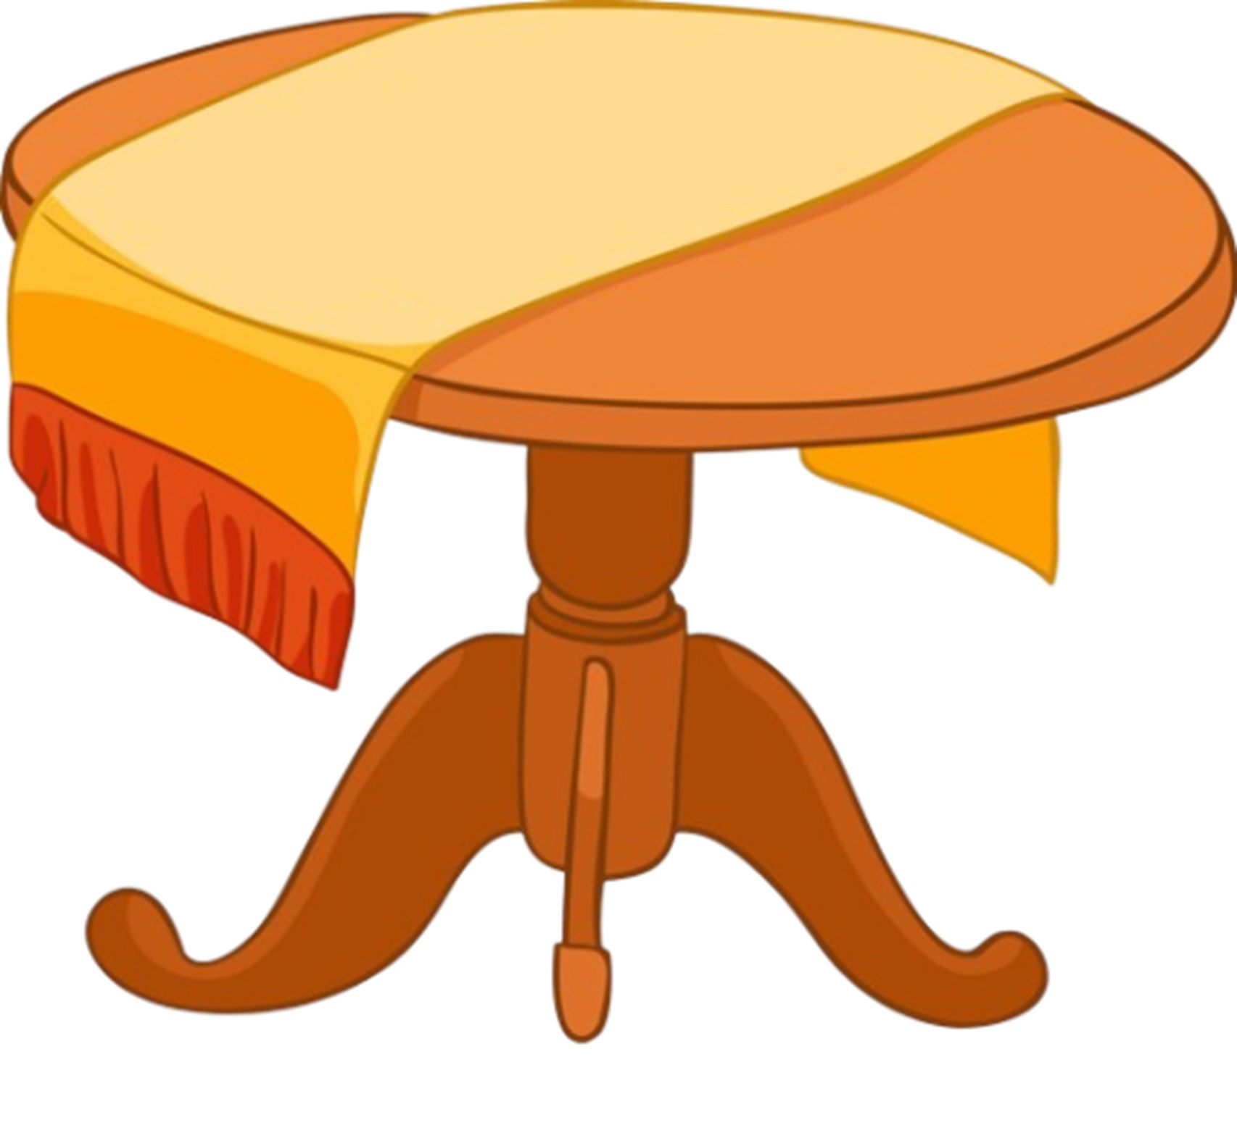

Put the words in order
on
are
table.
the
grapes
The
The
grapes
are
on
the
table.
BACK

Slide 27

Put the words in order
the
apple
The
table.
on
is
The
apple
is
on
the
table.
BACK

Slide 28

Put the words in order
table.
The
the
cake
is
on
The
cake
is
on
the
table.
BACK

Slide 29

Put the words in order
bananas
on
table.
the
The
are
The
bananas
are
on
the
table.
BACK

Slide 30
THANK YOU FOR PLAYING!

